Slide 1

Today’s word

Slide 2
Today’s Topics
  Last time:
    Combinations
    Permutations
    Group Assignment
TODAY: Probability!
    Sample Spaces and Event Spaces
    Axioms of Probability
    Lots of Examples
  Next week:
    Conditional Probability

Slide 3

Sets Review

Slide 4
Set Operations Review
Say E and F are subsets of S
S
E
F

Slide 5
Set Operations Review
Say E and F are events in S
  S = {1, 2, 3, 4, 5, 6} die roll outcome
  E = {1, 2} F = {2, 3} E ∪ F = {1, 2, 3}
Event that is in E or F
E ∪ F
S
E
F

Slide 6
Set Operations Review
Say E and F are events in S
  S = {1, 2, 3, 4, 5, 6} die roll outcome
  E = {1, 2} F = {2, 3} E F = {2}
  Note: mutually exclusive events means E F = ∅
Event that is in E and F
E ∩ F or EF
S
E
F

Slide 7
Set Operations Review
Say E and F are events in S
  S = {1, 2, 3, 4, 5, 6} die roll outcome
  E = {1, 2} E^{c} = {3, 4, 5, 6}
Event that is not in E (called complement of E)
E^{c} or ~E
S
E
F

Slide 8
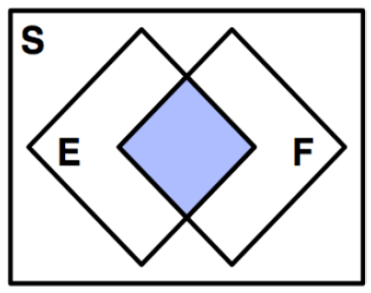
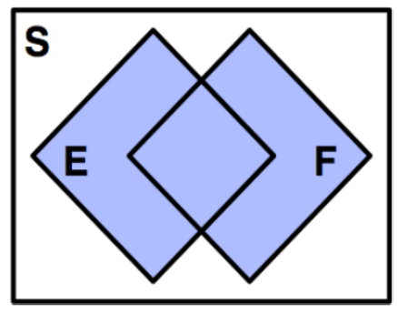
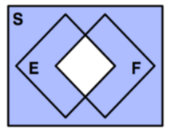
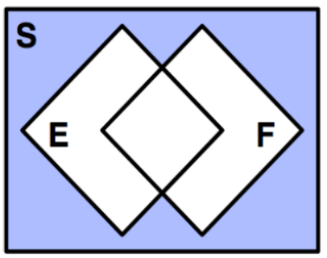
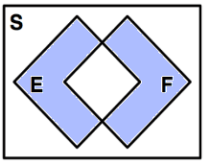
Which is the correct picture for E^{c} ∩ F^{c}
A
C
D
B
E

Slide 9
Set Operations Review
Say E and F are events in S
DeMorgan’s Laws
(E ∪ F)^{c} = E^{c} ∩ F^{c}
(E ∩ F)^{c} = E^{c} ∪ F^{c}
S
S
E
F
E
F

Slide 10
Tool Review
Problem Archetype | Use this tool
4-smudge iPhone Codes | Permutations
Choose 2 Hunger Games tributes | Combinations (Binomial)
Choosing stats books | Combinations with cases (No closed form)
Mississippi | Permutations with indistinguishable elements (Multinomial)
Assigning money to companies | Permutations with divider-method

Slide 11
Probability

Slide 12
Sample Space
Sample space, S, is set of all possible outcomes of an experiment
  Coin flip: S = {Head, Tails}
  Flipping two coins: S = {(H, H), (H, T), (T, H), (T, T)}
  Roll of 6-sided die: S = {1, 2, 3, 4, 5, 6}
  # emails in a day: S = {x | x ∈ Z, x ≥ 0} (non-neg. ints)
  YouTube hrs. in day: S = {x | x ∈ R, 0 ≤ x ≤ 24}

Slide 13
Events
Event, E, is some subset of S (E ⊆ S)
  Coin flip is heads: E = {Head}
  ≥ 1 head on 2 coin flips: E = {(H, H), (H, T), (T, H)}
  Roll of die is 3 or less: E = {1, 2, 3}
  # emails in a day ≤ 20: E = {x | x ∈ Z, 0 ≤ x ≤ 20}
  Wasted day (≥ 5 YT hrs.): E = {x | x ∈ R, 5 ≤ x ≤ 24}
Note: When Ross uses: ⊂ , he really means: ⊆

Slide 14
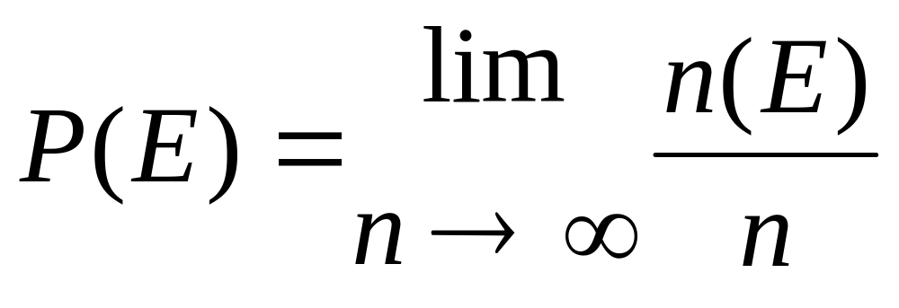
What is a Probability
What is a probability?
Axiom 1: 0 ≤ P(E) ≤ 1
Axiom 2: P(S) = 1
Axiom 3: If E and F mutually exclusive (E ∩ F = ∅),
then P(E) + P(F) = P(E ∪ F)

Slide 15
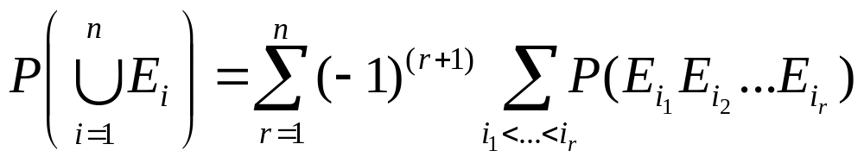
Implications of Axioms
P(E^{c}) = 1 – P(E) (= P(S) – P(E) )
If E ⊆ F, then P(E) ≤ P(F)
P(E ∪ F) = P(E) + P(F) – P(EF)
  This is just Inclusion-Exclusion Principle for Probability
General form of Inclusion-Exclusion Identity:

Slide 16
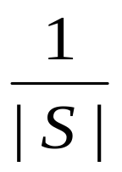
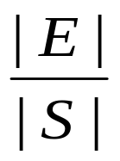
Equally Likely Outcomes
Some sample spaces have equally likely outcomes
  Coin flip: S = {Head, Tails}
  Flipping two coins: S = {(H, H), (H, T), (T, H), (T, T)}
  Roll of 6-sided die: S = {1, 2, 3, 4, 5, 6}
P(Each outcome) =
In that case, P(E) = =
number of outcomes in E
number of outcomes in S

Slide 17
Rolling Two Dice
Roll two 6-sided dice.
  What is P(sum = 7)?
S = {(1, 1), (1, 2), (1, 3), (1, 4), (1, 5), (1, 6),
(2, 1), (2, 2), (2, 3), (2, 4), (2, 5), (2, 6),
(3, 1), (3, 2), (3, 3), (3, 4), (3, 5), (3, 6),
(4, 1), (4, 2), (4, 3), (4, 4), (4, 5), (4, 6),
(5, 1), (5, 2), (5, 3), (5, 4), (5, 5), (5, 6),
(6, 1), (6, 2), (6, 3), (6, 4), (6, 5), (6, 6)}
E = {(1, 6), (2, 5), (3, 4), (4, 3), (5, 2), (6, 1)}
P(sum = 7) = |E|/|S| = 6/36 = 1/6

Slide 18

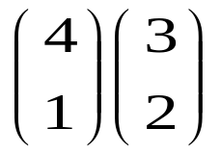
Twinkies and Ding Dongs
4 Twinkies and 3 Ding Dongs in a Bag. 3 drawn.
  What is P(1 Twinkie and 2 Ding Dongs drawn)?
Ordered:
  Pick 3 ordered items: |S| = 7 * 6 * 5 = 210
  Pick Twinkie as either 1st, 2nd, or 3rd item:
  |E| = (4 * 3 * 2) + (3 * 4 * 2) + (3 * 2 * 4) = 72
  P(1 Twinkie, 2 Ding Dongs) = 72/210 = 12/35
Unordered:
  |S| = = 35
  |E| = = 12
  P(1 Twinkie, 2 Ding Dongs drawn) = 12/35

Slide 19

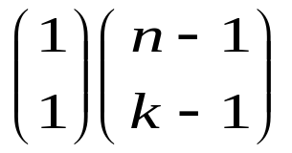
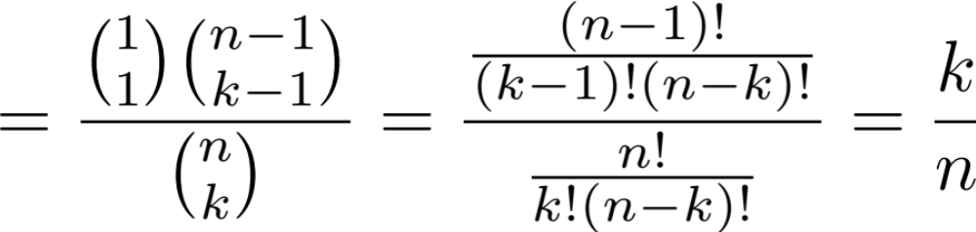
Chip Defect Detection
n chips manufactured, 1 of which is defective.
k chips randomly selected from n for testing.
  What is P(defective chip is in k selected chips)?
|S| =
|E| =
P(defective chip is in k selected chips)

Slide 20
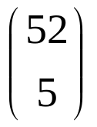
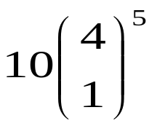
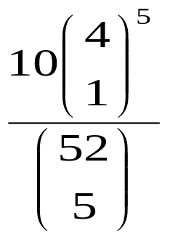
Any “Straight” Poker Hand
Consider 5 card poker hands.
  “straight” is 5 consecutive rank cards of any suit
  What is P(straight)?
  Note: this is a little different than the textbook
|S| =
|E| =
P(straight) = ≈ 0.00394

Slide 21
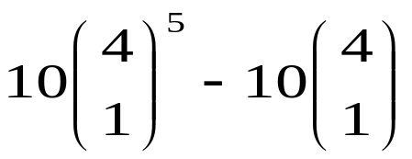
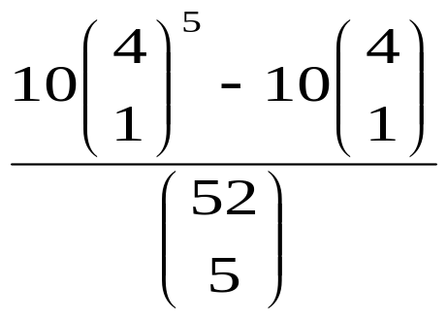
Official “Straight” Poker Hand
Consider 5 card poker hands.
  “straight” is 5 consecutive rank cards of any suit
  “straight flush” is 5 consecutive rank cards of same suit
  What is P(straight, but not straight flush)?
|S| =
|E| =
P(straight) = ≈ 0.00392

Slide 22
Card Flipping
52 card deck. Cards flipped one at a time.
  After first ace (of any suit) appears, consider next card
  Is P(next card = Ace Spades) < P(next card = 2 Clubs)?
  Initially, might think so, but consider the two cases:
  First note: |S| = 52! (all cards shuffled)
Case 1: Take Ace Spades out of deck
  Shuffle left over 51 cards, add Ace Spades after first ace
  |E| = 51! * 1 (only 1 place Ace Spades can be added)
Case 2: Do same as case 1, but...
  Replace “Ace Spades” with “2 Clubs” in description
  |E| and |S| are the same as case 1
  So P(next card = Ace Spade) = P(next card = 2 Clubs)

Slide 23
Selecting Programmers
Say 28% of all students program in Java
  7% program in C++
  5% program in Java and C++
What percentage of students do not program in Java or C++
  Let A = event that a random student programs in Java
  Let B = event that a random student programs in C++
  1 – P(A U B) = 1 – [P(A) + P(B) – P(AB)]
  = 1 – (0.28 + 0.07 – 0.05) = 0.7 → 70%
What percentage programs in C++, but not Java?
  P(A^{c} B) = P(B) – P(AB) = 0.07 – 0.05 = 0.02 → 2%

Slide 24


Slide 25

Serendipity
Say 21,000 people at Stanford
  You are friends with 150
  You go for a walk, see 216 random people.
  What is the probability that you see someone you know?

Slide 26
Birthdays
What is the probability that of n people, none share the same birthday (regardless of year)?
  |S| = (365)^{n}
  |E| = (365)(364)...(365 – n + 1)
  P(no matching birthdays)
  = (365)(364)...(365 – n + 1)/(365)^{n}
Interesting values of n
  n = 23: P(no matching birthdays) < ½ (least such n)
  n = 75: P(no matching birthdays) < 1/3,000
  n = 100: P(no matching birthdays) < 1/3,000,000
  n = 150:
  P(no matching birthdays) < 1/3,000,000,000,000,000

Slide 27
Birthdays
What is the probability that of n other people, none of them share the same birthday as you?
  |S| = (365)^{n}
  |E| = (364)^{n}
  P(no birthdays matching yours) = (364)^{n}/(365)^{n}
Interesting values of n
  n = 23: P(no matching birthdays) ≈ 0.9388
  n = 150: P(no matching birthdays) ≈ 0.6626
  n = 253: P(no matching birthdays) ≈ 0.4995
    Least such n for which P(no matching birthdays) < ½
  Why are these probabilities much higher than before?
    Anyone born on May 10th?
    Is today anyone’s birthday?

Slide 28
Crazy Version

Slide 29
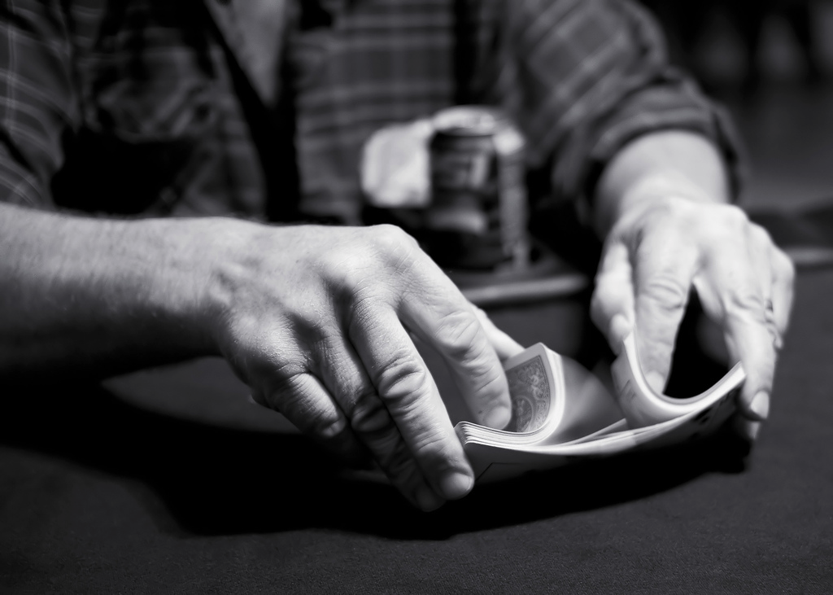
Trailing the dovetail shuffle to it’s lair – Persi Diaconosis

Slide 30
Making History
What is the probability that in the n shuffles seen since the start of time, yours is unique?
  |S| = (52!)^{n}
  |E| = (52! - 1)^{n}
  P(no deck matching yours) = (52!-1)^{n}/(52!)^{n}
For n = 10¹⁴,
  P(deck matching yours) < 0.000000001

