Slide 1
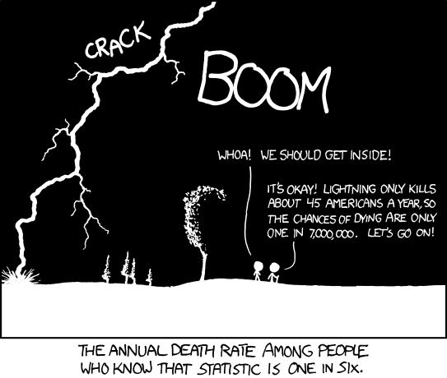
The Tragedy of Conditional Probability
Thanks xkcd! http://xkcd.com/795/

Slide 2
A Variant to Clarify Monty Hall Problem
Start with 1,000 envelopes, of which 1 is winner
  You get to choose 1 envelope
    Probability of choosing winner = 1/1000
  Consider remaining 999 envelopes
    Probability one of them is the winner = 999/1000
  I open 998 of remaining 999 (showing they are empty)
    Probability the last remaining envelope being winner = 999/1000
  Should you switch?
    Probability winning without switch =
    Probability winning with switch =
1
original # envelopes
original # envelopes - 1
original # envelopes

Slide 3
A Few Useful Formulas
For any events A and B:
P(A B) = P(B A) (Commutativity)
P(A B) = P(A | B) P(B) (Chain rule)
= P(B | A) P(A)
P(A B^{c}) = P(A) – P(AB) (Intersection)
P(A B) ≥ P(A) + P(B) – 1 (Bonferroni)

Slide 4
Generality of Conditional Probability
For any events A, B, and E, you can condition consistently on E, and these formulas still hold:
P(A B | E) = P(B A | E)
P(A B | E) = P(A | B E) P(B | E)
P(A | B E) = (Bayes’ Thm.)
Can think of E as “everything you already know”
Formally, P( • | E) satisfies 3 axioms of probability
P(B | A E) P(A | E)
P(B | E)

Slide 5
Odds
Odds of an event defined as:
Odds of H given observed evidence E:
After observing E, just update odds by:
P(A)
P(A)
=
P(A^{c})
1 - P(A)
P(H | E)
P(H) P(E | H) / P(E)
=
P(H^{c} | E)
P(H^{c}) P(E | H^{c}) / P(E)
P(H) P(E | H)
=
P(H^{c}) P(E | H^{c})
P(E | H)
P(E | H^{c})

Slide 6
Dissecting Bayes’ Theorem
Recall Bayes’ Theorem (common form):
Odds(H | E):
How odds of H change when evidence E observed
  Note that P(E) cancels out in odds formulation
This is a form of probabilistic inference
“Posterior”
“Likelihood”
“Prior”
P(E | H) P(H)
P(E)
P(H | E) =
P(H | E)
P(H^{c} | E)
P(E | H) P(H)
P(E | H^{c}) P(H^{c})
=

Slide 7
Coins and Urns?!
An urn contains 2 coins: A and B
  A comes up heads with probability ¼
  B comes up heads with probability ¾
  Pick coin (equally likely), flip it, and it comes up heads
  What are odds that A was picked (note: A^{c} = B)?
  Odds are 1/3:1 (or probability ¼) that A was picked
  Note: before observing heads P(A) / P(A^{c}) = 1:1
    Equally likely to pick A vs. not picking A (1 out of 2 chance)
P(A | heads)
P(A) P(heads | A)
=
P(A^{c} | heads)
P(A^{c}) P(heads | A^{c})
½ ¼
= = 1/3
½ ¾

Slide 8
It Always Comes Back to Dice
Roll two 6-sided dice, yielding values D₁ and D₂
  Let E be event: D₁ = 1
  Let F be event: D₂ = 1
What is P(E), P(F), and P(EF)?
  P(E) = 1/6, P(F) = 1/6, P(EF) = 1/36
  P(EF) = P(E) P(F) → E and F independent
Let G be event: D₁ + D₂ = 5 {(1, 4), (2, 3), (3, 2), (4, 1)}
What is P(E), P(G), and P(EG)?
  P(E) = 1/6, P(G) = 4/36 = 1/9, P(EG) = 1/36
  P(EG) ≠ P(E) P(G) → E and G dependent

Slide 9
Independence
Two events E and F are called independent if:
P(EF) = P(E) P(F)
Or, equivalently: P(E | F) = P(E)
Otherwise, they are called dependent events
Three events E, F, and G independent if:
P(EFG) = P(E) P(F) P(G), and
P(EF) = P(E) P(F), and
P(EG) = P(E) P(G), and
P(FG) = P(F) P(G)

Slide 10
Let’s Do a Proof
Given independent events E and F, prove:
P(E | F) = P(E | F^{c})
Proof:
  P(E F^{c}) = P(E) – P(EF)
  = P(E) – P(E) P(F)
  = P(E) [1 – P(F)]
  = P(E) P(F^{c})
  So, E and F^{c} independent, implying that:
  P(E | F^{c}) = P(E) = P(E | F)
Intuitively, if E and F are independent, knowing whether F holds gives us no information about E

Slide 11
Generalized Independence
General definition of Independence:
Events E₁, E₂, ..., E_{n} are independent if for every subset E_{1’}, E_{2’}, ..., E_{r’} (where r ≤ n) it holds that:
Example: outcomes of n separate flips of a coin are all independent of one another
  Each flip in this case is called a “trial” of the experiment

Slide 12
Two Dice
Roll two 6-sided dice, yielding values D₁ and D₂
  Let E be event: D₁ = 1
  Let F be event: D₂ = 6
  Are E and F independent?
Let G be event: D₁ + D₂ = 7
  Are E and G independent?
  P(E) = 1/6, P(G) = 1/6, P(E G) = 1/36 [roll (1, 6)]
  Are F and G independent?
  P(F) = 1/6, P(G) = 1/6, P(F G) = 1/36 [roll (1, 6)]
  Are E, F and G independent?
  P(EFG) = 1/36 ≠ 1/216 = (1/6)(1/6)(1/6)
Yes!
Yes!
Yes!
No!

Slide 13
Generating Random Bits
A computer produces a series of random bits, with probability p of producing a 1.
  Each bit generated is an independent trial
  E = first n bits are 1’s, followed by a single 0
  What is P(E)?
Solution
  P(first n 1’s) = P(1st bit=1) P(2nd bit=1) ... P(n^{th} bit=1)
= p^{n}
  P(n+1 bit=0) = (1 – p)
  P(E) = P(first n 1’s) P(n+1 bit=0) = p^{n} (1 – p)

Slide 14
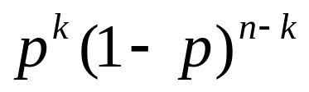
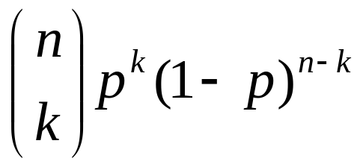
Coin Flips
Say a coin comes up heads with probability p
  Each coin flip is an independent trial
P(n heads on n coin flips) = p^{n}
P(n tails on n coin flips) = (1 – p)^{n}
P(first k heads, then n – k tails) =
P(exactly k heads on n coin flips) =

Slide 15
Hash Tables
m strings are hashed (equally randomly) into a hash table with n buckets
  Each string hashed is an independent trial
  E = at least one string hashed to first bucket
  What is P(E)?
Solution
  F_{i} = string i not hashed into first bucket (where 1 ≤ i ≤ m)
  P(F_{i}) = 1 – 1/n = (n – 1)/n (for all 1 ≤ i ≤ m)
  Event (F₁F₂…F_{m}) = no strings hashed to first bucket
  P(E) = 1 – P(F₁ F₂ …F_{m}) = 1 – P(F₁)P(F₂)…P(F_{m})
  = 1 – ((n – 1)/n)^{m}
  Similar to ≥ 1 of m people having same birthday as you

Slide 16
Yet More Hash Table Fun
m strings are hashed (unequally) into a hash table with n buckets
  Each string hashed is an independent trial, with probability p_{i} of getting hashed to bucket i
  E = At least 1 of buckets 1 to k has ≥ 1 string hashed to it
Solution
  F_{i} = at least one string hashed into i-th bucket
  P(E) = P(F₁ ∪ F₂ ∪ … ∪ F_{k}) = 1 – P((F₁ ∪ F₂ ∪ … ∪ F_{k})^{c})
  = 1 – P(F₁^{c} F₂^{c} …F_{k}^{c}) (DeMorgan’s Law)
  P(F₁^{c} F₂^{c} …F_{k}^{c}) = P(no strings hashed to buckets 1 to k)
  = (1 – p₁ – p₂ – … – p_{k})^{m}
  P(E) = 1 – (1 – p₁ – p₂ – … – p_{k})^{m}

Slide 17
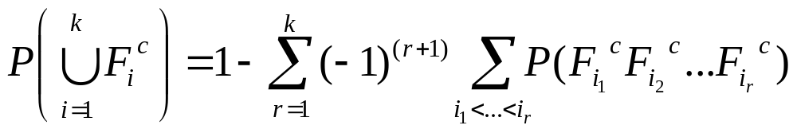
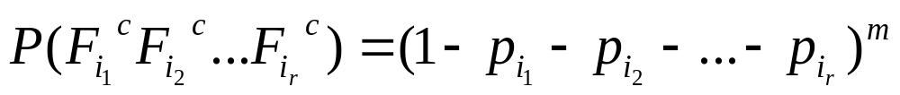
No, Really, it’s More Hash Table Fun
m strings are hashed (unequally) into a hash table with n buckets
  Each string hashed is an independent trial, with probability p_{i} of getting hashed to bucket i
  E = Each of buckets 1 to k has ≥ 1 string hashed to it
Solution
  F_{i} = at least one string hashed into i-th bucket
  P(E) = P(F₁ F₂ … F_{k}) = 1 – P((F₁ F₂ … F_{k})^{c})
  = 1 – P(F₁^{c} ∪ F₂^{c} ∪…∪ F_{k}^{c}) (DeMorgan’s Law)
  = 1 –
  where

Slide 18
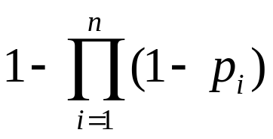
Sending Messages Through a Network
Consider the following parallel network:
  n independent routers, each with probability p_{i} of functioning (where 1 ≤ i ≤ n)
  E = functional path from A to B exists. What is P(E)?
Solution:
  P(E) = 1 – P(all routers fail)
  = 1 – (1 – p₁)(1 – p₂)…(1 – p_{n})
  =
p₁
p₂
A
B
p_{n}

Slide 19
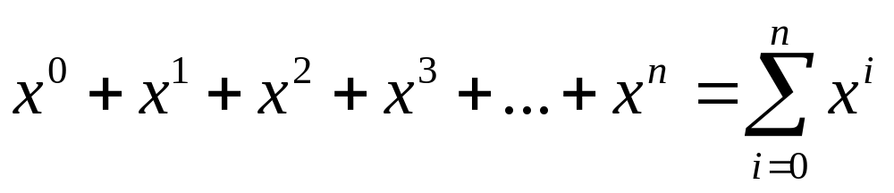
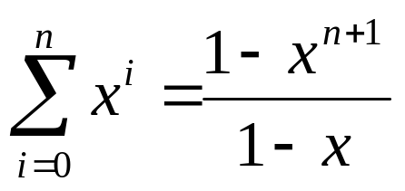
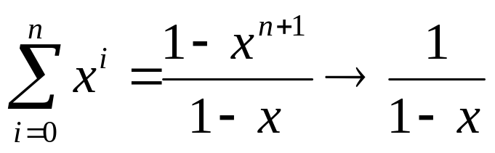
Reminder of Geometric Series
Geometric series:
From your “Calculation Reference” handout:
As n → ∞, and |x| < 1, then

Slide 20
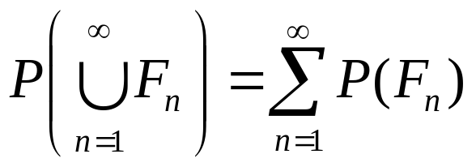
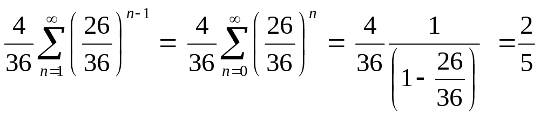
Simplified Craps
Two 6-sided dice repeatedly rolled (roll = ind. trial)
  E = 5 is rolled before a 7 is rolled
  What is P(E)?
Solution
  F_{n} = no 5 or 7 rolled in first n – 1 trials, 5 rolled on n^{th} trial
  P(E) =
  P(5 on any trial) = 4/36 P(7 on any trial) = 6/36
  P(F_{n}) = (1 – (10/36))^{n-1} (4/36) = (26/36)^{n-1} (4/36)
  P(E) =

Slide 21
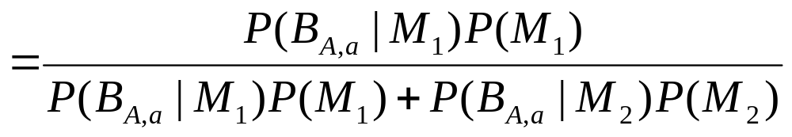
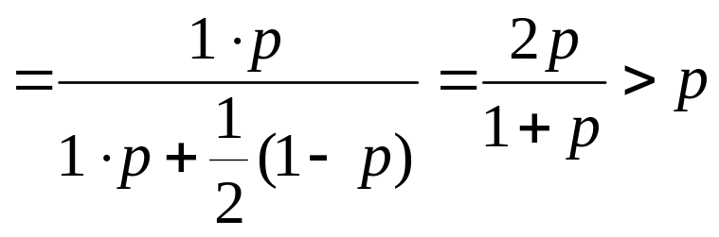
DNA Paternity Testing
Child is born with (A, a) gene pair (event B_{A,a})
  Mother has (A, A) gene pair
  Two possible fathers: M₁: (a, a) M₂: (a, A)
  P(M₁) = p P(M₂) = 1 - p
  What is P(M₁ | B_{A,a})?
Solution
  P(M₁ | B_{A,a}) = P(M₁ B_{A,a}) / P(B_{A,a})
  M₁ more likely to be father
  than he was before, since
  P(M₁ | B_{A,a}) > P(M₁)

