Slide 1
CIS 565 Final project: milestone 1 presentation
Group 3:
Srinath Rajagopalan
Somanshu Agarwal
Dhruv Karthik

Slide 2
Work as of now: Incremental VISUAL 3D mesh CREATION
We studied about the Incremental 3D Mesh creation visual odometry. Since the topic was new to all three of us, we explored many data processing techniques with 3D LIDAR point clouds.
Started working with CPU version.

Slide 3
New project proposal: gpu accelerated point cloud registration using gaussian mixture models
Traditional Iterative Closed Point (ICP) for scan matching has limitation of working only for few cases.
We use Hierarchical Gaussian Mixture Models for Point cloud Registration.
The proposed hierarchical approach achieves logarithmic complexity in model size and scales efficiently to data with billions of point cloud.

Slide 4
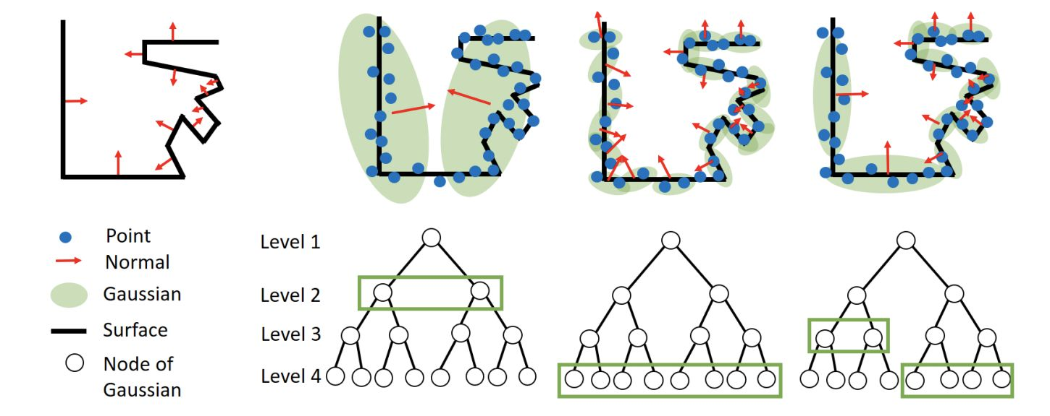
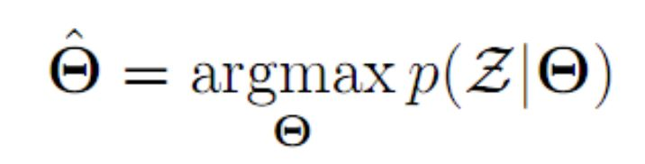
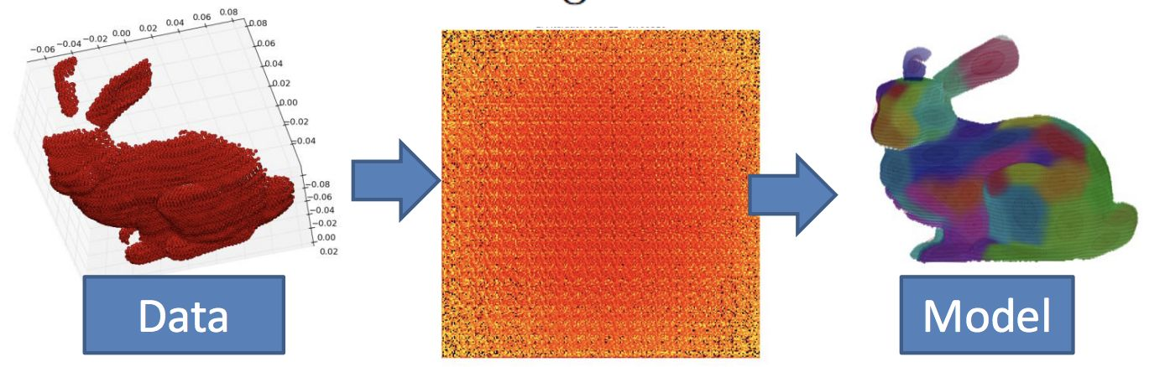
Explanation of adaptive hierarchical gmm model

Slide 5
FEATURES OF THE PROJECT
Nvidia released the paper in EECV 2018, but there is no code implementation available for HGMM with GPU’s. Hence, we will be contributing to the academic community.
Implementing this will be a wonderful challenge in applying many of the GPU acceleration concepts we learnt in the course (shared memory, memory coherence, parallel scans, CUDA streams,).

Slide 6
FUTURE Milestones:
11/25: ​Complete GPU version of single model GMM registration. Prototype Python version for HGMM.
12/02: ​Complete GPU version of Hierarchical GMM with CUDA/C++. Test it on a Waymo’s 3D LIDAR data. Benchmark with other implementations.
12/09:​ Implement additional optimizations (reduce bank conflicts).Test it on Dhruv’s 3D LIDAR and deploy it for Real-Time PCR on Penn Campus.

Slide 7
REFERENCES
https://developer.download.nvidia.com/video/gputechconf/gtc/2019/presentation/s9623-gpu-accelerated-3d-point-cloud-processing-with-hierarchical-gaussian-mixtures.pdf
https://arxiv.org/pdf/1807.02587.pdf

