Slide 1

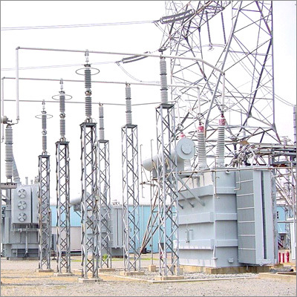
New Spin
Home
Config
Distance:
20.21 meters
Create Target List
See measurement Graph

Slide 2

New Spin
Home
Config
Notification Center
Automated Detection
enable notifications:
autoscan:
email:
john@doe.com
Target Deck:
MyList.xml
phone:
123-456-7890
carrier:
AT&T

