Slide 1
Chat Room
Javascript Full Stack
Software Engineering Crash Course

Slide 2
Deadline
Deadline:
Deadline: 7/11 Tue.
Penalty:
Penalty for hard deadline: 1 coffee + 2 week leetcode study plan.
For each late day, additional penalty +1 coffee.
Started on 7/5 Wed.
Break On 7/12 Wed. & 7/13 Thur.
Finished FSE Requirements, Demo, Code Review on 7/16 Sun.
Further Extension on 8/9 Wed.
Finished Private Messaging with Summary on 8/28 Mon.

Slide 3
Daily Timeline & Goals 7/5~7/7 Wed.~Fri.
7/5 Wed.:
Learn some few Javascript.
Played Zelda on Nintendo Switch For 3 Hours.
7/6 Thur.:
Learn some few ExpressJS socket.io
Explored Some Examples.
No Bug-Free Code Until Now.
7/8 Fri.:
Mentor Pair Programming.
Bug-Free Code For The First Time.
Github Initial Commit.

Slide 4
Daily Timeline & Goals 7/8 Sat.
Fully Understand The Codes So Far, and Add Comments.
Change some namings to meaningful namings.
Why express.static(“/”) doesn’t work.
express.stack(path), path = “.” “/” “public”
Server RESTful API HTTP GET: All clients get the new chat message when a new message is posted by 1 client.
Server Socket.io Broadcasting: The new client get all chat messages when a new client enters the room.
First Github Pull Request. Learned Some Git.

Slide 5
Daily Timeline & Goals 7/9 Sun.
Implement timestamp.
Refactor: Server generates UTC/Unix timestamp, then client transforms its own Time Zone.
Refactor: Remove Client to Server Socket.io Event Emitting. Moved The Broadcasting To "/messages" POST Router.
Frontend: Show All Chat Logs when client enters the room
Frontend: Show Timestamp
Change DB namings & understand express request & response fields, .

Slide 6
Daily Timeline & Goals 7/10 Mon.
Implement register: Server RESTful API.
Implement login: Server RESTful API.
Implement logout: Server RESTful API.

Slide 7
Daily Timeline & Goals 7/11 Tue.
Implement register: Client HTTP Request Frontend & HTML.
Implement login: Client HTTP Request Frontend & HTML.
Implement logout: Client HTTP Request Frontend & HTML.

Slide 8
Daily Timeline & Goals 7/14 Fri.
Authentication with express-session
https://github.com/expressjs/express/blob/master/examples/auth/index.js
Fix: Bypass Async Wait For DB I/O & session.regenerate() For Session Login
Implement sender info. (database, server & frontend)
Login / Logout Redirection, Homepage / Chat Room Redirection
Restrict Client Access to HTML Static Files
Restrict non-logged-in Users To Access "/messages" Router
Window Alert For Wrong Username / Password / Register Username Conflict By Status Code.

Slide 9
Daily Timeline & Goals 7/15 Sat.
Introduction to CI
feat: add css & html to chat room page for the chat box style looks.
refactor: use html div to replace ul li list to control each element's css styles(username, timestamp, chat text).
refactor: use Javascript DOM createElement() setAttribute() textContent appendChild() getElementById() to add a new chat post to html page.
feat: chat room page: trim timestamp string to exclude other time information.
feat: chat room page: change <input type="text"> to <textarea> for the chat text input box.

Slide 10
Daily Timeline & Goals 7/16 Sun.
feat: css fixed navigation bar.
feat: css: send button navigation bar.
feat: css login page.
jQuery To Replace onclick()
Quote, “The problem with the DOM element properties method is that only one event handler can be bound to an element per event.”, unquote.
Attach Multiple Events, Examples:
https://www.w3schools.com/jquery/event_on.asp
Finished FSE Requirements.
Demo.
Code Review.

Slide 11
Daily Timeline & Goals 7/31 Mon.
Deployed to render.com

Slide 12
Daily Timeline & Goals 8/9~8/11 Wed~Fri.
change SQL with "select … from … where …"
use try await
MVC.
Router-level middleware.

Slide 13
Daily Timeline & Goals 8/12 Sat.
Discussion: To solve the “this” binding problem when router mounts middleware, discussed Singleton.
Discussion: To solve the module export / import order problem, discuessed Singleton instance getter.

Slide 14
Daily Timeline & Goals 8/13 Sun.
refactor: To solve the “this” binding problem when router mounts middleware, used Singleton.
refactor: To solve the module export / import order problem, used Singleton instance getter.
refactor: Network Servers (express, socket.io, http) to a Module.
Then export them with Singleton instance getters.
refactor: Root-Level Middleware.
Design Doc: Private Messaging Design Doc
refactor: MVC message naming
feat: implemented rooms MVC model & SQL.

Slide 15
Daily Timeline & Goals 8/14 Mon.
feat: RESTful API GET POST /rooms
fix: module dependency cycle
for user_model & room_model

Slide 16
Daily Timeline & Goals 8/15 Tue.
feat: RESTful API GET POST /messages by socket.io

Slide 17
Daily Timeline & Goals 8/24 Thur.
doc: write design doc for a new private messaging & its socket.io design & way of implementation.

Slide 18
Daily Timeline & Goals 8/25 Fri.
fix: remove remove old private messaging design
chore: html textarea to replace input
feat: each chat room has its own URL
feat: room selection html css

Slide 19
Daily Timeline & Goals 8/26 Sat.
feat: room selection frontend
feat: after login, redirect to room selection page.

Slide 20
Daily Timeline & Goals 8/27 Sun.
feat: room creation html
feat: room creation frontend
feat: room selection page button in chat room
fix: post rooms duplicate usernames
feat: reload selection page when create rooms
fix: check room_id input exist or not
doc: understand session store
figure out the way for the server to get session data (except for req.session)
in branch doc/success-session-store-try

Slide 21
Daily Timeline & Goals 8/28 Mon.
feat: mounting of express-session middleware moved to upper dependency server/network.js from lower dependency router/root_middleware.js
feat: get session store data in socket.io connection event
feat: socket.io join room_id from session store
feat: socket.io emit to room_id
feat: add room_id subtitle to chat room page.
refactor: frontend util function
refactor: execute some of the initialization functions inside the ajax script in html.
fix: await checking room exist
deploy: deployed to render.com

Slide 22
Daily Timeline & Goals Future
Render Deployment: ok 7/31
Read About RESTful API: ok 8/12
Router-Level Middleware: ok 8/11
Online Status. Notification. Show username & room id.
NoSQL (detailed checkpoint TODO): mongoose boot camp ok.
Data Access Object
MongoDB. PostgreSQL. Redis. Interface
Testing
JWT
Online Status. Unread Message Status
Database Rollback by socket.io Acknowledgement
Scaling Up To Multiple Servers

Slide 23
Guide & Notes
Node.js http Module Server class:
https://nodejs.org/api/http.html#class-httpserver
Express Routing:
https://expressjs.com/en/guide/routing.html
https://expressjs.com/en/starter/basic-routing.html
Express Middleware Intro:
https://expressjs.com/en/guide/writing-middleware.html
Mounts middleware on Express router:
https://expressjs.com/en/api.html#app.use
https://stackoverflow.com/questions/10695629/what-is-the-parameter-next-used-for-in-express
res req, http module:
https://nodejs.org/en/docs/guides/anatomy-of-an-http-transaction
Express
https://reflectoring.io/express-middleware/

Slide 24
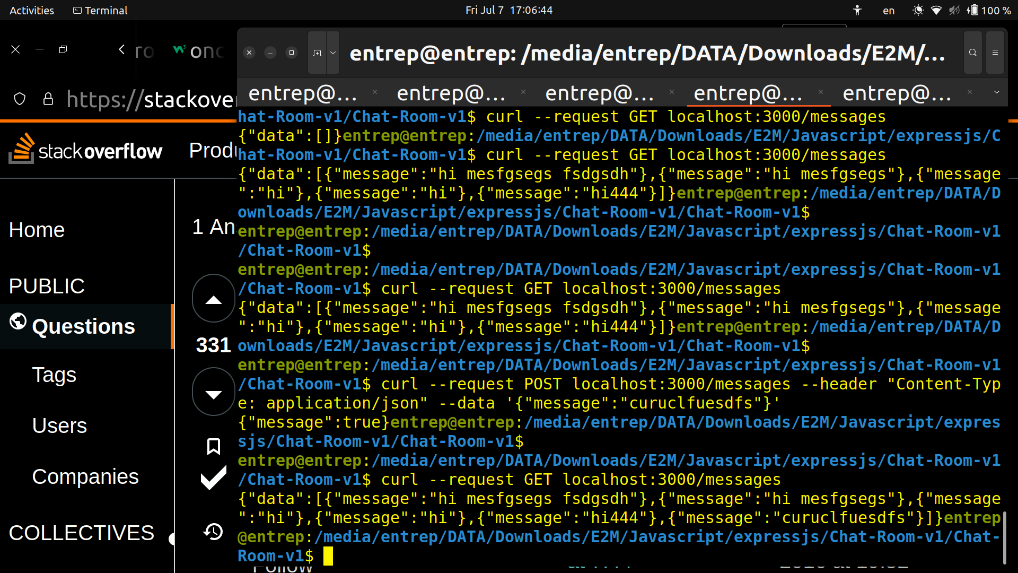
Guide & Notes
Use curl to simulate HTTP requests to the server
Verify server API works well.
Need to specify Content-Type. Mixing of Single & Double Quotes.
Use browser F12 to verify client side.

Slide 25
Guide & Notes

Slide 26
Guide & Notes
Commit Message: https://www.conventionalcommits.org/en/v1.0.0/
Pull request
git checkout -b feat/new-branch
New Feature Development on this branch, then git add . + git commit
git push origin feat/new-branch
Go to github page, change to the branch, and press the “compare and pull request” button
Delete the forked branch
Git pull
Delete branch:
git checkout go-to-branch
git branch -D branch-to-delete
Didn’t add / commit, but switch branch:
Work in progress
Git stash
Git stash list
Git stash pop
Or use git restore .
Rename a local branch name: git branch -m old_name new_name
git reset: undo commit (but not pushed)

Slide 27
Guide & Notes
User login example with express-session
https://expressjs.com/en/resources/middleware/session.html
Callback or I/O won’t wait
sqlite3 db.all() won’t wait.
express-session session.regenerate() won’t wait.
https://stackoverflow.com/questions/5010288/how-to-make-a-function-wait-until-a-callback-has-been-called-using-node-js
CSS: For CSS, use a CSS editor website for styling instead of running the whole program.
https://jsfiddle.net/azetjL8g/
…

Slide 28
Guide & Notes
MVC:
https://progressivecoder.com/how-to-create-a-nodejs-express-mvc-application/
JWT:
https://progressivecoder.com/nodejs-express-login-authentication-with-jwt-and-mysql/
(not checked link)
Sqlite3 doesn’t support Promise. Can’t await db.all(“select…”)
https://stackoverflow.com/questions/62456867/cannot-await-for-sqlite3-database-get-function-completion-in-node-js
https://stackoverflow.com/questions/64372255/how-to-use-async-await-in-sqlite3-db-get-and-db-all
https://www.npmjs.com/package/sqlite#examples
Maybe use sqlite.
User wrap a Promise function, as in stackoverflow.

Slide 29
Guide & Notes
express Request-Response Cycle != Return From Middleware Function
Use freecodecamp boilerplate-express for testing.
res.send() res.json() res.end(): don’t return from middleware function.
So we have to explicitly add “return;”
router.get(“/users”, userController.func) → “this” keyword undefined
https://stackoverflow.com/questions/45643005/why-is-this-undefined-in-this-class-method
what gets passed to your router is just a reference to the .list method. The userController instance gets lost.
This is not unique to routers - this is a generic property of how things are passed in Javascript.
Use: router.get('/users', userController.func.bind(userController))
Also, it seems func in another file can use the “active_username_set” global variable in router’s file.

Slide 30
Guide & Notes
MVC & express.js example
https://progressivecoder.com/how-to-create-a-nodejs-express-mvc-application/
https://github.com/dashsaurabh/node-express-mvc-demo/tree/master
Session Cookie vs Token Authentication
express session vs json web token
stores in server vs client side
great picture: https://www.geeksforgeeks.org/session-vs-token-based-authentication/
great picture: https://hackernoon.com/using-session-cookies-vs-jwt-for-authentication-sd2v3vci

Slide 31
Guide & Notes
server gets session data / express-session with session store
we can use req.session in router to get session data,
but what about other places like socket.io on event listener ?
https://stackoverflow.com/questions/19889552/how-to-access-express-session-memorystore-via-socket-io-objects
https://stackoverflow.com/questions/24887175/unable-to-get-session-from-session-store
store.all() store.get
server on event: socket.request.headers.cookie
https://www.section.io/engineering-education/session-management-in-nodejs-using-expressjs-and-express-session/
express-session.MemoryStore
Warning The default server-side session storage, MemoryStore, is purposely not designed for a production environment. It will leak memory under most conditions, does not scale past a single process, and is meant for debugging and developing.
https://expressjs.com/en/resources/middleware/session.html
it seems we need to manually call store.destroy() for this MemoryStore
socket.io with express.js: https://www.danielbaulig.de/socket-ioexpress/

Slide 32
Design Doc: API Send Messages
Write one RESTful API /messages, take chat message and print it out at server log using console.log (this small step is to verify your code work)
https://stackoverflow.com/questions/7172784/how-do-i-post-json-data-with-curl
Test that API using curl via command line
Enhance this API by store the data into sqlite3 (READ THE TUTORIAL)
https://www.npmjs.com/package/sqlite3?activeTab=readme
API Spec: next page
Reference: Express Basic routing
Reference: `cat backup.sql | sqlite3 hello.db` [Ref]
Res req are what we learn http messages in computer network courses.
Javascript has non-blocking I/O on async operations, including db.
Async await. promise.
…

Slide 33
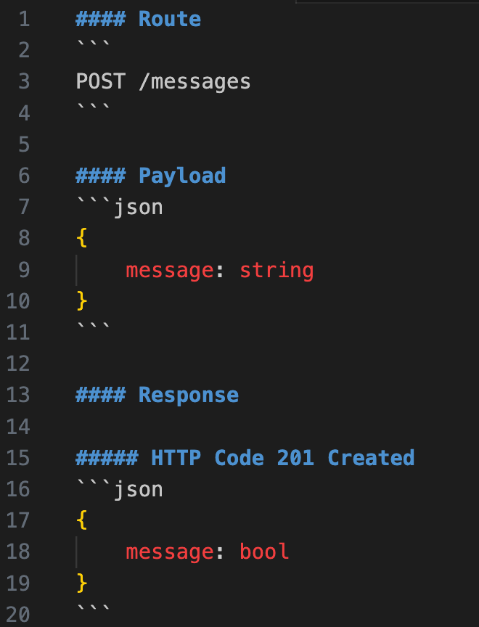
Spec

Slide 34
Design Doc: API Get Messages
Write one RESTful API /messages, get all chat messages from DB
Test that API using curl via command line
API Spec: next page
My NOTE: onclick vs form eventListener & enter keypress event.

Slide 35
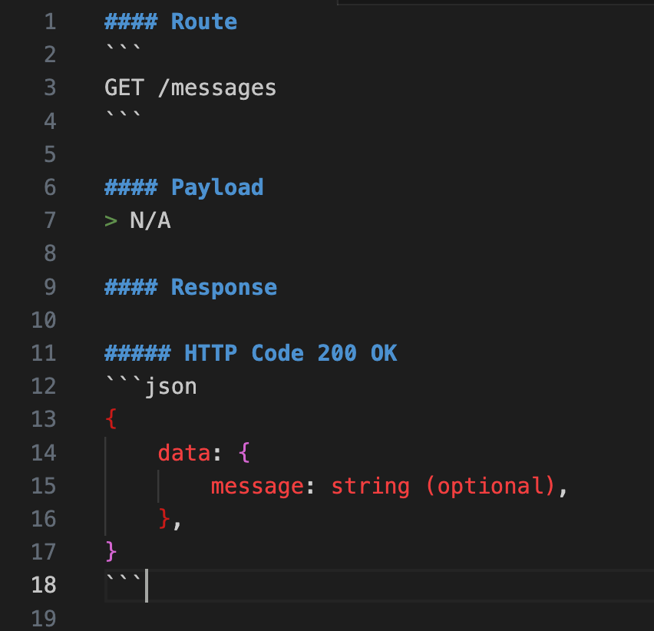
Spec

Slide 36
Design Doc: Front-end JS call RESTful API
Use ajax to call RESTful API send messages when user click send button
Use ajax to call RESTful API get messages when user enter chat room page
…

Slide 37
Design Doc: Implement sender
Enhance existing API by adding sender info to backend API & client-side call
QQ:
Where should we get user info?
Where should we store sender info?

Slide 38
Design Doc: Implement Register API
Do API Design
What’s the input data? -> Username & password
What should be the return value?
What should the route be? What is the HTTP method for creation? [Using HTTP Methods for RESTful Services]
What kind of error should we return if username already exists? I.e. username conflict [Client error responses]
Can we store plaintext password? -> we can skip this for now
Implement it :”)
POST for creation, status 201(Created) / 400(username conflict). Router path at “/register”

Slide 39
Design Doc: Implement Login API
Do API Design
What’s the input data? -> Username & password
What should be the return value?
What should the route be? What is the HTTP method for login? [Using HTTP Methods for RESTful Services]
What kind of error should we return if username not exists? [Client error responses]
What kind of error should we return if password not match? [Client error responses]
How to verify password if we store encrypted password? -> we can skip this for now
Implement it :”)
POST method. Router path at “/login”. 200 ok for success. 401 Unauthorized for incorrect username. 403 Forbidden for incorrect password. 400 Bad Request.
Case for being already logged in?

Slide 40
Design Doc: Implement Logout API
Do API Design
What’s the input data?
What should be the return value?
What should the route be? What is the HTTP method for logout? [Using HTTP Methods for RESTful Services]
What’s the user behavior after he/ she logout?
Implement it :”)
POST method. Router path at “/logout”. 200 ok for success. 400 bad request
Logout shall redirect the user to the home page, not the chat room. So response status code may be different.

Slide 41
Design Doc: Frontend for Register & Login
It’s up to you to design Frontend HTML/ CSS/ JS
Reference:
https://codesandbox.io/s/eqg36
…

Slide 42
Design Doc: Private Messaging Architecture
just wrap the codes with only public chat.
Database Schema
RESTful API
Frontend
Chat room html page
Room selection frontend & html page
homepage: (1) login page, if not logged in. (2) room selection page, otherwise
room selection page:(1) select existing. (2) create a new room by specifying usernames
the public room: all joins it automatically

Slide 43
Design Doc: Database Schema
Table messages:
message : string
timestamp_utc : string
username : string
room_id : string
Table rooms:
room_id : string
no array in sqlite3
room_id: “public_room” “member0#member1#member2#room”
Extensibility: not only 1-to-1 room, but rooms with members of any size.

Slide 44
Design Doc: Database Schema (cont.)
Table users2rooms:
many-to-many relationships, to solve sqlite3’s no array problem.
username: string
room_id: string
select username … where room_id = … → not needed, socket.io join() does the job.
select room_id … where username = … → API: GET /rooms
Process when a user logs in and gets all chat messages:
select room_id from users2rooms where username = …
for room_id in all selected chat rooms: select * from messages where room_id = room_id
socket.io join()

Slide 45
Design Doc: RESTful API
URI: GET /rooms
a room_id list is sent from the server to the frontend every time frontend needs it
username specified in request body
URI: POST /rooms
create a new chat room
member usernames specified in request body
naming:
MVC: with model / controller suffix
message and room have their own /routes /controllers /models
routers, controllers, models, sql table have consistent names.
URI: POST /users
when register, add the username to the public room in database (not socket.io)
only 1 chat_room_controller instance & chat_room model instance for all rooms.
UI Design: don’t need to authenticate for GET POST /rooms

Slide 46
Design Doc: RESTful API (cont.)
URI: GET /messages/:room_id
get all messages
if room not exist in database, insert 1.
req.params.room_id
this is when the user selects a particular room on the room selection html page.
socket.io join()
URI: POST /messages/:room_id
post new messages
if room not exist in database, insert 1.
call socket.io io.to(room_id).emit()
Steps: MVC: models → controllers → routers
Steps: tests with curl: create new rooms → logins → messages

Slide 47
Design Doc
Server: after login, redirects to the room selection page room_selection.html, then:
(1) join the socket to the room_id
(2) redirect to the host:3000/messages/:room_id url.
Client Proposal 1:
when calling enter_room_get_all_chat_logs() in client side, emit a join-room event to the server. (or the server doesn’t know client’s socket)
problem: duplicate joining the room if reloads
Client Proposal 2:
when page reloads or (after login & closing old page) opening a new page, socket.io server get a new “connection” event
To change room:
when I close the page or redirects to another page, the client side’s global variable socket is destroyed. → the lifetime of a html global variable

Slide 48
Design Doc
Client send room_id data to server:
‘cuz client’s socket global variable gets destroyed when reloads,
‘cuz (after login & closing old page) opening a new page, socket.io server get a new “connection” event
client: socket.on(“connect”, …) → emit a set-room_id event to the server.
Use chore/socket-io-try branch for proof-of-concept:
when reloads / open a new tab / new login on a private tab of the same browser,
socket.id changes
socket.id the same for server side & client side,
socket.id the same at 5 places in client side
(1) when first initialized by io(). (2) before / after emit(“ci socket”) & calling enter_room_get_all_chat_logs(). (3) in XMLHttpRequest onload

Slide 49
Wrap up
Watch writeup & checklist
Record the demo video

Slide 50
Design Pattern: Singleton for Instance Getters
Singleton, module export import order problem.

Slide 51
Bonus: OOP (C++)
Read This How to solve it; Example(s)
Composition over inheritance
Explain the difference between “has a” and “is a”
Design: Overloading vs. overriding vs. template
In your Shape implementation, which one do you use?
OOP:
https://en.wikipedia.org/wiki/SOLID
https://teddy-chen-tw.blogspot.com/2014/04/solid.html
Google test.

Slide 52
Bonus: OOP (C++) (Object-Oriented Design) (cont.)
Step1: Draw the UML Class Diagram for your shape.cpp implementation
Interface - shape
Implementation - circle, rectangle, …
Step2: TBA

Slide 53
What You’ve Learned So Far?
Simple full-stack app using JS
Elementary level RESTful API design
Map some concepts w/ practical implementation
HTTP Method
HTTP Status Code
Basic concept of socket in web app
Elementary level of coding SE practice
Modularity -> what does this mean?
Branch Naming Convention
Git
Break down feature into tasks implement given tasks & compose tasks back to working feature (and make sure it works)

Slide 54
Try to Answer The Following Questions (RESTful API)
Why POST /messages instead of POST /send-messages?
Do you name the register API POST /register? If so, does this follow RESTful practice?
Read Best Practices for Designing a Pragmatic RESTful API
Let’s say we have a new feature with the following spec, write the RESTful API design
Search history chat message by a single keyword
Search chat message by username
Search history chat message by time period (start timestamp & end timestamp)

Slide 55
One Step Further - Auth (1 day work)
Protect chatroom by jsonwebtoken
Only login user should have access to chatroom page
Server issues the JWT token to client-side [Hint: which API should we update?]
Let JWT token expire in one day
Store JWT token at user browser [Ref]
Clear token at user’s browser when user logout [Hint: client-side JS work]
Alt. for token: Survey and implement express-session
Why token over session? What’s RESTful best practice?
Keywork: RESTful API is stateless

Slide 56
One Step Further - Middleware (0.5 ~ 1 day work)
Study Router-level middleware
Implement parameter validator middleware with the following rule
POST /messages API should return 4xx error when receive empty payload
Login API receive empty username and/ or password should return 4xx error
Register API receive empty username and/ or password should return 4xx error
Register API receive the the following reserved username should return 400 bad request
admin
bothemrun
kobe
shangyi
Helpful Reference: Joi
Bonus: Can you make the design follow the open-closed principle?

Slide 57
One Step Further - Middleware (cont.)
Implement authenticate middleware to verify JWT token for /messages API
Optional Reading: Chain of Responsibility (Design Patterns)

Slide 58
One Step Further - CI (continuous integration) & Linter (<0.5 day)
Survey and apply prettier (optional: ESLint) (Ref)
npm install prettier
Try out prettier command
Update package.json, add a “format” script to format your JS file
Survey Github Action
Use Github Action to run prettier before every PR
Github Action not support private & ubuntu only has node 12 but prettier needs at least 14

Slide 59
One Step Further - Unit Testing (< 0.5 Days work)
Study Jest Getting Start

Slide 60
One Step Further - Integration Testing (1~2 Days work)
You’ll create a test-db using sqlite3 command line
Create table
Insert some random messages record
You’ll write first test case for GET /messages API
Call GET API
Verify return value is not None (your sqlite has sth inside b/c of first step)
You’ll write a test case for POST /messages API
Call POST API
Call GET API
Verify Given GET API contains the data that you post
Question: If the test case always create the same data, how can we make sure the code work?
My test case for POST is written with the following sequence
POST /messages - payload -> “hello world”
GET /messages -> return value contain “hello world”
When I run this test case first time, there is no “hello world”, so the test case can verify POST API work
When I run this test case second time, there is already a “hello world” in DB, so my assertion of GET will pass, but I can’t verify whether the “hello world” comes from my second POST API or first POST API
In other word, I might break the POST /messages API, but the DB still have the stale data, so the test case is still pass.

Slide 61
One Step Further - Integration Testing (cont.)
You’ll Study Setup and Teardown to automate the first step in previous page\
Why do we need setup & teardown?
You’ll add error handling for messages APIs
When user post a message but payload contains nothing, should return 400 bad request
Implement this test, let it fail
Fix the failed test case by modifying your POST /messages API
You’ll implement test case for register, login, and logout
You’ll implement 2 error handling for these three APIs
username not found -> what return code should be?
username conflict -> what return code should be?
Let the test cases fail
Fix the failed test cases by modifying your APIs

Slide 62
One Step Further - Integration Testing (cont.)
What you’re doing in previous page is called TDD (Test-Driven Development)
Add test case
Let it fail
Fix the test case by implementing/ modifying code
Let test case pass
Why TDD?
Integrate your testing process into Github Action, run at every PR

Slide 63
One Step Further - CI (continuous integration) (< 0.5 day)
Survey CircleCI
Use CircleCI to run unit tests/ integration tests at each PR

Slide 64
One Step Further - Architecture (1~2 days work)
Refactor your code by following MVC structure
Keyword: Fat models, Skinny controllers

Slide 65
One Step Further - Architecture (cont.)
Why fat models, skinny controllers?

Slide 66
N Step Further - Deployment/ CD (continuous delivery) (<1 day work)
Survey Render
Manually deploy your application to Render (sqlite3 version)
Access your application using your mobile phone & play around
What’s the difference between HTTP (localhost) & HTTPS (Render)?
Refine Github Action and run deployment when PR merge to main branch

Slide 67
DAO Design Pattern
DAO: Data Access Object
https://www.digitalocean.com/community/tutorials/dao-design-pattern
Why? No Array in sqlite3, but some other databases do. So not to have strong dependency on the choice of database.

Slide 68
N Step Further - NoSQL/ Refactor w/ test cases (1-2 days)
Use MongoDB instead of SQLite
Use Docker to serve your MongoDB [docker pull mongo:5.0.12]
Study Mongoose or MongoDB Node Driver (official)
You’ll update POST & GET /messages APIs first
You’ll run test cases to verify the refactor doesn’t break anything
You’ll manually act as user to verify the feature doesn’t break
You’ll update register, login, and logout APIs

Slide 69
N Step Further - NoSQL/ Refactor w/ test cases (cont.)
Does this application still work w/ Render? If not, why?

Slide 70
N Step Further - NoSQL/ Refactor w/ test cases (cont.)
Does your refactoring follow the Open-Closed Principle? That is, do you modify the code of existing functions, or you can extend the functionality by adding code only? If not, how can you improve the design?
[Keyword: Data Access Object] (~1 day work)

Slide 71
N Step Further - Object-Oriented Analysis (< 1 day)
Draw UML Sequence Diagrams for register/ login/ logout
Draw UML Sequence Diagrams for chat

Slide 72
N Step Further - Your own feature (1 week work)
Write a Use Case
Create a Mockup [Ref] [Use a 10 minutes email to create an account]
Implement the Feature
The feature should contain all HTTP method of RESTful APIs
GET, POST, PUT, DELETE
Implement the unit tests & integration tests
Bonus: Can you implement a design patterns?
Reference: Proposal & Report

Slide 73
Wrap Up
Write your resume & attach the demo video

Slide 74
What You’ve Learned So Far?
Basic knowledge of modern software development
Authentication
Middleware
Docker
SQL vs NoSQL
Experience software development lifecycle
Feature Implementation
Testing
Refactoring
Use Case Proposal
Basic knowledge of software architecture
MVC

Slide 75
Try to Answer The Following Questions (System Design)
What’s the difference between SQL & NoSQL?
[Designing Data-Intensive Applications Chapter 2] Highly Recommended
In chat room app, do you prefer SQL or NoSQL? Why?
What’s the benefit of using MVC? What’s the drawback?

Slide 76
Try to Answer The Following Questions (Refactoring)
What is refactoring?
How’s your feeling when refactoring [SQL -> NoSQL] w/ test cases? What will happen if you refactor the code w/o test cases?
How do you ensure the refactoring doesn’t break the code?
Write a general algorithm of refactoring
I.e. Step 1: xxx, Step 2: ooo, …

Slide 77
Try to Answer The Following Questions (UX/ PM)
As a developer, can you understand the use case you wrote?
To communicate, how do you feel when given only text-based writeup v.s. Clickable mockup?

Slide 78
Try to Answer The Following Questions (OOD)
What is OOP?
What is design patterns?
Is MVC a kind of pattern?
What’s the relationship between DP & OOP?

Slide 79
Try to Answer The Following Questions (Security)
Can you conduct SQL injection for your application (sqlite3 version)? How to prevent this?
What’s the risk of using JWT token? What if the client leaks there token?

Slide 80
Optional Topics
Encryption. JWT. My Own Feature.
Announcement. Admin.
Security Issues: SQL Injection. JWT. Session Fixation.
Design Pattern: OOP
Unit Testing
Integration Testing
Use jQuery
Template Engine
Socket.io Example: Private Messaging To Scaling up
https://socket.io/get-started/private-messaging-part-4/

Slide 81
References For Beginners
Project Example:
https://www.youtube.com/watch?v=SVnpp_OY4_E
Better express generator intro:
https://www.section.io/engineering-education/nodejs-app-express-generator/
Javascript + HTML
https://www.w3schools.com/jsref/
https://www.w3schools.com/js/
Express.js
https://expressjs.com/en/starter/installing.html
Socket.io
https://socket.io/get-started/chat
Express.js template / view engine
https://www.digitalocean.com/community/tutorials/nodejs-express-template-engines#what-template-engines-should-i-use
https://www.educative.io/answers/what-is-a-view-engine-in-expressjs
…

Slide 82
References For Beginners
Pug:
https://pugjs.org/api/getting-started.html
Express.js + socket.io chat room
https://www.freecodecamp.org/news/simple-chat-application-in-node-js-using-express-mongoose-and-socket-io-ee62d94f5804/
jQuery:
https://www.w3schools.com/jquery/jquery_syntax.asp
Client page:
addEventListener
jQuery
Mobile browser by meta viewport:
https://www.youtube.com/watch?v=duKr29QU5ZI
…

Slide 83
References For Beginners
Sqlite3:
https://www.digitalocean.com/community/tutorials/how-to-use-sqlite-with-node-js-on-ubuntu-22-04
…

Slide 84
Git Alias
[alias]
str = !git remote -v update
st = status
co = checkout
br = branch
ci = commit -a
pu = pull
ls = log --follow
mg = merge --no-ff
cibr = !export cur_br=$1 && echo $1 && (git push origin --delete ${cur_br} || echo "no remote branch ${cur_br}") && (git branch -D ${cur_br} || echo "no local branch ${cur_br}") && git branch ${cur_br} && git push origin ${cur_br} && echo "done"
rv = reset HEAD^
cm = !git co master && git pull origin master
cmfse = !git co main && git pull origin main
dd = !export cur_br=$1 && echo $1 && git push origin --delete ${cur_br} && git branch -d ${cur_br}
[pull]
rebase = false
[user]
name = shangyiy
email = shang.yi.yu.tw@gmail.com

