Slide 1
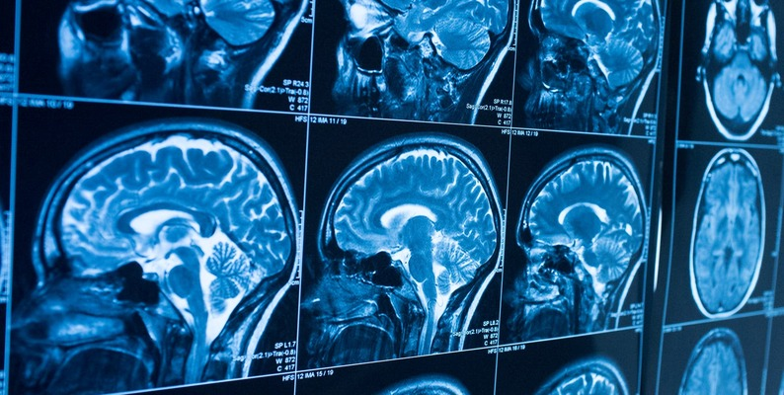
Brain Tumor MRI Classifier
Deep learning convolutional neural network (CNN) project

Slide 2
TABLE OF CONTENTS
01
03
02
04
Aim
Preprocess and Models
Dataset
Selecting the model

Slide 3
01
AIM

Slide 4
PURPOSE OF THE PROJECT
The model that we train takes a brain MRI image as input and gives an output to which class this image belongs to. These classes are; glioma, meningioma, pituitary, and no tumor. We have used supervised learning and deep learning CNN (Convolutional neural network).

Slide 5
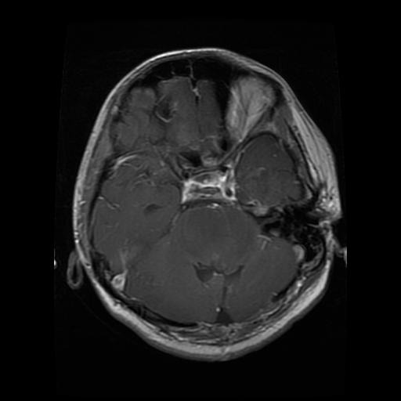
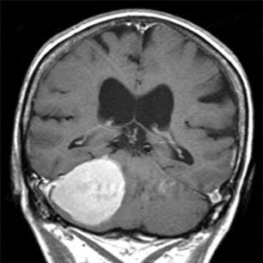
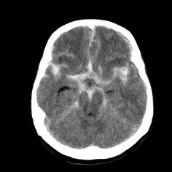
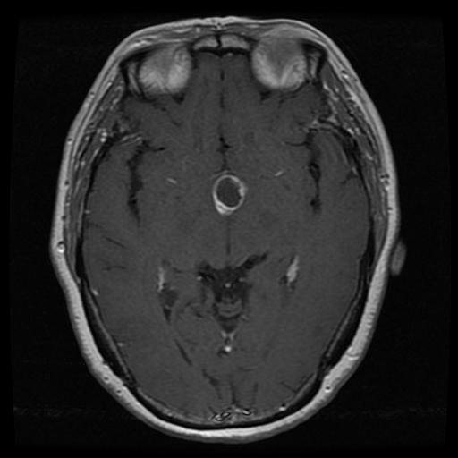
EXAMPLES OF THE CLASSES
Glioma
Meningioma
No Tumor
Pituitary

Slide 6

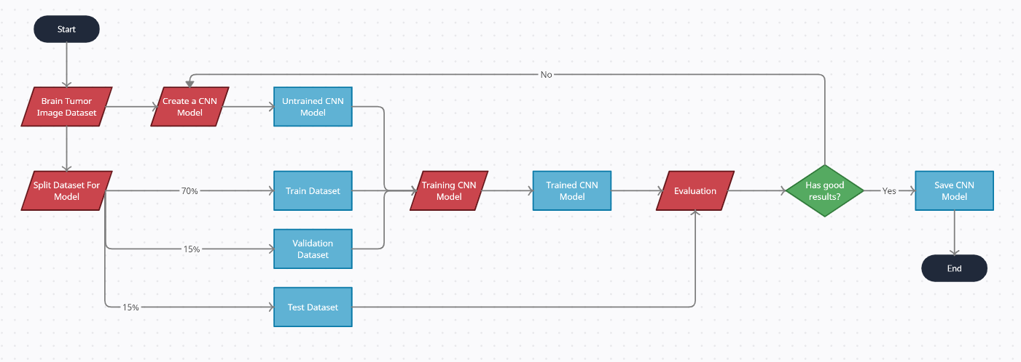
FLOWCHART

Slide 7
02
DATASET

Slide 8
7023
1645
Number of the instances
1621
Glioma
Meningioma
2000
1757
No Tumor
Pituitary

Slide 9
DATASET
Numbers of the instances

Slide 10
SPLITTED DATASET

Slide 11
03
PREPROCESS AND MODELS

Slide 12
CODE

Slide 13
04
SELECTING THE MODEL

Slide 14
1st Training

Slide 15
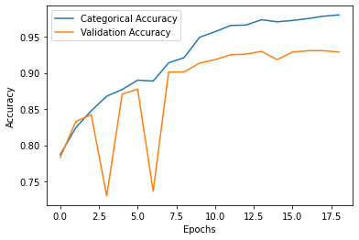
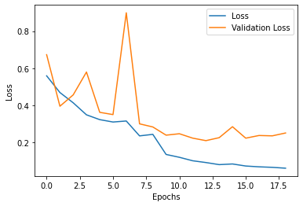
MODEL 1
Accuracy
Loss

Slide 16
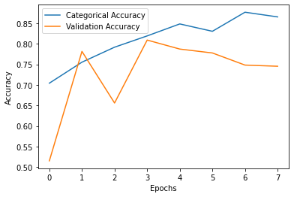
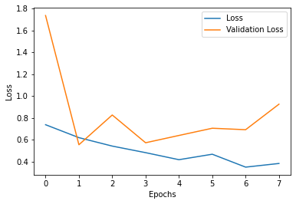
MODEL 2
Accuracy
Loss

Slide 17
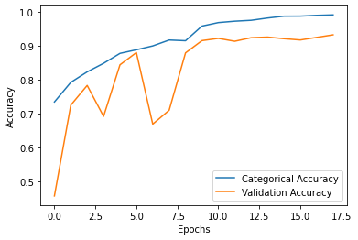
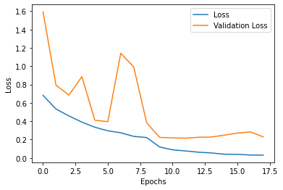
MODEL 3
Accuracy
Loss

Slide 18
TEST RESULTS
MODEL 1
MODEL 2
MODEL3
0.9527
0.7483
0.9395

Slide 19
2nd Training

Slide 20
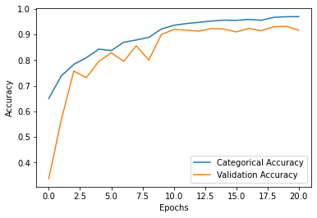
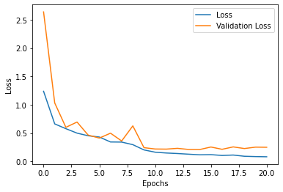
MODEL 1
Accuracy
Loss

Slide 21
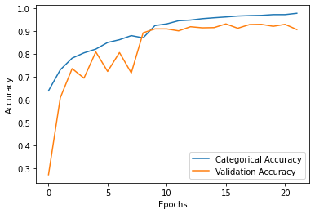
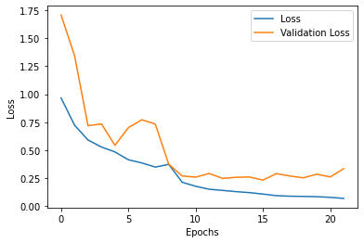
MODEL 2
Accuracy
Loss

Slide 22
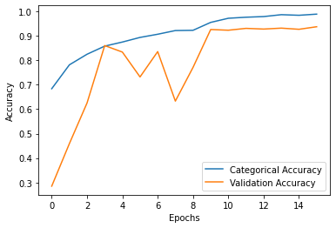
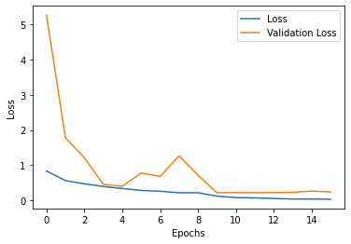
MODEL 3
Accuracy
Loss

Slide 23
TEST RESULTS
MODEL 1
MODEL 2
MODEL 3
0.9300
0.9205
0.9461

Slide 24

THANKS!
Recep Batuhan Dikmen
İrem Akanoğlu
___

