Slide 1
Data ANALYSIS PRESENTATION BY ISHEANOPA B. SHUMBA

Slide 2
Introduction
Hi everyone, thank you for the opportunity. In this video, I’ll walk you through the key findings from the load issues report, highlight the main patterns I observed, and share recommendations.
This report summarizes loads with issues by dispatcher and team, focusing on both the number of affected loads and the total duration of unresolved issues.

Slide 3
KEY FINDINGS
Starting with the overall findings, a small number of teams and dispatchers are responsible for a disproportionately high share of unresolved issue duration.
For example, the Aris team, particularly Liam Peterson and Nolan Pierce, shows the highest impact, with six problematic loads each and total issue durations of 71 and 64 days respectively.
This indicates that while the number of issues is important, the aging of those issues is a much bigger operational risk.
On the August team, we see several dispatchers with fewer loads but still meaningful total durations, such as Nathaniel Scott and Oscar Mitchell, which suggests delays are persisting even when issue volume is relatively low.
Overall, the data shows that issue duration is not evenly distributed, and a few long-running cases are driving most of the exposure

Slide 4
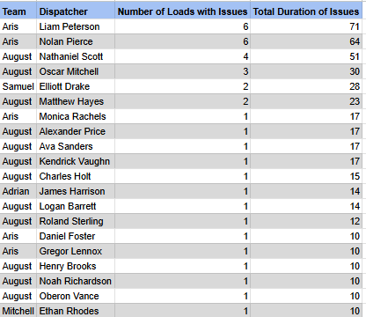
REPORT

Slide 5
Patterns and Insights
One clear pattern is that issue severity is driven more by duration than volume. Some dispatchers have only one or two problematic loads, yet those loads have remained unresolved for more than two weeks.
Another insight is that teams with higher total durations tend to have multiple aged issues, which may indicate either workflow bottlenecks, delayed documentation follow-ups, or insufficient escalation mechanisms.
Additionally, since the report excludes short-duration “Awaiting Money” cases, this confirms that the remaining issues represent genuinely overdue or high-risk cases, not normal processing delays.

Slide 6
Results Summary
To summarize the results:
A small group of dispatchers account for most unresolved issue days
Long-standing issues are a bigger concern than issue count alone
Certain teams may benefit from targeted process reviews rather than broad changes
This ranking approach helps prioritize where action will have the biggest impact

Slide 7
Recommendations
Based on the analysis, I would recommend a few improvements.
First, introduce age-based escalation thresholds, for example flagging any issue older than 10 or 14 days for automatic review.
Second, implement a weekly aging dashboard that focuses on total duration rather than just issue count, so teams can address problems before they become critical.
Third, standardize issue categorization in the Notes field or move it to a structured dropdown. This would reduce ambiguity and improve reporting accuracy.
Finally, focus coaching or process audits on dispatchers and teams with consistently high total durations, as this is where efficiency gains are most likely

