Slide 1

Linear Regression
01

Slide 2

Today’s Agenda
Machine Learning
Types of Machine Learning
Regression
Assumption of Linear Regression
Role of ML in Linear Regression
Example
Fitting A Linear Regression Model
Metrics for Evaluating Model’s Performance
Hands on With Bike Share data set
02

Slide 3
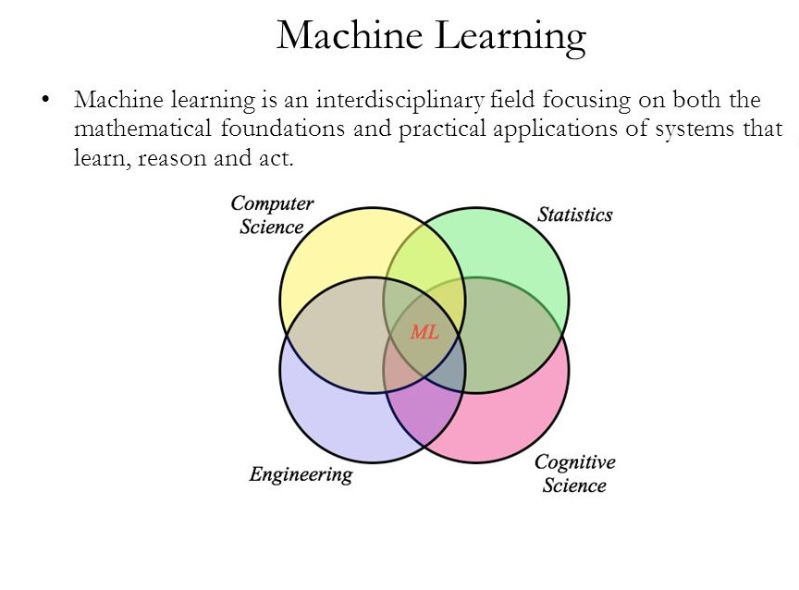
Machine Learning
03

Slide 4
Types of Machine Learning
Supervised Learning
Unsupervised Learning
Linear Regression
Logistic Regression
Decision Trees
Random Forest
SVM
kNN
Naïve Bayes
Neural Nets
k-Means
Hierarchical Clustering
Recommender Systems
04

Slide 5
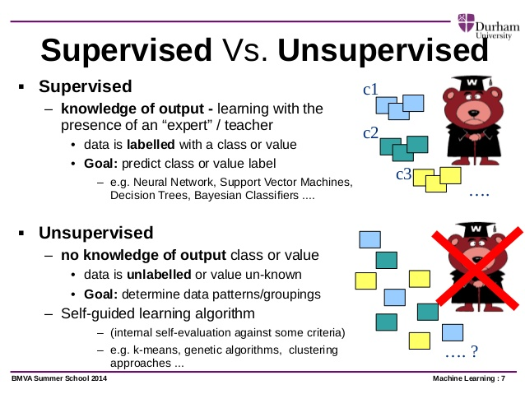
05

Slide 6
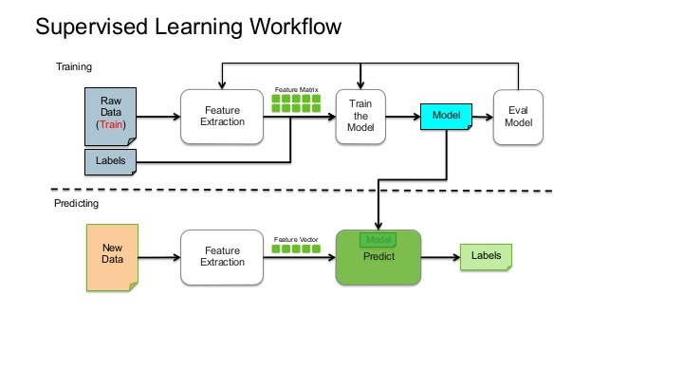
Supervised Machine Learning Workflow
06
05

Slide 7

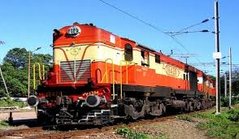

Examples for Supervised Learning
How many minutes will the flight be delayed
Is flight on time
How many hours will battery last
Will the battery last till end of the day
How many seats are available 10 days prior to journey
Can I get a confirmed ticket for booking 10 days in advance
07
03

Slide 8
Machine Learning Algorithm – Today’s session
Supervised Learning
Unsupervised Learning
Linear Regression
Logistic Regression
Decision Trees
Random Forest
SVM
kNN
Naïve Bayes
Neural Nets
k-Means
Hierarchical Clustering
Recommender Systems
08
02

Slide 9
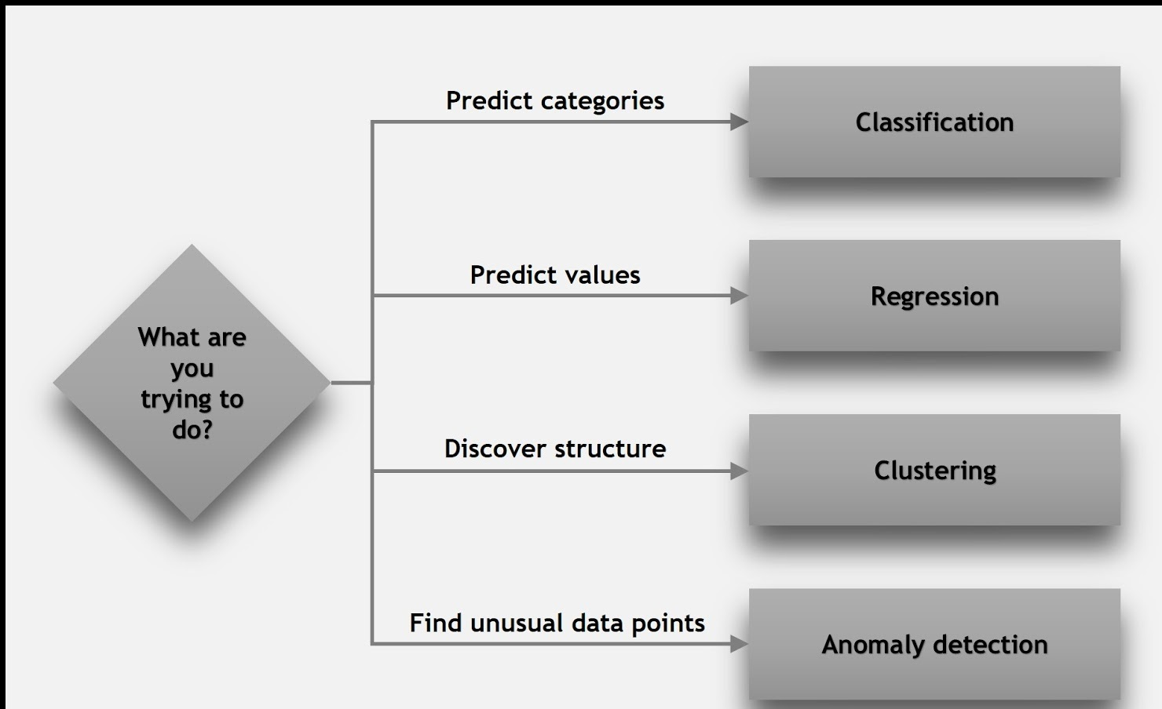
09
01

Slide 10

Supervised Learning- Regression
How many hours will battery last
Will the battery last till end of the day
How many seats are available 10 days prior to journey
Can I get a confirmed ticket for booking 10 days in advance
How many minutes will the flight be delayed
Is flight on time
10
04

Slide 11
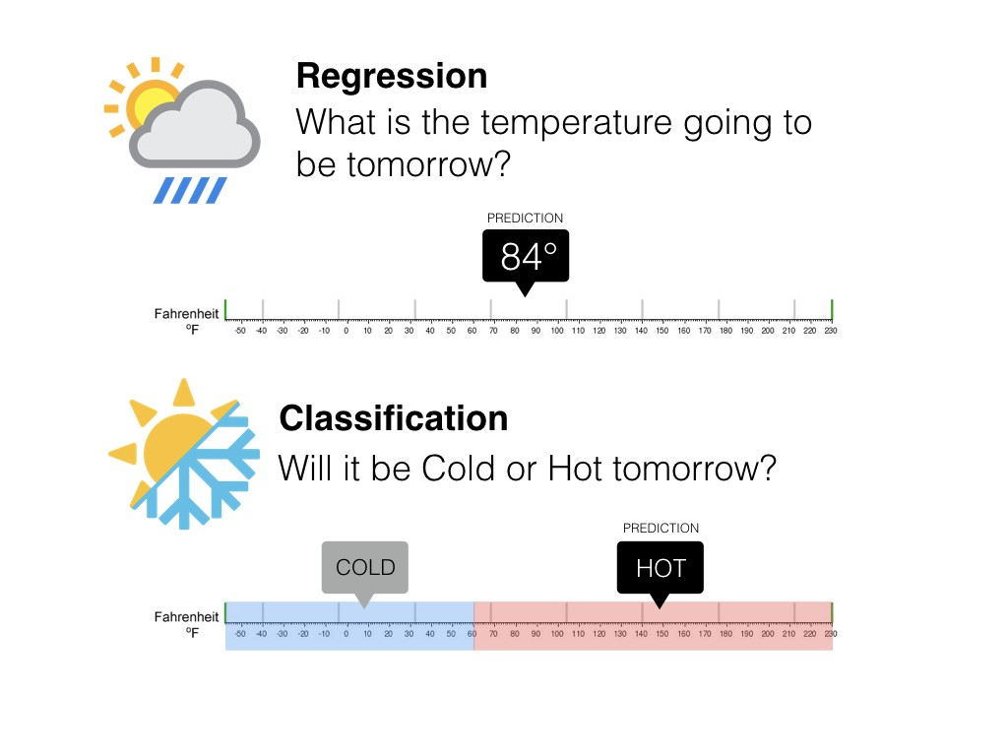
Quick Check – Regression or Classification
11
05

Slide 12
Linear Regression
Univariate and Multivariate
12
07

Slide 13
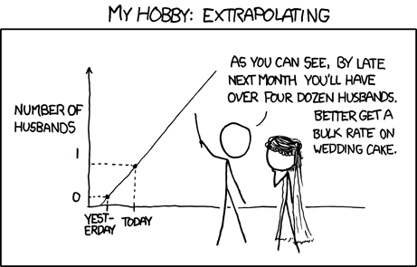
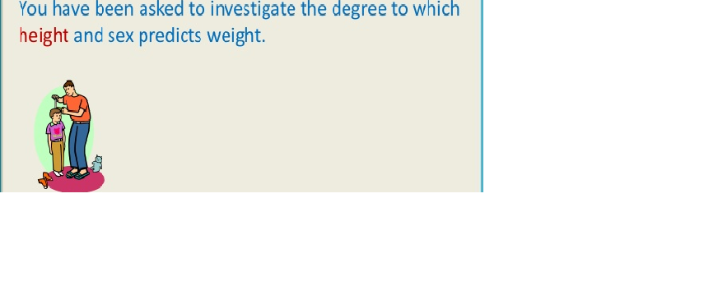
Univariate vs Multivariate
13
07

Slide 14
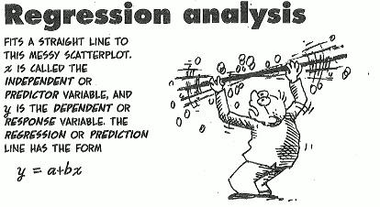
Regression Analysis
Used when you want to predict a continuous dependent variable from a number of independent variables.
Dependent variable must be continuous for Linear regression, if it is categorical then we apply logistic regression.
The independent variables used in regression can be either continuous or categorical.
Simple linear regression analysis means “fitting a straight line to data”
We want to estimate Y at some specific values of X_{i}
14
08

Slide 15
What is Linear?
Remember this: Y=mX+c ?
y
y
y
B
B
B
N
A
A
A
Desired Value
x
x
x
Expected value of y at given level of x =
15
09

Slide 16
Prediction With Linear Regression
If you know something about X, this knowledge helps you predict something about Y.
Equation for prediction value:
Outcome variable
Intercept
y
Slope
Y_{i} = β₀ + β₁*x_{i} + random error
N
B
Predictor variable
Fixed – exactly on the line
Follows a normal distribution
A
x
16
10

Slide 17
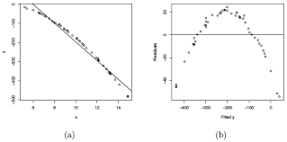
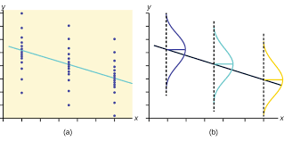
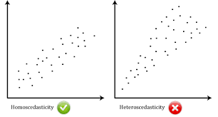
Linear regression assumptions
1. The relationship between X and Y is linear
3. Y is distributed normally at
each value of X
2. The variance of Y at every value of X is the same
17
11

Slide 18
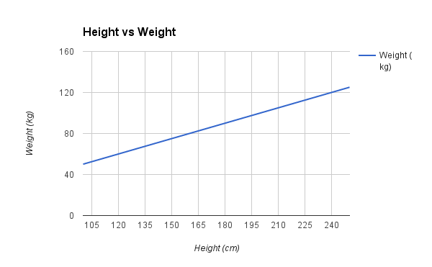
Relationship Between Study Variable & Explanatory Variable
In the figure left , the regression Line indicates positive correlation between Height & weight that is if height increases weight also increases
18
07

Slide 19
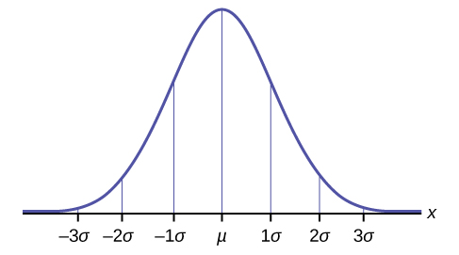

Normal Distribution
The Normal Distribution has:
mean = median = mode
symmetry about the center
50% of values less than the mean and 50% greater than the mean
19
07

Slide 20
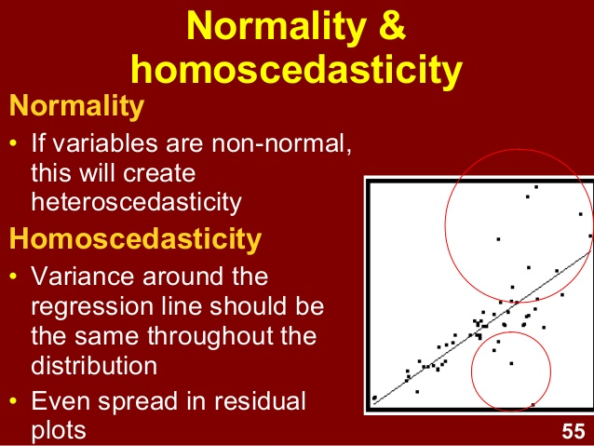
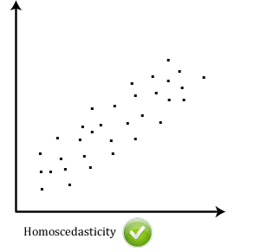
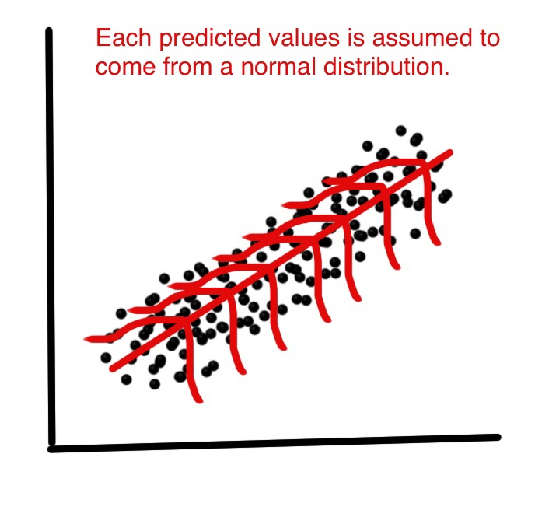
Normal Distribution & Homoscedasticity
20
07

Slide 21
Quick Recap
Machine Learning(Supervised & Unsupervised)
Linear Regression
Equation of Linear Regression
Assumptions of Linear Regression(Linear Relationship, Normal Distribution & Homoscedasticity)
21
05

Slide 22

House Price : What is the right price?
Pricing without Machine Learning
How will one go about ask/sell price?
What factors will you potentially consider ?
Size of the house (say in sq.ft), Land area, Apt vs Ind. House
Recent sale in the neighborhood
Locality
Age of house
House specific factors: Tiling, wood work, design etc.,
Sentiment in the real estate market, stock market, job market
Inflation
Historical importance
New development – some techpark coming up etc.,
Demonetization
Policy guidelines & countless other factors
There is no magic formula for right price just like ones salary
22
12

Slide 23

Can a house broker come up with Magic formula?
Can he price the house ?
Can he quantify his intuition for the price ?
Can he tell what directionality the price takes given a factor – ex: Age of House?
Assuming he has all historical information can he quantify the intuition
No broker potentially just with experience can quantify his intuition
23
13

Slide 24


Can Machine Learning help with estimating the probable price?
LEARNING PROCESS
PREDICTION
Size of the house (say in sq.ft), Land area, Apt vs Ind. House
Recent sale in the neighborhood
Locality
Age of house
House specific factors: Tiling, wood work, design etc.,
Sentiment in the real estate market, stock market, job market
Inflation
Historical importance
New development – some techpark coming up etc.,
Demonetization
Policy guidelines & countless other factors
Size of the house (say in sq.ft), Land area, Apt vs Ind. House
Recent sale in the neighborhood
Locality
Age of house
House specific factors: Tiling, wood work, design etc.,
Sentiment in the real estate market, stock market, job market
Inflation
Historical importance
New development – some techpark coming up etc.,
Demonetization
Policy guidelines & countless other factors
House Price = f(Area, Locality, …)
ML
ML
ML
How do the machine learn the magic formula?
24
14

Slide 25
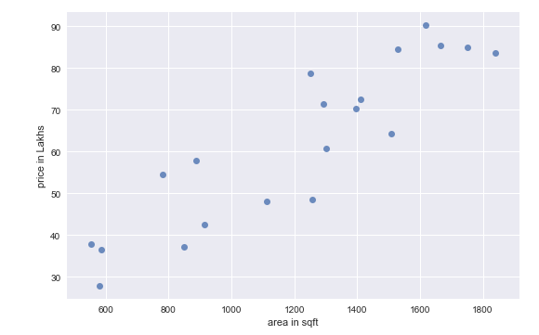
Let us start simple: Just one factor (Area in sq.ft vs. Price in Lakhs)
Suppose a new house comes for sale with 1200 sq.ft.
How will you price it?
What is reasonable price?
25
15

Slide 26
Method to Madness: (Area in sq.ft vs. Price in Lakhs)
Can we approximate the data points as some line
House Price = m * Area + c
How to define the best possible line?
26
16

Slide 27
Defining the Criterion: (Area in sq.ft vs. Price in Lakhs)
error (e) = Price - (m * Area + c)
Goal : Minimize Error
e₃
e₃
e₄
e₃
e₄
Which error to be minimized:
Sum of Errors :
Sum of Absolute Errors:
Sum of Squared Errors:
e₄
e₁ + e₂ + e₃ +e₄ + …..+ e_{n}
e₂
e₂
e₂
e₁
|e₁|+|e₂|+|e₃|+|e₄| + ...+ |e_{n}|
e₁
e₁
e₁² + e₂² + e₃² +e₄² + …..+ e_{n}²
Machine Learning here is identifying optimal m & c for the data
27
17

Slide 28
Which error criterion to use
Actual = [ 6 10 14 18]
Predicted = [ 7 9 16 16]
Error = Actual – Predicted = [-1, 1, -2, 2]
Sum of Errors = -1 + 1 - 2 + 2 = 0
Sum of Absolute Errors = 1 + 1 + 2 + 2 = 6
Sum of Squared Errors = 1 + 1 + 4 + 4 = 10
Try for different values of m & c choose the line that minimizes the error
28
18

Slide 29
Deep Dive : Sum of Absolute Errors
Intuitively the green lines looks the best approximation for the data
Price
However the sum of absolute errors is same for all the lines
Sum of Absolute Errors has multiple optimal solutions and mathematically elegant
Area
NOT USED IN PRACTICE
29
19

Slide 30
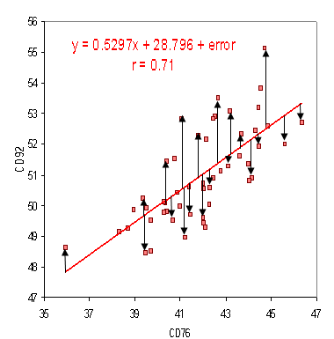
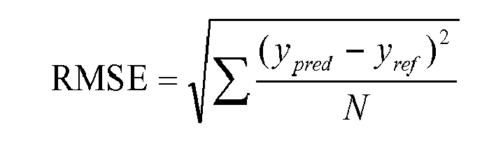
RMSE
Root Mean Square Error (RMSE) is the standard deviation of the residuals (prediction errors). Residuals are a measure of how far from the regression line data points are; RMSE is a measure of how spread out these residuals are. In other words, it tells you how concentrated the data is around the line of best fit. Root mean square error is commonly used in climatology, forecasting, and regression analysis to verify experimental results.
30
05

Slide 31
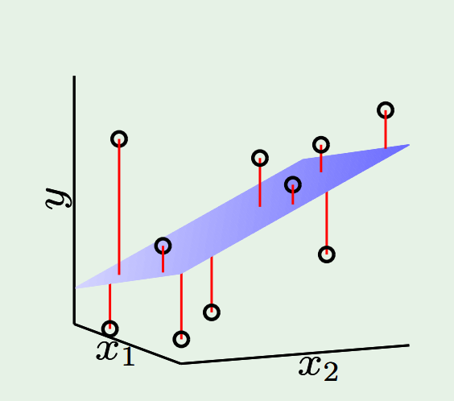
Defining the Criterion: Two factors/inputs/attributes
Goal : Minimize Error
error (e) = Price - (m1 * x1 + m2 * x2 + c)
Which error to be minimized:
Sum of Squared Errors:
Minimize e₁² + e₂² + e₃² +e₄² + …..+ e_{n}²
Machine Learning is identifying optimal m1, m2 & c for the data
31
20

Slide 32
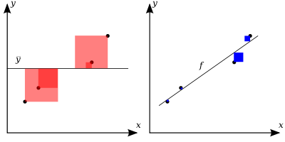
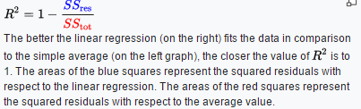
R-squared Explained
https://en.wikipedia.org/wiki/Coefficient_of_determination
32
21

Slide 33
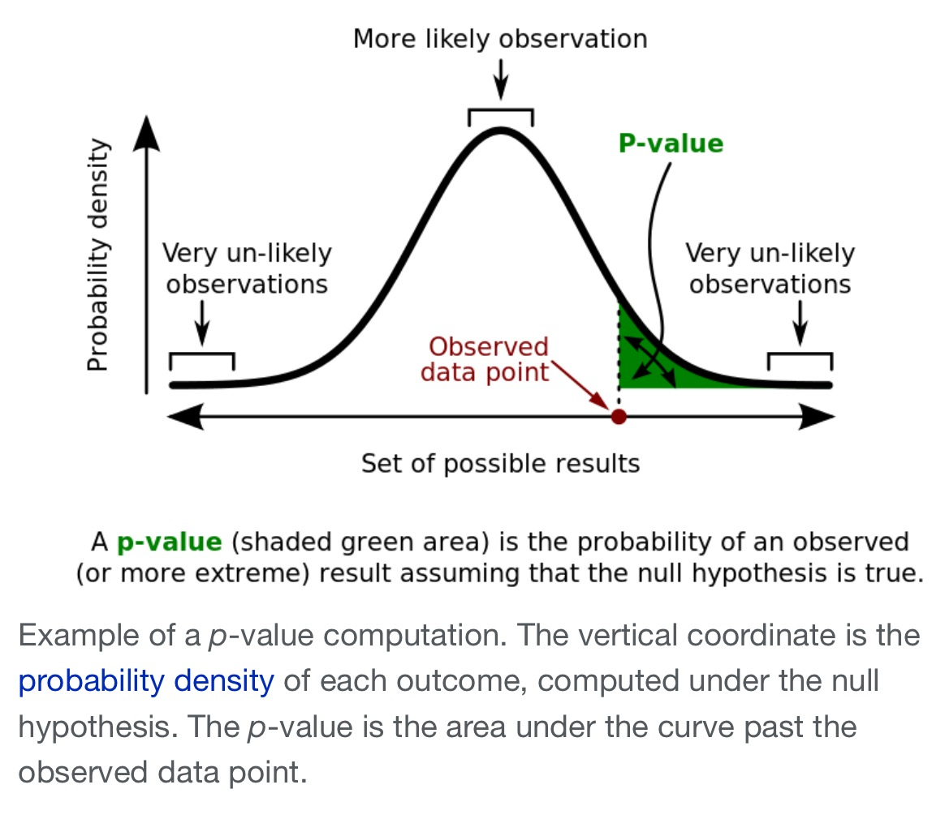
P-Value Explained
33
22

Slide 34
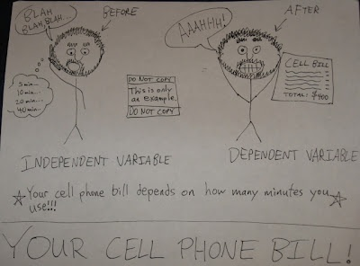

Revise: Demystifying few terminologies
Dependent vs Independent Variable
Continuous vs Categorical Variable
How many hours will battery last
Will the battery last till end of the day
Dependent ~ Outcome/Response
Independent ~ predictor, attribute, feature etc.,
34
23

Slide 35

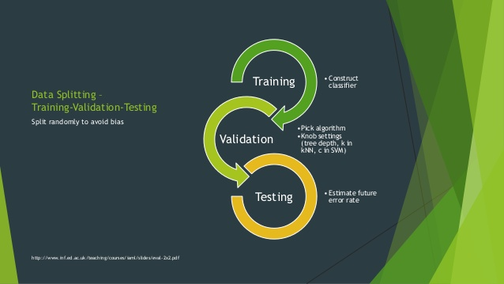
Train – Validation - Test
35
24

Slide 36
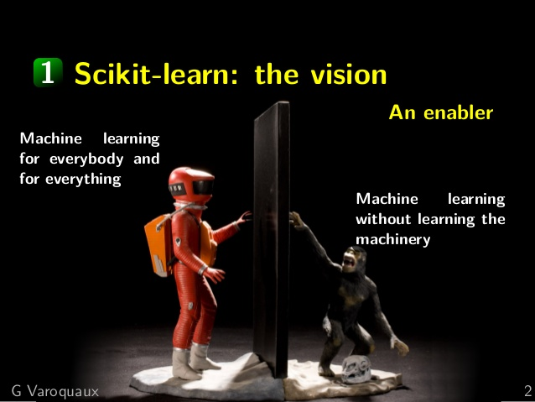

Scikit-learn : Machine learning without learning the machinery
Machine learning for applications
Ease of use
Light and easy to install package
A general-purpose high level language: Python
High standards
State-of-the-art algorithms
High quality bindings: performance and fine control
Open Source
BSD license
Community driven
Installation
conda install scikit-learn
36
25

Slide 37
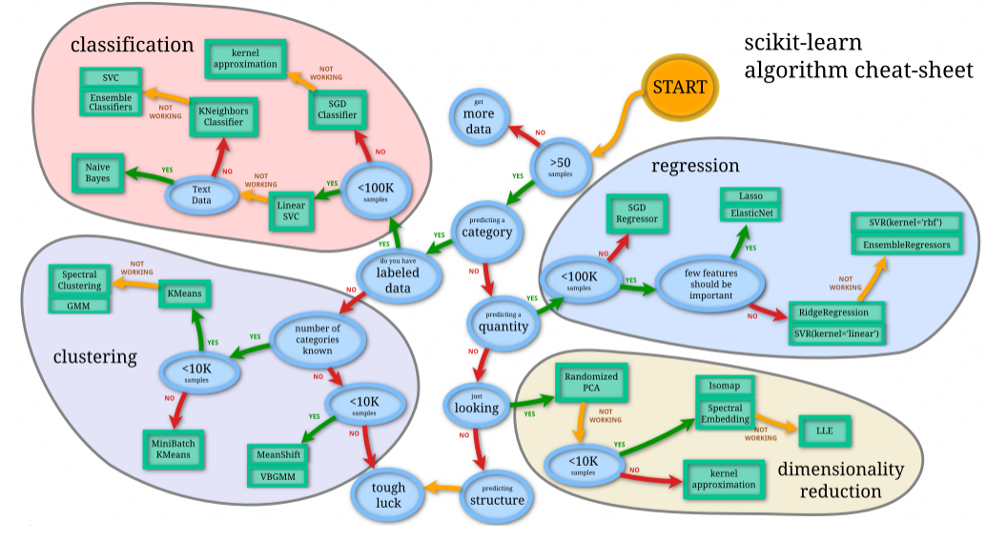
Sklearn Cheatsheet
37
26

Slide 38

Hands on: Intro to Bike Sharing Data Set
Bike sharing systems are a means of renting bicycles where the process of obtaining membership, rental, and bike return is automated via a network of kiosk locations throughout a city. Using these systems, people are able rent a bike from a one location and return it to a different place on an as-needed basis.
Data Fields
datetime - hourly date + timestamp season - 1 = spring, 2 = summer, 3 = fall, 4 = winter holiday - whether the day is considered a holiday workingday - whether the day is neither a weekend nor holiday weather - 1: Clear, Few clouds, Partly cloudy, Partly cloudy 2: Mist + Cloudy, Mist + Broken clouds, Mist + Few clouds, Mist 3: Light Snow, Light Rain + Thunderstorm + Scattered clouds, Light Rain + Scattered clouds 4: Heavy Rain + Ice Pallets + Thunderstorm + Mist, Snow + Fog temp - temperature in Celsius atemp - "feels like" temperature in Celsius humidity - relative humidity windspeed - wind speed casual - number of non-registered user rentals initiated registered - number of registered user rentals initiated count - number of total rentals
https://www.kaggle.com/c/bike-sharing-demand
38
27

Slide 39
Summary
Machine Learning & its Types
Regression: predicting Continuous numeric data
Linear Regression is a subfield of Supervised Machine Learning
Linear Regression Model Building
Determining Model Performance
Preparing Data for Model(Splitting)
Scikit Learn In Machine learning
Hands on with Bike Share Data
39
26

Slide 40


40
26

