Slide 1
OPRTATING SYSTEM

Slide 2
List of Topics
Introduction to Operating System
Process Management
Inter Process Communication
Deadlock
Memory Management
I/O Management
File System
System Protection
Unix/Linux File system
Case Study on XV6 Operating System

Slide 3
Introduction to Operating System
What is Operating System
Need for an OS:
User and System View
History of OS
Processes and Tools

Slide 4
What is Operating System
Operating System (or shortly OS) primarily provides services for running applications on a computer system.
A Program that acts as an intermediary between a user of a computer and computer hardware.
Goals of OS:-
Execute user programs and makes solving user problems easier.
Makes the computer system convenient to use.
Use the computer hardware in an efficient manner.

Slide 5
Need of Operating System
The central part of a computer system is a processing engine called CPU. A system should make it possible for a user’s application to use the processing unit.
A user application would need to store information. The OS makes memory available to an application when required.
Similarly, user applications need use of input facility to communicate with the application.
This is often in the form of a key board, or a mouse or even a joy stick (if the application is a game for instance).

Slide 6
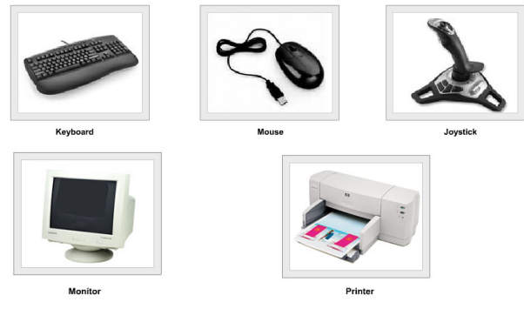
Output may be available in some other forms. For example it may be a video or an audio file.
Let us consider few applications.
Document Design
Accounting
E-mail
Image processing
Games

Slide 7
Each of the above application requires resources
Processing information
Storage of Information
Mechanism to inputting information
Provision for outputting information
Note :- The OS offers generic services to support all the above operations. To that extent an OS operation is application neutral and service specific.

Slide 8
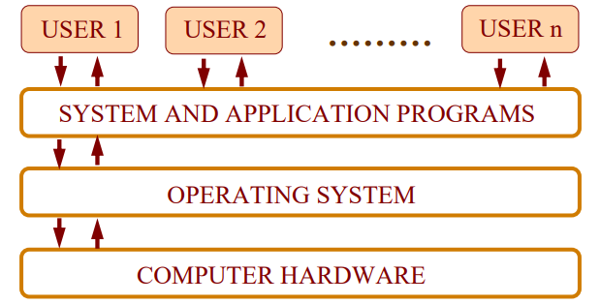
User and System View

Slide 9
From the user point of view the primary consideration is always the convenience. It should be easy to use an application. In launching an application, it helps to have an icon which gives a clue which application it is. OS needs to ensure that system resources are utilized efficiently. it is important for an operating system to have a control policy and algorithm to allocate the system resources.

Slide 10
Functions of an Operating System
Memory Management
Process Management
Device Management
File Management
Security
Control over system performance
Error detecting
Coordination between other software and users

Slide 11
Types of OS
Batch operating system
Time-sharing operating systems
Distributed operating System
Network operating System
Real Time operating System

Slide 12
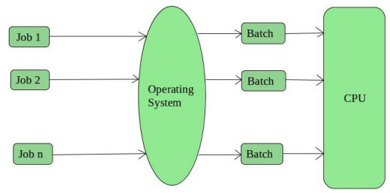
Batch operating system
This type of operating system do not interact with the computer directly.
There is an operator which takes similar jobs having same requirement and group them into batches.
It is the responsibility of operator to sort the jobs with similar needs.

Slide 13
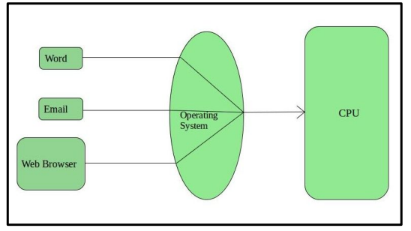
Time-Sharing Operating Systems
Each task has given some time to execute, so that all the tasks work
smoothly.
These systems are also known as Multitasking Systems.
The task can be from single user or from different users also.

Slide 14
Time-Sharing Operating Systems
Advantages of Time-Sharing OS:
Each task gets an equal opportunity
CPU idle time can be reduced
Disadvantages of Time-Sharing OS:
Reliability problem
Data communication problem

Slide 15
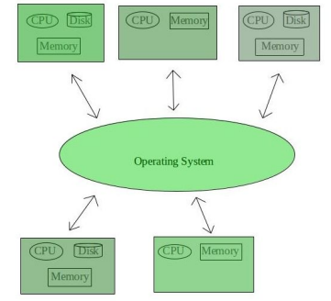
Distributed Operating System
Various autonomous interconnected computers communicate each other using a shared communication network.
Independent systems possess their own memory unit and CPU. These are referred as loosely coupled systems or distributed systems.

Slide 16
Distributed Operating System
Advantages of Distributed Operating System
Failure of one will not affect the other network communication, as all systems are independent from each other.
Load on host computer reduces
Delay in data processing reduces
Disadvantages of Distributed Operating System:
Failure of the main network will stop the entire communication

Slide 17
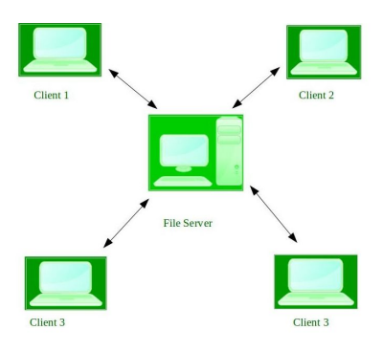
Network Operating System
These systems runs on a server and provides the capability to manage data, users, groups, security, applications, and other networking functions.
These type of operating systems allows shared access of files, printers, security, applications, and other networking functions over a small private network.

Slide 18
Network Operating System
Advantages of Network Operating System:
Highly stable centralized servers
Server access are possible remotely from different locations and types of systems
New technologies and hardware up-gradation are easily integrated to the system
Disadvantages of Network Operating System
Servers are costly
User has to depend on central location for most operations
Maintenance and updates are required regularly
Examples of Network Operating System are: Microsoft Windows Server 2003, Microsoft Windows Server 2008, UNIX, Linux, Mac OS

Slide 19
Real-Time Operating System
Real-time systems are used when there are time requirements are very strict like missile systems, air traffic control systems, robots etc.
Hard Real-Time Systems:
These OSs are meant for the applications where time constraints are very strict and even the shortest possible delay is not acceptable.
Soft Real-Time Systems:
These OSs are for applications where for time-constraint is less strict.

Slide 20
Real-Time Operating System
Advantages of RTOS:
Maximum Consumption
Task Shifting
Memory Allocation
Disadvantages of RTOS
Limited Tasks
Complex Algorithms
Use heavy system resources
Examples of Real-Time Operating Systems are :- weapon systems, robots, air traffic control systems

Slide 21
Modes of Operating System
Operating System Works in two modes:
User Mode:
Applications run in user mode.
In User mode, the executing code has no ability to directly access hardware or reference memory.
Kernel Mode:
core operating system components run in kernel mode.
Kernel mode is generally reserved for the lowest-level, most trusted functions of the operating system

Slide 22
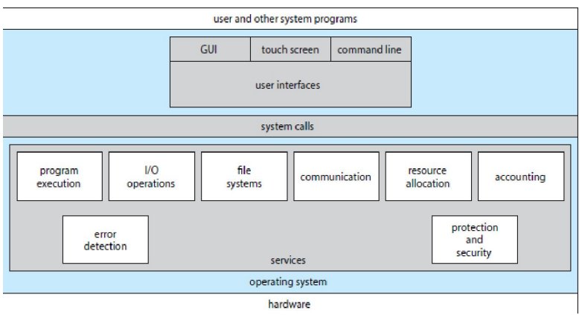
OS Services
Program execution
I/O operations
File System manipulation
Communication
Error Detection
Resource Allocation
Protection
Accounting

Slide 23
OS services that are helpful to the user
User Interface :- Almost all operating systems have a user interface (UI) because otherwise there is no chance to talk to the system.
Difference Types of user interface
Command Line (CLI) :- uses text commands and method for entering them through keyboard for typing command.
Graphics User Interface (GUI) :- interface is a windows system with a pointing device to direct I/O, choose from menus, and make selections and a keyboard to enter text.
Batch Interface:- commands and directives to control those commands are entered into 2 files and those files are executed.

Slide 24
OS services that are helpful to the user
Program Execution :- The system must be able to load a program into memory, and to run that program end execution either normally or abnormally indicating errors.
I/O operations :- A running program may required I/O which may involved a file or an I/O device.
File System Manipulation :- Programs need to read and write files and directories, create and delete them, search them, list files information, permission management.

Slide 25
OS services that are helpful to the user
Communications:- Processes may exchange information on same computer or between computer over a network.
Communications may be via shared memory or through message passing.
Error detection:- OS needs to be constantly aware of possible error.
May occur in the CPU and memory hardware, in I/O devices , in user program.
For each type of error, OS should take the appropriate action to ensure correct and consistent computing.

Slide 26
OS services that are helpful to the user
Resource allocation:-When multiple users or multiple jobs are running concurrently, resources must be allocated to each of them.
Accounting:- To keep track of which users use how much and what kind of computer resources.
Protection and Security:- The owners of information stored in a multiuser or networked computer system may want to control use of that information, concurrent processes should not interfere with each other

Slide 27
System Call
Programming interface to the services provided by the OS
Typically written in a high-level language (C or C++)
Mostly accessed by programs via a high-level Application Programming Interface (API) rather than direct system call use
Three most common APIs are
Win32 API for Windows,
POSIX API for POSIX-based systems (including virtually all versions of UNIX, Linux, and Mac OS X), and
Java API for the Java virtual machine (JVM)

Slide 28
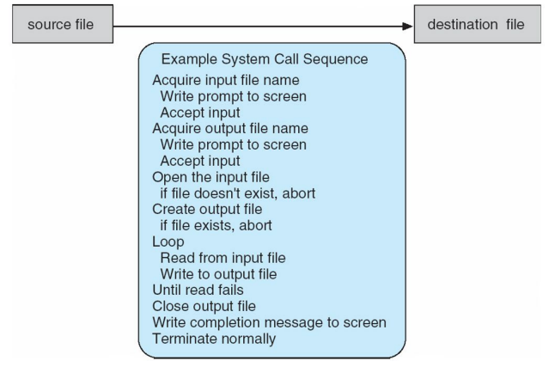
Example of System Calls
System call sequence to copy the contents of one file to another file.

Slide 29
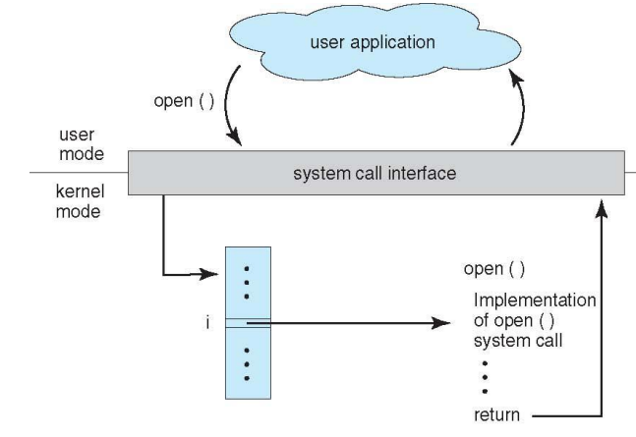
API – System Call – OS Relationship

Slide 30
Types of System Calls
Process control :-
create process, terminate process
end, abort
load, execute
get process attributes, set process attributes
wait for time
wait event, signal event
allocate and free memory (High level program so create dynamic memory)
Dump memory if error
Debugger for determining bugs, single step execution
Locks for managing access to shared data between processes

Slide 31
Types of System Calls
File management :-
create file, delete file
open, close file
read, write, reposition
get and set file attributes

Slide 32
Types of System Calls
Device management :-
request device, release device
read, write, reposition
get device attributes, set device attributes
logically attach or detach devices

Slide 33
Types of System Calls
Information maintenance:-
get time or date, set time or date
get system data, set system data
get and set process, file, or device attributes

Slide 34
Types of System Calls
Communications between processes :-
create, delete communication connection
send, receive messages if message passing model to host name or process name
Shared-memory model create and gain access to memory regions
transfer status information
attach and detach remote devices

Slide 35
Types of System Calls
Protection:-
Control access to resources
Get and set permissions
Allow and deny user access

Slide 36
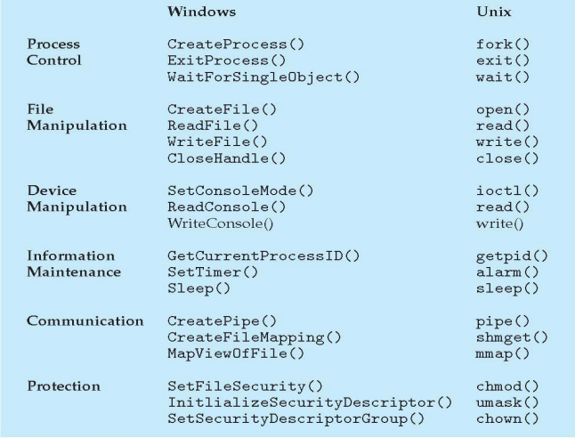
Examples of Windows and Unix System Calls

