Slide 1


By BittuCoins

Slide 2


Slide 3
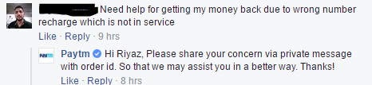
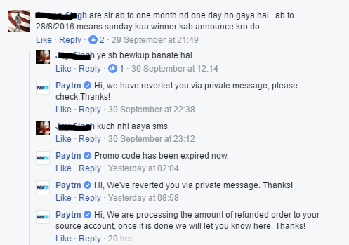
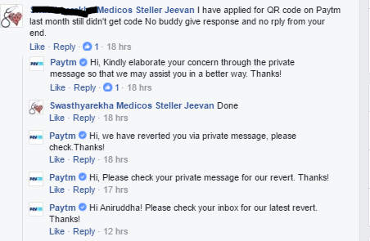


Slide 4
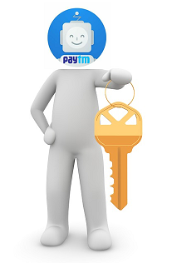


Slide 5
Why Bot is the Solution ?
A Chatbot can reply instantly to N number of users at the same time.
Humans can make mistakes or may take time to solve an issue , but chatbot will be more accurate as it will have a proper record / database.
Customer service staff is not always available or sometimes really busy , chatbot will be easily able to handle FAQ.
Which will ultimately help in reducing load of customer service.

Slide 6
