Slide 1



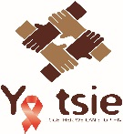

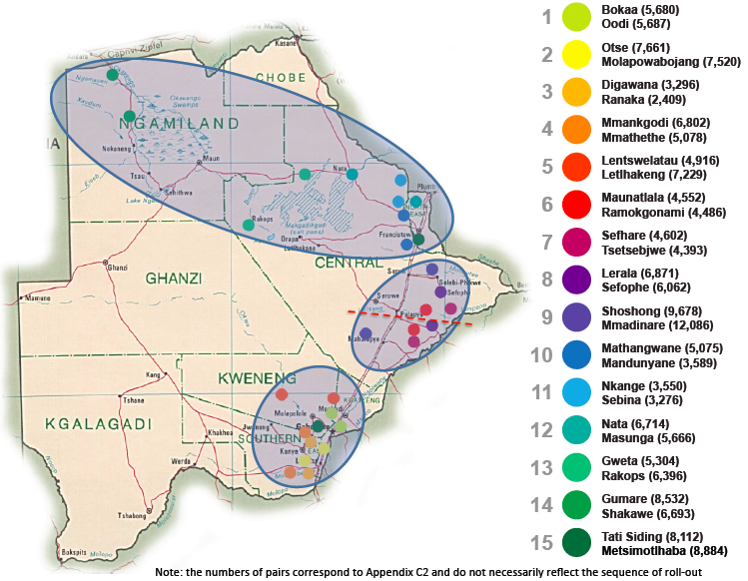
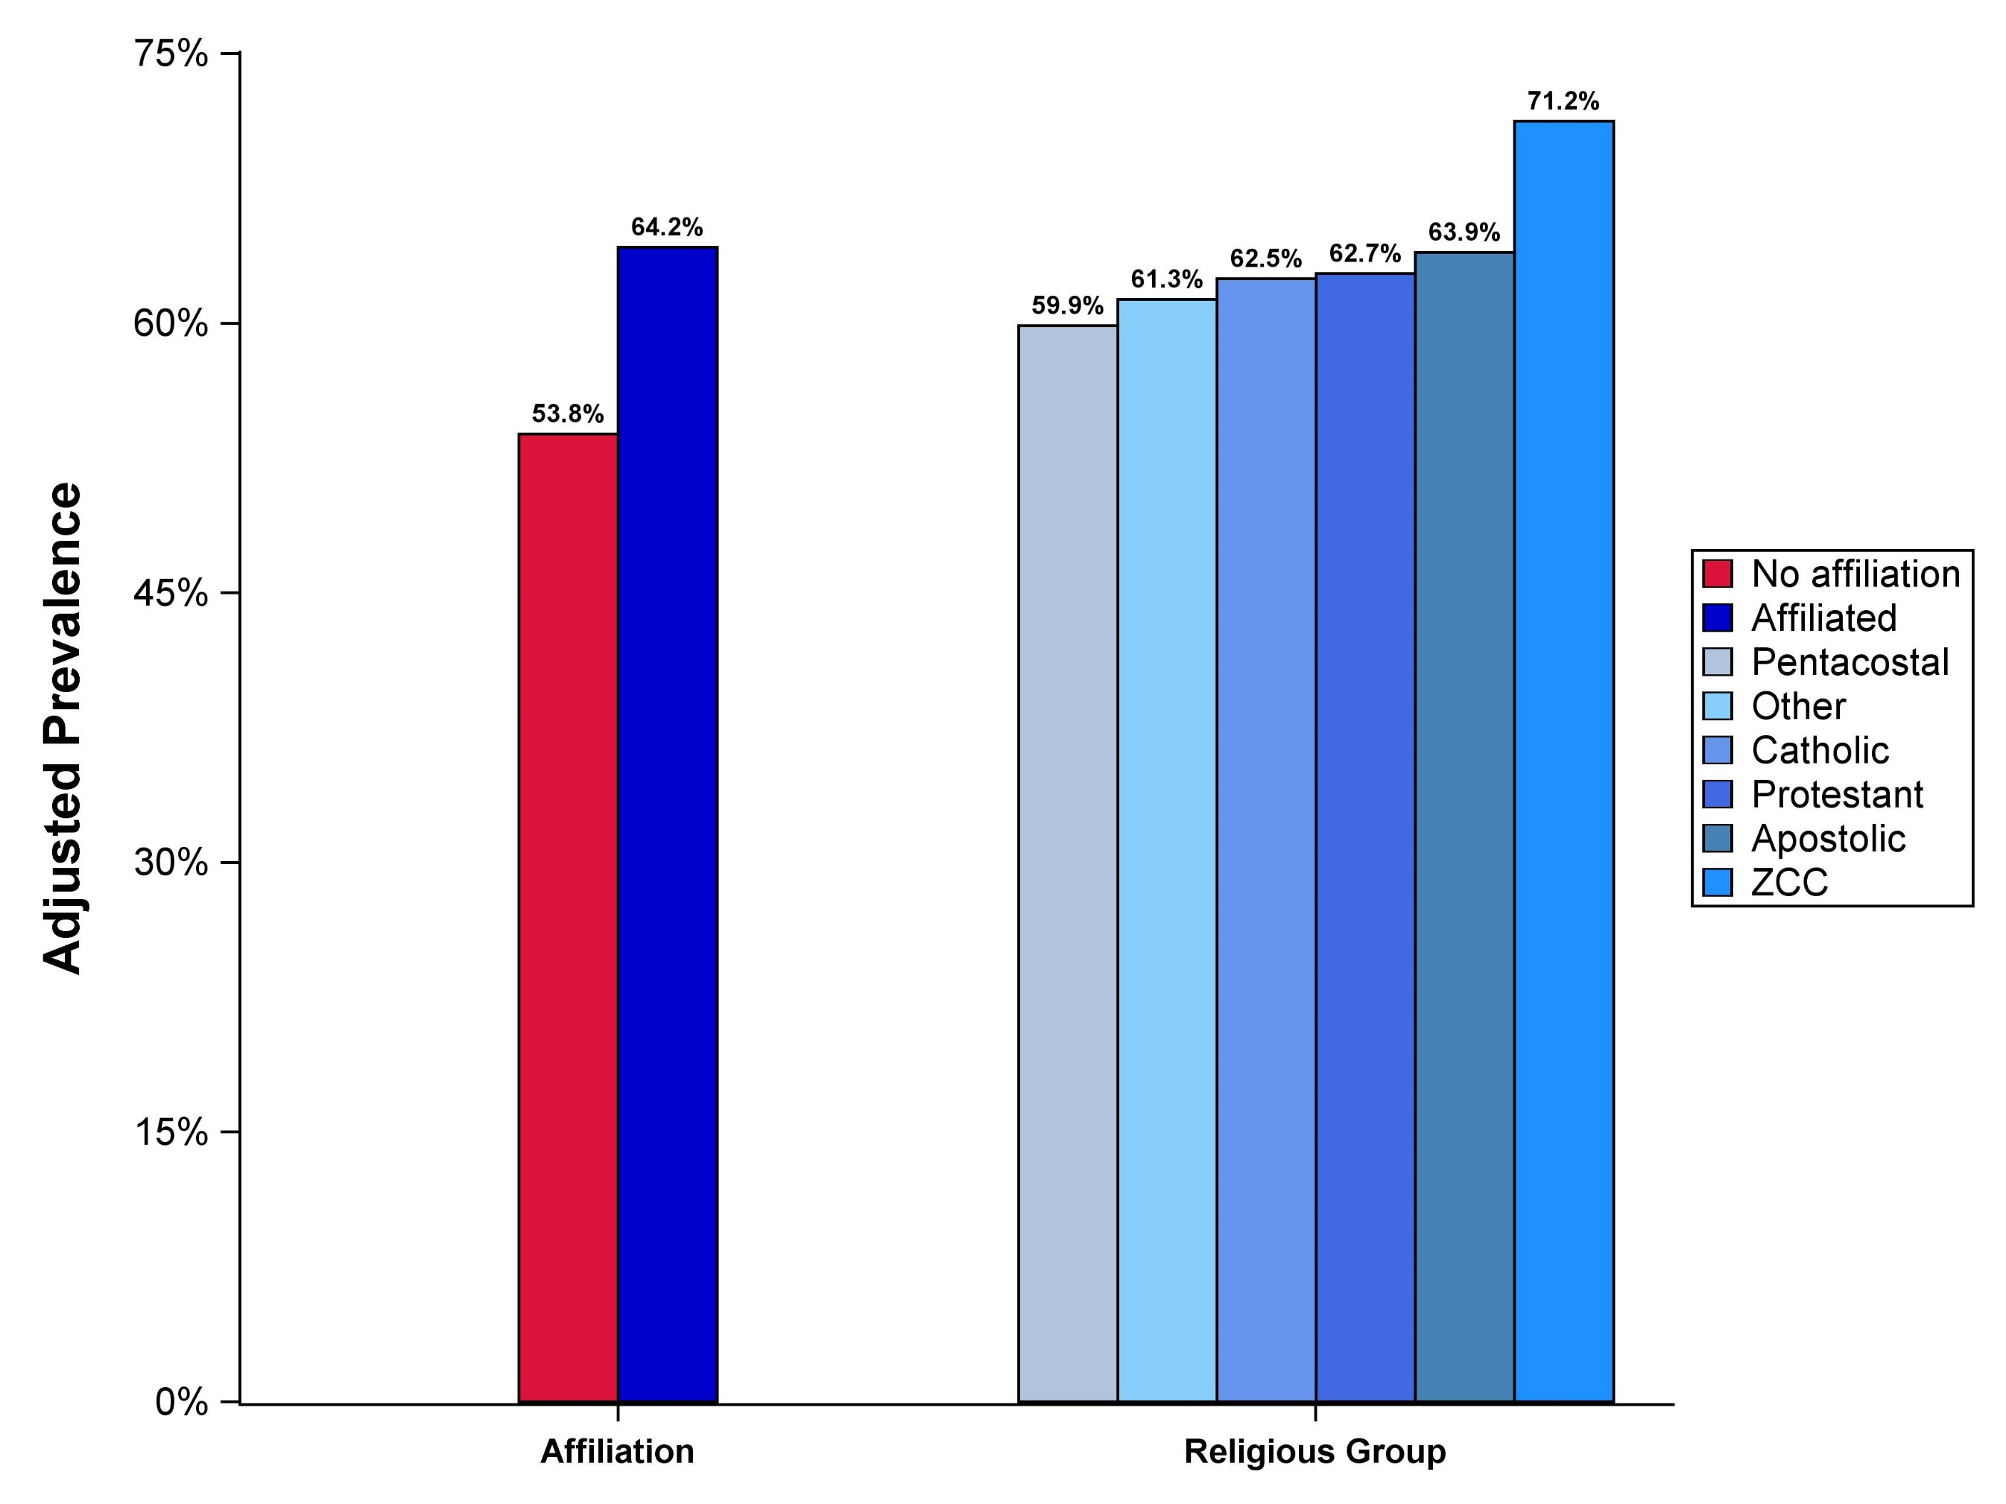
RELIGIOUS AFFILIATION AND UPTAKE OF HIV TESTING, TREATMENT AND VIRAL SUPPRESSION IN BOTSWANA
Mompati Mmalane¹, Jean Leidner², Nealia Khan³, Molly Pretorius Holme³, Baraedi W. Sento⁴,
Mary Grace Alwano⁵, Joseph Makhema¹, Thandie Phindela⁶, Kara Bennett⁷, Kathleen E. Wirth^{3,8}
¹Botswana Harvard AIDS Institute Partnership, Gaborone, Botswana; ²Goodtables Consulting, Norman, OK, USA; ³Department of Immunology and Infectious Diseases, Harvard T.H. Chan School of Public Health, Boston, MA, USA; ⁴Tebelopele HIV Testing and Counseling Center, Gaborone, Botswana; ⁵Center for Disease Control and Prevention, Gaborone, Botswana; ⁶Ministry of Health, Gaborone, Botswana; ⁷Bennett Statistical Consulting Inc, Ballston Lake, NY, USA;
⁸Department of Epidemiology, Harvard T.H. Chan School of Public Health, Boston, MA, USA
Poster # TUPEC0869
BACKGROUND AND OBJECTIVE
RESULTS
HIV infection is a chronic condition associated with high levels of stigma and hopelessness which can lead to depression.
HIV-infected individuals may seek religion and spirituality as a coping strategy.
Attitudes toward testing for and treatment of HIV infection may differ across different religious denominations depending on their doctrines and teachings.
Botswana, with the 3rd highest HIV prevalence in the world, has about 70% of its population estimated to belong to some religious group.
Religious practices may influence HIV-related health-seeking behaviors like HIV testing, initiation of antiretroviral therapy (ART), and adherence to ART.
We sought to examine the relationship between religious affiliation, HIV prevalence and uptake of HIV testing, treatment and viral suppression.
After adjustment for age and gender, any religious affiliation was significantly associated with lower HIV prevalence (PR: 0.88; 95%CI: 0.83-0.95) (Table 2).
Table 2. Univariable and multivariable-adjusted associations between HIV infection status by religious affiliation and denomination.
 |  | Univariable |  |  | Multivariable-adjusted*
Characteristic (n with data) |  | PR | (95% CI) | P | PR | (95% CI) | P
Religious affiliation | Non-religious | 1 | (ref) | 0.01 | 1 | (ref) | 0.004
 | Religious | 1.12 | (1.03-1.2) |  | 0.89 | (0.83-0.95
Religious denomination | Non-religious | 1 | (ref) | 0.002 | 1 | (ref) | 0.002
 | Apostolic | 1.22 | (1.11-1.34) |  | 0.96 | (0.89-1.03)
 | Catholic | 0.89 | (0.75-1.05) |  | 0.69 | (0.6-0.8)
 | Protestant | 1.00 | (0.89-1.14) |  | 0.85 | (0.75-0.96)
 | Other | 0.81 | (0.66-0.99) |  | 0.68 | (0.56-0.81)
 | Pentecostal | 0.91 | (0.81-1.01) |  | 0.81 | (0.74-0.89)
 | Zion Christian Church (ZCC) | 1.29 | (1.15-1.44) |  | 0.94 | (0.85-1.03)
METHODS
In univariable analyses, any religious affiliation was positively and significantly associated with achievement of the combined UNAIDS 90-90-90 target (P<0.001); the association remained significant after adjustment (PR: 1.08; 95%CI: 1.02-1.14) (Table 3).
Similarly, in adjusted analyses affiliation with Apostolic, Pentecostal and Zion Christian Church religious denominations (as compared to no affiliation) was significantly associated with a 7%, 9%, and 13% higher absolute probability of meeting the combined UNAIDS 90-90-90 target.
The Botswana Combination Prevention Project (BCPP) is a large, ongoing community-randomized HIV prevention trial in Botswana. A baseline household survey was administered from Oct 2013 to Nov 2015 in 30 peri-urban and rural communities with an average population of 6,000 residents (Figure 1).
Figure 1. Map of 30 pair-matched communities participating in the BCPP
Table 3. Univariable and multivariable-adjusted associations between achievement of combined UNAIDS 90-90-90 target by religious affiliation and denomination.
 |  | Univariable |  |  | Multivariable-adjusted*
Characteristic (n with data) |  | PR | (95% CI) | P | PR | (95% CI) | P
Religious affiliation | Non-religious | 1 | (ref) | 0.001 | 1 | (ref) | 0.02
 | Religious | 1.14 | (1.08-1.2) |  | 1.08 | (1.02-1.14)
Religious denomination | Non-religious | 1 | (ref) | 0.02 | 1 | (ref) | 0.08
 | Apostolic | 1.11 | (1.06-1.18) |  | 1.07 | (1.01-1.12)
 | Catholic | 1.1 | (0.97-1.23) |  | 1.01 | (0.9-1.12)
 | Protestant | 1.14 | (1.02-1.28) |  | 1.08 | (0.96-1.21)
 | Other | 1.10 | (0.96-1.27) |  | 1.04 | (0.91-1.19)
 | Pentecostal | 1.13 | (1.04-1.22) |  | 1.09 | (1.01-1.17)
 | Zion Christian Church (ZCC) | 1.22 | (1.13-1.31) |  | 1.13 | (1.05-1.21)
Figure 2. Adjusted prevalence of achievement of combined UNAIDS 90-90-90 target by religious affiliation and denomination.
All consenting Botswana citizens or spouses of citizens aged 16-64 years in a 20% random sample of all households in each community were enrolled.
Self-reported religious affiliation and denomination was collected on all subjects. Among HIV-infected subjects, documentation of prior diagnosis and treatment status was obtained.
Blood was taken for HIV testing (in the absence of prior documentation of a positive HIV status), and for viral load measurement, which was done on all patients who were HIV-infected, irrespective of prior knowledge of HIV status.
Achievement of the combined UNAIDS 90-90-90 targets was defined as the proportion of all HIV-infected participants diagnosed and on treatment with an HIV-1 RNA <400 copies/mL.
Modified Poisson generalized estimating equations were used to obtain univariable and multivariable-adjusted prevalence ratios (PR) and 95% confidence intervals (CI) for the associations between religious affiliation and (a) HIV status and (b) binary outcome indicating achievement of the combined UNAIDS 90-90-90 target.
RESULTS
CONCLUSIONS
Table 1. Baseline characteristics of N=12,602 participants with religious affiliation data
Religious affiliation was significantly associated with increased uptake of HIV testing, treatment and viral suppression in Botswana.
Compared with non-religious HIV-infected participants, members of Apostolic, Pentecostal, and ZCC religious denominations were positively associated with higher probability of meeting the combined UNAIDS 90-90-90 target.
More work is needed to understand facilitators for and barriers to uptake of HIV prevention interventions across different religious denominations.
Botswana should consider leveraging on the high prevalence of religiosity among its citizens to accelerate progress to reach the UNAIDS 90-90-90 targets by 2020.
 |  |  | Religious affiliation
Characteristic (n with data) |  | Total (N=12,602) | Non-religious (N=3,968) | Religious (N=8,634)
Gender (n=12,602) | Male | 4,557 (36%) | 2,278 (57%) | 2,279 (26%)
Geographical region (n=12,602) | Central | 3,344 (27%) | 1,182 (30%) | 2,162 (25%)
 | Northern | 4,671 (37%) | 1,369 (35%) | 3,302 (38%)
 | Southern | 4,587 (36%) | 1,417 (36%) | 3,170 (37%)
Highest education level (n=12,527) | Non-formal | 1,350 (11%) | 452 (11%) | 898 (11%)
 | Primary | 2,473 (20%) | 668 (17%) | 1,805 (21%)
 | Junior Secondary | 4,659 (37%) | 1,631(41%) | 3,028 (35%)
 | Senior Secondary | 2,192 (18%) | 710 (18%) | 1,482 (17%)
 | Higher than Senior | 1,853 (15%) | 484 (12%) | 1,369 (16%)
Age at interview (n=12,602) | 16-19 years | 1,372 (11%) | 455 (12%) | 917 (11%)
 | 20-29 years | 3,839 (31%) | 1,474 (37%) | 2,365 (27%)
 | 30-39 years | 3,053 (24%) | 1,002 (25%) | 2,051 (24%)
 | 40-49 years | 2,017 (16%) | 529 (13%) | 1,488 (17%)
 | 50-59 years | 1,712 (14%) | 376 (10%) | 1,336 (16%)
 | 60-64 years | 609 (5%) | 132 (3%) | 477 (6%)
Currently not working (n=12,597) | Yes | 8,748 (70%) | 2,837 (72%) | 5,911 (69%)
Marital status (n=12,598) | Single and never married | 9,913 (79%) | 3,508 (88%) | 6,405 (74%)
 | Married | 2,080 (17%) | 370 (9%) | 1,710 (20%)
 | Widowed, divorced, or separated | 605 (5%) | 90 (2%) | 515 (6%)
Number partners, past 1 year (n=11,963) | 0 | 2,601 (22%) | 764 (20%) | 1,837 (22%)
 | 1 | 6,485 (54%) | 1,945 (51%) | 4,540 (55%)
 | 2 or more | 2,877 (24%) | 1,071 (28%) | 1,806 (22%)
Multiple and concurrent partners (n=9,361) | Yes | 2,769 (30%) | 1,033 (34%) | 1,736 (27%)
Inconsistent condom use (n=9,076) | Yes | 5,188 (57%) | 1,638 (56%) | 3,550 (58%)
Male and circumcised (n=4,556) | Yes | 1,430 (31%) | 647 (28%) | 783 (34%)
LIMITATIONS
Assessment of religiosity was coarse; detailed information on history and frequency of attendance and participation in religious activities was not available.
Although we adjusted for age and gender, confounding due to unmeasured factors could bias our findings.
Information on both religious affiliation and HIV status, treatment, and viral suppression was obtained at the same time-point. Therefore, we are unable to confirm whether religious affiliation was established prior to or after HIV infection (i.e. reverse causation).
ACKNOWLEDGEMENTS
We would like to acknowledge the study participants, Ya Tsie field teams, community leadership as well as support from the Government of Botswana and the Botswana-Harvard-HIV Reference Laboratory staff. We also thank the Botswana Ministry of Health and the Centers for Disease Control and Prevention Botswana.
BCPP is funded by the President’s Emergency Fund for AIDS Relief (PEPFAR) through the U.S. Centers for Disease Control and Prevention.
The study is registered at ClinicalTrials.gov (NCT01965470).
Notes:
Results of thesis: Nucleotide diversity between the vif, vpr, tat (1st exon), and rev (1st exon) isolates was significantly higher than the diversity of the samples to the consensus sequence (: vif (p<0.0001), vpr (p<0.0001), tat (p=0.0004), and rev(p=0.0029).
Two tailed t-tests were used to calculate differences in nucleotide diversity between samples and compared to consensus for each gene.
Don’t use lineages…..distances to consenus is and between samples remove from poster use thesis
V10 short sentences differences in viral load
Column how many per study were used in table …….
Makes dead virus…..viral protein….
Mentoin criteria for 3 to 1 controls
Randomly selected……
Small number of sequences and short length of sequences did not allow analysis for bootstrap values ; re-run w/ bootstrap….re-calculate threshold should be 80; cluster w/ subtype c w/ high boostrap values

