Slide 1
Airline Data Management and Analysis Using Power BI
Prepared By: Botta Lokesh
Tools Used:
Power BI
Power Query
DAX
Excel

Slide 2
Problem Statement
The airline industry handles large volumes of flight, passenger, and ticketing data.
Challenges include:
Monitoring flight performance
Managing passenger information
Tracking booking status
Identifying operational improvements
This project analyzes airline operations using Power BI to provide actionable insights and improve decision-making.

Slide 3
Project Objectives
Objectives
Analyze flight operations
Track passenger distribution
Monitor ticket booking status
Identify best-performing flights
Compare airline performance
Create an interactive dashboard
Support data-driven decisions

Slide 4
Datasets Used
Flight Information
FlightID
FlightNumber
Airline
Destination
Status
Passenger Information
PassengerID
FlightID
SeatNumber
Ticket Information
TicketID
FlightID
BookingStatus

Slide 5
Data Cleaning & Transformation
Power Query Operations
✔ Removed duplicate records
✔ Removed blank rows
✔ Removed errors
✔ Changed data types
✔ Selected required columns
✔ Created Conditional Column
✔ Extracted Flight Number using Column From Examples

Slide 6
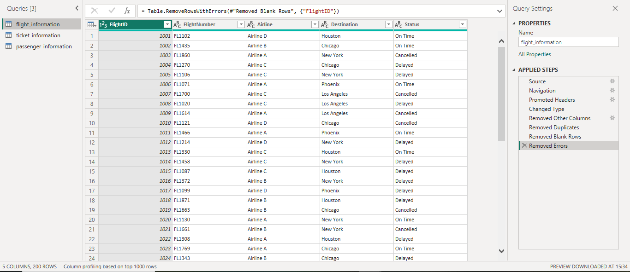
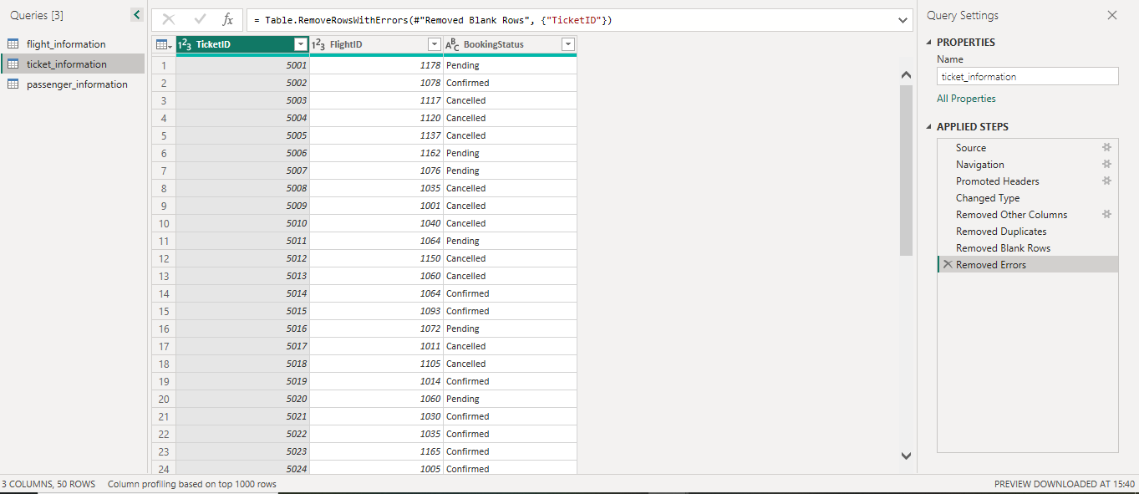
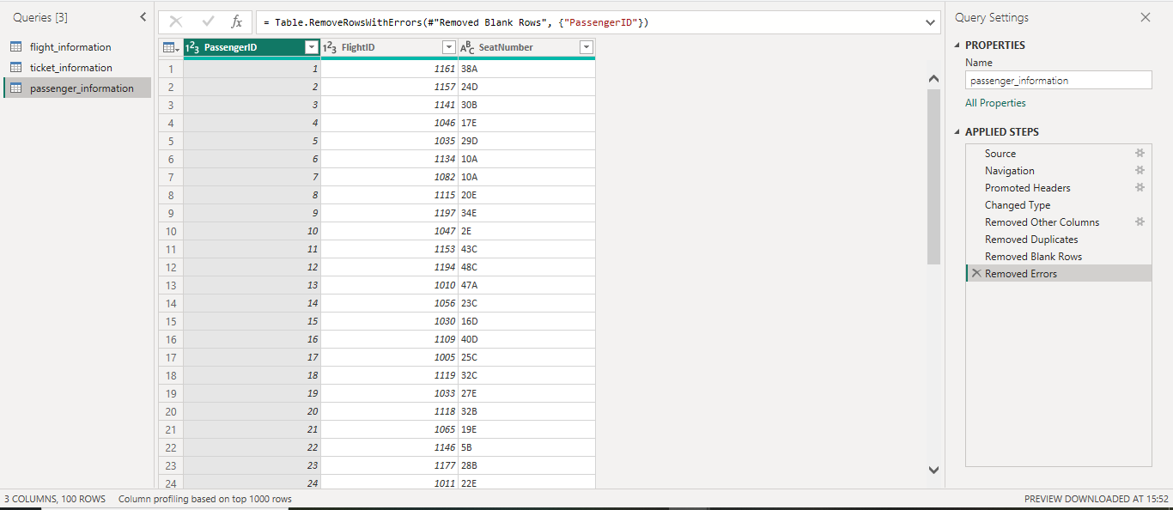

Slide 7
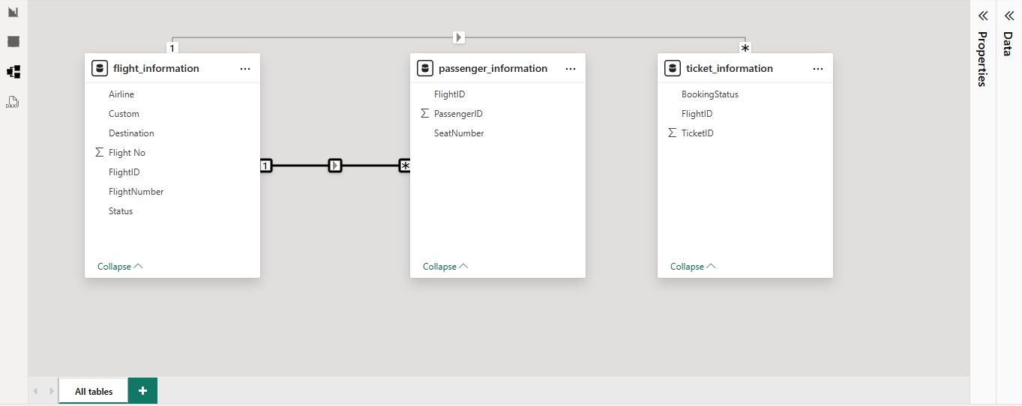
Data Modeling
Key:
FlightID
Cardinality:
One-to-Many Relationship

Slide 8
DAX Measures
Total Flights =
COUNT(flight_information[FlightID])
Total Passengers =
COUNT(passenger_information[PassengerID])
Total Tickets =
COUNT(ticket_information[TicketID])

Slide 9
Flight Performance Measures
Best Flights =
CALCULATE(COUNT(flight_information[FlightID]),
flight_information[Custom] = "Best")
Delayed Flights =
CALCULATE(COUNT(flight_information[FlightID]),
flight_information[Status] = "Delayed")
Cancelled Flights =
CALCULATE(COUNT(flight_information[FlightID]),
flight_information[Status] = "Cancelled“)

Slide 10
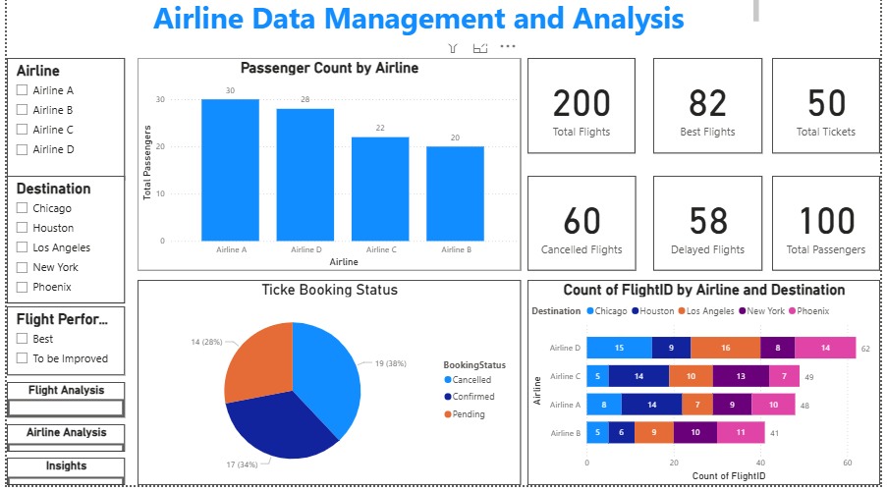
Dashboard

Slide 11
Dashboard Overview
KPI Cards
KPI | Value
Total Flights | 200
Best Flights | 82
Total Tickets | 50
Cancelled Flights | 60
Delayed Flights | 58
Total Passengers | 100

Slide 12
Visualizations Used
Passenger Count by Airline
Shows passenger distribution among airlines.
Ticket Booking Status
Displays Confirmed, Cancelled, and Pending bookings.
Flight Count by Airline and Destination
Compares airline performance across destinations.
Interactive Slicers
Airline
Destination
Flight Performance

Slide 13
Key Findings
Airline Performance
Airline D operates the highest number of flights (62 flights).
Airline A operates 48 flights.
Airline C operates 49 flights.
Airline B operates 41 flights.
Flight Performance
Best Flights = 82
Delayed Flights = 58
Cancelled Flights = 60

Slide 14
Key Findings
Passenger Analysis
Airline A has the highest passenger count (30 passengers).
Airline D follows with 28 passengers.
Booking Analysis
Cancelled bookings: 19
Confirmed bookings: 17
Pending bookings: 14

Slide 15
Business Impact
Benefits of the Dashboard
Centralized airline data monitoring
Improved flight performance tracking
Better booking trend analysis
Enhanced operational visibility
Faster decision-making using interactive reports

Slide 16
Project Conclusion
This project demonstrates the use of Power BI for transforming raw airline operational data into actionable business insights. Through data cleaning, modeling, DAX calculations, interactive dashboards, and security implementation, the solution enables efficient monitoring of flight performance, passenger management, and booking trends. The dashboard supports data-driven decision-making and provides a scalable foundation for future airline analytics initiatives.

Slide 17
THANK YOU

