Slide 1
KPMG Data Analysis using Excel
Customer Segmentation, Transaction Analysis & CLV Analysis
Tools Used:
MS Excel | Pivot Tables | Power Query | Dashboard | Data Visualization
Submitted by:
BOTTA LOKESH

Slide 2
Project Overview
Content:
This project focuses on analyzing customer demographics, transaction behavior, and customer lifetime value using Excel. The analysis helps identify business trends, high-value customers, and opportunities for business growth.
Project Objectives:
Perform data cleaning and preprocessing
Segment customers based on demographics
Analyze sales and transaction trends
Identify customer purchase behavior
Calculate Customer Lifetime Value (CLV)
Generate business recommendations

Slide 3
Dataset Information
Content:
The project uses four datasets provided by KPMG to perform analysis and generate insights.
Datasets Used:
1. Customer Address Dataset
Contains customer location details and property valuation.
2. Customer Demographic Dataset
Contains customer personal information, wealth segment, tenure, and industry details.
3. Transactions Dataset
Contains transaction records, product information, and sales details.
4. New Customer Dataset
Contains potential customer information and estimated customer value.

Slide 4
Data Cleaning Process
Data cleaning was performed to improve data quality and ensure accurate analysis.
Cleaning Activities Performed:
Removed duplicate records
Standardized state names and address formatting
Corrected inconsistent gender values
Handled missing and null values
Fixed transaction date formats
Cleaned invalid and erroneous entries
Standardized job titles and industry categories
Outcome:
The datasets became structured, consistent, and ready for analysis.

Slide 5
Customer Segmentation Analysis
Customer segmentation was performed to identify important customer groups based on demographics and purchasing behavior.
Key Analysis Performed:
Wealth Segment Analysis
Identified customer distribution by wealth segment
Calculated average customer tenure
Gender Analysis
Compared customer count by gender
Analyzed average bike-related purchases
Job Industry Analysis
Identified customer distribution across industries
Analyzed wealth segment distribution within industries
Outcome:
The analysis helped identify high-value customer segments and customer behavior patterns.

Slide 6
Transaction Analysis
Transaction analysis was performed to identify sales trends, product performance, and customer purchasing patterns.
Analysis Performed:
Sales Trend Analysis
Analyzed monthly sales performance
Identified seasonal sales trends and spikes
Product Performance Analysis
Compared sales across different brands
Evaluated product line performance
Calculated average list prices
Customer Purchase Behavior
Identified top 10 customers based on transaction value
Calculated average purchases per customer
Outcome:
The analysis provided insights into product demand and customer buying behavior.

Slide 7
New Customer Insights
New customer analysis was performed to identify potential customer behavior and future revenue opportunities.
Analysis Performed:
Customer Demographics
Wealth segment distribution
Industry category analysis
Location Analysis
Customer distribution by state
Property valuation analysis
Revenue Estimation
Estimated potential revenue from new customers
Identified valuable customer groups
Outcome:
The analysis helps the business target profitable customer segments and expansion opportunities.

Slide 8
Customer Lifetime Value (CLV)
Customer Lifetime Value (CLV) analysis was performed to identify the most valuable customers for the business.
CLV Formula:
CLV = (Average Purchase Value × Purchase Frequency) × Customer Lifespan
Analysis Performed:
Calculated CLV for each customer
Compared CLV across wealth segments
Analyzed CLV by demographics
Identified high-value customers
Outcome:
The analysis helps improve customer retention and marketing strategies.

Slide 9
Excel Dashboard Showcase
An interactive Excel dashboard was created to visualize business performance and customer insights.
Dashboard Features:
KPI Cards
Interactive Charts
Dynamic Slicers
Customer Filters
Sales Trend Visualization
Product Performance Tracking
Key KPIs:
Total Sales
Total Customers
Total Transactions
Average CLV
Revenue by Product Line
Outcome:
The dashboard enables quick and effective business decision-making.

Slide 10
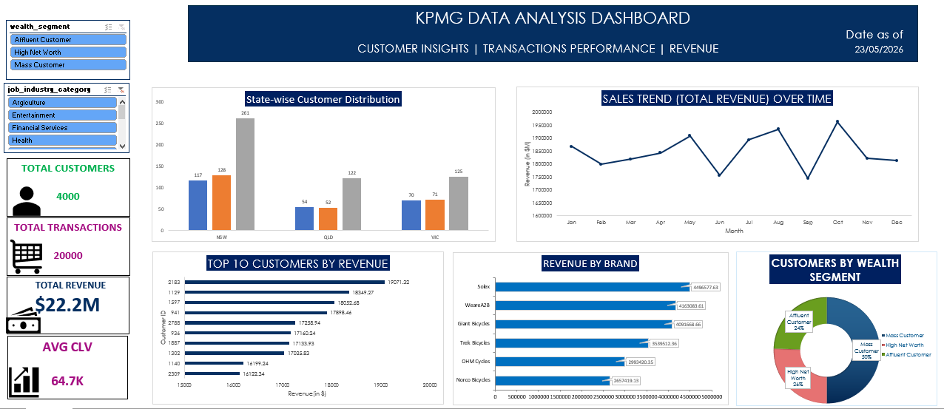

Slide 11
Key Insights
Key Findings from the Analysis:
Mass customer segment contributed the highest number of customers.
Customers from NSW generated significant business value.
Standard product line achieved strong sales performance.
High wealth segment customers showed higher CLV.
Monthly sales trends indicated seasonal business growth.
Top customers contributed a major share of total revenue.
Interactive dashboards improved data visualization and reporting.

Slide 12
Business Recommendations
Recommendations:
Focus marketing campaigns on high CLV customers.
Introduce loyalty programs for repeat customers.
Increase promotion for high-performing product lines.
Expand business operations in high-performing states.
Improve customer retention strategies.
Use dashboard reporting for better business decisions.
Expected Benefits:
Increased customer retention
Improved sales performance
Better business planning
Higher customer satisfaction

Slide 13
Challenges Faced
Challenges Encountered During the Project:
Handling missing and inconsistent data
Cleaning incorrect gender and state values
Managing large datasets in Excel
Creating dynamic dashboard visualizations
Calculating Customer Lifetime Value accurately
Aligning multiple charts and slicers
Solution:
Data cleaning and Excel analytical tools were used to overcome these challenges.

Slide 14
Skills Demonstrated
Technical Skills:
MS Excel
Pivot Tables
Power Query
Dashboard Development
Data Visualization
KPI Analysis
Data Cleaning
Analytical Skills:
Customer Segmentation
Transaction Analysis
Business Insights Generation
Problem Solving
Data Storytelling

Slide 15
Conclusion
The KPMG Data Analysis project successfully analyzed customer demographics, transactions, and customer lifetime value using Excel tools and techniques.
The project helped identify high-value customers, business trends, and opportunities for business growth through effective data analysis and dashboard visualization.
The insights generated from this project can support better business decision-making and marketing strategies.

Slide 16
THANK YOU

