Slide 1
Walmart Sales Analysis Using MySQL
Prepared By: Botta Lokesh
Tools Used: MySQL 8.0, Excel, PowerPoint
Data Analytics Project

Slide 2
Project Overview
Project Objective
To analyze Walmart sales data and identify:
Branch performance trends
Product profitability
Customer purchasing behavior
Payment preferences
Sales growth opportunities
Tools Used
MySQL 8.0
SQL Window Functions
CTEs
Excel
PowerPoint
Key Outcome
Generate actionable business insights from transactional sales data.

Slide 3
Business Problem Statement
Content
Walmart aims to:
Increase revenue growth
Improve product performance
Understand customer behavior
Enhance customer retention
Optimize payment methods
Improve operational efficiency
Key Business Questions
Which branch performs best?
Which products generate the highest profit?
Who are the most valuable customers?
What factors influence sales performance?

Slide 4
Dataset Overview
Key Columns
Invoice ID
Branch
City
Customer Type
Gender
Product Line
Total Sales
Payment Method
Rating
Insight
The dataset provides transaction-level sales information across multiple branches and cities.
Metric | Value
Total Records | 1000
Branches | 3
Cities | 3
Product Lines | 6
Payment Methods | 3
Customer Types | 2

Slide 5
Data Cleaning & Preprocessing
Cleaning Activities Performed
✅ Missing Value Checks
✅ Duplicate Record Validation
✅ Date Conversion
✅ Time Conversion
✅ Data Type Validation
✅ Outlier Detection
✅ Business Rule Validation
Result
The dataset was confirmed to be clean and ready for analysis.
Key Insight
No major data quality issues were identified.

Slide 6
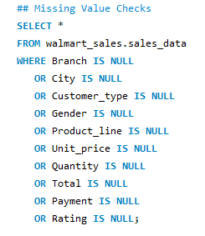
Missing Value Analysis
Objective Identify incomplete records that may affect analysis accuracy. SQL Check Performed validation across all major columns. Result ✅ No Missing Values Found Key Insight The dataset is 100% complete, ensuring reliable analysis and reporting. Recommendation Proceed with analysis without imputation or record removal.

Slide 7
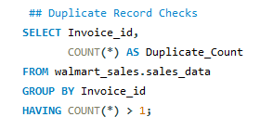
Duplicate Record Validation
Objective Ensure each transaction is unique. Result ✅ No Duplicate Transactions Found Key Insight All sales records are unique and suitable for accurate aggregation. Recommendation No deduplication required.

Slide 8
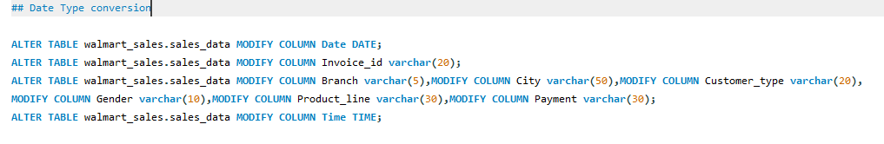
Data Type Conversion & Validation
Objective :Ensure columns use appropriate data types. Result: Data Types Successfully Validated Key Insight :Proper data types improve query accuracy and performance. Recommendation: Continue using standardized formats for future data imports.

Slide 9
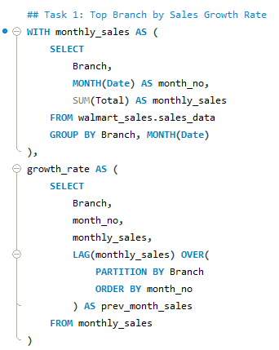
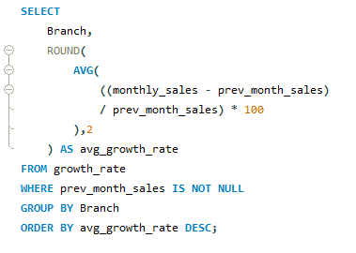
Task 1 – Branch Sales Growth Rate Analysis

Slide 10

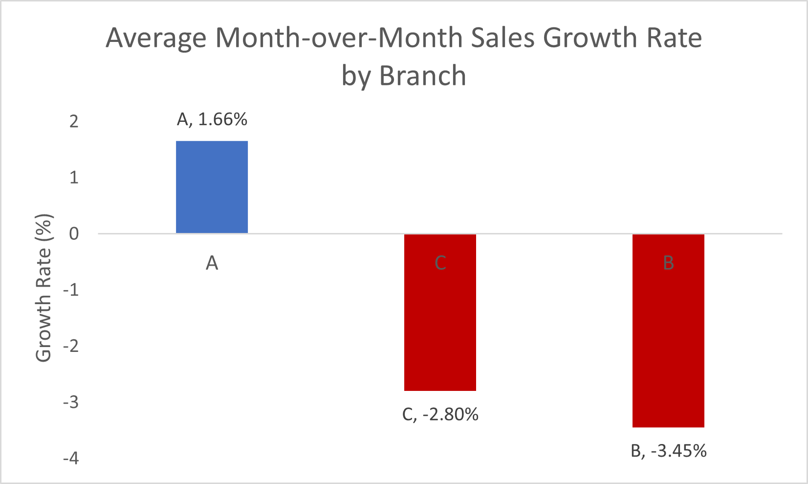
Task 1 Results & Visualization
Key Insights
Branch A achieved the highest average sales growth rate of 1.66%.
Branches B and C experienced negative sales growth.
Branch B recorded the lowest growth rate at -3.45%.
Sales performance varies significantly across branches.
Recommendations
Study Branch A's sales strategies and replicate them.
Investigate causes of declining sales in Branches B and C.
Launch branch-specific marketing campaigns.
Monitor monthly growth trends continuously.

Slide 11
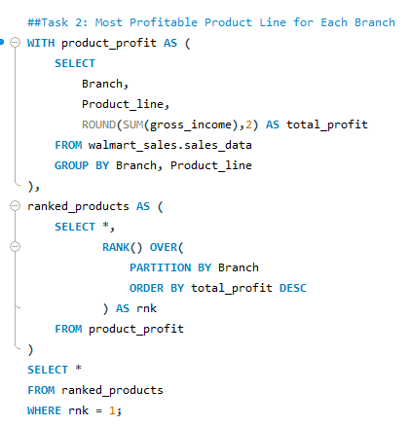

Task 2 – Most Profitable Product Line by Branch

Slide 12
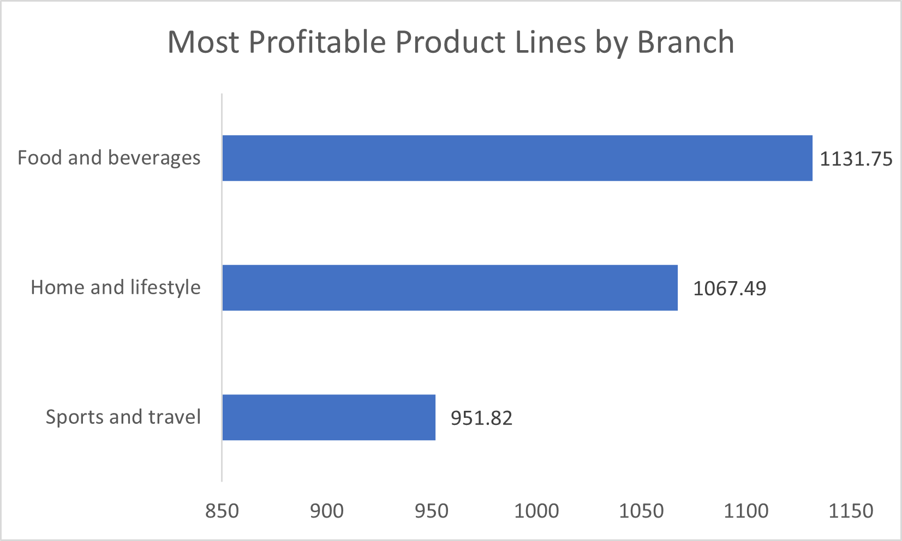
Task 2 Visualization
Key Insights Branch A's most profitable category is Home & Lifestyle. Branch B performs best in Sports & Travel. Branch C generates the highest profit from Food & Beverages. Product profitability differs across branches. Recommendations Increase inventory for top-performing product lines. Design branch-specific promotional campaigns. Improve visibility of profitable categories. Optimize shelf space allocation.

Slide 13
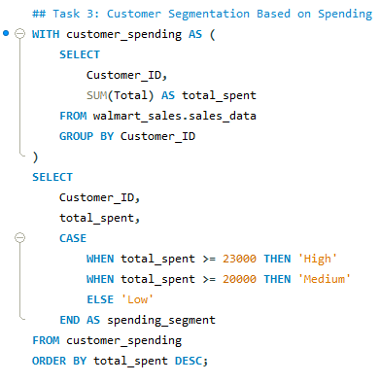
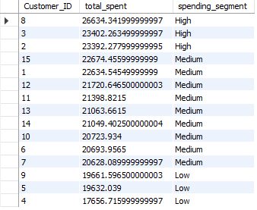
Task 3 – Customer Spending Segmentation

Slide 14
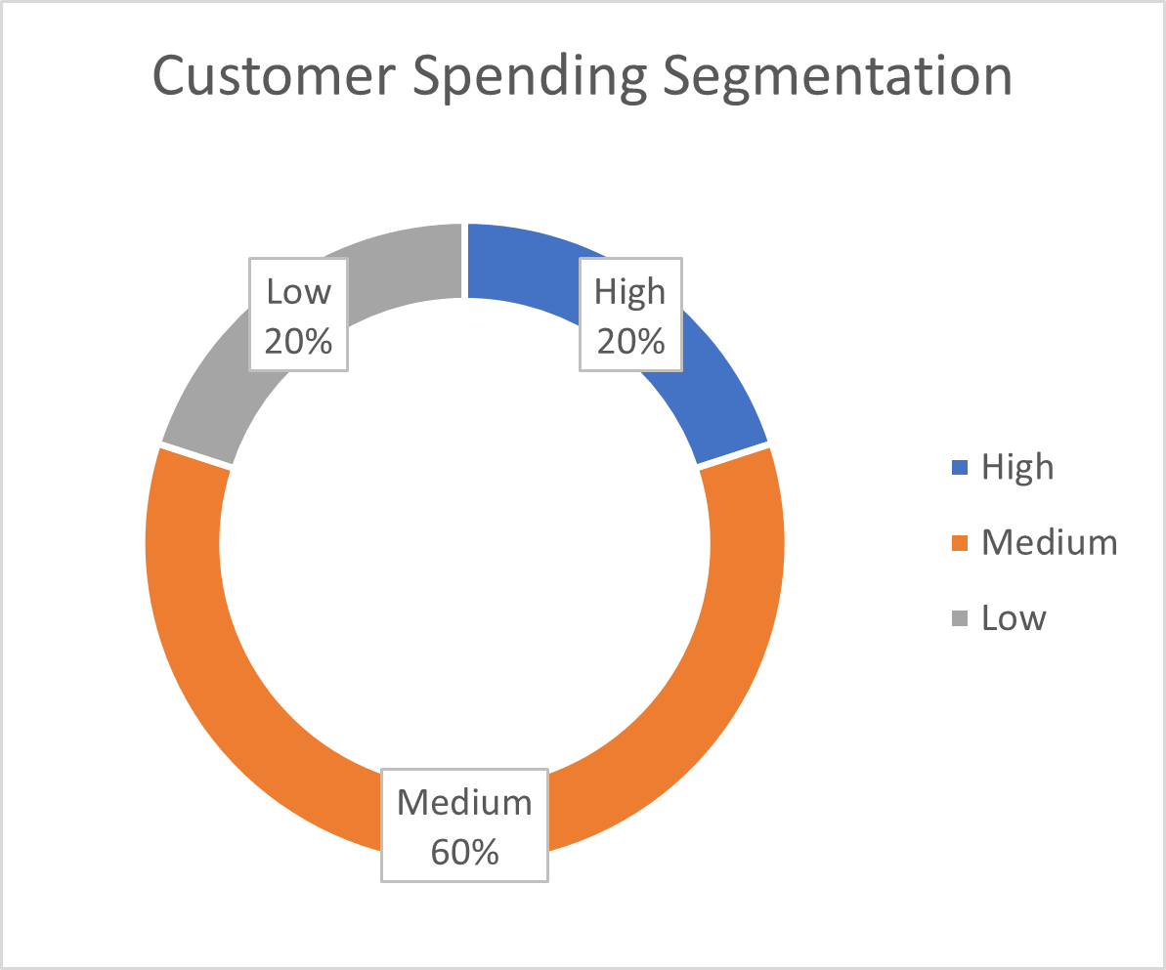
Task 3 Visualization
Key Insights 60% of customers belong to the Medium spending segment. High-value customers account for 20%. Low-spending customers account for 20%. Revenue is concentrated among a small group of customers. Recommendations Create loyalty programs for high-value customers. Upsell medium-spending customers. Offer personalized discounts to low-spending customers. Implement customer retention initiatives.

Slide 15
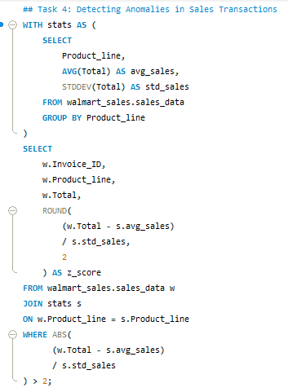
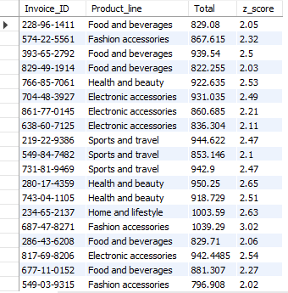
Task 4 – Anomaly Detection

Slide 16
Task 4 Findings
Key Insights Multiple transactions show unusually high sales values. Some product lines contain more anomalies than others. Potential bulk purchases or exceptional transactions exist. Outliers can significantly impact performance metrics. Recommendations Monitor abnormal transactions regularly. Verify unusually high-value purchases. Implement fraud detection mechanisms. Use anomaly alerts for operational monitoring.

Slide 17
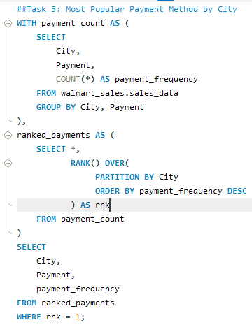

Task 5 – Payment Method Analysis

Slide 18
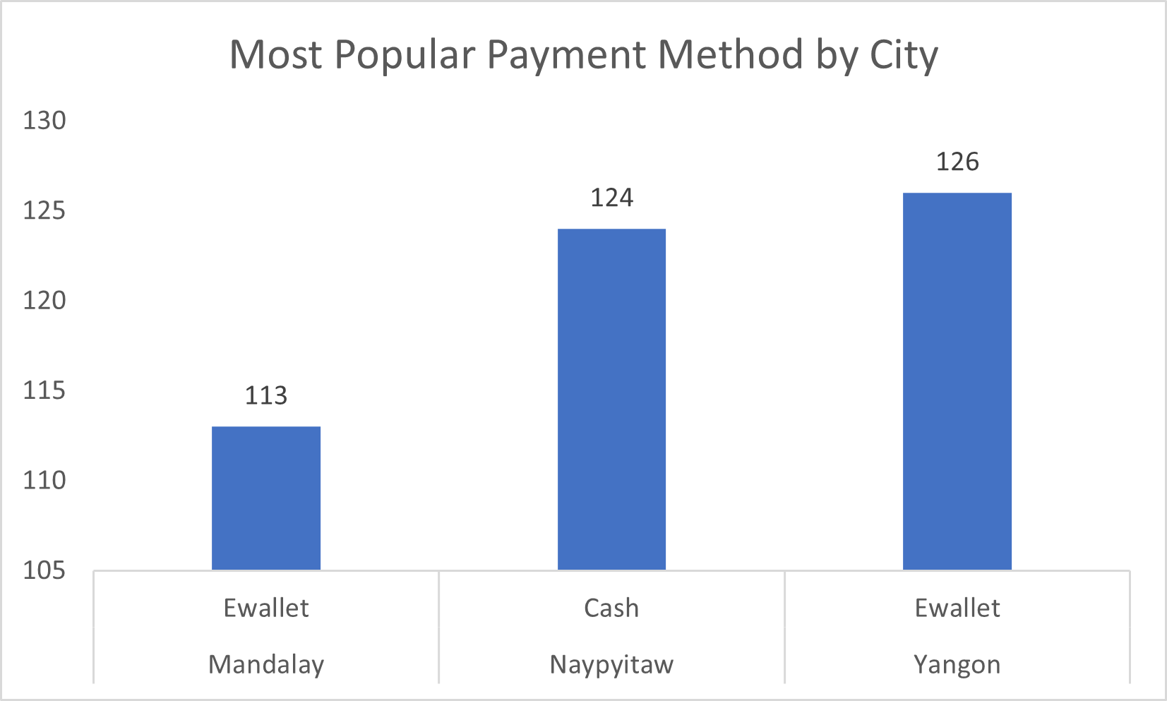
Task 5 Visualization
Key Insights E-wallet is the preferred payment method in Mandalay. Cash dominates transactions in Naypyitaw. E-wallet is also most popular in Yangon. Digital payments are widely adopted. Recommendations Expand digital payment promotions. Offer cashback incentives for E-wallet users. Encourage digital adoption in cash-dominant cities. Partner with payment providers for exclusive offers.

Slide 19
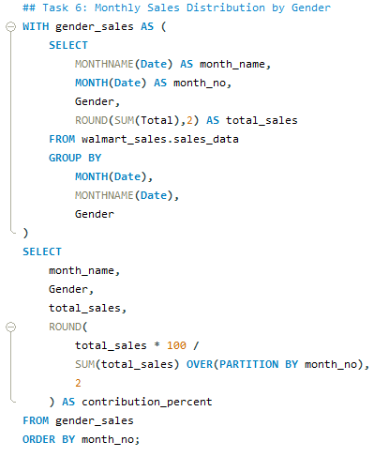
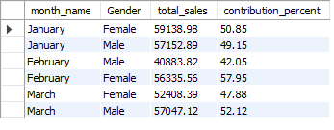
Task 6 – Monthly Sales Distribution by Gender

Slide 20
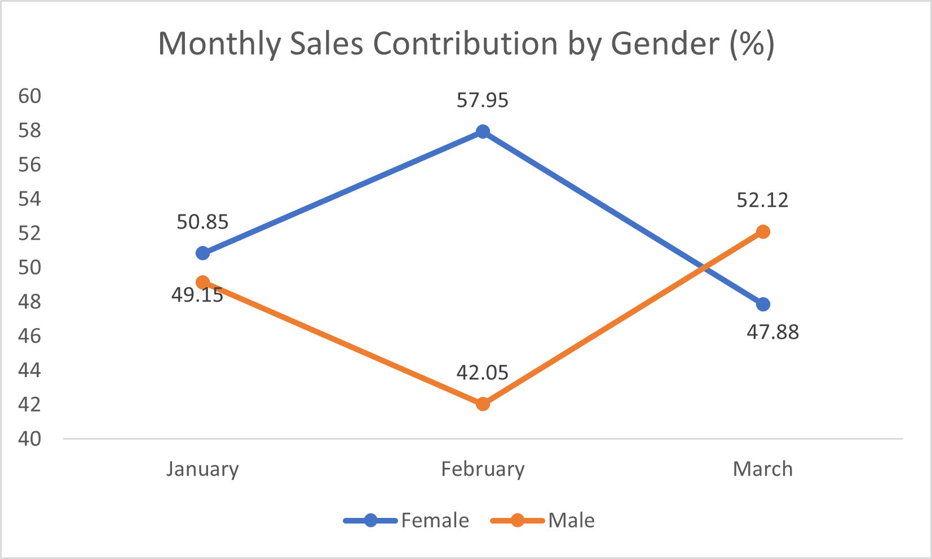
Task 6 Visualization
Key Insights Female customers contributed more sales in January and February. Male customers contributed more sales in March. Gender contributions remain relatively balanced. Purchasing behavior varies across months. Recommendations Launch gender-targeted marketing campaigns. Analyze product preferences by gender. Develop personalized offers. Track gender-based trends quarterly.

Slide 21
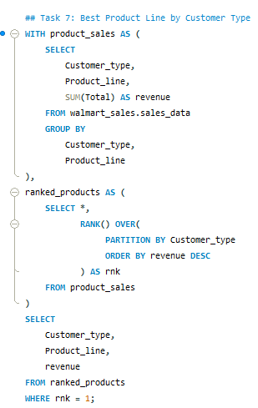

Task 7 – Product Preference by Customer Type

Slide 22
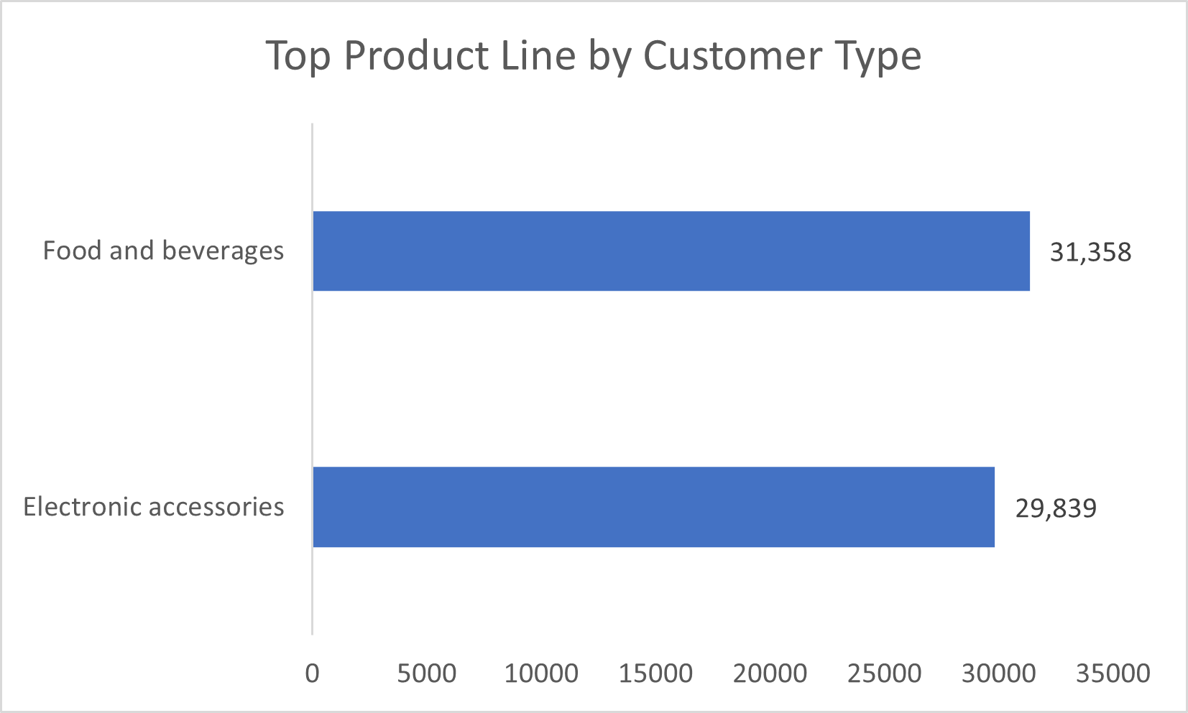
Task 7 Visualization
Key Insights Members prefer Food & Beverages. Normal customers prefer Electronic Accessories. Customer type influences purchasing behavior. Revenue patterns differ across segments. Recommendations Offer member-exclusive promotions on Food & Beverages. Promote Electronics to attract Normal customers. Customize campaigns by customer type. Improve cross-selling opportunities.

Slide 23
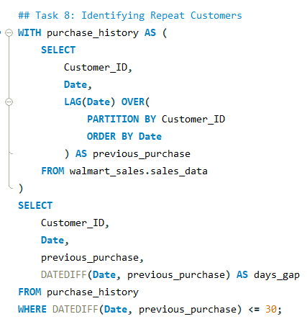
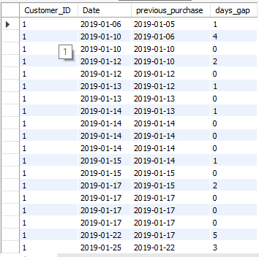
Task 8 – Repeat Customer Analysis

Slide 24
Task 8 Result
Key Insights Several customers make purchases within short intervals. Repeat purchasing behavior is evident. Customer retention contributes significantly to sales. Frequent shoppers provide recurring revenue. Recommendations Introduce loyalty reward programs. Send personalized offers to repeat customers. Develop retention-focused marketing campaigns. Track customer lifetime value.

Slide 25
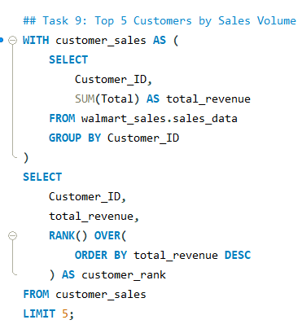
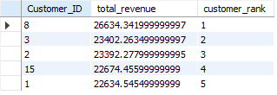
Task 9 – Top 5 Customers by Revenue

Slide 26
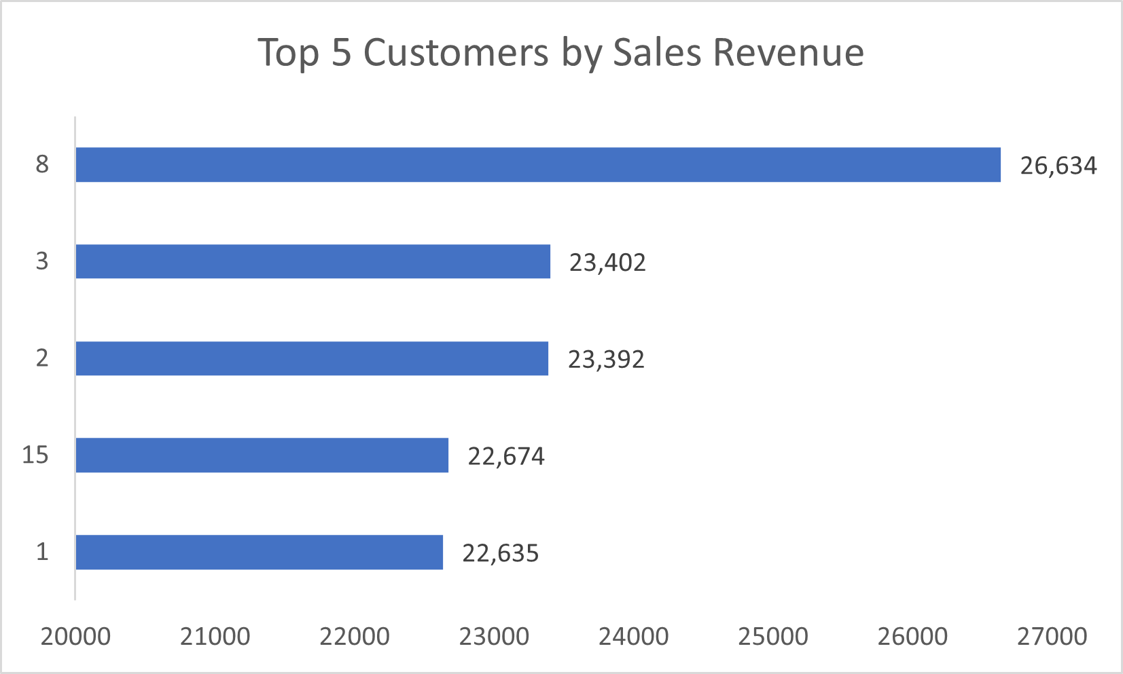
Task 9 Visualization
Key Insights Customer 8 generated the highest revenue. The top 5 customers contribute a substantial share of sales. Revenue among top customers is relatively close. High-value customers are critical to business performance. Recommendations Create VIP customer programs. Offer exclusive rewards to top customers. Increase engagement through personalized marketing. Monitor churn risk among top customers.

Slide 27
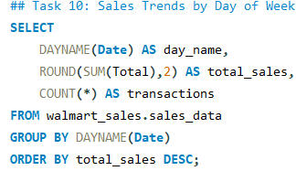
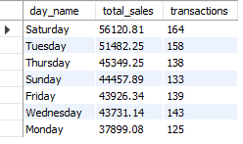
Task 10 – Sales Trends by Day of Week

Slide 28
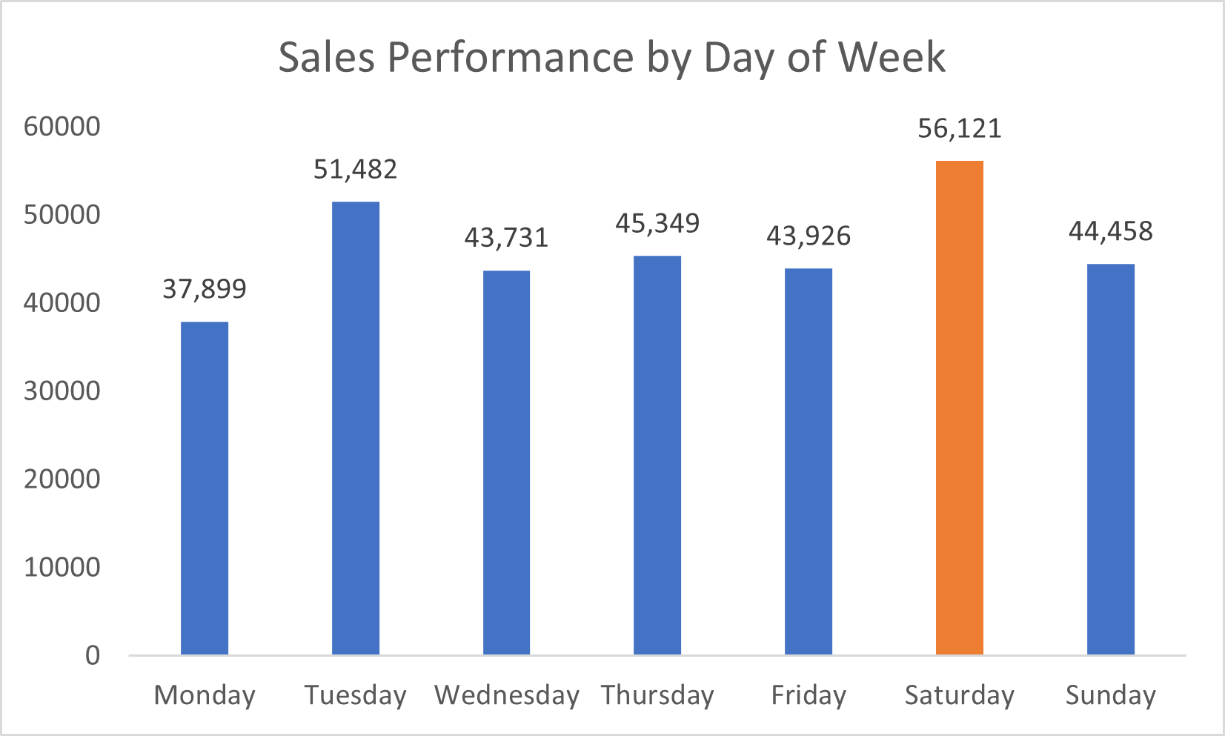
Task 10 Visualization
Key Insights Saturday generated the highest sales revenue. Tuesday recorded the second-highest sales. Monday generated the lowest sales revenue. Weekend sales outperform weekday sales. Recommendations Increase staffing during weekends. Ensure adequate inventory before Saturdays. Introduce promotional campaigns on Mondays. Schedule marketing events on high-traffic days.

Slide 29
Key Business Insights
📈 Branch Performance
Branch A achieved the highest average sales growth rate (1.66%).
Branches B and C experienced negative growth, indicating potential performance challenges.
💰 Product Profitability
Food & Beverages emerged as the most profitable product category.
Product profitability varies significantly across branches.
👥 Customer Behavior
Medium-spending customers represent the largest customer segment (60%).
A small group of high-value customers contributes a significant share of total revenue.
💳 Payment Preferences
E-wallet is the preferred payment method in Mandalay and Yangon.
Digital payment adoption is increasing across cities.
📅 Sales Trends
Saturday generated the highest sales revenue.
Monday recorded the lowest sales performance.
⭐ Customer Value
Customer 8 generated the highest revenue among all customers.
Repeat purchase behavior indicates strong customer retention potential.

Slide 30
Strategic Recommendations
Revenue Growth
Replicate successful sales strategies from Branch A in other branches.
Focus marketing efforts on underperforming branches.
Product Strategy
Increase inventory allocation for high-profit product lines.
Promote branch-specific best-selling categories.
Customer Retention
Launch loyalty programs for repeat and high-value customers.
Offer personalized promotions based on spending behavior.
Payment Optimization
Expand digital payment incentives and cashback programs.
Encourage E-wallet adoption in cash-dominant locations.
Operational Improvements
Increase staffing and inventory during weekends, especially Saturdays.
Introduce promotional campaigns on low-performing weekdays such as Monday.
Risk Monitoring
Implement automated anomaly detection for unusual transactions.
Regularly monitor sales patterns to identify emerging trends.

Slide 31
SQL Concepts Applied
Data Cleaning & Validation
Missing Value Checks
Duplicate Record Validation
Data Type Conversion
Business Rule Validation
Data Quality Assessment
Aggregate Functions
SUM()
AVG()
COUNT()
MAX()
MIN()
Date & Time Functions
MONTH()
MONTHNAME()
DAYNAME()
DATEDIFF()
DATE_FORMAT()
Window Functions
LAG()
RANK()
DENSE_RANK()
OVER()
PARTITION BY
Common Table Expressions (CTEs)
WITH Clause
Multi-Level CTEs
Query Simplification
Modular Query Design
Conditional Logic
CASE WHEN Statements
Customer Segmentation
Business Rule Implementation

Slide 32
SQL Concepts Applied
Statistical Analysis
AVG()
STDDEV()
Z-Score Calculation
Anomaly Detection
Ranking & Performance Analysis
Top Customers Identification
Product Line Ranking
Branch Performance Ranking
Revenue-Based Analysis
Business Analytics Techniques
Sales Growth Analysis
Customer Segmentation
Payment Method Analysis
Profitability Analysis
Trend Analysis
Repeat Customer Analysis
SQL Skills Demonstrated
Data Cleaning
Exploratory Data Analysis (EDA)
Advanced SQL Querying
Window Functions
Business Intelligence
Data-Driven Decision Making

Slide 33
Conclusion
Project Summary
This project analyzed Walmart sales transaction data using MySQL to identify business trends, customer purchasing patterns, product profitability, and operational opportunities.
Key Achievements
Performed complete data cleaning and validation
Solved 10 business-driven analytical problems
Applied advanced SQL concepts including:
CTEs
Window Functions
Ranking Functions
Statistical Analysis

Slide 34
Identified
Highest growth branch
Most profitable product lines
Customer spending segments
Repeat customers
Sales anomalies
Peak sales days
Business Impact
The insights generated can help Walmart improve:
Revenue growth
Customer retention
Inventory planning
Marketing effectiveness
Operational efficiency
Skills Demonstrated
MySQL
Data Analysis
Business Intelligence
Data Cleaning
Statistical Analysis
Data Visualization
Problem Solving

Slide 35
Thank You
Walmart Sales Performance Analysis Using MySQL
Prepared By: Botta Lokesh
Aspiring Data Analyst

