Slide 1
Introduction to Machine Learning
Goetz Botterweck

Slide 2
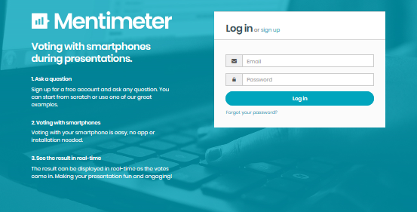
Mentimeter Test Run

Slide 3
1. Overview

Slide 4
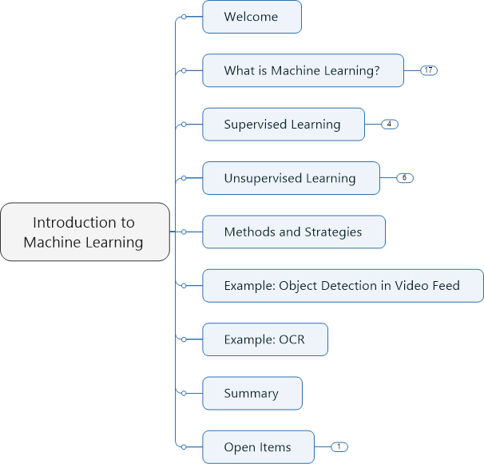
Overview
To be updated.

Slide 5
Learning Objectives
Cognitive
On successful completion of this module, students should be able to:
LO1. Explain basic concepts, techniques, and possible applications of machine learning
LO2. Analyse a given problem to choose and apply an appropriate machine learning technique
LO3. Explain design considerations and trade-offs associated with choosing and applying machine learning techniques
LO4. Evaluate a given machine learning approach (technique + chosen set-up) with respect to fitness for a given problem and give recommendations on how to improve results
LO5. Identify and apply relevant best practices for machine learning projects
LO6. Develop an implementation of the main steps of selected ML techniques in a programming language, including the translation from conceptual algorithms into code
Affective (Attitudes and Values)
LO7. Appreciate the design challenges associated with machine learning problems, including awareness of non-technical aspects (ethics, privacy, societal effects)
LO8. Participate in team activities in the design process (e.g., collaborating to find, evaluate, and improve potential solutions)

Slide 6
Acknowledgement
Inspired by and using material from “Machine Learning”, online course by Andrew Ng, Standford University, offered on Coursera

Slide 7
2. What is Machine Learning?

Slide 8
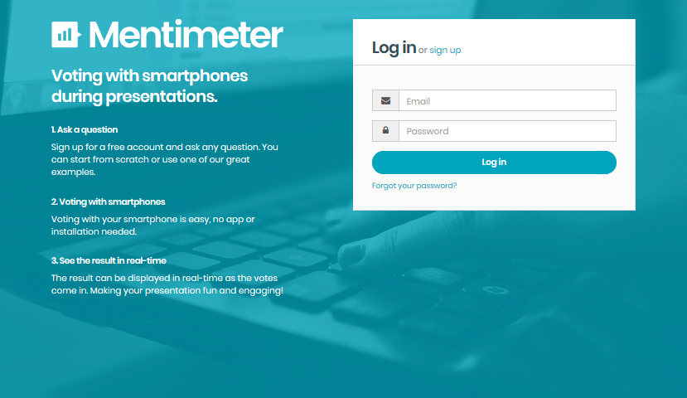

Slide 9
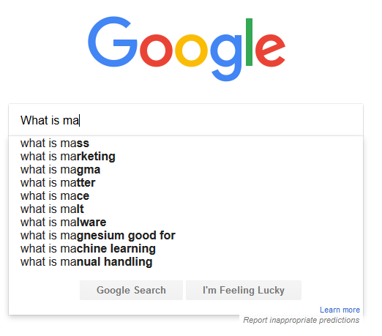



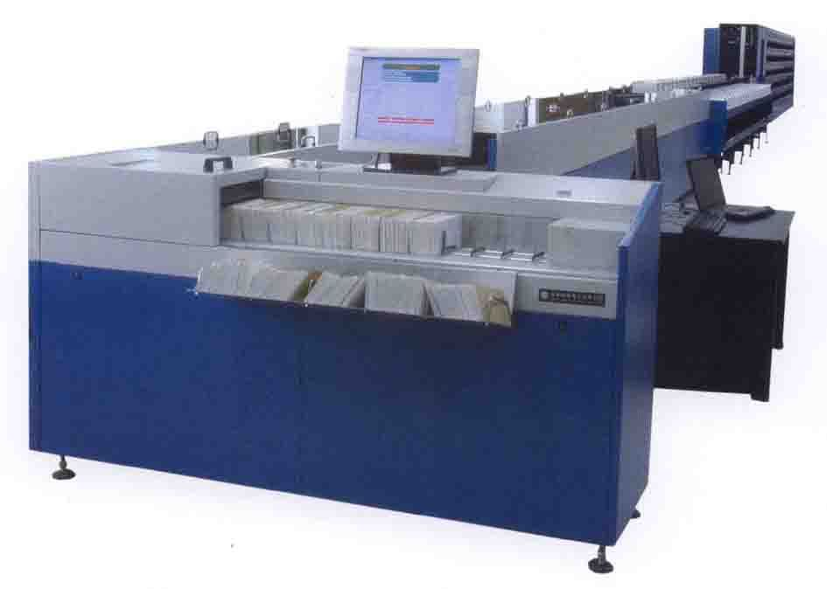
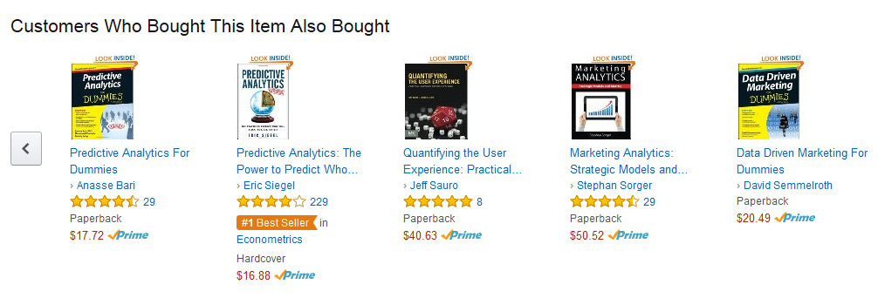
What is Machine Learning?
Notes:
You probably use it many times a day without even noticing it.
Every time that use Google search the web, And the machine suggests search terms
Algorithms has learned how to rank web pages.
Recognise friends in Facebook
Spam filtering

Slide 10
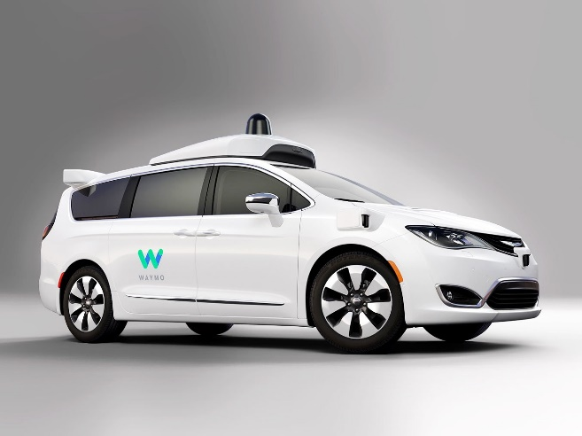
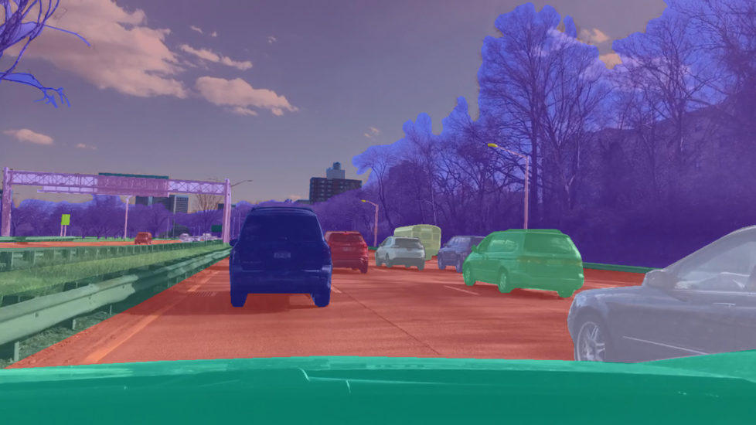
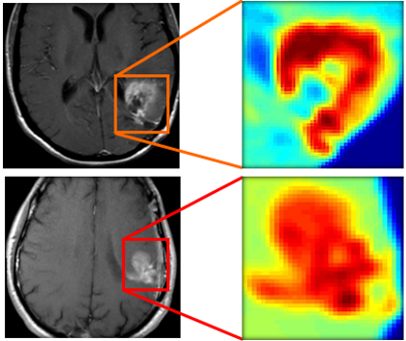
What is Machine Learning?
Notes:
http://engineering.case.edu/centers/ccipd/research/computational-diagnostics
https://www.therobotreport.com/uc-berkeley-opens-self-driving-dataset-bdd100k/

Slide 11
Just learning the algorithms is not enough.
How to solve problems? Get things to work?

Slide 12
Origins of Machine Learning
Grew out of work in Artificial Intelligence
We can program machines to do solve certain problems algorithmicly eg. sort data, find shortest path in a graph
Other interesting problems are more difficult to “encode” in traditional programming.
Idea: Machine has to learn completing the task by itself.
Based on recent advances in computer technology

Slide 13
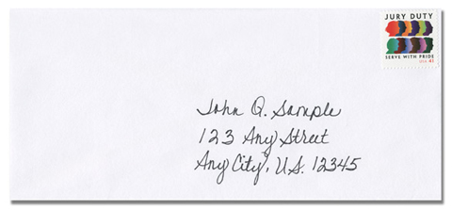
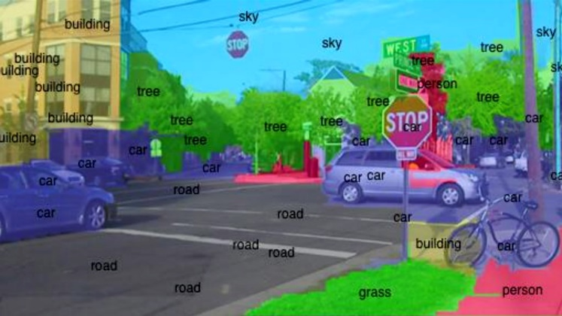
Examples of Machine Learning Applications
Data mining
Large datasets, from growth of the web + automation
e.g., web usage data, electronic medical records, computational biology, data sets in engineering
Applications that cannot be programmed
Autonomous helicopter
Handwriting recognition
Natural Language Processing
Computer Vision

Slide 14
Examples of Machine Learning Applications (2)
Self-customizing programs
E.g., Amazon web store, Netflix movie recommendations
Understanding human learning

Slide 15
Annual Salary src: indeed.com, average USD/year across USA, 15 Nov 2018

Slide 16
Experience E
Task T
Performance measure P

Slide 17
Kinds of Machine Learning Approaches
Supervised learning – we teach the algorithm
Unsupervised learning – we let it learn by itself
Reinforcement learning
Recommender systems

Slide 18
3. Supervised Learning

Slide 19
Supervised Learning
Right answers are given to the algorithm
Regression: predict continuous valued output (e.g., price)
Classification: discrete valued output (e.g., medical test 0 or 1)
Notes:
features, infinite number of features, SVM

Slide 20
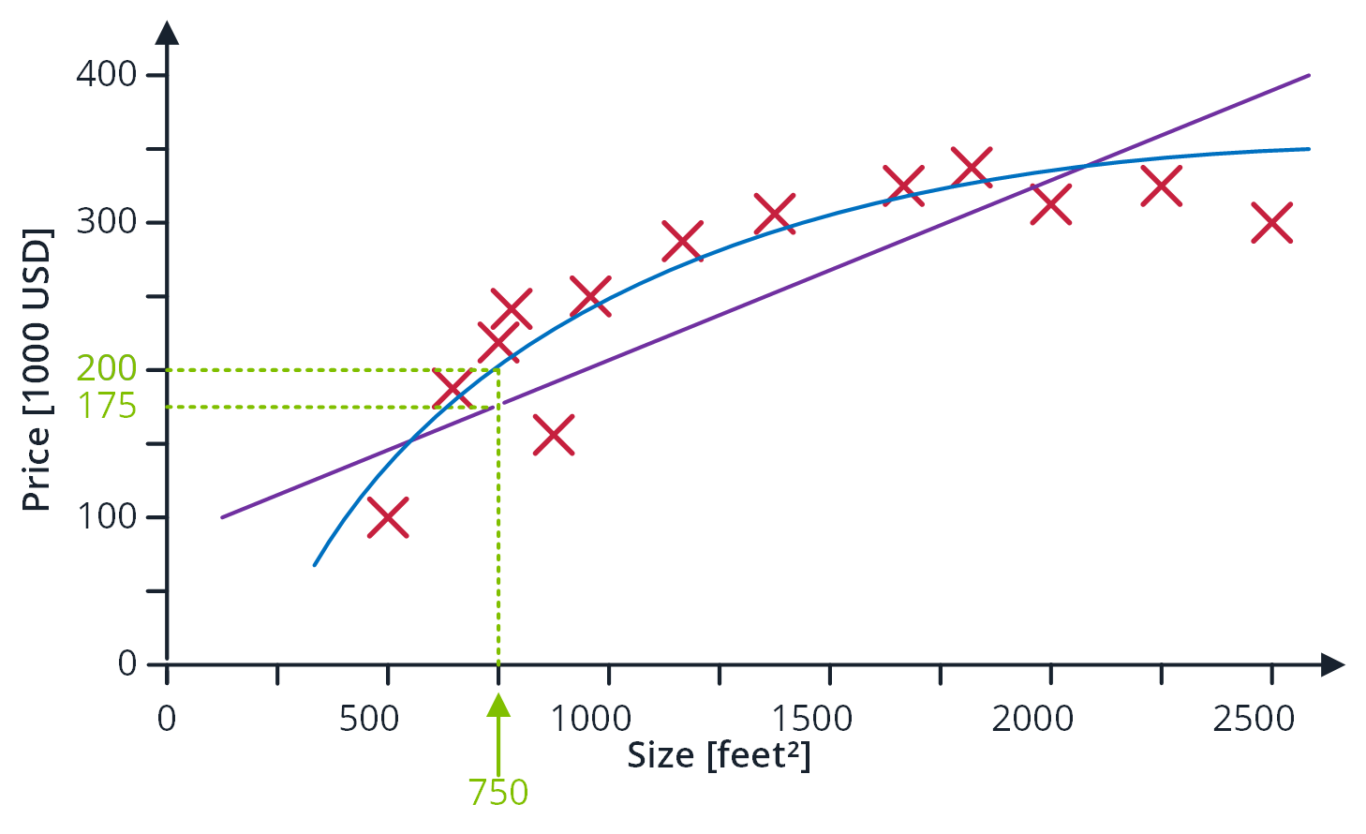
Housing Price Prediction

Slide 21
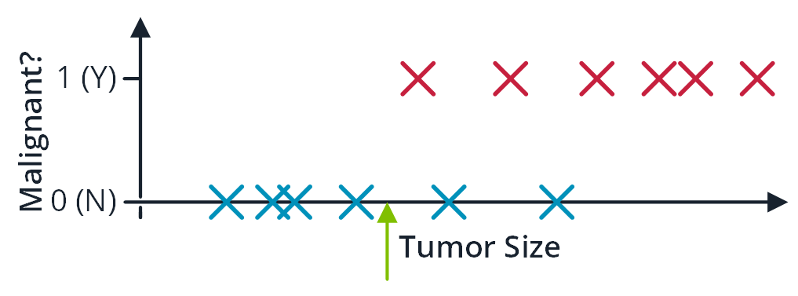
Breast Cancer (malignant, benign)

Slide 22
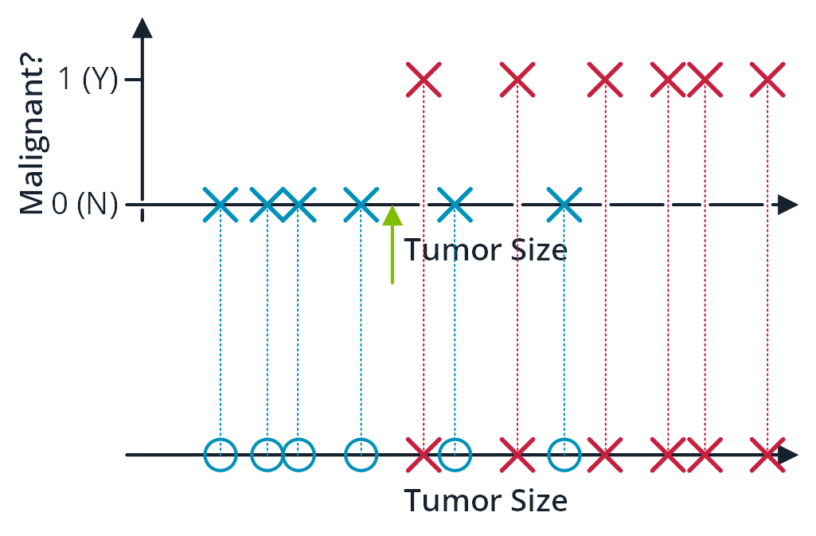
Breast Cancer (malignant, benign)

Slide 23
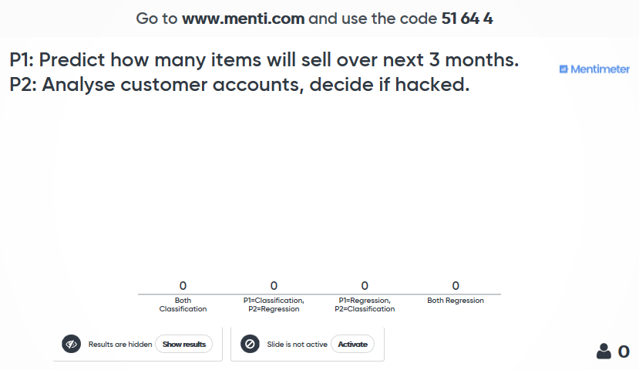

Slide 24
4. Unsupervised Learning

Slide 25
Unsupervised Learning
clustering, automatically finding structure
cocktail party problem

Slide 26
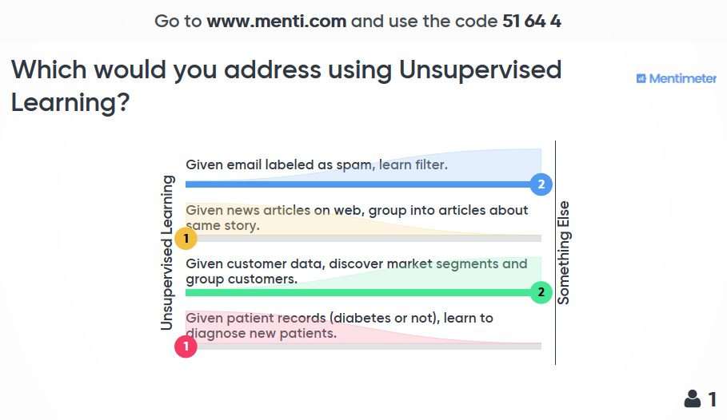

Slide 27
5. Methods and Strategies

Slide 28
6. Summary

Slide 29
Resources

Slide 30
Resources
Machine Learning, Online Course in Coursera, Andrew Ng, Standford University, https://www.coursera.org/learn/machine-learning
Mitchell (2017) Machine Learning, McGraw Hill
Gèron (2017) Hands-On Machine Learning with Scikit-Learn and Tensor Flow: Concepts, Tools, and Techniques to Build Intelligent Systems, O’Reilly
Müller and Guido (2016) Introduction to Machine Learning with Python: A Guide for Data Scientists, O’Reilly

