Slide 1
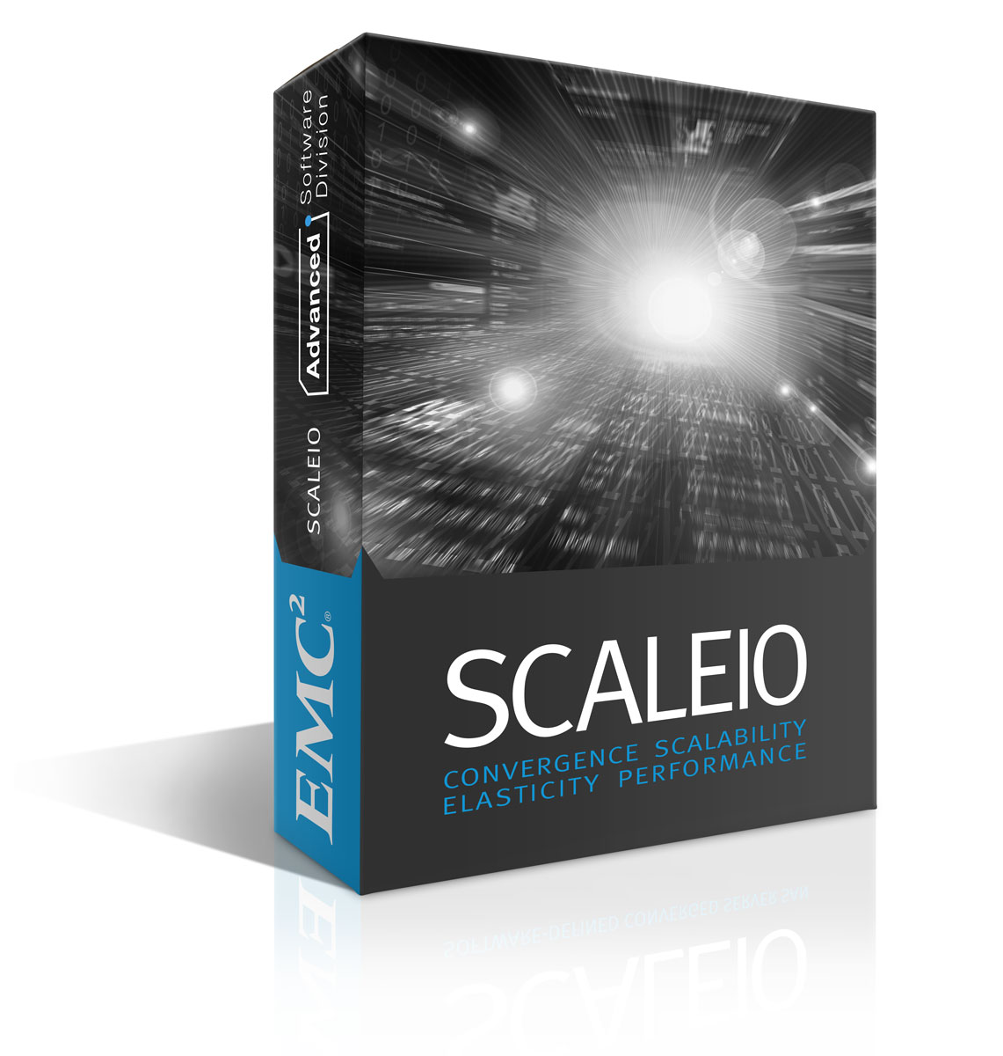
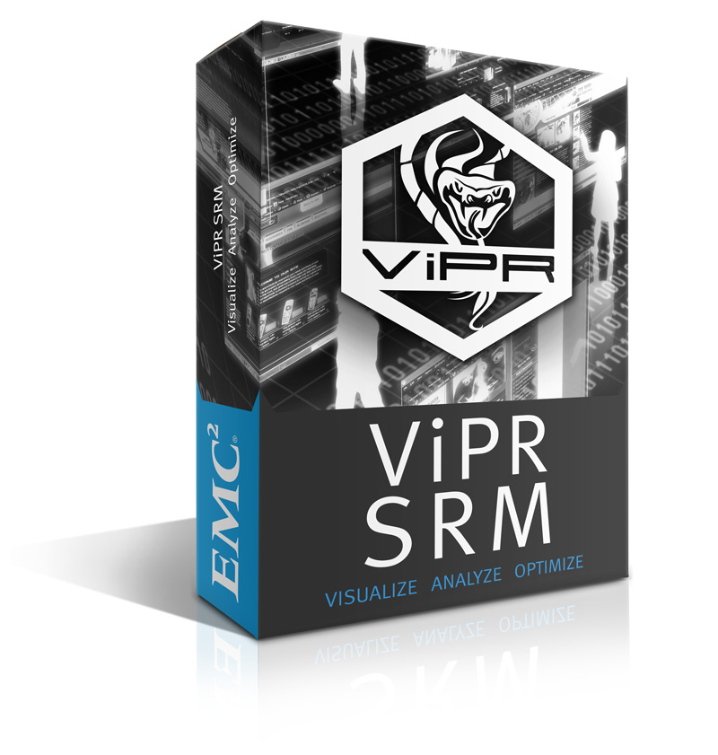









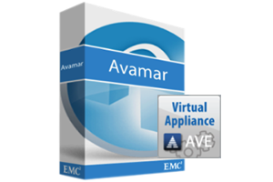


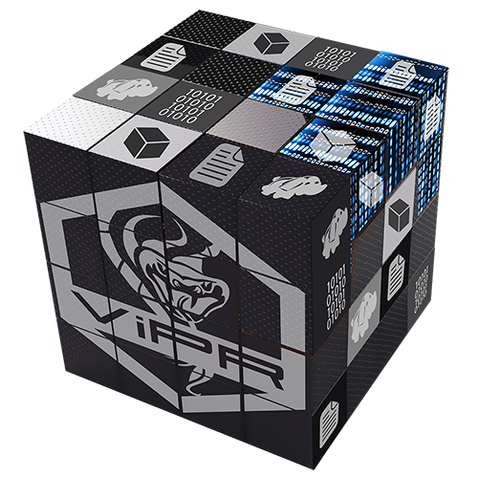
labbuildr
.\build-lab.ps1 -HyperV -ScaleIO -defaults -NMM
Karsten bott, MSPecialist EMEA germany
Notes:
Hello and welcome to Understanding Microsoft Azure. I’m Paul Galjan, the global lead for EMC’s Microsoft Specialists in Presales engineering. Microsoft Azure is a rather large topic, and it includes dozens of offerings, so today we’ll get a grasp of: what Azure is, how it gets sold, how to both integrate and compete with it, and how to manage Azure conversations overall.

Slide 2
do „It“ on yoUR (VMWARE) WORKSTATION
deploy MS Apps and Infra ( Exchange, SQL, Sharepoint, AD, DNS, DC, nested Hyper-V )
add EMC Software to the menu (Networker + NMM, ScaleIO, DataDomain, Avamar, Cloud –array –boost …)
add additional Services ( ECS, ViPR, SRM … )
try some new ( CoprHD build, Openstack, Mesos, docker … )
no special skills required !

Slide 3
Free and frictionless
All software downloaded automatically as part of deployment if not available locally
Space efficient Snapshot technologies
100% Powershell
PowerShell module for VMware Workstation
Documented and available on GitHub
100%Customizable ( Custom Domains, Networks etc)
Single command to deploy (eg. .\build-lab.ps1 -HyperV -ScaleIO -defaults –NMM)
Zero Touch Deployments
Flexible and expandable

Slide 4
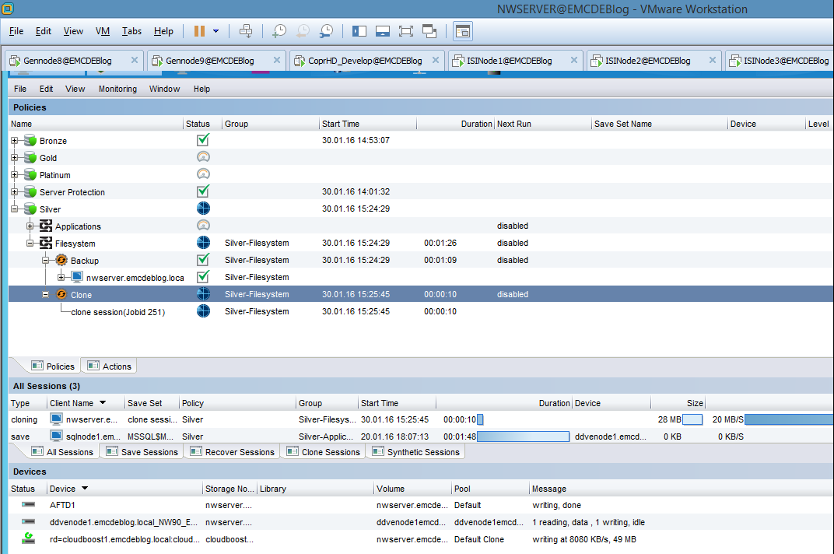
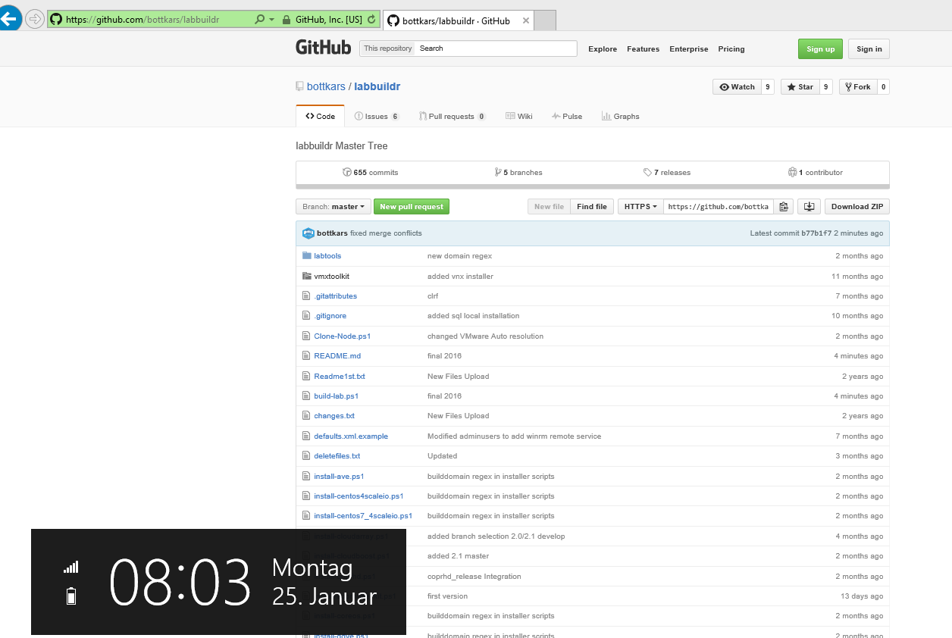
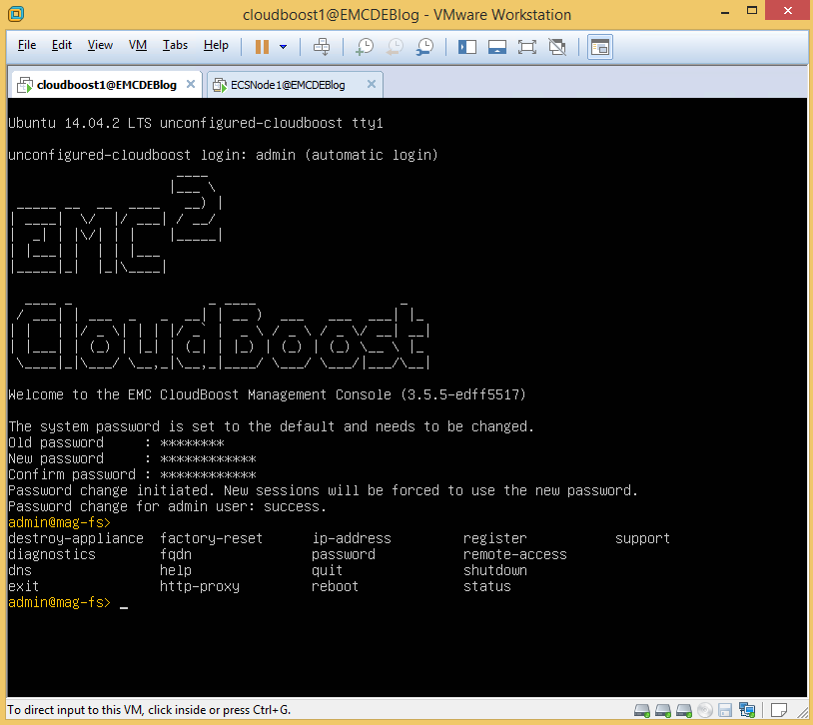
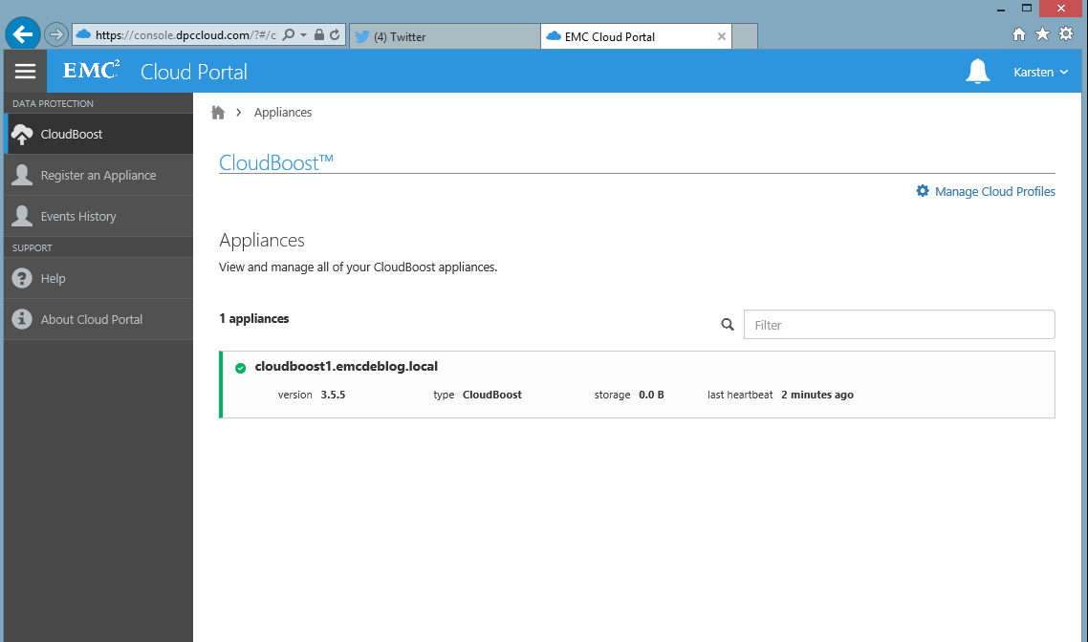
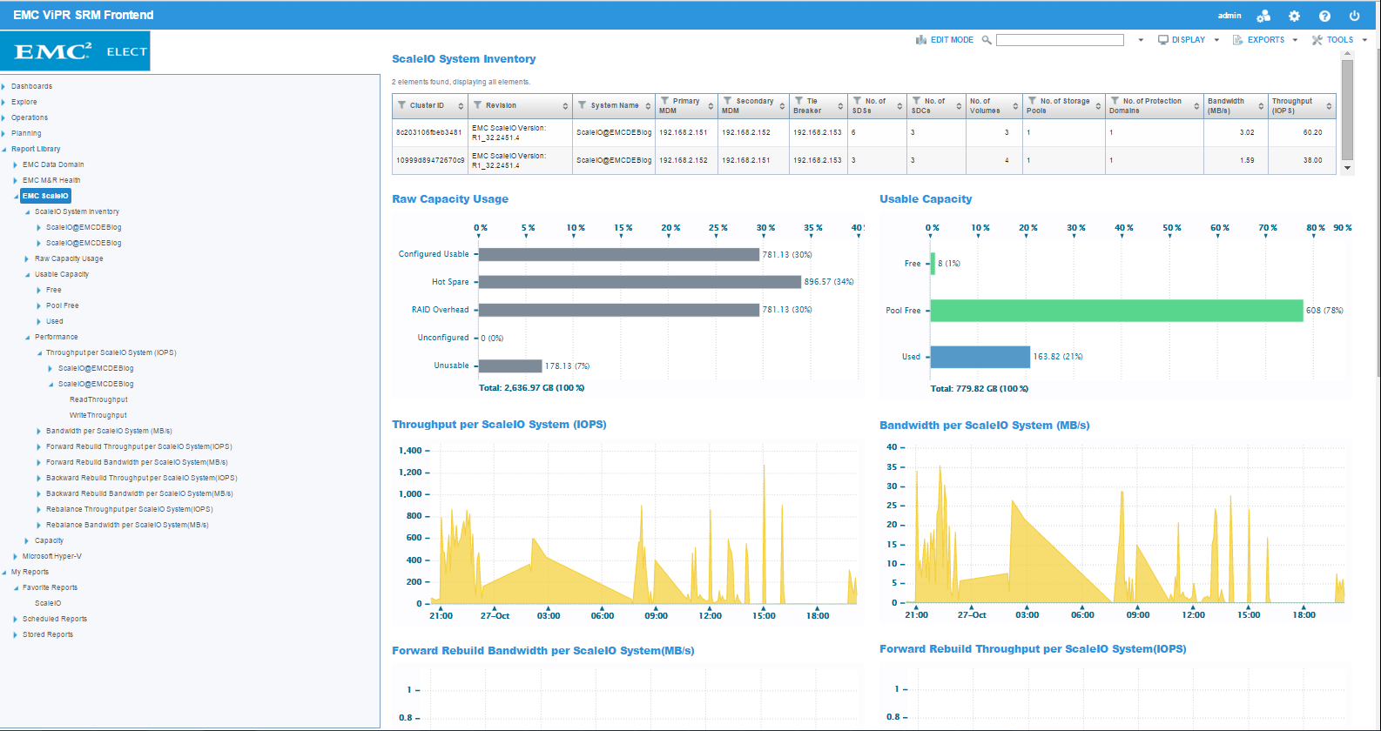
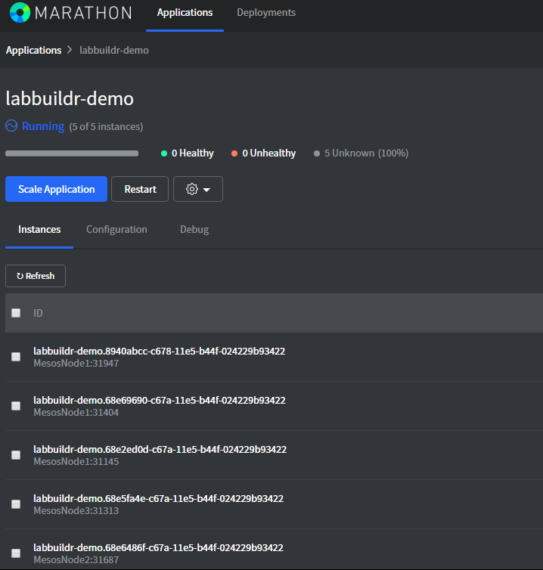

Slide 5
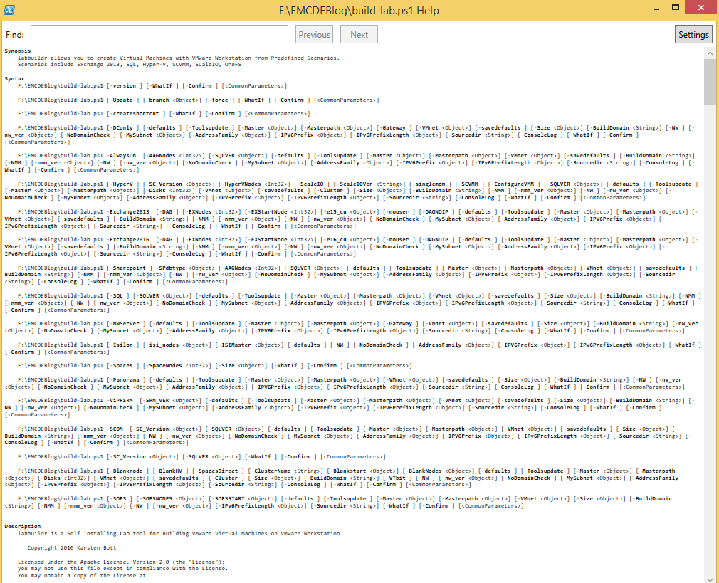
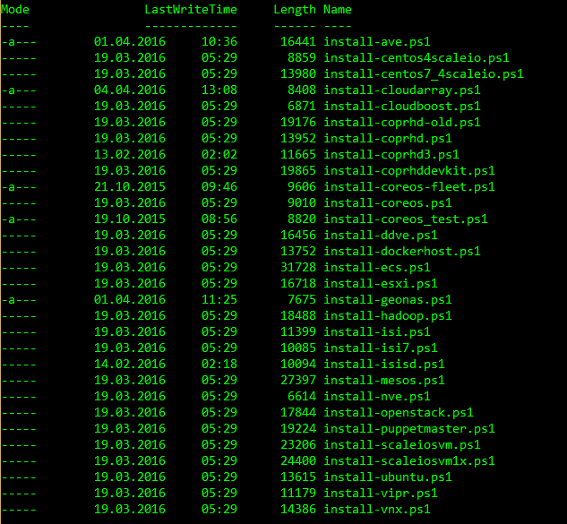
CorE Scenarios + solutionpacks

Slide 6

links
https://github.com/bottkars/labbuildr
https://github.com/bottkars/labbuildr/wiki
https://github.com/bottkars/vmxtoolkit
https://github.com/emccode/siotoolkit
https://github.com/bottkars/SIORestToolkit

Slide 7
1-2-3 Install labbuildr
1 Check Requirements
  https://github.com/bottkars/labbuildr/wiki#hardware-requirements
  https://github.com/bottkars/labbuildr/wiki#software-requirements
2 Run Installation
  https://github.com/bottkars/labbuildr/wiki/1.0-Installation#installation
3 Build Labs

Slide 8
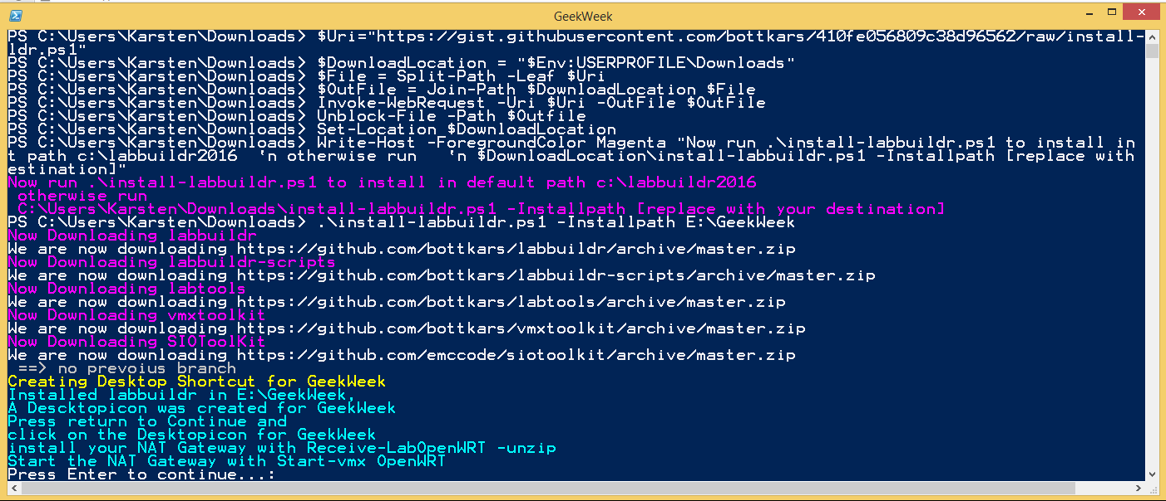
Installation

Slide 9
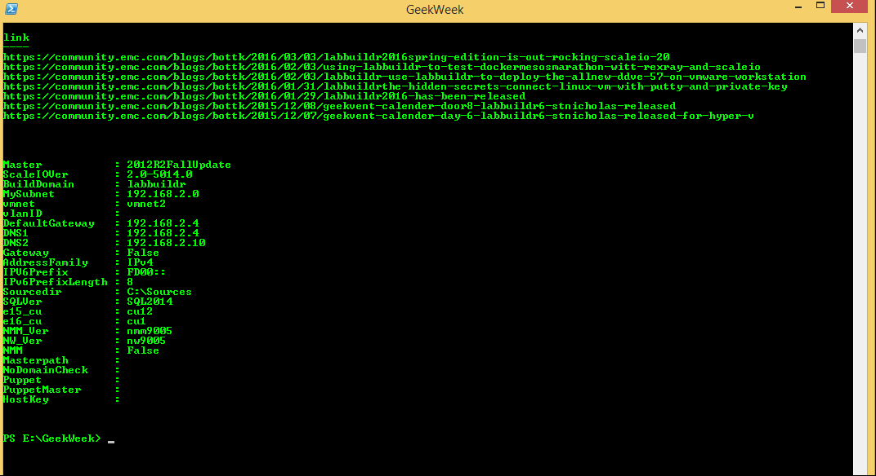
Start

Slide 10
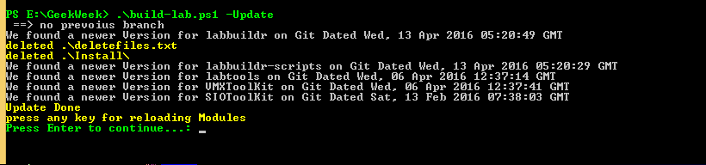
Test update feature

Slide 11
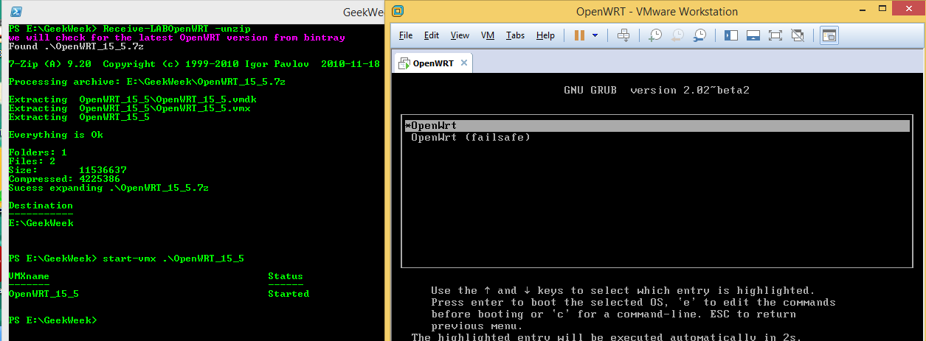
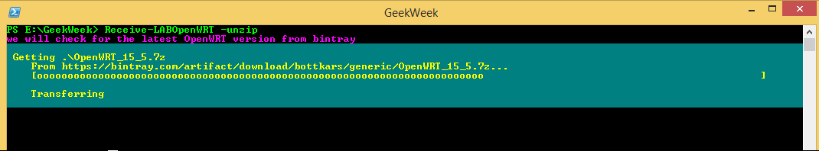
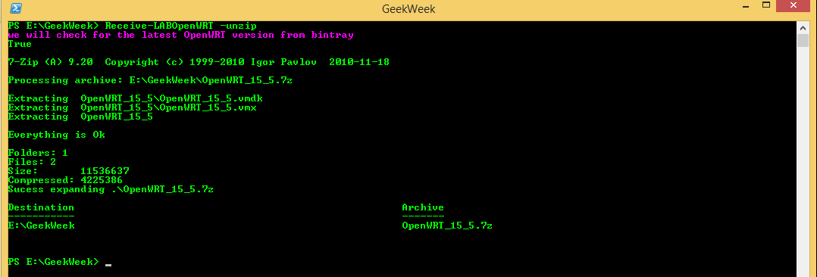
My first vm – Magic
Opennwrt download

Slide 12
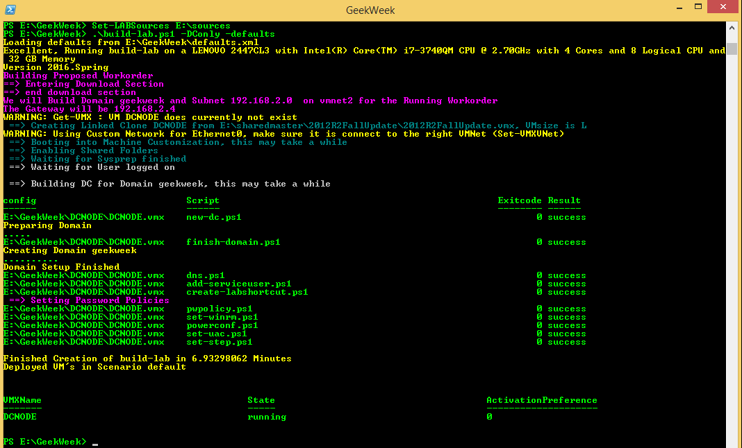
Build first lab

Slide 13
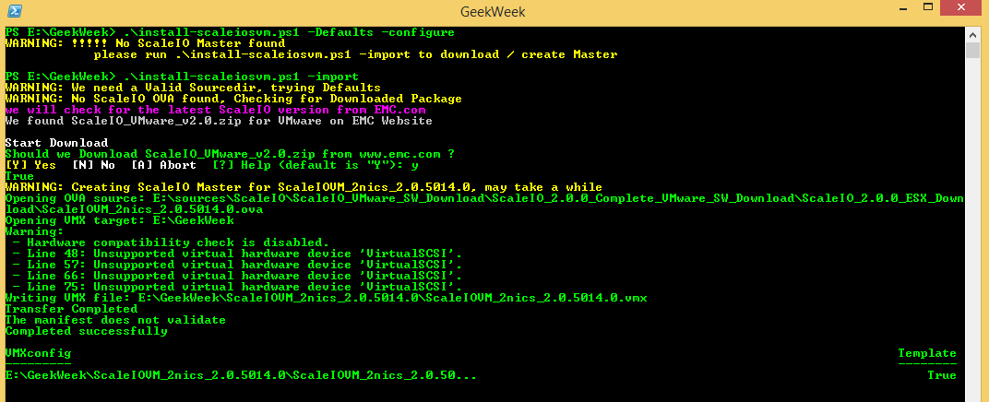
Scaleio SVM deployment

Slide 14
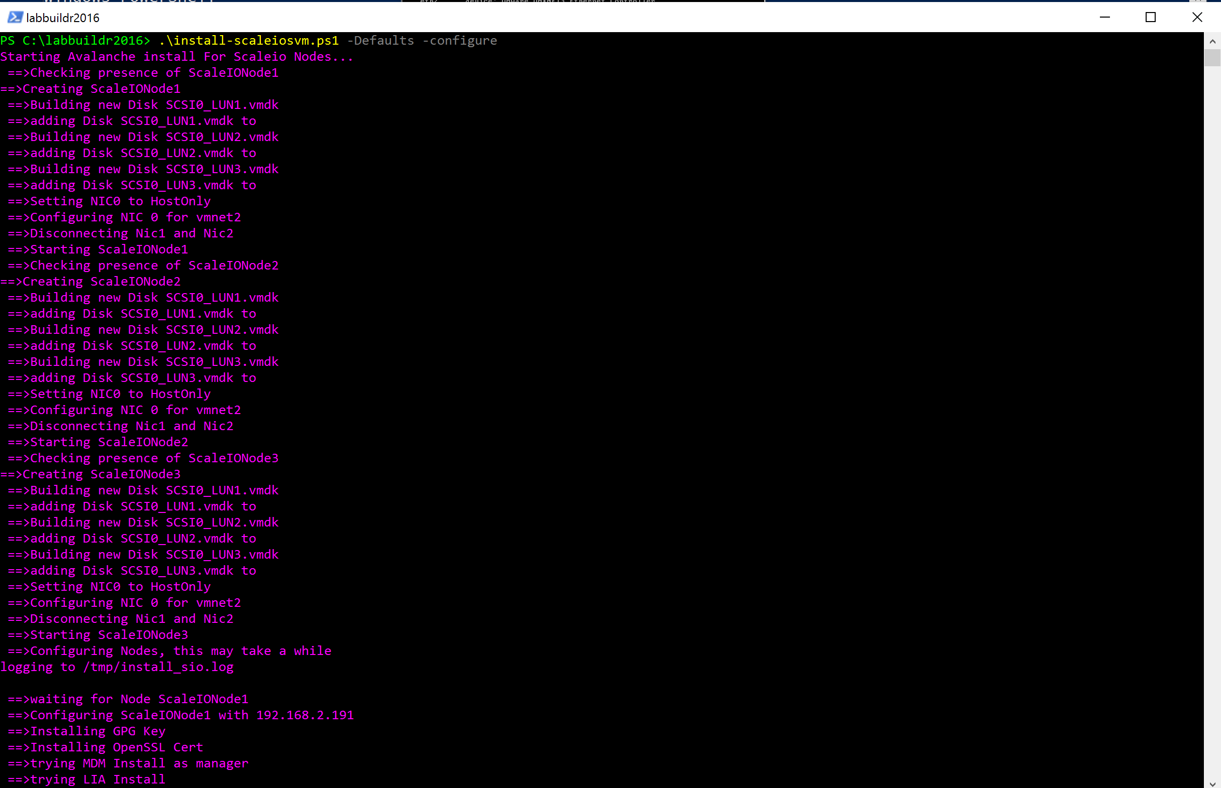
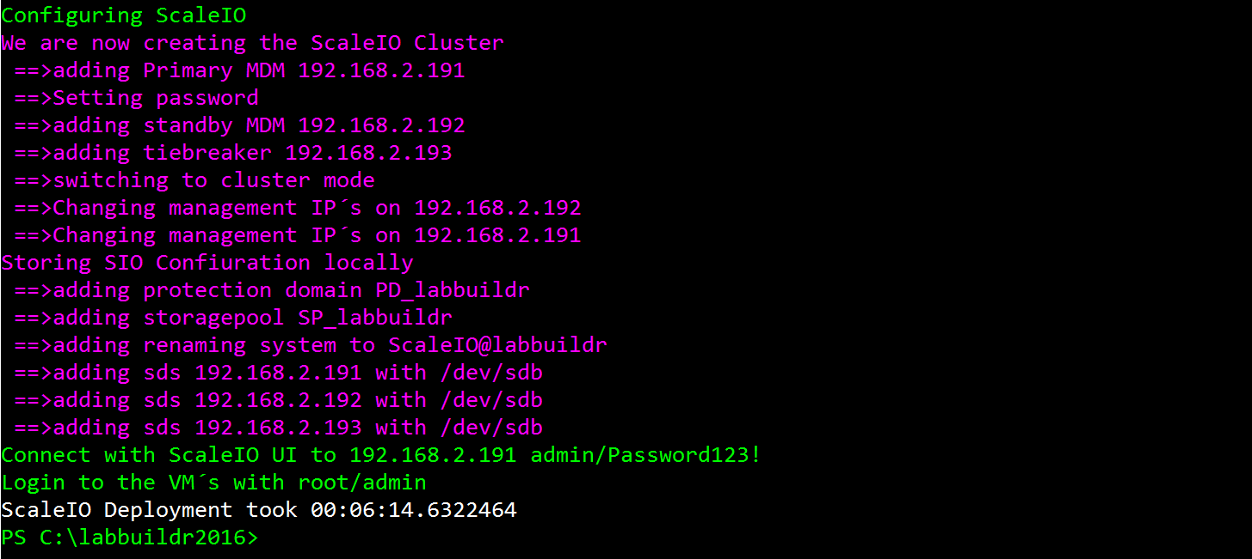
Scaleiosvm deployment

Slide 15
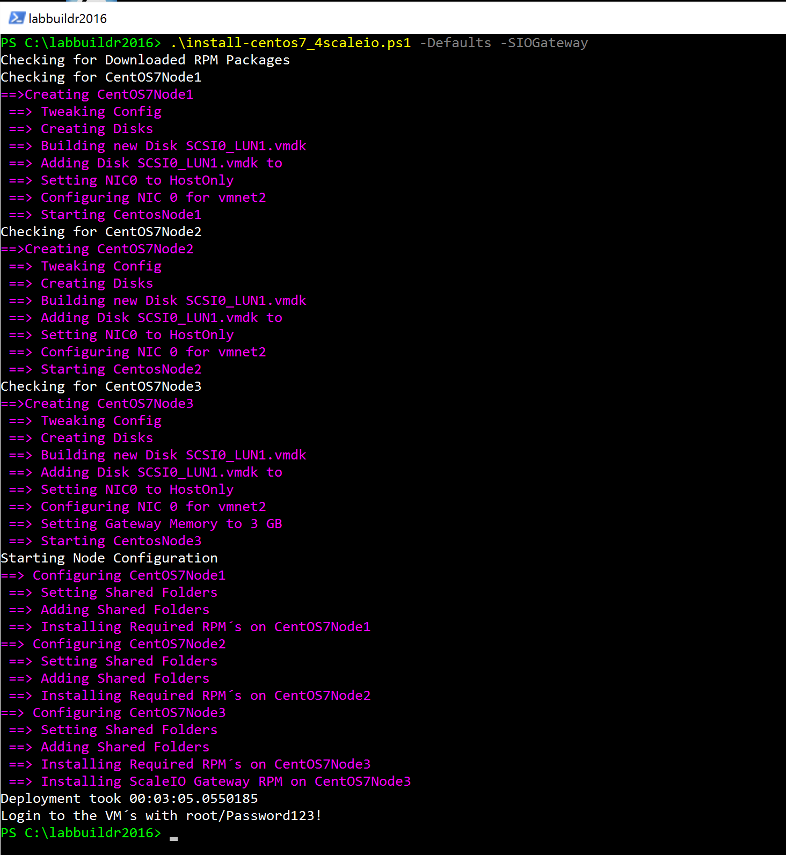
Deploy centos ( for scaleio with gateway)

