Slide 1

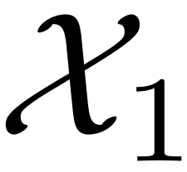
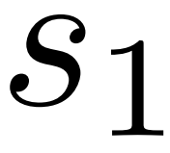
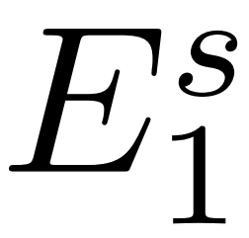
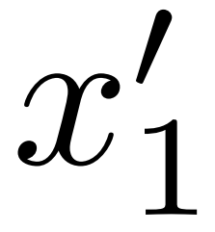
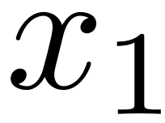
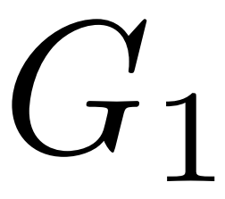
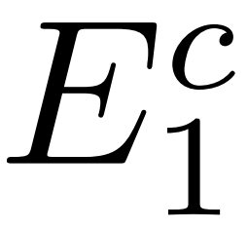
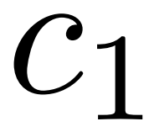
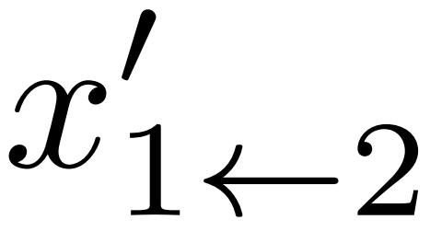

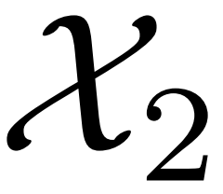
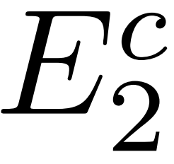
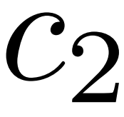
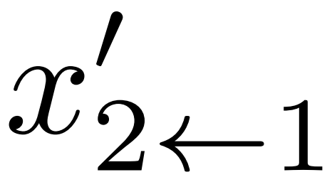
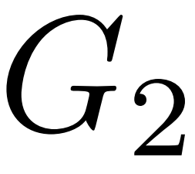
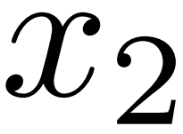
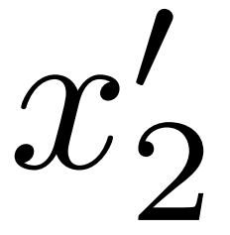
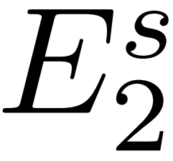
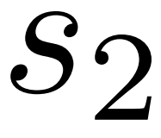
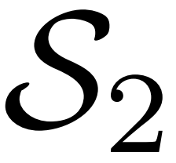
Encoder
Decoder
Emotion 1
Emotion 2

Slide 2
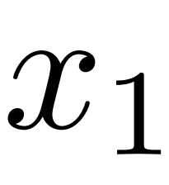
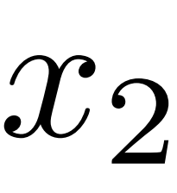
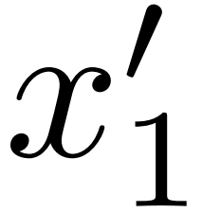
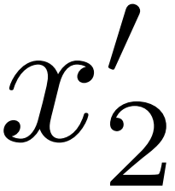
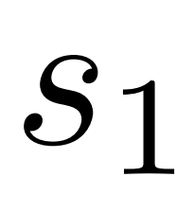
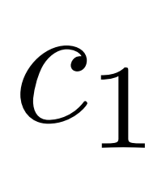
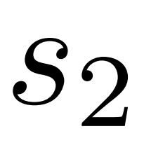
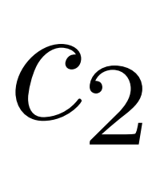

Slide 3
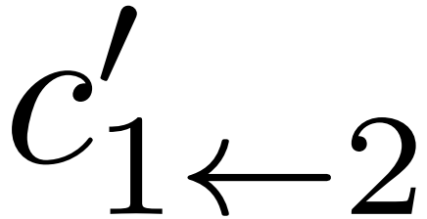
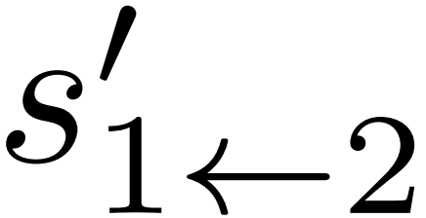
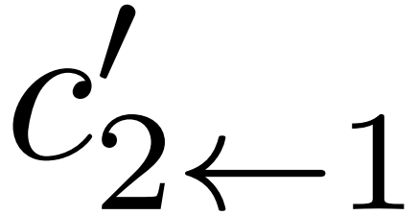
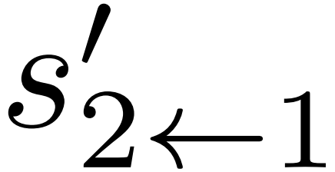

Slide 4
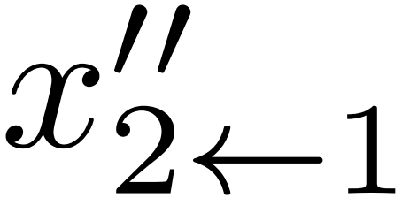
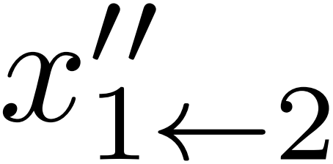
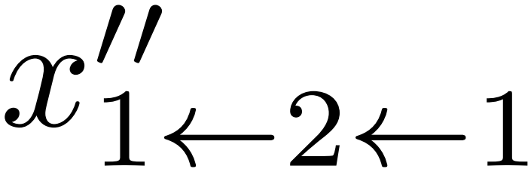
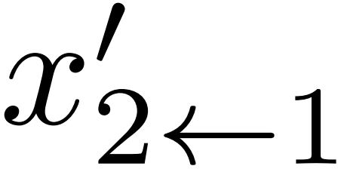
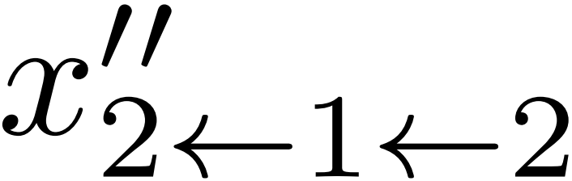
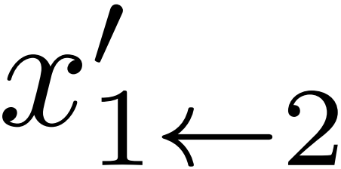

Slide 5

























$$G_{1}$$
$$G_{2}$$
$$E_{1}^{c}$$
$$E_{2}^{c}$$
$$E_{1}^{s}$$
$$E_{2}^{s}$$
…
$$E_{1}^{c}$$
$$E_{1}^{s}$$
$$G_{1}$$
$$G_{2}$$
$$E_{2}^{c}$$
$$E_{2}^{s}$$
$$G_{2}$$
$$G_{1}$$
Origin from
Conversion
Conversion
…
Latent Space
$$E_{2}^{c}$$
$$E_{2}^{s}$$
$$G_{2}$$
$$E_{1}^{c}$$
$$E_{1}^{s}$$
$$G_{1}$$
Origin from
$$G_{1}$$
$$G_{2}$$
…
$$L_{cycle}^{s_{1}}$$
$$L_{cycle}^{c_{1}}$$
$$L_{GAN}^{1}$$
$$L_{recon}^{1}$$
$$L_{GAN}^{1}$$
$$L_{recon}^{1}$$
$$L_{cycle}^{s_{2}}$$
$$L_{cycle}^{c_{2}}$$

Slide 6
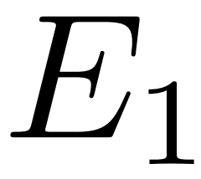
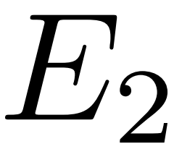

Slide 7


Slide 8




Slide 9

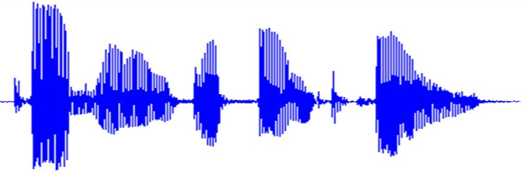

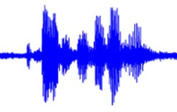
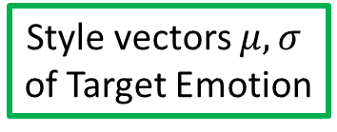
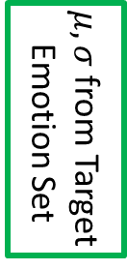
Speech analyzer
Log Gaussian
Normalization
$μ, σ$ from Target
Emotion Set
Autoencoder
GAN
Style vectors $μ, σ$
of Target Emotion
Vocoder

Slide 10
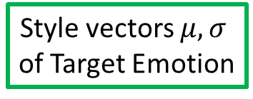
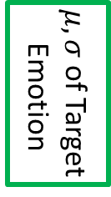
Speech analyzer
Gaussian
Normalize
$μ, σ$ of Target
Emotion
Autoencoder
GAN
Style vectors $μ, σ$
of Target Emotion
Vocoder

Slide 11
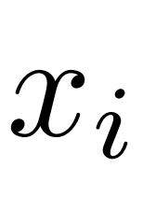


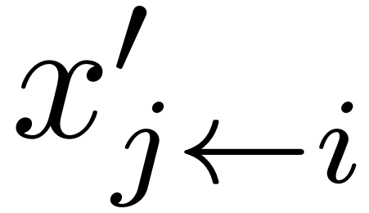






Content encoder ($E^{C}$)
conv1d
IN
GLU
conv1d
IN
GLU
Sum
Downsample $×$2
Resblock $×$4
Decoder ($G$)
Sum
conv1d
Pixel Shuffler
AdaIN
GLU
conv1d
AdaResblock $×$4
Upsample $×$2

Slide 12
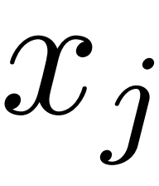
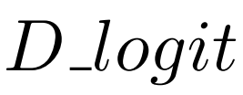




Style encoder ($E^{S}$)
conv1d
GLU
conv1d
GLU
Avg Pooling
conv1d
MLP
Downsample $×$2
Discriminator ($D$)
conv2d
GLU
conv2d
IN
GLU
Fully Connected
Sigmoid
Downsample $×$3

Slide 14
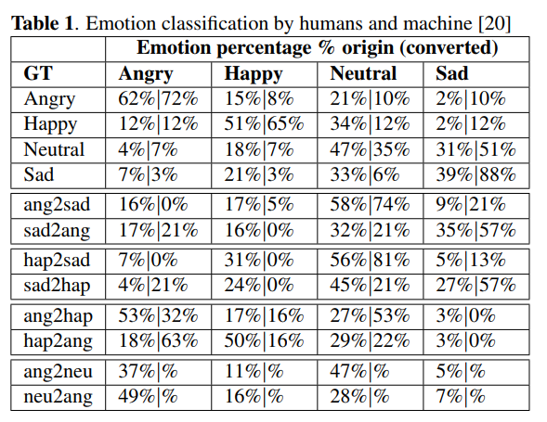

Slide 16












Slide 17


Slide 18
















Slide 19




Slide 20

Transportation Cost
Iteration

