Slide 1
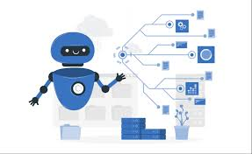
Telegram Bot
By:-
Aman Singh
2108020100009

Slide 2
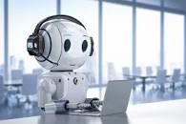
Contents
Introduction to Telegram Bots
Benefits of Telegram Bots
Types of Telegram Bots
How Telegram Bots Work
Telegram Bot Development
Security and Privacy

Slide 3
What is a Telegram Bot?
A Telegram bot is essentially a Telegram account operated by software rather than a human. It can send and receive messages, multimedia content, and interact with users just like a regular Telegram user.
Telegram bot are basically uses a messaging ,command ,Multimedia,
Long polling ,customization
Telegram bots are versatile tools that have found applications in a wide range of industries and use cases.

Slide 4

Benefits of Telegram Bots
Automation
Efficiency, 24/7 availability, scalability, and cost-effectiveness.
Multifunction ,Customization ,Integration
Notification and Alerts
Language Support
Game and Entertainment
Educational Tools
Global Search

Slide 5

Types of Telegram Bots
Telegram bots are different types-
Customer Support Bots
Informational Bots
Entertainment Bots
Transactional Bots

Slide 6
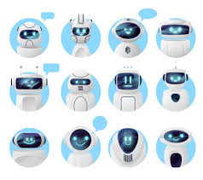
How Telegram Bots Work
Create a Bot:
Create Telegram bot →Search box → Bot Father → Ask for new Bot → Provide API token → Authentication Telegram API
Programming the Bot:
Bot Logic
Bot Commands
Inline Queries:
Bot Updates and Maintenance
Bot Deployment:.
Bot Promotion:

Slide 7
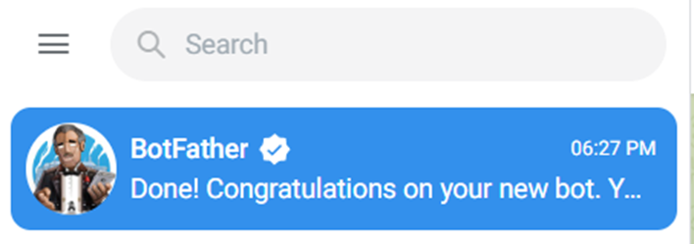
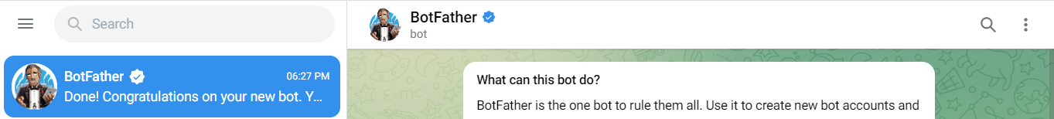
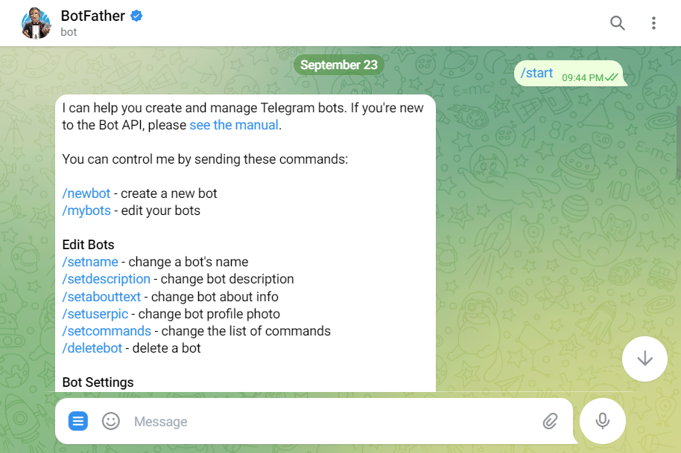

Slide 8
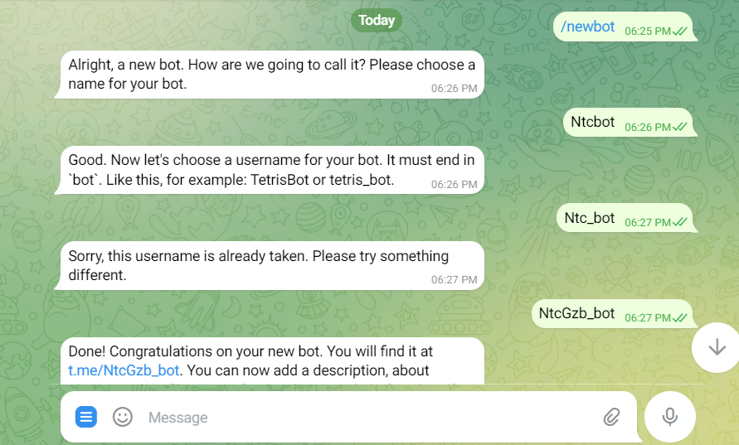
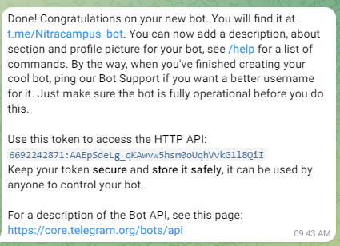

Slide 9
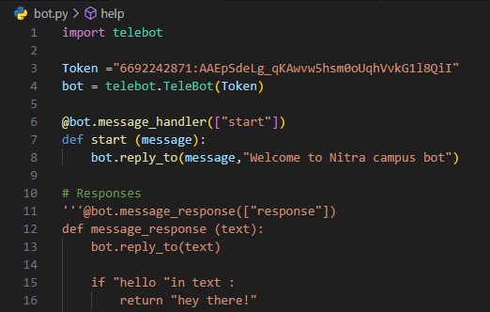
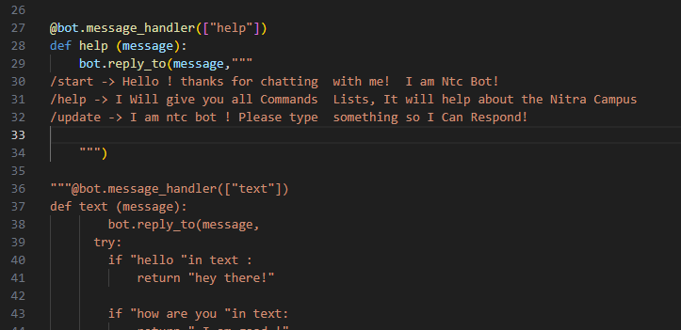
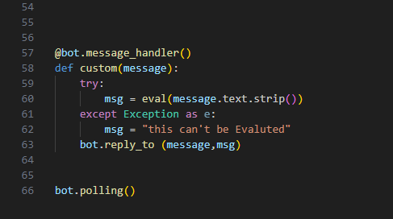
Telegram Bot Development

Slide 10
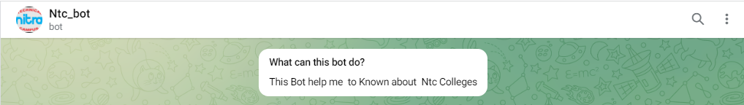
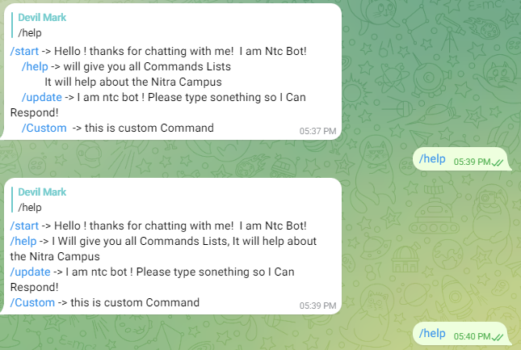
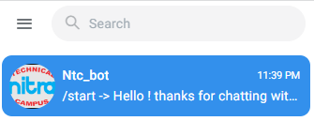
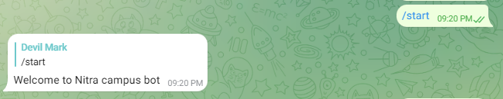
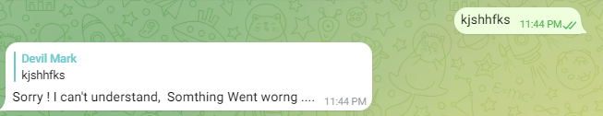

Slide 11
Security and Privacy
API Token Security:
Protect your bot's API token (BotFather provides this during bot creation) as if it were a password.
HTTPS:
Ensure your bot's communication with Telegram's servers occurs over HTTPS.
Data Encryption:
If you store user data, use encryption to protect it. Telegram itself provides end-to-end encryption for messages sent between users.
Permissions:
Use the Telegram Bot API's built-in role-based access control system
Secure Your Server:
Ensure your server hosting the bot is properly configured with security best practices
Verify User Inputs:
Sanitize and validate user inputs to prevent security

Slide 12
Thank you

