Slide 1
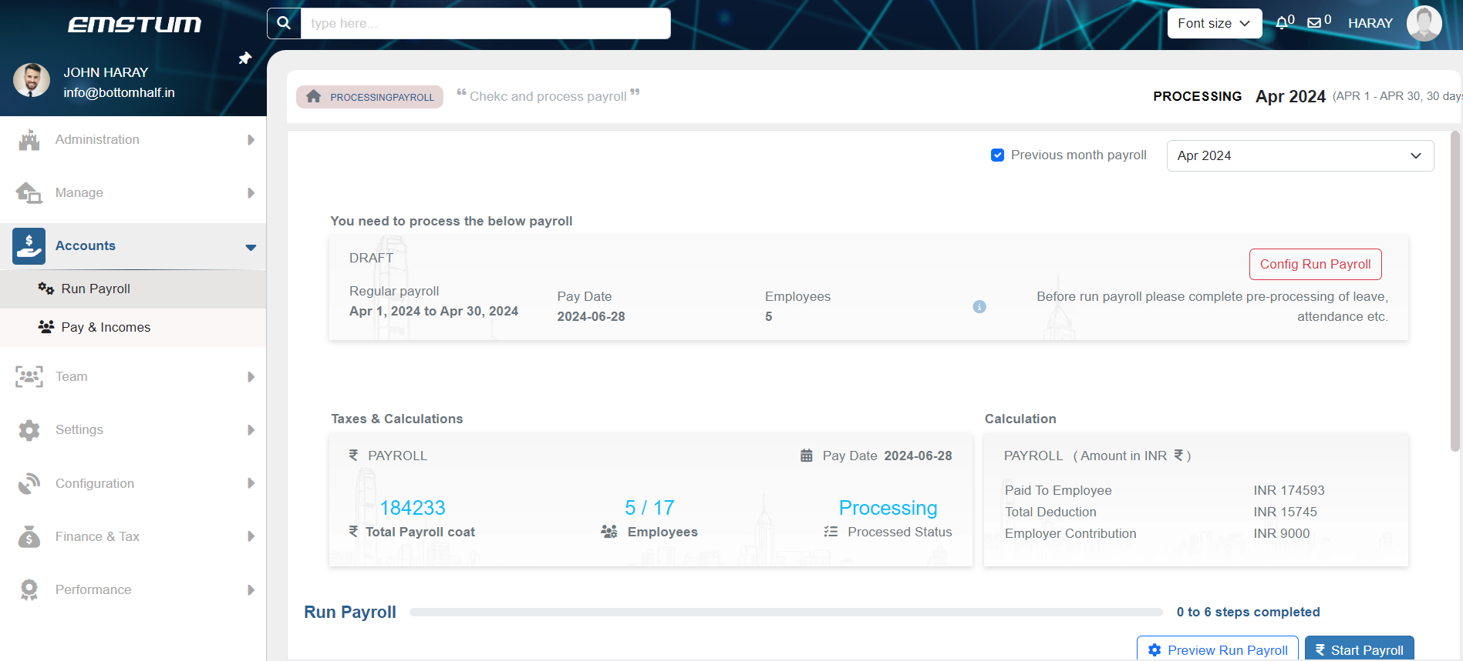
RUN PAYROLL
Payroll Processing refers to the complete set of steps involved in calculating the total remuneration of each employee.
Add bonus, adhoc payment etc. for the employee’s for each months
Customize the rule for new joinee and employee serving notice
Company over rule and management if applicable

Slide 2
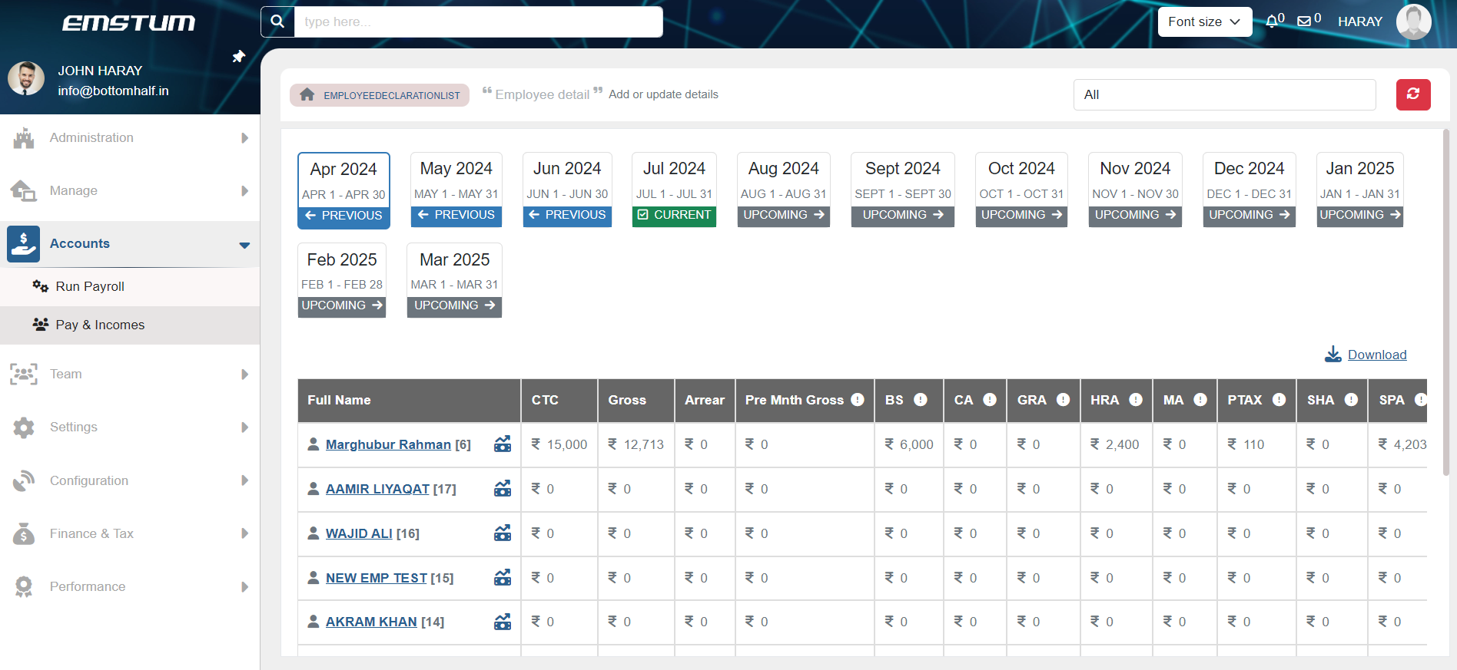
Pay and Income
Gain clear visibility into employee salary details after each successful payroll run.
Access individual employee salary breakdowns, including a breakdown by month.
Easily view and analyze salary information for informed decision-making.
Export salary details in Excel format for further analysis or record-keeping purposes.

