Slide 1
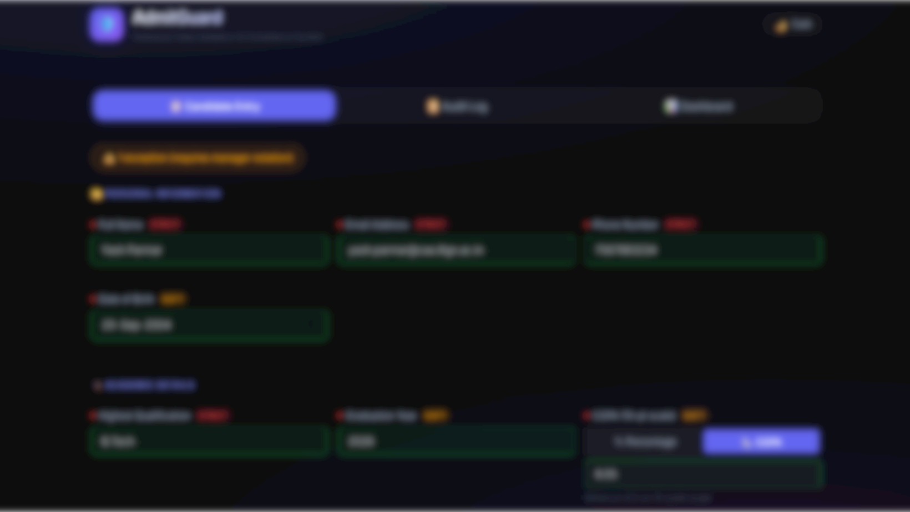
AdmitGuard
Admission Data Validation & Compliance System
Yash Kiritkumar Parmar - 26171033
PG Diploma, CAA, IIT-Gandhinagar

Slide 2
Current Admission Woes
The Challenges of Manual Data Entry
1
2
3
4
Manual Data Entry in
Excel
No Real-Time
Validation
Lack of Exception
Tracking
High Risk of Data Loss
Potential for compliance
gaps and incomplete
records.
Leads to errors and
inefficiencies.
Errors are discovered late in
the process, increasing
rework and ineficiency.
Difficulty in managing and
reviewing borderline
candidates.
5
6
7
8
Invalid Data Entries
Inconsistent Rule
Application
Compliance Gaps
Lack of Oversight
Common errors include
incorrect phone numbers,
emails, and duplicate
entries.
Absence of a clear audit
trail for accreditation
reviews.
Borderline candidates may
go unnoticed without
proper tracking.
Varying standards due to
different operators applying
rules.

Slide 3
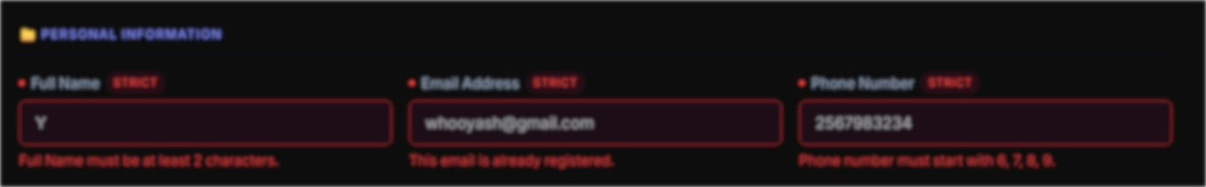
Key Features & Core Pillars
The Solution: AdmitGuard
Key Features
Real-time Validation: Instantaneous verification of admission eligibility rules.
Structured Exception Handling: Documented rationale for all exceptions.
Complete Audit Trails: Comprehensive logging of all actions for transparency and accountability.
Managerial Oversight: Dedicated admin panel for effective control and monitoring.

Slide 4




Architecture Overview
A Robust and Efficient Tech Stack
Architecture Pattern
Validators
Tech Stack
Key Implementation
Details
Browser (SPA) ↔ Flask API
Server ↔ SQLite Database
Strict + Soft Validators
Backend: Python 3, Flask
Database: SQLite Frontend:
Vanilla HTML5, CSS3,
JavaScript
Zero client-side validation.
Secure Flask sessions for
authentication. WAL mode
SQLite for concurrency.

Slide 5


Strict Validation Rules
7 Non-Negotiable Rules for Form Submission
Field
Rule
Full Name
Required, ≥2 chars, no numbers
Email
Valid format, unique
Phone
Exactly 10 digits (starts 6/7/8/9)
Highest Qualification
Must be from allowed list
Interview Status
Cleared / Waitlisted (Rejected blocks)
Aadhaar Number
Exactly 12 digits
Offer Letter Sent
Only if interview status is Cleared/Waitlisted
UI Feedback: Red 'STRICT' badge, inline red error messages, red/green field borders.

Slide 6
Soft Validation Rules & Exception System
Configurable thresholds with documented rationale for overrides.
Validation Rules
  Rules with configurable
  thresholds that can be
  overridden with documented
  rationale.
Date of Birth
  Age between 18 and 35 years.
Graduation Year
  Between 2015 and 2025.
Percentage / CGPA
  Minimum of 60% or 6.0 CGPA.
Screening Test Score
  Minimum of 40 out of 100.
Exception Override Flow
  Step-by-step process for
  handling exceptions.
Soft Rule Failure &
Warning
  User is notified when a
  validation rule is not met.
Operator Intervention
  Operator explicitly enables the
  exception and provides a
  justification.
Rationale Entry
  Justification must be at least 30
  characters and include specific
  keywords.
Submission
  Process can be submitted once
  a valid rationale is provided.

Slide 7


Exception Flagging System
Automating Escalation for Closer Review
Automatic Flagging
Visual Indicator
Database Status Update
Candidates with more than 2
exceptions are automatically flagged
for manager review.
A pulsing red badge appears,
indicating potential escalation.
The candidate's record is updated
with 'flagged_for_review: true'.
Audit Trail
UI Feedback
Detailed logs of exceptions and their rationales are
maintained.
Clear visual cues indicate the number of exceptions (Green:
0, Yellow: 1, Red: 3+).

Slide 8
Frontend UI — Candidate Entry Form
A clean and intuitive single-page application designed for efficiency and user experience.
Three-Tab Layout
  Seamless navigation between Candidate Entry, Audit
  Log, and Dashboard.
Modern Aesthetics
  Features a dark mode interface, glassmorphism effects,
  animated gradients, and the modern Inter font.
Structured Sections
  Comprehensive data capture across Personal Info,
  Academics, Admission Process, and Identity.
Real-time Validation
  Instant API-driven validation on every field blur for
  immediate feedback.
Interactive Enhancements
  Includes a score type toggle for dynamic input and a
  Ctrl+Enter shortcut for quick submission.

Slide 9


Frontend UI — Audit Log
A comprehensive and searchable history of all actions.
Live Table
Filtering & Search
Status Badges
All submissions loaded dynamically for real-
time tracking.
Easily filter by exceptions/flagged items and
search by name or email.
Clear visual indicators for submission, edits,
deletions, exceptions, and review flags.
Inline Details
Data Export
Exception rationales displayed directly within the log for immediate
context.
One-click CSV and JSON download options for data analysis and
archiving.
A comprehensive and searchable history of all actions.

Slide 10
Admin Panel (KartaDharta) 🔐
Secure management interface for KartaDharta, offering robust control and oversight.
Access
  Access the admin panel at `localhost:5000/prabandhak`.
  Default credentials: admin/admin123.
Secure Login
  Features a glassmorphism design with integrated error
  handling for a protected entry point.
Overview Dashboard
  Displays key statistics through cards, mirroring the
  public-facing dashboard for quick insights.
Candidate Management
  Includes a searchable and sortable table with
  comprehensive Edit and Delete functionalities.
Audit Integration
  All administrative actions are securely logged with
  specific identifiers: `ADMIN_EDIT` and `ADMIN_DELETE`.
Route Protection
  All admin endpoints are secured through robust session
  authentication.

Slide 11
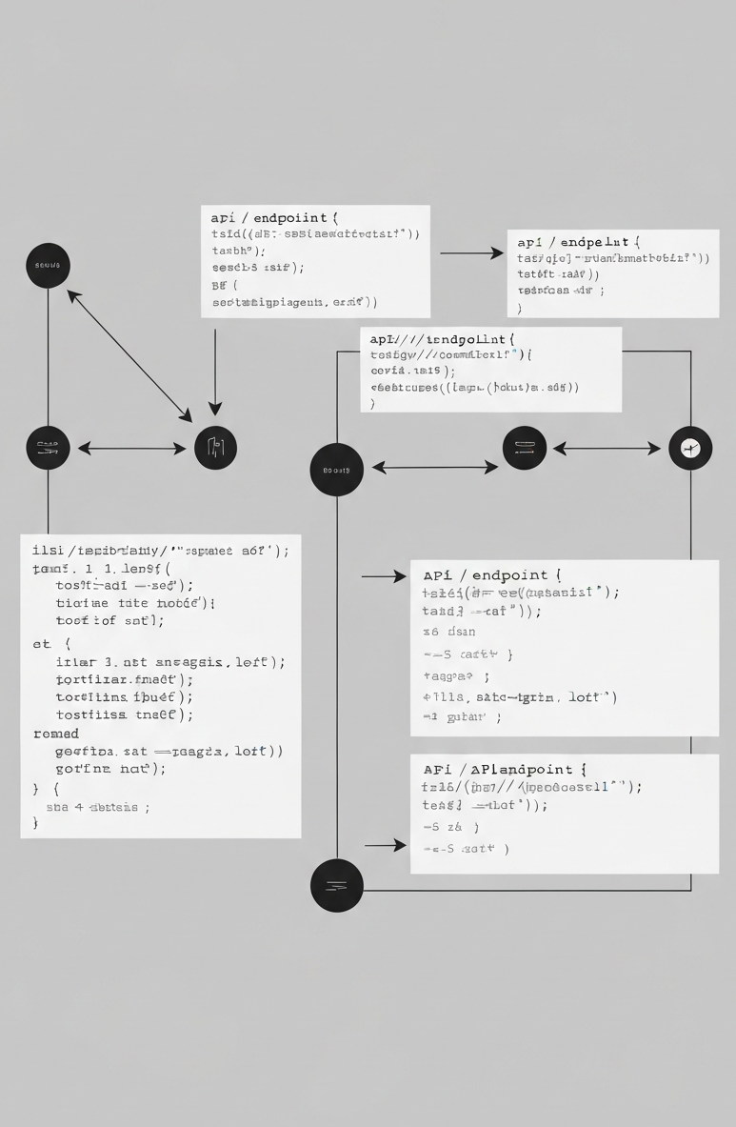
API Endpoints:
Complete Reference
A comprehensive set of RESTful API endpoints for integration and
management.
Public Endpoints
  Includes 12 endpoints such as /api/validate, /api/candidates, /api/audit-log,
  and /api/export/{csv|json}.
Admin Endpoints (Protected)
  Features 6 protected endpoints for administrative tasks, including
  /api/admin/login, /api/admin/logout, /api/admin/candidates, and
  /api/admin/candidates/.
Total Endpoints: 18

Slide 12


Database Design: SQLite Schema
Candidates Table
Audit Log Table
Stores comprehensive candidate information
including personal, academic, and flexible
exception data. Features review flags for
status management.
Logs all significant actions (SUBMISSION,
ADMIN_EDIT, ADMIN_DELETE) performed on
candidate data, recording details, exception
counts, and timestamps.

Slide 13



Project Structure
Organized Codebase for Maintainability
Source Code
Prompts Directory
Documentation & Logs
Separated into `src/backend` (Flask
API) and `src/frontend` (Web Interface).
Contains R.I.C.E. prompt files for AI-
assisted development.
Includes `README.md` for project
documentation and `sprint-log.md` for
build progress.
Key principles include clear backend/frontend separation and a dedicated prompts directory.

Slide 14
Sprint Timeline
Rapid development cycle completed in a single day.
Sprint 1
Sprint 3
Sprint 4
Core Backend, Strict Validators
Frontend UI, Glassmorphism
Design
Polish, Export, Search, Shortcuts
Sprint 2
Sprint 3+
Sprint 5
Soft Rules, Exception System,
Audit Log
Database Persistence (SQLite)
Admin Panel, Auth, CRUD
All 6 sprints completed in a single day.

Slide 15
Development Methodology
Leveraging AI with the R.I.C.E. Framework
R.I.C.E. Framework
  A structured approach for AI persona and development
  definition.
Role
  Definition of the AI persona.
Intent
  Defining the build objective for the AI.
Constraints
  Specifying technical requirements and limitations.
Expected Outcome
  Establishing verification criteria for success.
Prompt Log
  13 documented R.I.C.E. prompts used to guide feature
  development.

Slide 16
Key Design Decisions
Strategic choices for efficiency and robustness
Zero Client-Side Validation
  Ensures a single source of truth
  enforced on the backend.
Rules as Python Flags
  Enables straightforward
  adjustment of thresholds and
  parameters.
SQLite Database
  Offers zero-configuration setup,
  perfect for single-server
  deployments.
Flask Sessions for Auth
  Implements simple and secure
  server-side authentication.
Vanilla JS
  Achieves a minimal bundle size
  without the need for a build step.
Blueprint Architecture
  Facilitates a clean separation of
  concerns within the application.
WAL Mode SQLite
  Enhances efficient concurrent read
  and write operations.
Hardcoded Admin
Credentials
  Simplifies development, with easy
  configuration options available.

Slide 17
How to Run
Simple setup for immediate use.
Clone the repository
  Use `git clone
  https://github.com/bottyash/admitguard-yash-
  parmar.git` to get the code.
Install dependencies
  Run `pip install flask flask-cors` to install required
  packages.
Start the server
  Navigate to `src/backend` and run `python app.py`.
Access the application
  Main App: `http://localhost:5000` Admin Panel:
  `http://localhost:5000/prabandhak` (Credentials:
  `admin/admin123`)
No build step or Docker required – just Python.

Slide 18
Demo Flow
A guided walkthrough of AdmitGuard's capabilities
Candidate Entry
Frontend UI
Admin Panel
Theme Switch
Demonstrate form
submission (valid/invalid
data), strict/soft rules, and
exception handling.
Showcase the Audit Log
(live updates, filtering,
export) and Dashboard
(stats, rules reference).
Log in, perform CRUD
operations on candidates,
and observe audit trail
updates.
Demonstrate the dark/light
mode toggle.

Slide 19


AdmitGuard Impact
Comprehensive and Efficient Admission System
Validated Data
Secure Admin Panel
Ensures data integrity with 11 fields and 11
validation rules (7 strict, 4 soft).
Protected by session authentication for secure
access.
Compliance Features
Lightweight Architecture
Supports regulatory adherence with structured
exceptions, audit trails, and manager flagging.
Efficiently built with minimal dependencies
(Flask, SQLite) and ~3,000 lines of code.
Usability
Rapid Development
Provides a responsive, intuitive interface with
data export capabilities.
Developed in 6 sprints within a single day
using 13 R.I.C.E. prompts.
AdmitGuard delivers a robust and user-friendly admission system, rapidly developed for efficiency and compliance.

Slide 20
Future Development Avenues
Future Scopes: Expanding AdmitGuard's Capabilities
Third-Party Tool & LLM Integrations
Leverage existing open API endpoints for seamless external system connections.
Enable sophisticated data analysis and insights through advanced Large Language Models.
Facilitate automated communication workflows or intelligent candidate screening.
Google Sheets Automation
Offer Google Sheets as a modern, cloud-based alternative to traditional Excel for data management.
Enable real-time synchronization and collaborative editing.
Streamline data import/export processes, enhancing accessibility and integration with other cloud services.

