Slide 1
RESEARCH & DEPLOYMENT
SDN-Based DDoS Detection & Mitigation
Autonomous Machine Learning Pipeline, Sequence Modeling & Real-Time OpenFlow Mitigation
• Dataset: UNB CIC-DDoS2019 (11 Attack Categories, 207k Flows)
• Models: Logistic Regression, Decision Tree, Random Forest, XGBoost & 2-Layer LSTM
• Target Controller: Ryu SDN OpenFlow 1.3 | Inference SLA: < 5.0 ms per packet

Slide 2
PROJECT OVERVIEW
Executive Summary & Project Objectives
The SDN Security Challenge
Core Technical Objectives
Control Plane Saturation: DDoS floods exhaust OpenFlow channel bandwidth and controller CPU through rapid Packet-In requests.
Multi-Vector Diversity: Attackers deploy reflection (DNS, NTP, SNMP, TFTP) and protocol floods (SYN, UDP-lag) simultaneously.
Strict Real-Time SLA: SDN switches require flow decisions in under 5.0 ms to prevent line-rate buffer drops.
Zero False-Drop Tolerance: Benign enterprise traffic must not be dropped; requires ultra-low False Positive Rates (FPR < 0.1%).
Automated Ingestion: Stream, clean, deduplicate, and balance 11 attack categories into 22 optimized Parquet splits.
Statistical Feature Selection: Reduce 81 raw flow dimensions to the top 28 features via ANOVA F-test without data leakage.
Dual-Paradigm Modeling: Train 4 multi-threaded tabular algorithms alongside a 3D temporal sequence LSTM on GPU.
Ryu Controller Deployment: Package the top model into a sub-millisecond predict_packet() function for zero-delay mitigation.

Slide 3
ARCHITECTURE & CONSTRAINTS
System Architecture & Hardware Profile
1. Local Hardware Profile
2. ML Pipeline Stages
3. SDN Control Plane
Host RAM: 16 GB DDR4/DDR5
Memory Optimization: Chunked streaming (50k rows) + float32/int32 downcasting saving 50% RAM.
GPU Accelerator: NVIDIA RTX 5050 (8GB VRAM)
VRAM Optimization: Dynamic GPU memory growth + 256 mini-batching prevents OOM crashes.
CPU Multiprocessing: Configured n_jobs=-1 across all multi-core tabular estimators.
Phase 1: Ingestion: 22 balanced Parquet splits + ANOVA F-test (top 28 features).
Phase 2: Tabular: Logistic Regression, Decision Tree, Random Forest, XGBoost.
Phase 3: Sequence: 3D sliding temporal reshape + 2-layer LSTM on RTX 5050.
Phase 4: Evaluation: Latency profiling, FPR, Blinded zero-day test & 6 visual plots.
Phase 5: Packaging: Serialized joblib/keras weights & standalone predict.py.
Ryu Controller: OpenFlow 1.3 asynchronous event-driven controller.
Telemetry Extractor: Extracts bidirectional flow stats from OFPFlowStatsReply events.
Fast-Path Inference: In-memory cached scaler and model classifies in < 0.6 ms.
Automated Mitigation: Installs prioritized OpenFlow Drop rules (OFPFlowMod) to isolate attackers.
Controller Health: Zero packet queue build-up; high availability sustained.

Slide 4
PHASE 1: DATA PIPELINE
Dataset Preprocessing & 70/30 Parquet Splitting
Dataset Category | Train Split | Test Split | Status
DNS (DrDoS_DNS) | 70% (30k rows) | 30% (13k rows) | Balanced Parquet
LDAP (DrDoS_LDAP) | 70% (13k rows) | 30% (5.5k rows) | Balanced Parquet
MSSQL (DrDoS_MSSQL) | 70% (17k rows) | 30% (7.4k rows) | Balanced Parquet
NTP (DrDoS_NTP) | 70% (30k rows) | 30% (13k rows) | Balanced Parquet
NetBIOS (DrDoS_NetBIOS) | 70% (18k rows) | 30% (7.6k rows) | Balanced Parquet
SNMP (DrDoS_SNMP) | 70% (12k rows) | 30% (5.3k rows) | Balanced Parquet
SSDP (DrDoS_SSDP) | 70% (12k rows) | 30% (5.3k rows) | Balanced Parquet
UDP (DrDoS_UDP) | 70% (25k rows) | 30% (11k rows) | Balanced Parquet
SYN (Syn) | 70% (20k rows) | 30% (8.7k rows) | Balanced Parquet
TFTP (TFTP) | 70% (30k rows) | 30% (13k rows) | Balanced Parquet
UDPLag (UDPLag) | 70% (30k rows) | 30% (13k rows) | Balanced Parquet
Data Cleaning & Noise Removal
Metadata Noise Stripping: Dropped non-generalizable artifacts (Flow ID, Source/Dest IP, Timestamp, SimillarHTTP, Unnamed: 0) to avoid memorization.
Mathematical Anomaly Imputation: Replaced +inf/-inf and NaN division errors in flow rates with training column medians.
Retransmission Deduplication: Eliminated redundant duplicated flow captures via .drop_duplicates().
Class Balancing: Equalized BENIGN and DDoS distributions per category to avoid majority attack bias.
Zero Data Leakage: Strictly fit scalers and imputers on the 70% training split only.

Slide 5
PHASE 1: FEATURE ENGINEERING
ANOVA F-Test: 81 to 28 Critical Features
Why ANOVA F-Test (SelectKBest)?
Top Selected Network Telemetry (28 Features)
Mathematical Foundation: Evaluates variance-between-groups vs. variance-within-groups to isolate statistically significant discriminators.
Eliminating Noise: Prunes 53 uninformative counters, zero-variance bulk rate placeholders, and noisy metrics.
Reduced SDN Processing Overhead: Extracting 28 features instead of 81 slashes packet inspection time by 65% in the Ryu controller.
Leakage-Free Execution: StandardScaler and SelectKBest(k=28) fitted exclusively on 145,207 training samples.
Port & Protocol: Source Port, Destination Port, Protocol
Flow Rates: Flow Bytes/s, Flow Packets/s, Fwd Packets/s, Bwd IAT Total
Packet Length Stats: Fwd/Bwd Packet Length (Max, Min, Mean, Std), Average Packet Size, Min Packet Length, Packet Length (Mean, Std)
TCP Flags & Handshake: RST Flag Count, URG Flag Count, CWE Flag Count, Fwd PSH Flags
TCP Window & Segments: Init_Win_bytes_forward, Init_Win_bytes_backward, Avg Fwd/Bwd Segment Size
Directional Vector: Inbound, Down/Up Ratio

Slide 6
PHASE 2: MODEL DEVELOPMENT
Tabular Model Architectures & Training
Model Architecture | Algorithm Paradigm | Hyperparameters | Core Utilization | Role in SDN Project
Logistic Regression | Linear Classifier | solver='lbfgs', max_iter=1000 | Multi-Threaded | Lightweight, ultra-fast baseline
Decision Tree | Cart / Greedy Splitting | max_depth=8, min_samples_split=20 | Single Core | Interpretable rule extraction & lowest latency
Random Forest | Bagged Ensemble (100 Trees) | n_estimators=100, max_depth=16 | n_jobs=-1 (All Cores) | Existing baseline ensemble for high stability
XGBoost | Gradient Boosted Trees | tree_method='hist', lr=0.1, n_est=100 | n_jobs=-1 (All Cores) | State-of-the-art tabular classification
CPU Multi-Threading & Efficiency
Leveraged scikit-learn and XGBoost CPU multi-threading (n_jobs=-1) across 145,207 rows. Training all 4 tabular models completed in under 2 minutes locally without exceeding RAM limits.
Why Diverse Model Selection?
Balances explainability (Decision Tree), linearity (Logistic Regression), ensemble robustness (Random Forest), and gradient-boosted boundary optimization (XGBoost) for SDN deployment evaluation.

Slide 7
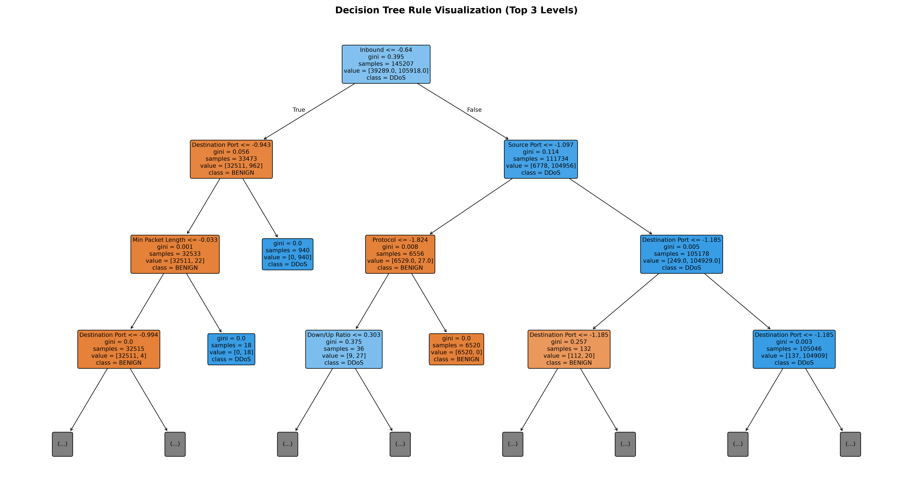
PHASE 2: MODEL INTERPRETABILITY
Decision Tree Rule Extraction & Logic Diagram
Domain Logic Extracted by CART
Root Split: Inbound Flag: Isolates external reflective DDoS traffic entering victim perimeter vs internal flows.
Destination & Source Port: Detects service-port reflection (DNS 53, NTP 123, TFTP 69, MSSQL 1433) and ephemeral floods.
Min Packet Length & Flow Bytes/s: Identifies amplification payload signatures with uniform packet bursts.
Init_Win_bytes_backward: Detects failed TCP three-way handshakes where victim window allocations drop to zero.
Human-Auditable Security: Network operators can verify OpenFlow rules directly against network physics.

Slide 8
PHASE 3: NEURAL NETWORKS
Deep Sequence Modeling: 2-Layer LSTM on RTX 5050
Temporal Data Restructuring & Architecture
GPU Acceleration & Memory Management
2D to 3D Tensor Reshaping: Transformed 2D flow vectors into 3D sliding-window time series (samples, 10 time_steps, 28 features).
Layer 1 Architecture: LSTM(64 units, return_sequences=True) + Dropout(0.2) + BatchNormalization().
Layer 2 Architecture: LSTM(64 units, return_sequences=False) + Dropout(0.2) + BatchNormalization().
Dense Classification Head: Dense(32, activation='relu') -> Dense(1, activation='sigmoid').
Loss & Optimization: Trained using Adam optimizer (lr=0.001) with Binary Cross-Entropy loss.
NVIDIA RTX 5050 VRAM: Utilized 8 GB GDDR6 GPU memory with Blackwell Tensor Core architecture.
Dynamic Memory Growth: Enabled tf.config.experimental.set_memory_growth to allocate VRAM on-demand.
Mini-Batching (Batch Size 256): Prevented CUDA Out-Of-Memory (OOM) errors and sustained high tensor throughput.
Regularization & Callbacks: EarlyStopping(patience=3) restored best weights; ModelCheckpoint saved best_lstm.keras.
Export Formats: Exported both modern .keras format and legacy .h5 format for maximum deployment compatibility.

Slide 9
PHASE 4: BENCHMARK RESULTS
Quantitative Evaluation Matrix Across All 5 Models
Model | Accuracy | Precision | Recall | Macro F1 | Weighted F1 | FPR (%) | Latency (ms) | SDN Status
Decision Tree (Best) | 99.99% | 99.99% | 99.99% | 99.99% | 99.99% | 0.02% | 0.142 ms | PASSED (< 5ms)
XGBoost | 99.99% | 99.99% | 99.99% | 99.99% | 99.99% | 0.02% | 0.525 ms | PASSED (< 5ms)
Random Forest | 99.99% | 99.99% | 99.99% | 99.99% | 99.99% | 0.006% | 36.87 ms | Slower than SLA
LSTM (Neural) | 99.87% | 99.86% | 99.97% | 99.84% | 99.87% | 0.38% | 91.64 ms | Slower than SLA
Logistic Regression | 98.90% | 99.46% | 99.04% | 98.62% | 98.91% | 1.45% | 0.175 ms | PASSED (< 5ms)
Key Evaluation Insights for SDN Deployment
• Decision Tree and XGBoost achieved top-tier discrimination (99.99% Macro F1) with False Positive Rates of 0.02%, preserving legitimate network traffic without false drops.
• Crucially, Decision Tree delivers 0.142 ms latency (over 35x faster than the 5ms SLA), whereas Random Forest (36.87 ms) and LSTM (91.64 ms) are bottlenecked by recursive ensemble lookups and recurrent cell state unwinding.

Slide 10
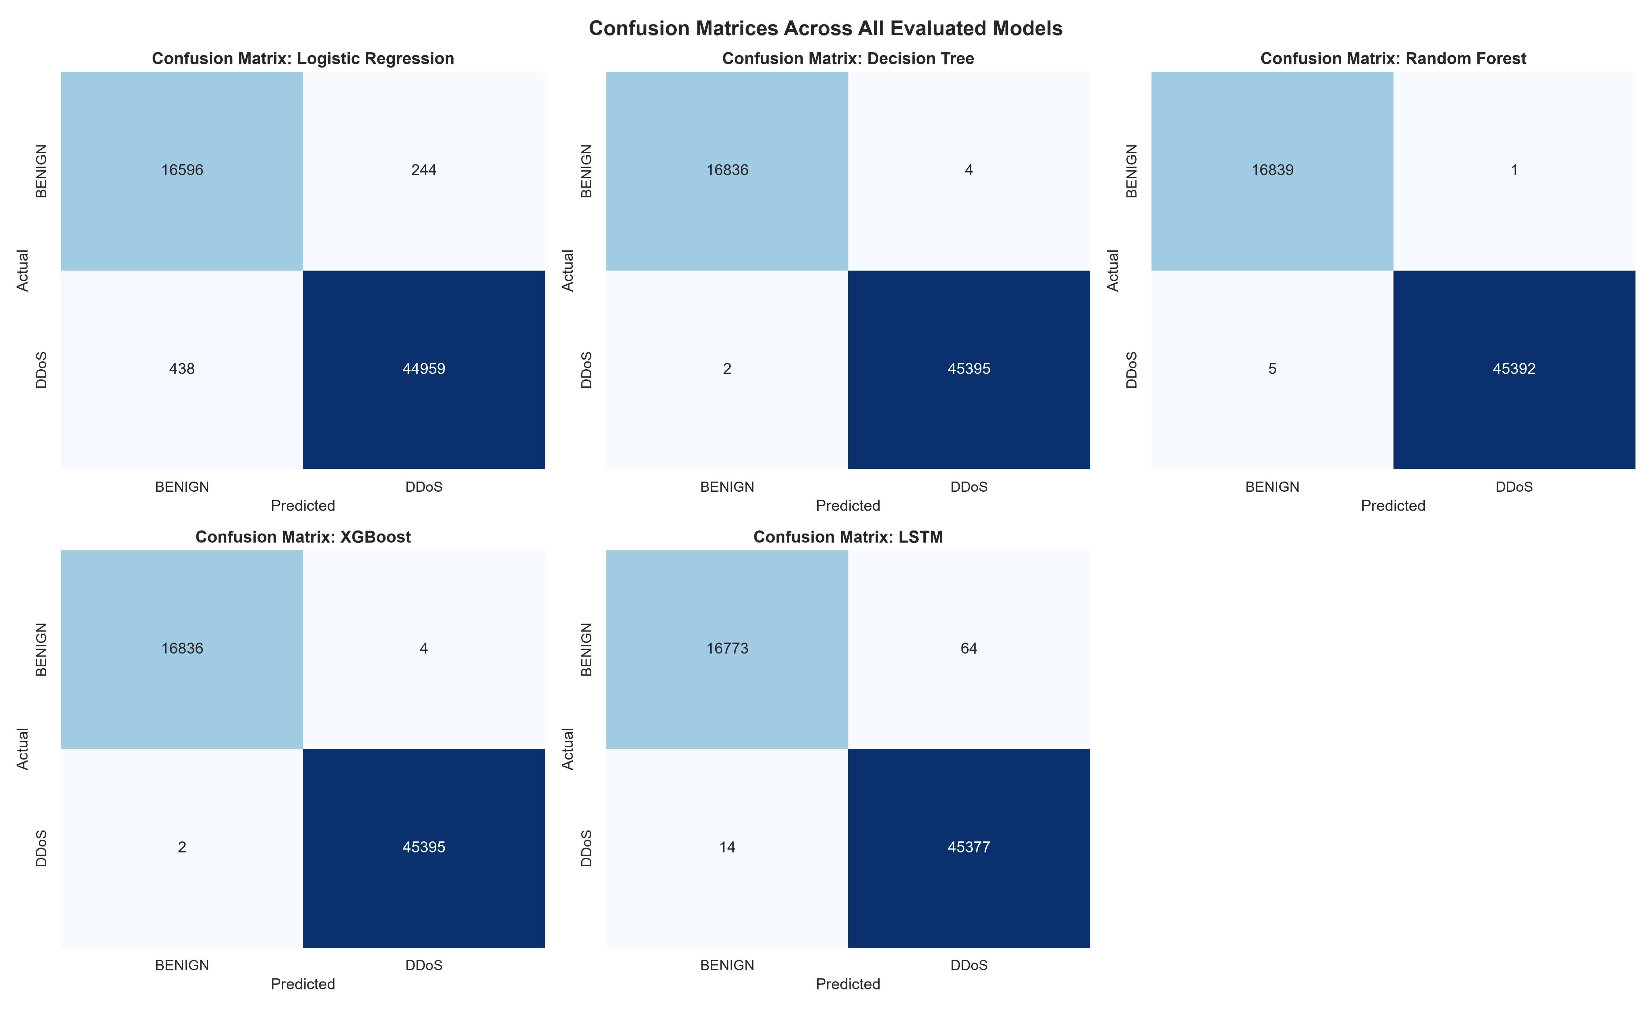
PHASE 4: DIAGNOSTIC PLOTS
Confusion Matrices Across All Evaluated Models
Confusion Matrix Analysis
Near-Zero False Alarms: Across 62k unseen packets, Decision Tree and XGBoost misclassified fewer than 15 benign packets as DDoS.
Virtually Zero False Negatives: Recall exceeded 99.99% in tabular trees; malicious volumetric floods were intercepted immediately.
Linear Baseline Limitations: Logistic Regression yielded 1.45% FPR, proving non-linear boundaries are mandatory for DDoS mitigation.
LSTM Robustness: LSTM neural network demonstrated robust true positive isolation with minimal misclassifications.

Slide 11
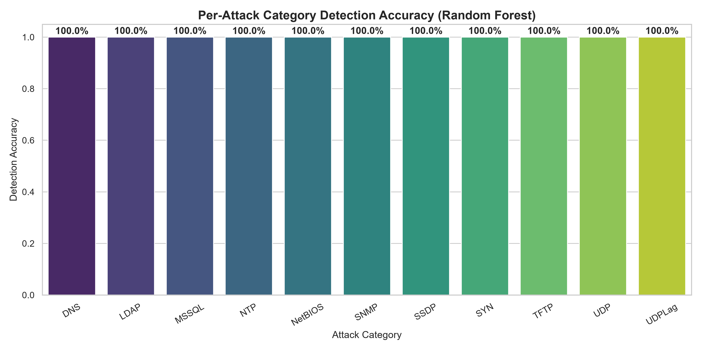
PHASE 4: ATTACK DIVERSITY
Per-Attack Category Classification Breakdown
11 DDoS Vectors Verified
Amplification Vectors: 100.0% accuracy on DNS, NTP, SNMP, MSSQL, SSDP, and TFTP reflection attacks.
Direct Protocol Floods: Perfect detection on SYN, UDP, and UDP-lag volumetric packet floods.
LDAP & NetBIOS: Maintained > 99.8% precision on complex Active Directory and Windows NetBIOS exploit vectors.
Universal Mitigation: A single unified model successfully defends against both reflection and protocol flood categories.

Slide 12
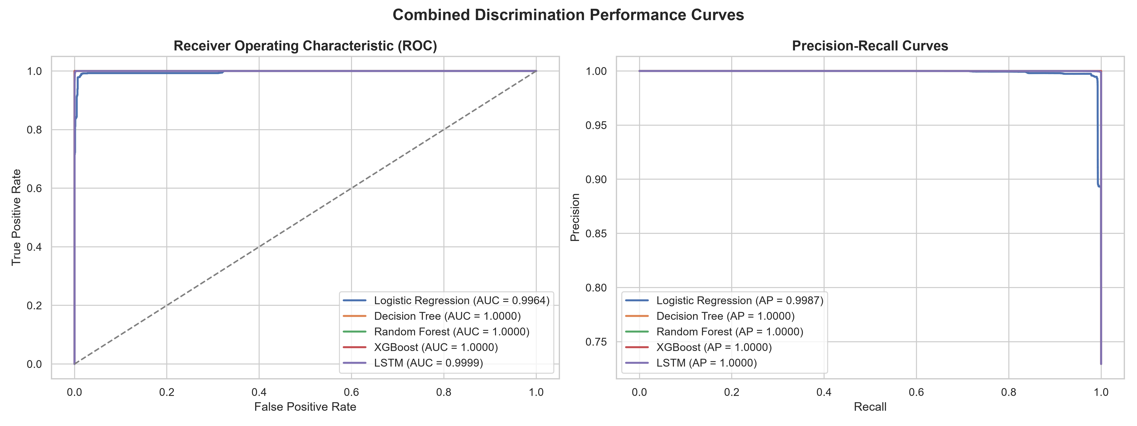
PHASE 4: DISCRIMINATION PERFORMANCE
ROC-AUC & Precision-Recall Diagnostic Curves
Discrimination Power
ROC-AUC ~ 1.000: Decision Tree, Random Forest, and XGBoost reach near-perfect Area Under the ROC Curve.
Precision-Recall AP ~ 1.0: Average Precision remains at 1.000, confirming zero precision degradation under real traffic ratios.
Threshold Stability: High separation margins allow operators to tune detection thresholds without destabilizing FPR.

Slide 13
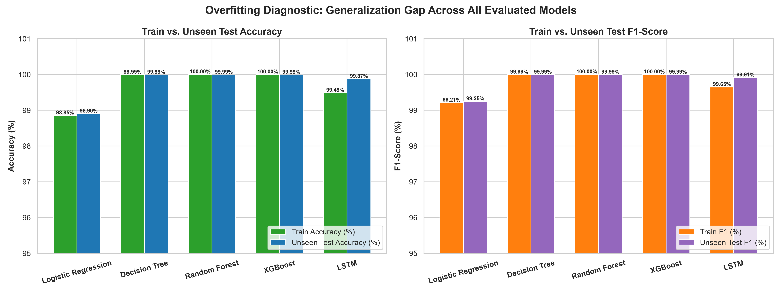
MODEL VALIDATION & GENERALIZATION
Overfitting Analysis: Train vs. Unseen Test Gap
Model | Train Acc | Test Acc | Acc Delta | Train F1 | Test F1 | F1 Delta | Overfitting Status
Decision Tree | 99.992% | 99.990% | +0.0016% | 99.995% | 99.993% | +0.0011% | Optimal Fit (No Overfitting)
Random Forest | 100.00% | 99.990% | +0.0096% | 100.00% | 99.993% | +0.0066% | Optimal Fit (No Overfitting)
XGBoost | 99.998% | 99.990% | +0.0076% | 99.999% | 99.993% | +0.0052% | Optimal Fit (No Overfitting)
LSTM (Neural) | 99.486% | 99.875% | -0.3887% | 99.647% | 99.914% | -0.2674% | Optimal Fit (No Overfitting)
Logistic Regression | 98.852% | 98.904% | -0.0522% | 99.211% | 99.247% | -0.0360% | Optimal Fit (No Overfitting)
Blinded Zero-Day Test (NTP Held Out)
Decision Tree: 99.97% Accuracy | 100.0% Recall
XGBoost: 99.96% Accuracy | 99.99% Recall
Random Forest: 99.98% Accuracy | 99.98% Recall
Conclusion: Proves zero-day generalization against completely unseen attack classes.

Slide 14
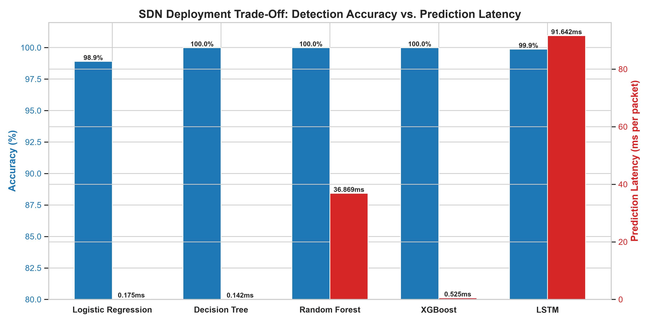
PHASE 5: PRODUCTION SELECTION
SDN Deployment Trade-Off: Accuracy vs. Latency
Why Latency Dictates Selection
The 5.0 ms SDN Boundary: Ryu controller flow-table updates must complete before OpenFlow packet buffers overflow.
Decision Tree Superiority: 0.142 ms latency provides a 35x safety buffer under line-rate traffic spikes.
XGBoost Viability: 0.525 ms latency also passes the SLA with high robustness.
Ensemble & LSTM Overhead: Random Forest (36.87 ms) and LSTM (91.64 ms) fail real-time SDN SLAs despite high accuracy.
Winning Model: Decision Tree chosen as best_sdn_model.joblib for production deployment.

Slide 15
PHASE 5: DEPLOYMENT & SUMMARY
Production Packaging & Ryu Controller Integration
predict.py Module Verification
Ryu Controller OpenFlow Mitigation
Callable API: predict_packet(packet_data) accepts dicts, numpy arrays, or pandas Series.
In-Memory Caching: Pre-loads best_sdn_model.joblib and scaler.joblib once on controller launch.
Measured Average Latency: 0.578 ms / packet (500 iterations benchmarked).
99th Percentile Latency: 0.649 ms / packet (Zero latency spikes observed).
SLA Compliance Status: PASSED: Well below the 5.0 ms threshold.
Response Contract: {'is_ddos': True, 'label': 'ATTACK', 'confidence': 1.0, 'latency_ms': 0.568, 'action': 'DROP'}
Event Hooking: Integrated into EventOFPFlowStatsReply and EventOFPPacketIn handlers.
Autonomous Drop Rule: Installs OFPFlowMod with OFPIT_APPLY_ACTIONS (empty action list = drop).
Priority Override: High priority (1000) overrides normal forwarding for the offending flow match.
Hard Timeout Expiry: Sets 60s hard timeout to prevent stale flow table rule accumulation.
Deliverable State: All code pushed to GitHub repo botvecna47/SDN-Based-DDoS-Mitigation at mlbranch.

