Slide 1


University of Mysore
Department of Studies in Computer Science
Mysore - 570006
PRESENTATION OF END-OF-CYCLE PROJECT FOR THE AWARD OF THE
MASTER OF SCIENCE IN COMPUTER SCIENCE
Topic :
« Developing an Efficient Prediction Model of Heart Disease using Machine Learning Techniques»
Presented By :
Mr. Boubacar Boureima Mohamed
Reg. No. 20MSC10
Internal Guide :
Chairman :
Smt. L Hamsaveni
Associate Professor,
DoS in Computer Science,
University of Mysore
Dr. D S Guru
Professor & Chairman,
DoS in Computer Science,
University of Mysore
26 / 08 / 2022

Slide 2

Introduction
I
Preliminary Study
Presentation of the project
Plan
II
Analysis & Design
Analysis and Design
III
Demo
Presentation of the system
Conclusion
2/22

Slide 3
Introduction
.
Introduction
In today’s world, cardiovascular disease is the leading cause of death. Heart disease prediction is a critical challenge in the medical data processing. The emergence of machine learning techniques has demonstrated their effectiveness in disease prediction from massive amounts of healthcare data.
Heart disease is difficult to recognize due to a variety of risk factors such as high blood pressure, cholesterol, and abnormal pulse rate. Because of the disease’s complexity, it must be handled with care.
This project analyses the algorithms and methods used to implement prediction of heart disease. It is directed towards machine learning and also to provide a detailed analysis of heart disease risk based on several factors that may have a direct impact on cardiovascular health.
Part I
Part II
Part III
Conclusion
3/22
HEART DISEASE PREDICTION SYSTEM
Notes:
L’évolution de la nouvelle technologie de l’information et de la communication contribue au développement de plusieurs domaines grâce à ses applications variées en industrie, communication, santé… etc.
L’automatisation est donc le phénomène le plus important de notre époque . C’est ainsi que, dans le cadre de notre formation comme l’imposent les règles de notre école (IAI-Niger), la fin de la 3ème année du cycle des Analystes Programmeurs est sanctionnée par un stage pratique d’au moins trois (3) mois en entreprise.
C’est dans cette optique que nous avons eu la chance d’effectuer notre stage à SYNETCOM et qu’il nous a été proposé comme thème de projet de fin d’études la « Conception d’une plateforme web de gestion de don de sang ».

Slide 4
Introduction
I
Preliminary Study
Presentation of the project
Plan
4/22

Slide 5
Preliminary Study
I. Presentation of the project
Introduction
.
Proposed System
.
Part I
From studying different algorithms to make re-optimization to the existing system to find better results, researchers have gone through many different ways. The observable factor is that although the accuracy has been quite good. However, domain specific issues of healthcare are still to be resolved, and to get better accuracy of heart disease prediction, precisely work shall be done.
Hence, developing an efficient prediction model of heart disease based machine learning techniques at low cost to predict cardiovascular disease. The proposed system not only performs the task of disease prediction but also identifies and classifies heart disease patient and non-heart disease patient automatically along with the reducing of the cost to early detect heart disease using machine learning techniques. After analysis the various categories data, the system will predict the risk of heart disease with higher accuracy.
Part II
Part III
Conclusion
5/22
HEART DISEASE PREDICTION SYSTEM

Slide 6
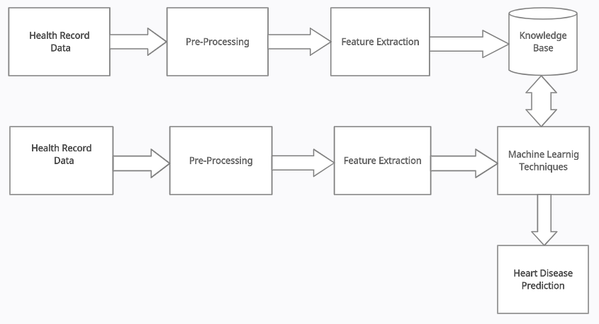
Preliminary Study
I. Presentation of the project
Introduction
.
Architecture of the System
.
Part I
Part II
Part III
#Training Phase
Conclusion
#Testing Phase
6/22
HEART DISEASE PREDICTION SYSTEM

Slide 7
Introduction
I
Preliminary Study
Presentation of the project
Plan
II
Analysis & Design
Analysis and Design
7/22

Slide 8
Analysis and Design
I. Analysis
Introduction
.
System Analysis
Part I
Systems analysis is a process of collecting factual data, understand the processes involved, identifying problems and recommending feasible suggestions for improving the system functioning.
The major objectives of systems analysis are to find answers for each business process: What is being done, How is it being done, Who is doing it, When is he doing it, Why is it being done and How can it be improved?
The result of this process is a logical system design. Systems analysis is an iterative process that continues until a preferred and acceptable solution emerges.
.
Part II
Part III
Conclusion
8/22
HEART DISEASE PREDICTION SYSTEM

Slide 9
Analysis and Design
I. Analysis
Introduction
.
1
Dataset Collection
Part I
Data
Pre-Processing
.
Part II
2
Part III
Feature Extraction
Conclusion
3
4
Heart Disease Prediction
9/22
HEART DISEASE PREDICTION SYSTEM
Notes:
Le processus unifié ou unified process en anglais ou unfied software developpement process est une famille de méthode de développement de logiciel orienté objet

Slide 10

Analysis and Design
1
I. Analysis
Step 1
Dataset
Dataset Collection
Initially, we collect a dataset for our heart disease prediction system. After the collection of the dataset, we split the dataset into training data and testing data.
The training dataset is used for prediction model learning and testing data is used for evaluating the prediction model. For this project, 75% of training data is used and 25% of data is used for testing.
The dataset used for this project is Heart Disease Cleveland UCI. The dataset consists of 76 attributes; out of which, 14 attributes are used for the system.
10/22
HEART DISEASE PREDICTION SYSTEM
Notes:
Une personne du CTS accueille le futur donneur, l’enregistre en lui attribuant un numéro unique qui permettra de l’identifier et suivre la chaîne entière du don et lui remet un questionnaire de santé à remplir. Il s’agit d’un document de préparation à l’entretien médical.

Slide 11
Analysis and Design
2
I. Analysis
Step 2
Pre-Processing
Data Pre-Processing
Data pre-processing is an important step for the creation of a machine learning model. Initially, data may not be clean or in the required format for the model which can cause misleading outcomes.
In pre-processing of data, we transform data into our required format. It is used to deal with noises, duplicates, and missing values of the dataset.
Data pre-processing has the activities like importing datasets, splitting datasets, attribute scaling, etc. Preprocessing of data is required for improving the accuracy of the model.
11/22
HEART DISEASE PREDICTION SYSTEM
Notes:
Le médecin procède à un examen clinique : il consiste en la prise de tension artérielle, de température, du poids et étudie le questionnaire du donneur . Cet examen est obligatoire avant chaque don de sang. À l'issue de l'entretien, le donneur et le médecin signent conjointement le questionnaire confirmant que le donneur :
A donné son consentement pour la poursuite du processus de don.
Affirme que tous les renseignements qu'il a fournis sont à sa connaissance exacts.
Affirme que le donneur est médicalement apte au don.

Slide 12
Analysis and Design
3
I. Analysis
Step 3
Feature Extraction
Feature Extraction
In machine learning, a feature is a separate assessable property or characteristic of a phenomenon being detected. Picking informative, perceptive and independent features is a vital step for effective algorithms in classification.
When the input data to an algorithm is too huge to be processed and it is suspected to be redundant. Then it can be converted into a reduced set of features the selected features are expected to contain the appropriate information from the input data, so that the desired task can be performed by using this reduced demonstration instead of the complete initial data.
12/22
HEART DISEASE PREDICTION SYSTEM
Notes:
Alors que le donneur est allongé sur le lit l’infirmière prépare le matériel stérile et à usage unique afin de prélever le sang.
Lorsque le volume prescrit est prélevé, l'automate interrompe l'écoulement et son alarme en informe l'infirmière.
Elle identifie la poche et les tubes avec le numéro de don du donneur.

Slide 13
Analysis and Design
4
I. Analysis
Step 4
Prediction
Heart Disease Prediction
Once you have gone through collecting data, preparing the data, selecting the model, and training and evaluating the model and tuning the attributes.
It is now time to use various machine learning algorithms like Support Vector Machine, Logistic Regression, Decision Tree, and Random Forest for classification.
Comparative analysis is performed among algorithms and the algorithm that gives the highest accuracy is used for heart disease prediction.
13/22
HEART DISEASE PREDICTION SYSTEM
Notes:
Après le don, une collation est offerte au donneur pour une bonne récupération.
Ce moment agréable et important permet d'observer un court repos sous surveillance médicale.

Slide 14
Analysis and Design
II. Design
Introduction
.
System Design
Part I
System design is the process, which involves conceiving, planning and carrying out the plan by generating the necessary reports and inputs. In other words, design phase acts as a bridge between the software requirement specification and implementation phase, which satisfies those requirements. System Design is the transformation of the analysis model into a system design model.
The goal is to divide the problem into manageably small modules that can be solved separately, the different modules have to cooperate and communicate together to solve the problem. The complete project is broken down into different identifiable modules. Each module can be understood separately. All the modules at last are combined to get the solution of the complete system.
.
Part II
Part III
Conclusion
14/22
HEART DISEASE PREDICTION SYSTEM

Slide 15
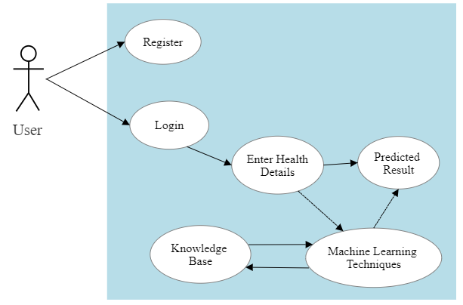
Analysis and Design
II. Design
Introduction
.
Use Case Diagram
Part I
.
Part II
Part III
Conclusion
15/22
HEART DISEASE PREDICTION SYSTEM

Slide 16
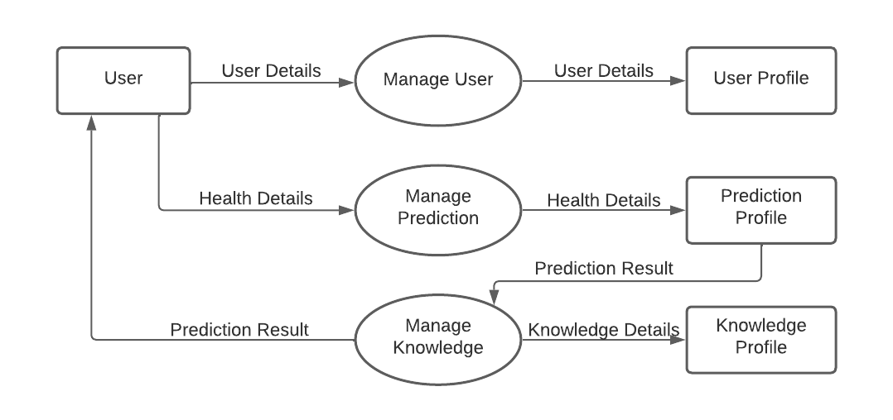
Analysis and Design
II. Design
Introduction
.
Data Flow Diagram
Part I
.
Part II
Part III
Conclusion
16/22
HEART DISEASE PREDICTION SYSTEM

Slide 17
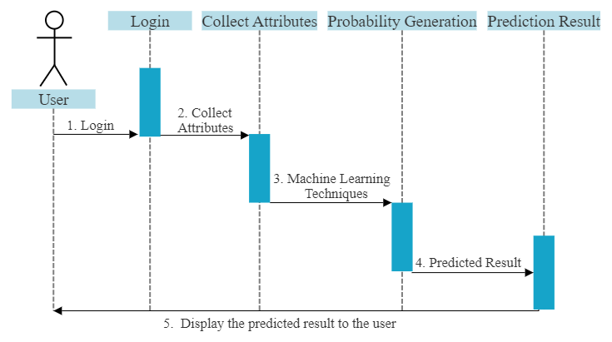
Analysis and Design
II. Design
Introduction
.
Sequence Diagram
Part I
.
Part II
Part III
Conclusion
17/22
HEART DISEASE PREDICTION SYSTEM

Slide 18
Introduction
I
Preliminary Study
Presentation of the project
Plan
II
Analysis & Design
Analysis and Design
III
Demo
Presentation of the system
18/22

Slide 19








Implementation
I. Software Specification
Introduction
.
Used Tools
Part I
Part II
.
Part III
Conclusion
19/22
HEART DISEASE PREDICTION SYSTEM
Notes:
Comme langage de programmation nous avons utiliser PHP pour produire nos page web dynamique, le Html pour la partie statique combiné au CSS pour une ergonomie plus que conviviale, jQuery ajax javascript pour rendre page le html dynamique, Bootstrap pour faire du responsive design Et enfin LARAVEL: qui est un Framework web open-source écrit en PHP respectant le principe modèle-vue-contrôleur et entièrement développé en programmation orientée objet.

Slide 20
Implementation
II. Presentation of the System
Introduction
.
Part I
Part II
Demo
.
Part III
Conclusion
20/22
HEART DISEASE PREDICTION SYSTEM

Slide 21
Conclusion
Introduction
.
In this project, we develop an inexpensive but flexible and scalable heart disease prediction system that integrates the capabilities of AI and Machine Learning Techniques for cardiovascular disease prediction of a patient’s health status.
Through experimental analysis, we have shown that the proposed framework is scalable and reliable with high classification accuracy. We believe that the proposed work can address the healthcare spending challenges by substantially reducing inefficiency and saving valuable lives.
We are currently implementing the proposed algorithm and testing it in a real-life environment.
Part I
Part II
.
Part III
Conclusion
21/22
HEART DISEASE PREDICTION SYSTEM

Slide 22

Thank You
For Your Attention !
22/22

Slide 23
University of Mysore
Department of Studies in Computer Science
Mysore - 570006
PRESENTATION OF END-OF-CYCLE PROJECT FOR THE AWARD OF THE
MASTER OF SCIENCE IN COMPUTER SCIENCE
Topic :
« Developing an Efficient Prediction Model of Heart Disease using Machine Learning Techniques»
Presented By :
Mr. Boubacar Boureima Mohamed
Reg. No. 20MSC10
Internal Guide :
Chairman :
Smt. L Hamsaveni
Associate Professor,
DoS in Computer Science,
University of Mysore
Dr. D S Guru
Professor & Chairman,
DoS in Computer Science,
University of Mysore
26 / 08 / 2022

