Slide 1
Housing – Ames Iowa
Matt Boubin

Slide 2

Outline
Introduction
  Background
  Hypothesis
Data EDA
  Outliers
  Years
  Numerical Data
Analysis
  Machine Learning Results
  Hyperparameters
Results

Slide 3
Introduction - Background
Housing Data describing market in Ames Iowa
2930 Observations
79 Variables
  23 Nominal
  23 Ordinal
  14 Discrete
  20 Continuous
Experiment Goals
Determine Accuracy of housing price prediction
Understand which variables contribute most to the prediction of housing prices

Slide 4
Introduction - Hypothesis
Most important features
  Lot Area
  Overall Quality
  Ground Living Area
  Neighborhood Location

Slide 5
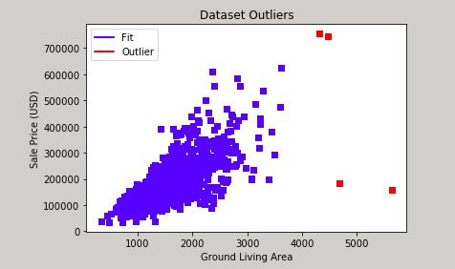
EDA - Outliers
Outliers are defined in dataset documentation
Consists of large homes in disrepair

Slide 6
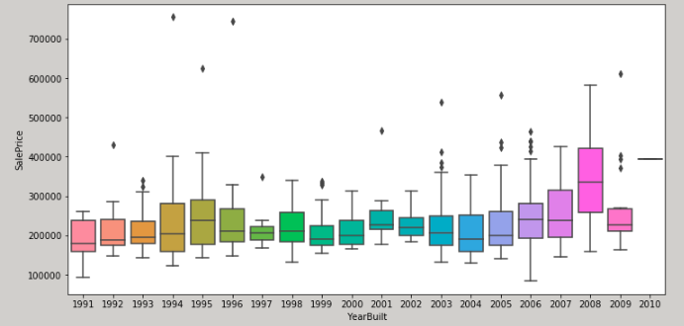
EDA – Years

Slide 7
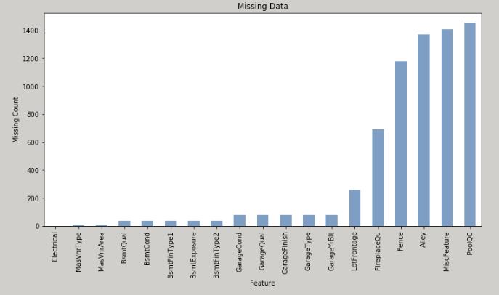
EDA – Missingness
Missing data
  19 variables
Most missing
  Pool Quality
  Fence
  Alley
  Misc Features

Slide 8
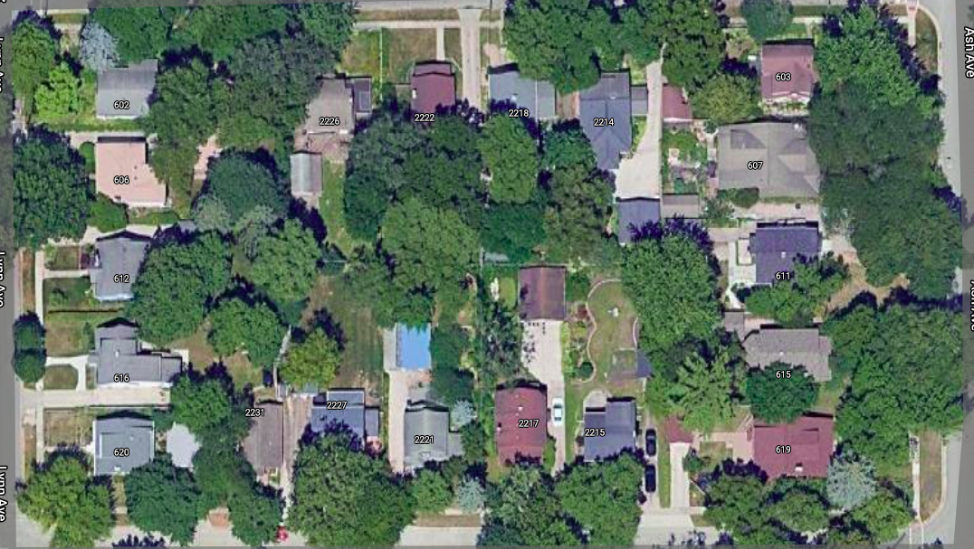
EDA – Data Imputation
Imputation by Neighborhood
  Garage Year Built
  Lot Frontage
Mean Imputation

Slide 9
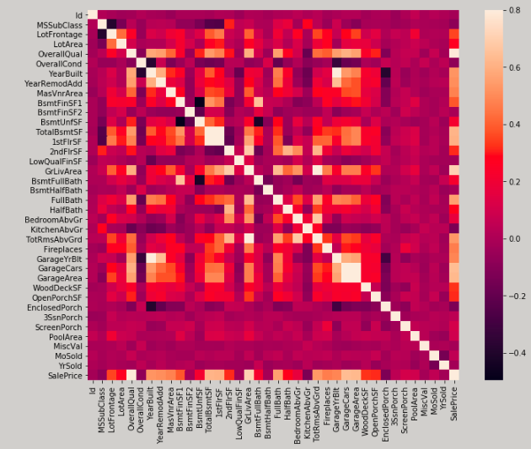
Data Preprocessing – Correlation
Highly Correlated Variables
  Garage Quality
  Garage Condition
Removed for Multiple Linear Regression

Slide 10
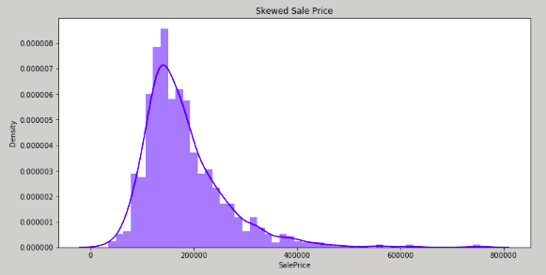
EDA Sale Density
Highly Correlated Variables
  Garage Quality
  Garage Condition
Removed for Multiple Linear Regression

