Slide 1
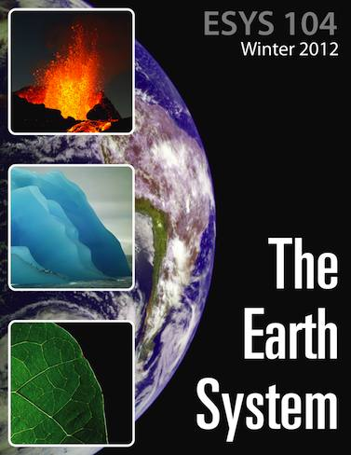
Earth Materials
Fall 2026
#3: Plate Tectonics

Slide 2
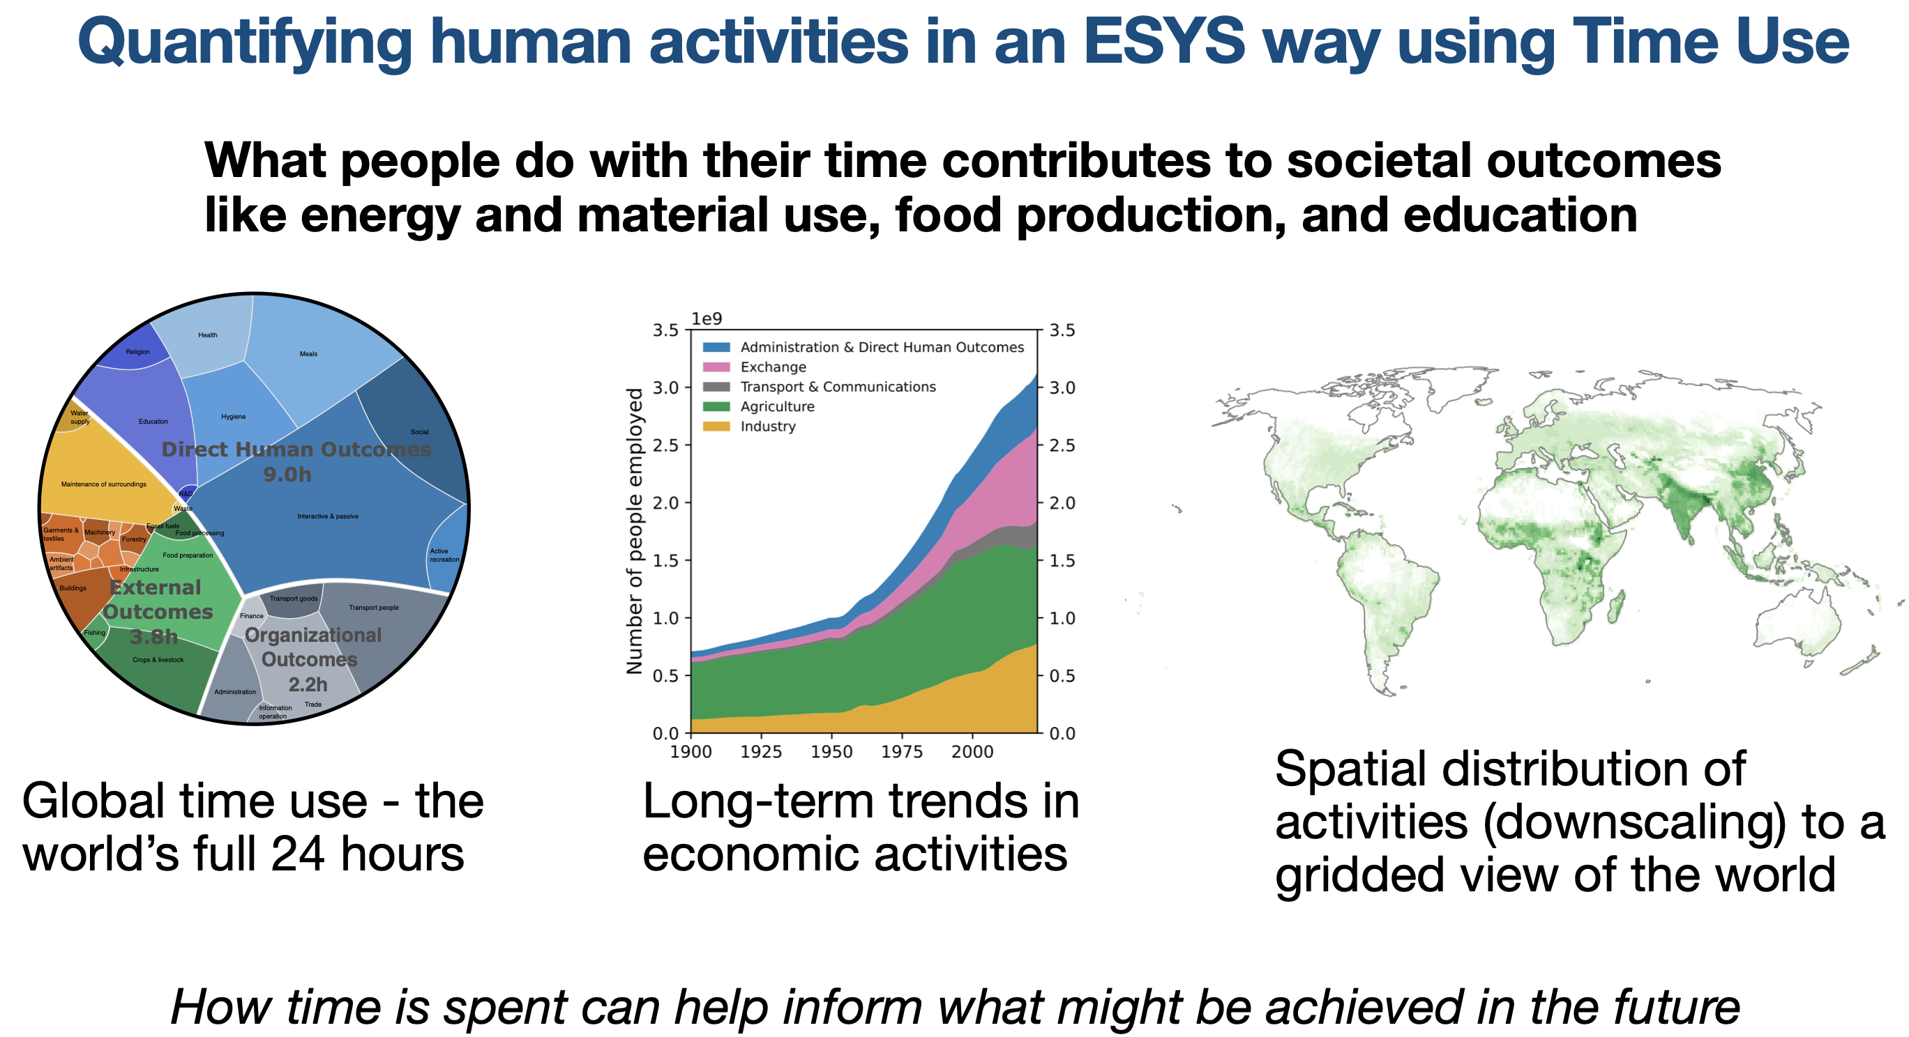
William Fajzel

Slide 3
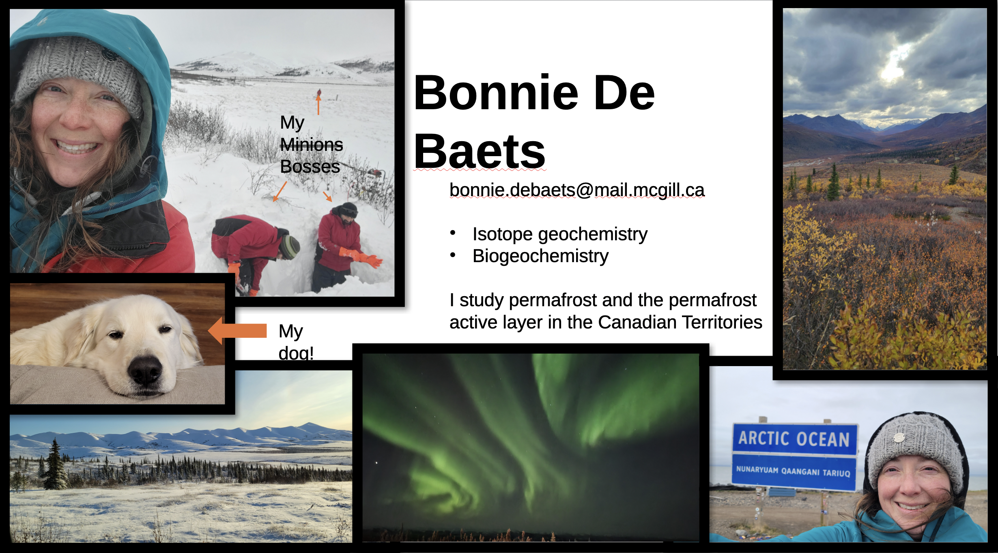

Slide 4
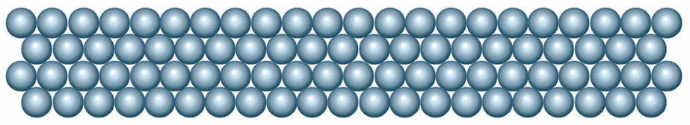
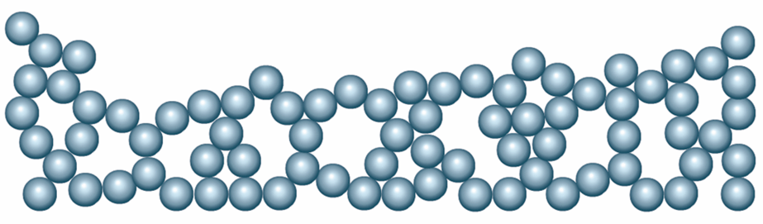
Crystals have ordered arrangements of atoms
Order
Disorder

Slide 5
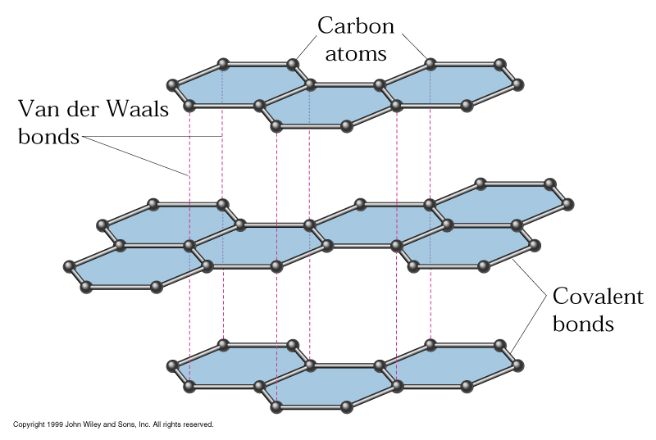
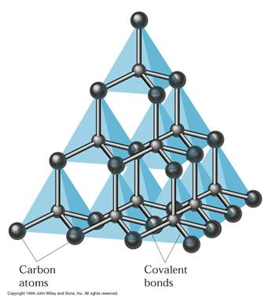
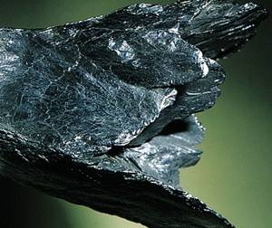
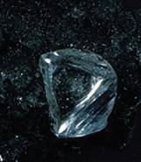
Same composition, different mineral

Slide 6
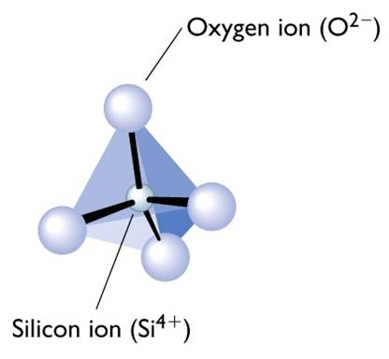
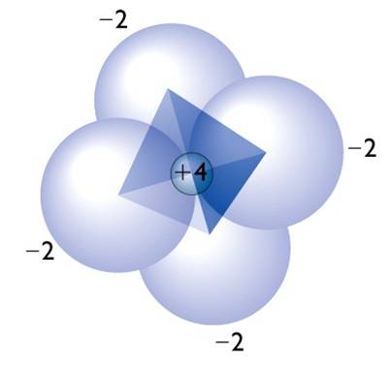
Silicate Minerals
Silicon and oxygen make up most rocks
45% of whole earth
75% of crust
These rocks are called silicates
Very strong covalent bonds
great material strength
difficult to weather

Slide 7
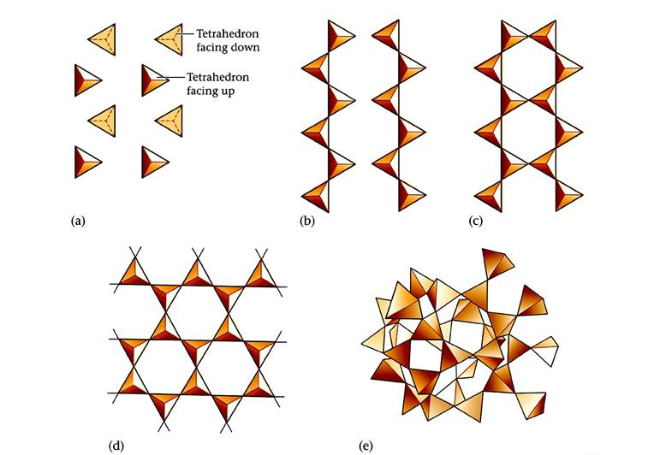
Silicate Structures
Olivine
Pyroxene
Amphibole
(Fe,Mg)Si₂O₄
(Fe,Mg)SiO₃
(Ca,Mg,Fe)₇Si₈O₂₂(OH)₂
Mica
Quartz, Feldspar
K(Al,Mg,Fe)₃Si₃O₁₀(OH)₂
SiO₂, (K,Na)AlSi₃O₈

Slide 8
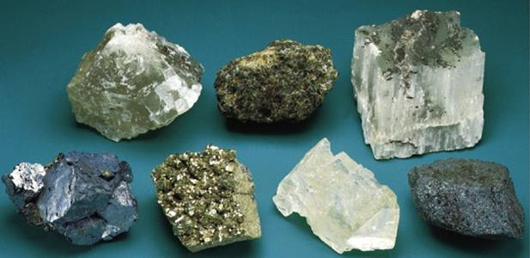
Non-Silicate Minerals
Salts
Oxides
Sulfates
Carbonates
Sulfides
Important mineral class for many reasons
Carbonates: 1/5 of world’s sedimentary rocks
Oxides: Major ores
Sulfides: Major ores
Phosphates: Biostructures (teeth), fertilizer
They have unique mechanical and physical properties

Slide 9
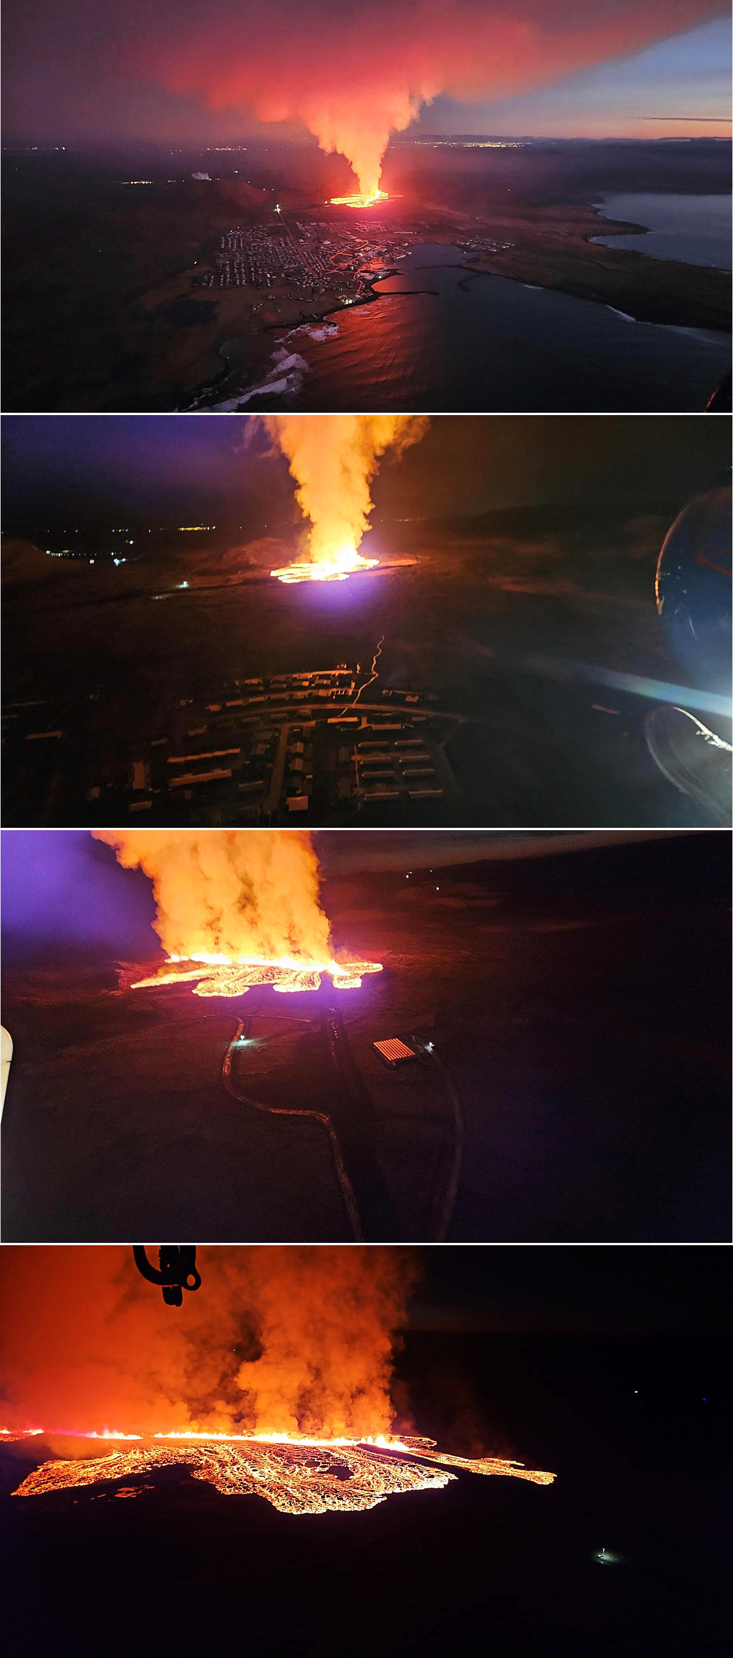
Iceland

Slide 10
Iceland

Slide 11
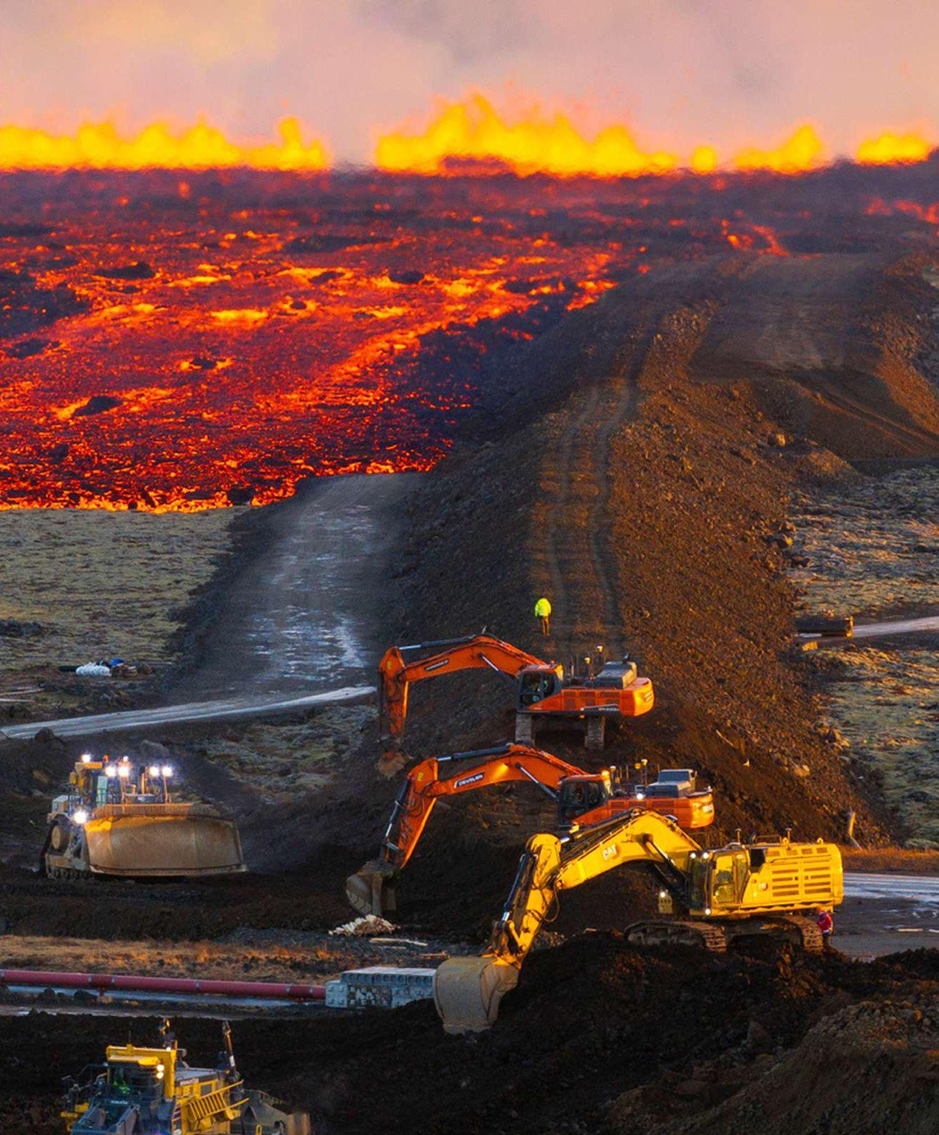
Iceland

Slide 12
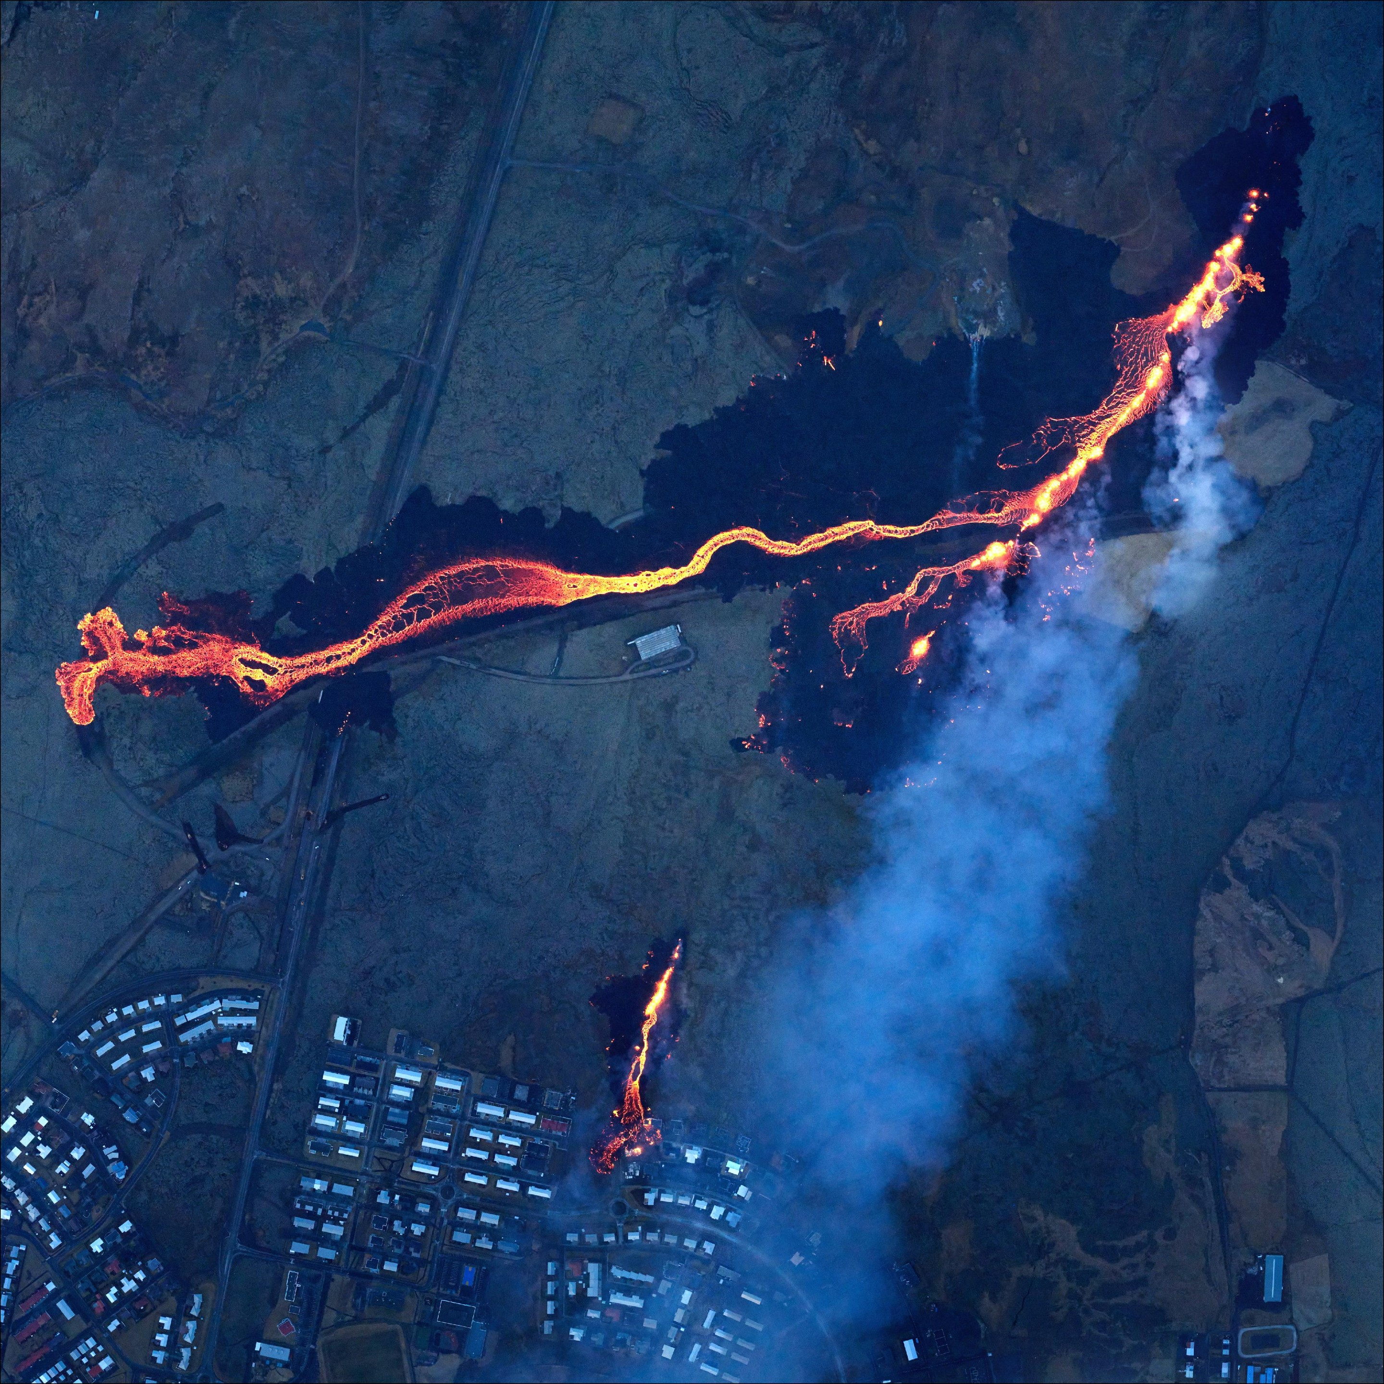
Iceland

Slide 13
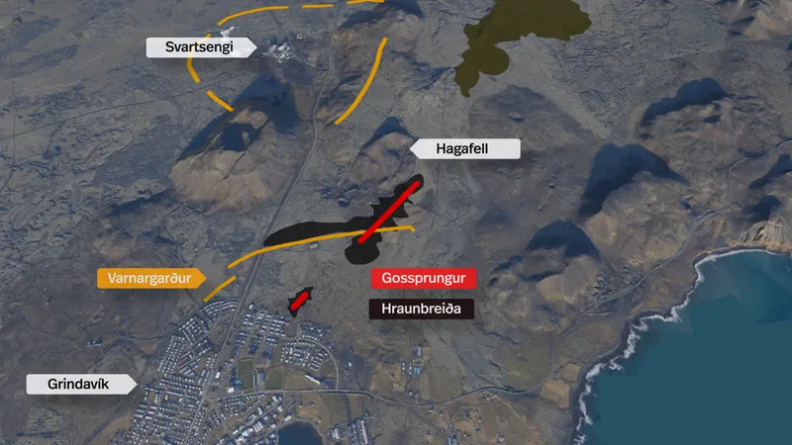
Iceland

Slide 14
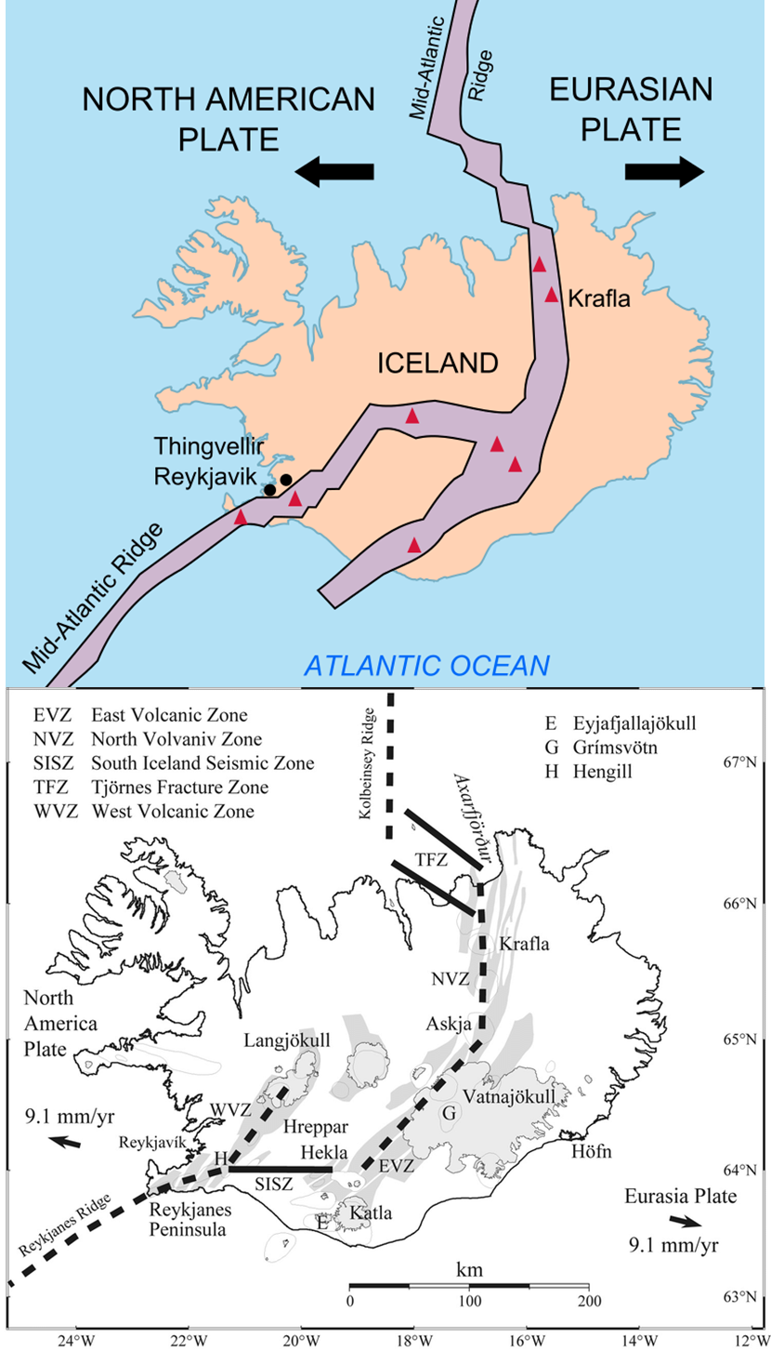
Iceland

Slide 15
Plate Tectonics
The paradigm of “How the Earth Works.”
Earth’s outer shell is broken into rigid plates that move.
Moving plates change the face of planet Earth.
A case study of a scientific revolution.
A powerful idea based on multiple lines of evidence.
It provides a unified mechanism explaining:
Igneous, sedimentary, and metamorphic rocks.
The distribution of earthquakes and volcanoes.
The origin of continents and ocean basins.
The distribution of fossil plants and animals.
The genesis and destruction of mountain chains.
Continental drift.

Slide 16
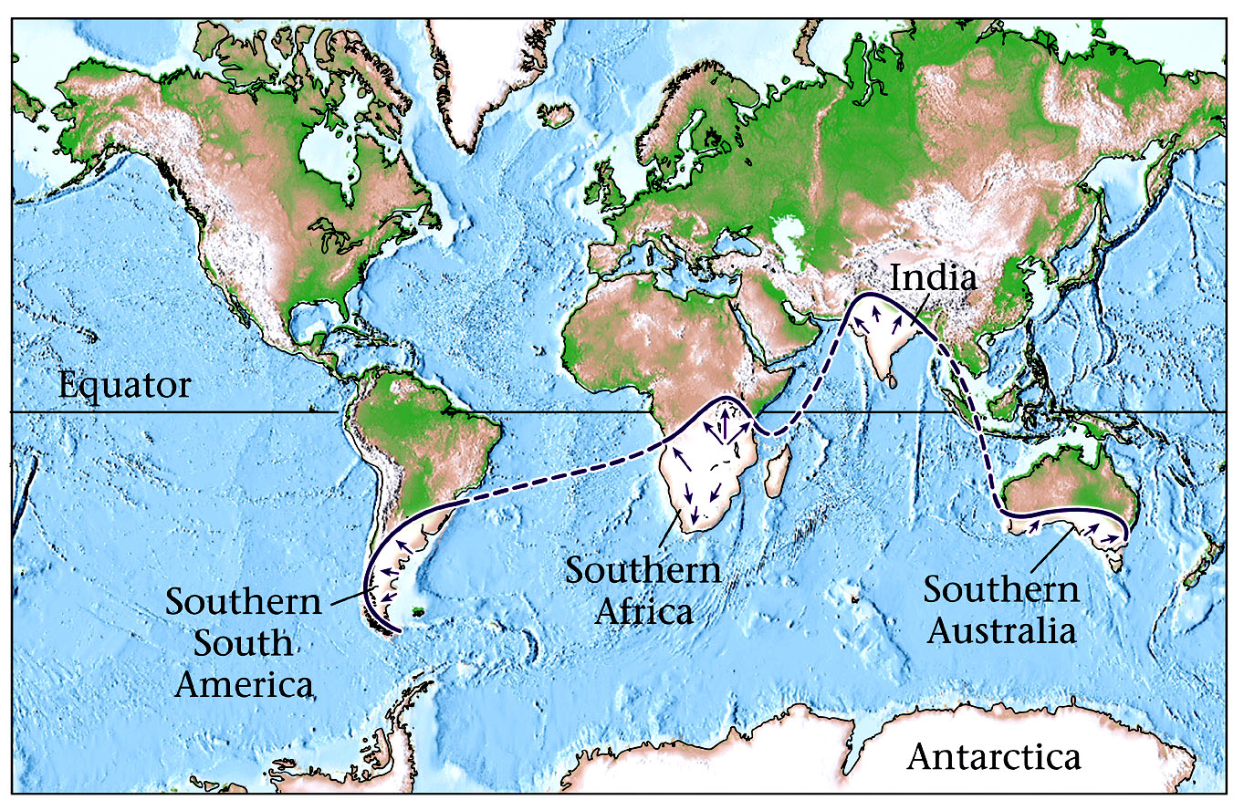
Glaciation 180 million years ago
W. W. Norton & Co.

Slide 17
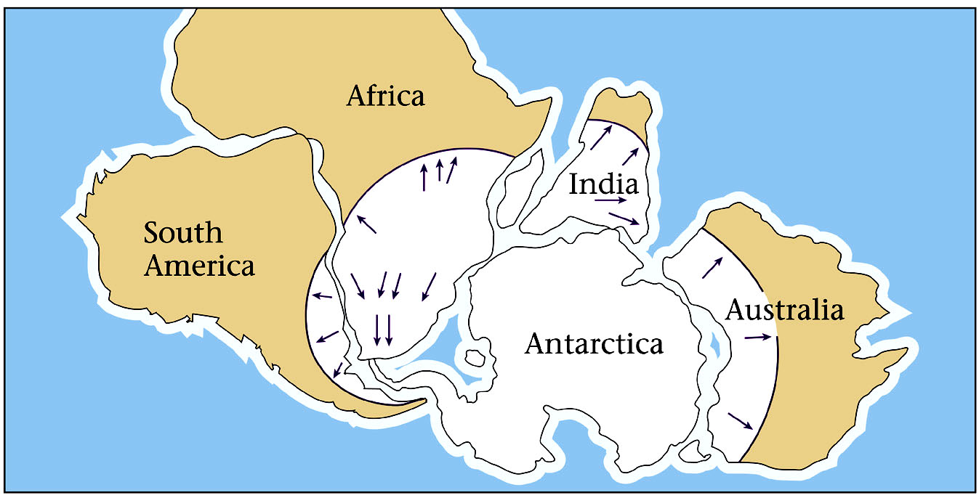
When the continents are joined…
W. W. Norton & Co.

Slide 18
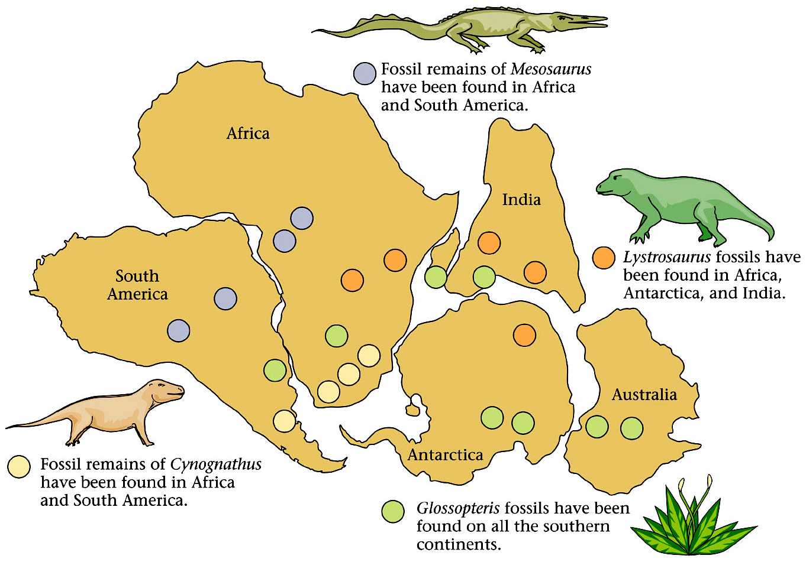
Continental Drift and the fossil record
W. W. Norton & Co.

Slide 19
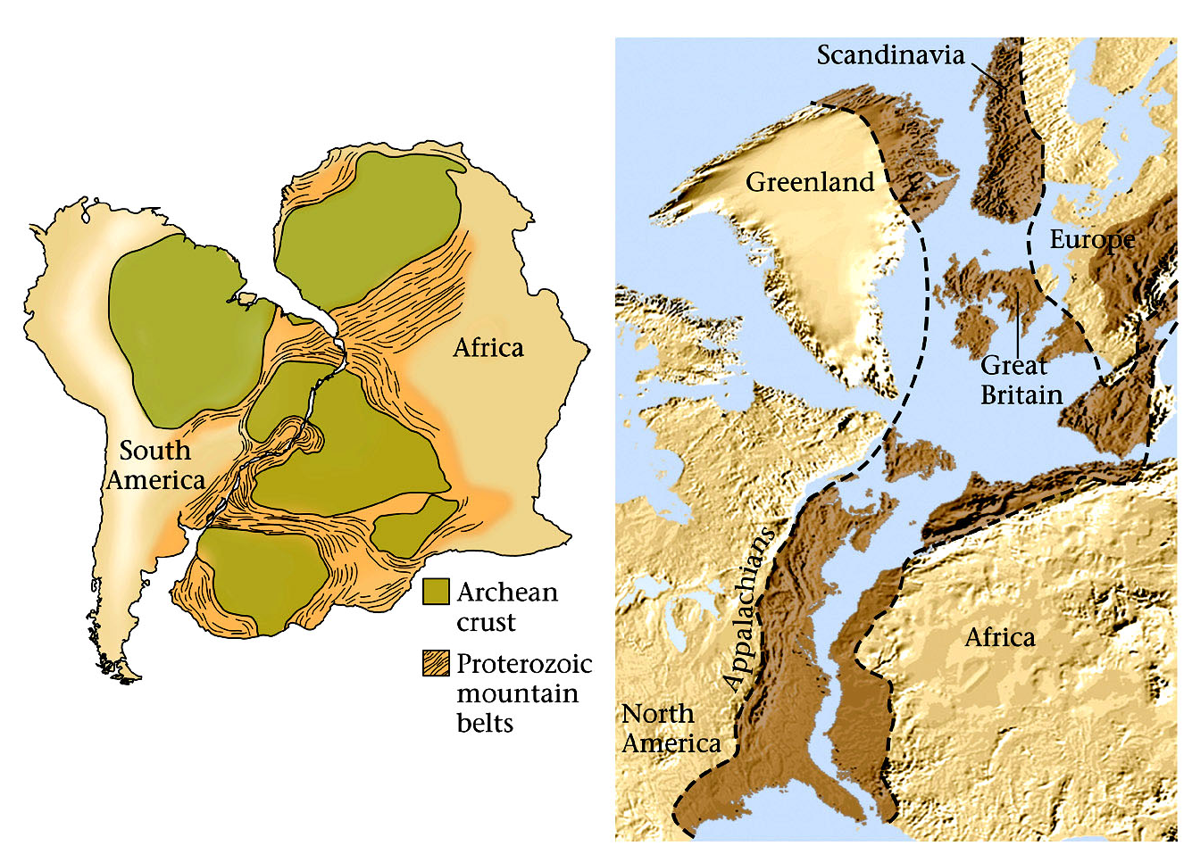
Mountain belts and Continental Drift
W. W. Norton & Co.

Slide 20
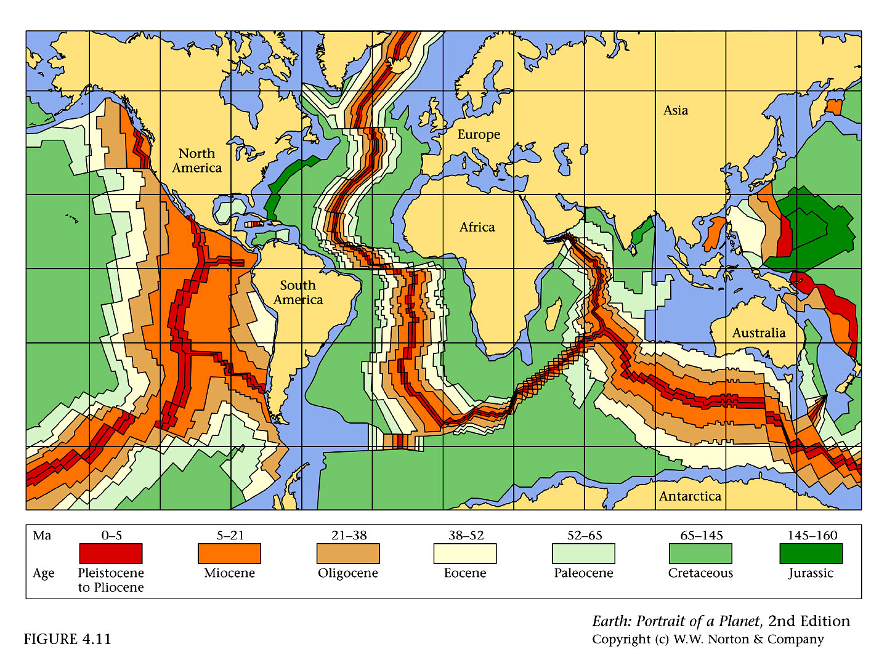
1960s: Ocean Crust Age

Slide 21
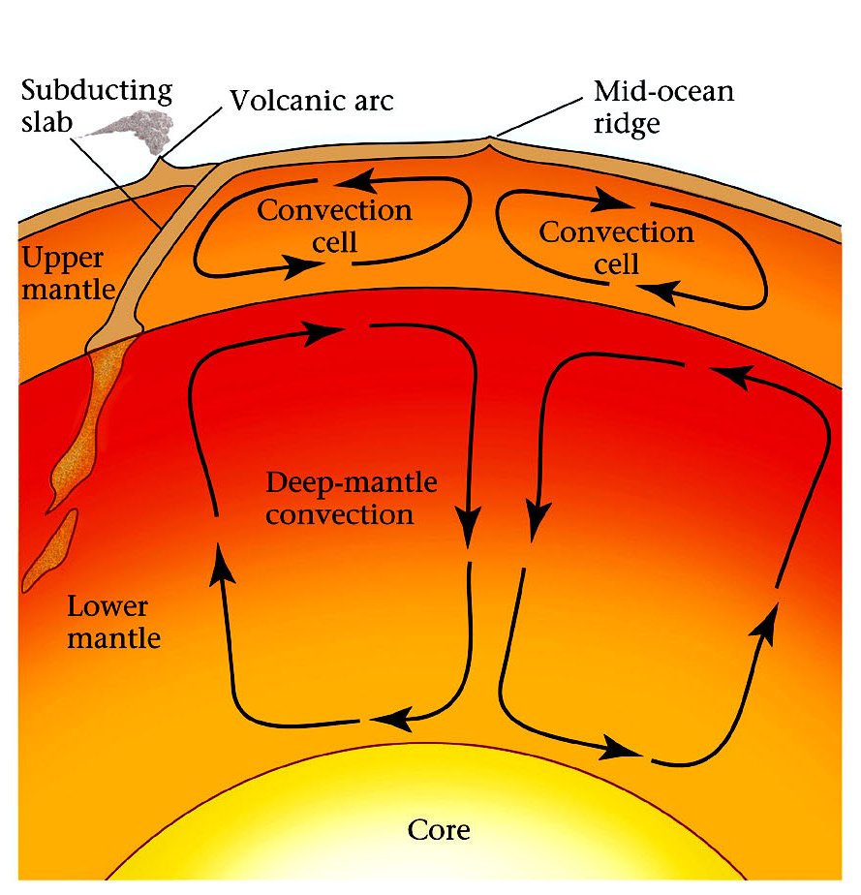
Mantle convection and Plate Tectonics

Slide 22
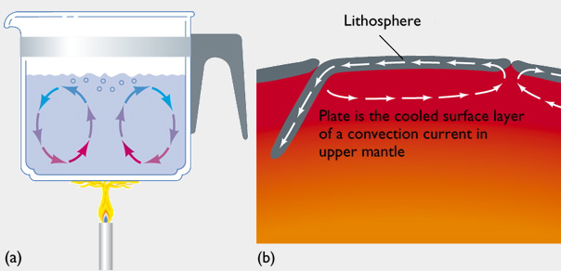
Thermal Convection
Convection takes hot material and moves (advects) it to a colder place. A pot on a stove is an example.
The convection that dives plate tectonics is different:
The mantle is solid
Heating is mostly from within (radioactive decay), not from below
The lithosphere controls the cooling and the geometry

Slide 23
Thermal Convection
The convection that dives plate tectonics is different:
The mantle is solid
Heating is mostly from within (radioactive decay), not from below
The lithosphere controls the cooling and the geometry

Slide 24
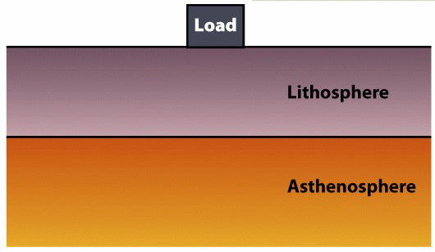
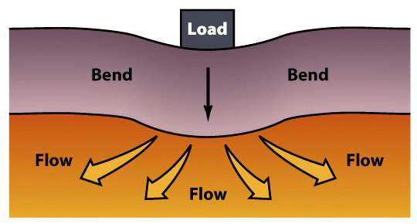
Lithosphere
Tectonic plates are fragments of lithosphere.
  Lithosphere is made of both crust and the upper mantle.
  The lithosphere is in motion over the asthenosphere.
Lithosphere bends elastically when loaded.
Asthenosphere flows plastically when loaded.

Slide 25
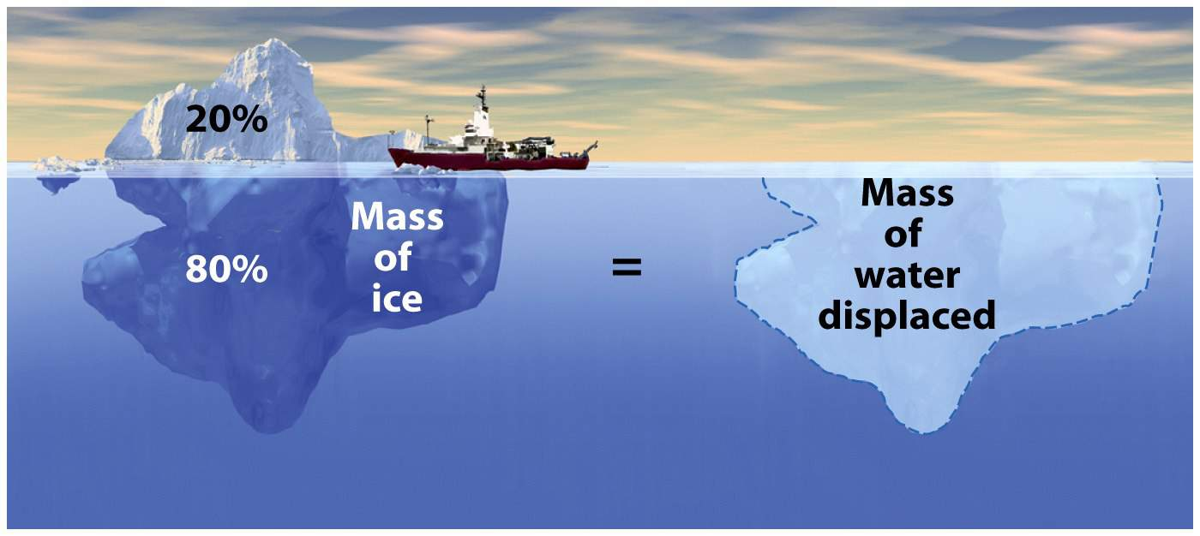
Archimedean Buoyancy
Floating solids displace water equal to their mass.
An iceberg “sinks” until the mass of water it displaces is equal to the total mass of the iceberg.
This concept applies to lithospheric plates.
  Continental plates – Float higher.
  Oceanic plates – Float lower.

Slide 26
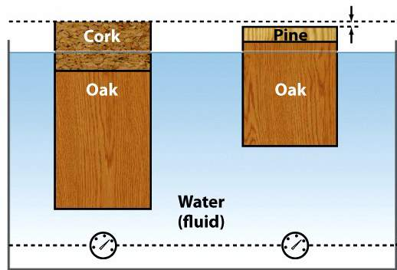
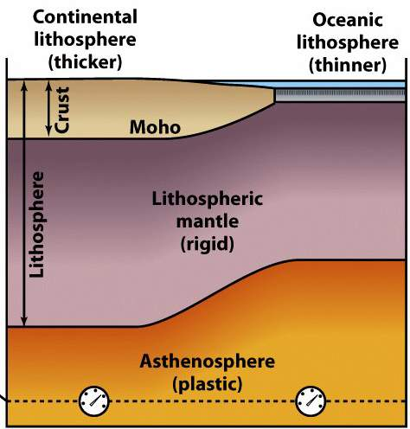
2 Types of Lithosphere
Continental ~ 150 km thick.
  Granitic crust.
    35-40 km thick.
    Less dense.
    More buoyant – Floats higher.
Oceanic ~ 7 to 100 km thick.
  Basaltic crust.
    7-10 km thick.
    More dense.
    Less buoyant – Floats lower.
    Subducts

Slide 27
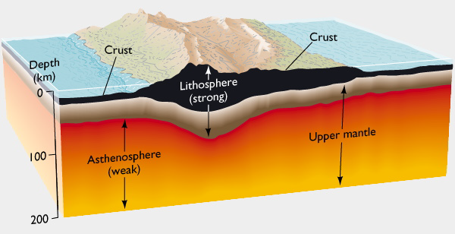
The Crust and Upper Mantle
Continental crust is buoyant; oceanic crust is more dense, and sinks back into the mantle.
The asthenosphere is the warmer, weak mantle that (although it’s solid) on a geological timescale flows like a liquid would.

Slide 28
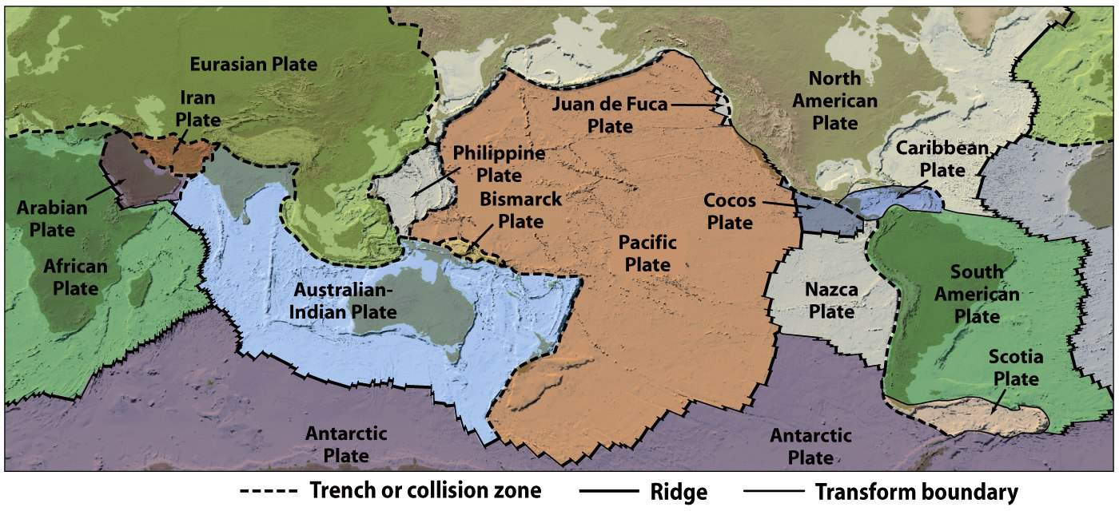
Plate Boundaries
Lithosphere is fragmented into ~ 20 tectonic plates.
Plates move continuously at a rate of 1 to 15 cm/yr.
  This motion appears to be slow on a human time scale.
  Yet it is extremely rapid on a geologic time scale.
Plates interact along their boundaries.

Slide 29
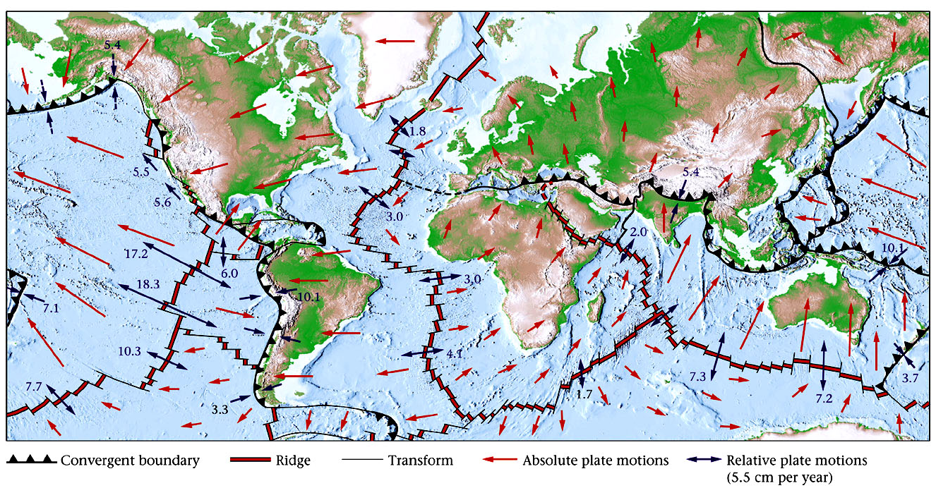
Rates of plate motion

Slide 30
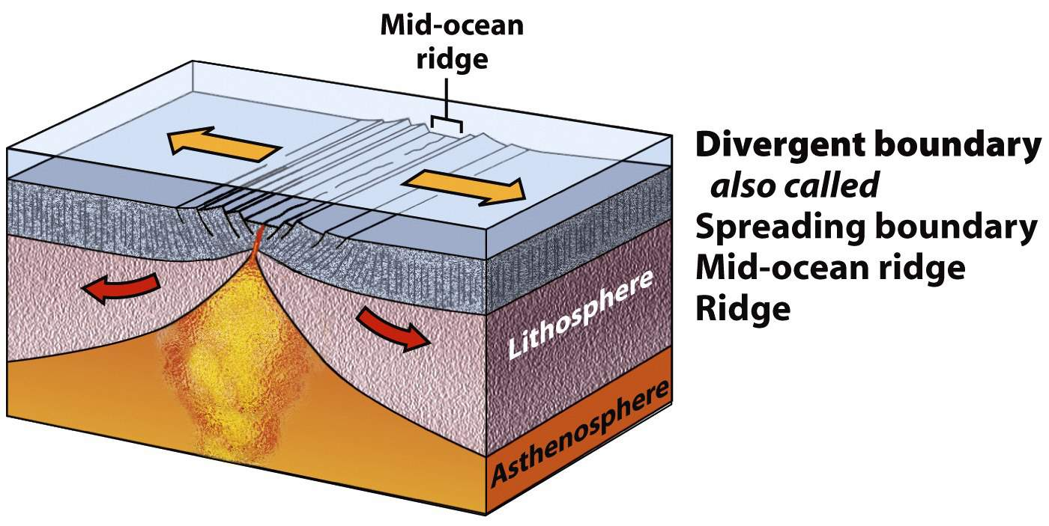
Plate Boundaries: 3 Types
Divergent – Tectonic plates move apart.

Slide 31
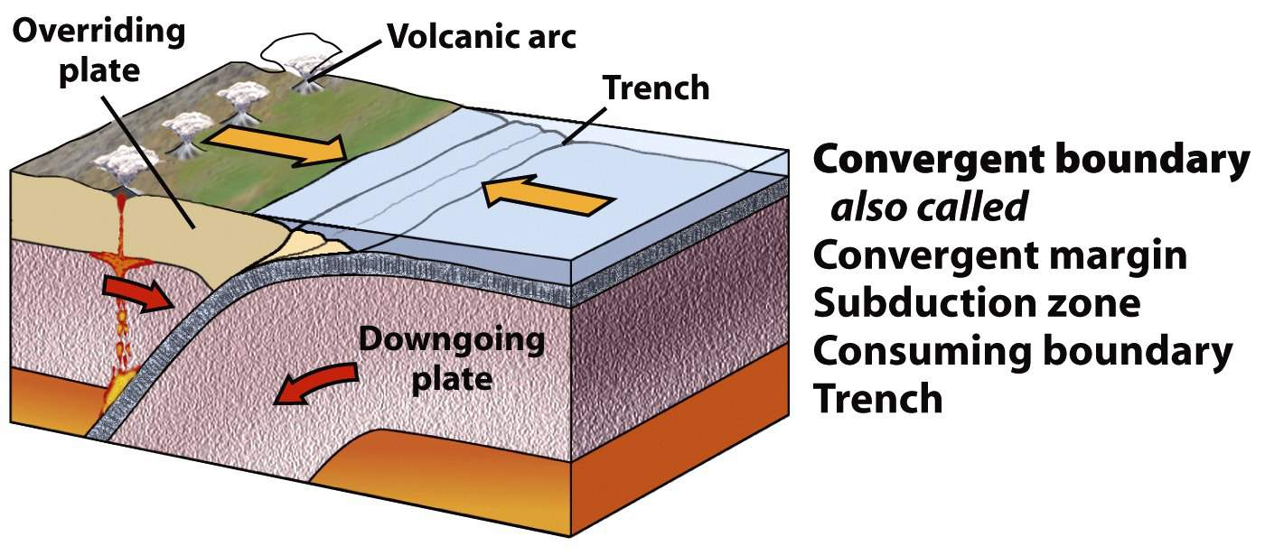
Plate Boundaries: 3 Types
Convergent – Tectonic plates move together.

Slide 32
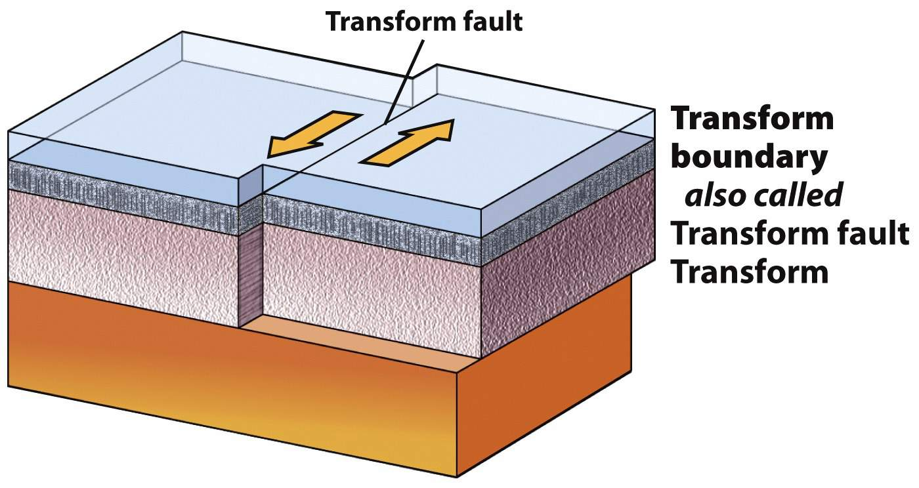
Plate Boundaries: 3 Types
Transform – Tectonic plates slide sideways.

Slide 33
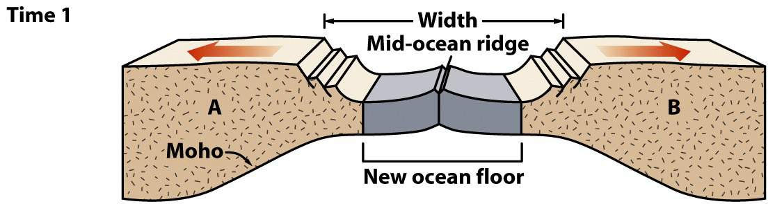
Divergent Boundaries
Sea-floor spreading progression.
  Early stage
    Rifting has progressed to mid-ocean ridge formation.
    Before substantial widening of the ocean.
    Forms a long, thin ocean basin with young oceanic crust.
  Example: The Red Sea
Note: This diagram only depicts the crust,
not the entire lithosphere.
Time 1

Slide 34
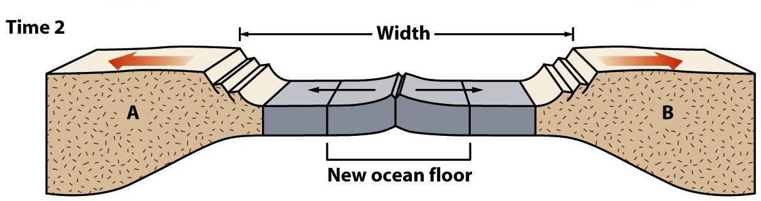
Divergent Boundaries
Sea-floor spreading progression.
  Mid-stage
    Ocean begins to widen.
    New seafloor is added at the mid-ocean ridge.
    Continents move farther apart.
  Example: Greenland and the North Atlantic
Note: This diagram only depicts the crust, not the entire lithosphere.
Time 2

Slide 35
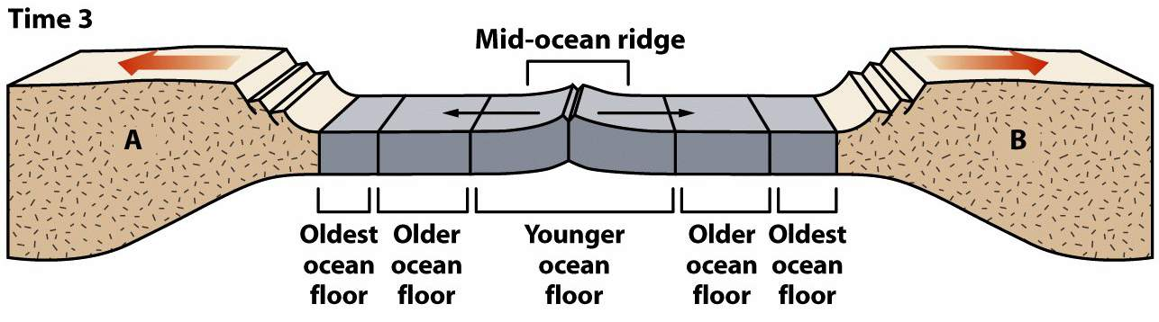
Divergent Boundaries
Sea-floor spreading progression.
  Late stage
    Mature, wide ocean basin.
    Linear increase in age with distance from central ridge.
    Edge of ocean basin - oldest; ridge proximal - youngest.
  Example: The Atlantic Ocean
Note: This diagram only depicts the crust, not the entire lithosphere.
Time 3

Slide 36
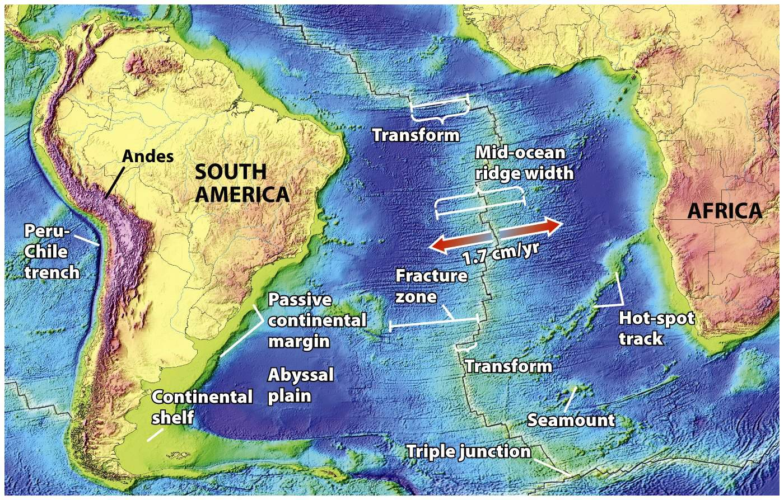
Mid-Ocean Ridges
Linear mountain ranges in Earth’s ocean basins.
Example: The Mid-Atlantic Ridge
  Snakes N-S through the entire Atlantic Ocean.
  Elevated ridge (1,500 km wide) 2 km above abyssal plains.
  Axial rift valley is the site of eruptions.

Slide 37
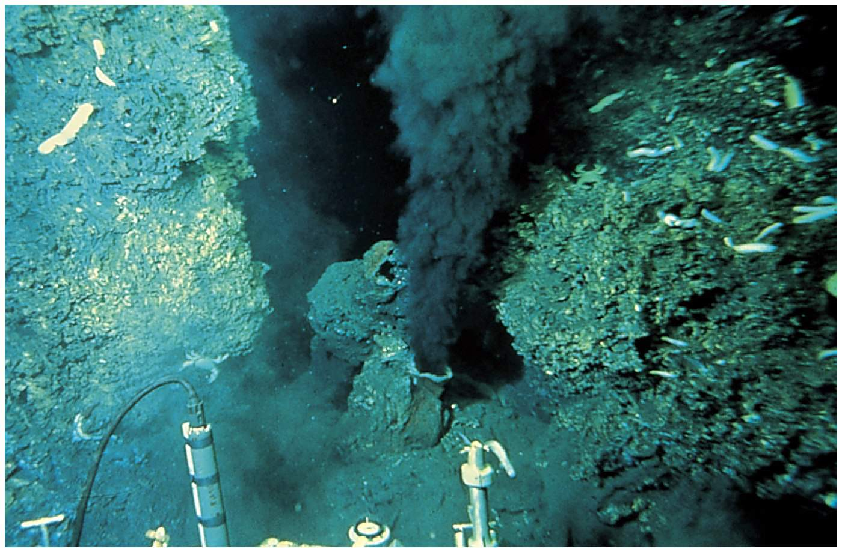
Mid-Ocean Ridges
“Black smokers” are found at some MORs.
  Water entering fractured rock is heated by magma.
  Hot water dissolves minerals and cycles back out of rock.
  When water reaches the sea, minerals precipitate quickly.

Slide 38
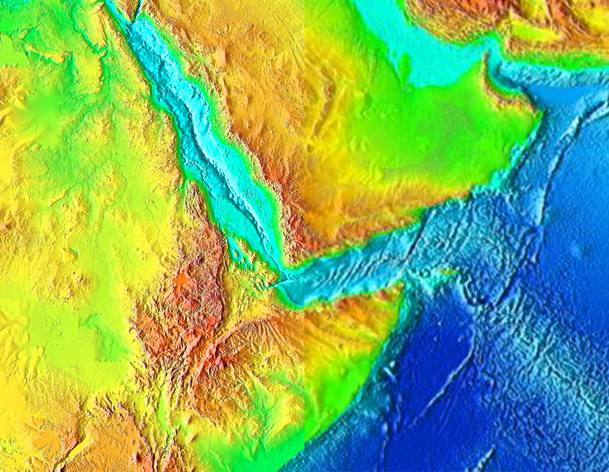
Divergent Margins – Triple Junctions
Triple junctions are places where three different plates come together. In this case, three divergent plate margins

Slide 39
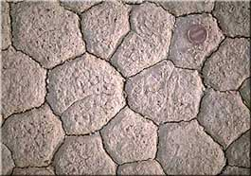
Mudcracks – Triple Junctions
Shrinkage and tension as the mud dries

Slide 40
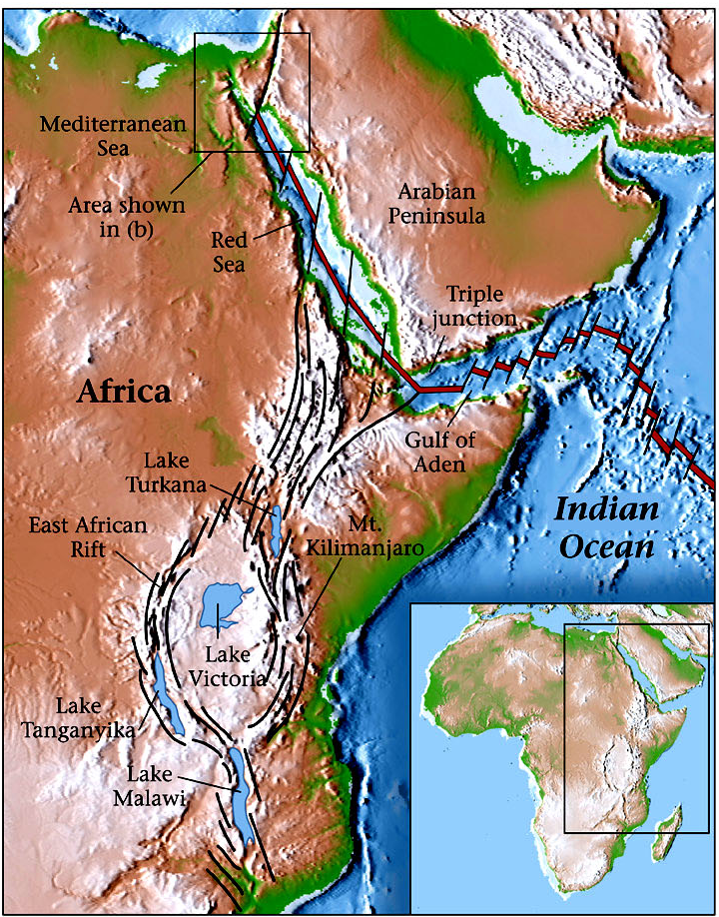
Continental Rifting: East Africa
The Arabian plate is rifting from the African plate.
Rifting has progressed to sea-floor spreading in…
    The Red Sea
    The Gulf of Aden
East African Rift – On-going rift.
    Thinned crust.
    Elongate trough.
    Volcanoes.

Slide 41
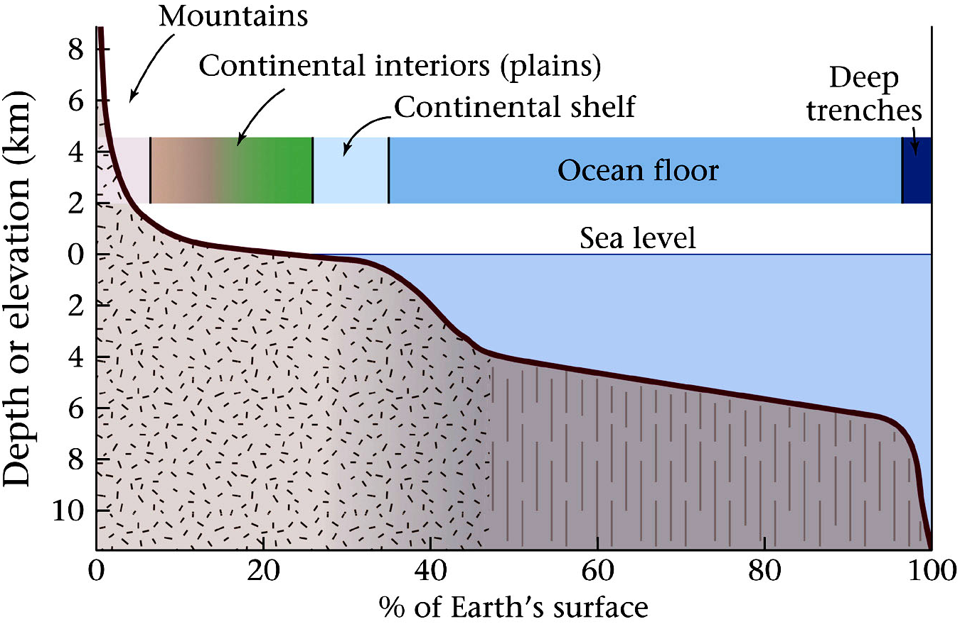
Hypsographic Curve
Everest +8850m
Mariana Trench -11000m

Slide 42
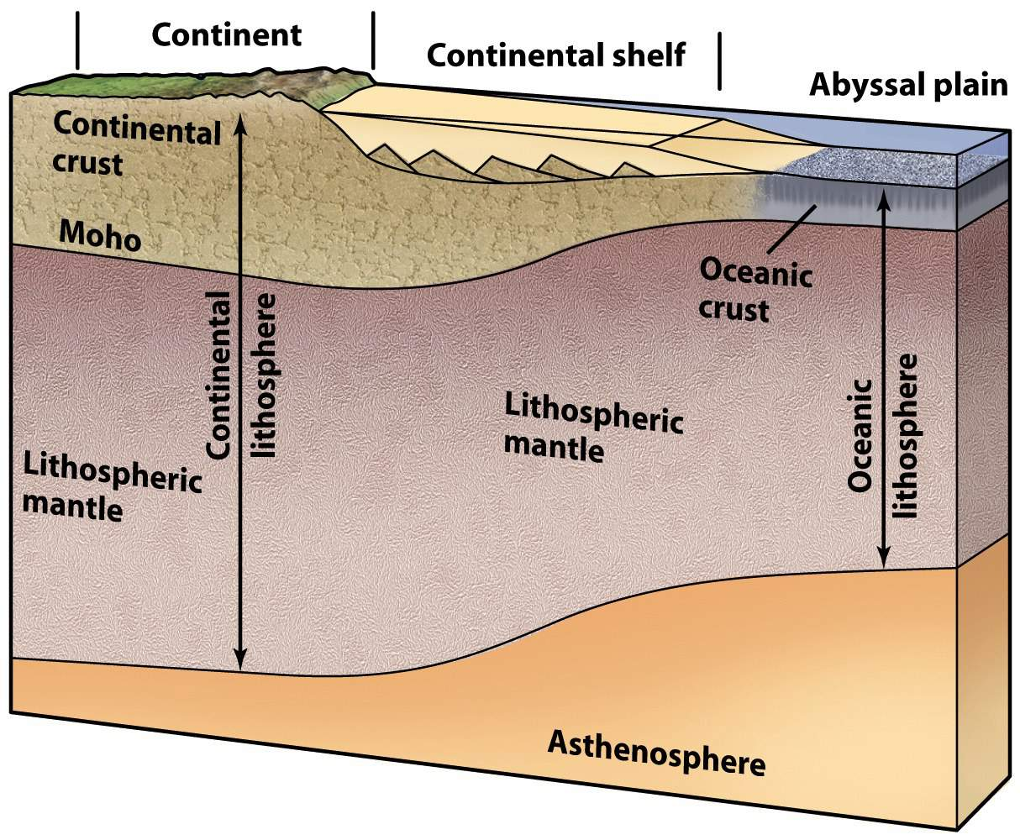
Continental Margins
Where land meets the ocean.
  Margins near plate boundaries are “active.”
  Margins far from plate boundaries are “passive.”
Passive margin continental crust thins seaward.
  Transitions into oceanic crust.
  Traps eroded sediment.
  Develops into the
continental shelf.

Slide 43
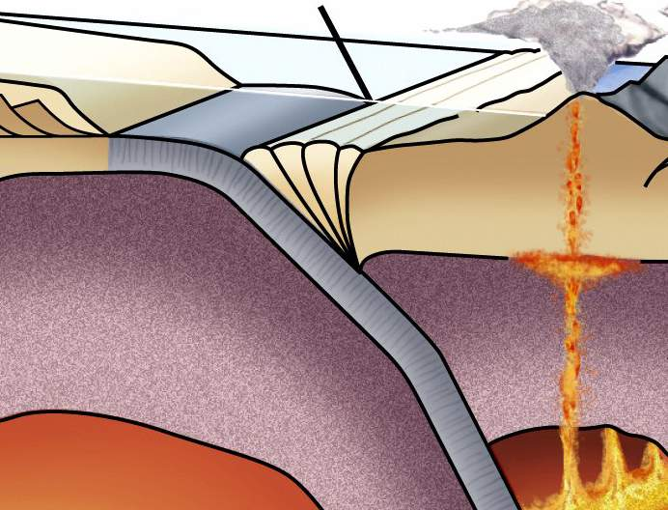
Convergent Boundaries
Lithospheric plates move toward one another.
One plate dives back into the mantle (subduction).
Subduction recycles oceanic lithosphere.
  Subduction is balanced by sea-floor spreading.
  Earth maintains a constant circumference.

Slide 44
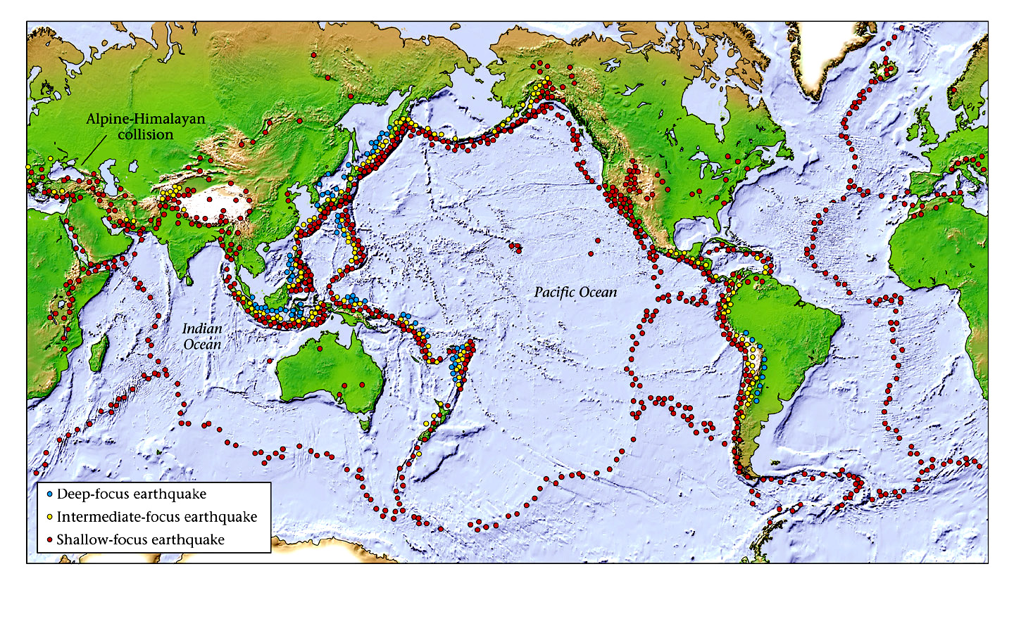
Distribution of Earthquake Locations
Trend from shallow to deep focus earthquakes - subduction

Slide 45
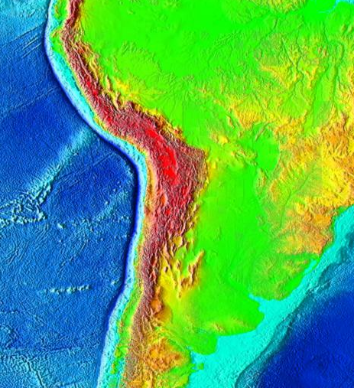
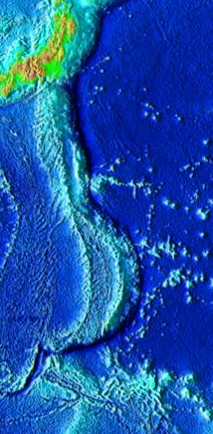
Convergent Margins – Ocean Trenches
Marianas
Trench
Andes Mts.
Peru-Chile
Trench
Many subduction zones are ocean trenches.
The deepest spot on earth, the Marianas Trench,
is a convergent plate boundary

Slide 46

Convergent Boundaries
Subducting plate descent is revealed as earthquakes deepen away from trench. Quakes cease below 660 km.
The subducted slab releases water, causing the mantle above to partially melt (called magma). The magma will rise to the surface and form volcanic chains or arcs, like the Andes

Slide 47

Distribution of World’s Volcanoes
Iceland
Hawaii
East
African
Rift

Slide 48



Plate Collision
Subduction consumes ocean basins.
Ocean closure ends in continental collision.
Buoyant continental crust will not subduct.

Slide 49

Convergent Margins – The Himalayas

Slide 50

Transform Boundaries
Lithosphere slides past; not created or destroyed.
  Many transforms offset spreading ridge segments.
  Some transforms cut through continental crust.
Characterized by…
  Earthquakes.
  Absence of volcanism.

Slide 51


Transform Boundaries
Continental transforms – Chop continental crust.
  Example: The San Andreas Fault.

Slide 52


Transform Margins – Dead-Sea Transform
Another famous transform fault is the Dead Sea

Slide 53

Relative Plate Motions
Eurasian Plate
Arabian Plate
African Plate
All plates move relative to each other.
All plate motions add to zero globally

Slide 54

Pangea – Most recent supercontintent
Completely assembled by 250 million years ago

Slide 55


Hot Spots
Hot spot volcanoes create seamounts.
  Seamounts age away from originating hot spot.
  Age change marks direction of overriding plate motion.

Slide 56

Hawaii – classic hot spot
Hawaii-Emperor Seamount Chain)
Hot Spot
Relative plate motion
As plates pass over hot spots, they create volcanic chains
Other hotspots include Iceland and Yellowstone

Slide 57
Readings
Lecture 4: Reservoirs and Resources (Monday, 14 Sep)
Australian Museum
https://australianmuseum.net.au/learn/minerals/geological-deposits/geological-ore-deposits/
Read: Geological ore deposits
Focus on the geological processes that concentrate the ore (no need to memorize ore mineral names, for example)

Slide 58
Readings
Lecture 4: Reservoirs and Resources (Monday, 14 Sep)
Diamonds:
Smithsonian Magazine
https://www.smithsonianmag.com/science-nature/diamonds-unearthed-141629226/
http://geology.com/articles/diamonds-from-coal/
Royal Ontario Museum
https://www.rom.on.ca/en/blog/gem-month-canadian-diamonds

