Slide 1
Layer 3 VPN Network model
IETF draft
Updated:10th Oct 2019, Version 01

Slide 2
Index
Follow the last meeting action points (APs):
Hierarchy: Dicussion on GitHub?
Vision: Present possible workflows detected for the L3NM
Explain covered scenarios
Workflows to implement
Security:

Slide 3
Hierarchy
The list of open issues are stored in the GitHub repo:
https://github.com/oscargdd/l3nm/issues:
Issue # | Description | Status
1 | ISIS not included in Routing Protocols | No particular Need identified
2 | Segment Routing to be added | No particular Need identified
12 | Site Berarer Issue | Closed – NEW AP
13 | Is "site" concept needed in the network model? | Closed – NEW AP
14 | Process ID in OSPF | Pending analysis
15 | Hierarchy: Site & Bearer Removal | Discussion Needed

Slide 4
Vision –UC1
DESCRIPTION
L3VPN created between two ip domains
The SDTN should coordinate resources between the domain network controllers (i.e RTs, RD, EncapType, Terminations, Transport…).
SDTN
L3NM
L3NM
SDNc
SDNc
Domain 1
Domain 2

Slide 5
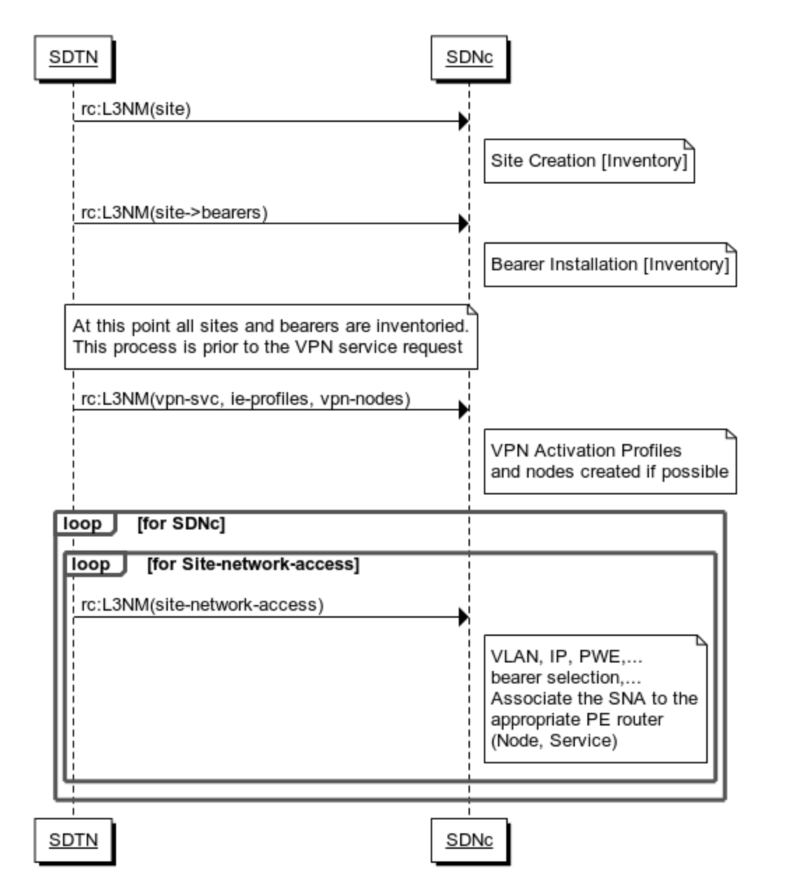
Vision –UC1

Slide 6
Vision –UC2
L3NM
DESCRIPTION
L3VPN created in a single domain Sceneario
The SDNC can auto assign the network resources.
SDNc
Domain 1

Slide 7
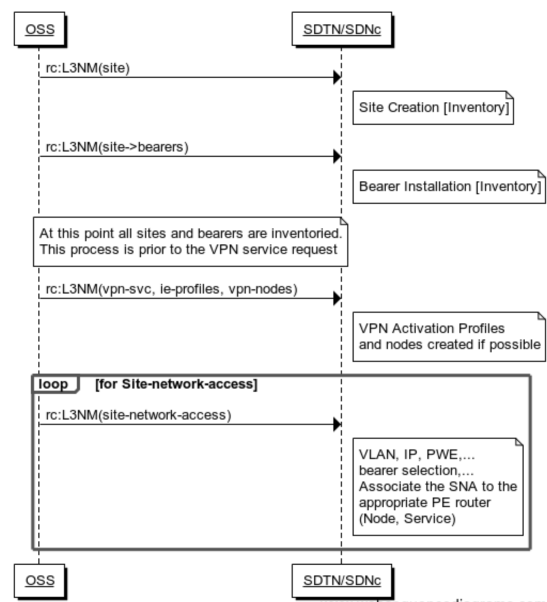
Vision –UC2

Slide 8
Security
Authentication/Authorization parameters must be included in the L3NM in the CE-PE connecting protocols (OSPF, BGP).
authentication-key
authentication-type (password/message digest)
message digest key
group "INTERNET_CAPITAL_TOWER"
neighbor 200.30.104.82
authentication-key "HhxkNZUSNjBIYOpytRN.vN5EcGUmO1G9joA3hK5.eEz2Z227wpwuHxWvQfUc4TMSevH/NYrn6B6" hash2
local-address 200.30.104.60
import "IMPORT_"
export "EXPORT_"
local-as XXXX
peer-as YYYY

Slide 9
Thanks
Oscar González
Victor López
Samir Barguil

