Slide 1
An Update of Operators Requirements on Network Management Protocols and Modelling draft-boucadair-nmop-rfc3535-20years-later
IETF#123, Madrid , July 2025
Mohamed Boucadair (Orange)
Luis M. Contreras (Telefonica)
Óscar Gonzalez de Dios (Telefonica)
Thomas Graf (Swisscom)
Reshad Rahman (Equinix)
Lionel Tailhardat (Orange)

Slide 2
NMOP Work Item
The current topics of focus for the working group are:
NETCONF/YANG Push integration with Apache Kafka & time series databases
Anomaly detection and incident management
Issues related to deployment/usage of YANG topology modules (e.g., to model a Digital Map)
Consider/plan an approach for updating RFC 3535-bis (collecting updated operator requirements for IETF network management solutions)
Excerpt from the NMOP Charter

Slide 3
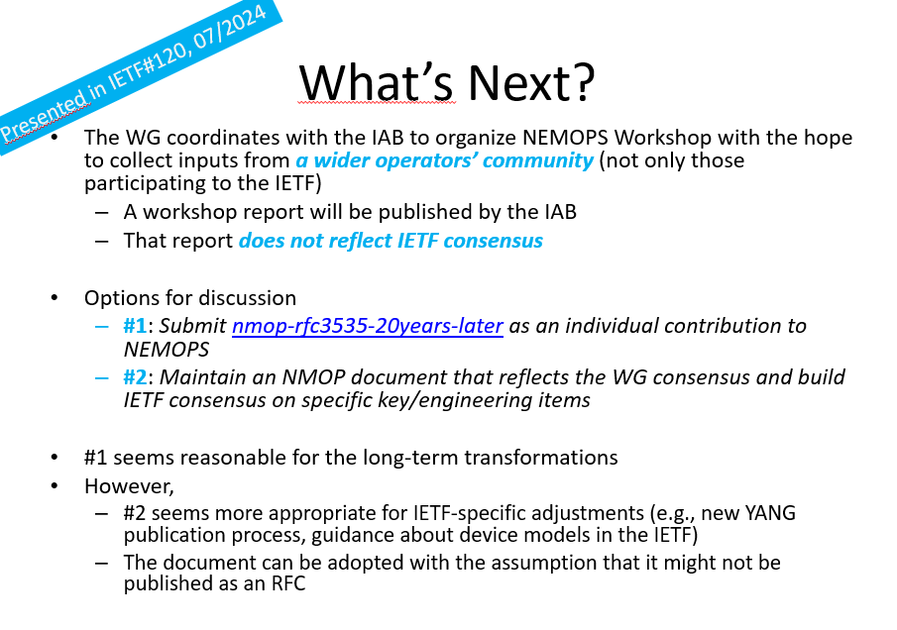
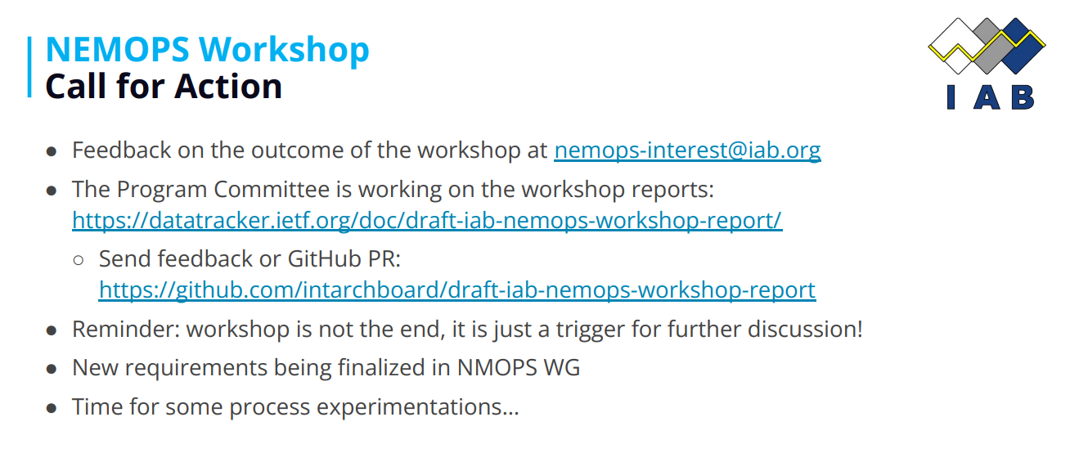

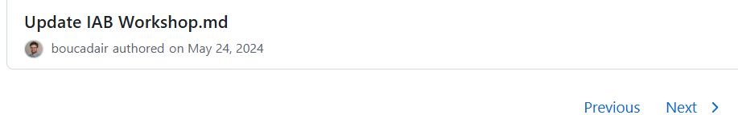
Some History
OPSAREA IETF#122
NEMOPS
First commit to drafting NEMOPS CFP
NMOP

Slide 4
This SHOULD NOT Be …
a remake of NEMOPS Workshop
a mirror of items that are already covered by advanced specifications
a collection of random items without clear justification

Slide 5
What’s in Then?
A consolidated list of new requirements together with operators’ prioritization of that list (strong, nice-to-have)
draft-iab-nemops-workshop-report does not update RFC3535 requirements
A collaborative effort that involves all interested parties to build a very few set of actionable items that will be the focus of immediate work in the IETF
Actionable by the IETF as a whole, including WGs, ADs, etc.

Slide 6
But …
“..portions of the industry may not be participating in NMOP and thus the resulting document could be heavily skewed toward an IETF specific viewpoint.”
Remember that RFC3535 only reflected the consensus of the very few operators present in the room
A more inclusive approach is followed here:
Capture requirements from operators participating in NMOP
Extract requirements from all papers submitted to NEMOPS
Extract requirements voiced in other venues (outreach events/surveys) than the IETF
Public disclosure of all operators’ assessments
All data is publicly available: Source

Slide 7
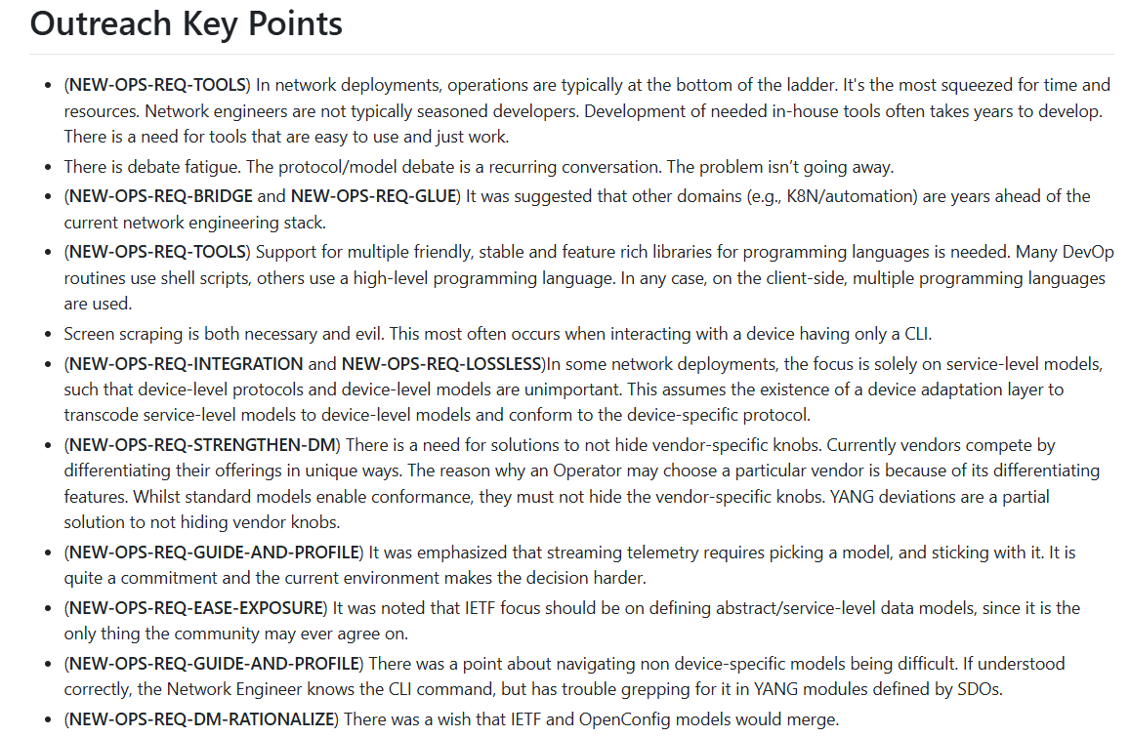
Sample Requirements from outside IETF

Slide 8
Candidate Direction of Work
Rationalize device models space and avoid redundant efforts
Clear guidance for the development of device models in the IETF
More agile process for developing YANG modules
More Profiling
E.g., A profile with a set of recommendations about core/key NETCONF/RESTCONF features with the appropriate justification will help the emergence of more implementations that meet the operators’ needs
YANG profiles
Reassess the value of some IETF proposals vs. competing/emerging solutions would be useful (e.g., gRPC vs. YANG-Push)

Slide 9
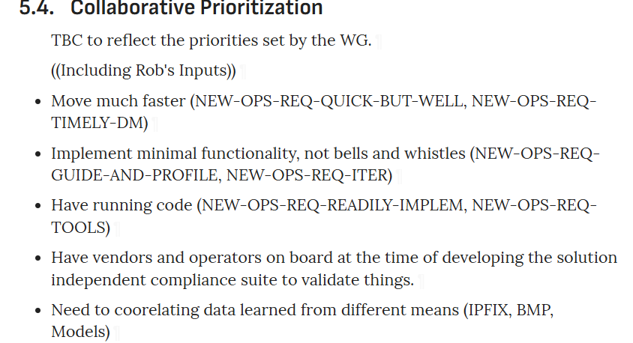
Next Steps
Update the new operators requirements list with more assessments form other oparators
Update

