Slide 1
Final Project: Compare & Contrast — Dual Implementation of an Expense Approval Workflow
Dolsom BOUDA​
041246719
Algonquin College
Cloud Development & Operations

Slide 2
Introduction Business Rules
Rule | Description
Input | Employee name, email, amount, category, description, manager email
Validation | Reject missing fields or invalid category
Auto-Approve | Amount < $100 → approved immediately
Manager Approval | Amount ≥ $100 → wait for manager decision
Timeout | No response in 2 min → escalated
Notification | Employee receives email with final outcome

Slide 3
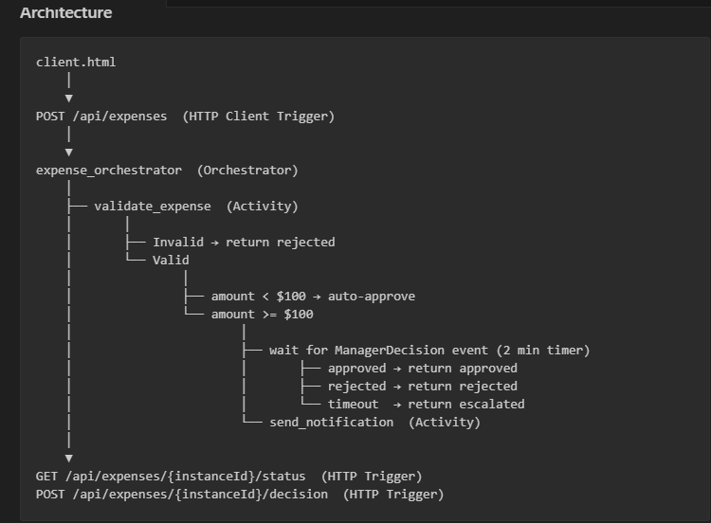
Version A — Durable Functions (Code-First)
Key Design Decisions:
Python v2 programming model
Human Interaction pattern:
wait_for_external_event() + create_timer() + task_any()
All orchestration logic in a single function_app.py
2-minute durable timer for escalation

Slide 4
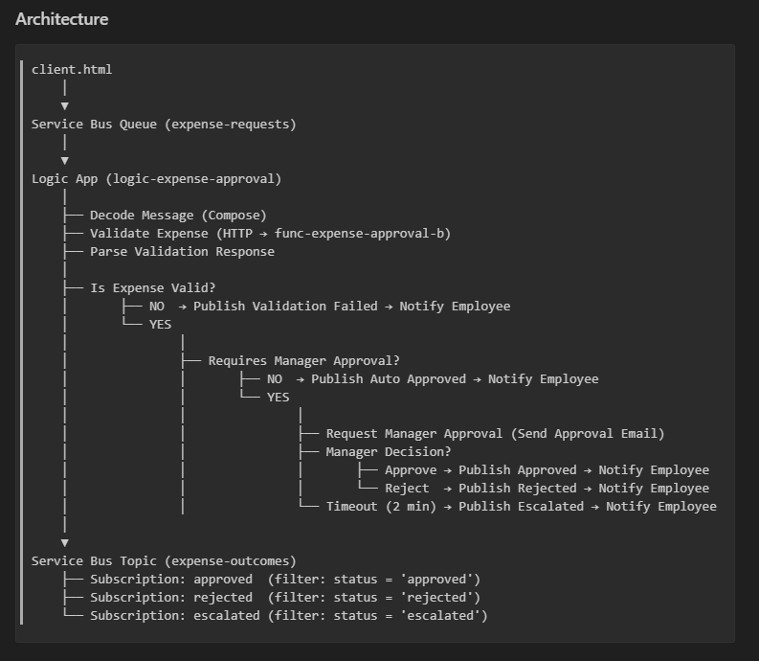
Version B — Logic Apps + Service Bus (Visual/Declarative)
Key Design Decisions:
Service Bus queue as entry point (decouples submission from processing)
Logic App handles all branching visually
Send Approval Email connector for manager approval (built-in Approve/Reject buttons)
3 filtered topic subscriptions for outcome routing
Azure Function only handles validation

Slide 5
Side-by-Side Comparison
Dimension | Version A | Version B
Development | More complex, code-first | Faster, visual designer
Testability | Full local testing | Azure only, no automation
Error Handling | Full code control, retry policies | Portal config, visual history
Human Interaction | Native pattern, flexible | Approval connector, limited options
Observability | JSON status endpoint | Visual run history, accessible
Cost (100/day) | ~$0.12/month | ~$10.63/month
Cost (10,000/day) | ~$1.20/month | ~$80.31/month

Slide 6
Recommendation: Which One for Production?
Recommended: Version B for most organizations
Pre-built connectors for email, Teams, ERP, HR systems
Visual designer accessible to non-developers
Portal run history for compliance and auditing
Faster to build and extend
Choose Version A when:
Team is Python-first
Workflow logic is highly complex or algorithmic
Cost is a primary concern
Strict version control and CI/CD required

Slide 7
Lessons Learned
What surprised me:
Durable Functions are deceptively strict
Logic Apps hides complexity behind simplicity
The Human Interaction pattern is not free in either version
Cost is not obvious until you look
What I would do differently:
Build Version B first to validate the business logic visually, then implement Version A with full confidence in the expected behavior
Add Application Insights from day one: Diagnosing cold start issues and orchestration replays without telemetry cost significant time
Use a realistic timeout (15-30 minutes) for production.

Slide 8
Thank You
Dolsom BOUDA​
041246719
Algonquin College
Cloud Development & Operations

