Slide 1
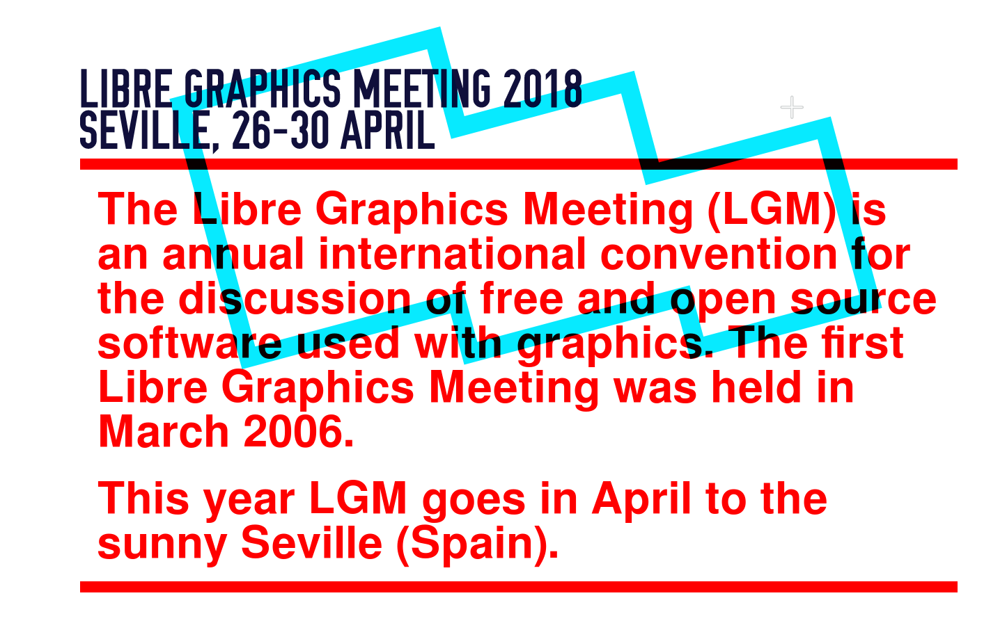
Notes:
The title of this presentation is "State of Libre Graphics". Before I will go through the slides submitted by a number of projects, let me say this in general:
That state is good! Important projects have been making important releases in the past year, releases that were well received and well executed. Other projects are on the verge of making important releases. Every improvement to any of our projects improves the state of libre graphics! The user-base is growing, and artists can earn their living using nothing but libre graphics software.
Sure, there's a lot to be done still -- whether it's bringing our software to tablets, improving interoperability, supporting standards or increasing community reach-out -- but all of that is fun and rewarding stuff to do!

Slide 2
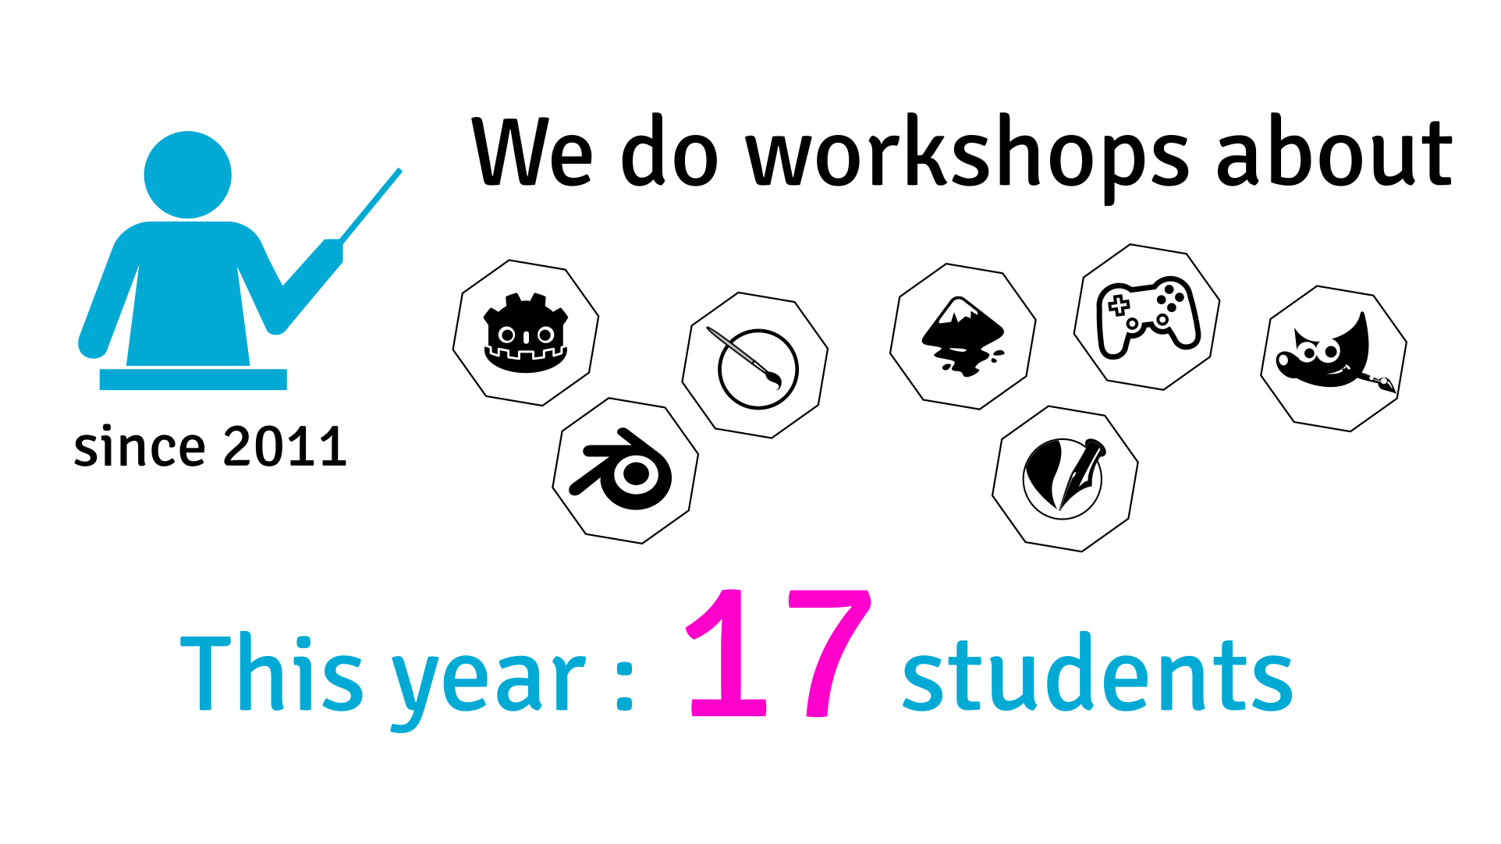
Notes:
Since 2011, Afgral has been organising workshops and trainings about
- Game design and art
- Illustrations
- Web development, marketing and esign
- Ebooks creation

Slide 3
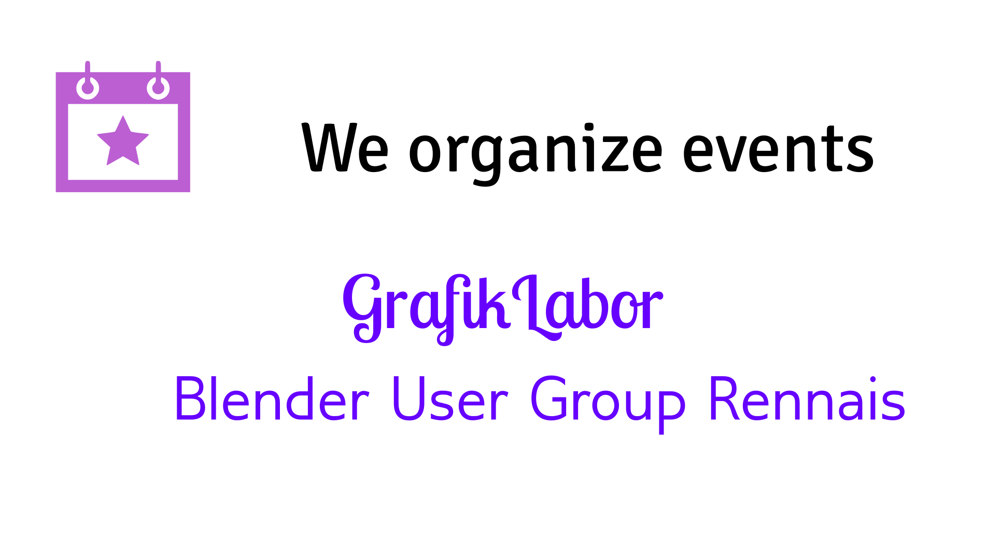
Notes:
Afgral is also organizing a yearly GrafikLabor over a weekend with talks, workshops and hackatons.
They also coordinate the local Blender User Group in Rennes.

Slide 4
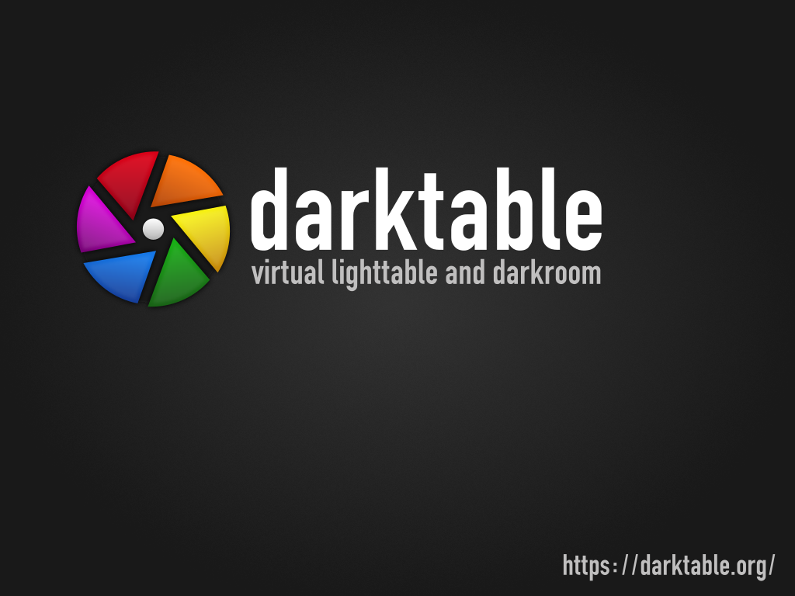
Notes:
- darktable is a raw converter and program to manage your digital images, processing images with high precision.
- darktable wasn't represented at last LGM, so here is an overview over the last two years.

Slide 5
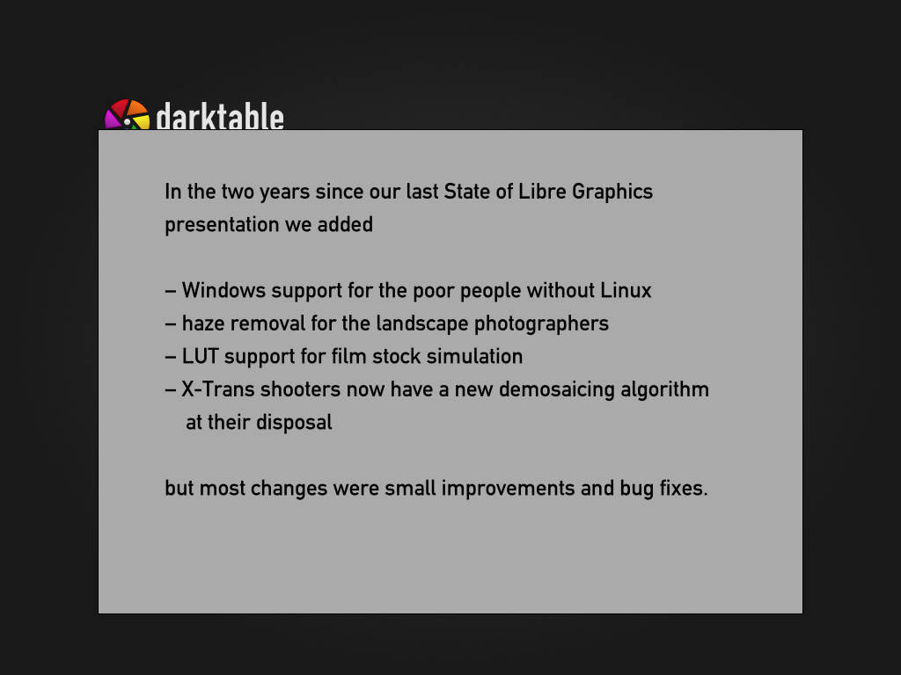
Notes:
- Hell froze over and a Windows port happened. It's quite stable already and mostly works but some parts are still work in progress.
- A new module for haze removal was added. You can use it to make landscape photos nicer and more contrasty.
- Another new module allows to use Look Up Tables to apply certain looks to the photos.
– The sensors in some Fuji cameras require special methods for demosaicing. A new one was added for better results.
- Most work in darktable isn't about shiny new features that lend themselves to be put on slides. So even when the release notes don't mention anything interesting it makes sense to update anyway.

Slide 6
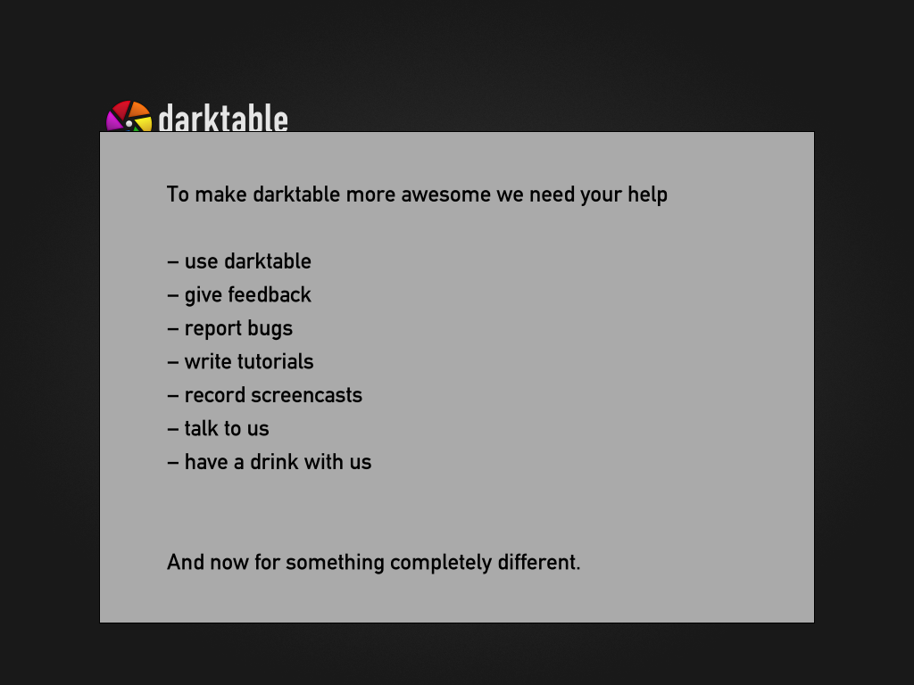
Notes:
- darktable has a relatively small core team but quite a few people contributing. That can be by writing code, reporting bugs or motivating the others to do more work.

Slide 7


Slide 8
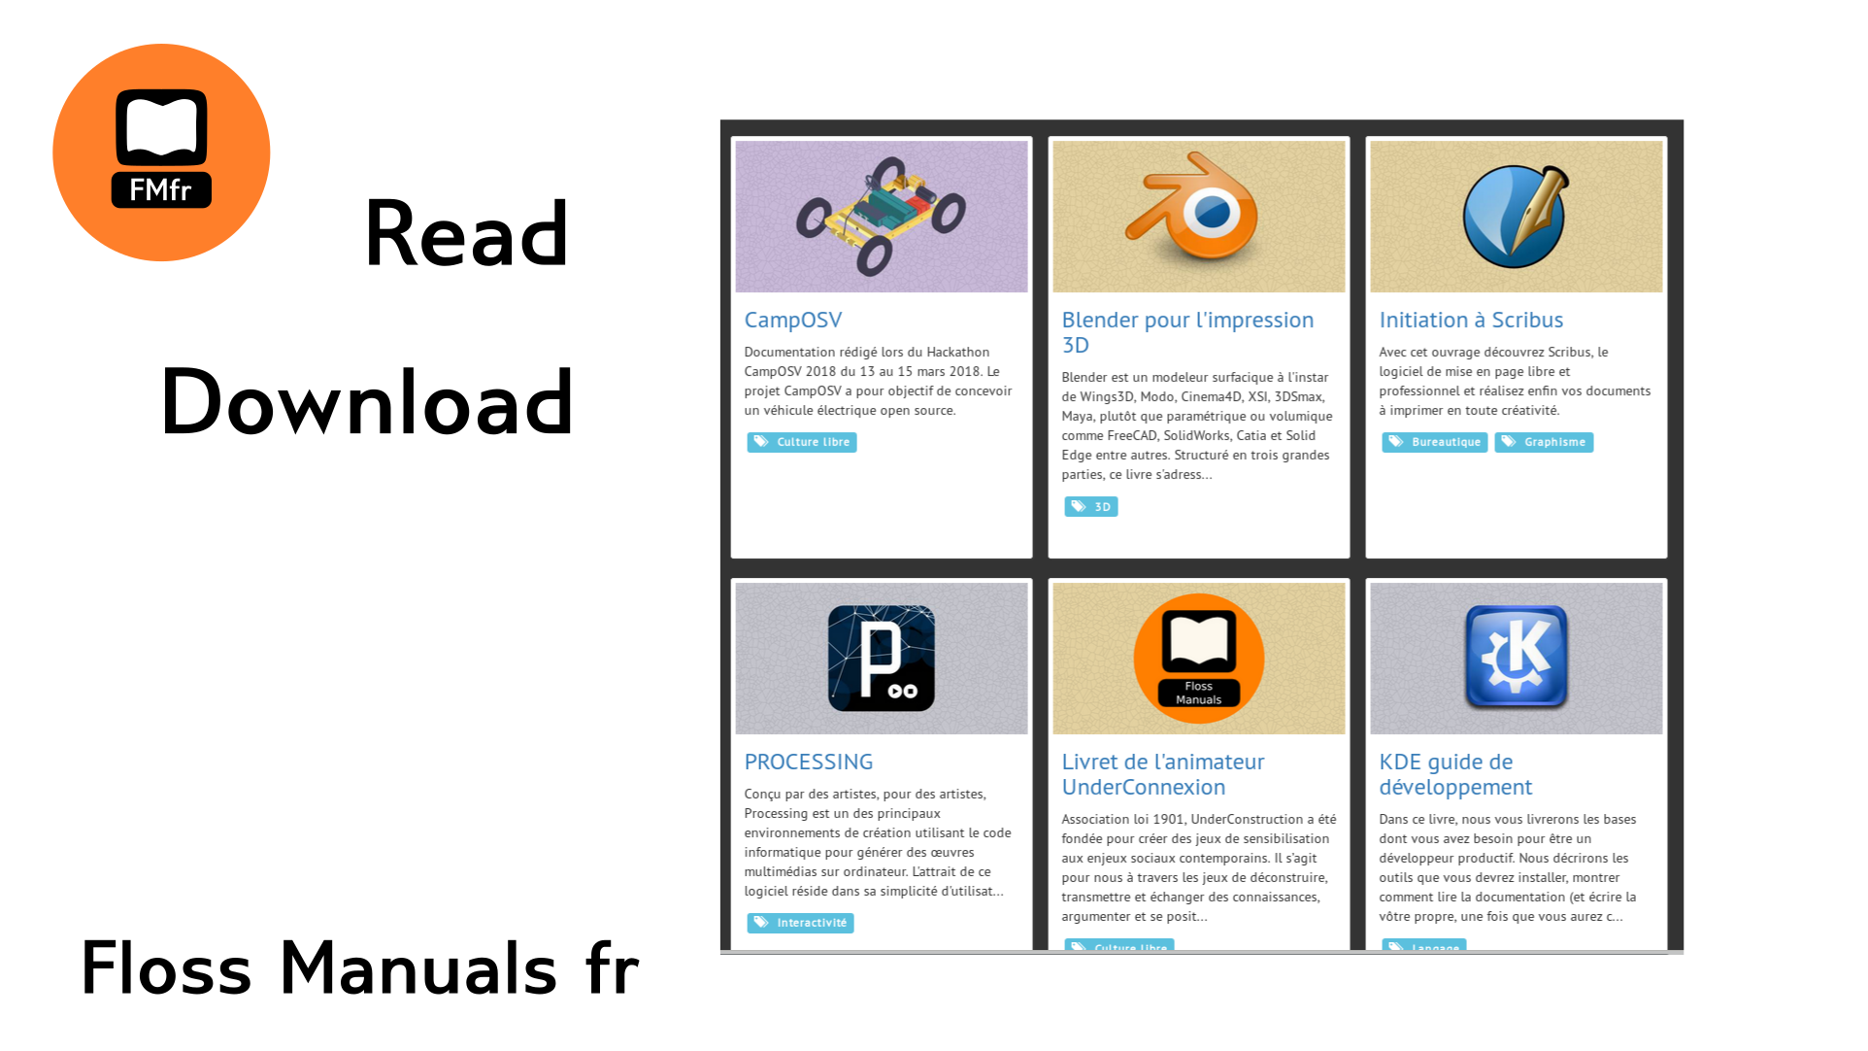

Slide 9
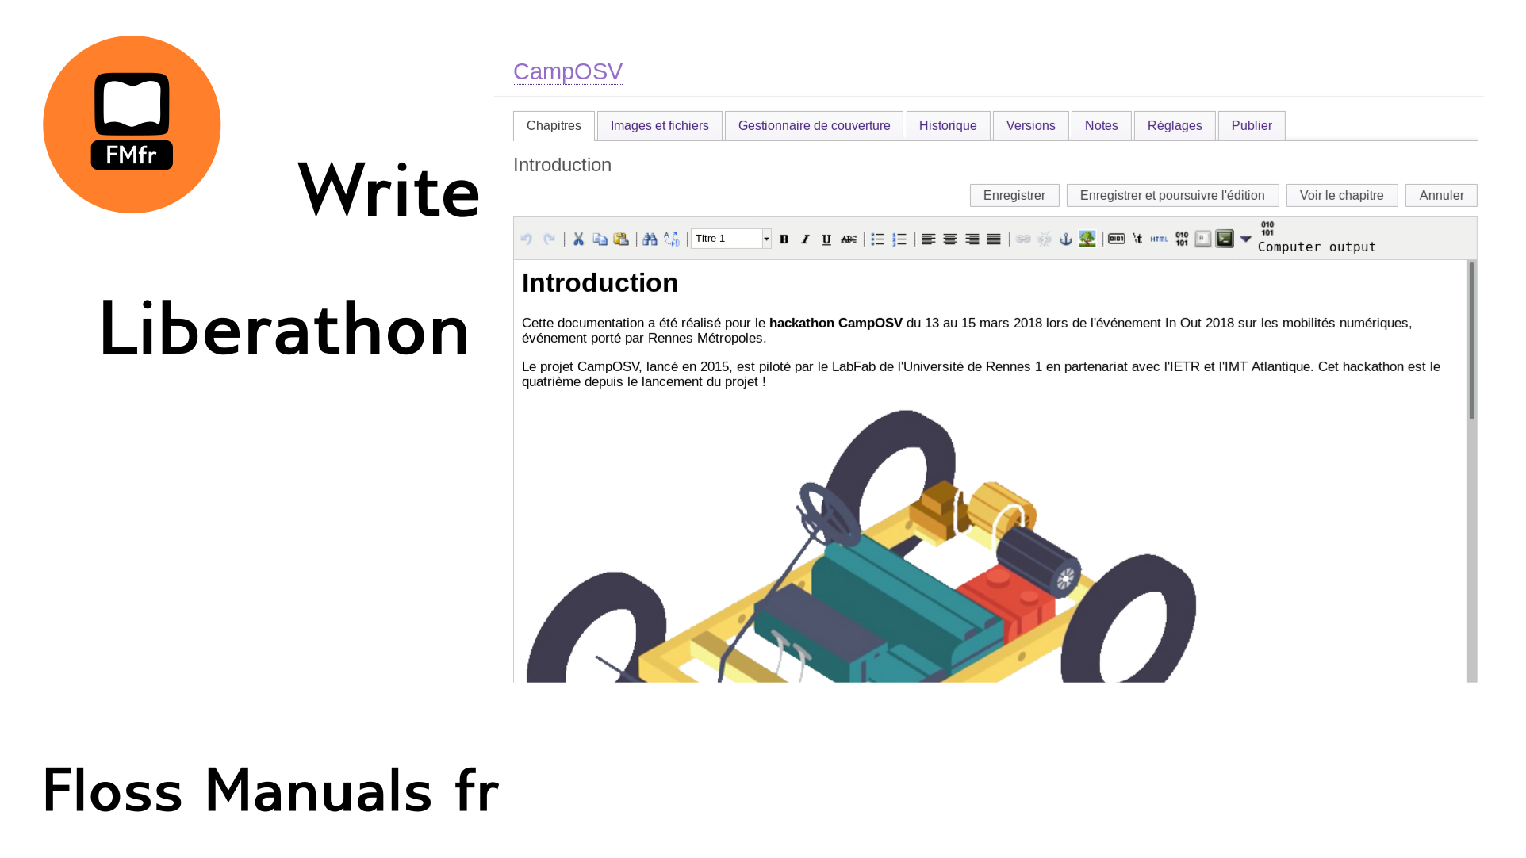

Slide 10

Notes:
freieFarbe (in German) or freeColour (in English), previously an informal initiative, is now recognised as a German non-profit organisation. One of its main purposes is to create an open colour system as an alternative to proprietary vendors like Pantone.
During its first year as a non-profit organisation freeColour achieved two major goals:

Slide 11

Notes:
The creation of a printed and digital colour reference based on open standards and mathematics, namely the HLC Colour Atlas, which is available in German and English. The printed Colour Atlas is being created with a high-end proof printer and dwarfs most other printed colour references in terms of measurable colour correctness. The colours and their names are free and not subject to copyright, patent or trademark law.

Slide 12
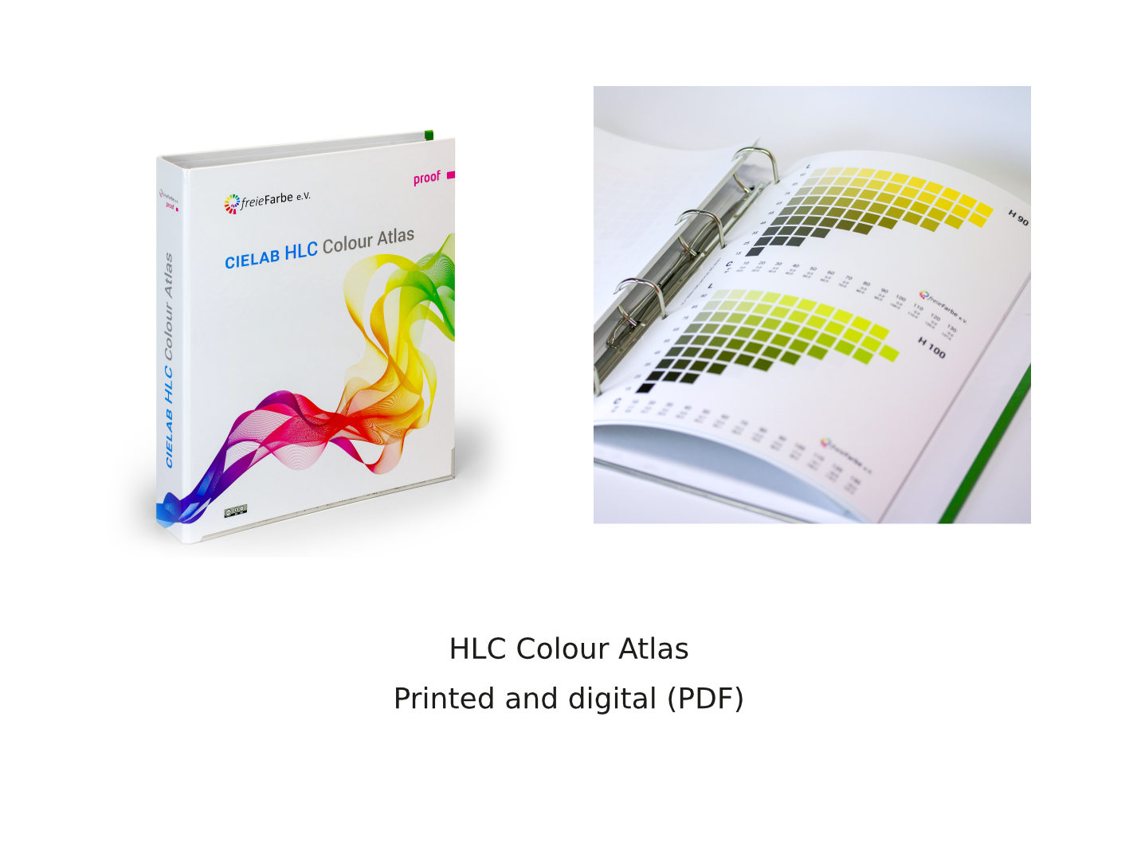
Notes:
freeColour is currently cooperating with the German standards organisation DIN [pronounced like DEEN] to create a so-called "DIN SPEC" for "Open Colour Communication", which is a preliminary stage of what may later become a DIN [pronounced like DEEN] Standard and even further down the road an ISO Standard.

Slide 13
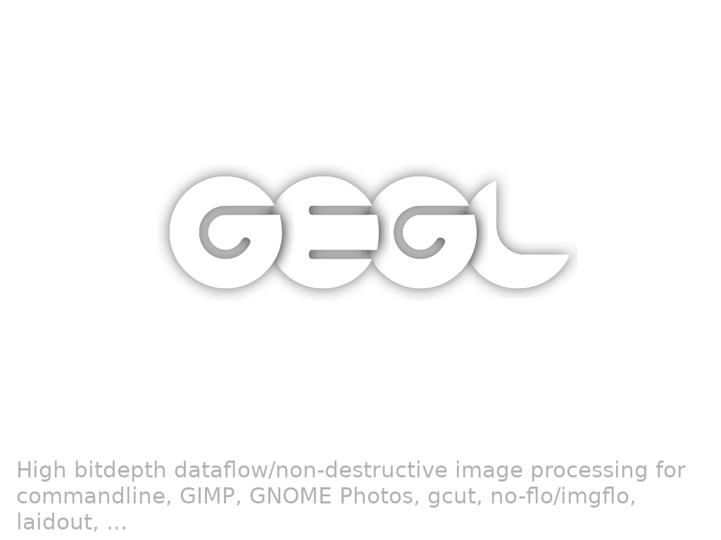
Notes:
GEGL is a library originally started in 2000 by Rythm and Hues in Hollywood to bring GIMP higher bitdepth than 8 bit and a new modular engine. It powers the coming GIMP-2.10 release as well as other tools reusing its components.

Slide 14
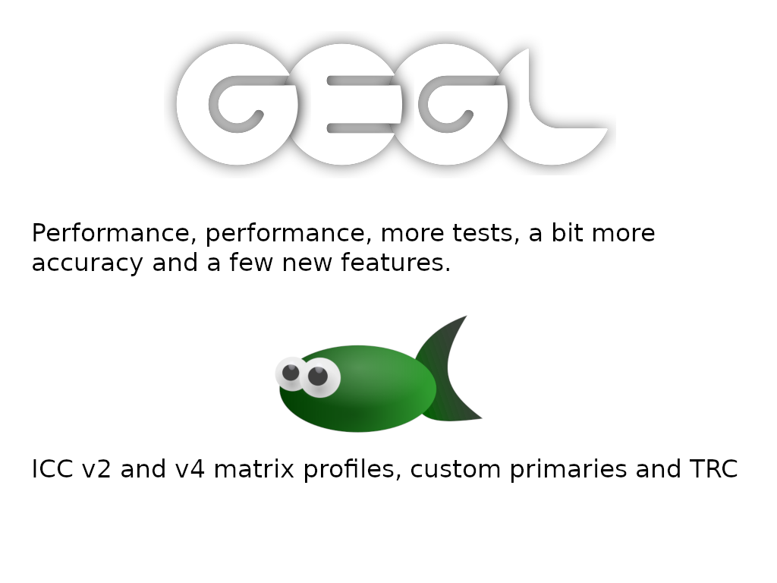
Notes:
GEGL's uses of multiple threads is now on by default. But the OpenCL code paths are not. Intels beignet OpenCL implementation gives correct results but is slower than using multiple CPU threads and the nvidia drivers yield unexpected and unacceptable results for many operations.
babl, GEGL and GIMPs pixel-format description and conversion library got native support for suing ICC v2/v4 matrix+TRC profiles, which is more than 10 times faster than using stock lcms2 for the conversions.

Slide 15
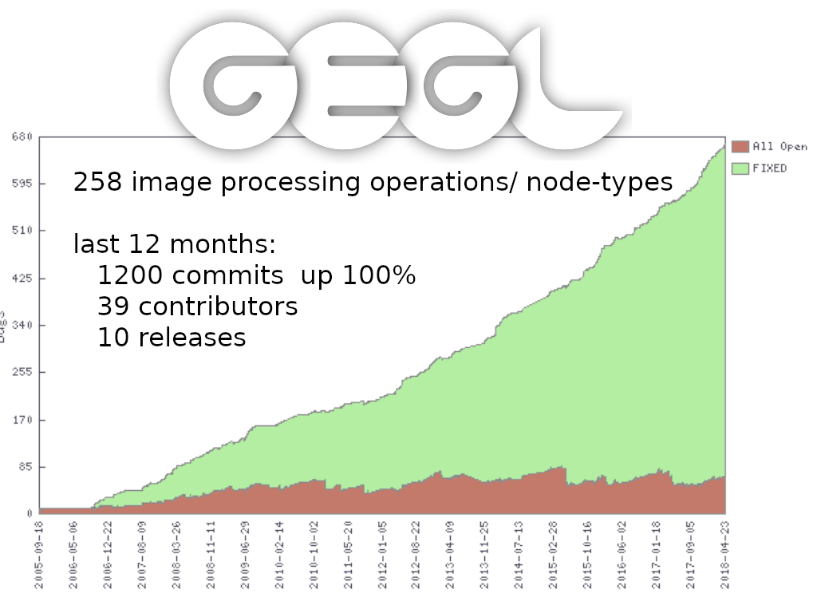
Notes:
Development has accelerated in the last year, with almost monthly releases, more commits and a high rate of bugs being fixed.
A stable API frozen release that can power a very backwards compatible GIMP-2.10 series is coming.

Slide 16
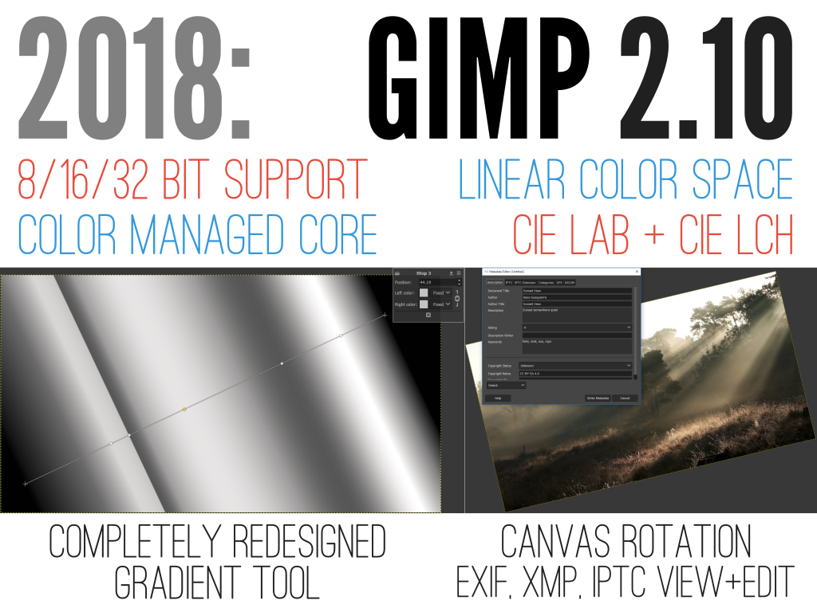
Notes:
2018: Gimp 2.10 finalized, feature:
- High bit depth support
- Linear color space workflow
- Color management as a core feature
- More use for CIE LAB and CIE LCH
- New transformation tools
- Completely redesigned Gradient tool
- Canvas rotation / flipping for digital painting
- Exif, XMP, IPTC viewing and editing
- Native WebP, OpenEXR, RGBE support
- Imprvoed TIFF and PSD support
- More GEGL-based filters with on-canvas preview than is good for ya!
- Multi-threading

Slide 17
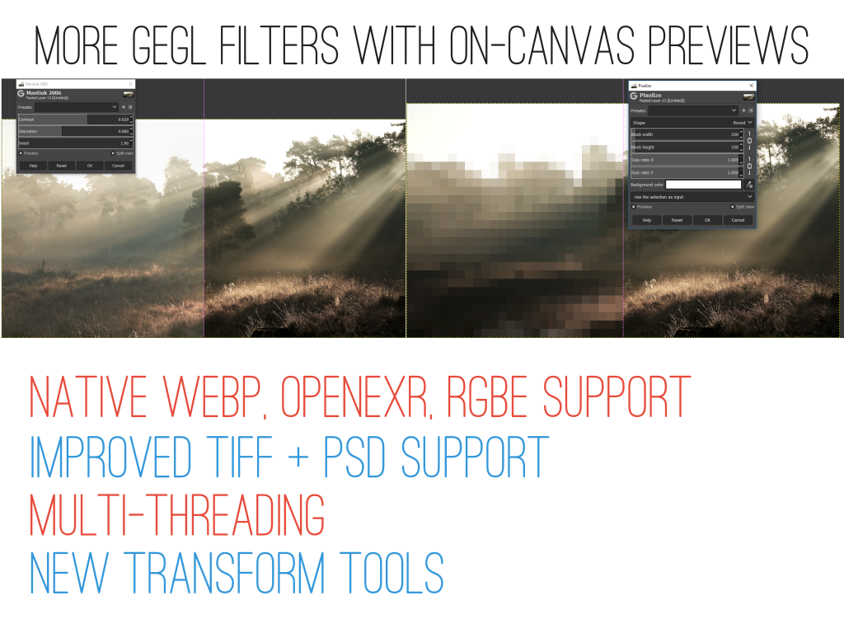
Notes:
- Bugfixing after v.2.10.0 release
- 2.10.xseries developed in parallel with 3.0
- 2.10.x open for new features
What 3.0 means:
- GTK+3 port
- API deprecation
- Better Wayland support
- Better support for graphic tablets on Windows (or so they say)

Slide 18
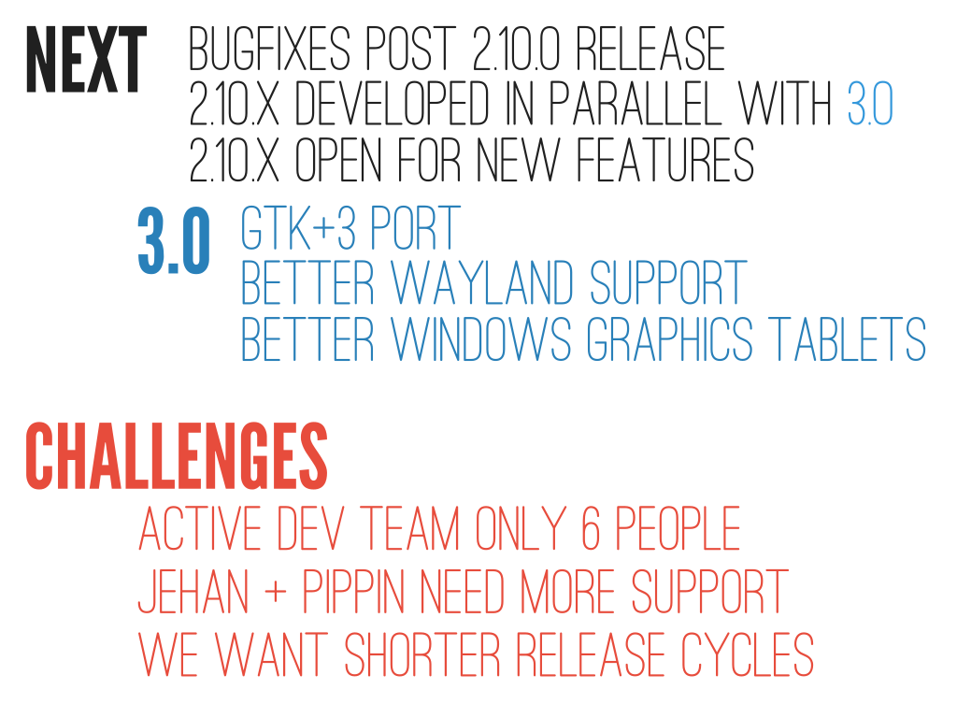
Notes:
Challenges
- Active dev team is only 6 people
- Jehan and Øyvind need a lot more community support via Patreon / Liberpay (they are getting there)
- 3.0 timeframe cannot be realistically estimated at this point
- We want shorter release cycles to keep both users and contributors interested (hence opening 2.10.x for new features)

Slide 19
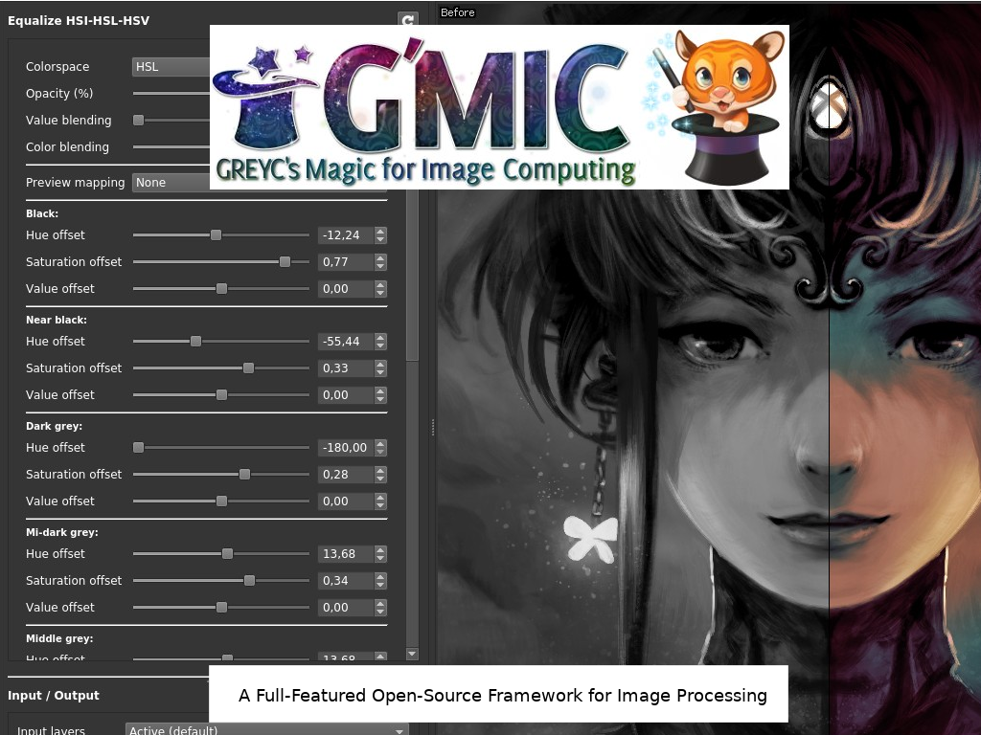
Notes:
G'MIC provides many different user interfaces to convert, manipulate, filter and visualize generic image datasets. It has more than 950 image processing functions. Due to its scripting capabilities, many more can be added.

Slide 20
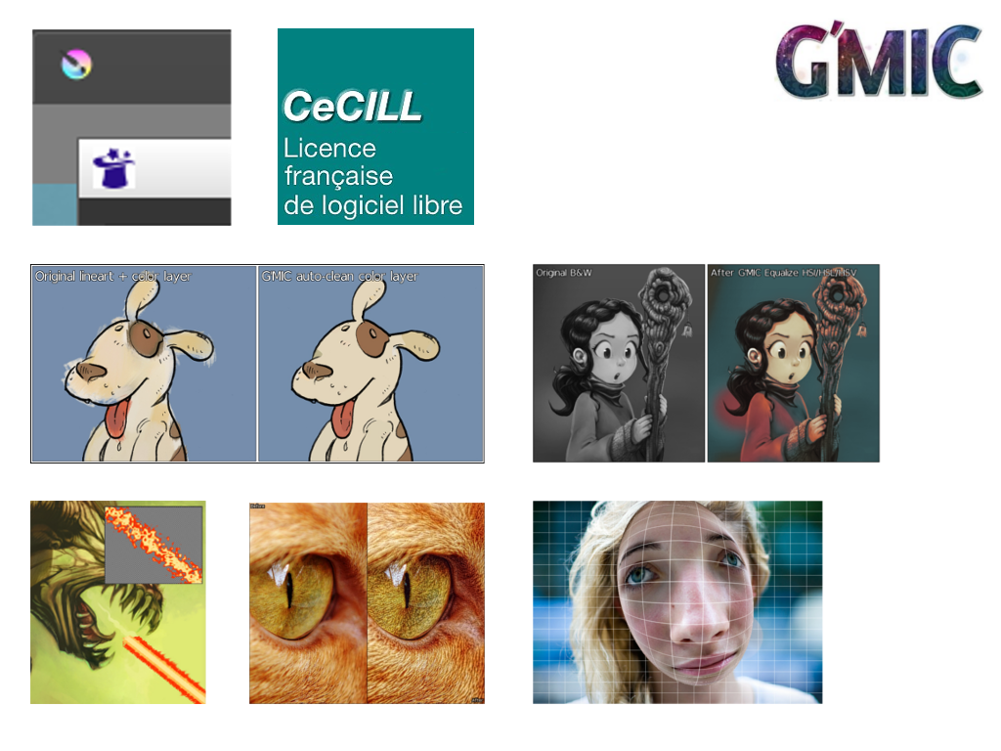
Notes:
## G'MIC-Qt plugin for Krita
The G'MIC-Qt plugin is now available for Krita 3.3+. Although it is not feature complete yet, we've received positive feedback.
## CeCILL-C, a more permissive license
The G'MIC core is now dual-licensed CeCILL-C (LGPL-compatible) or CeCILL (GPL-compatible). It's now possible to integrate `libgmic` and `gmic_stdlib` in closed-source software as long as modifications are given back to the community. This change does not affect the plugin or community filters.
## Improving the lineart colorization filter
The filter has two new features: "Autoclean" helps keep colors within the contour boundaries and hatching detection limits the number of small colored areas generated.
## Color equalizer in HSI, HSL and HSV spaces
This new filter allows the user to modify the hue and saturation for various brightness ranges in an image while maintaining brightness. E.g., a digital artist would be able to quickly colorize his or her grayscale artwork.
## Angular deformations
_Crease_ is a new local deformation filter that makes images "crispy"; e.g., make comic panels jagged or improve David Revoy's alien death ray.
## Detail enhancement without the "halos"
_Magic details_ and _Equalize local histograms_ are filters that consider the geometric content of the image (anisotropy) for local enhancement, allowing more detail and color to come through while reducing halos that typically arise from enhancement.
## Image deformations
Filters that apply geometric deformations are added regularly; e.g., we could add a local spherical or ellipsoidal deformation using _Spherize_.

Slide 21
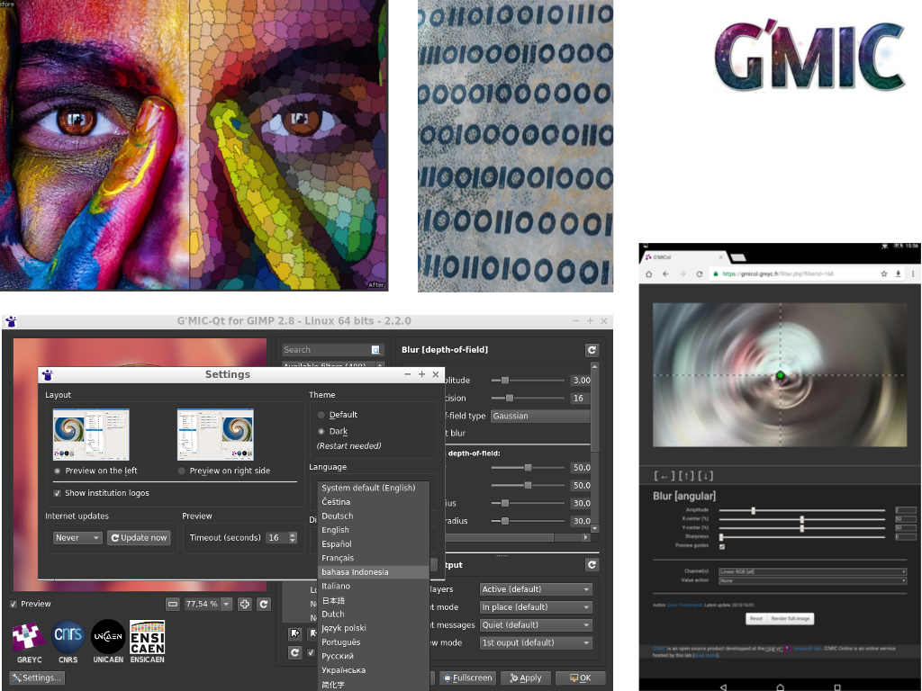
Notes:
## Artistic abstractions
An example of this is the new Super-pixels filter that partitions an image, based on similar colors, into geometric shapes that align to the contours. This is achieved by using the SLIC method (Simple Linear Iterative Clustering).
## G'MIC core and interpreter
- Syntax improvements making scripts easier to write, read and execute with a lower memory footprint.
- The math expression evaluator has received many optimizations and features making it more robust and capable.
- Support for .yuv video files now extends to more sampling modes (4:2:0, 4:2:2 or 4:4:4).
## A better G’MIC-Qt plugin
- The ability to set a timeout for previewing computationally intensive filters.
- Better management of filter parameters via menus, persistent values and a reset button.
- Preview area is cleaner and easier to zoom and maximize.
- Language support independent from the system defaults.
## G'MIC Online redesign
_G'MIC Online_ is a web service that allows you to apply G'MIC filters within a browser. It has been redesigned to be responsive to mobile devices.
## Image sources:
-G'MIC core / binaries: https://www.flickr.com/photos/mikecogh/8192314996/

Slide 22
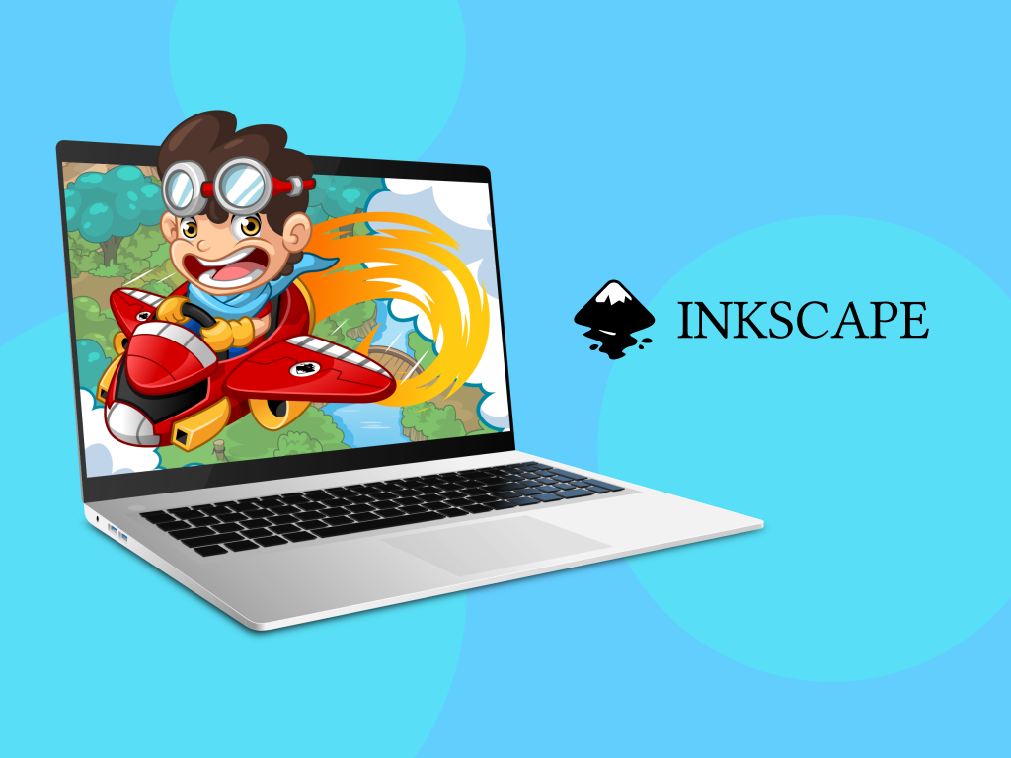
Notes:
Inkscape is professional quality vector graphics software which runs on Windows, MacOS and GNU/Linux. It is used by design professionals and hobbyists worldwide, for creating a wide variety of graphics such as illustrations, icons, logos, diagrams, maps and web graphics. Inkscape uses the W3C open standard SVG (Scalable Vector Graphics) as its native format, and is free and open-source software.
During the last year Inkscape has seen an increase in adoption among "makers". These are individuals using the vector drawing capabilities of Inkscape to help them fabricate physical objects. Inkscape continues to see strong usage among artists, graphic designers, students, educators, and more.

Slide 23
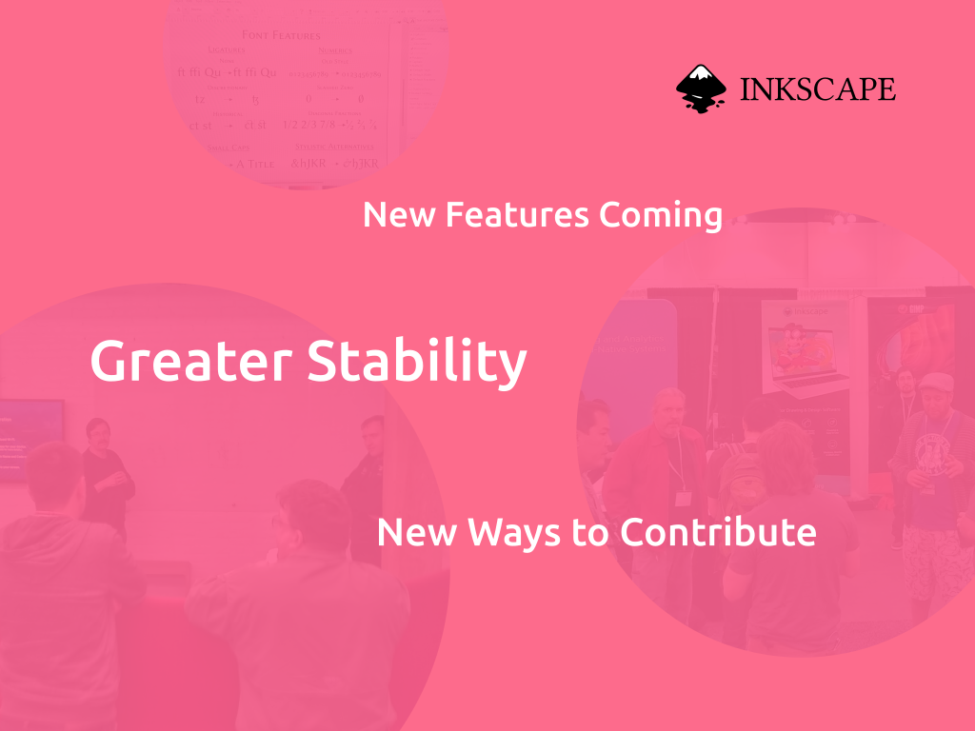
Notes:
The release of 0.92.2, and just recently 0.92.3, brought a number of fixes and usability enhancements to Inkscape. The recent Hackfest in the United States included significant work on Variable Fonts, and that work will continue here. The team is also working on migrating code from GTK2 to GTK3, which will enable many improvements to the user interface. The following release will be an unstable release in preparation for a rock-solid 1.0!
With the code migrated to GitLab, and the creation of a new outreach and promotion team called the Vectors, it is easier than ever for both developers and regular users to get involved in helping to make Inkscape even better!

Slide 24
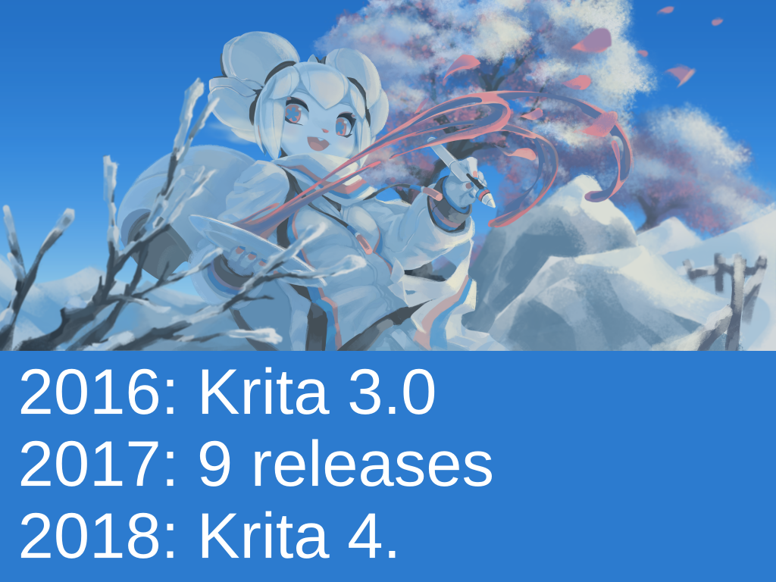
Notes:
Krita in 2017/2018
Releases: Krita 3.0 was released in 2016, We made 9 releases of Krita 3 in 2017. We released Krita 4 in 2018 with a new text tool, svg support, python scripting, improved use of multi-core systems thanks to a project sponsored by Intel.

Slide 25
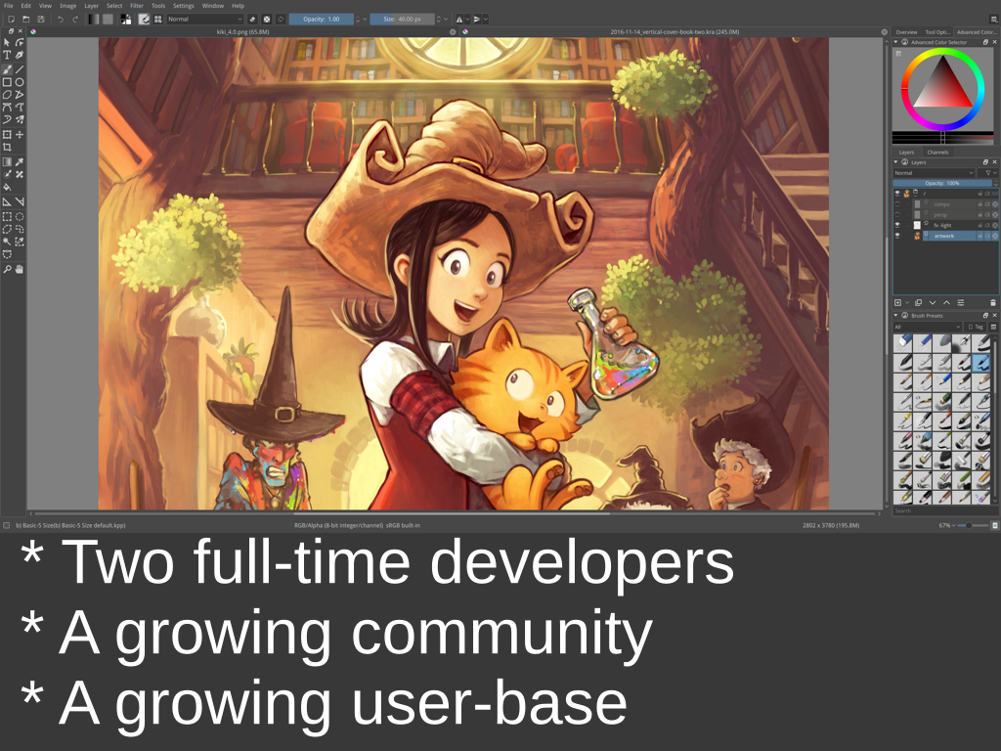
Notes:
2017 was a difficult year, but the community rallied magnificiently. We now have two people working on krita full-time, and one working on Krita part-time. The community and userbase are growing and very healthy. Krita is the second-busiest project in the KDE community, directly after
the desktop shell project itself.

Slide 26
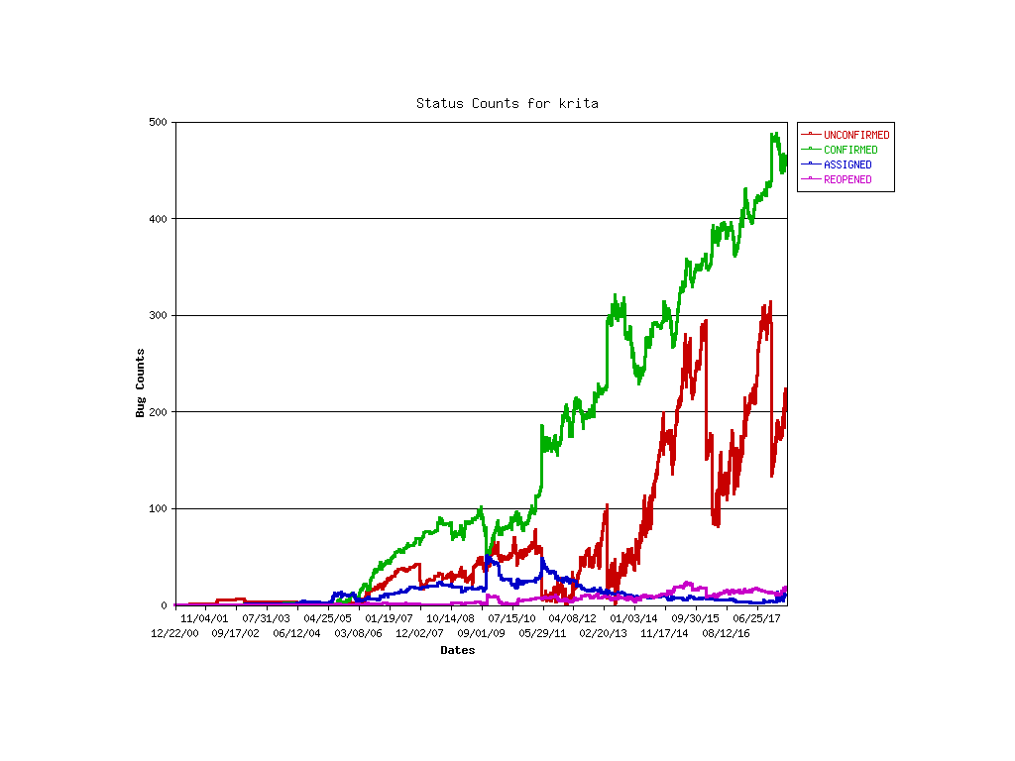
Notes:
Plan for 2018
The main thing is stabilizing. We've been doing feature-oriented fund raisers 3 times (2014, 2015, 2016), so lots of stuff got added. We've decided to take a year to work on behind-the scenes things, like resource management, improve the testing framework, get rid of a bunch of long-standing bugs. We intend to have 6 releases of Krita 4 this year.

Slide 27
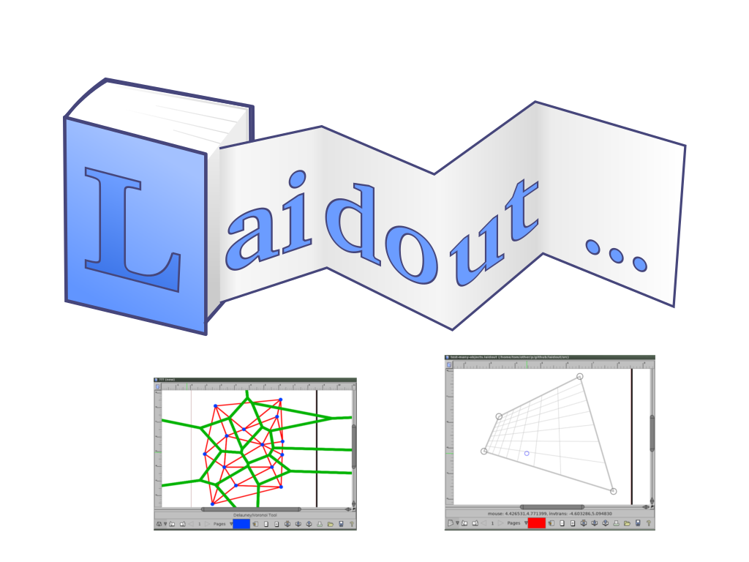
Notes:
Laidout continues to explore various types of interfaces.

Slide 28
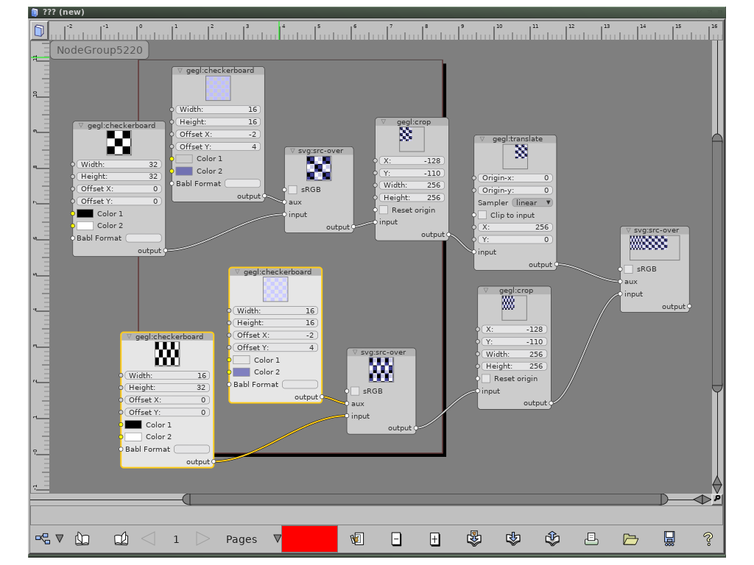
Notes:
For instance, Laidout now has a node based interface, implemented in part with gegl nodes.
One can also import and export filters from svg files.

Slide 29
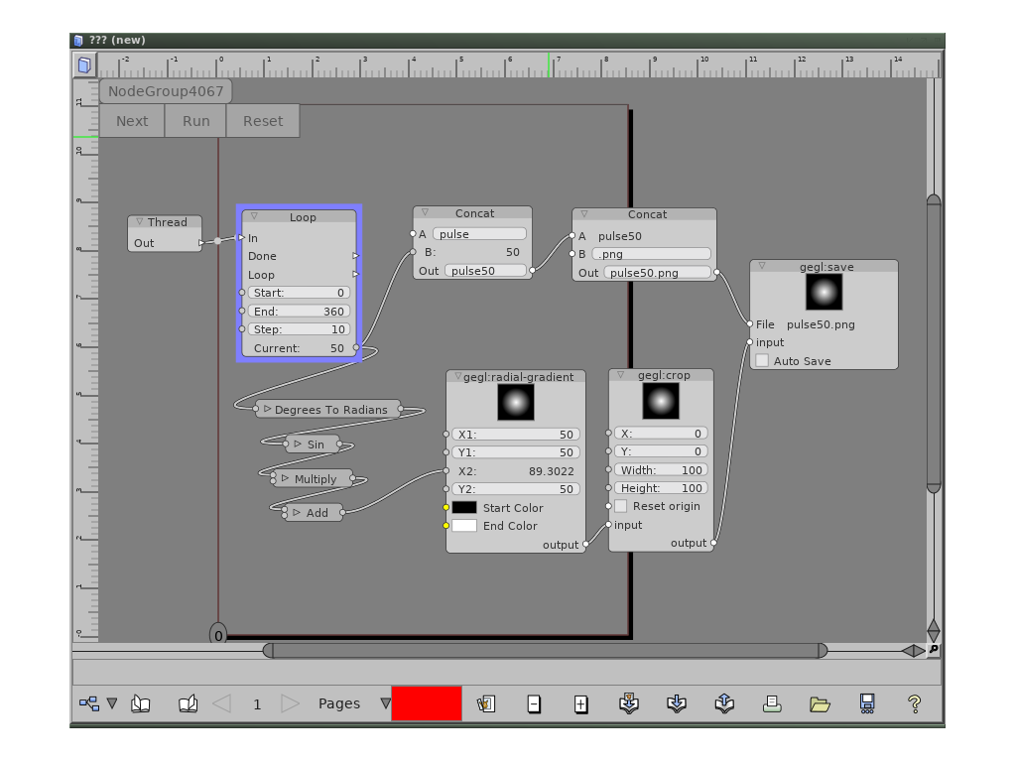
Notes:
Work continues connecting these nodes to Laidout objects, such as use as object filters. Also to come are more ways to interoperate between node systems of different applications.

Slide 30
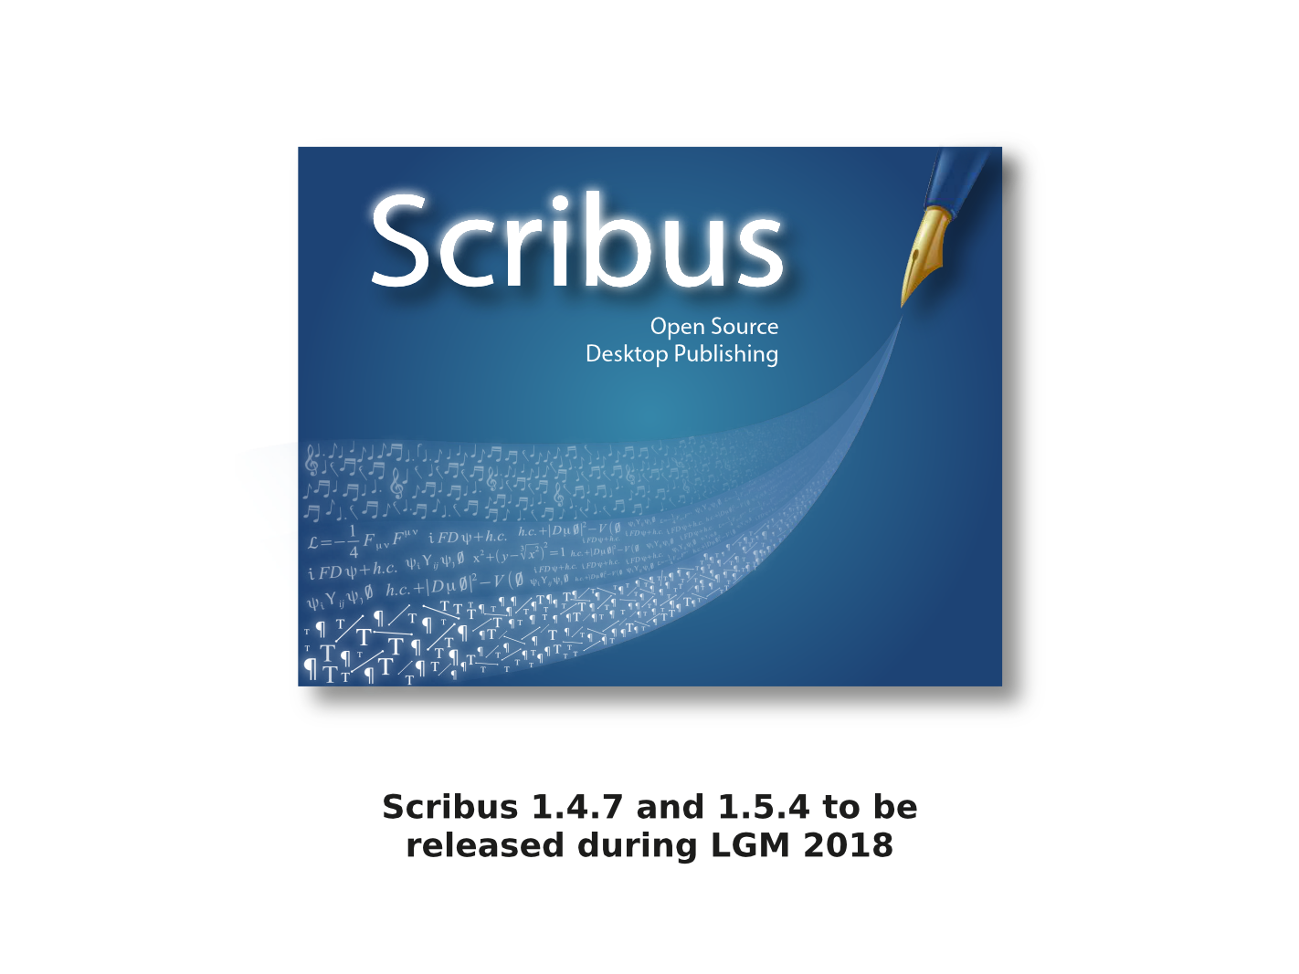
Notes:
Since the last LGM, Scribus has undergone some major changes and seen one official release. The Scribus Team will release version 1.4.7 in the stable branch and version 1.5.4 in the stable development branch during this year's LGM. More disruptive changes are currently being implemented, tested and refined in a few experimental branches.

Slide 31
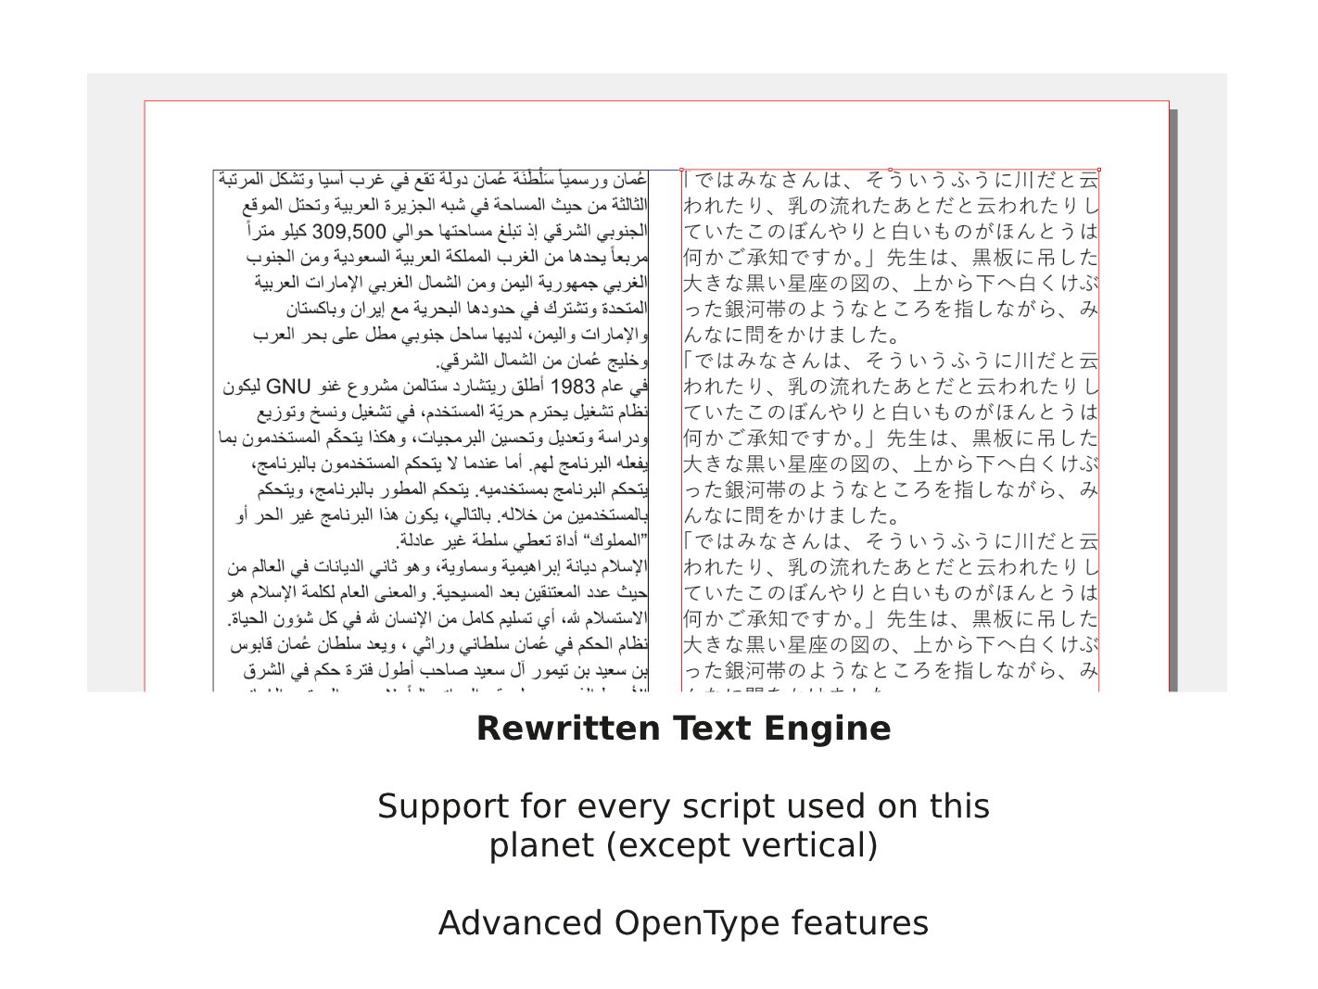
Notes:
The first major change was the replacement of the ageing and outdated text enginge with one completely rewritten from scratch by a team led by Khaled Hosny. As a result, Scribus now supports every writing system in the world, including many of those that are usually ignored by the major vendors of commercial DTP software. There are still some limitations regarding so-called CJK scripts -- CJK standing for Chinese, Japanese and Korean, which also includes Mongolian --, because vertical text direction isn't supported yet.
The rewrite also resulted in a preview for fonts in font selectors, a remarkable speed-up in text rendering and hence working with long documents, and a vastly improved PDF export when it comes to text.
Since so many text-related features had been added, it was inevitable to remove the "Text" tab from the already monstrously-sized Properties Palette and to create a separate "Text Properties Palette".

Slide 32
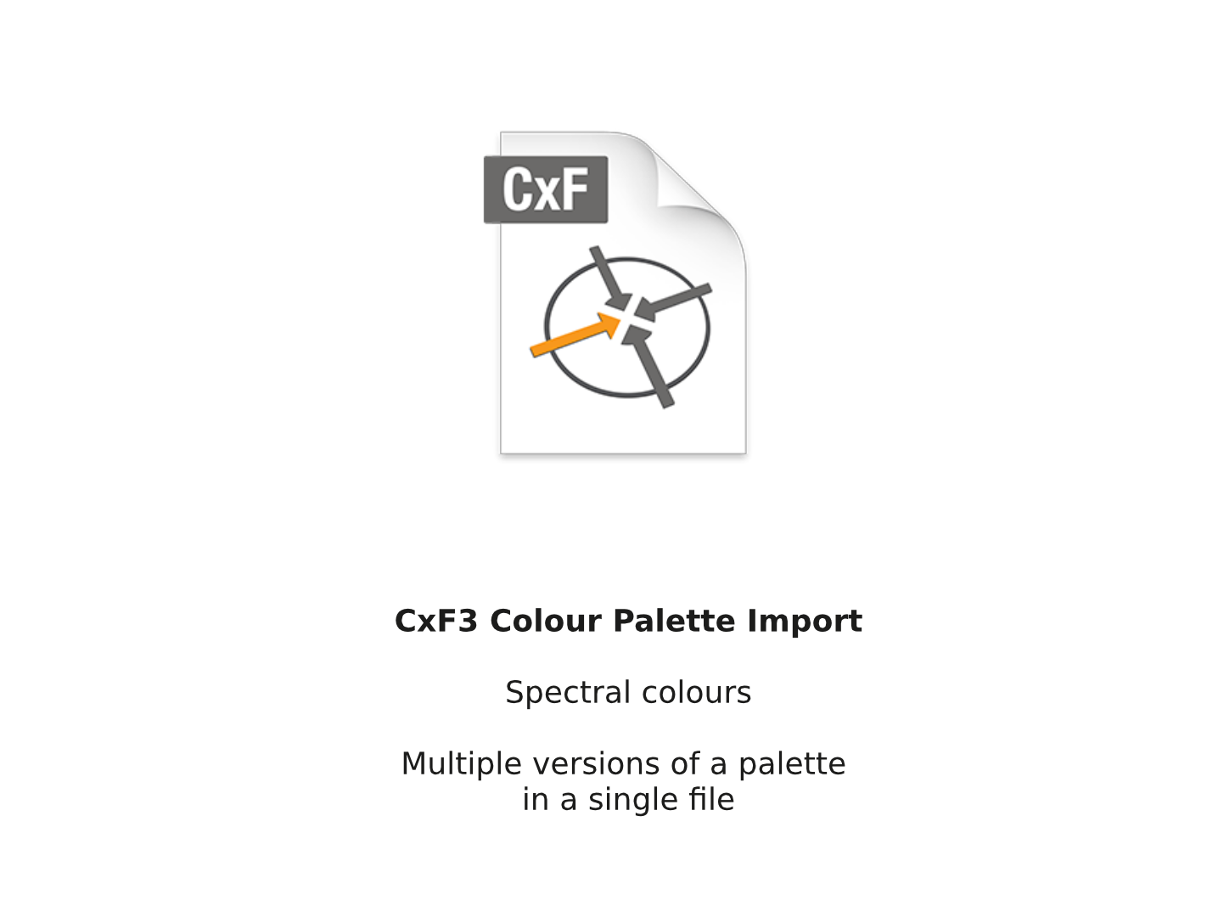
Notes:
The second major change is related to colours. First, Jean Ghali expanded the colour precision for fill colours to 64 Bit per channel. As a comparison, InDesign CC offers 16 Bit, and QuarkXpress still seems to work, at least partially, on an 8 Bit foundation.
More importantly, as of Scribus version 1.5.4, Scribus will be the first end user software to support the open standard CxF3 for colour palettes. Ironically, CxF3 was developed by one of the most proprietary companies out there, namely X-Rite/Pantone. It is, however, a useful standard, because it allows for more than one version of a colour palette in a single file, so you can use

