Slide 1
S-NET Scholar Net
Bijoyan Das
Boudhayan Dev
Prodipto Lahiri

Slide 2
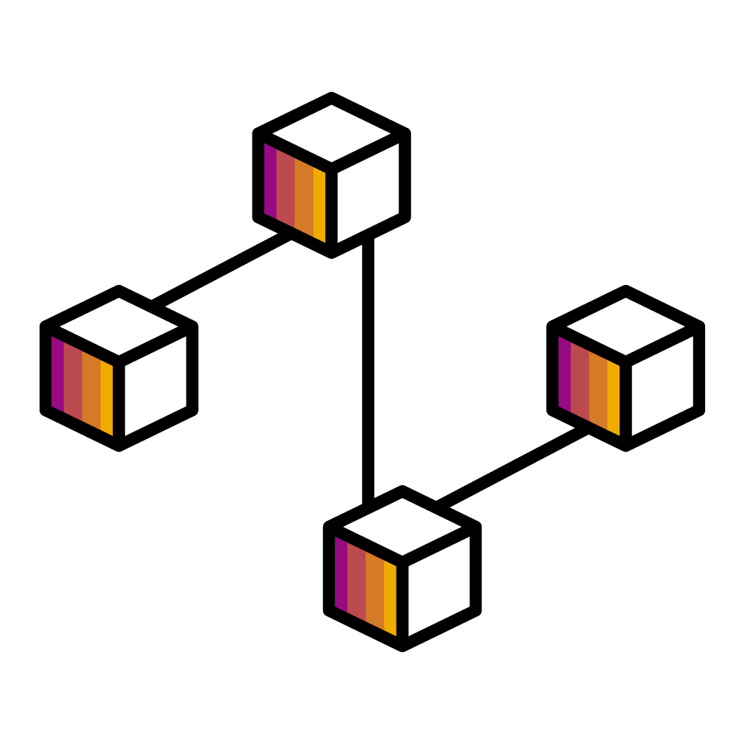

What is Snet?
The technology that powers Scholars and managers to connect with others and know each others skills and expertise…
This allows them to not only search teams but also fellow employees with similar interests

Slide 3
PROJECT DETAILS
S-Net is an application that will serve as a portal to connect managers, jobs and scholars.
The application will recommend jobs to the scholars based on their interest.
The application will identify the best person to provide help to the scholar based on their area of interest.
The application will allow managers to post new jobs as well.

Slide 4
INTERACTION DIAGRAM DETAILS
SCHOLARS | MANAGER | ADMIN
CRUD Interests. Search relevant jobs as per interests. Access the details of scholars who have worked in those teams in the past. Enter level of expertise. | Post job requirements. Approve the scholar details for their teams. Approve the scholars’ level of expertise. View scholars’ past works to scrutinize applications. | CRUD Scholars. CRUD Managers. Control and Maintenance.

Slide 5
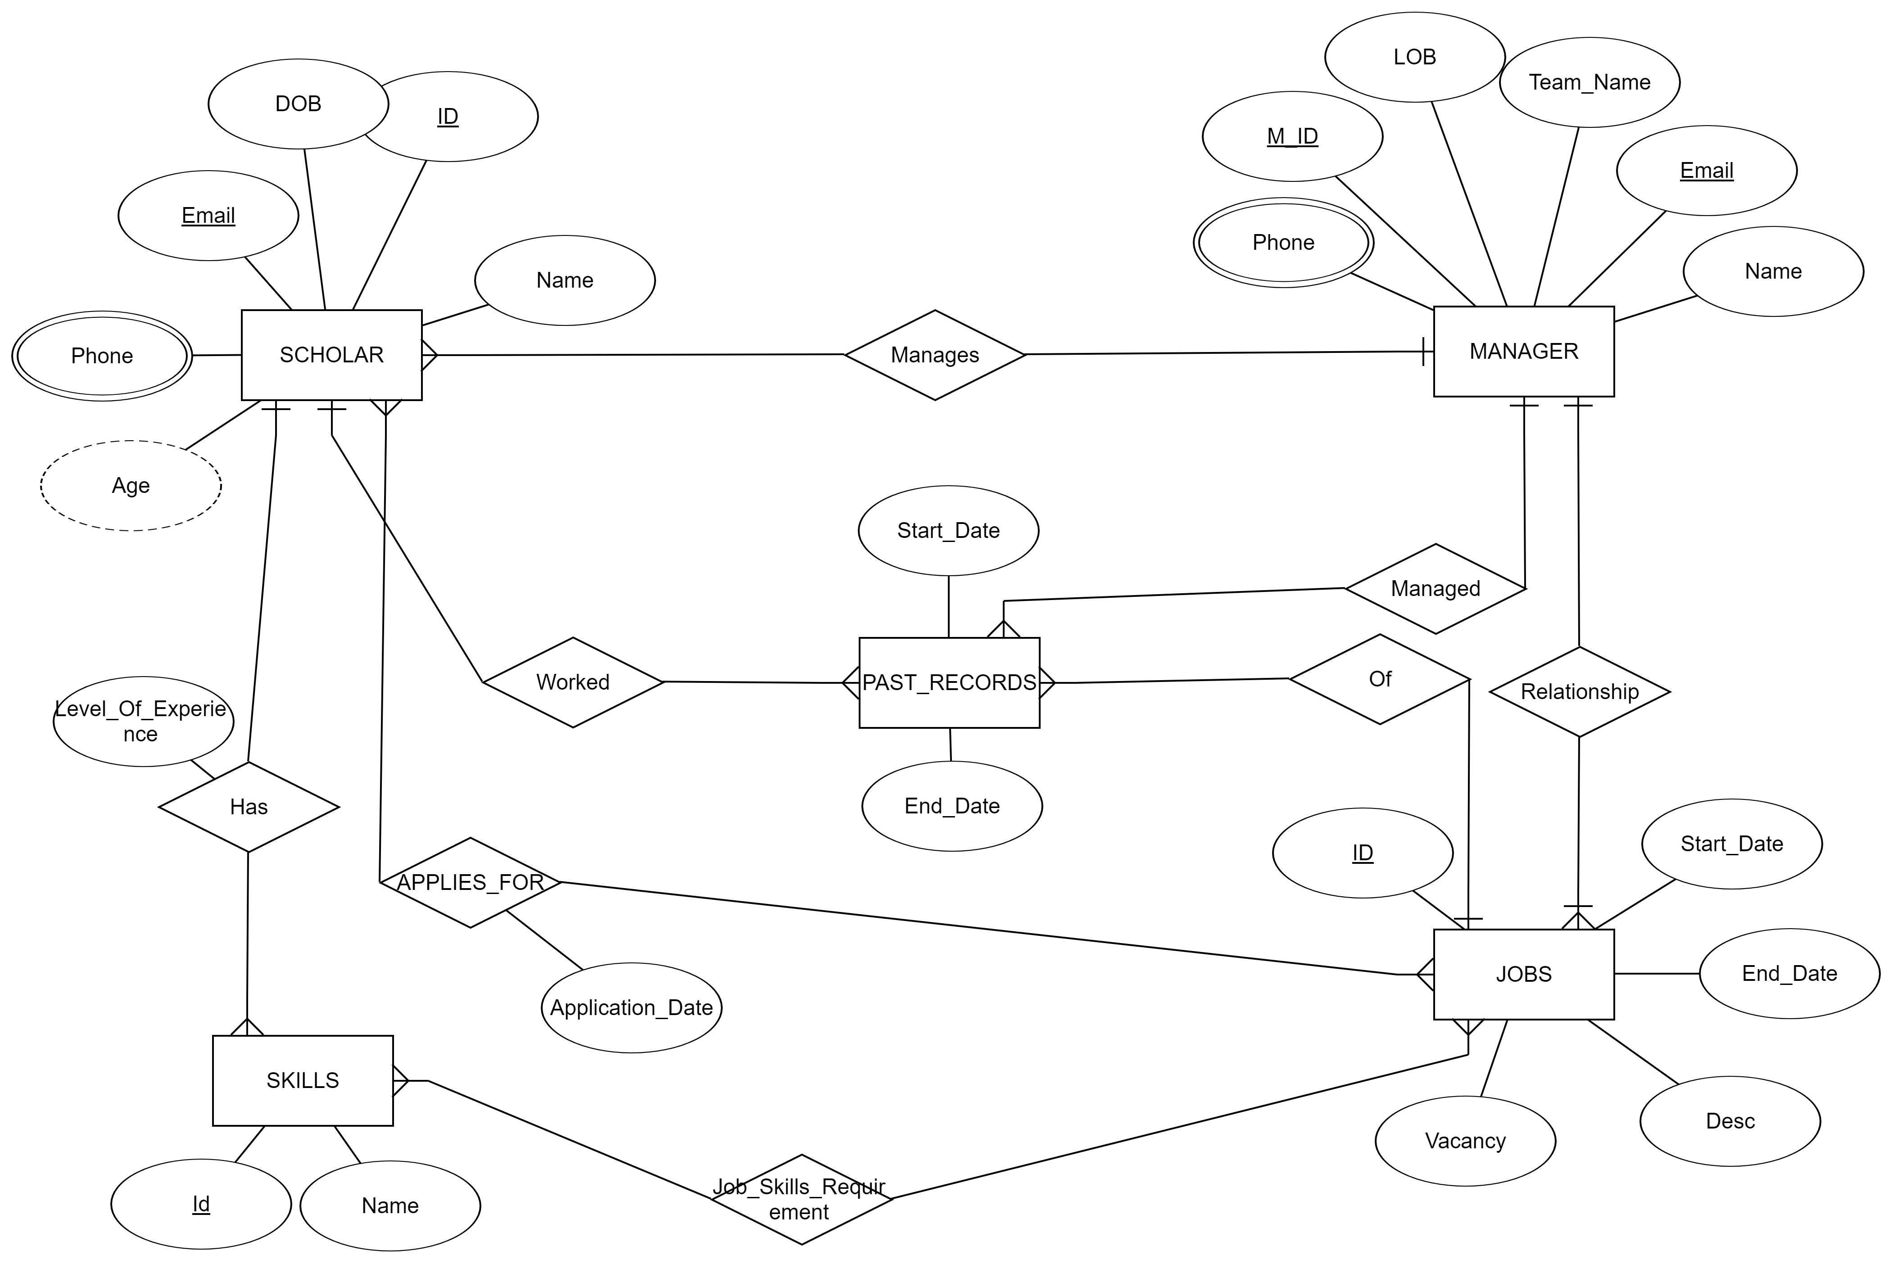
ER DIAGRAM
BASE TABLES
1. SCHOLAR
2. MANAGER
3. JOBS
4. PAST_RECORDS
5. SKILLS

Slide 6




Database Layer
Procedural Layer
Service Layer
Interface Layer

Slide 7



Personas in Snet
Scholars
Managers
Admin
Notes:
Q1. Who invented blockchain and in which year.

Slide 8

Demo

Slide 9
Thank you.
Contact information:
Bijoyan Das
bijoyan.das@sap.com
Boudhayan Dev
boudhayan.dev@sap.com
Prodipto Lahiri
prodipto.lahiri@sap.com

