Slide 1
Invasives: Zebra Mussels
Mariah Boudreau
Amanda Jones
Kerria Burns

Slide 2
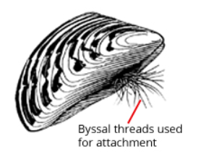
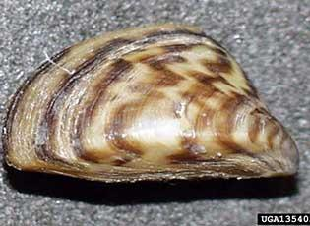
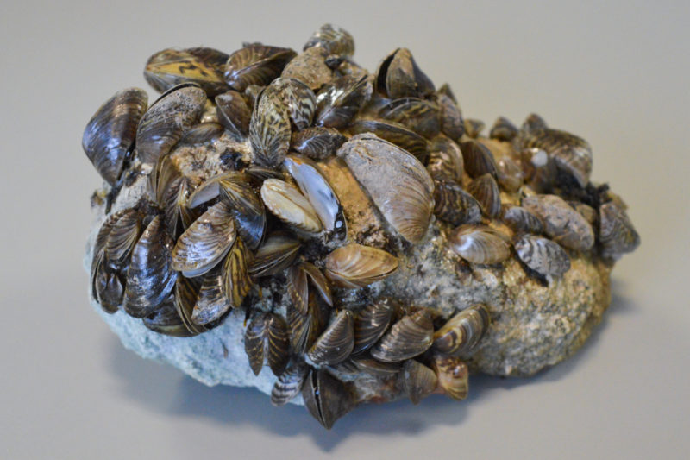
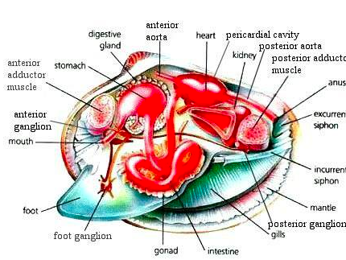
What is a zebra mussel?
Notes:
Invasive species found in the Great Lakes region and throughout the mid and eastern U.S.
Native to Europe, introduced to Lake St. Clair in 1985
Phylum: Mollusca, class: Bivalvia
Bivalves originated in early Cambrian
Live attached to all sorts of hard substrates: other invertebrates, structures, debris, logs

Slide 3
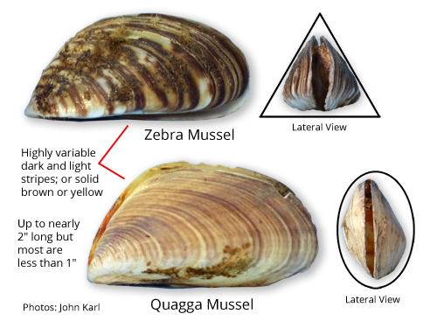
Difference between zebra and quagga mussel
Notes:
Quagga mussels outcompete and can reach greater depths and are more cold-tolerant than zebra mussels
Quagga mussels do not need hard substrate to attach to
Zebra mussels at 899 per square meter, but quagga mussels at 7,790 per square meter
Quagga mussels almost completely displaced zebra mussels in Lake Michigan between 2000 and 2005
Quagga mussels have spread further west

Slide 4
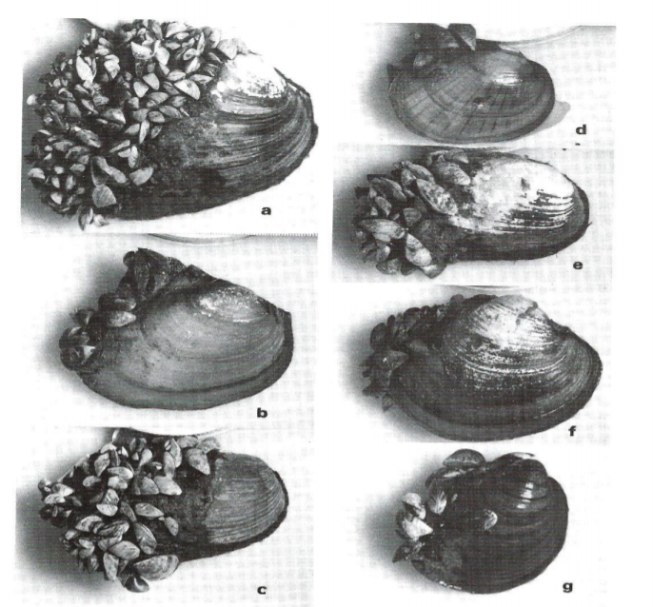
Comparison to native bivalves
Mackie 1991
Notes:
Anatomical differences: attachment to substrate vs. life in the sediments

Slide 5
Why are zebra mussels important?

Slide 6
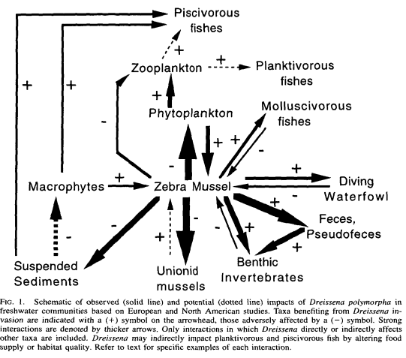
MacIsaac 2015

Slide 7
Other ecological roles
Change abundance and composition of invertebrates in sediment

Slide 8
Zebra mussels in the Great Lakes
Show all great lakes with occurrences
Where highest?

Slide 9
Conditions conducive (or not)
Characteristics of lakes that make them amenable to zebra mussel introduction
Mention lake Superior’s absence of

Slide 10
Temperature
Effects on reproduction
Physiological limits

Slide 11
Image sources
https://www.invasivespeciesinfo.gov/profile/zebra-mussel
http://www.seagrant.umn.edu/ais/mussel
https://reportingtexas.com/october-floods-might-slow-spread-of-invasive-zebra-mussel/

