Slide 1
In the grim future is nuclear war
Huddled within 6 shelters are the last remants of humanity
All that stands between them and ICBMs falling onto them
Is an A.I.

Slide 2

Project Missle Command
By:
Shannon Smith
Michael Mahrous
Image Credit: fewerton/Shutterstock.com

Slide 3
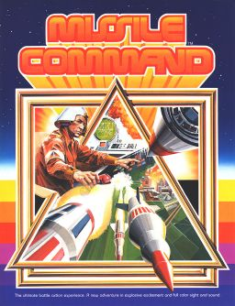
What is Missle Command?
To quote Wikipedia:
“Missile Command is a 1980 shoot 'em up arcade video game developed and published by Atari, Inc. and licensed to Sega for Japanese and European releases. It was designed by Dave Theurer[...]. Released during the Cold War, the player uses a trackball to defend six cities from intercontinental ballistic missiles by launching anti-ballistic missiles from three bases.”
By Source, Fair use, https://en.wikipedia.org/w/index.php?curid=24932097

Slide 4
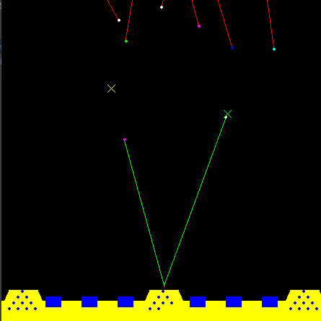
Training Methodology
For the environment we used a python recreation of the game by user
Forestf90 on GitHub
We retrofitted the program to take an AI agent in place of a human with a mouse
We employed two models for this to compare results:
Pytorch Sequential Model
Genetic Algorithm
Both models take in input of size 50, representing the possible positions of the ICBMs and whether the shelters and silos are still up. They present output of size 3 representing if the agent should take a shot, and where
https://github.com/Forestf90/MissileCommand
Under GPL-3.0 License

Slide 5
Pytorch Sequential Model
Model takes input of size 50, and feeds it through a Linear Model using
512/1024/128 and ReLU activation.
When the model is fed it returns the output of the model or epsilon variant.
The state information is stored in a replay deque, to be later fed through.
As the game generates a score at the end, the reward is split among the
entries within the deque

Slide 6
Genetic Algorithm
Model takes input of size 50, and feeds it through a Linear Model using
512/1024/128 and ReLU activation.
When the model is fed it returns the output of the model or epsilon variant.
The state information is stored in a replay deque, to be later fed through.
As the game generates a score at the end, the reward is split among the
entries within the deque

Slide 7
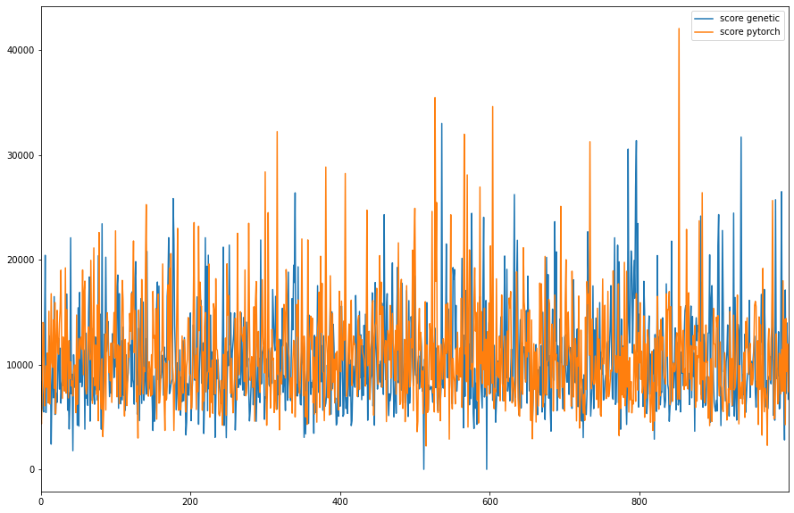
Comparasion by Score

Slide 8
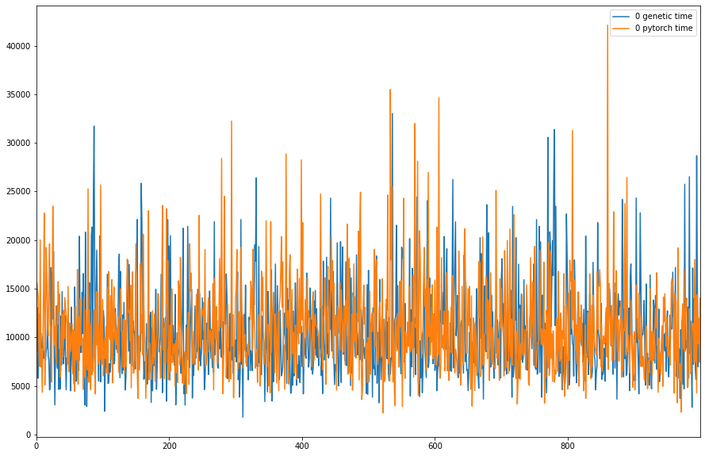
Comparasion by Time

Slide 9
