Slide 1

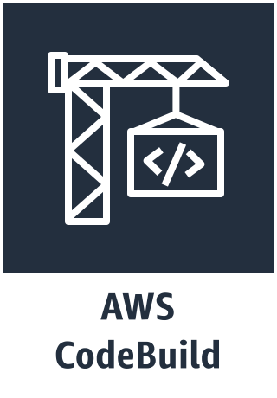
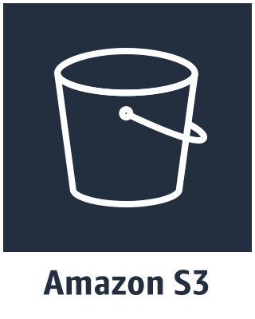


GitHub
create/update PR
Contributors
triggers CI build
view CI build logs
github-codebuild-logs app
sends
copies build log
triggers
Build Status Update
(CloudWatch Event)
ProcessBuildEvents

