Slide 1
Machine Learning Algorithms
Konstantinos I. Bougioukas, MSc, PhD
2026

Slide 2


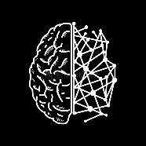
AI Hierarchy
AI
≥
Symbolic AI (LISP, PROLOG)
→ Expert Systems
ML
→ Discovering Patterns
(e.g., Prediction)
→ Spotting outliers
(e.g., Cryptography)
DL
NN→
FM
LLM
CHATBOT
GEN AI
AUD
VID
DEEP FAKES

Slide 3
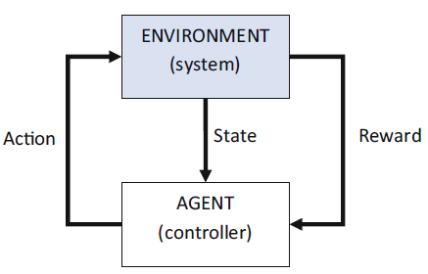
Learning methods of ML
Supervised Learning
(learns from labelled data)
Unsupervised Learning
(finds hidden patterns)
Reinforcement Learning
(Learns by trial and error,
rewards and penalties)
Regression: when the labels contain continuous values
Classification: when there are a discrete number of labels (classes)
Classic Algorithms
Linear, Polynomial Regression
k-Nearest Neighbours (k-NN)
Support Vector Machine (SVM)
Naïve Bayes Classifier
Decision Trees
Random Forest
Simple layer artificial network
Clustering (e.g., K-means, Hierarchical Clustering, DBSCAN)
Dimensionality Reduction (e.g., PCA)
Some of the existing applications:
Self-driving cars
Recommendation systems
Robotics.
Automated game play.
Notes:
Self-driving cars. A control system based on reinforcement learning is used to
adjust acceleration, braking and steering.
• Automated financial trading. The reward is based on the profit or loss for each
trade. The reinforcement learning Environment is built using historical stock
prices.
• Recommendation systems. The reward is given when, for example, the users
click on an item. Real-time learning improves the machine learning model or
recommendation systems are trained on historical data.
• Traffic light control.
• Logistics and supply chain optimization.
• Control and industrial applications, e.g., for optimizing energy consumption,
efficient equipment tuning, etc.
• Optimizing treatment policies or medication dosage in healthcare.
• Advertising optimization.
• Various types of automation.
• Robotics.
• Automated game play.

Slide 4
Supervised Learning Example

Slide 5




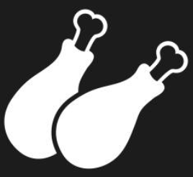







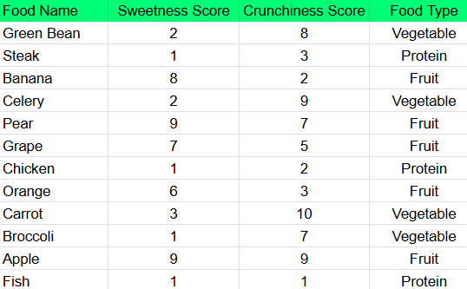
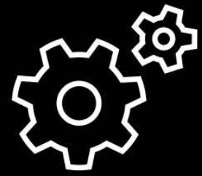
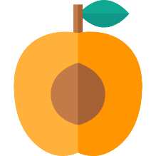

Labeled Data
vegetable
protein
fruit
vegetable
fruit
fruit
protein
fruit
vegetable
vegetable
fruit
protein
Feature extraction e.g., sweetness, crunchiness
Supervised Learning
Target output (labels)
Features
Experts labeled the foods
Algorithm
Learning to label
New data (sweetness = 6, crunchiness = 4 for apricot)
Fruit
Model

Slide 6
Classification Example: k-Nearest Neighbours (k-NN)
Algorithm of k‑NN
Vegetable
Carrot
Fruit
Choose a value for k (the number of "neighbours" we want to look at). For example, k=3.
Choose distance metric (e.g., Euclidean distance)
For a new data point:
Compute distance to all training points
Select the 3 closest
Majority Vote: 2 reds , 1 blue
Celery
Crunchiness Score
Green Bean
Apple
Broccoli
Pear
New data (apricot)
Bacon
Protein
Grape
Steak
Chicken
Orange
Banana
Fish
Sweetness Score

Slide 7
Advantages of k‑NN
Easy Algorithm
Algorithm = distance + neighbor selection procedure
(k-NN is considered a lazy learning algorithm because it doesn’t really train a model in advance)
Simple Model
Model = stored dataset + chosen k + distance rule
Disadvantages of k‑NN
Choice of k Is Crucial
Poor Performance with Imbalanced Classes
For classification, k‑NN may be biased toward majority classes if data is imbalanced.
Notes:
A small k can overfit (too sensitive), and a large k can underfit (too smooth).
Finding the right value of k usually requires cross‑validation.

Slide 8
Unsupervised Learning Example

Slide 9
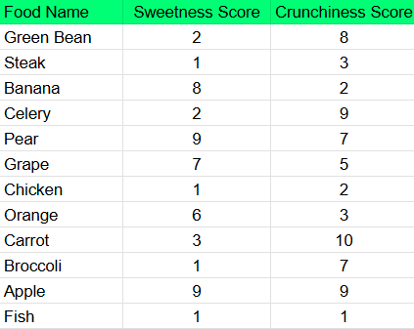

Unlabeled Data
Feature extraction e.g., sweetness, crunchiness
Unsupervised Learning
Features
Algorithm
Learning to cluster
New data (sweetness = 6, crunchiness =4 for apricot)
Model

Slide 10
Clustering Example: k-means (unsupervised)
Algorithm of k‑means
Choose k (the number of clusters). In this example, k=3.
Initialize 3 positions for centroids randomly. Each of the centroids now represents a cluster.
Measure the distance from the first data point (Green Bean) to each of the cluster centroids.
Assign the point to the cluster that is closest to it.
Carrot
Celery
Crunchiness Score
Green Bean
Apple
X
X
Broccoli
Pear
Bacon
Grape
X
Steak
Chicken
Orange
Fish
Banana
Sweetness Score

Slide 11
Clustering Example: k-means (unsupervised)
Algorithm of k‑means
Choose k (the number of clusters). In this example, k=3.
Initialize 3 positions for centroids randomly. Each of the centroids now represents a cluster.
Measure the distance from the first data point (Green Bean) to each of the cluster centroids.
Assign the point to the cluster that is closest to it.
Repeat for all data points (e.g., Steak) to be initially assigned to a cluster.
Carrot
Celery
Green Bean
Crunchiness Score
X
Apple
X
Broccoli
Pear
Bacon
Grape
X
Steak
Chicken
Orange
Fish
Banana
Sweetness Score

Slide 12
Clustering Example: k-means (unsupervised)
Algorithm of k‑means
Choose k (the number of clusters). In this example, k=3.
Initialize 3 positions for centroids randomly. Each of the centroids now represents a cluster.
Measure the distance from the first data point (Green Bean) to each of the cluster centroids.
Assign the point to the cluster that is closest to it.
Repeat for all data points (e.g., Banana) to be initially assigned to a cluster.
Carrot
Celery
Green Bean
Crunchiness Score
X
Apple
X
Broccoli
Pear
Bacon
Grape
X
Steak
Chicken
Orange
Fish
Banana
Sweetness Score

Slide 13
Clustering Example: k-means (unsupervised)
Algorithm of k‑means
Choose k (the number of clusters). In this example, k=3.
Initialize 3 positions for centroids randomly. Each of the centroids now represents a cluster.
Measure the distance from the first data point (Green Bean) to each of the cluster centroids.
Assign the point to the cluster that is closest to it.
Repeat for all data points (e.g., Celery) to be initially assigned to a cluster.
Carrot
Celery
Green Bean
Crunchiness Score
X
Apple
X
Broccoli
Pear
Bacon
Grape
X
Steak
Chicken
Orange
Fish
Banana
Sweetness Score

Slide 14
Clustering Example: k-means (unsupervised)
Algorithm of k‑means
Choose k (the number of clusters). In this example, k=3.
Initialize 3 positions for centroids randomly. Each of the centroids now represents a cluster.
Measure the distance from the first data point (Green Bean) to each of the cluster centroids.
Assign the point to the cluster that is closest to it.
Repeat for all data points (e.g., Pear) to be initially assigned to a cluster.
Carrot
Celery
Green Bean
Crunchiness Score
X
Apple
X
Broccoli
Pear
Bacon
Grape
X
Steak
Chicken
Orange
Fish
Banana
Sweetness Score

Slide 15
Clustering Example: k-means (unsupervised)
Algorithm of k‑means
Choose k (the number of clusters). In this example, k=3.
Initialize 3 positions for centroids randomly. Each of the centroids now represents a cluster.
Measure the distance from the first data point (Green Bean) to each of the cluster centroids.
Assign the point to the cluster that is closest to it.
Repeat for all data points (e.g., Grape) to be initially assigned to a cluster.
Carrot
Celery
Green Bean
Crunchiness Score
X
Apple
X
Broccoli
Pear
Bacon
Grape
X
Steak
Chicken
Orange
Fish
Banana
Sweetness Score

Slide 16
Clustering Example: k-means (unsupervised)
Algorithm of k‑means
Choose k (the number of clusters). In this example, k=3.
Initialize 3 positions for centroids randomly. Each of the centroids now represents a cluster.
Measure the distance from the first data point (Green Bean) to each of the cluster centroids.
Assign the point to the cluster that is closest to it.
Repeat for all data points (e.g., Chicken) to be initially assigned to a cluster.
Carrot
Celery
Green Bean
Crunchiness Score
X
Apple
X
Broccoli
Pear
Bacon
Grape
X
Steak
Chicken
Orange
Fish
Banana
Sweetness Score

Slide 17
Clustering Example: k-means (unsupervised)
Algorithm of k‑means
Choose k (the number of clusters). In this example, k=3.
Initialize 3 positions for centroids randomly. Each of the centroids now represents a cluster.
Measure the distance from the first data point (Green Bean) to each of the cluster centroids.
Assign the point to the cluster that is closest to it.
Repeat for all data points (e.g., Orange) to be initially assigned to a cluster.
Carrot
Celery
Green Bean
Crunchiness Score
X
Apple
X
Broccoli
Pear
Bacon
Grape
X
Steak
Chicken
Orange
Fish
Banana
Sweetness Score

Slide 18
Clustering Example: k-means (unsupervised)
Algorithm of k‑means
Choose k (the number of clusters). In this example, k=3.
Initialize 3 positions for centroids randomly. Each of the centroids now represents a cluster.
Measure the distance from the first data point (Green Bean) to each of the cluster centroids.
Assign the point to the cluster that is closest to it.
Repeat for all the points to be initially assigned to a cluster.
Update centroids (mean of assigned points).
Carrot
Celery
Green Bean
X
Crunchiness Score
X
Apple
X
X
Broccoli
Pear
Bacon
Grape
X
Steak
X
Orange
Chicken
Fish
Banana
Sweetness Score

Slide 19
Clustering Example: k-means (unsupervised)
Algorithm of k‑means
Choose k (the number of clusters). In this example, k=3.
Initialize 3 positions for centroids randomly. Each of the centroids now represents a cluster.
Measure the distance from the first data point (Green Bean) to each of the cluster centroids.
Assign the point to the cluster that is closest to it.
Repeat for all the points to be initially assigned to a cluster.
Update centroids (mean of assigned points).
Repeat Steps 3 to 6.
Carrot
Celery
Green Bean
X
Crunchiness Score
Apple
Broccoli
X
Pear
Bacon
Grape
Steak
X
Chicken
Orange
Fish
Banana
Sweetness Score

Slide 20
Clustering Example: k-means (unsupervised)
Algorithm of k‑means
Choose k (the number of clusters). In this example, k=3.
Initialize 3 positions for centroids randomly. Each of the centroids now represents a cluster.
Measure the distance from the first data point (Green Bean) to each of the cluster centroids.
Assign the point to the cluster that is closest to it.
Repeat for all the points to be initially assigned to a cluster.
Update centroids (mean of assigned points).
Repeat Steps 3 to 6 until the centroids stop moving.
Carrot
Celery
X
Crunchiness Score
Green Bean
Apple
Broccoli
Pear
X
Bacon
Grape
Steak
X
Chicken
Orange
Fish
Banana
Sweetness Score

Slide 21
Advantages of k‑means
Simple and Easy to Understand
Algorithm = iterative centroid update procedure
Model = the learned centroid positions
Converges Quickly
It typically reaches a stable set of centroids within a few iterations.
Disadvantages of k‑means
Choice of k Is Crucial
Sensitive to Initialization
The initial placement of centroids can significantly influence the final clustering results
Assumes Spherical Clusters
Notes:
A small k can overfit (too sensitive), and a large k can underfit (too smooth).
Finding the right value of k usually requires cross‑validation.

