Slide 1
Deep Learning
Konstantinos I. Bougioukas, MSc, PhD
2026

Slide 2
Predict house prices
Single neural neuron
bias
Feature | Value | Normalized Value
m² | 120 | 0.6
No. bedrooms | 2 | 0.4
age | 30 | 0.3
Zip code | 55132 (7/10) | 0.7
0.6
w1
1
0.4
w2
b
w3
N
Output
0.3
w4
neuron
0.7
weights
Σ
Νeuron
Input vector X
Σ
Linear
part:
z = 0.6 · w1 + 0.4 · w2 + 0.3 · w3 + 0.7 · w1 + b
Activation function introduce non-linearity into each neuron’s output, enabling the network to learn and represent complex patterns and associations in the input data.
Non-Linear
part:
σ(z) activation function

Slide 3
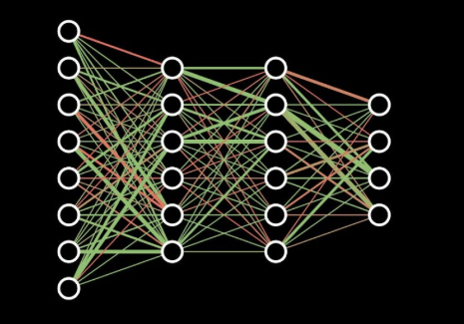
Deep Learning
It is a kind of machine learning which uses multi-layered neural networks and big data.
“black box”
The neural network consists of:
an input layer (vector of values)
several hidden layers
output layer
Output layer
hidden layers
Input layer

Slide 4
Building blocks of an artificial neuron network (ANN)
Architecture (structure of the ANN)
Algorithm (the learning procedure e.g., backpropagation combined with Gradient Descent)
Model (Final learned weights and biases)
Data (The Fuel)

Slide 5
Multi-layer neural neuron architecture
Three “Hidden layers” each of three neurons
0.6
N1
N1
N1
0.4
N2
N2
N2
N1
0.3
N3
N3
N3
0.7
Input layer (vector of values)
Output layer
33 weights + 10 biases = 43 parameters

Slide 6
Multi-layer neural neuron architecture
Three “Hidden layers” each of three neurons
0.6
N1
N1
N1
0.4
N2
N2
N2
N1
0.3
N3
N3
N3
0.7
Input layer
Hidden layer 1
Output layer

Slide 7
Multi-layer neural neuron architecture
Three “Hidden layers” each of three neurons
0.6
N1
N1
N1
0.4
N2
N2
N2
N1
0.3
N3
N3
N3
0.7
Input layer
Hidden layer 1
Output layer

Slide 8
Multi-layer neural neuron architecture
Three “Hidden layers” each of three neurons
0.6
N1
N1
N1
0.4
N2
N2
N2
N1
0.3
N3
N3
N3
0.7
Input layer
Hidden layer 1
Output layer

Slide 9
Multi-layer neural neuron architecture
Three “Hidden layers” each of three neurons
0.6
N1
N1
N1
0.4
N2
N2
N2
N1
0.3
N3
N3
N3
0.7
Input layer
Hidden layer 2
Output layer

Slide 10
Multi-layer neural neuron architecture
Three “Hidden layers” each of three neurons
0.6
N1
N1
N1
0.4
N2
N2
N2
N1
0.3
N3
N3
N3
0.7
Input layer
Hidden layer 2
Output layer

Slide 11
Multi-layer neural neuron architecture
Three “Hidden layers” each of three neurons
0.6
N1
N1
N1
0.4
N2
N2
N2
N1
0.3
N3
N3
N3
0.7
Input layer
Hidden layer 2
Output layer

Slide 12
Multi-layer neural neuron architecture
Three “Hidden layers” each of three neurons
0.6
N1
N1
N1
0.4
N2
N2
N2
N1
0.3
N3
N3
N3
0.7
Input layer
Hidden layer 2
Output layer

Slide 13
Multi-layer neural neuron architecture
Three “Hidden layers” each of three neurons
0.6
N1
N1
N1
0.4
N2
N2
N2
N1
0.3
N3
N3
N3
0.7
Input layer
Hidden layer 3
Output layer

Slide 14
Multi-layer neural neuron architecture
Three “Hidden layers” each of three neurons
0.6
N1
N1
N1
0.4
N2
N2
N2
N1
0.3
N3
N3
N3
0.7
Input layer
Hidden layer 3
Output layer

Slide 15
Multi-layer neural neuron architecture
Three “Hidden layers” each of three neurons
0.6
N1
N1
N1
0.4
N2
N2
N2
N1
0.3
N3
N3
N3
0.7
Input layer
Hidden layer 3
Output layer

Slide 16
Multi-layer neural neuron architecture
Three “Hidden layers” each of three neurons
0.6
N1
N1
N1
0.4
N2
N2
N2
N1
0.3
N3
N3
N3
0.7
Input layer
Hidden layer 3
Output layer

Slide 17
Multi-layer neural neuron architecture
Three “Hidden layers” each of three neurons
0.6
N1
N1
N1
0.4
N2
N2
N2
N1
ŷ
0.3
prediction
N3
N3
N3
0.7
Input layer
Output layer

Slide 18
Feedforward (the prediction)
0.6
N1
N1
N1
0.4
N2
N2
N2
N1
0.3
N3
N3
N3
0.7
Input layer
Output layer

Slide 19
Feedforward (the prediction)
0.6
N1
N1
N1
0.4
N2
N2
N2
N1
0.3
N3
N3
N3
0.7
Input layer
Output layer

Slide 20
Feedforward (the prediction)
0.6
N1
N1
N1
0.4
N2
N2
N2
N1
0.3
N3
N3
N3
0.7
Input layer
Output layer

Slide 21
Feedforward (the prediction)
0.6
N1
N1
N1
0.4
N2
N2
N2
N1
0.3
N3
N3
N3
0.7
Input layer
Output layer

Slide 22
Feedforward (the prediction)
0.6
N1
N1
N1
0.4
N2
N2
N2
N1
ŷ
0.3
prediction
N3
N3
N3
0.7
Input layer
Output layer

Slide 23
Measuring Error
In data we have (x1, y1)
0.6
N1
N1
N1
0.4
N2
N2
N2
N1
ŷ1
0.3
N3
N3
N3
0.7
Error: (y1 - ŷ1)²
X1

Slide 24
Measuring Error
In data we have (x2, y2)
0.5
N1
N1
N1
0.3
N2
N2
N2
N1
ŷ2
0.4
N3
N3
N3
0.8
Error: (y2 - ŷ2)²
X2

Slide 25

Mini-batch approach
Instead of calculating the error for one single row of data (SGD) or the entire dataset (Batch), we divide the data into small groups called mini-batches.
Split: We divide the training set into small equal-sized groups (common sizes n are 32, 64, or 128).
Feedforward: We pass one mini-batch through the network at once.
Loss Calculation: We calculate the average loss for just those 32 or 64 samples.
Loss (cost) function for regression:
Mean Squared Error (MSE)
$$MSE=\frac{1}{n}\sum_{i=1}^{n}{{\left(y_{i}−\hat{y_{i}}\right)}^{2}}$$

Slide 26
Backpropagation (the correction)
0.6
N1
N1
N1
0.4
The error is propagated backward through the network
N2
N2
N2
N1
0.3
N3
N3
N3
Adjust the weights
0.7
Input layer
Output layer

Slide 27
Backpropagation (the correction)
0.6
N1
N1
N1
0.4
The error is propagated backward through the network
N2
N2
N2
N1
0.3
N3
N3
N3
0.7
Adjust the weights
Input layer
Output layer

Slide 28
Backpropagation (the correction)
0.6
N1
N1
N1
0.4
The error is propagated backward through the network
N2
N2
N2
N1
0.3
N3
N3
N3
0.7
Adjust the weights
Input layer
Output layer

Slide 29
Backpropagation (the correction)
0.6
N1
N1
N1
0.4
The error is propagated backward through the network
N2
N2
N2
N1
0.3
N3
N3
N3
0.7
Adjust the weights
Input layer
Output layer

Slide 30
Learning process
Prediction (forward pass): The ANN predicts a price using the current weights and biases by propagating the input features forward through all layers.
Loss Calculation: The Loss Function (e.g., Mean Squared Error, MSE) measures how far the prediction is from the true value. The goal of training is to minimize this value.
Backpropagation: The error is propagated backward through the network using the chain rule of calculus. This computes the gradient (partial derivative) of the loss with respect to every weight and bias, revealing how much each parameter contributed to the error.
Gradient Descent Optimization: Gradient Descent algorithm used to find the optimal weights and biases that minimize the Loss function. It iteratively adjusts (updates) the weights and biases in the direction that reduces the loss more rapidly.
Iteration (Epochs & Batches): Steps 1–4 repeat across mini-batches of training data for multiple epochs until the loss converges to a minimum.

Slide 31
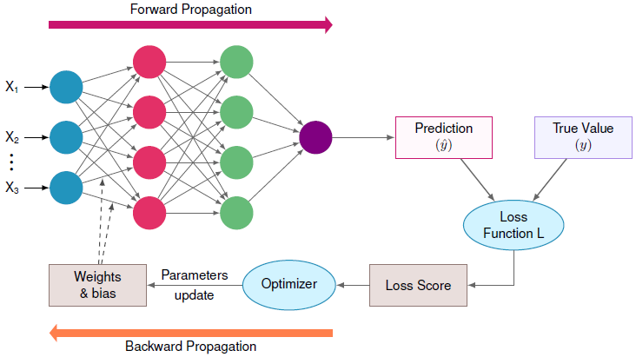
Schematic representation of MNN
Source: https://mlsysbook.ai/book/contents/core/dl_primer/dl_primer.html

Slide 32
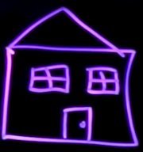
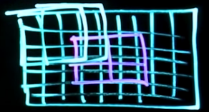
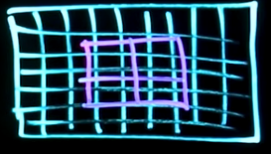
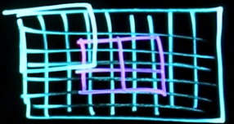

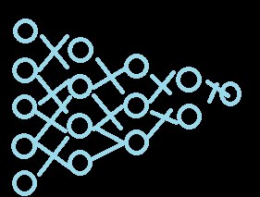











Convolutional Neural Network (CNN)
Zoom in a particular part and we get the window.
CNN could say that these two objects are the same thing through the application of filters
CNN
Pooling process
Task 1: pattern recognition of edges and angles
Filter 1
Filter 2
Filter 3
Task 2: pattern recognition of house components
Task 3: pattern recognition of type of building
Notes:
Within these layers we have sth called filters. And it’s the filters that perform the pattern recognition.
A filter is basically a 3x3 block. Within the block we can specify a pattern to look for.

Slide 33
Generative Adversarial Network (GAN)
Unsupervised Learning
(it effectively supervised itself)
Supervised Learning
Generator
Input
CNN
Creates fake samples
Model
Predicted Output
Expected Output
CNN
Discriminator
Real
samples
Update
Domain

