Slide 1
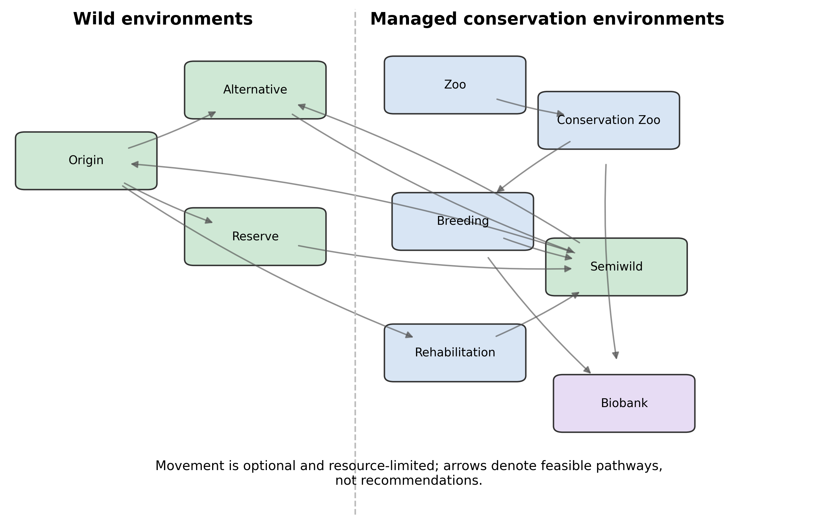
Figure 1. Conservation network represented in the simulation.
Figure 1. Conservation network represented in the simulation. Arrows denote potential movement among wild, managed, transitional, rehabilitation, and biobank nodes; feasible policies act on observed rather than true state.
Image-based artwork; edit titles/captions here and regenerate artwork with make figures.

Slide 2
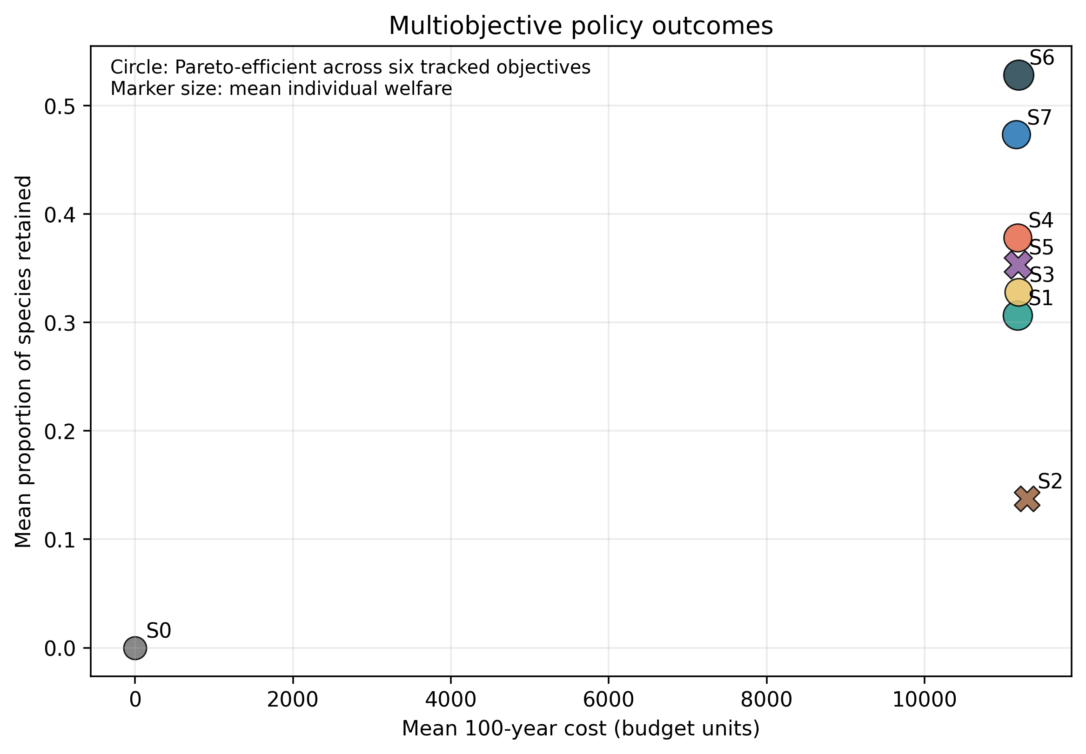
Figure 2. Multiobjective policy comparison and Pareto status under the declared aggregate objectives.
Figure 2. Multiobjective policy comparison and Pareto status under the declared aggregate objectives.
Image-based artwork; edit titles/captions here and regenerate artwork with make figures.

Slide 3
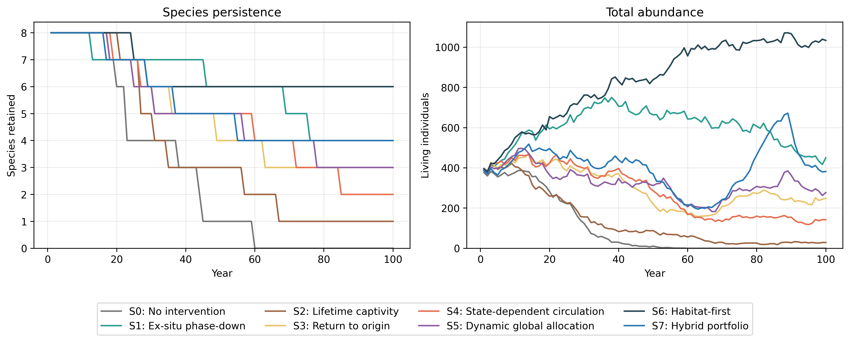
Figure 3. Mean 100-year trajectories under the eight conservation policies.
Figure 3. Mean 100-year trajectories under the eight conservation policies. Trajectories are synthetic model outcomes, not forecasts for real taxa.
Image-based artwork; edit titles/captions here and regenerate artwork with make figures.

Slide 4
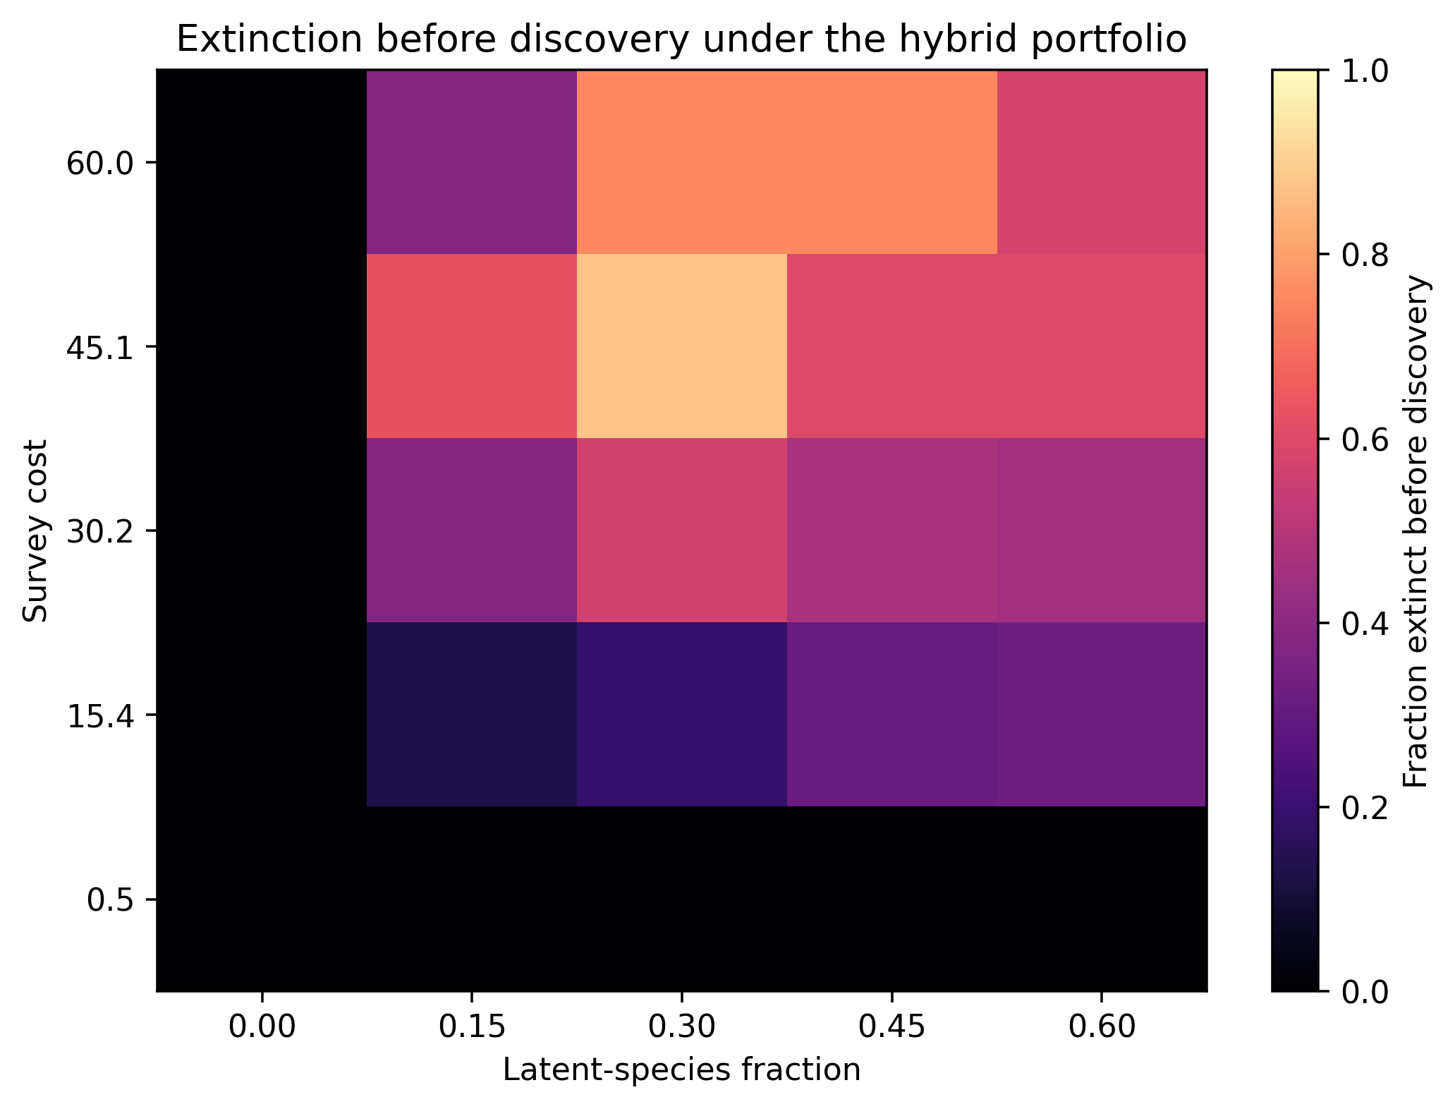
Figure 4. Extinction-before-discovery outcomes across latent-species fraction and survey-cost conditions.
Figure 4. Extinction-before-discovery outcomes across latent-species fraction and survey-cost conditions.
Image-based artwork; edit titles/captions here and regenerate artwork with make figures.

Slide 5
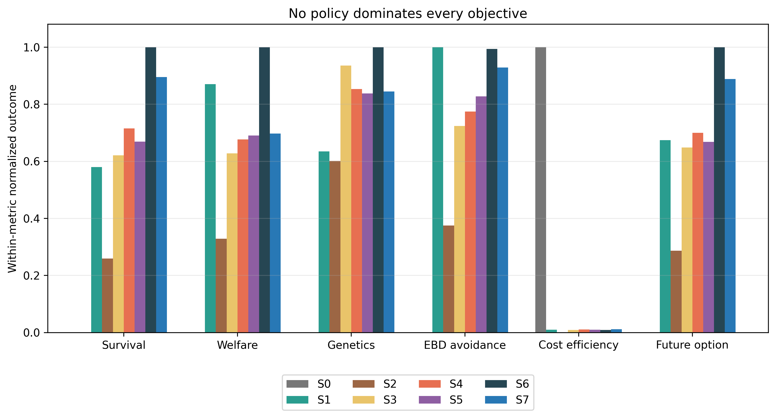
Figure 5. Normalized cross-objective outcomes.
Figure 5. Normalized cross-objective outcomes. Normalization is descriptive and does not define cardinal utility.
Image-based artwork; edit titles/captions here and regenerate artwork with make figures.

Slide 6
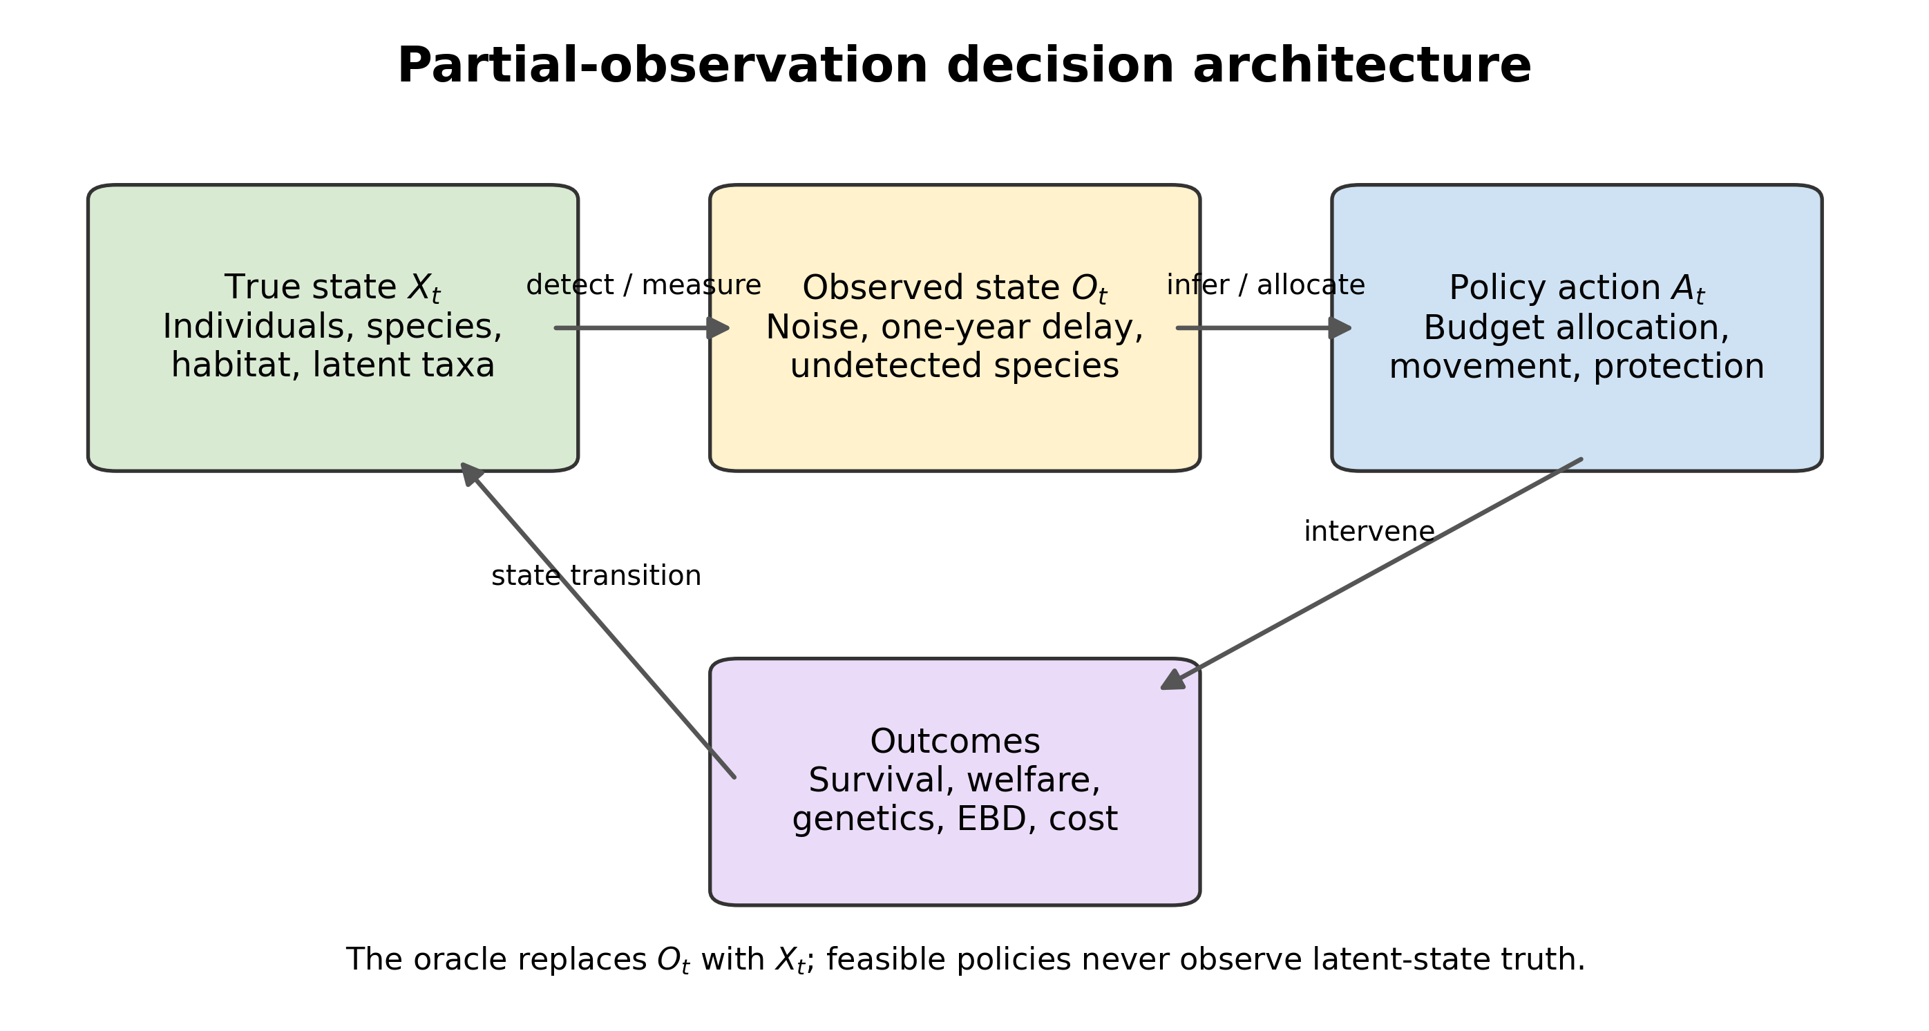
Figure 6. Partial-observation architecture separating true ecological state, observations, policy actions, and realized outcomes.
Figure 6. Partial-observation architecture separating true ecological state, observations, policy actions, and realized outcomes.
Image-based artwork; edit titles/captions here and regenerate artwork with make figures.

Slide 7
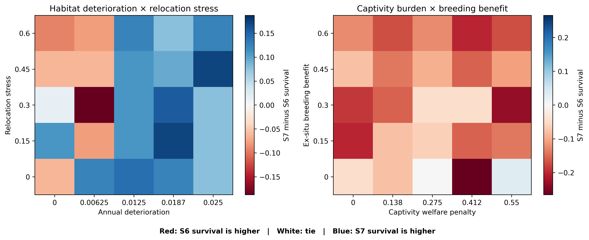
Figure 7. Policy-reversal surfaces for selected two-factor sweeps.
Figure 7. Policy-reversal surfaces for selected two-factor sweeps. Color represents the difference in 100-year survival between the hybrid portfolio (S7) and habitat-first policy (S6).
Image-based artwork; edit titles/captions here and regenerate artwork with make figures.

Slide 8
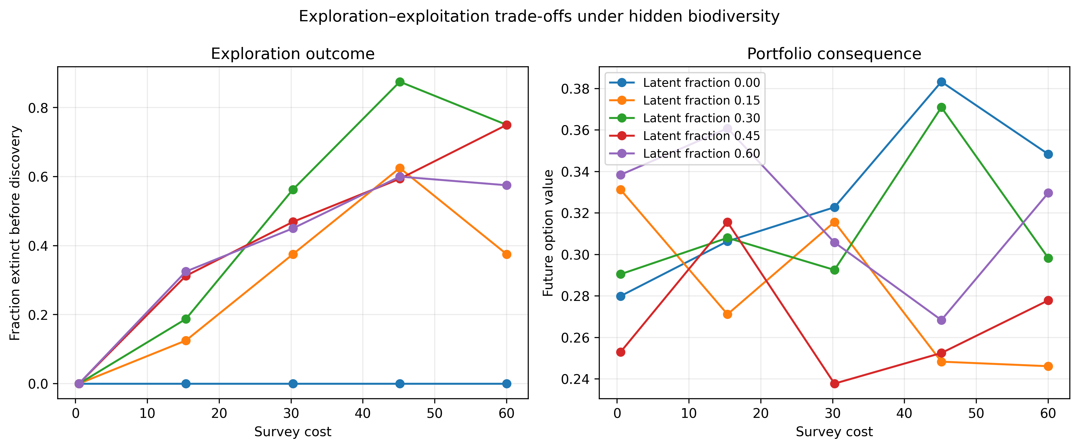
Figure 8. Exploration–exploitation patterns across survey-cost conditions.
Figure 8. Exploration–exploitation patterns across survey-cost conditions.
Image-based artwork; edit titles/captions here and regenerate artwork with make figures.

Slide 9
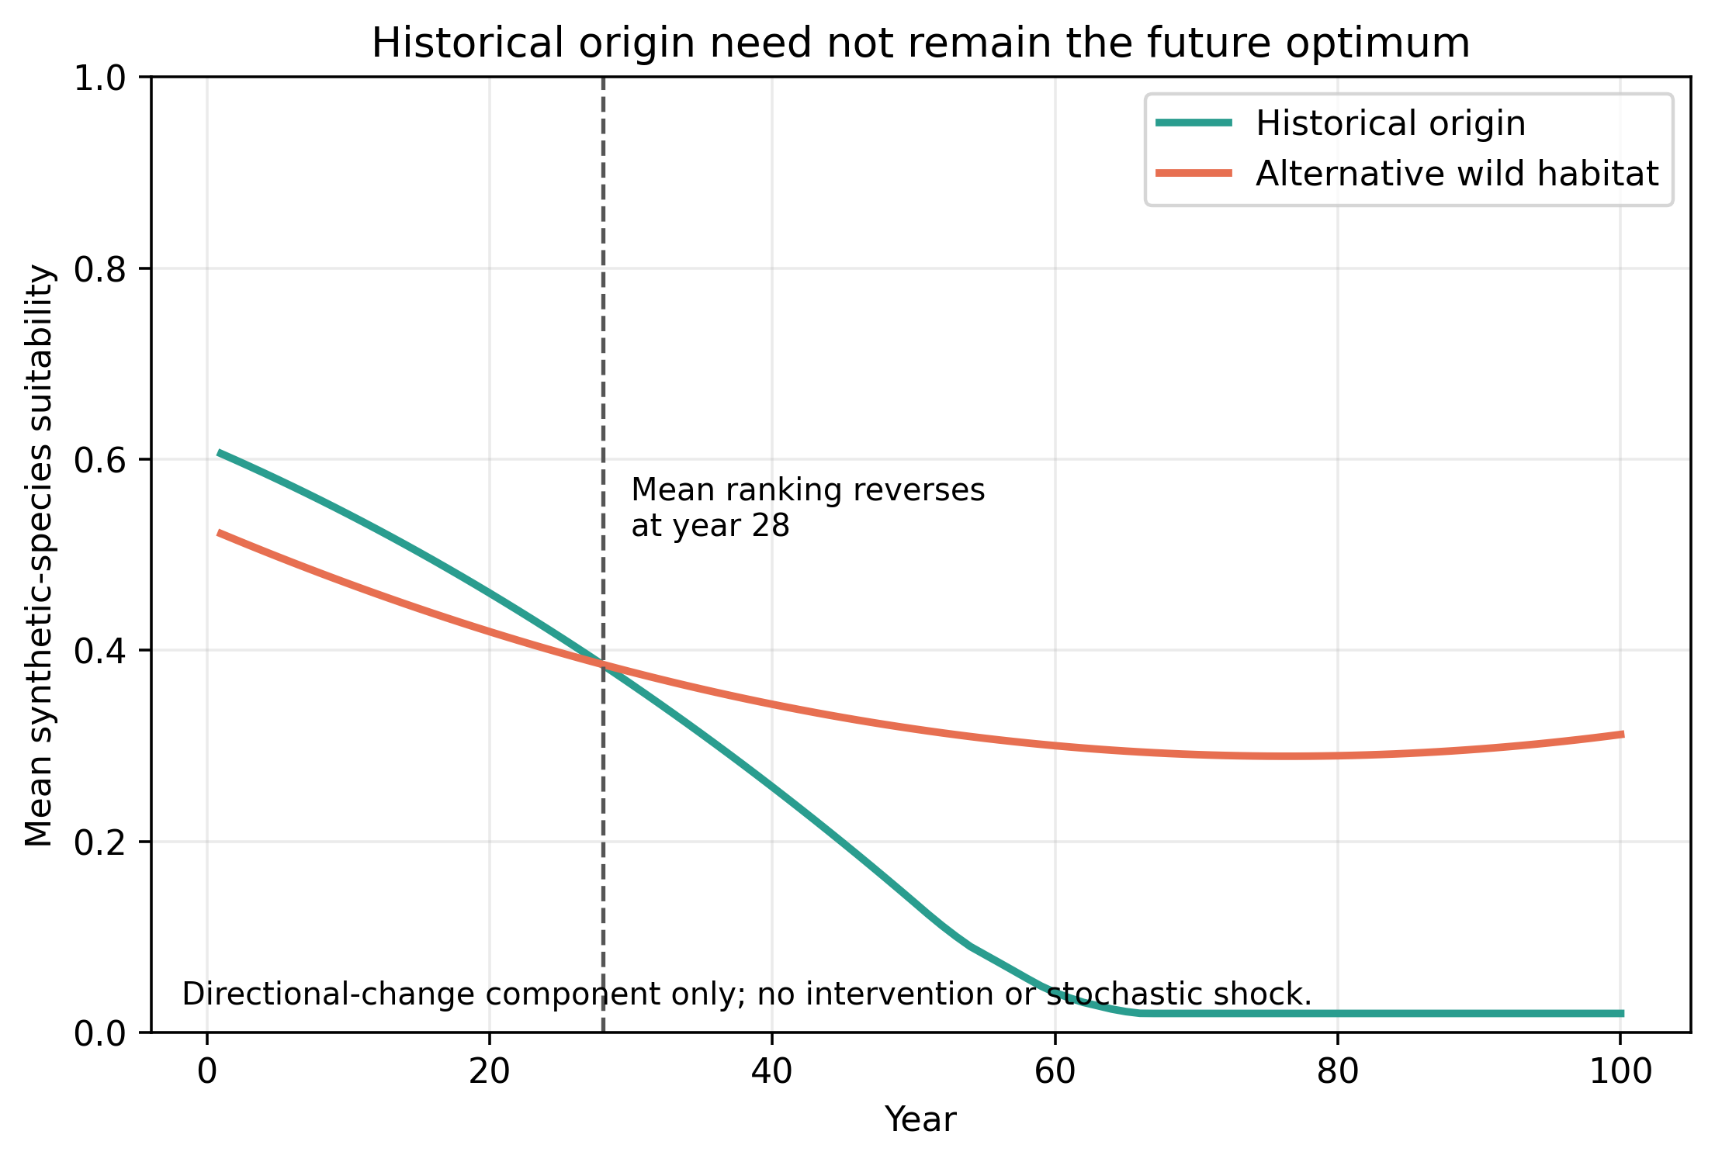
Figure 9. Origin-to-future habitat-quality shift under the deterministic component of directional environmental change.
Figure 9. Origin-to-future habitat-quality shift under the deterministic component of directional environmental change.
Image-based artwork; edit titles/captions here and regenerate artwork with make figures.

