Slide 1
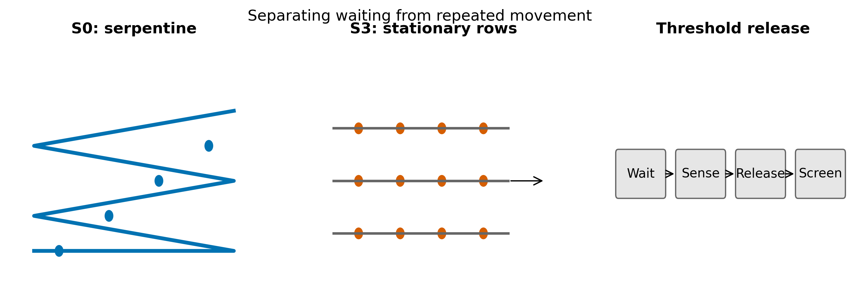
Figure 1
Conceptual control architecture; diagrams are generic and not site layouts.

Slide 2
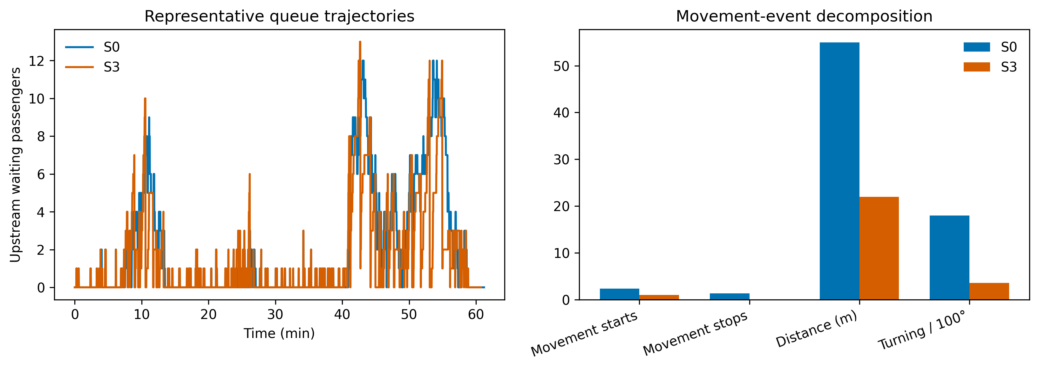
Figure 2
One common-seed realization; movement endpoints are modeled locomotion metrics.

Slide 3
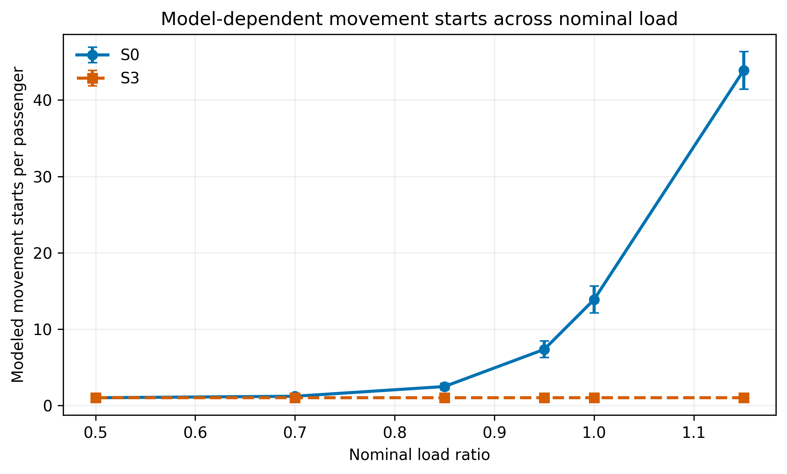
Figure 3
Model-dependent mean movement starts and 95% Monte Carlo intervals; S3 has one start by construction under the specified progression rule.

Slide 4
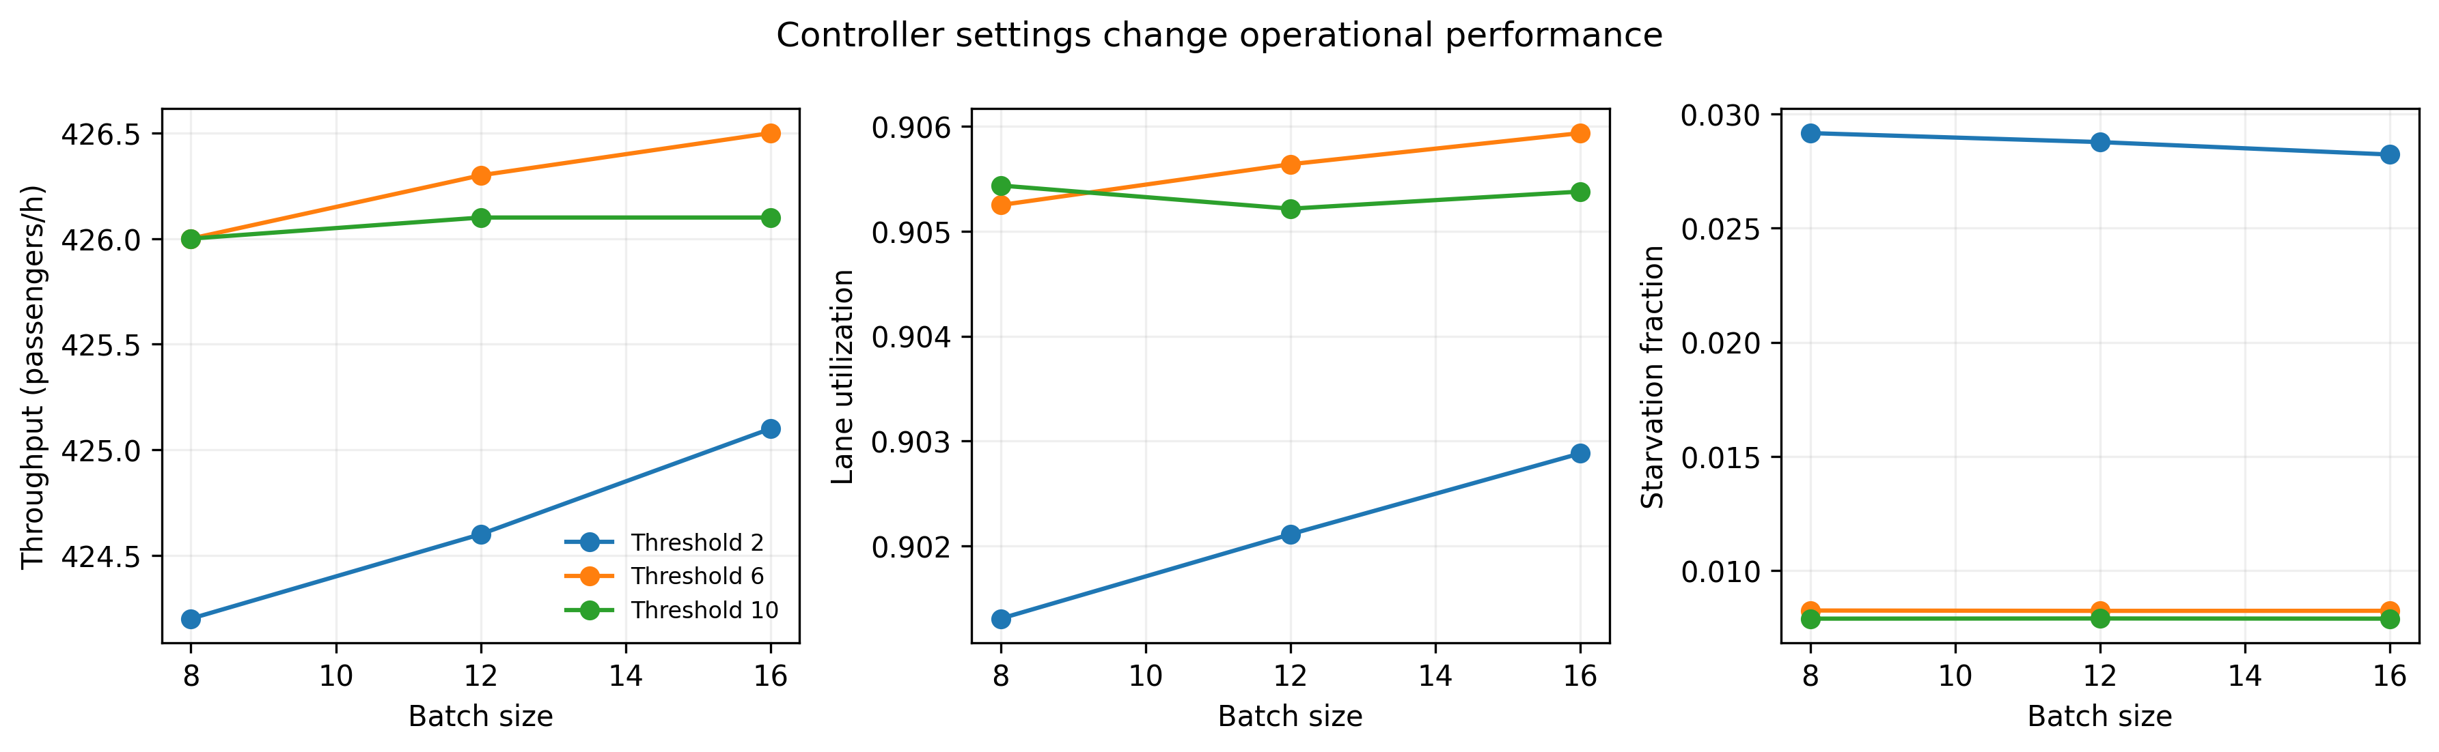
Figure 4
S3/B1 designs at load 0.95; endpoints remain separate rather than weighted.

Slide 5
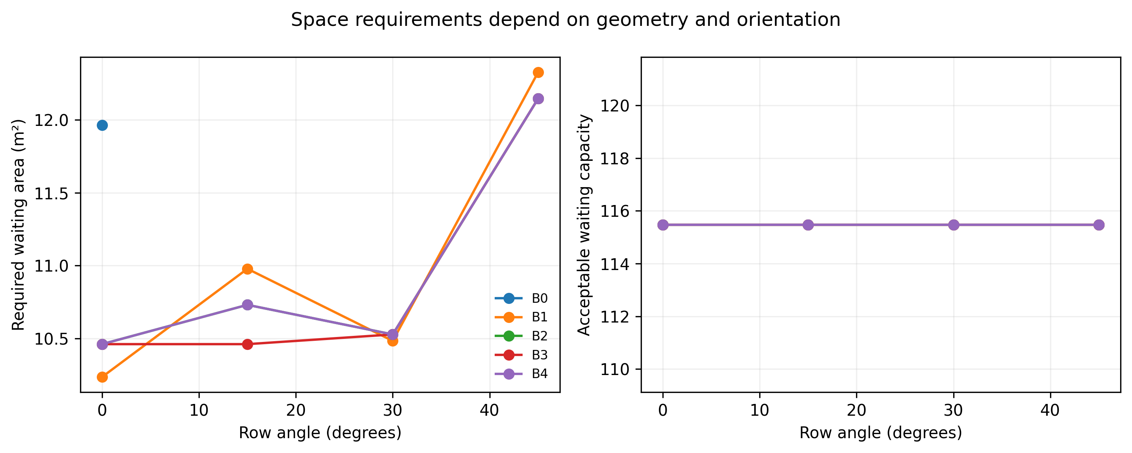
Figure 5
Phase 3 generic geometry screen averaged across seeds and footprint cases.

Slide 6
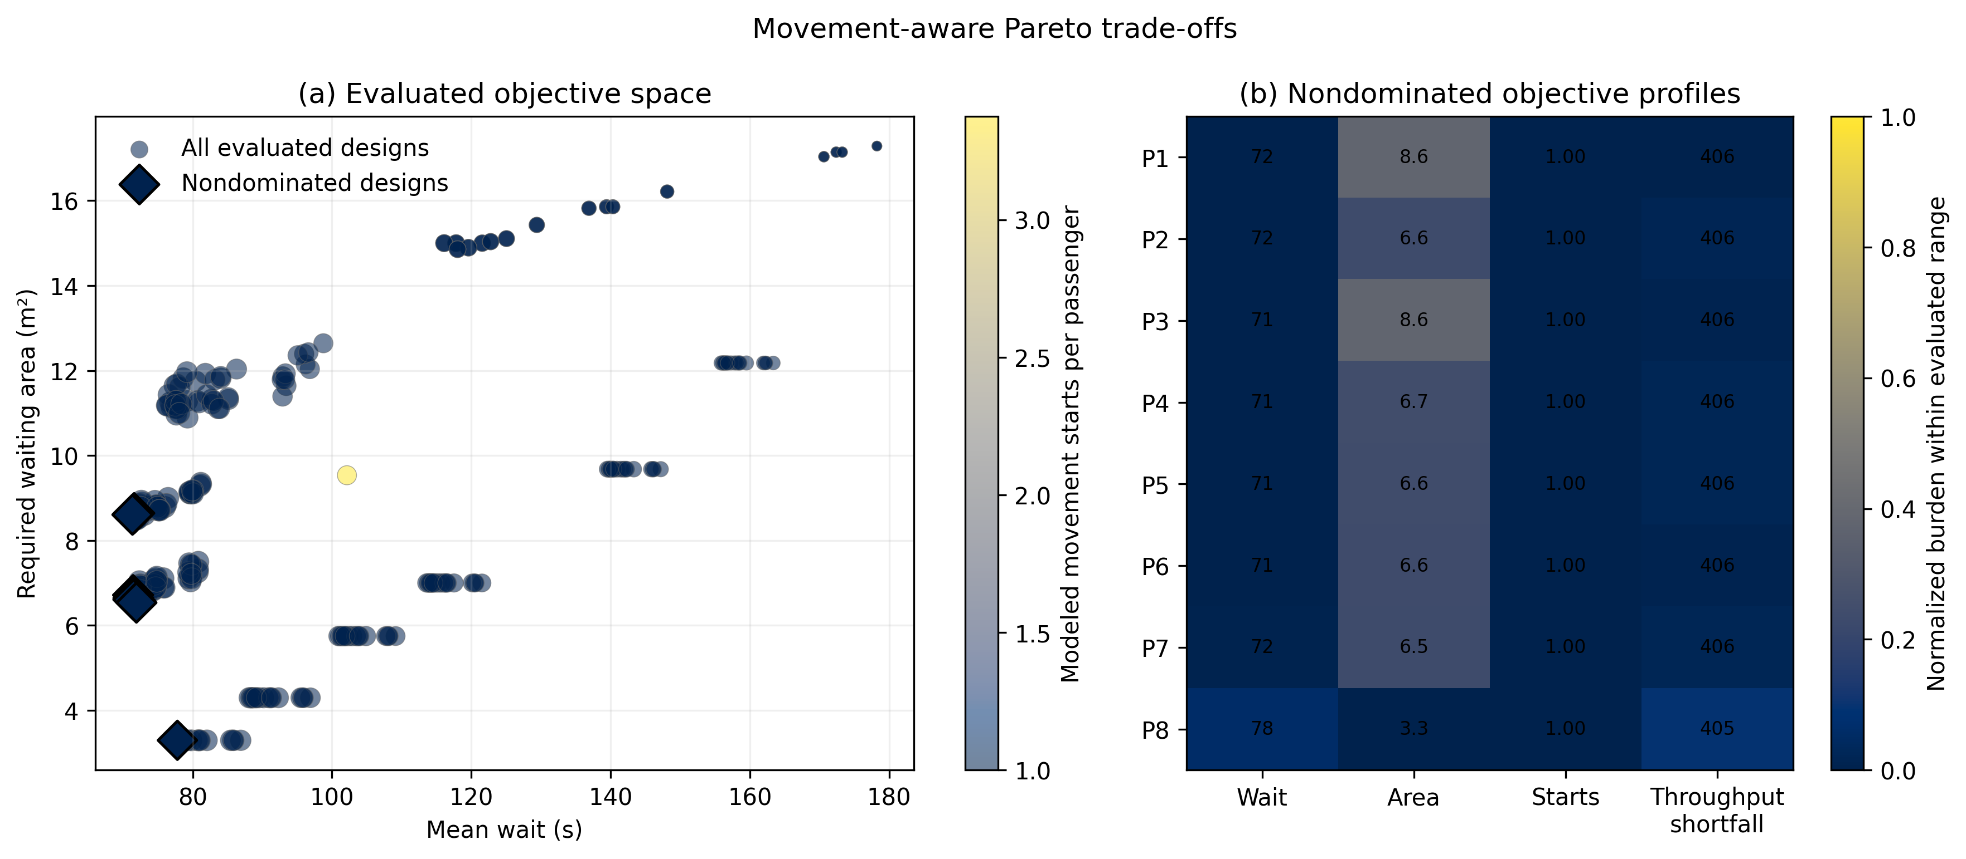
Figure 6
All evaluated designs are circles: x is mean wait, y is conditional required waiting area, monotonic-lightness color is modeled starts/passenger, and marker area is throughput. The eight nondominated designs are black-edged diamonds and their normalized objective profiles are shown at right; all share one modeled start/passenger under the current progression rule.

Slide 7
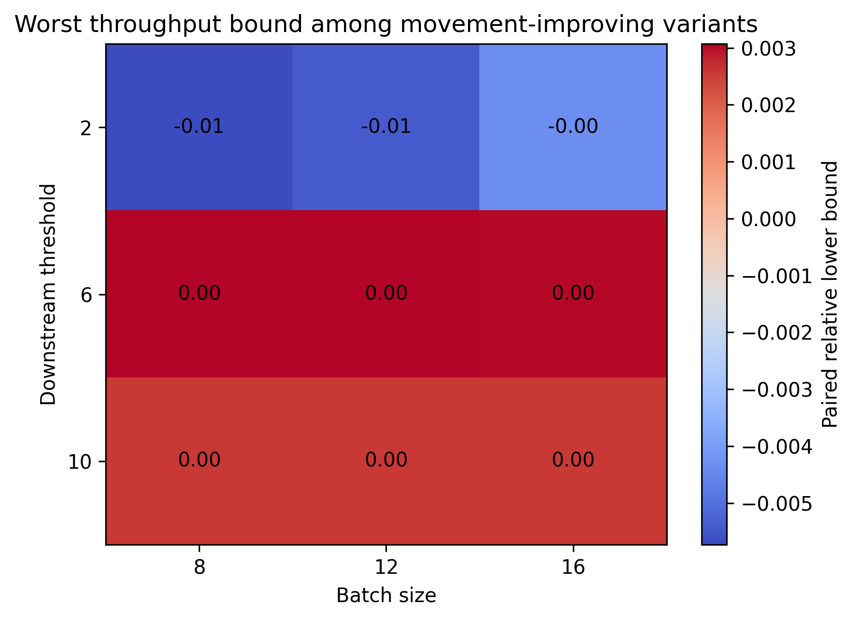
Figure 7
All cells improve movement starts; the acceptability threshold is −0.02.

Slide 8
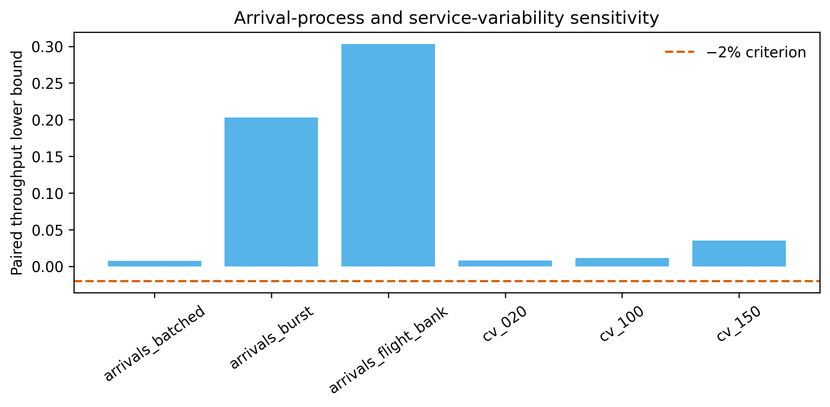
Figure S1
Phase 8 paired throughput lower bounds.

Slide 9
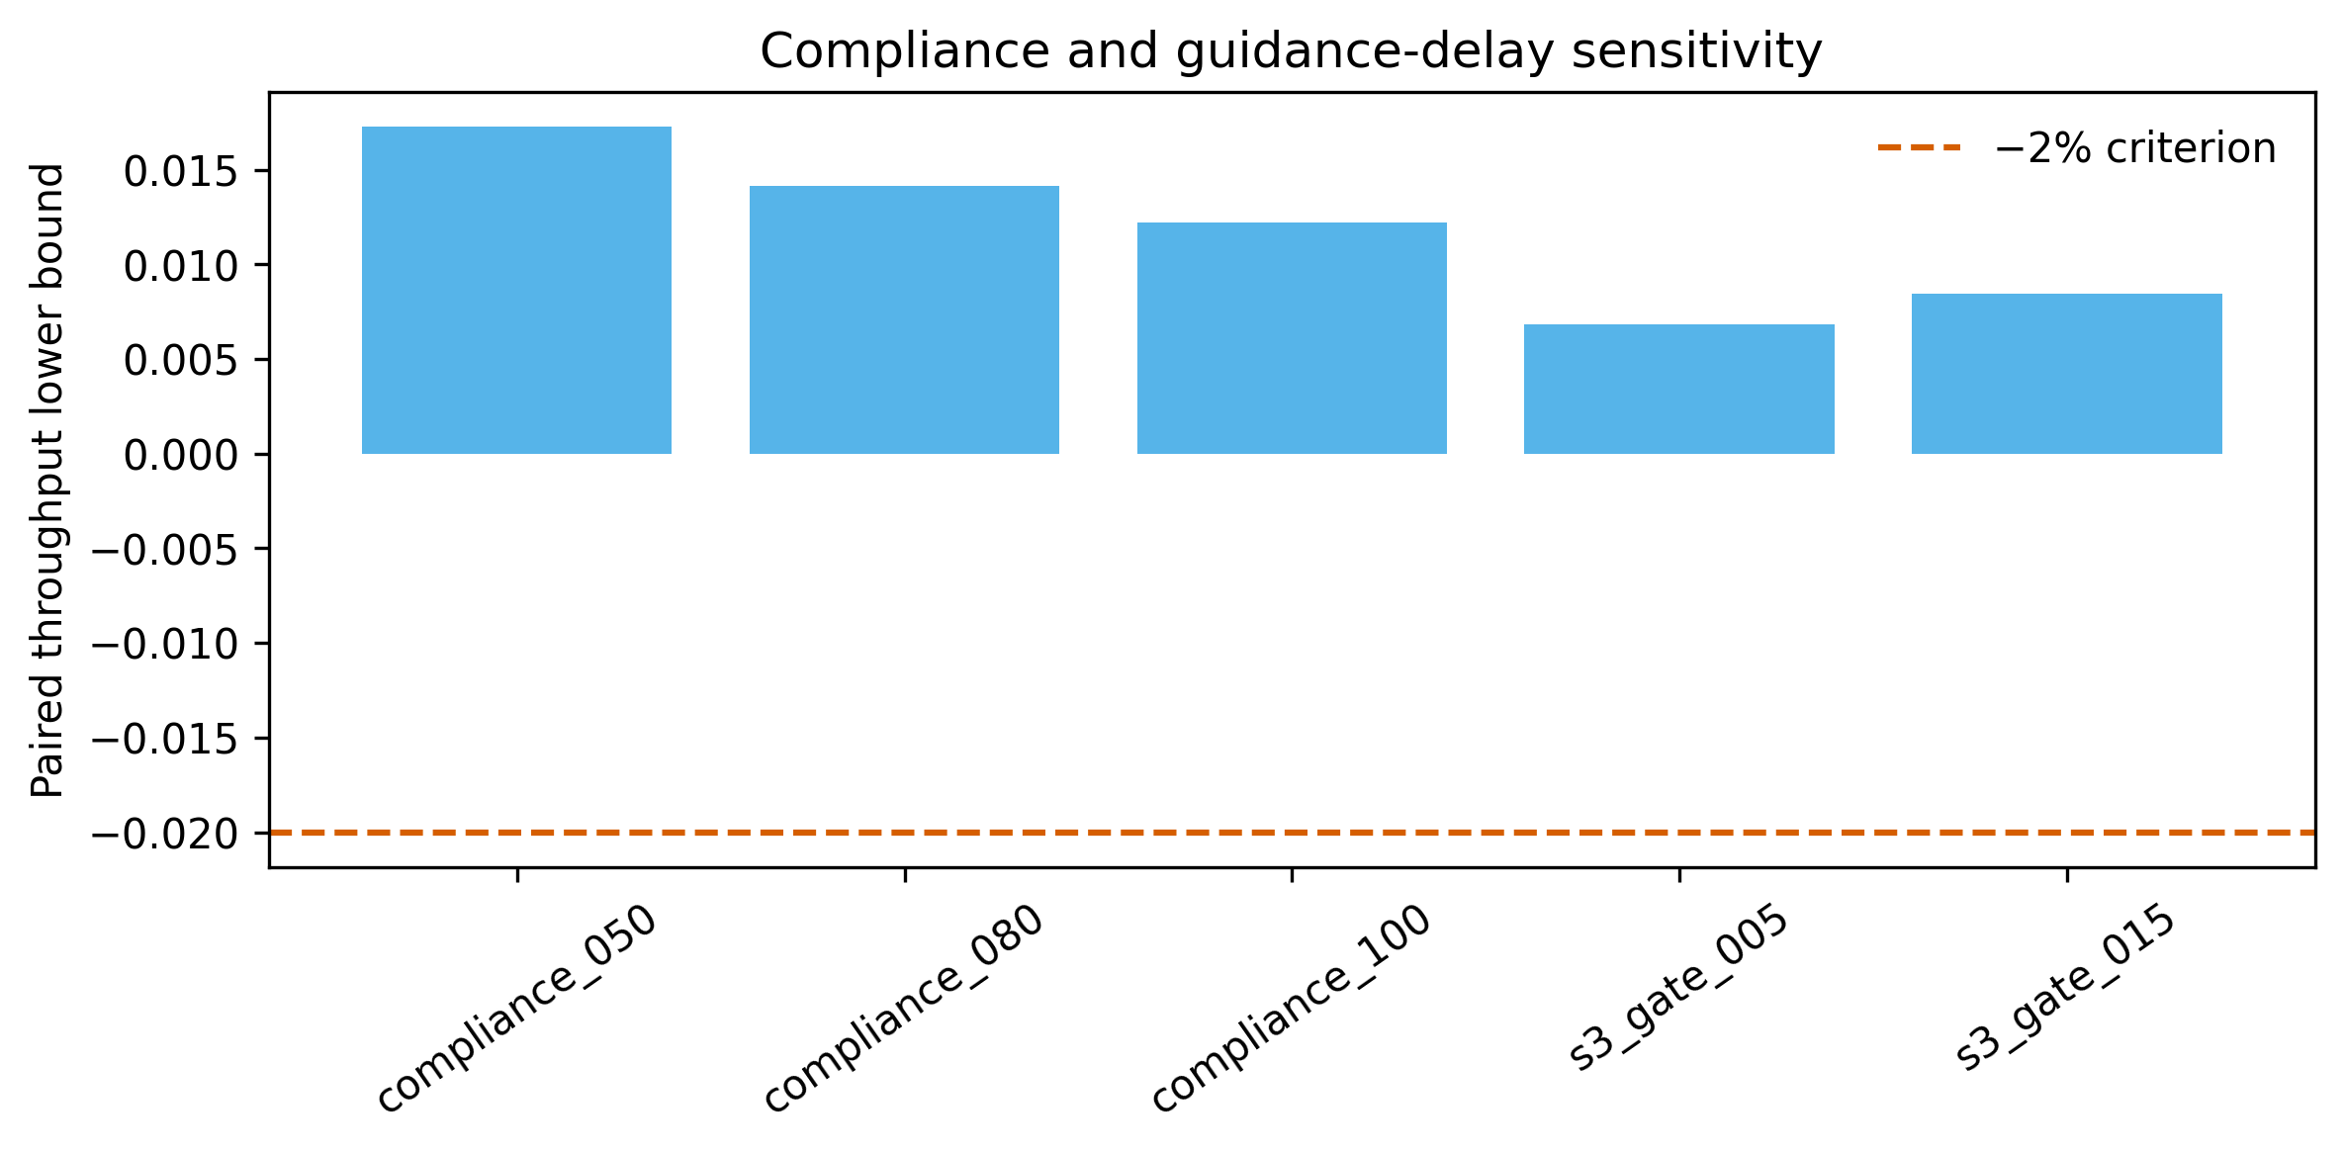
Figure S2
Phase 8 paired throughput lower bounds.

Slide 10
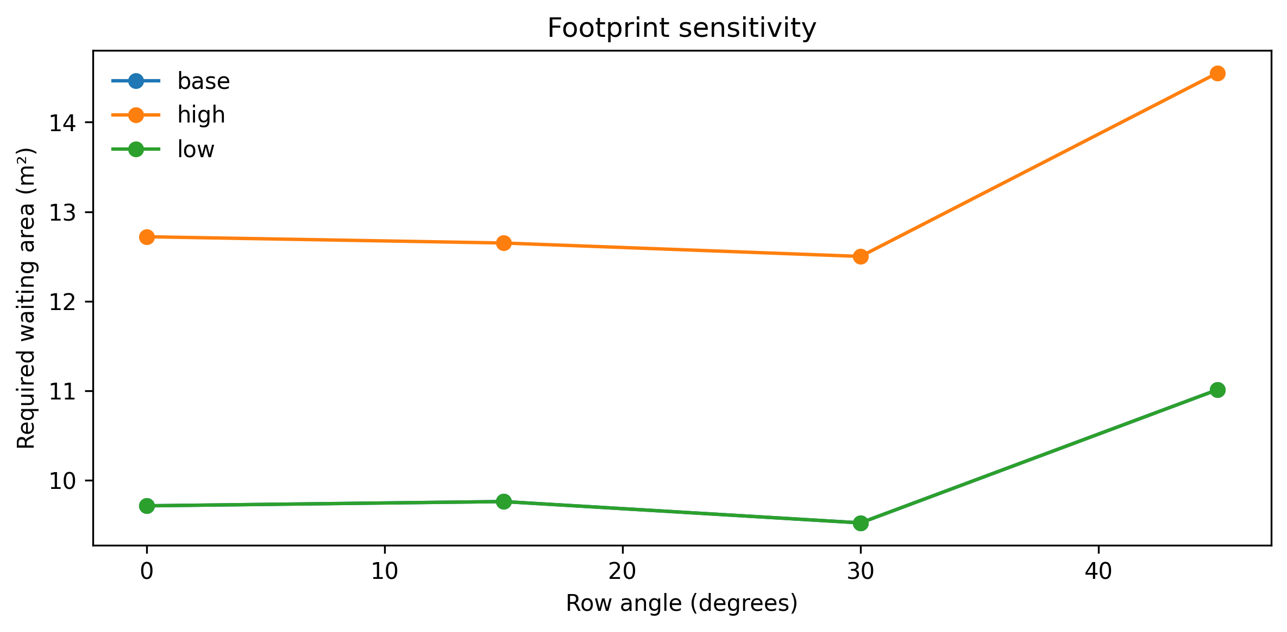
Figure S3
Generic geometry sensitivity; accessibility minima remain constraints.

Slide 11
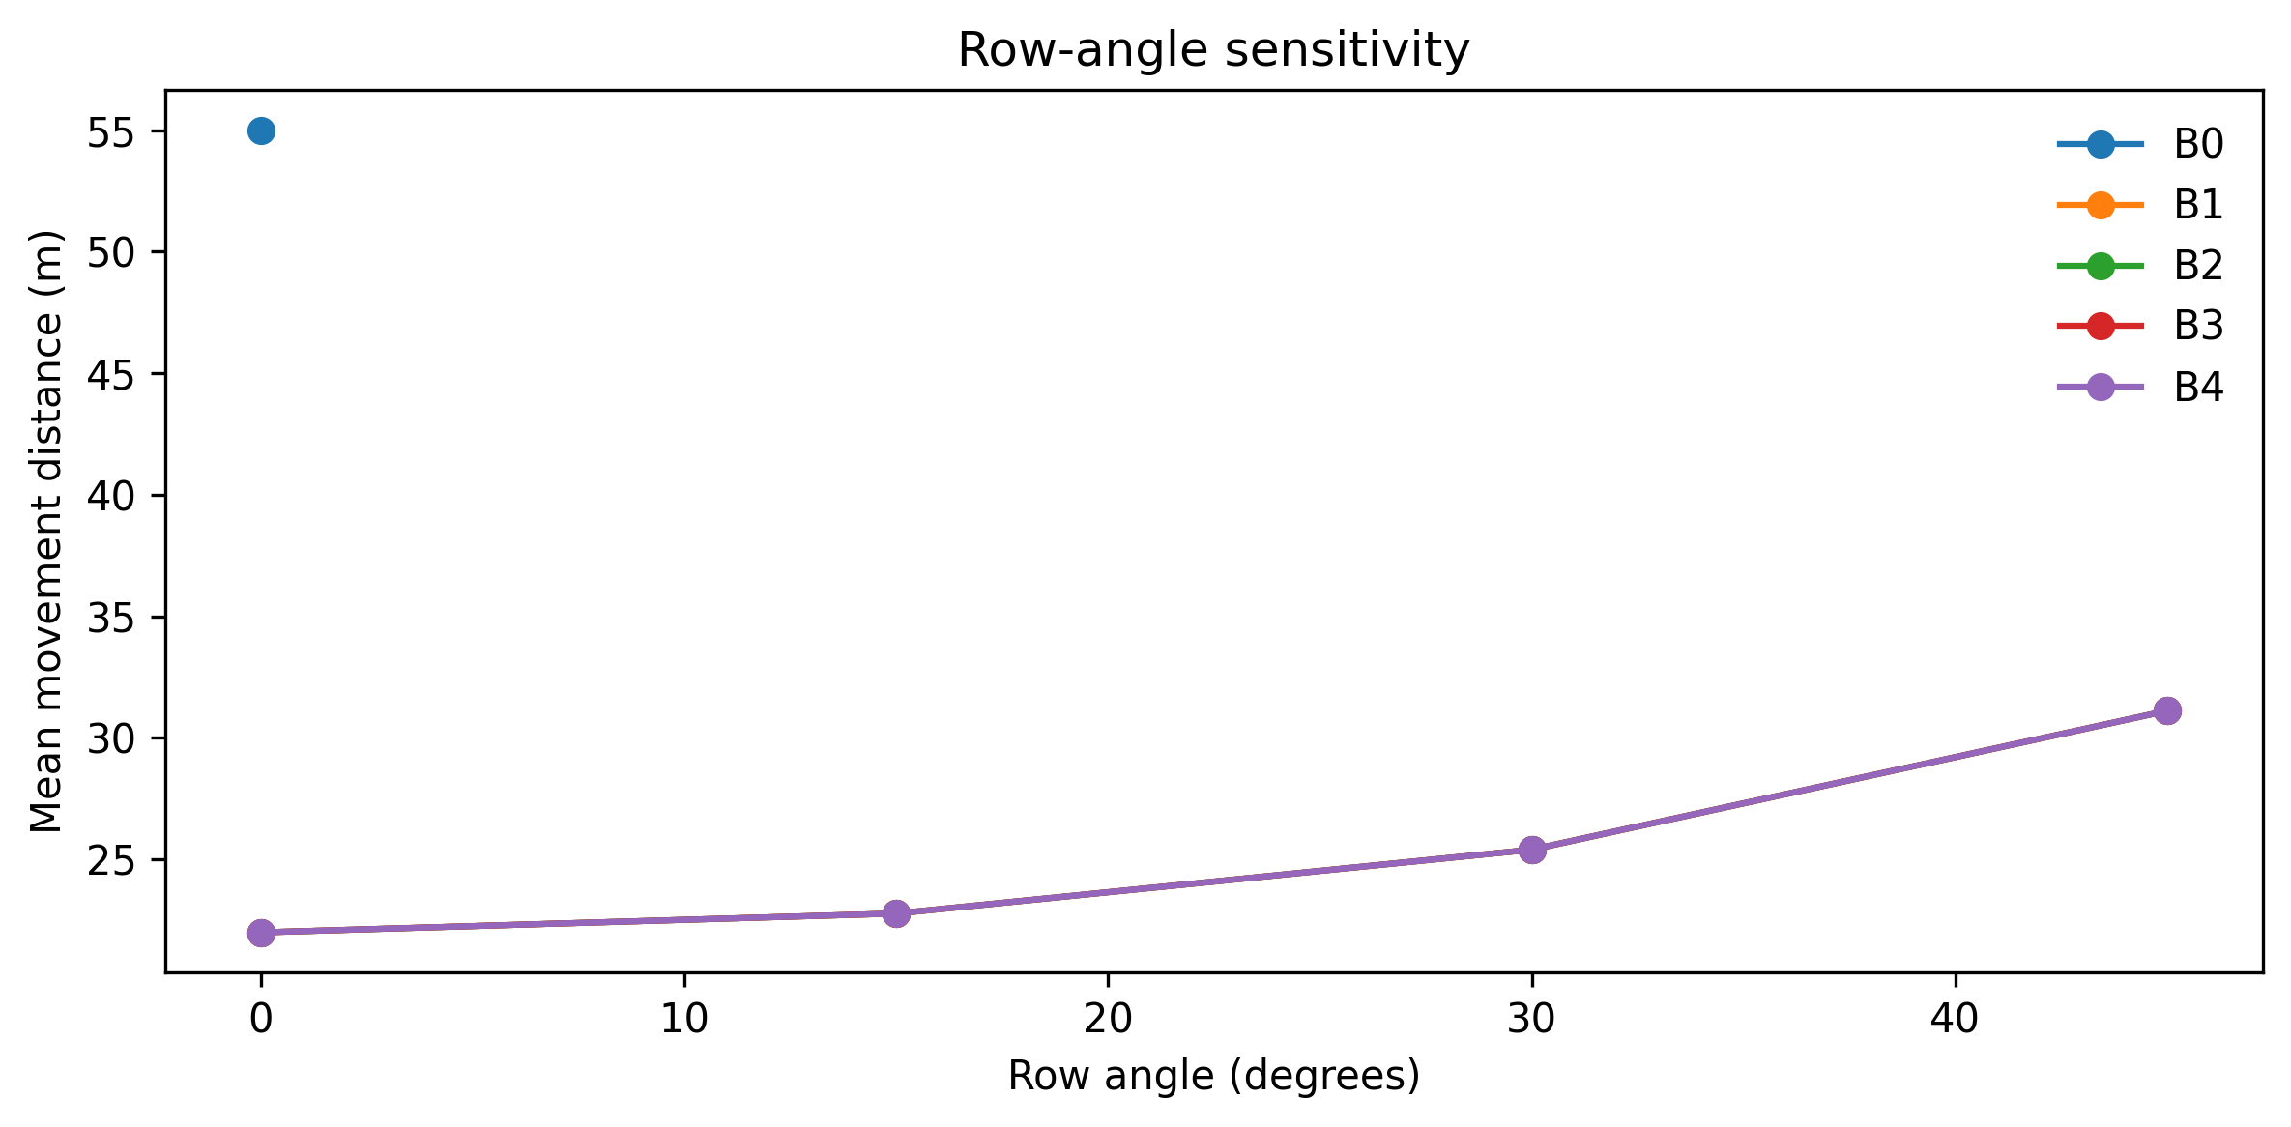
Figure S4
Generic geometry sensitivity; accessibility minima remain constraints.

Slide 12
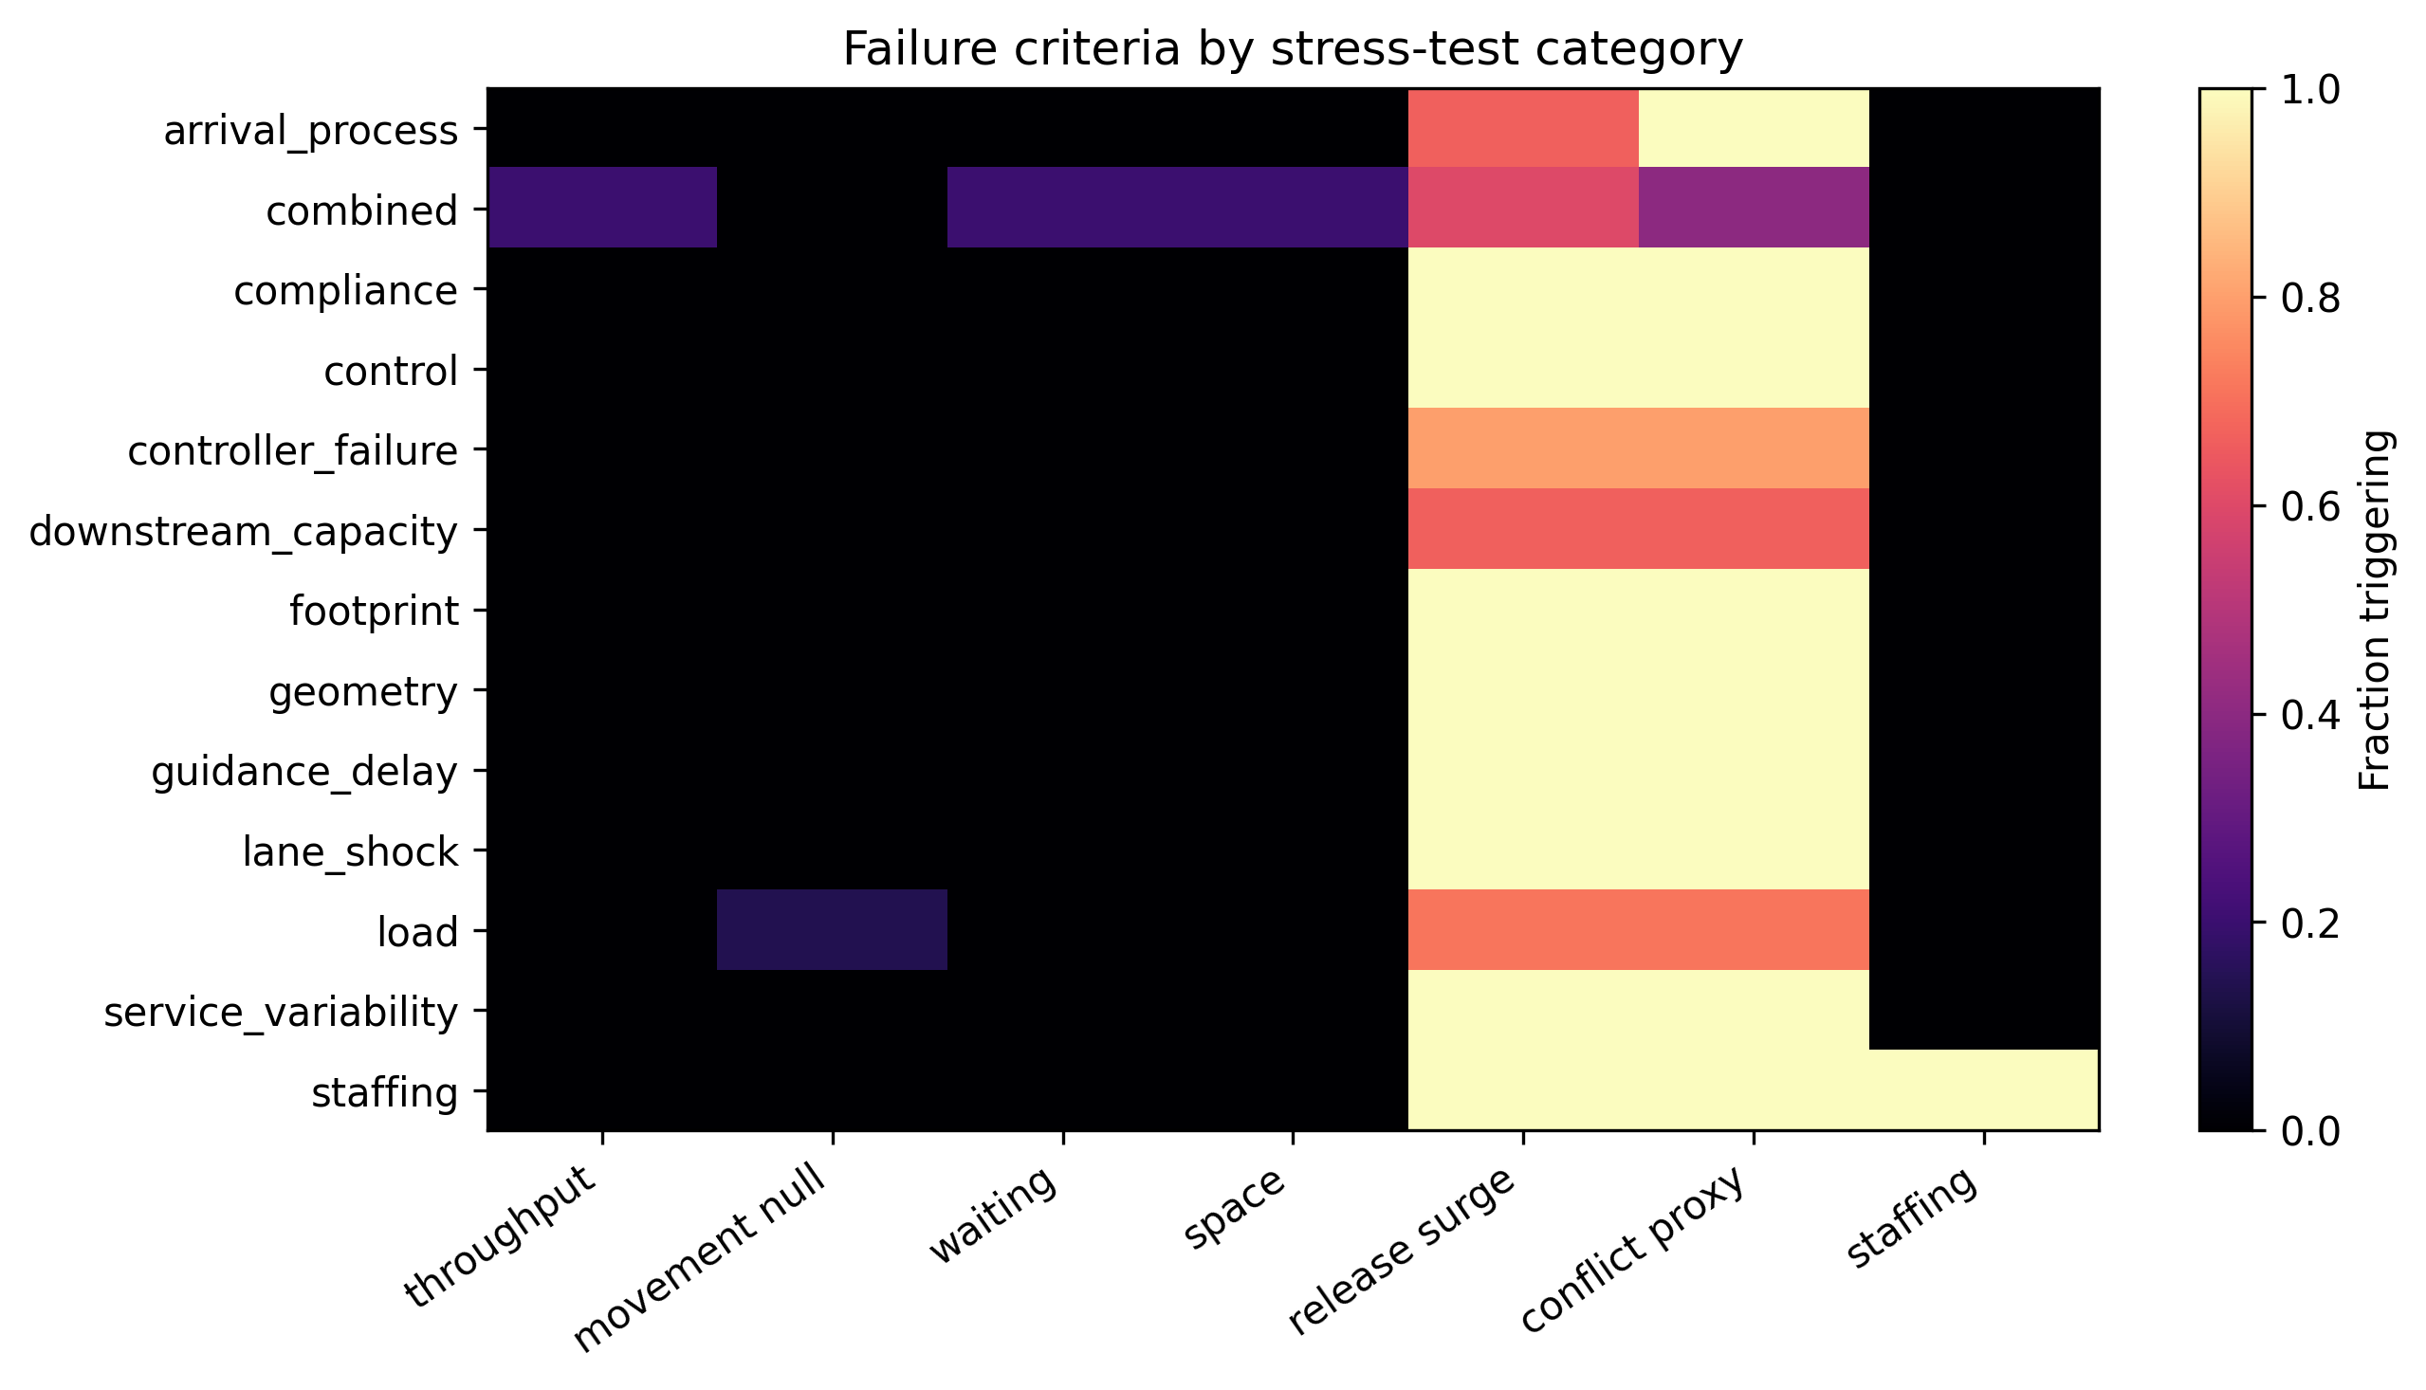
Figure S5
Proxy criteria are engineering screens, not validated safety thresholds.

Slide 13
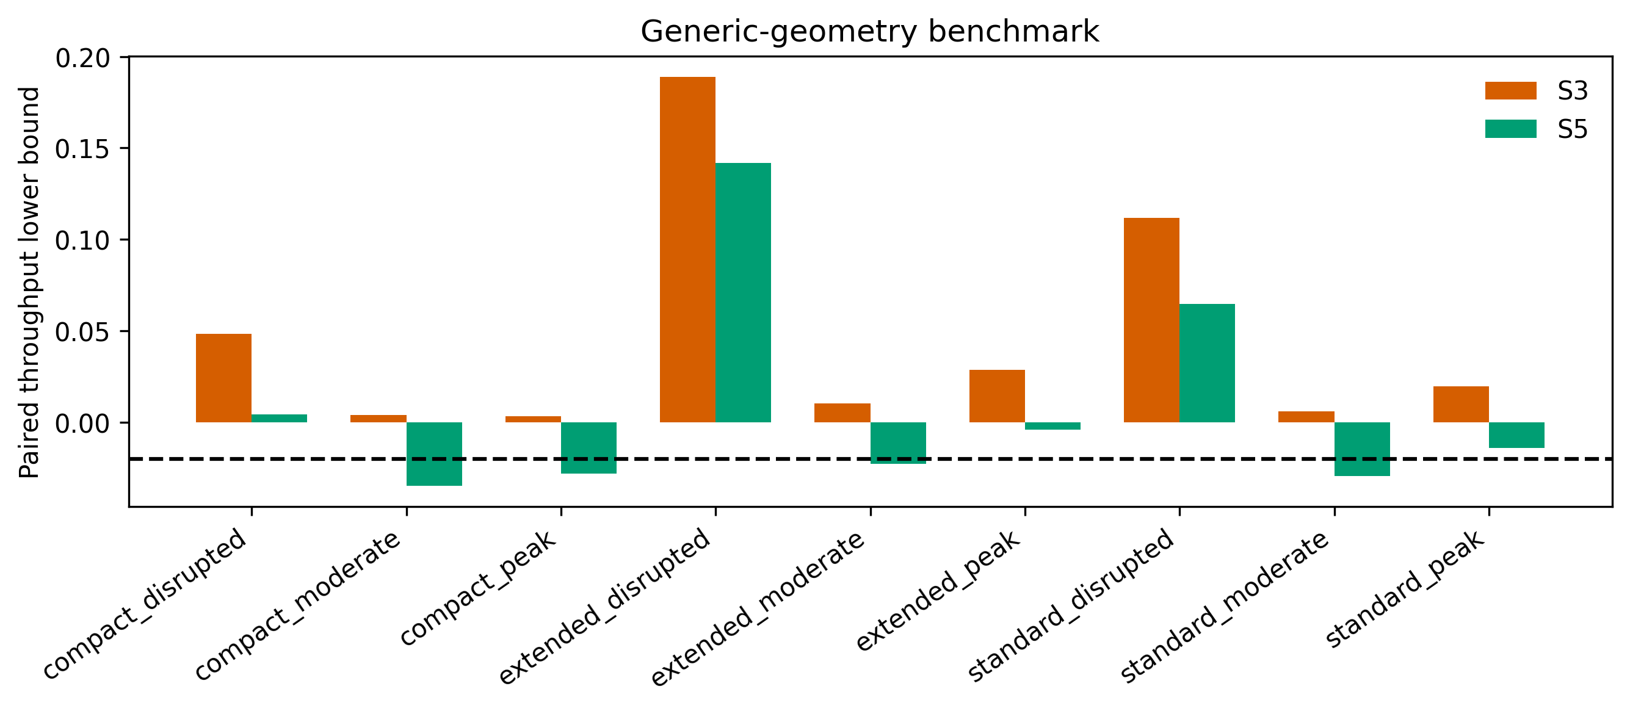
Figure S6
Finite benchmark results do not establish universal transferability.

Slide 14
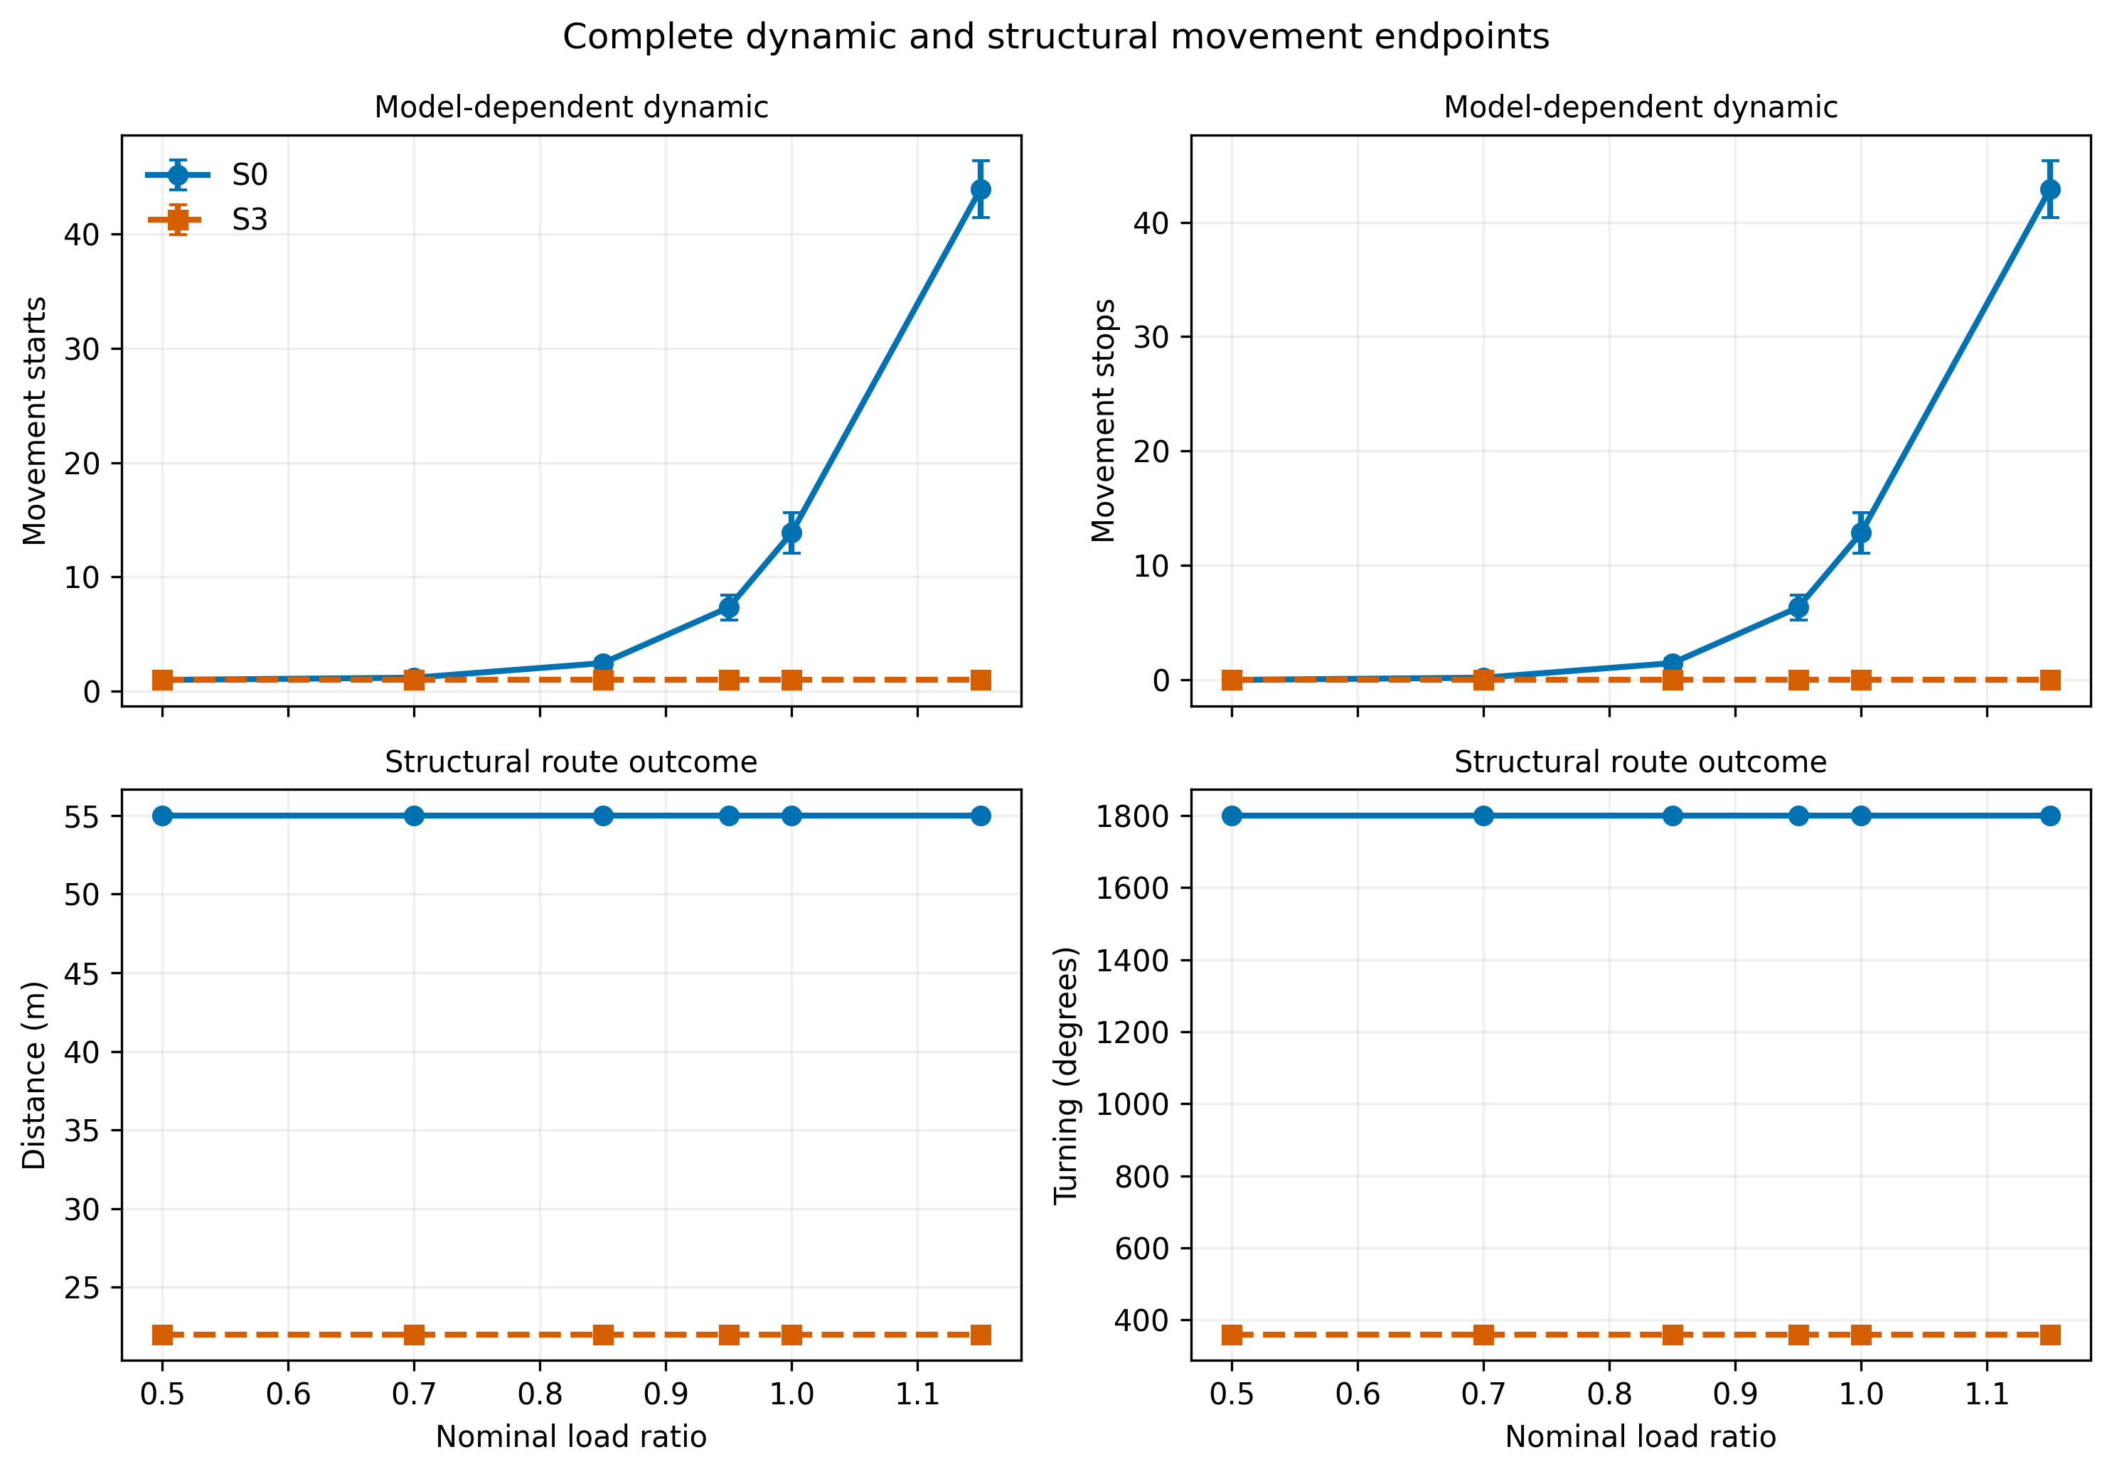
Figure S7
Complete movement endpoint panel. Starts and stops are model-dependent dynamic outcomes; distance and turning are structural route outcomes. Means and 95% Monte Carlo intervals are shown.

