Slide 1
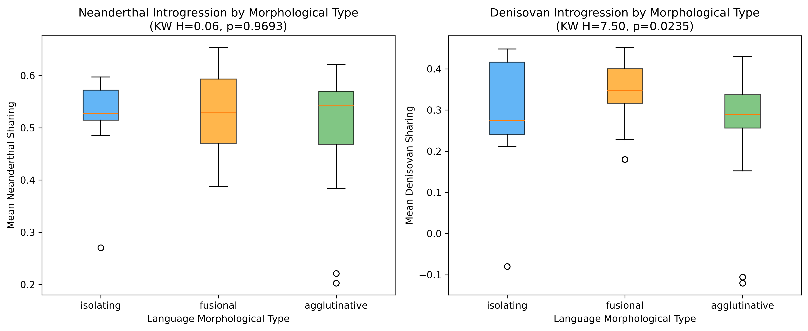
Figure 1
Archaic introgression by language morphological type (Kruskal-Wallis test).

Slide 2
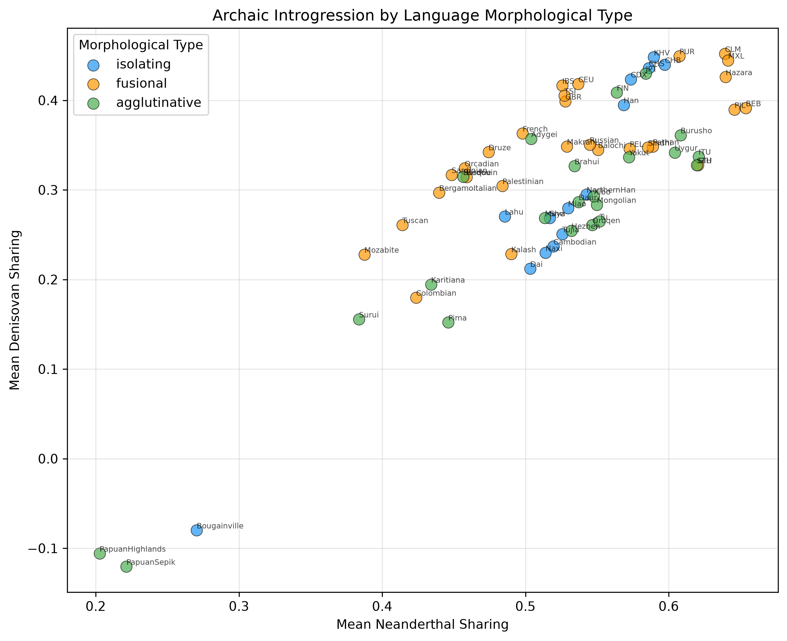
Figure 2
Bivariate scatter: Neanderthal x Denisovan sharing colored by morphological type.

Slide 3
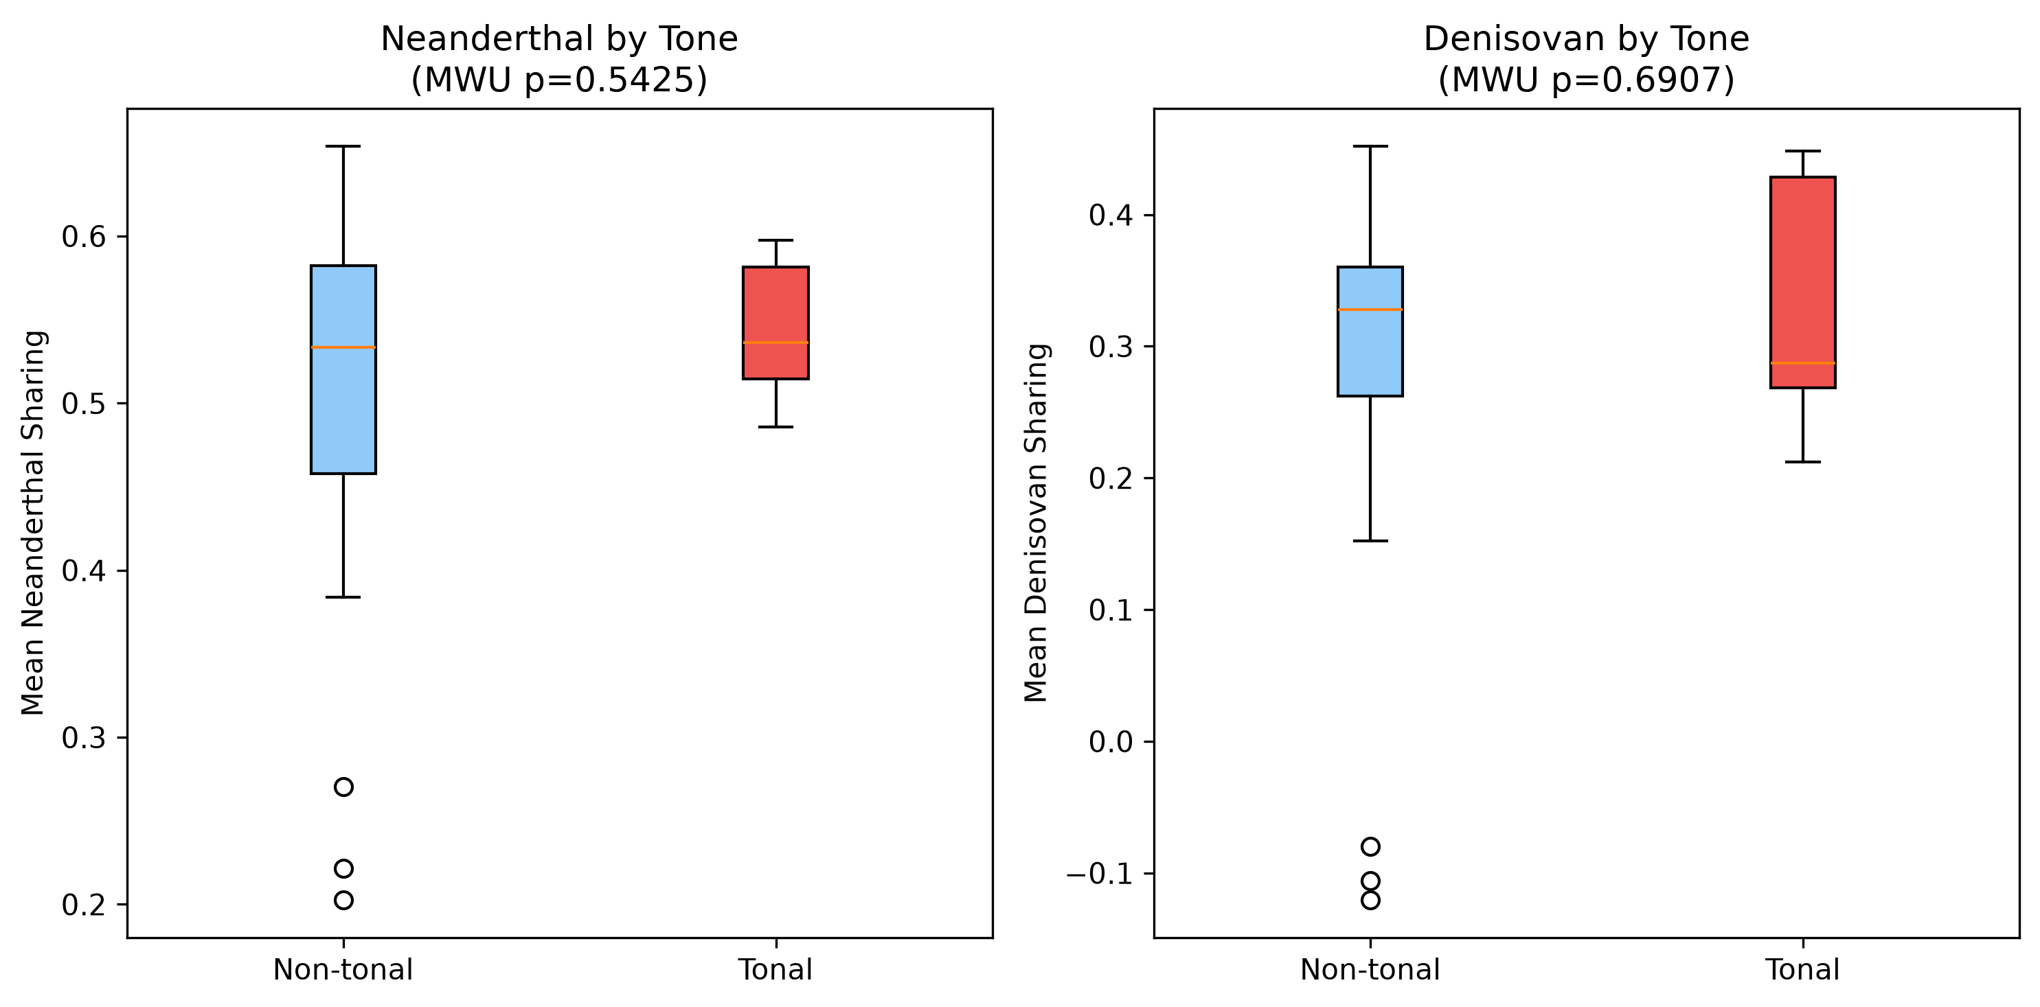
Figure 3
Archaic introgression in tonal vs. non-tonal languages (Mann-Whitney U test).

Slide 4
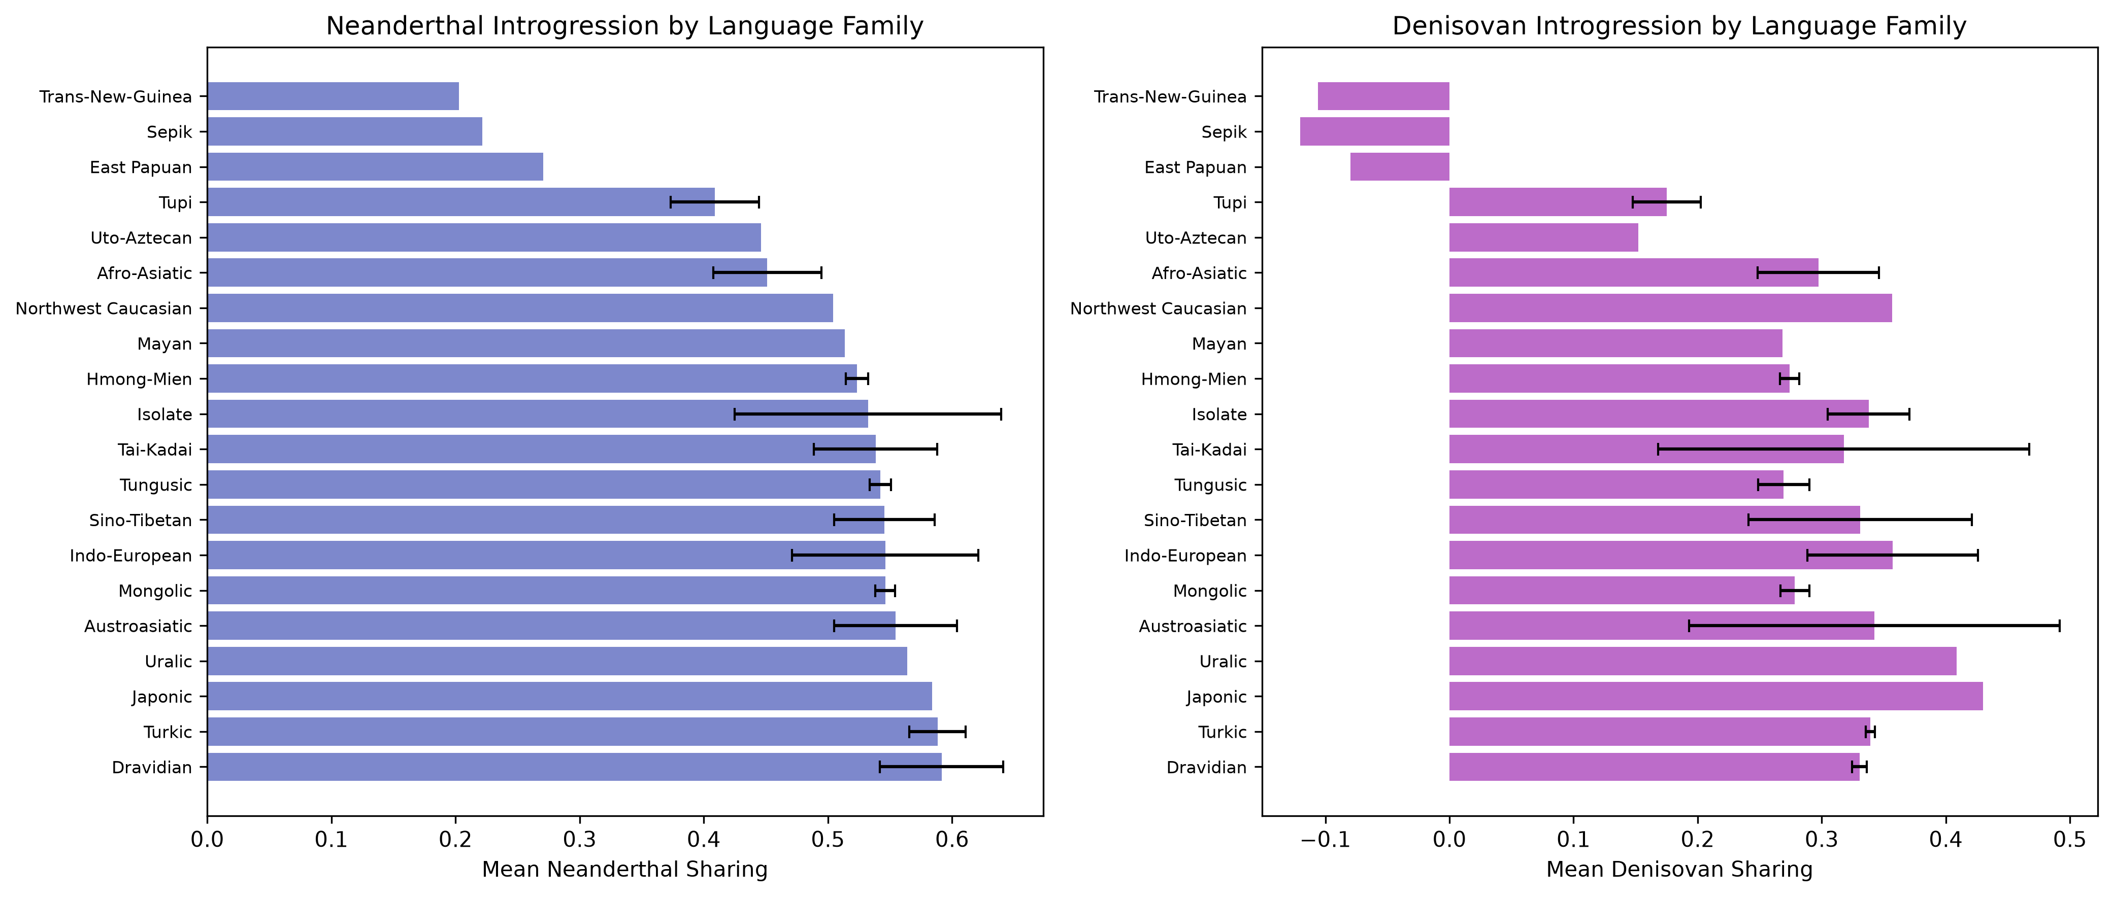
Figure 4
Archaic introgression by language family (mean +/- SD).

Slide 5
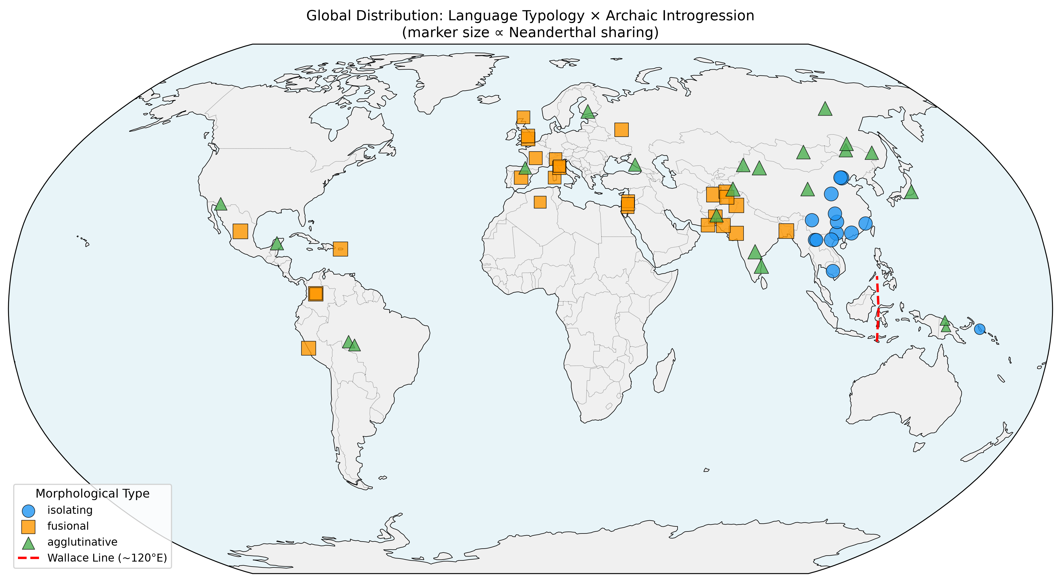
Figure 5
Global distribution: language typology x archaic introgression (marker size = Neanderthal).

