Slide 1
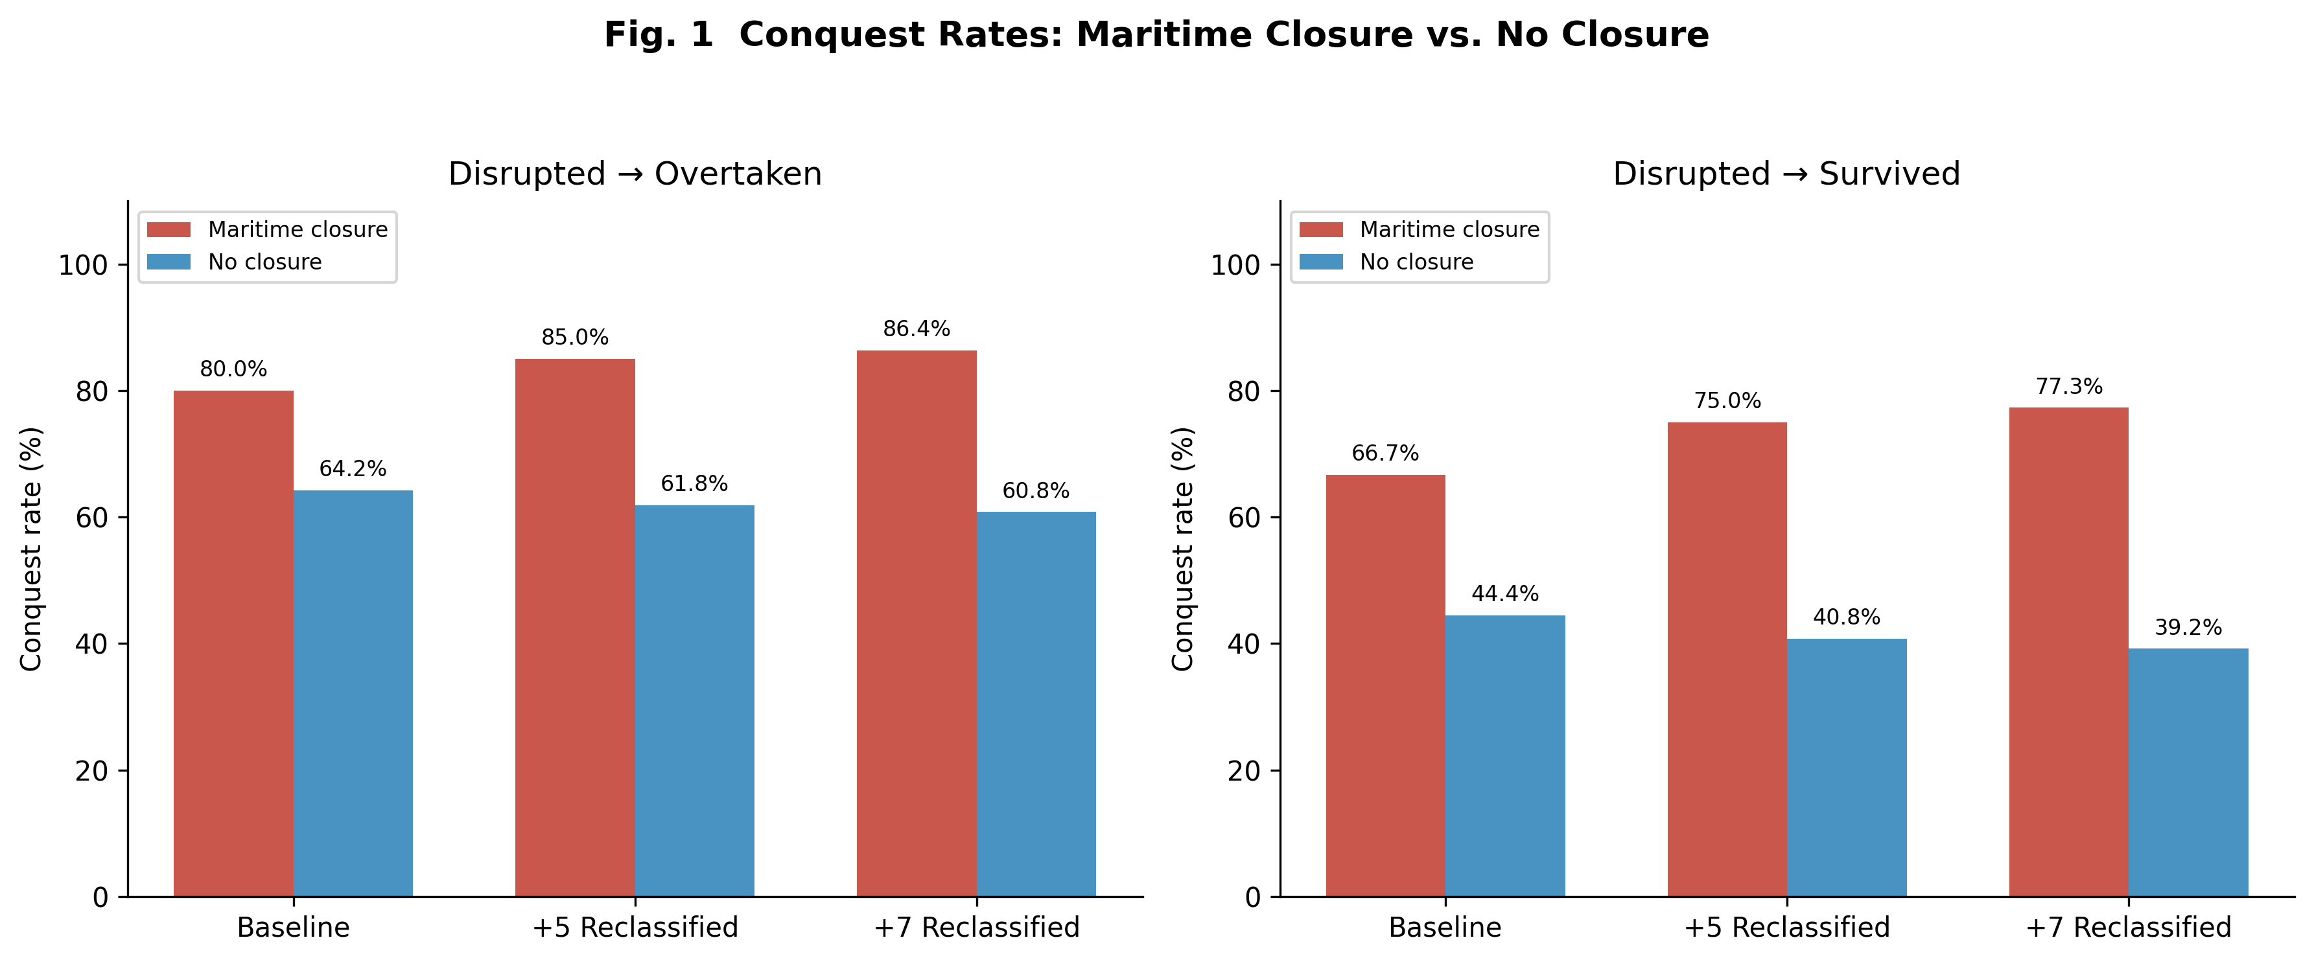
Fig. 1
Conquest rates by closure classification across six sensitivity scenarios. Bars show conquest rates for closed (including technically excluded) vs. open polities. Significance thresholds: *p < 0.05, **p < 0.01.

Slide 2
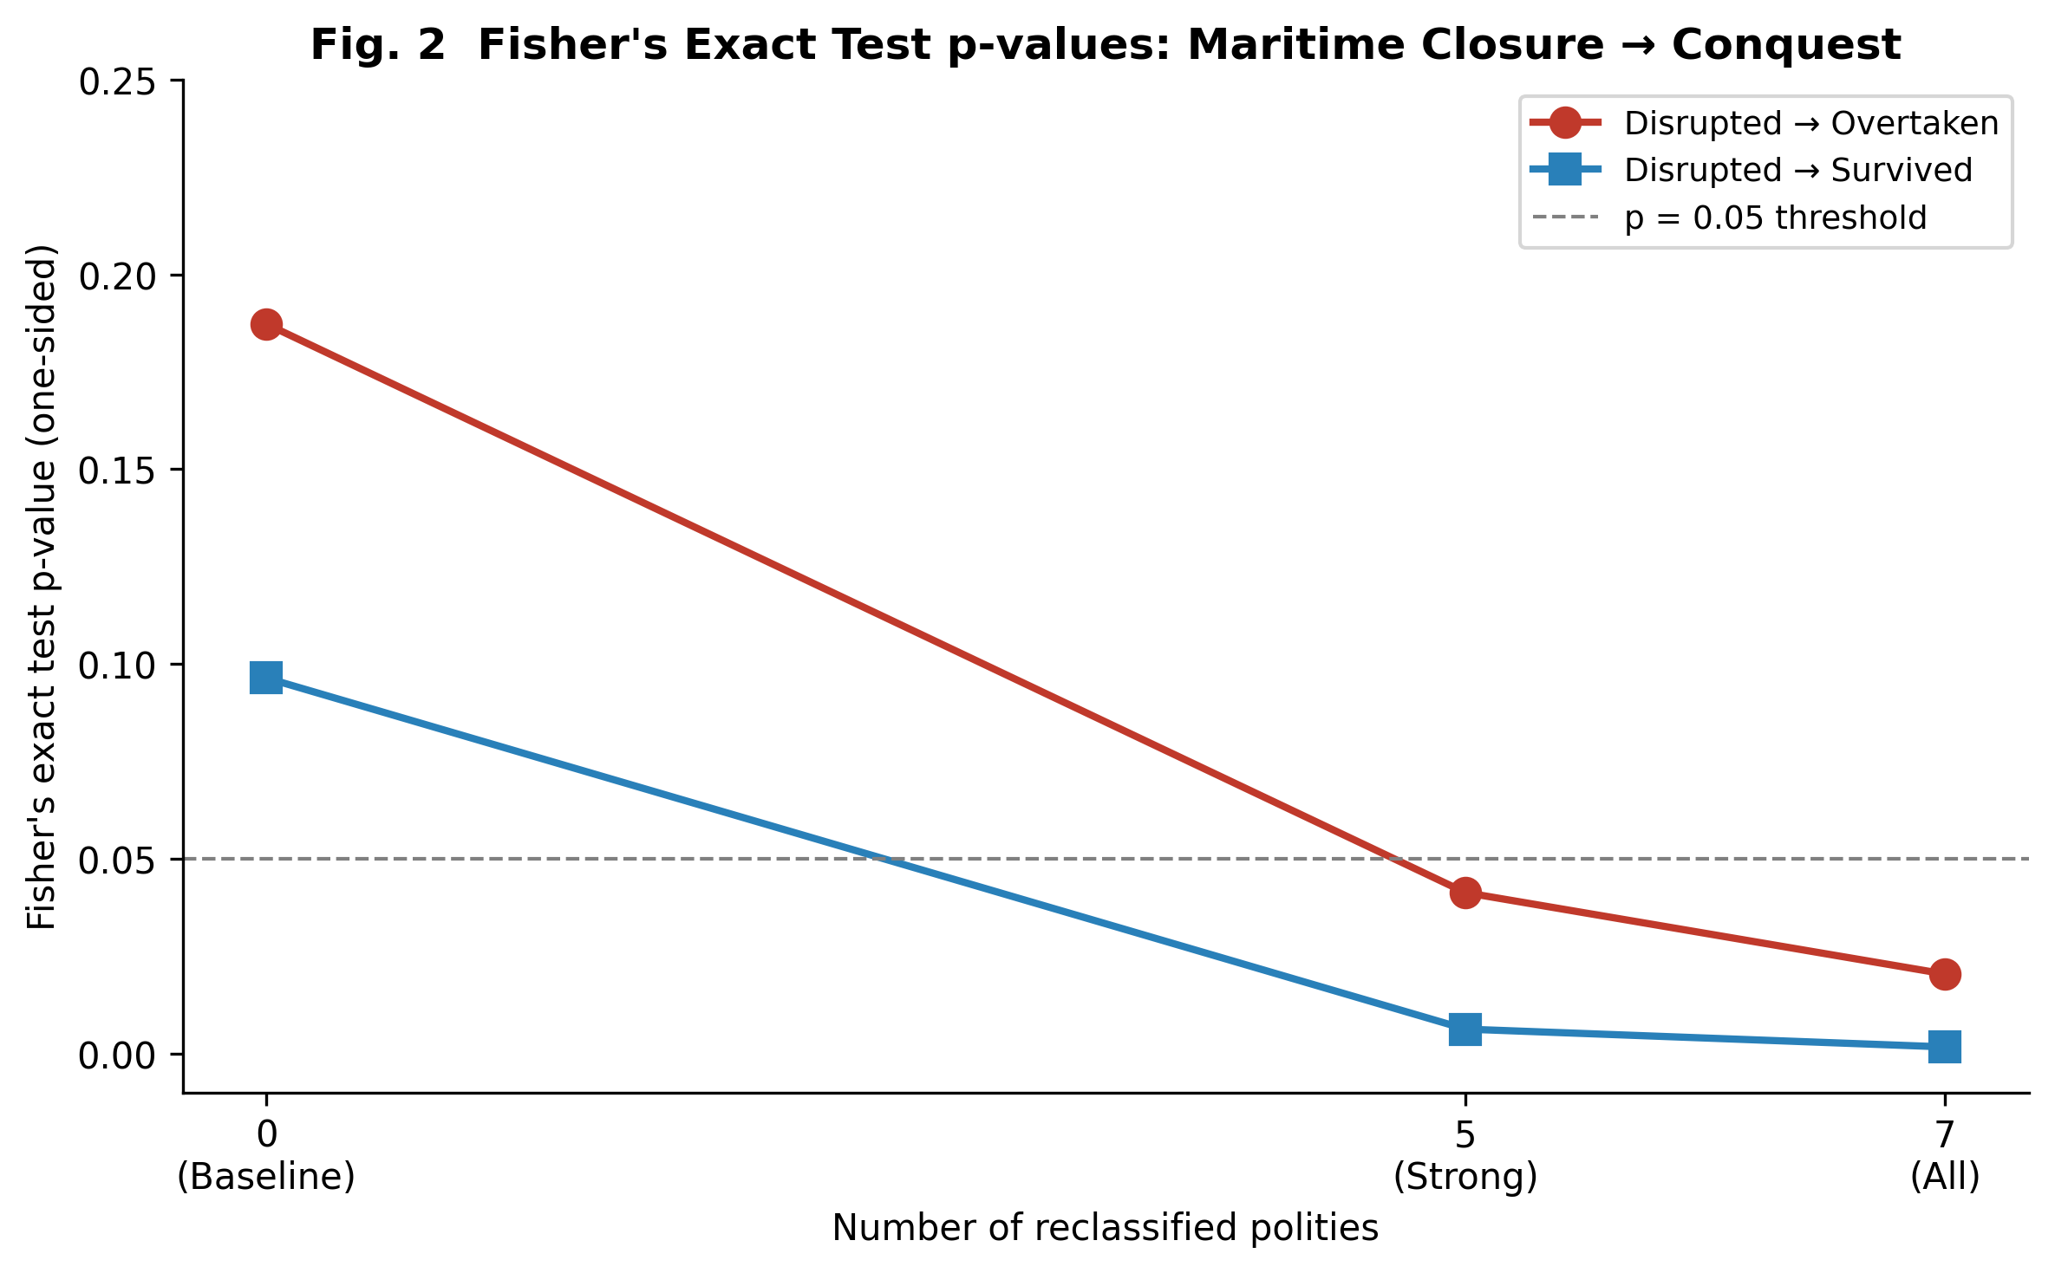
Fig. 2
Progressive strengthening of Fisher's exact test p-values as technically excluded polities are reclassified from open to closed. The dashed line indicates p = 0.05.

Slide 3
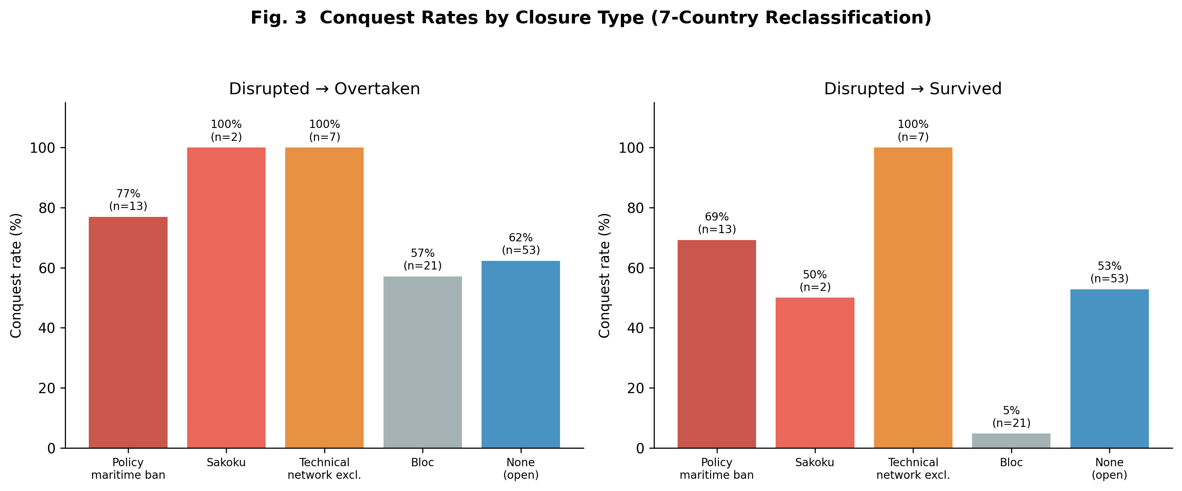
Fig. 3
Conquest rates disaggregated by closure type under the 7-country reclassification. Technical exclusion (zero technology flow) produces the highest conquest rate, followed by policy bans, sakoku, and bloc closures.

Slide 4
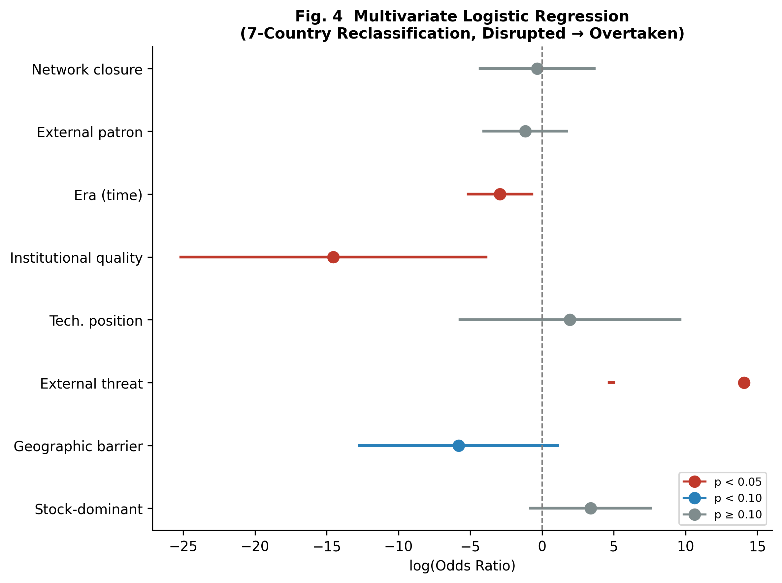
Fig. 4
Forest plot of multivariate logistic regression coefficients (log-odds) under the 7-country reclassification with disrupted = overtaken. External threat and institutional quality are the strongest predictors; the network closure indicator is not independently significant.

