Slide 1
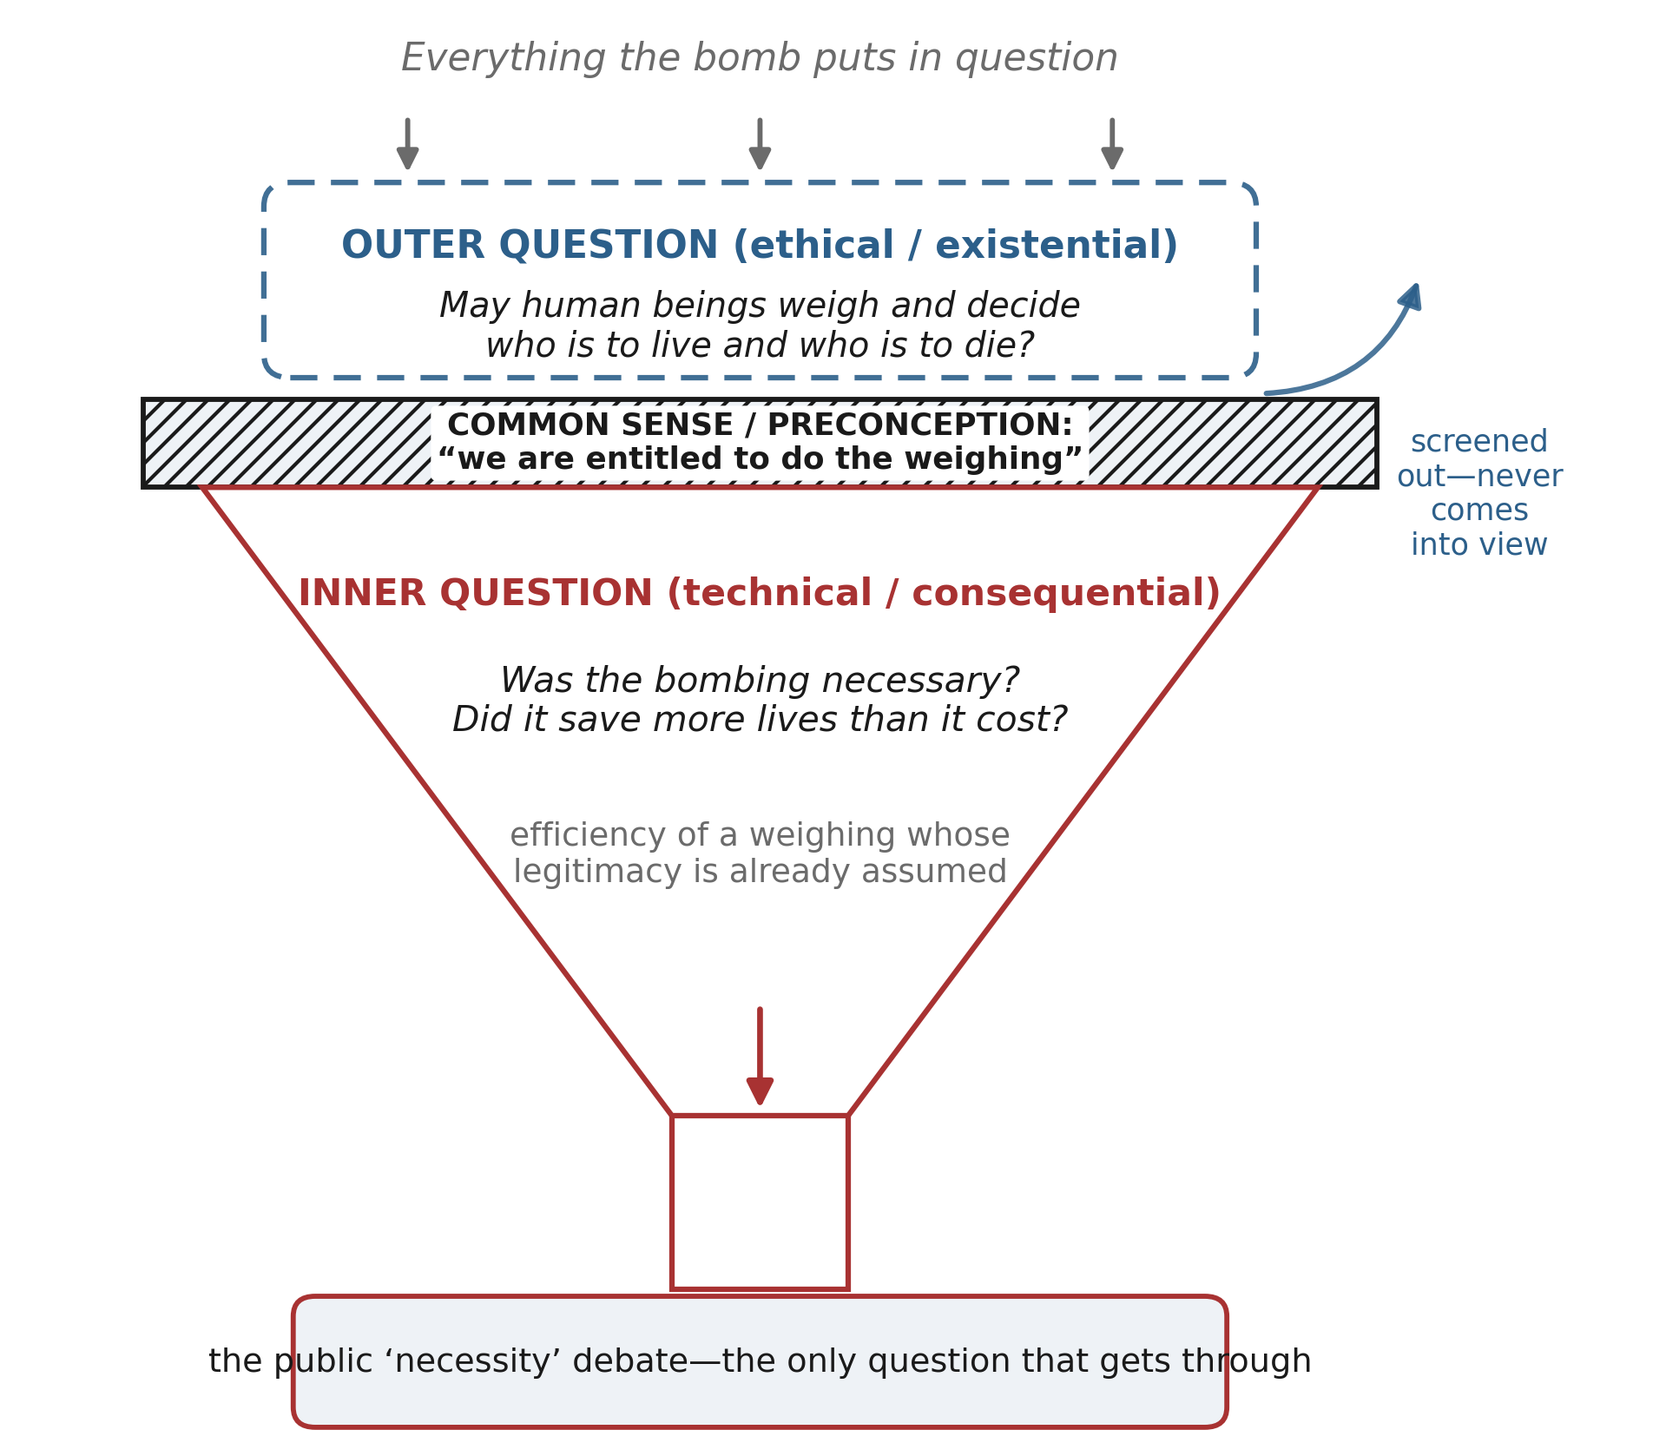
Figure 1. Two layers of the question
Figure 1. The funnel of attention. Every question the bombing raises enters at the top, but a layer of common sense and preconception—that we are entitled to do the weighing—acts as a sieve: only the inner, technical (“was it necessary?”) question passes through into public debate, while the outer question—whether such weighing is ours to perform at all—is screened out and never comes into view.

Slide 2
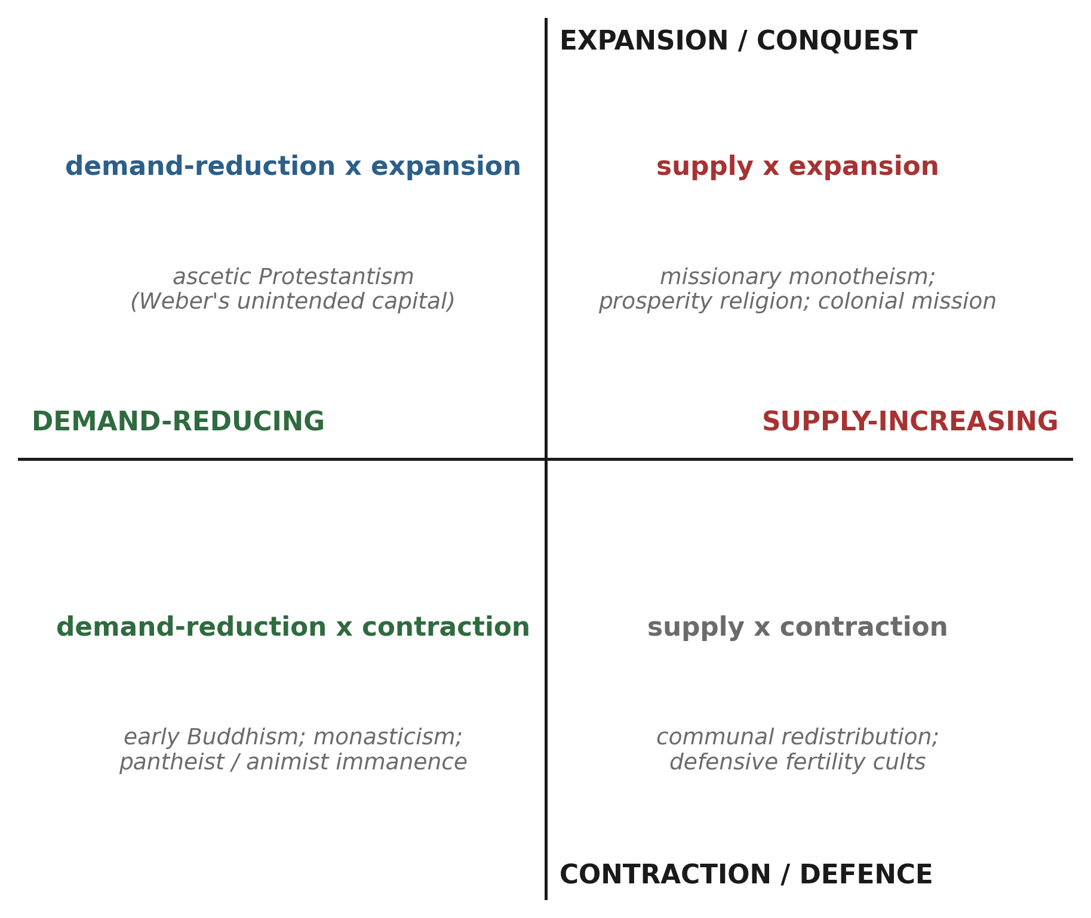
Figure 2. Supply–demand × expansion–contraction
Figure 2. Two independent axes—supply-increasing vs. demand-reducing, and expansion vs. contraction—with illustrative religious and economic types. The naive alignment of monotheism with expansion and pantheism with restraint holds only as a tendency; ascetic Protestantism and expansionist polytheism occupy the off-diagonal cells.

Slide 3
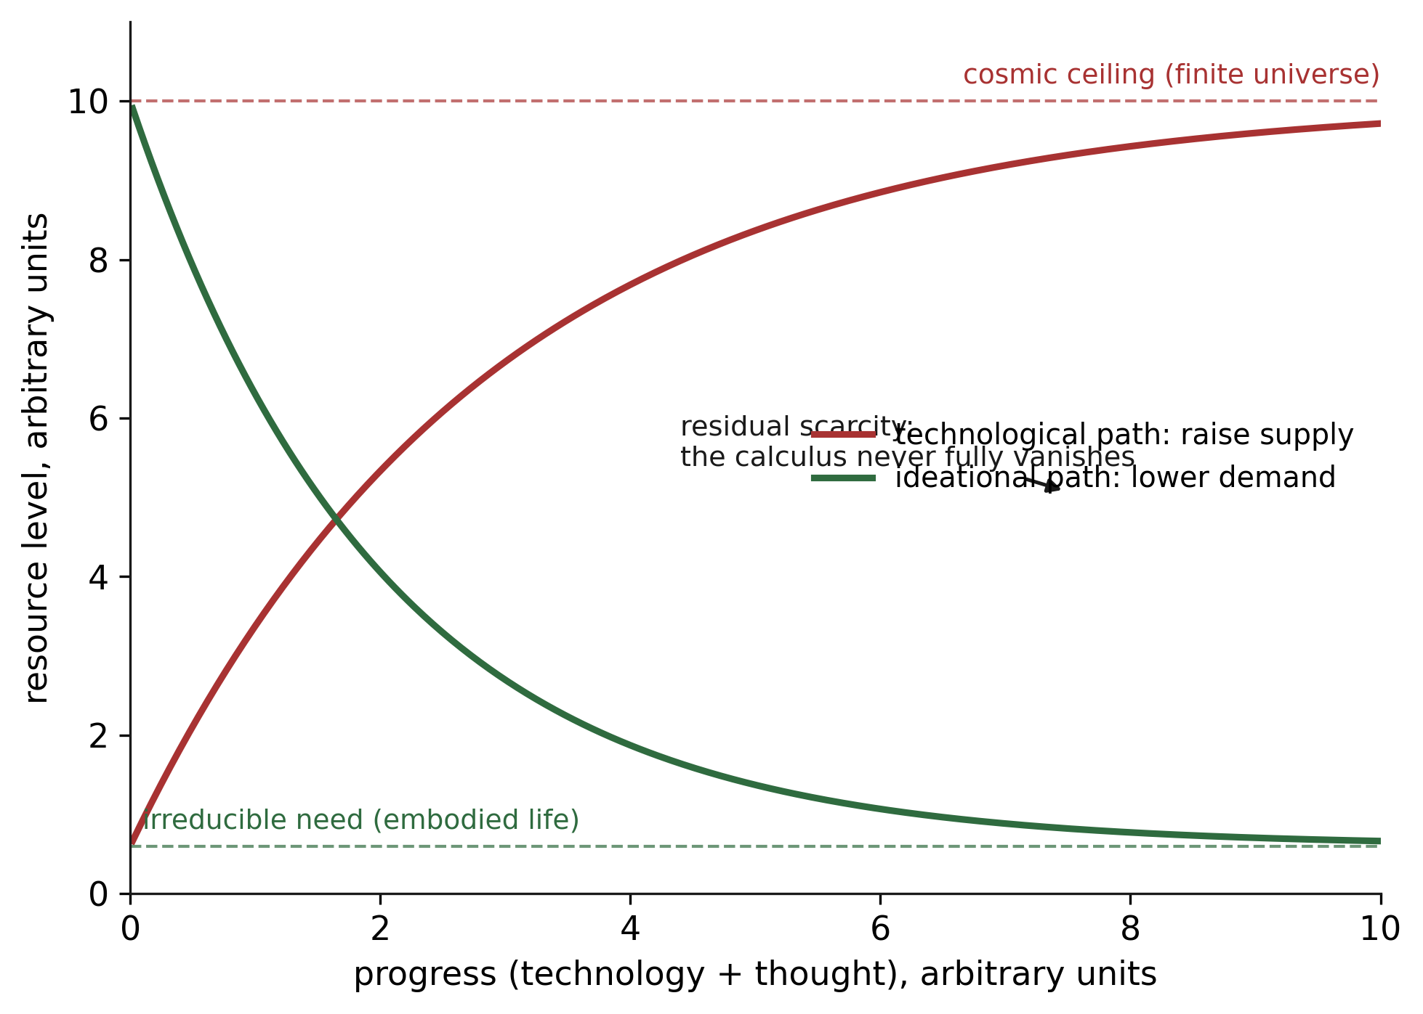
Figure 3. Asymptotic relief from the calculus
Figure 3. Asymptotic model of relief from the calculus. Raising supply approaches a cosmic ceiling; reducing demand approaches an irreducible floor set by embodied need. Neither reaches zero scarcity, so a residue of tragic weighing always remains; the claim is directional, not utopian.

