Slide 1
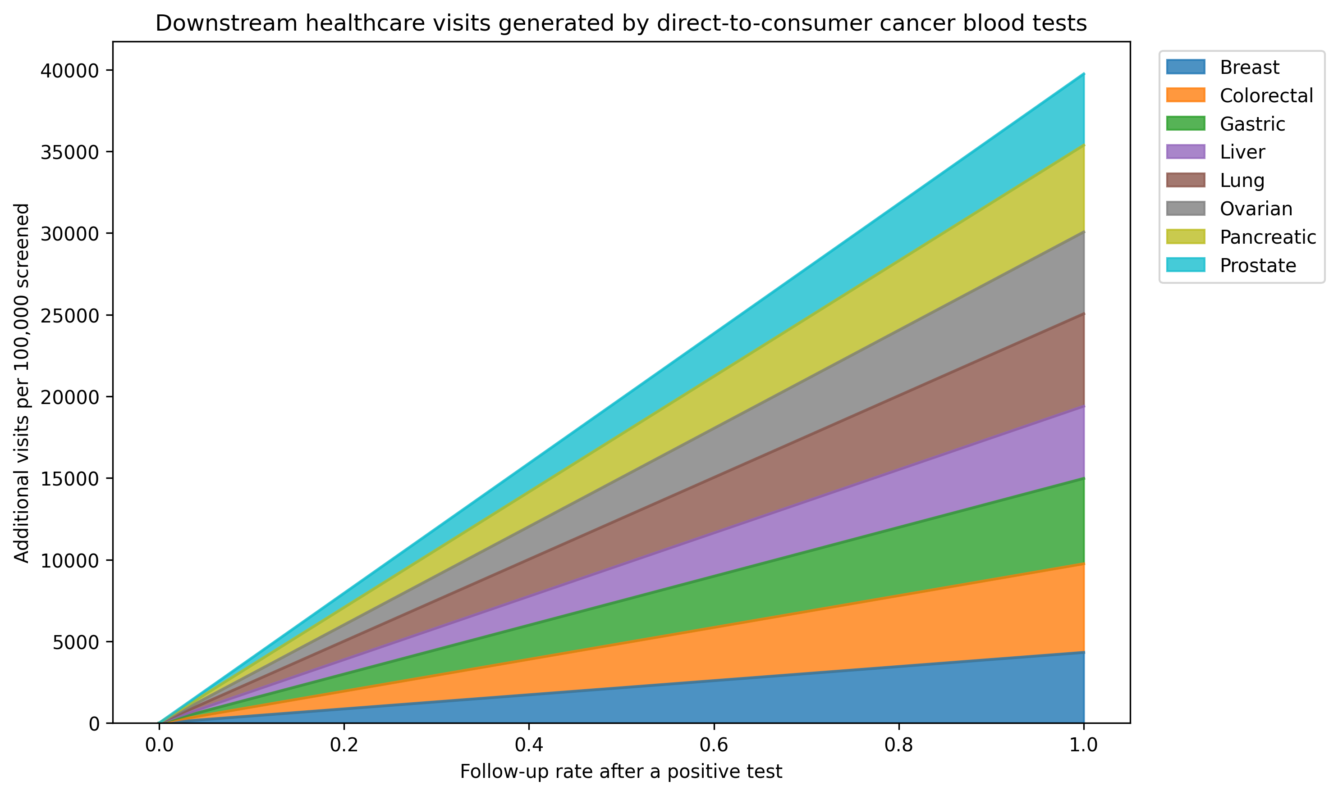
Figure 1. Total downstream visits by follow-up rate

Slide 2
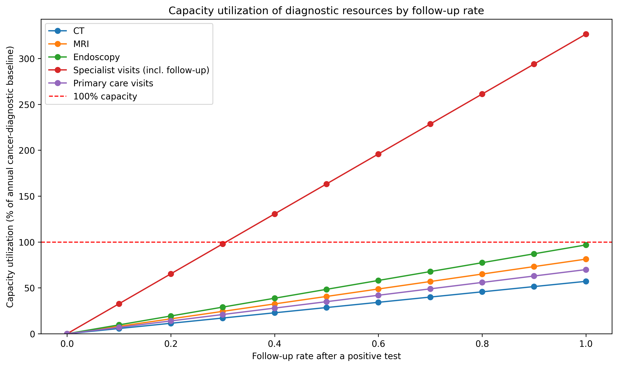
Figure 2. Diagnostic capacity utilisation by follow-up rate

Slide 3
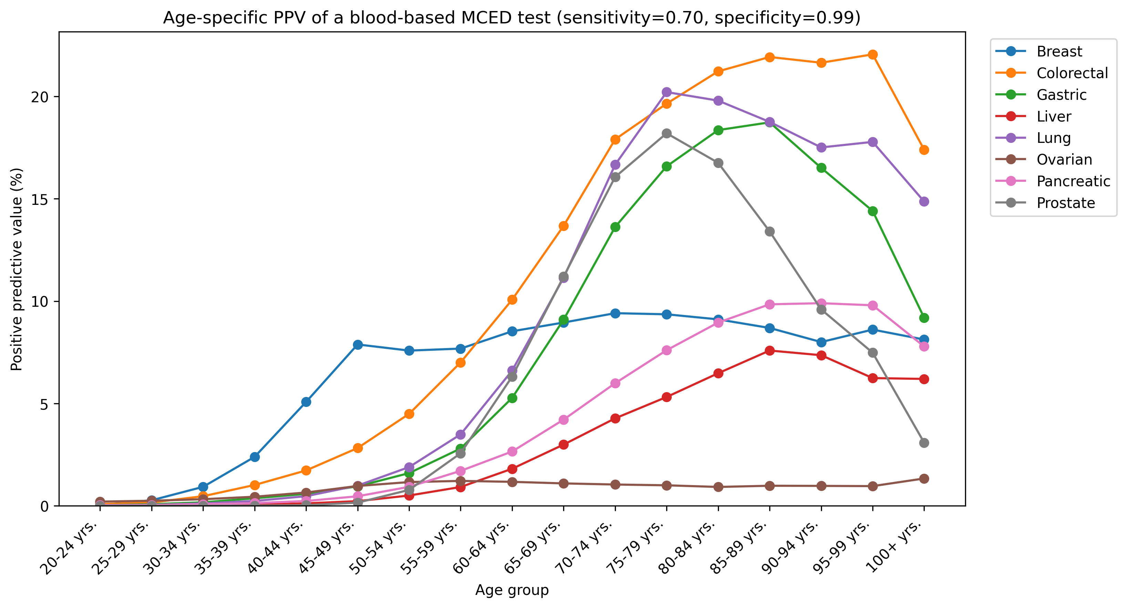
Figure 3. Age-specific PPV by cancer type

Slide 4
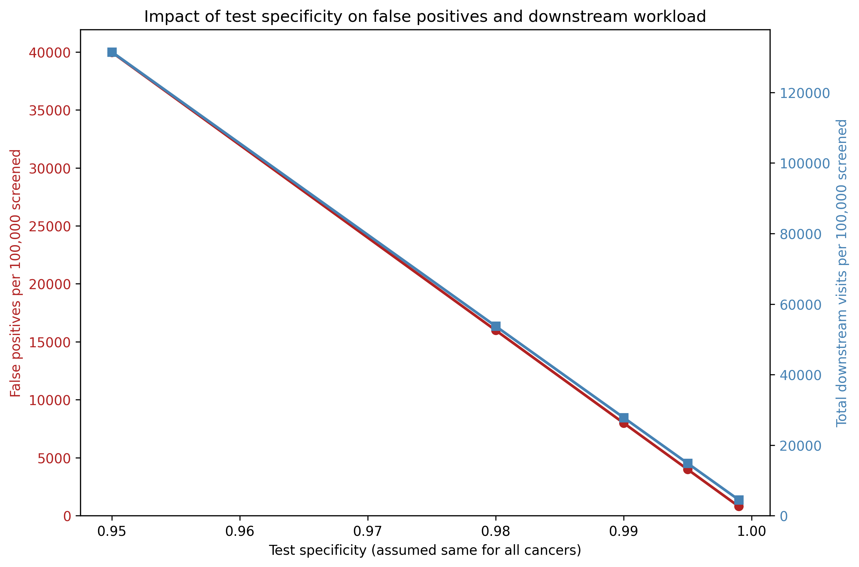
Figure 4. PPV and total positives across specificity values

Slide 5
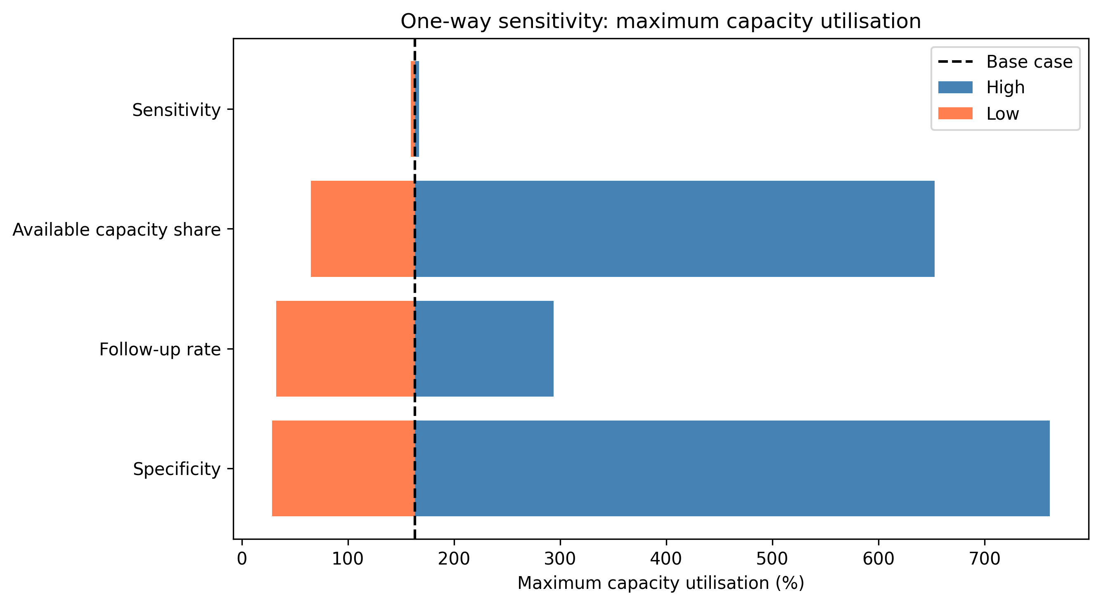
Supplementary Figure S1. One-way sensitivity of maximum capacity utilisation

Slide 6
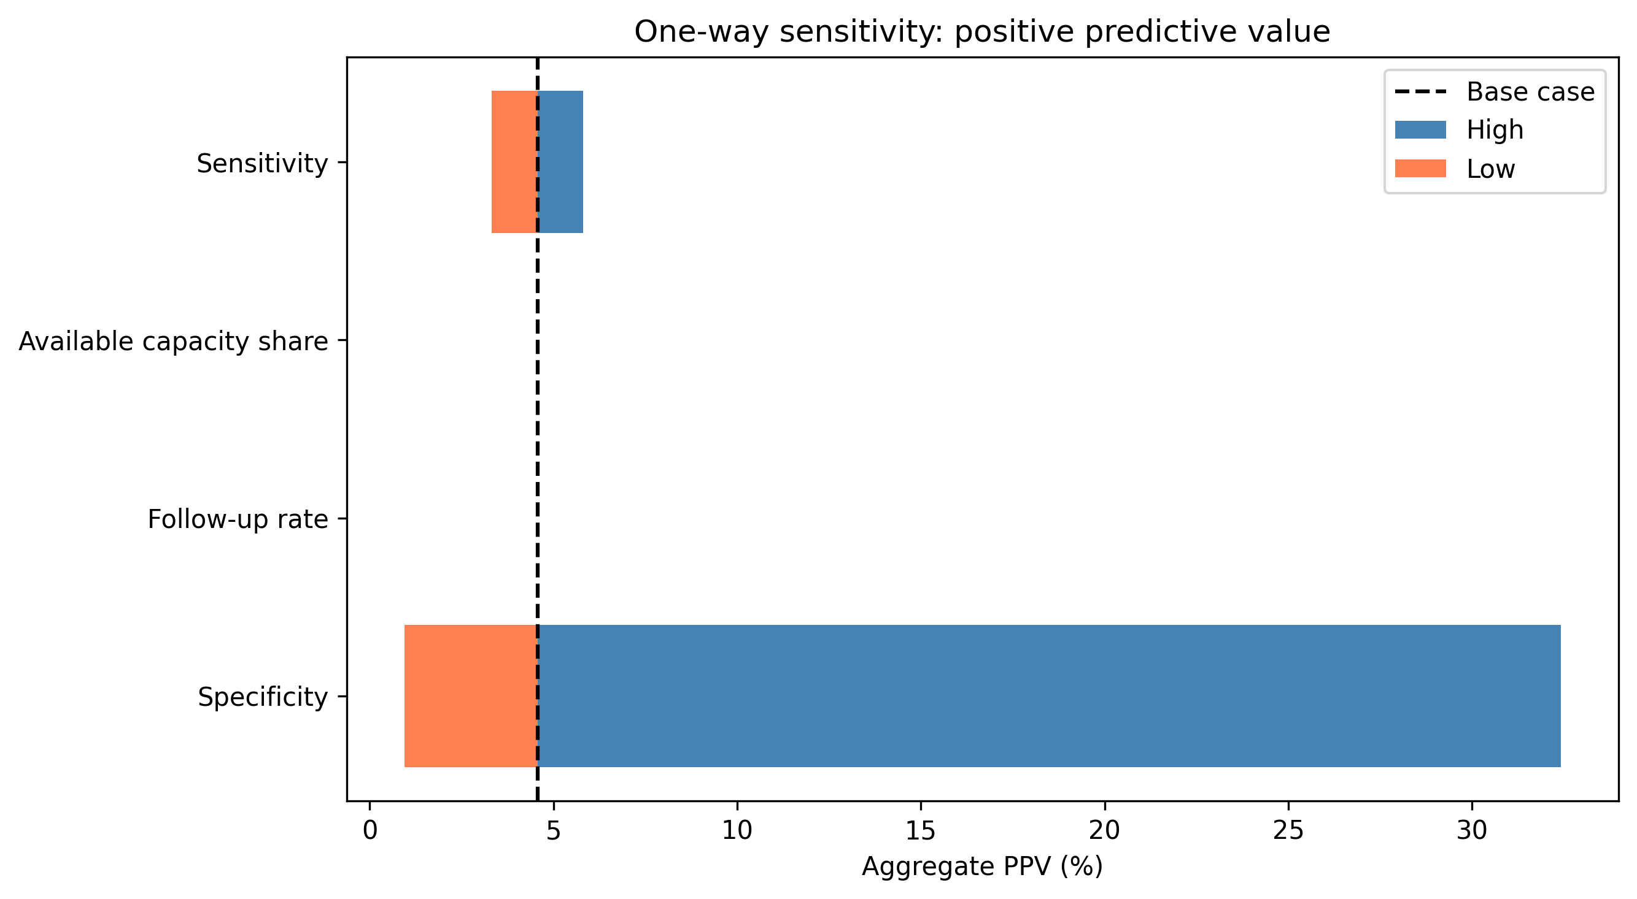
Supplementary Figure S2. One-way sensitivity of aggregate PPV

Slide 7
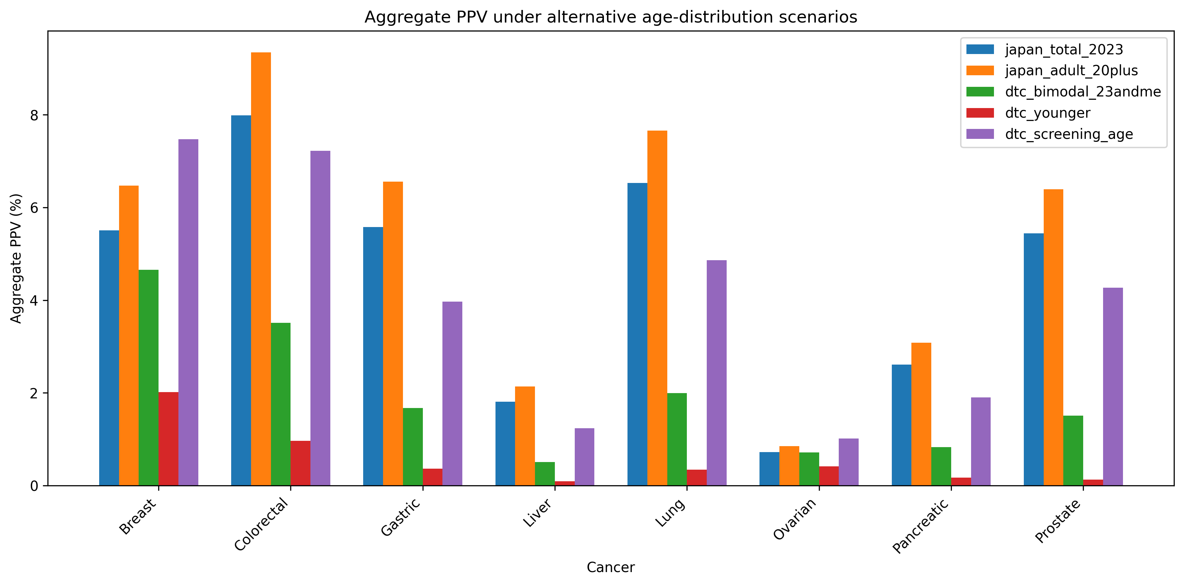
Supplementary Figure S3. Aggregate PPV under alternative age-distribution scenarios

