Slide 1
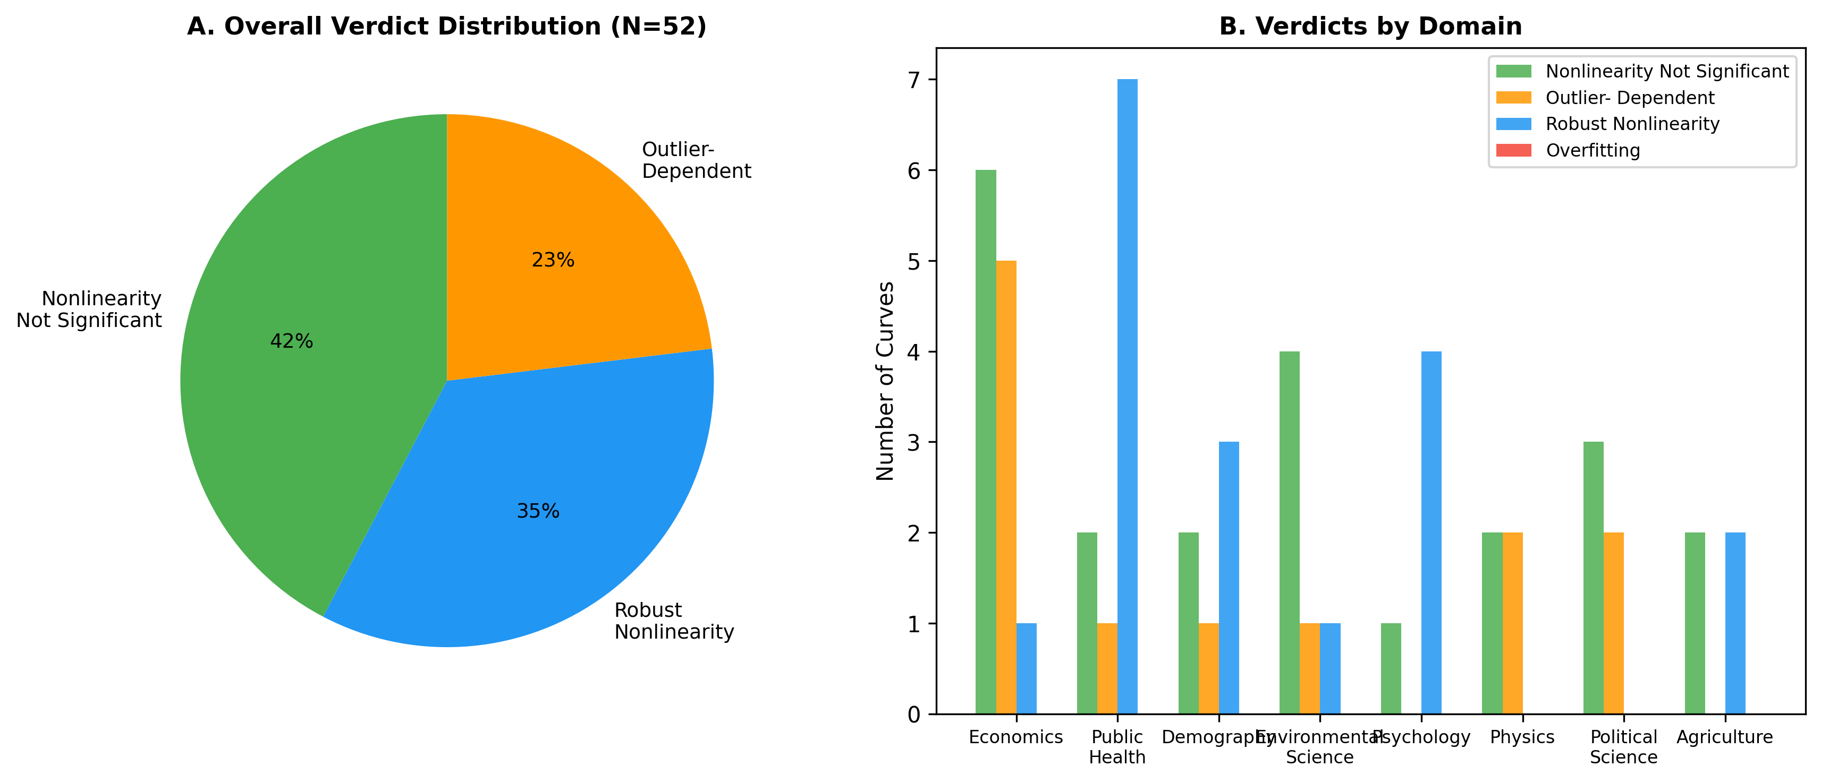
Figure 1: Verdict Distribution
Distribution of verdicts across 52 canonical curves by domain.

Slide 2
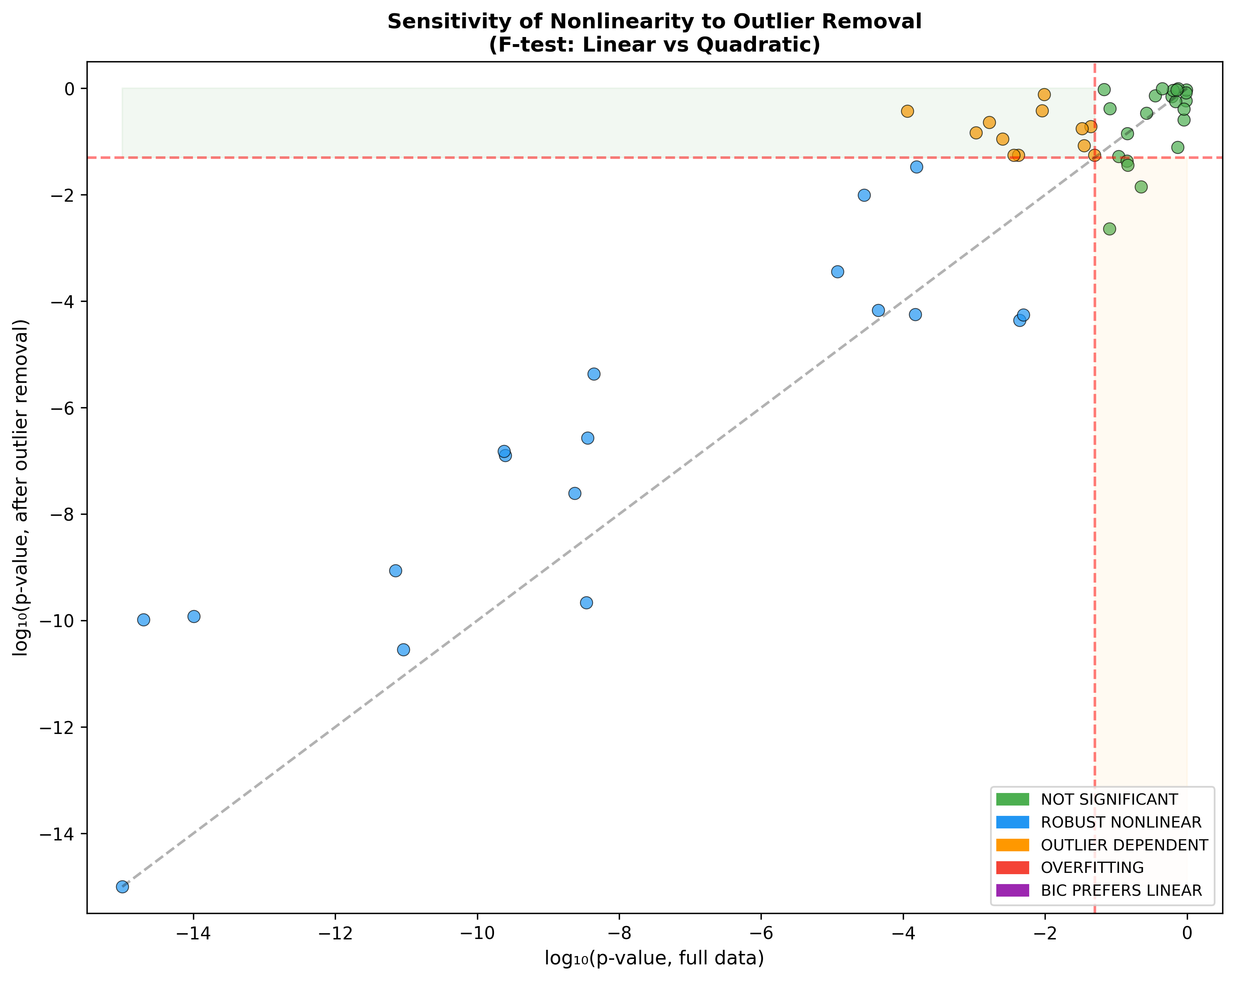
Figure 2: Sensitivity Analysis
F-test p-values before and after outlier removal (Cook's distance top 3).

Slide 3
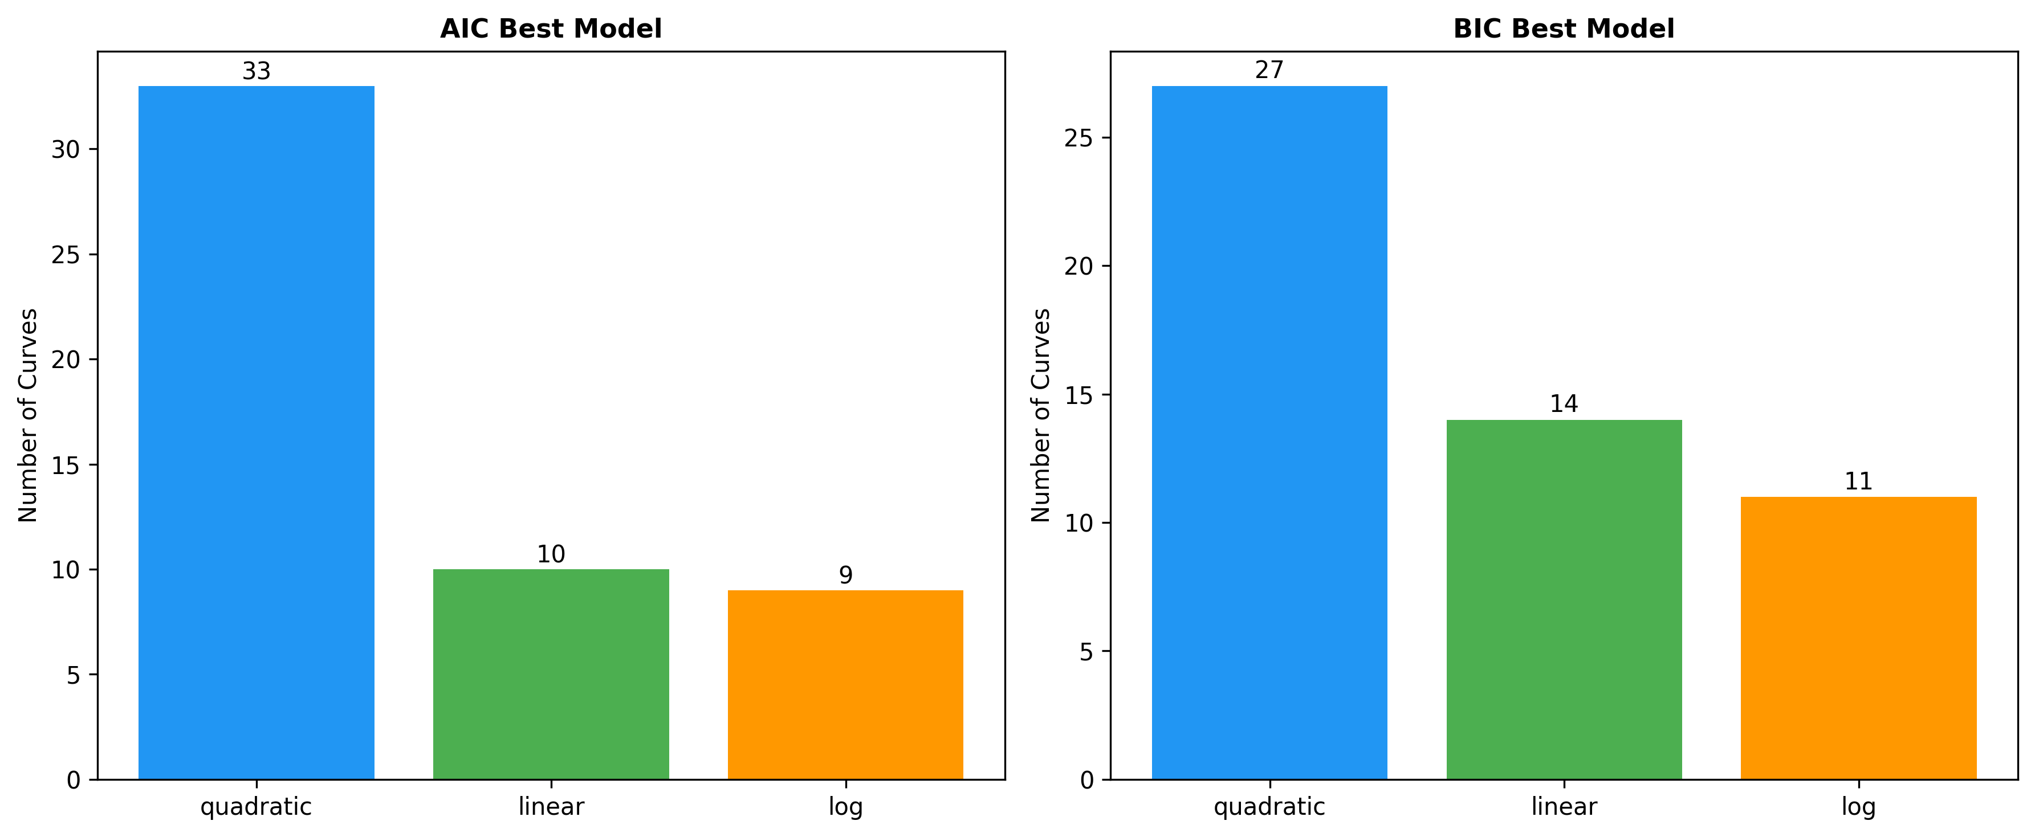
Figure 3: Model Comparison (AIC/BIC)
Model preference by AIC and BIC for linear, quadratic, and log models.

Slide 4
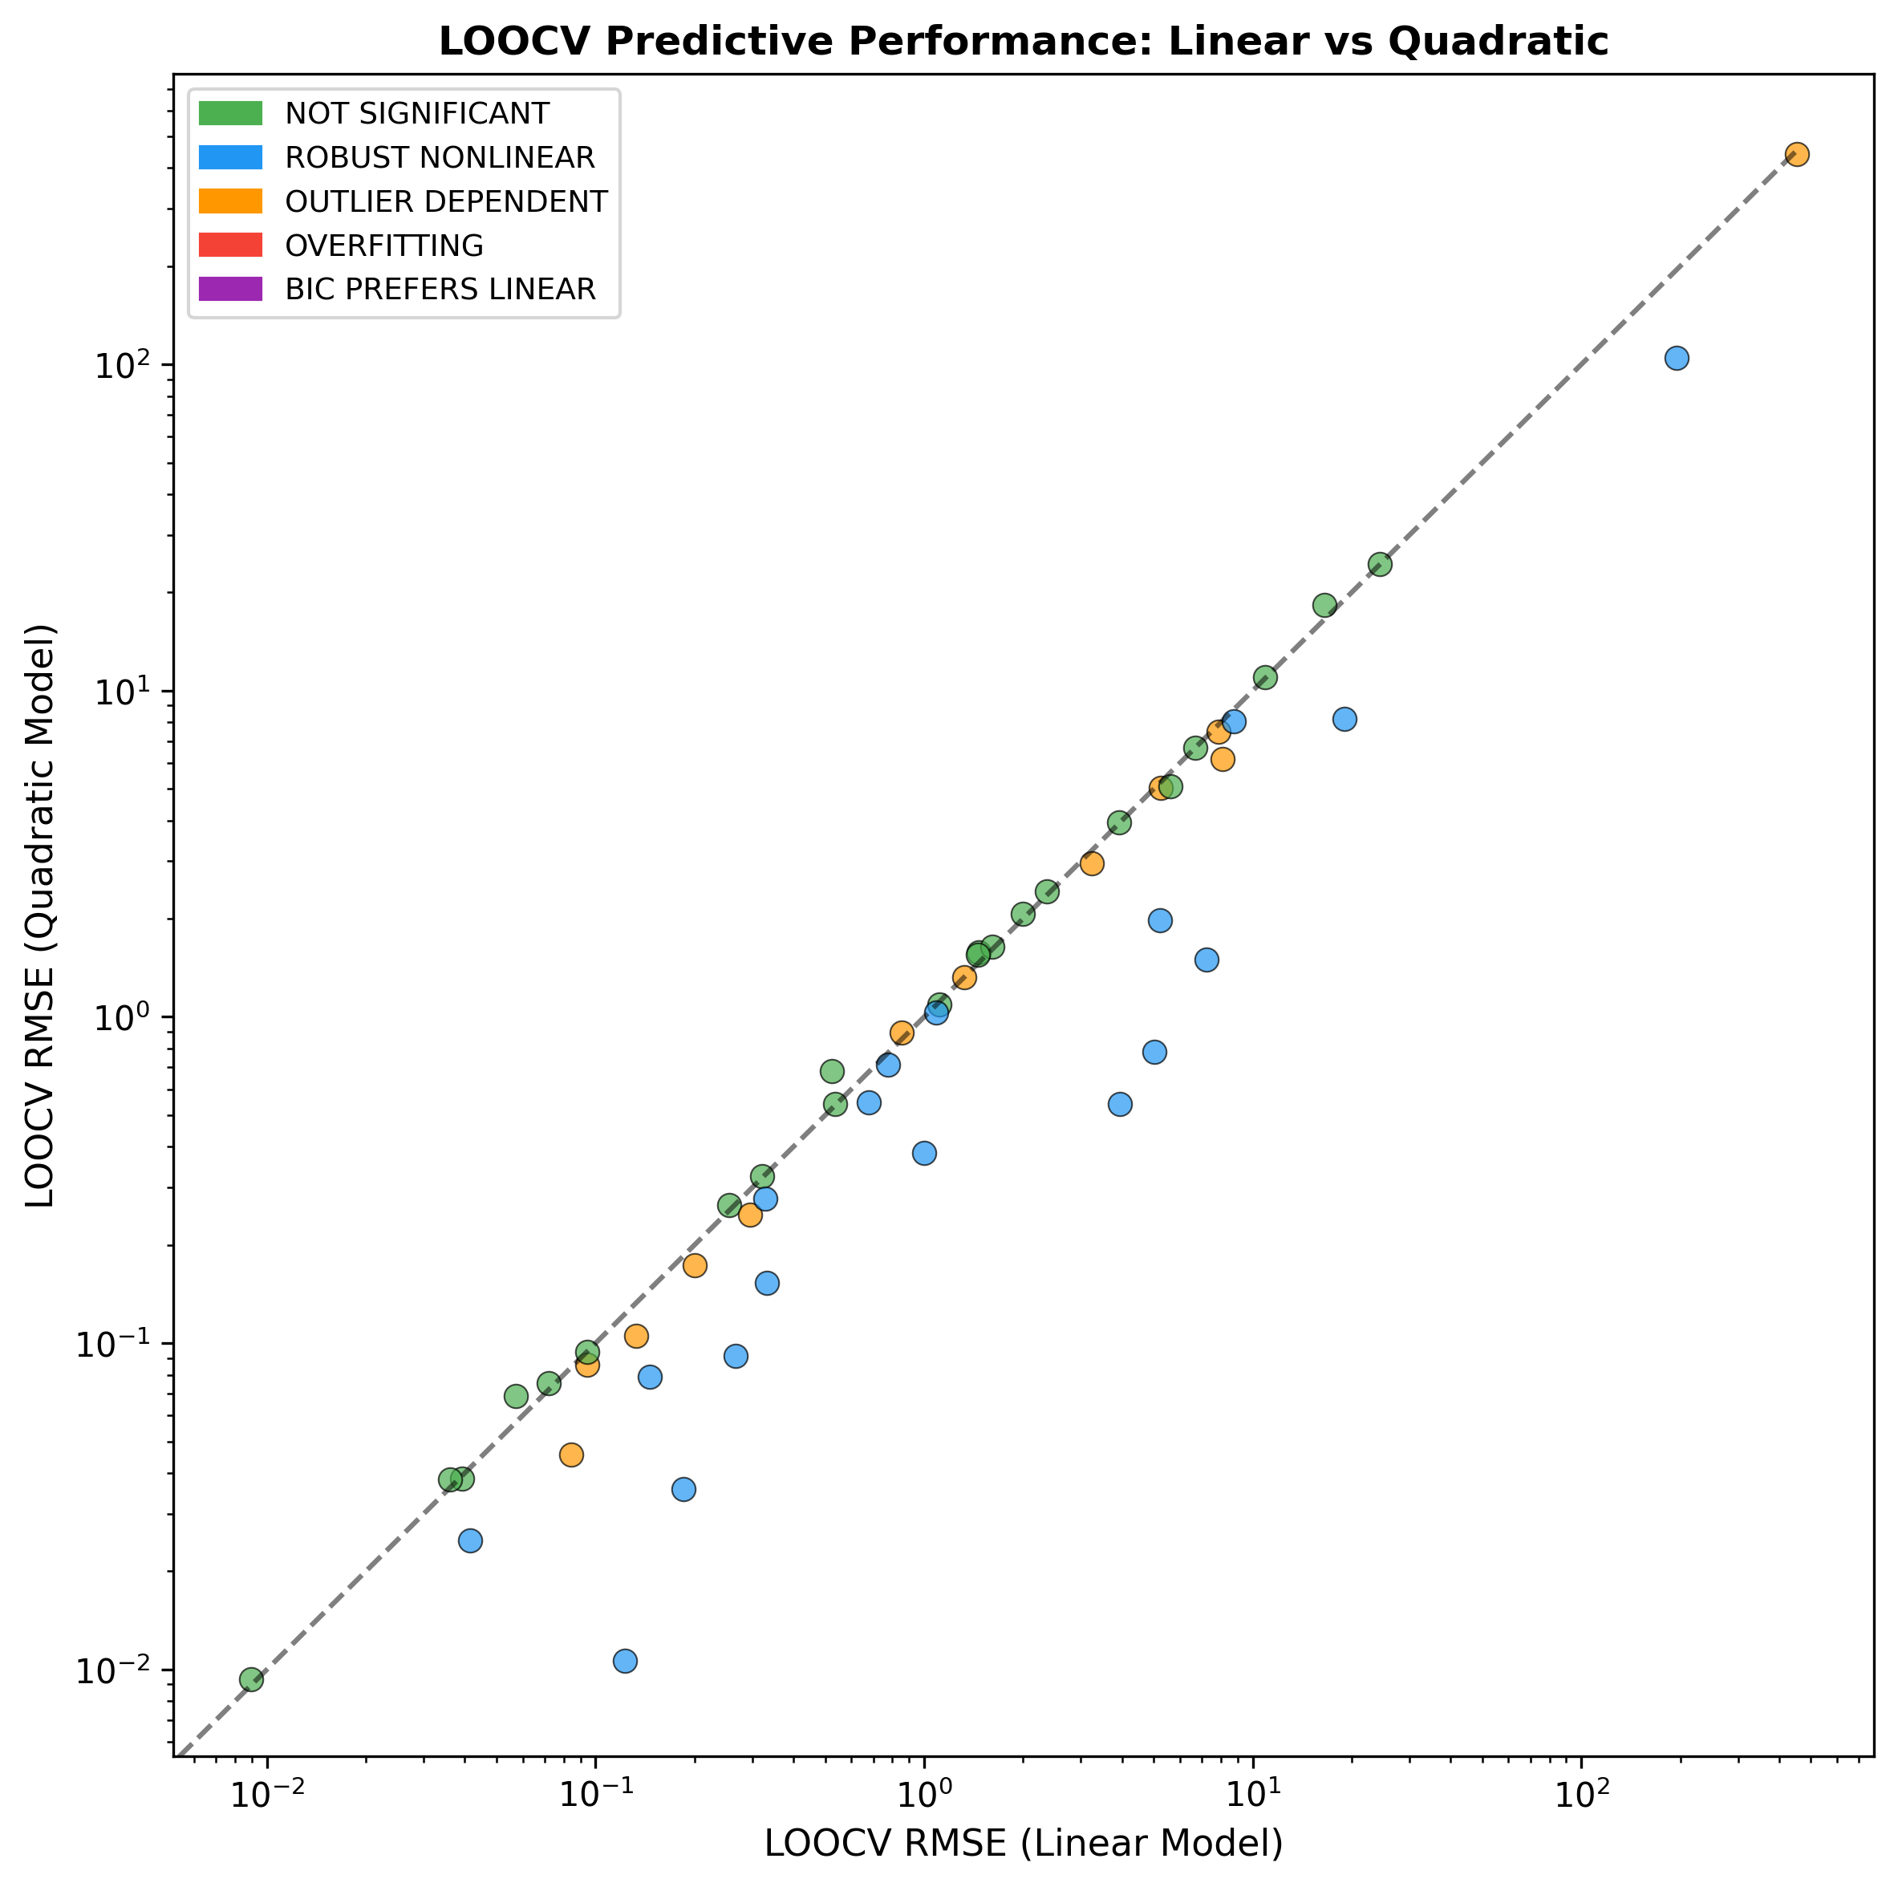
Figure 4: LOOCV Comparison
Leave-one-out cross-validation RMSE: linear vs quadratic models.

Slide 5
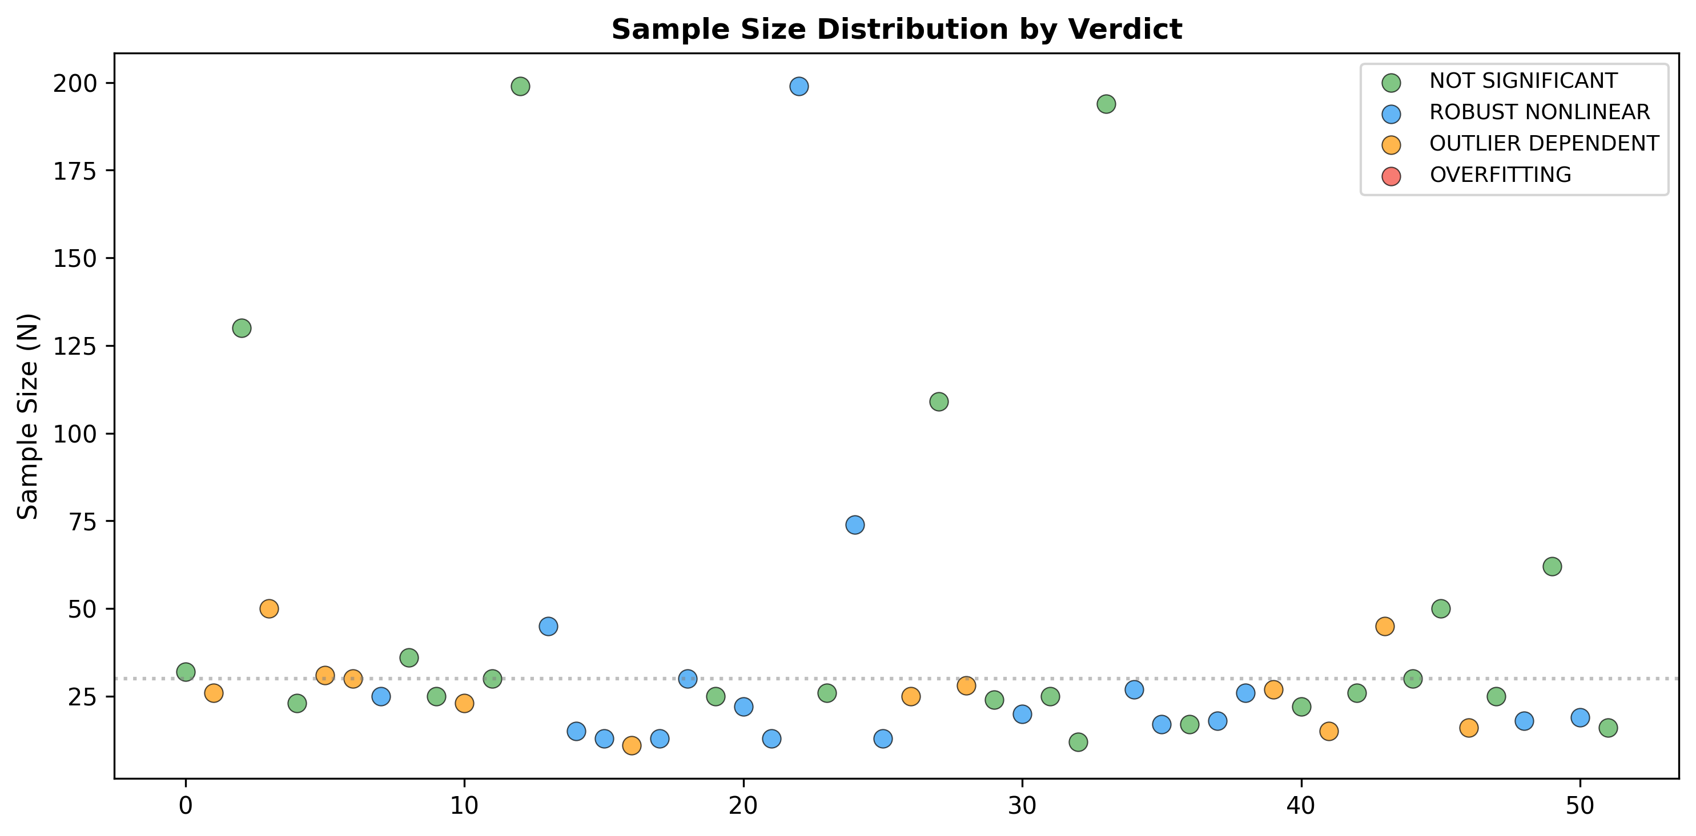
Figure 5: Sample Size vs Verdict
Relationship between sample size and analysis verdict.

