Slide 1
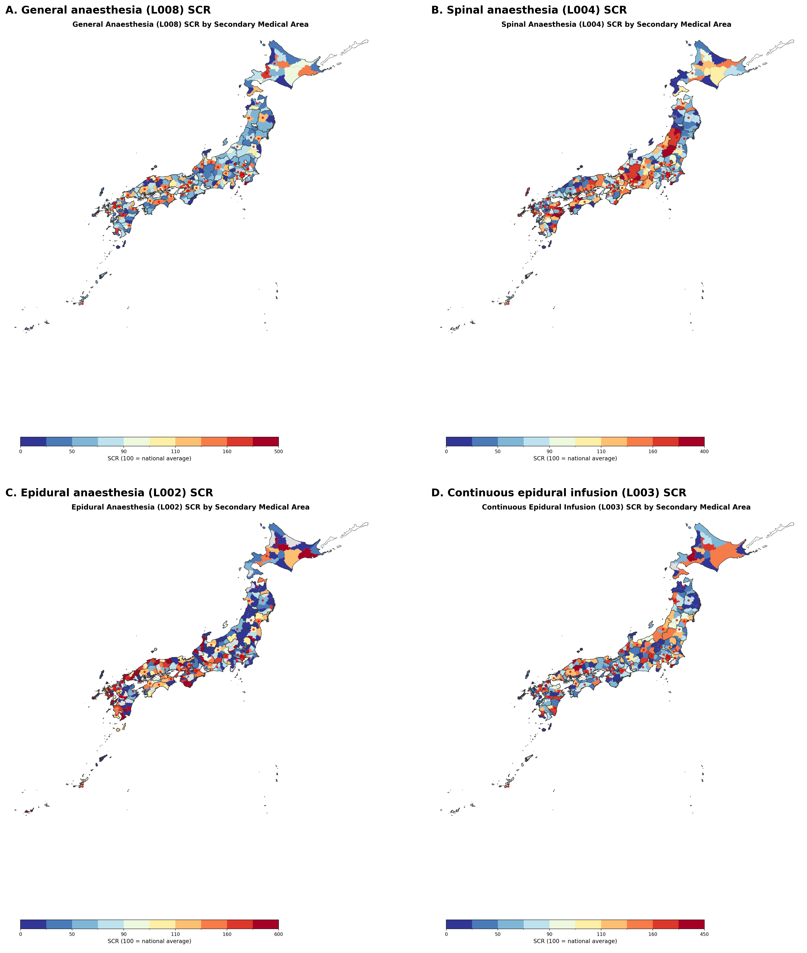
Figure 1. Geographic distribution of anaesthesia standardised claim ratios across 335 secondary medical areas of Japan, fiscal year 2022
(A) General anaesthesia (L008). (B) Spinal anaesthesia (L004). (C) Epidural anaesthesia as main anaesthetic (L002). (D) Continuous epidural infusion (L003). Choropleth maps shaded by quintile of the standardised claim ratio (national average = 100). Red circles mark secondary medical areas containing at least one university hospital. Areas masked by the data provider owing to low volume are shown in grey.

Slide 2
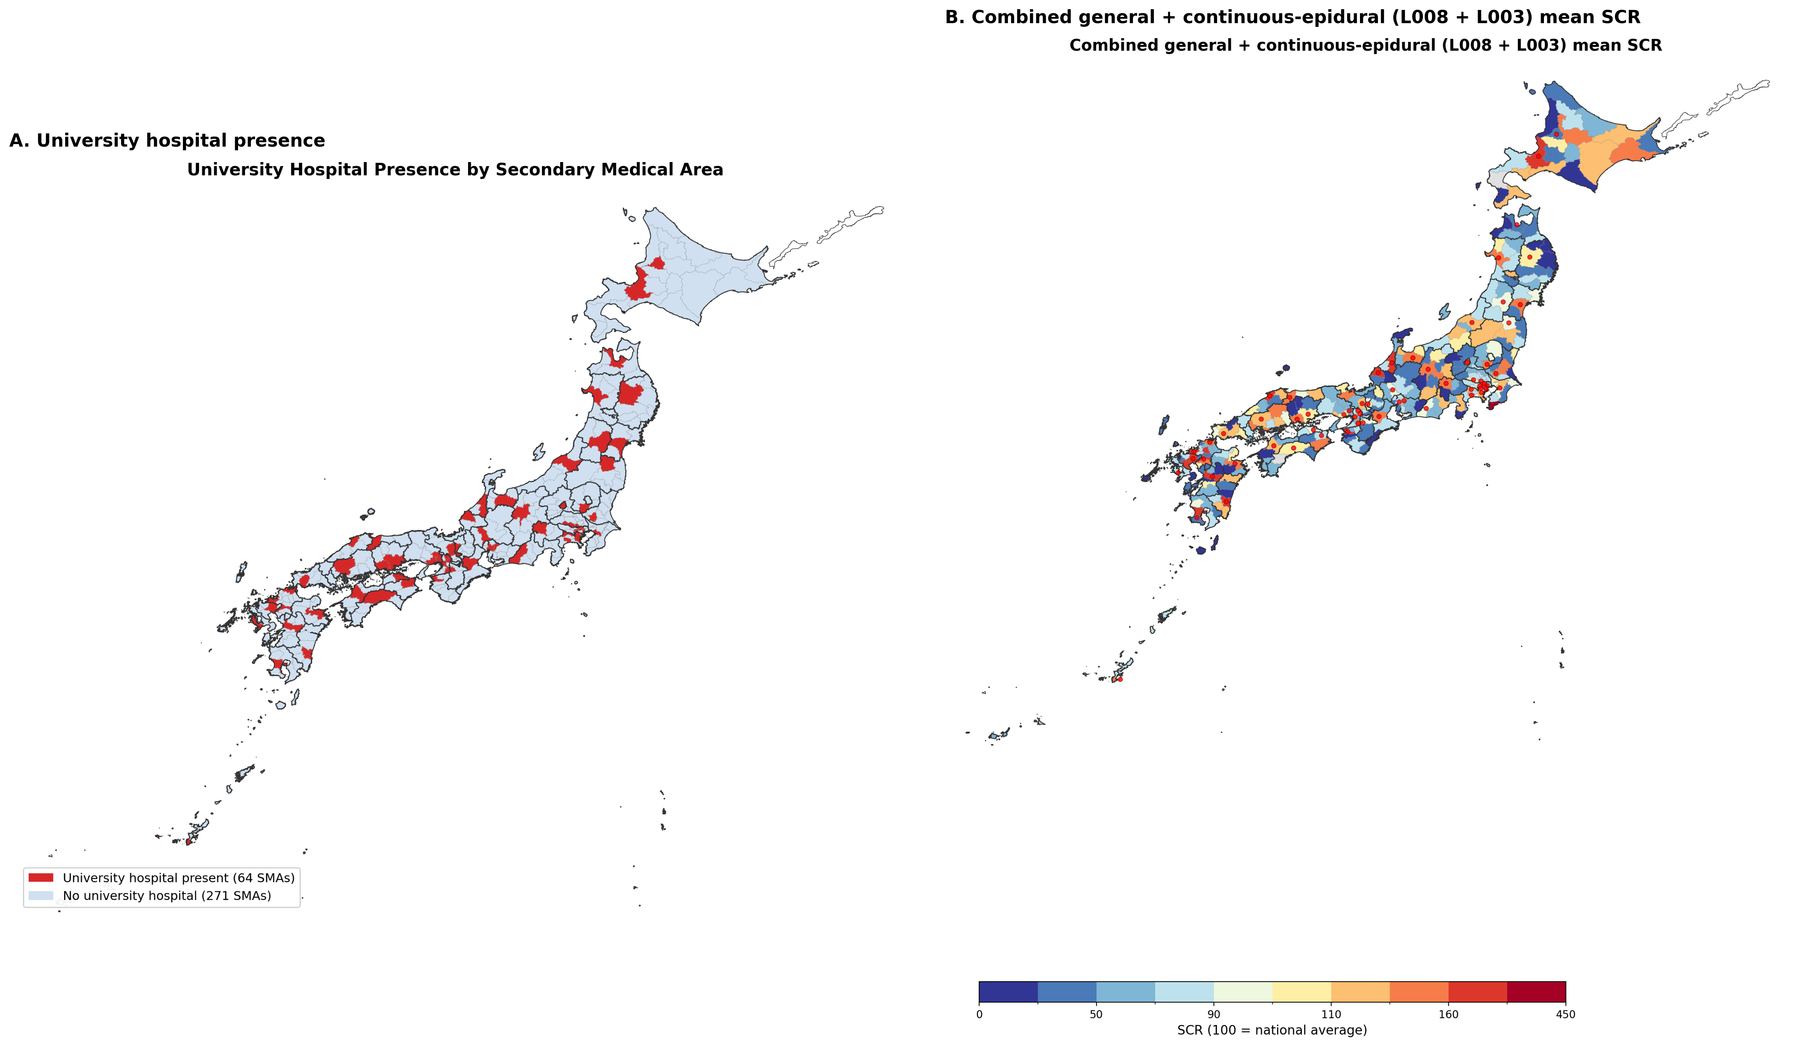
Figure 2. University hospital presence and the combined general-anaesthesia plus continuous-epidural measure.
(A) Distribution of secondary medical areas containing at least one university hospital (n = 64 of 335; red). (B) Choropleth map of the combined general-anaesthesia plus continuous-epidural standardised claim ratio (mean of L008 and L003 SCR; 331 areas with data for both codes), shaded by quintile. Red circles mark secondary medical areas containing at least one university hospital. Areas masked by the data provider for either code are shown in grey.

