Slide 1
Regional variation in anaesthesia practice across 335 secondary medical areas in Japan
A cross-sectional analysis of national claims data

Slide 2
Table 1. Anaesthesia procedure codes analysed
Code | Procedure | Clinical significance | SMAs with data
L008 | Closed-circuit general anaesthesia | Primary indicator of GA volume | 334
L002 | Epidural anaesthesia | Regional technique (alone or combined) | 307
L003 | Continuous epidural infusion | Direct indicator of GA+epidural combination | 331
L004 | Spinal anaesthesia | Alternative to GA for suitable procedures | 334
L009 | Anaesthesia management fee I | Proxy for specialist anaesthesiologist staffing | 314
L100 | Nerve block (inpatient) | Indicator of pain clinic activity | 335

Slide 3
Table 2. Distribution of standardised claim ratios (national average = 100)
Code | Procedure | P10 | P50 | P90 | CV (%) | n
L008 | General anaesthesia | 32.3 | 73.2 | 131.5 | 54.6 | 334
L002 | Epidural anaesthesia | 7.6 | 73.9 | 184.0 | 83.2 | 307
L003 | Continuous epidural infusion | 19.0 | 73.1 | 150.0 | 64.9 | 331
L004 | Spinal anaesthesia | 31.1 | 84.3 | 169.0 | 56.3 | 334
L009 | Anaesthesia management fee I | 32.5 | 79.1 | 149.1 | 57.2 | 314
L100 | Nerve block (inpatient) | 23.4 | 72.2 | 174.7 | 72.1 | 335

Slide 4
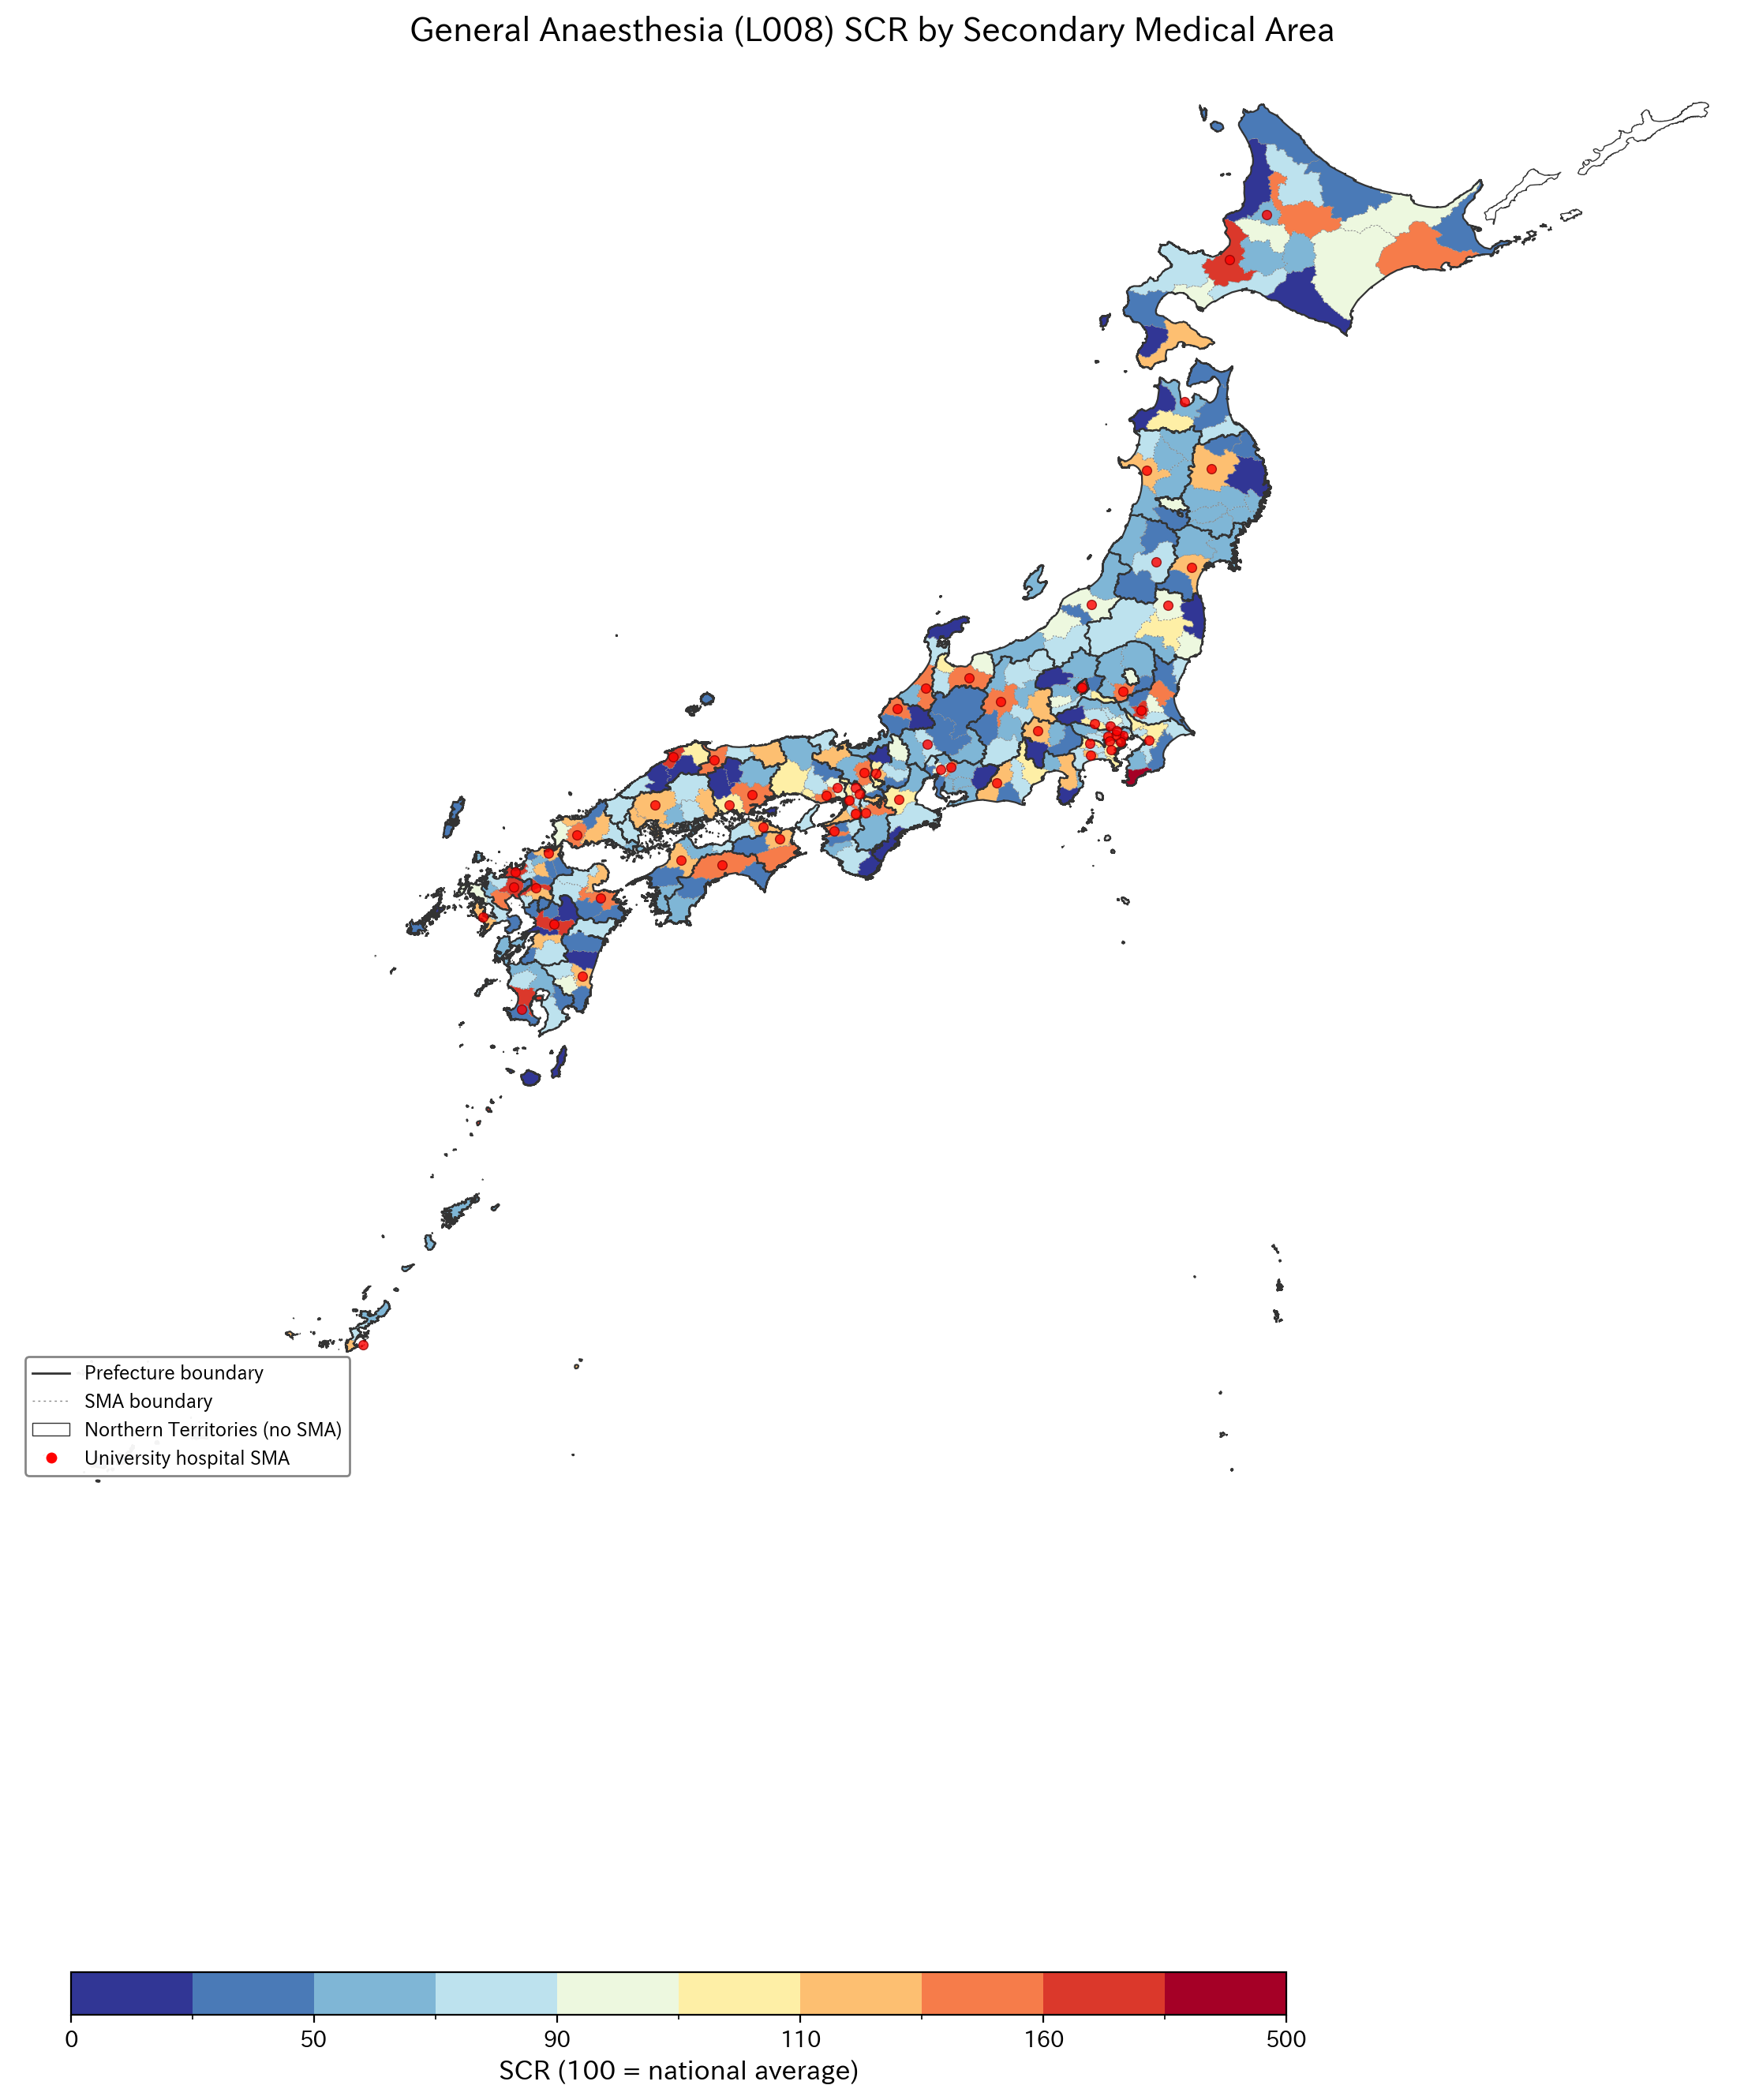
Figure 1
Figure 1. General anaesthesia (L008) standardised claim ratio by secondary medical area. Solid lines = prefectural boundaries; dashed lines = SMA boundaries. Northern Territories shown in white (no SMA designated).

Slide 5
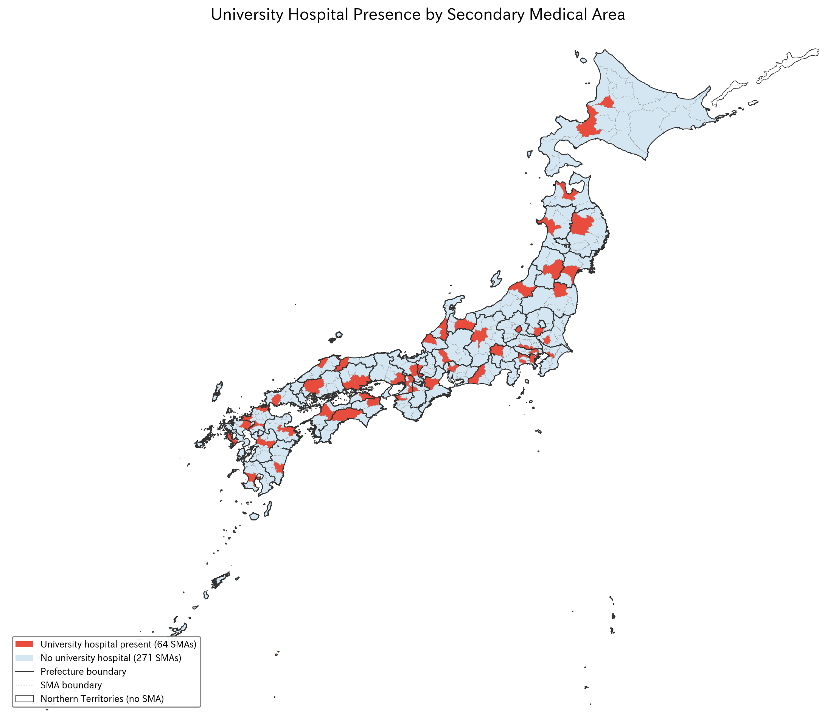
Figure 2
Figure 2. University hospital presence by secondary medical area. Red circles indicate SMAs containing one or more university hospitals (64 of 335 SMAs).

Slide 6
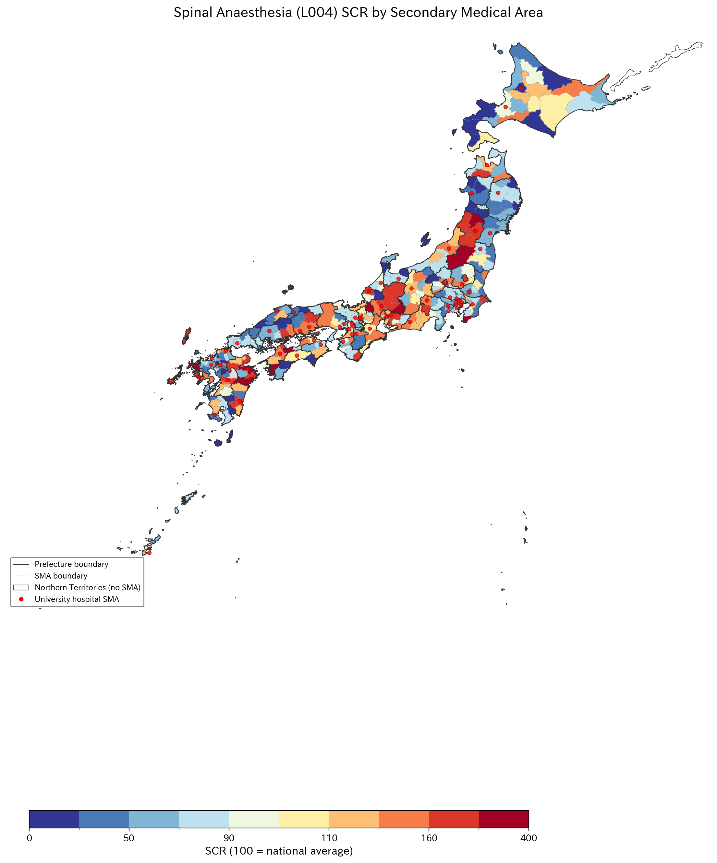
Figure 3
Figure 3. Spinal anaesthesia (L004) standardised claim ratio by secondary medical area.

Slide 7
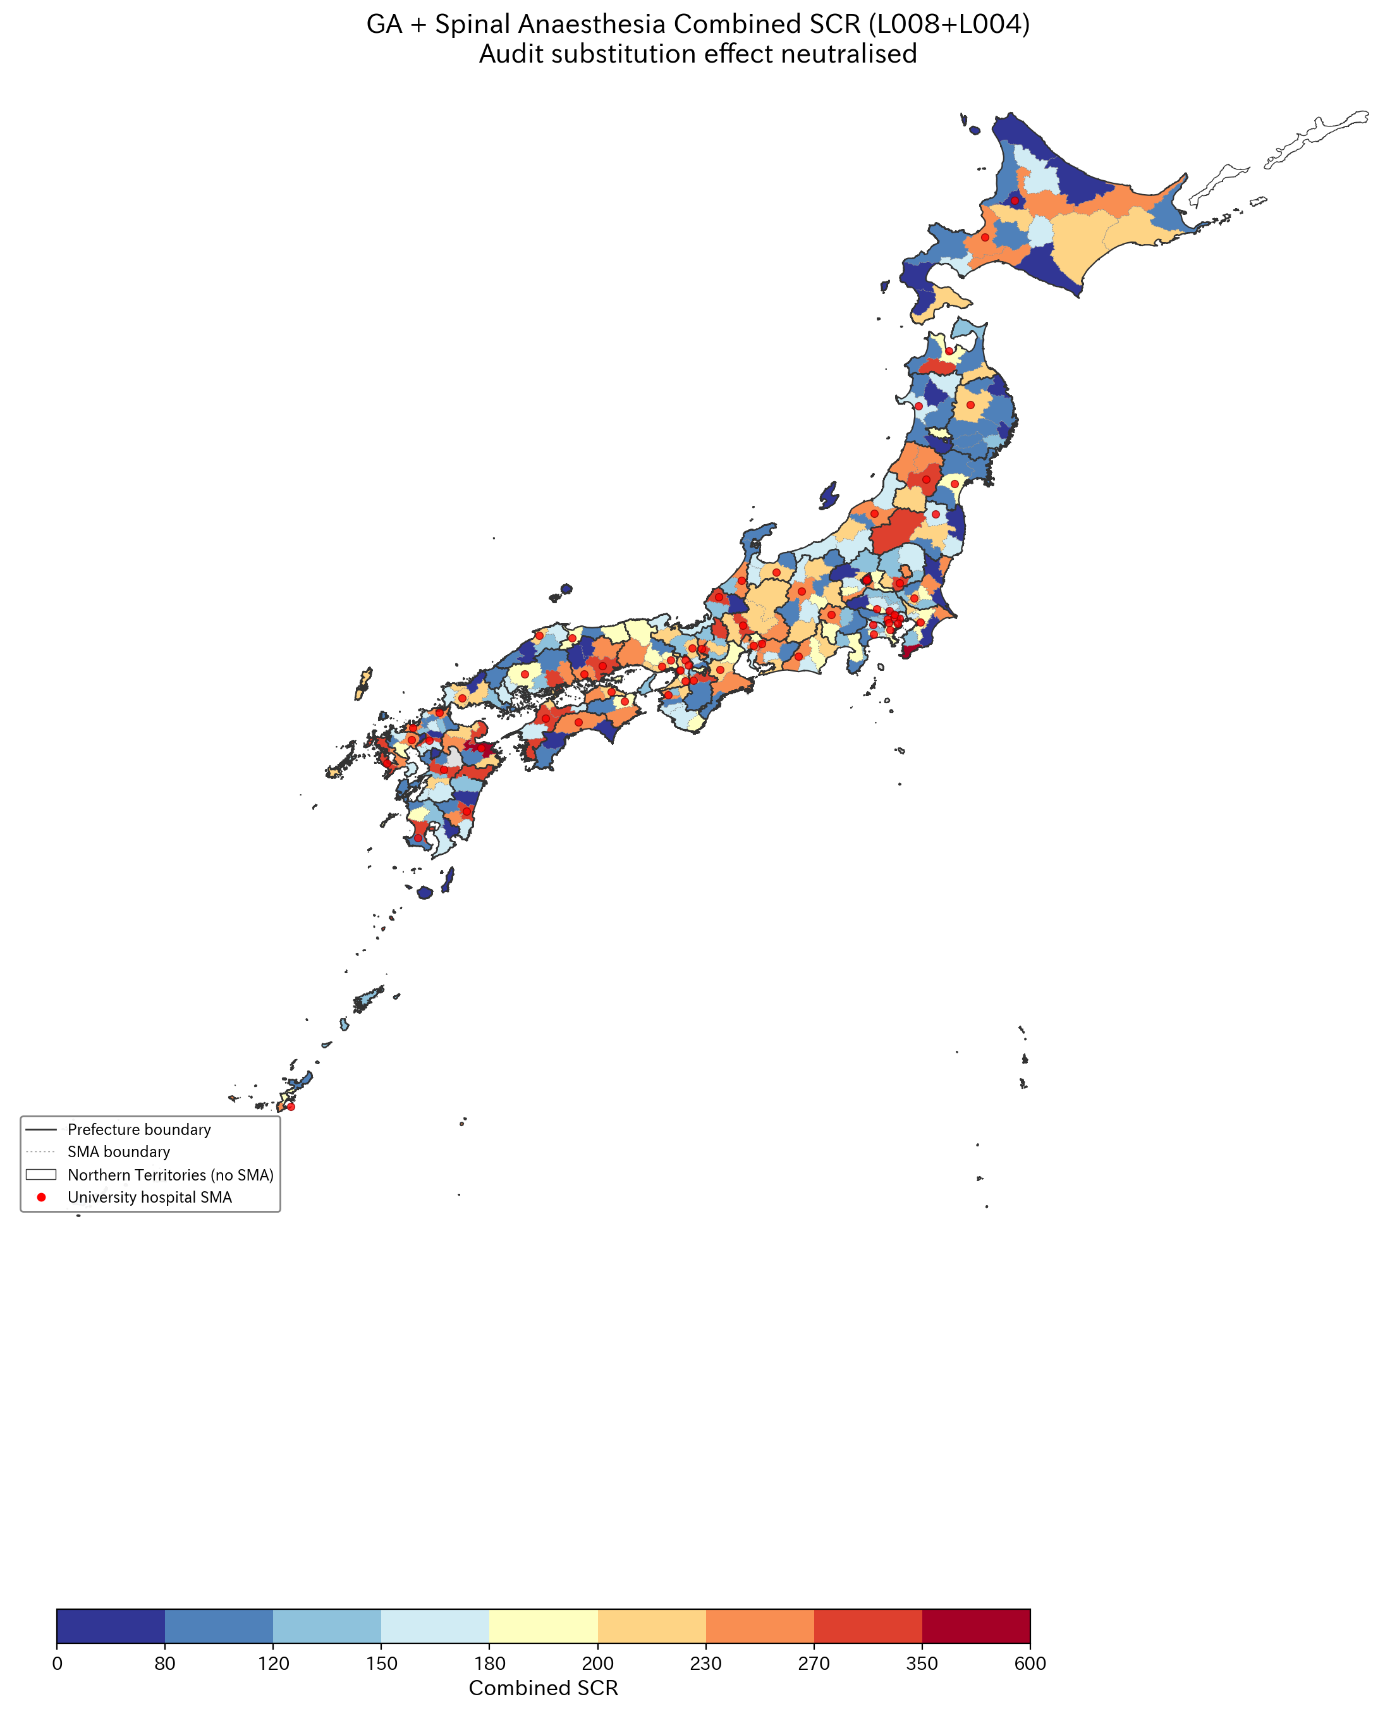
Figure 4
Figure 4. Combined general + spinal anaesthesia (L008+L004) standardised claim ratio. Combining these codes neutralises audit-driven reclassification.

Slide 8
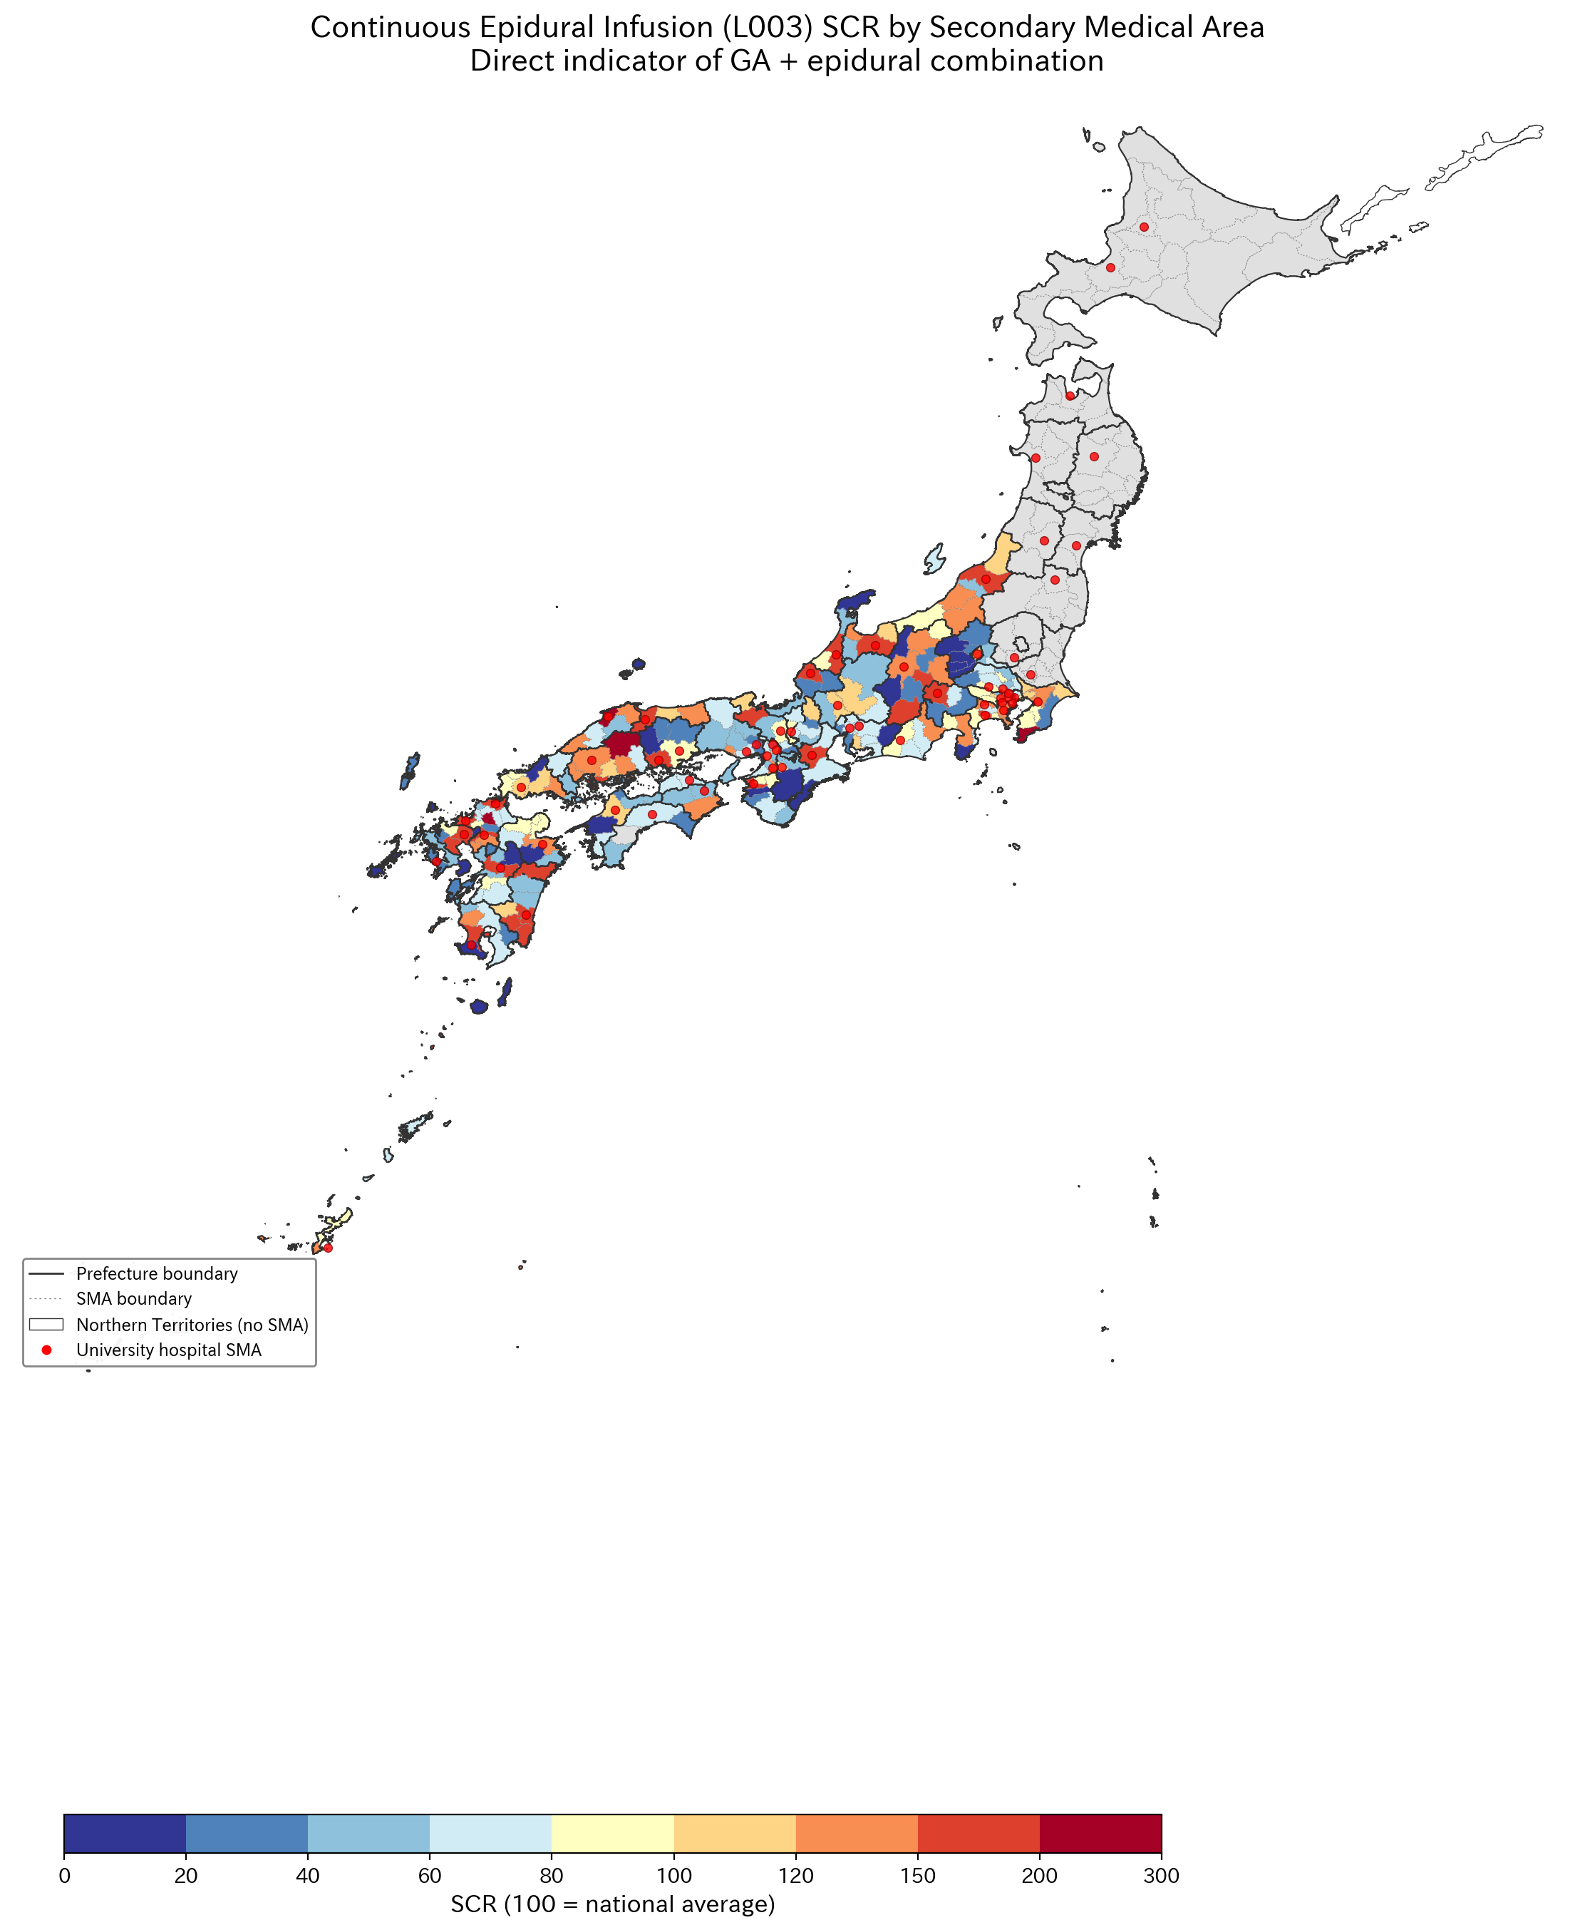
Figure 5
Figure 5. Continuous epidural infusion (L003) SCR — direct indicator of combined GA–epidural technique. CV=64.9%.

Slide 9
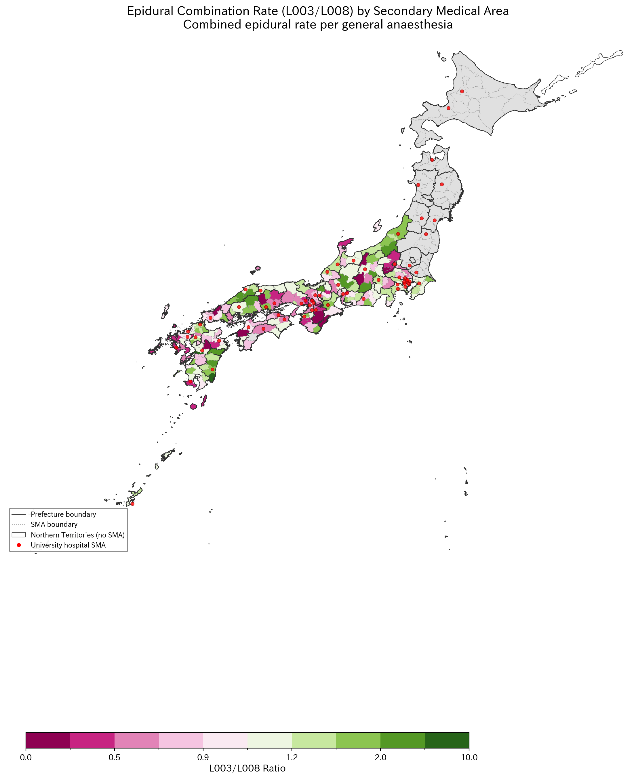
Figure 6
Figure 6. L003/L008 ratio (combined epidural rate per GA case), adjusted for surgery volume.

Slide 10
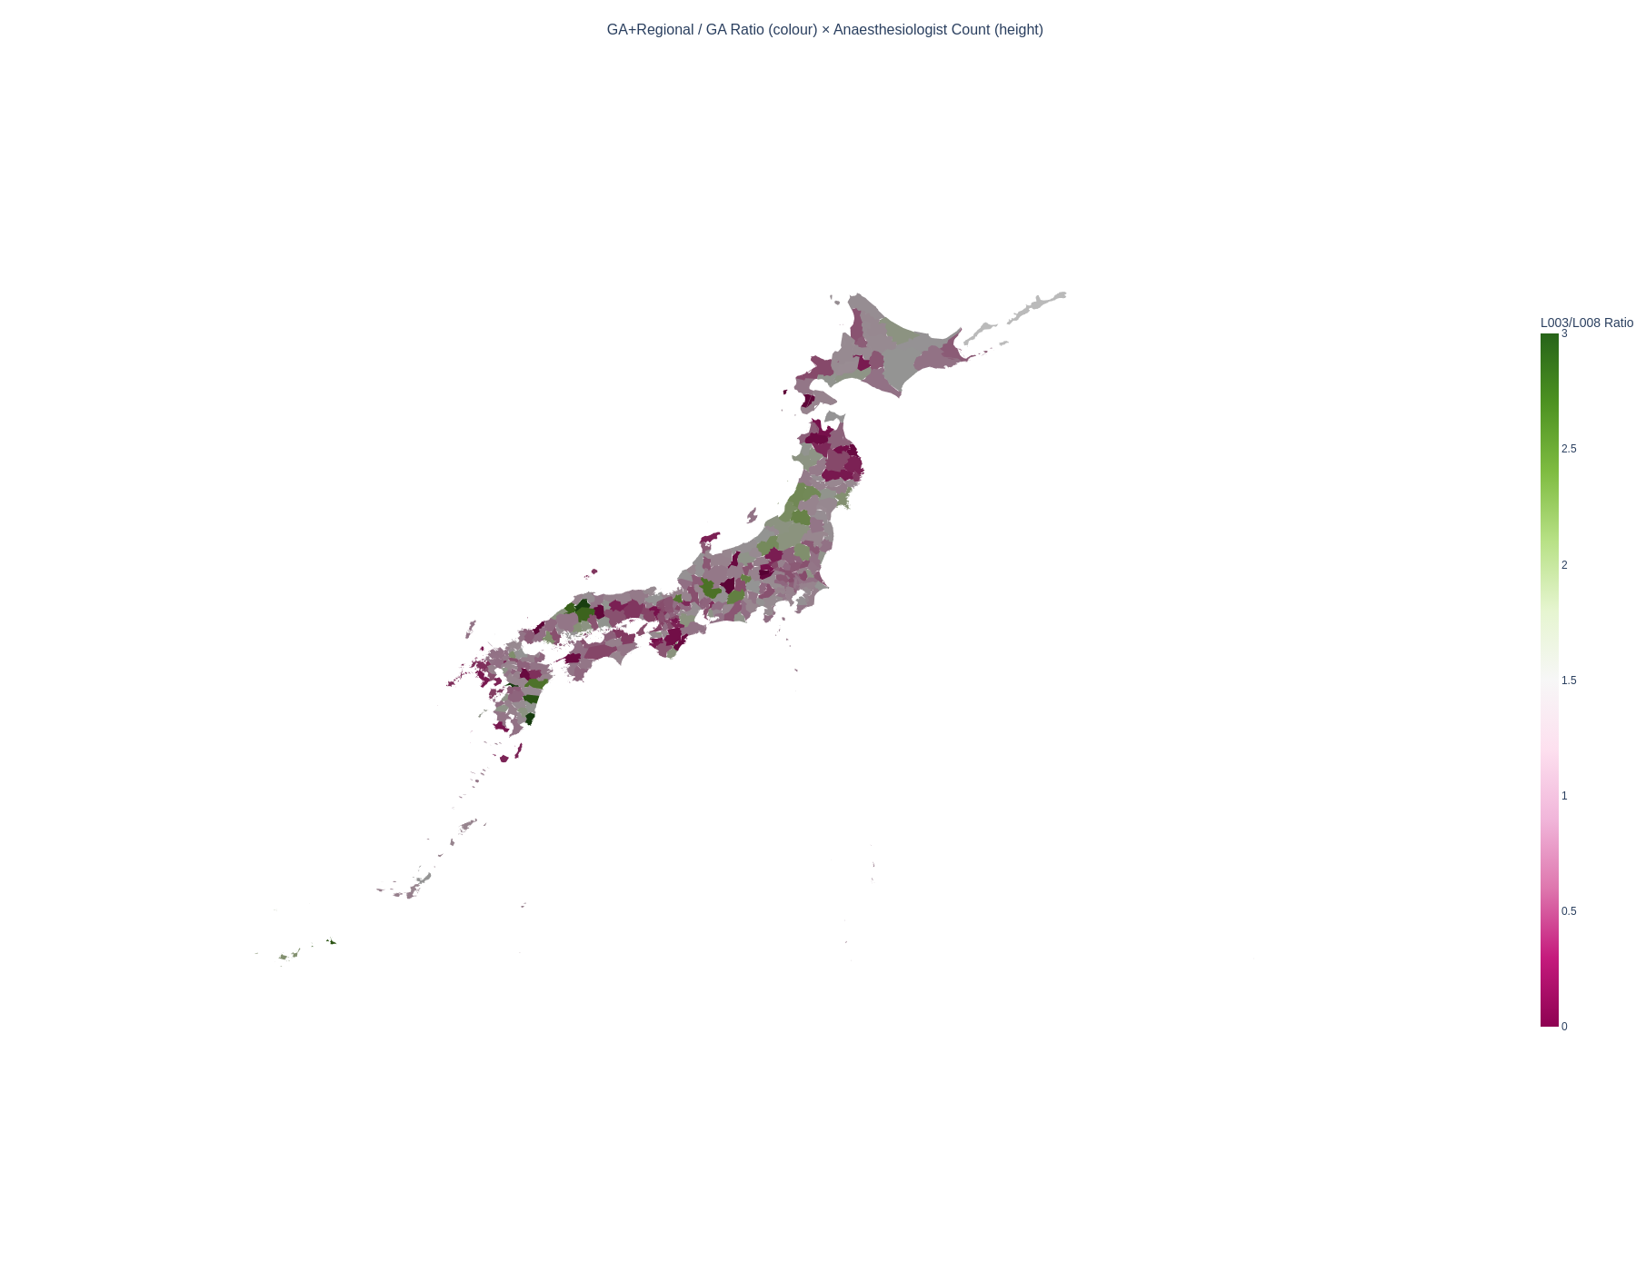
Figure 7
Figure 7. 3D extruded map: colour = L003/L008 ratio (combined epidural rate), height = anaesthesiologist count.

Slide 11
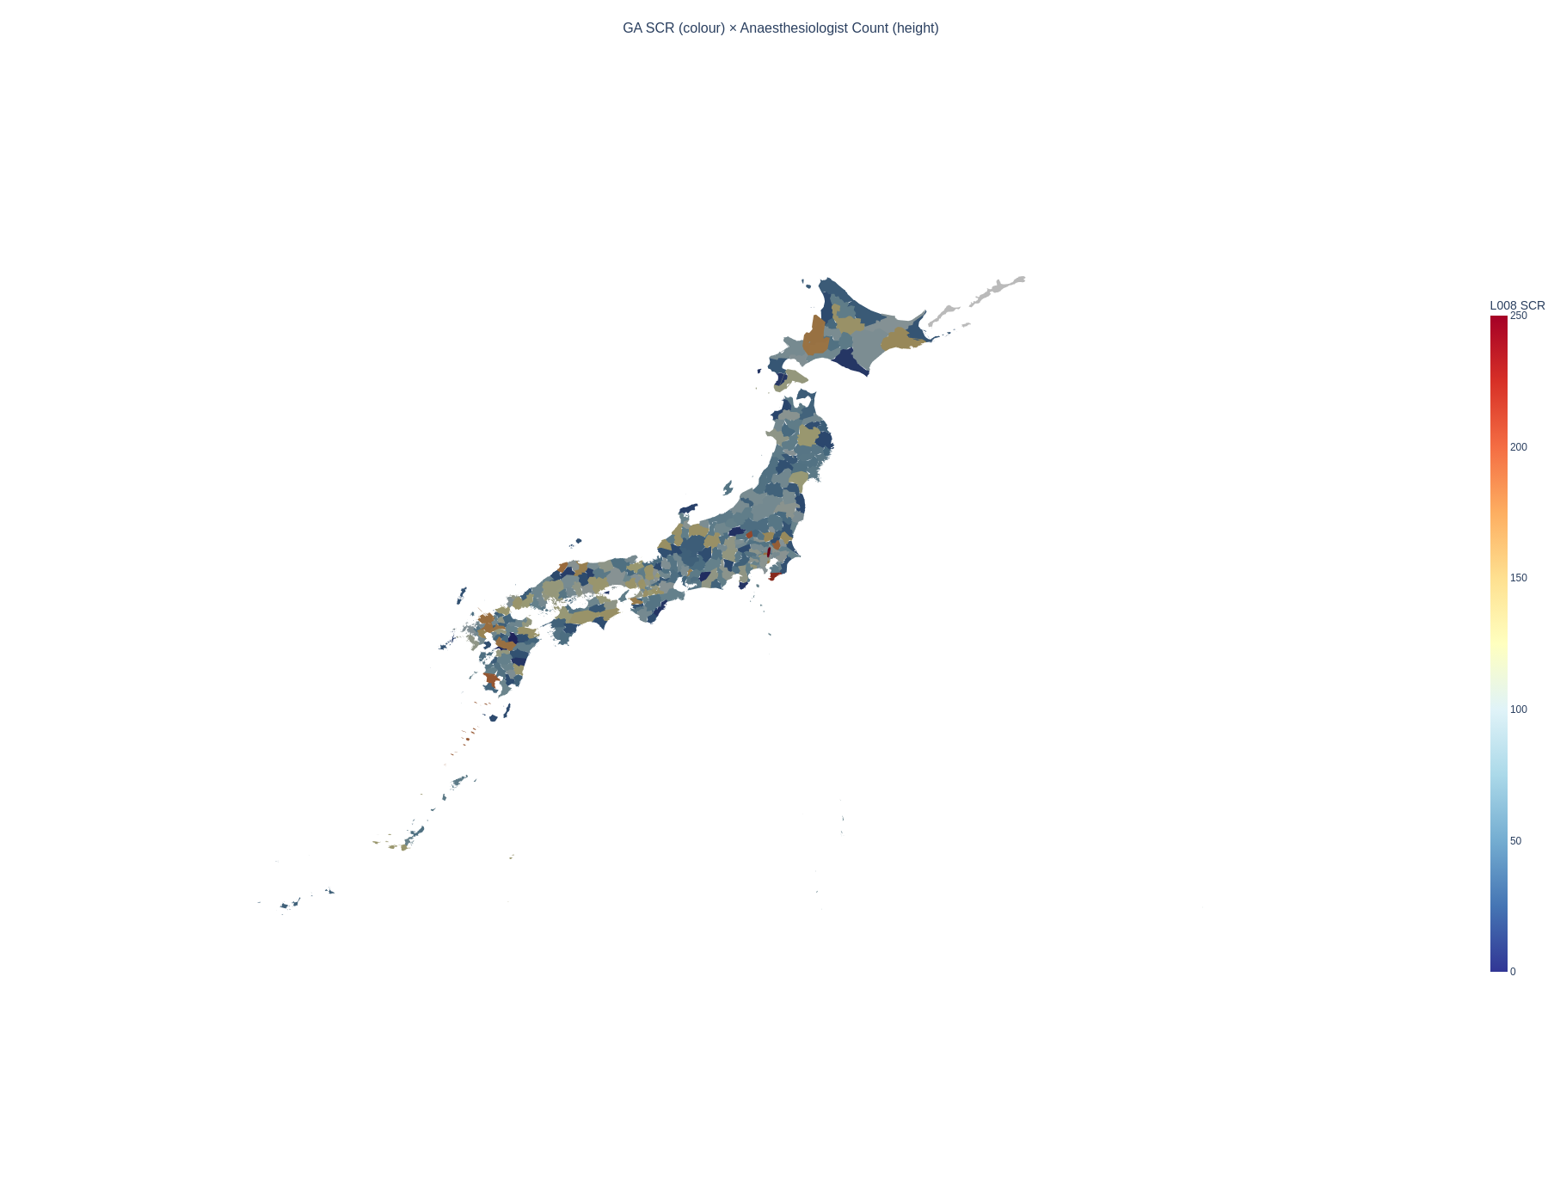
Figure 8
Figure 8. 3D extruded map: colour = L008 SCR (general anaesthesia volume), height = anaesthesiologist count.

Slide 12
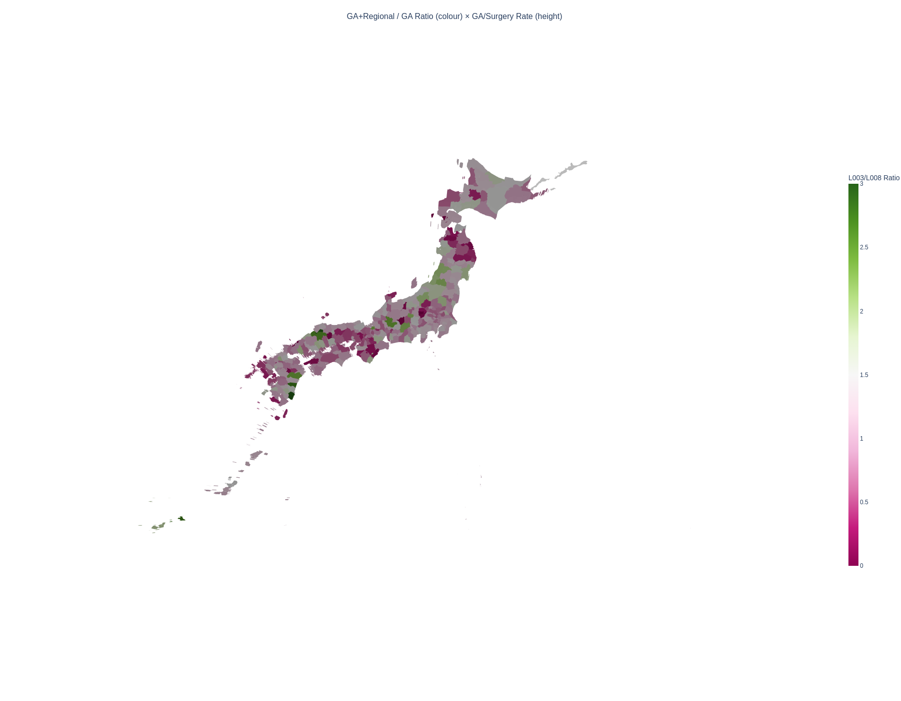
Figure 9
Figure 9. 3D extruded map: colour = L003/L008 ratio, height = GA per surgery ratio (L008/K-chapter SCR).

Slide 13
STROBE Checklist (Cross-sectional study)
Item | STROBE recommendation | Location in manuscript
1a | Title and abstract | Title page and structured abstract
1b | Informative abstract | Structured abstract with all required elements
2 | Background/rationale | Introduction paragraphs 1–3
3 | Objectives | Introduction paragraph 5
4 | Study design | Methods: Study design and data sources
5 | Setting | Methods: 335 SMAs, FY2022 data
6a | Participants/eligibility | N/A (ecological study)
7 | Variables | Methods: Anaesthesia codes (Table 1)
8 | Data sources | Methods: Study design and data sources
9 | Bias | Methods: Sensitivity analyses; Discussion: Limitations
10 | Study size | Methods: 335 SMAs, 47 prefectures
11 | Quantitative variables | Methods: Statistical analysis
12 | Statistical methods | Methods: Statistical analysis
13 | Participants | Results: 334 SMAs with L008 data
14 | Descriptive data | Results: Table 2
15 | Outcome data | Results: Regional variation section
16 | Main results | Results: Sensitivity analyses 1–3
17 | Other analyses | Results: Combined SCR, Pain clinic spillover
18 | Key results | Discussion: Principal findings
19 | Limitations | Discussion: Strengths and limitations
20 | Interpretation | Discussion: Comparison with literature
21 | Generalisability | Discussion: Conclusions
22 | Funding | [To be completed]

