Slide 1
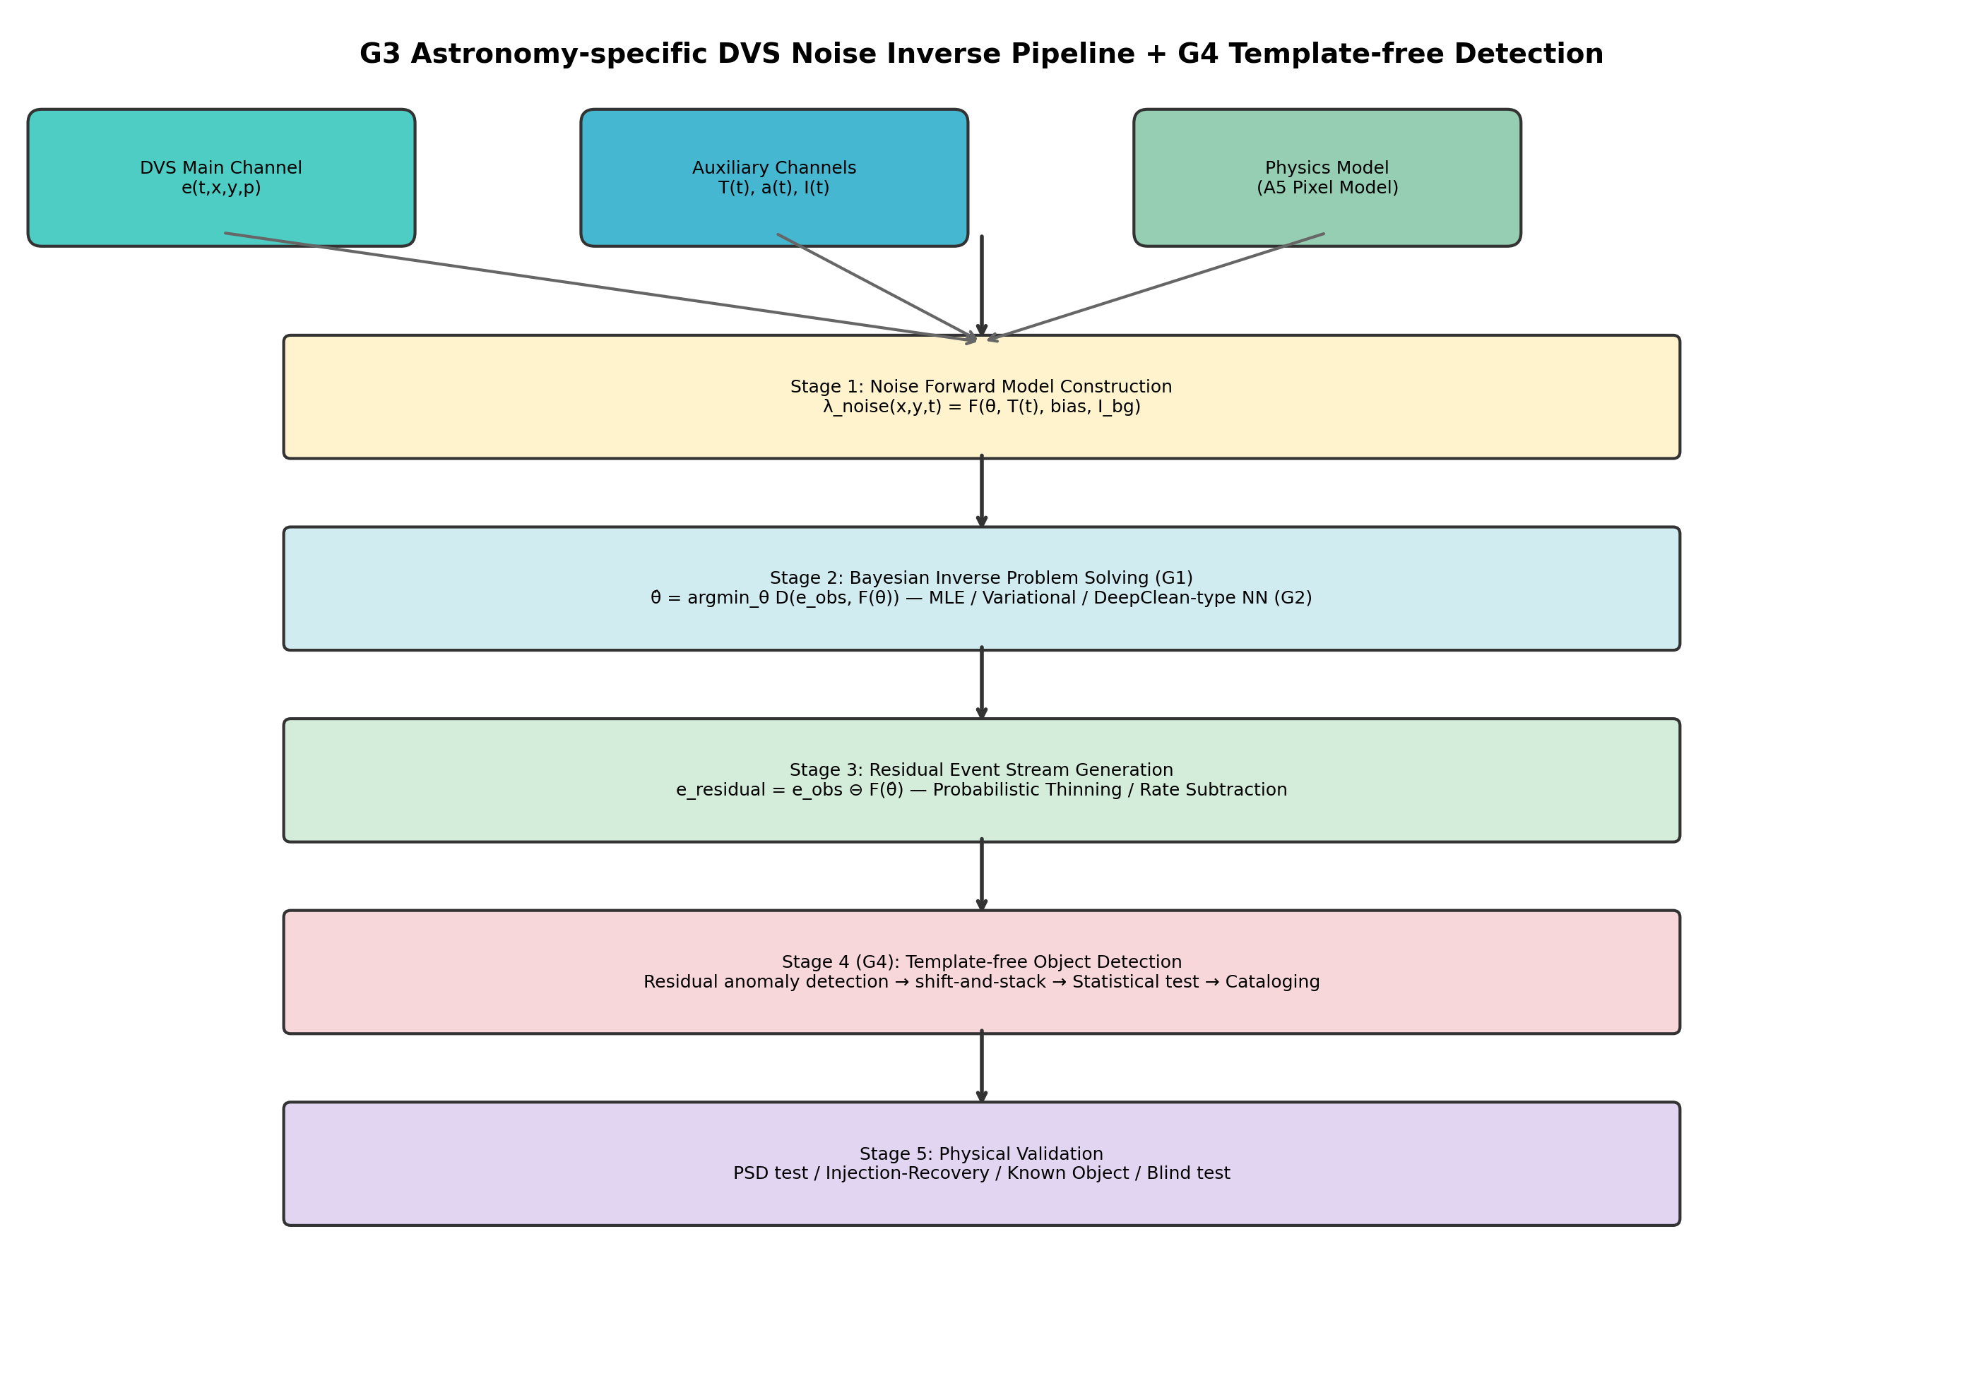
Fig. 1: PI-DC-DVS Pipeline Architecture
System architecture of the PI-DC-DVS noise inverse problem pipeline. Four stages: (1) noise forward model; (2) Bayesian inverse problem; (3) residual generation; (4) calibration and verification.

Slide 2
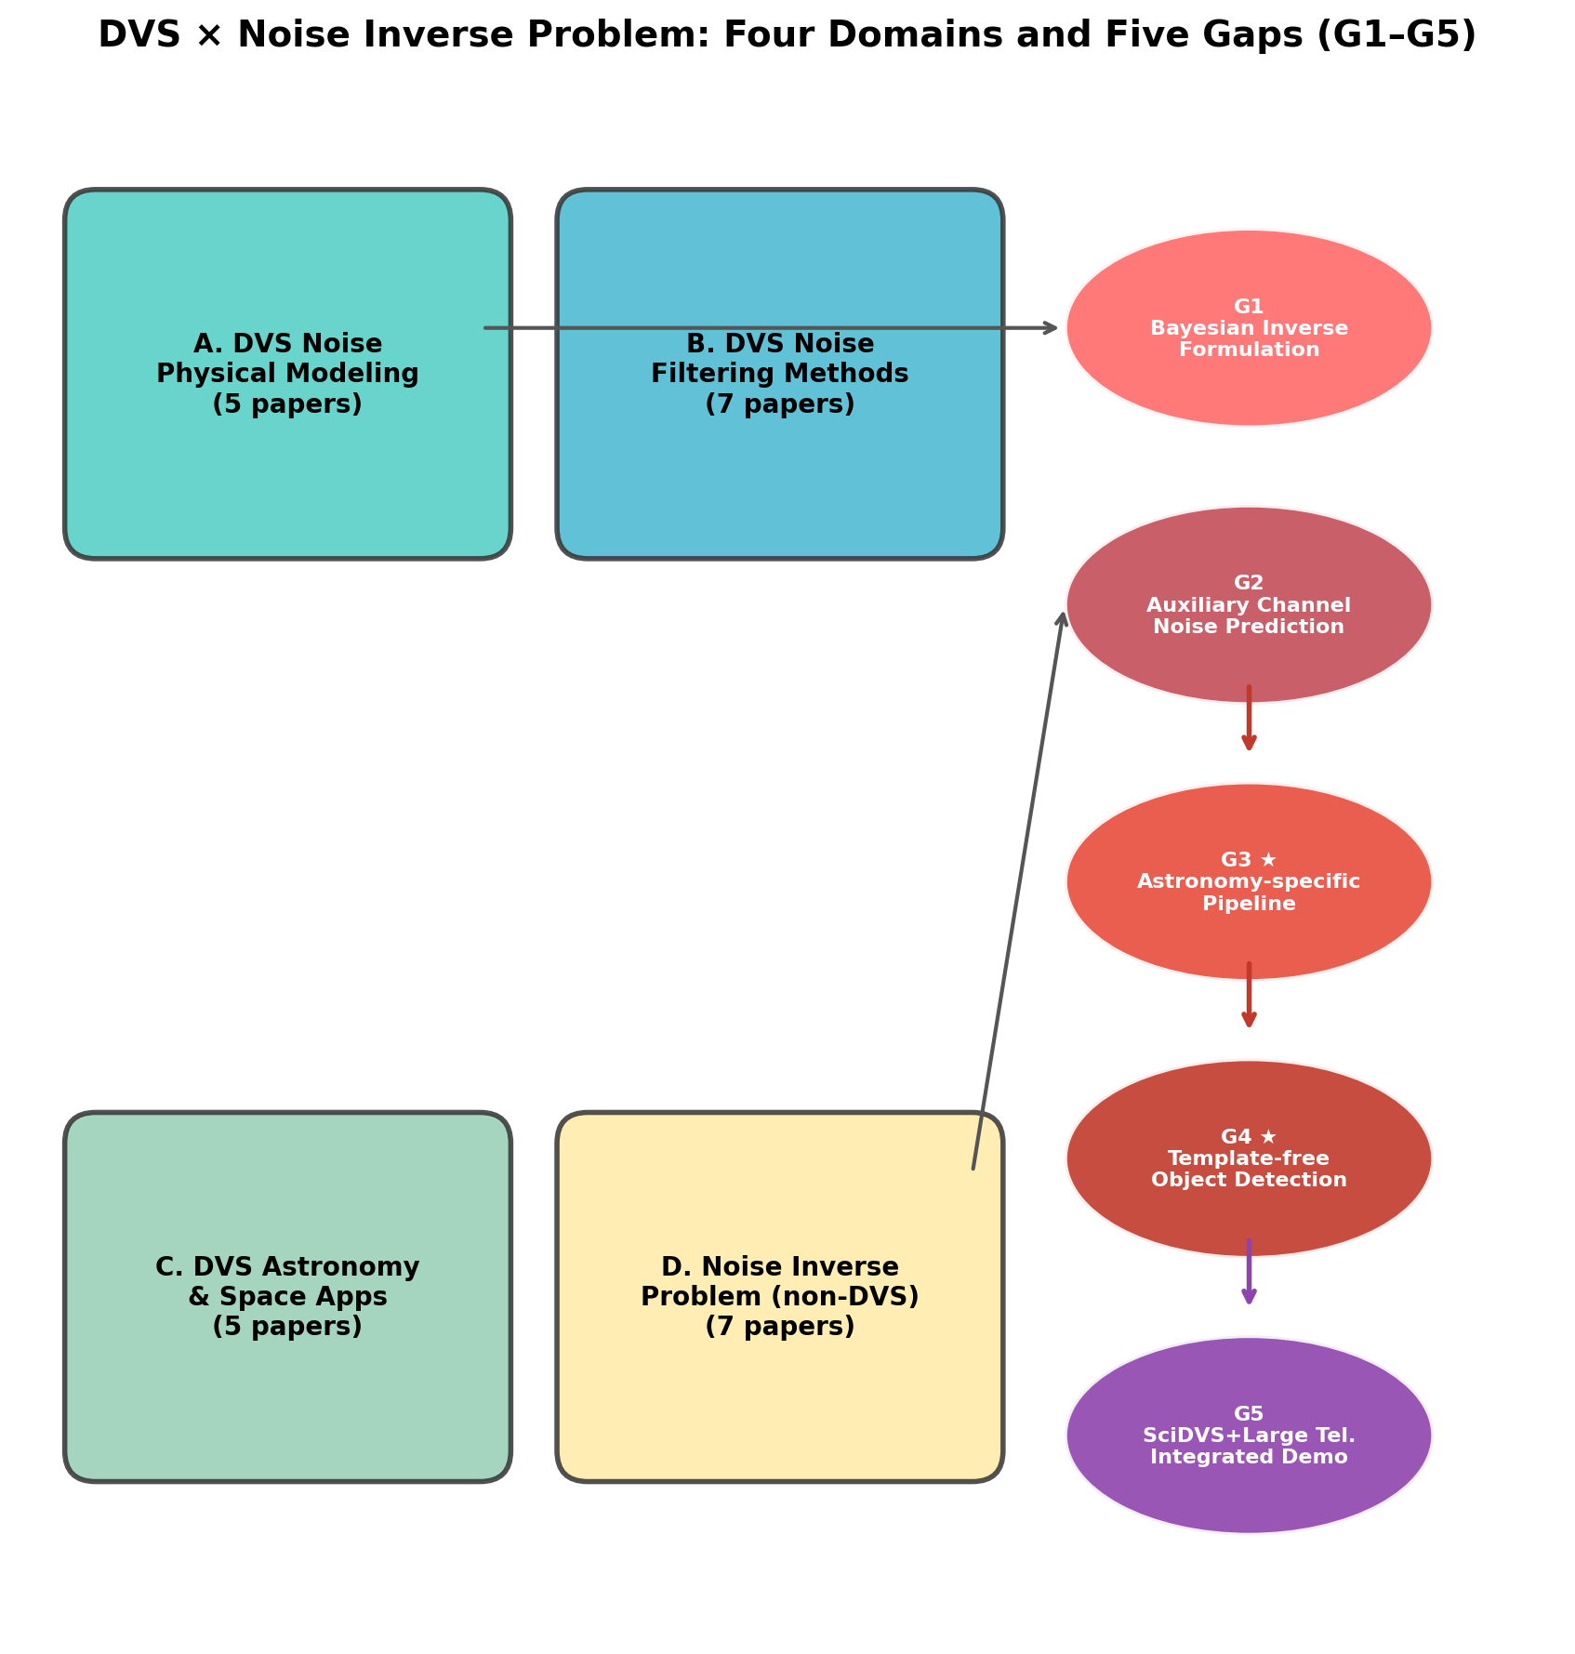
Fig. 2: Research Gap Map
Gap map showing four domains (A-D) and identified research gaps. Cal-6 satellite trail calibration is highlighted as a novel contribution.

Slide 3
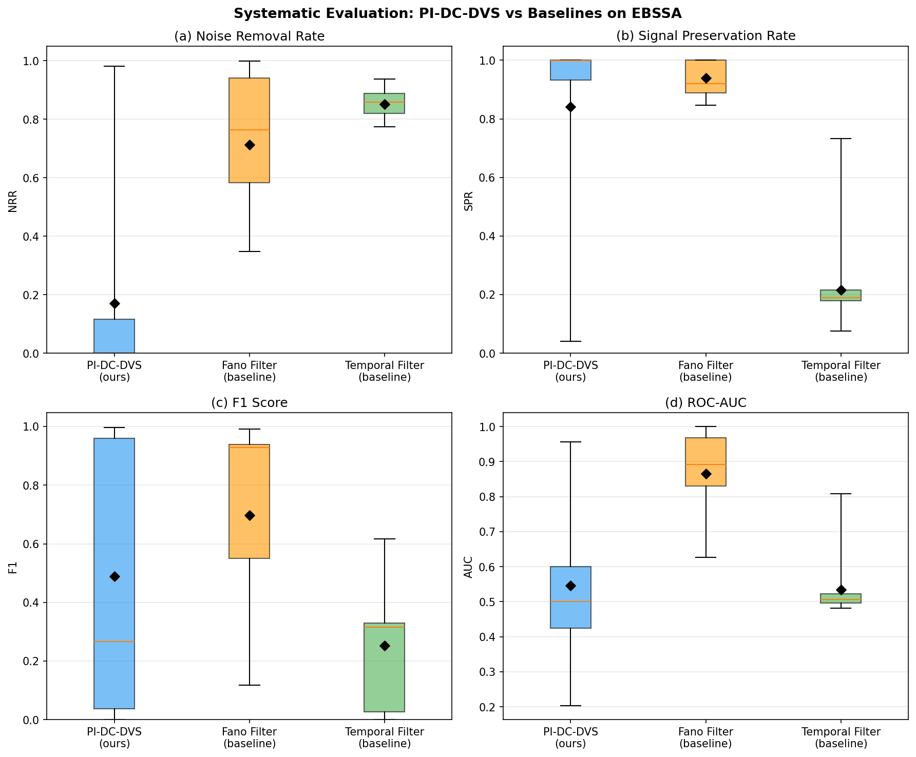
Fig. 3: Systematic Evaluation — 3-Method Comparison
Systematic evaluation on 20 EBSSA recordings. Four-panel boxplot: NRR, SPR, F1, AUC. Fano filter achieves best balance (AUC = 0.866).

Slide 4
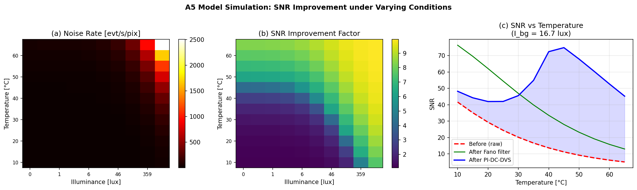
Fig. 4: A5 Noise Rate Simulation
A5-based noise rate simulation: noise rate, SNR improvement, and factor map across temperature–illuminance space. Mean 5.4×, max 10.0×.

Slide 5
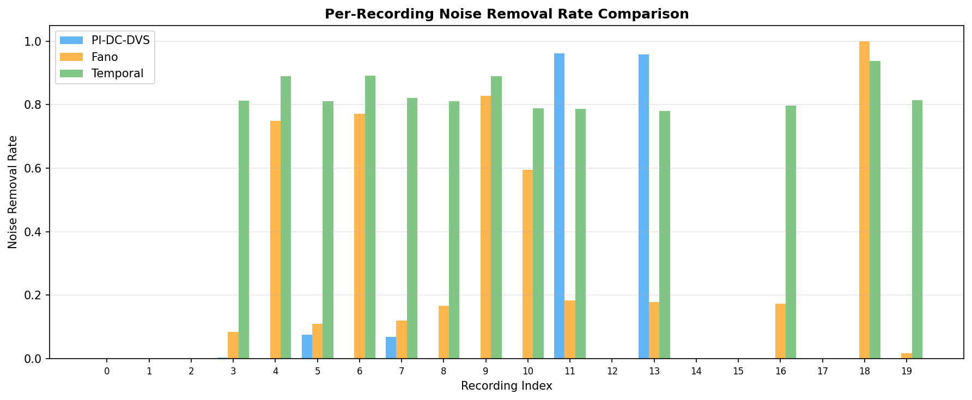
Fig. 5: Per-Recording Noise Removal Comparison
Per-recording noise removal rate comparison. Fano filter (blue) consistently outperforms temporal filter (orange).

Slide 6
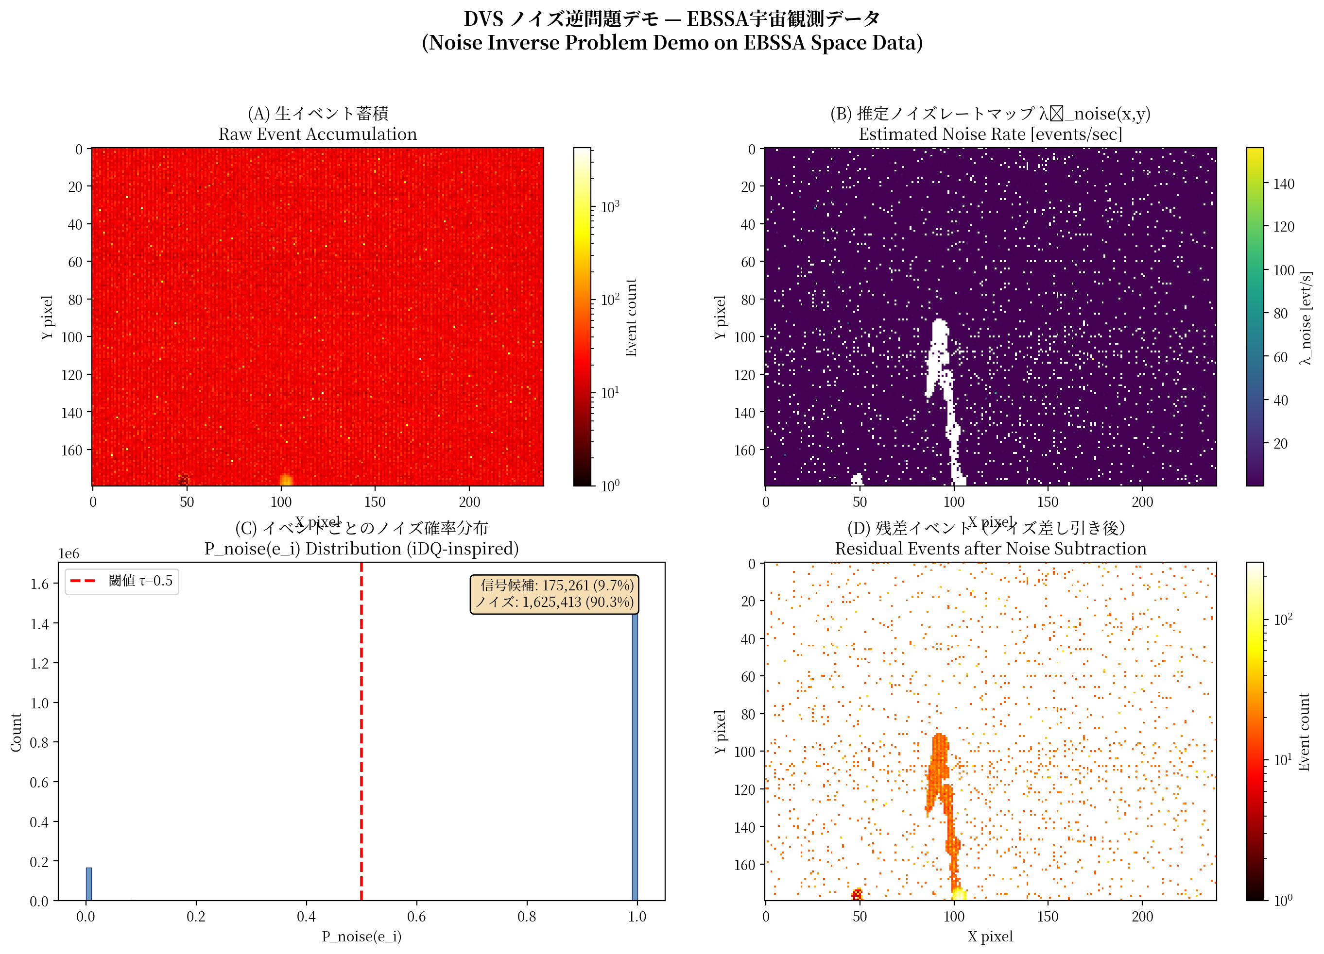
Fig. 6: Proof-of-Concept Demonstration
Noise inverse problem demonstration on EBSSA data. 90.3% noise removal with satellite trajectory clearly visible.

Slide 7
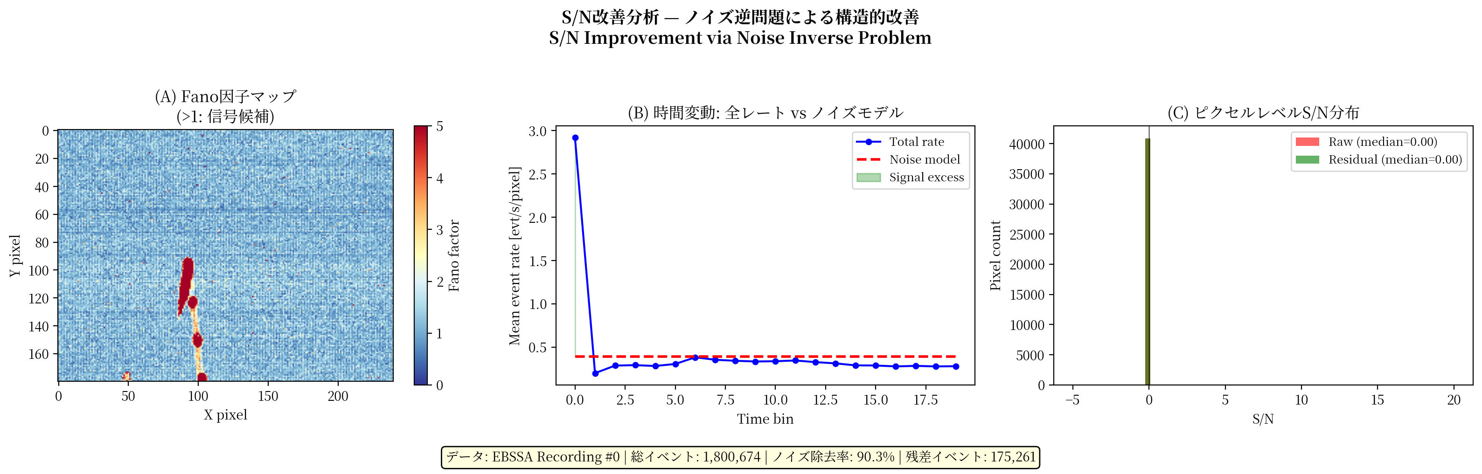
Fig. 7: SNR Improvement Analysis
SNR improvement analysis: Fano factor spatial map, temporal dynamics, and per-pixel SNR distribution before and after noise subtraction.

