Slide 1
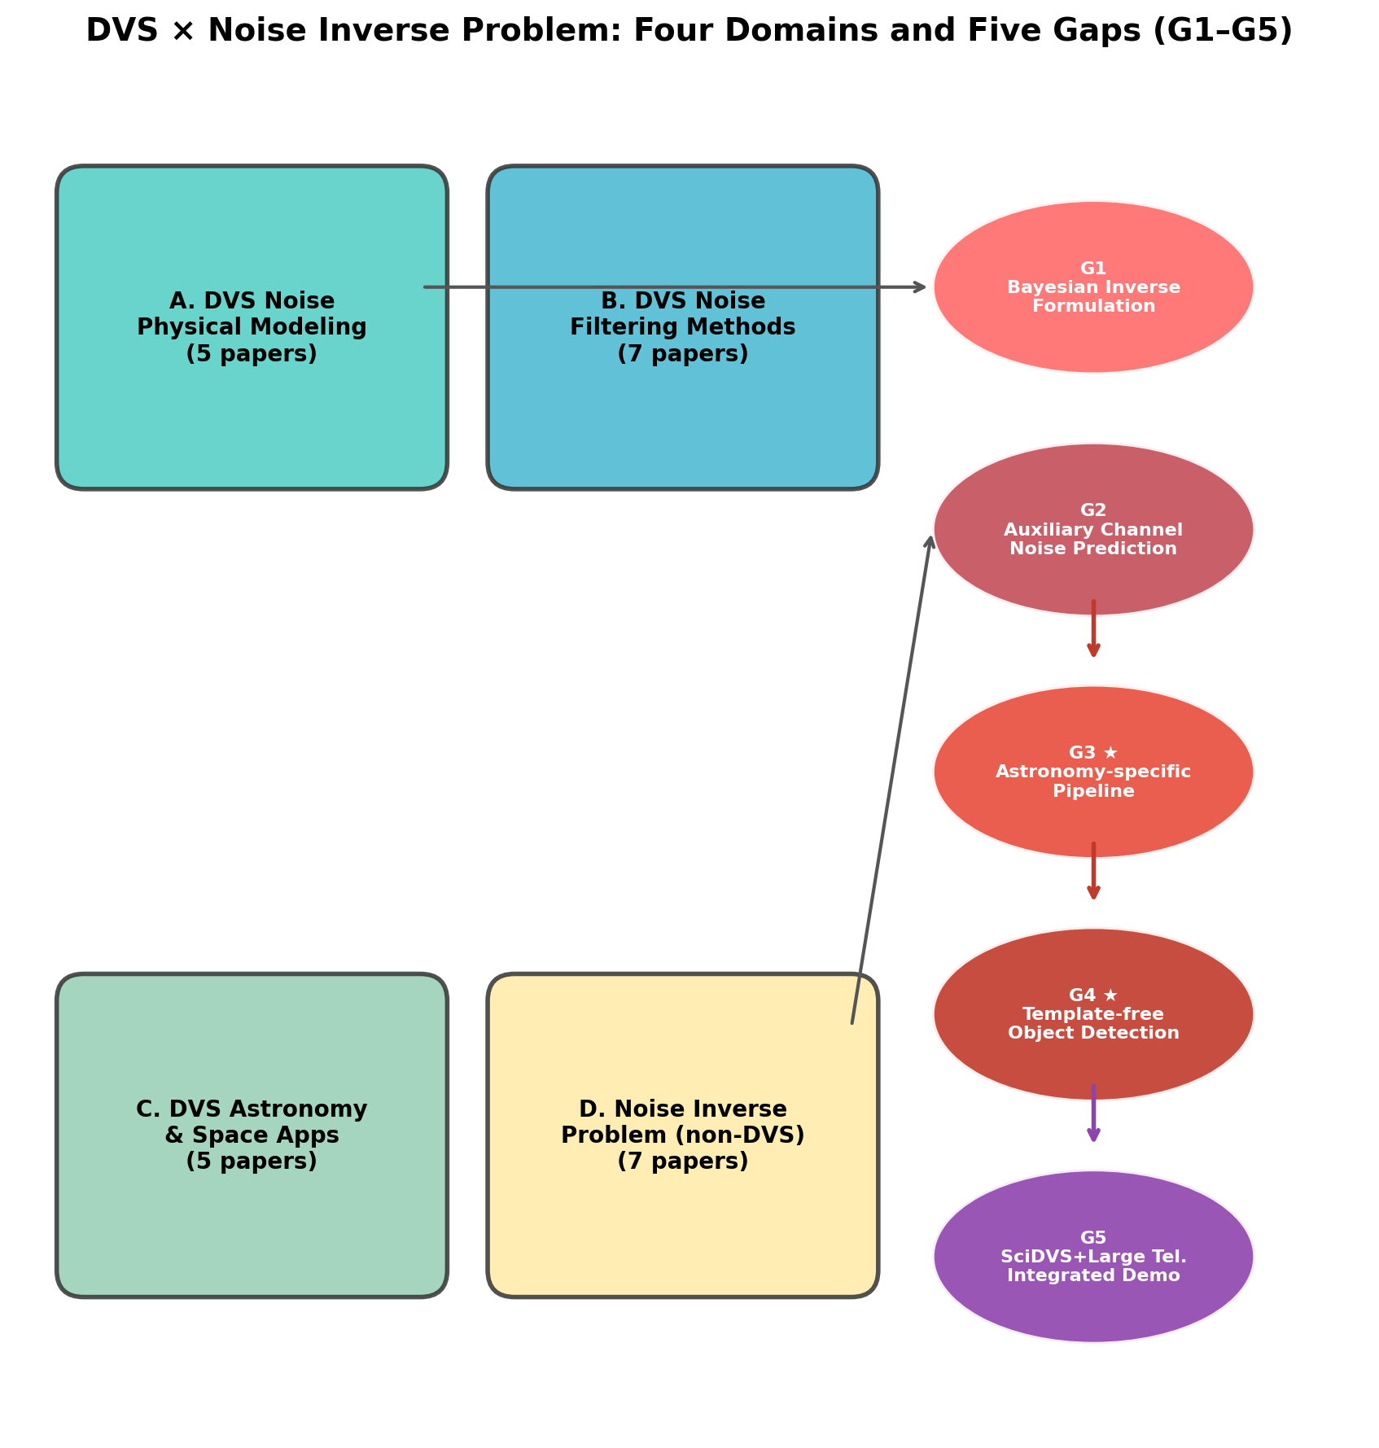
Fig. 1 — Gap Map
Gap map showing the four surveyed domains and identified research gaps.

Slide 2
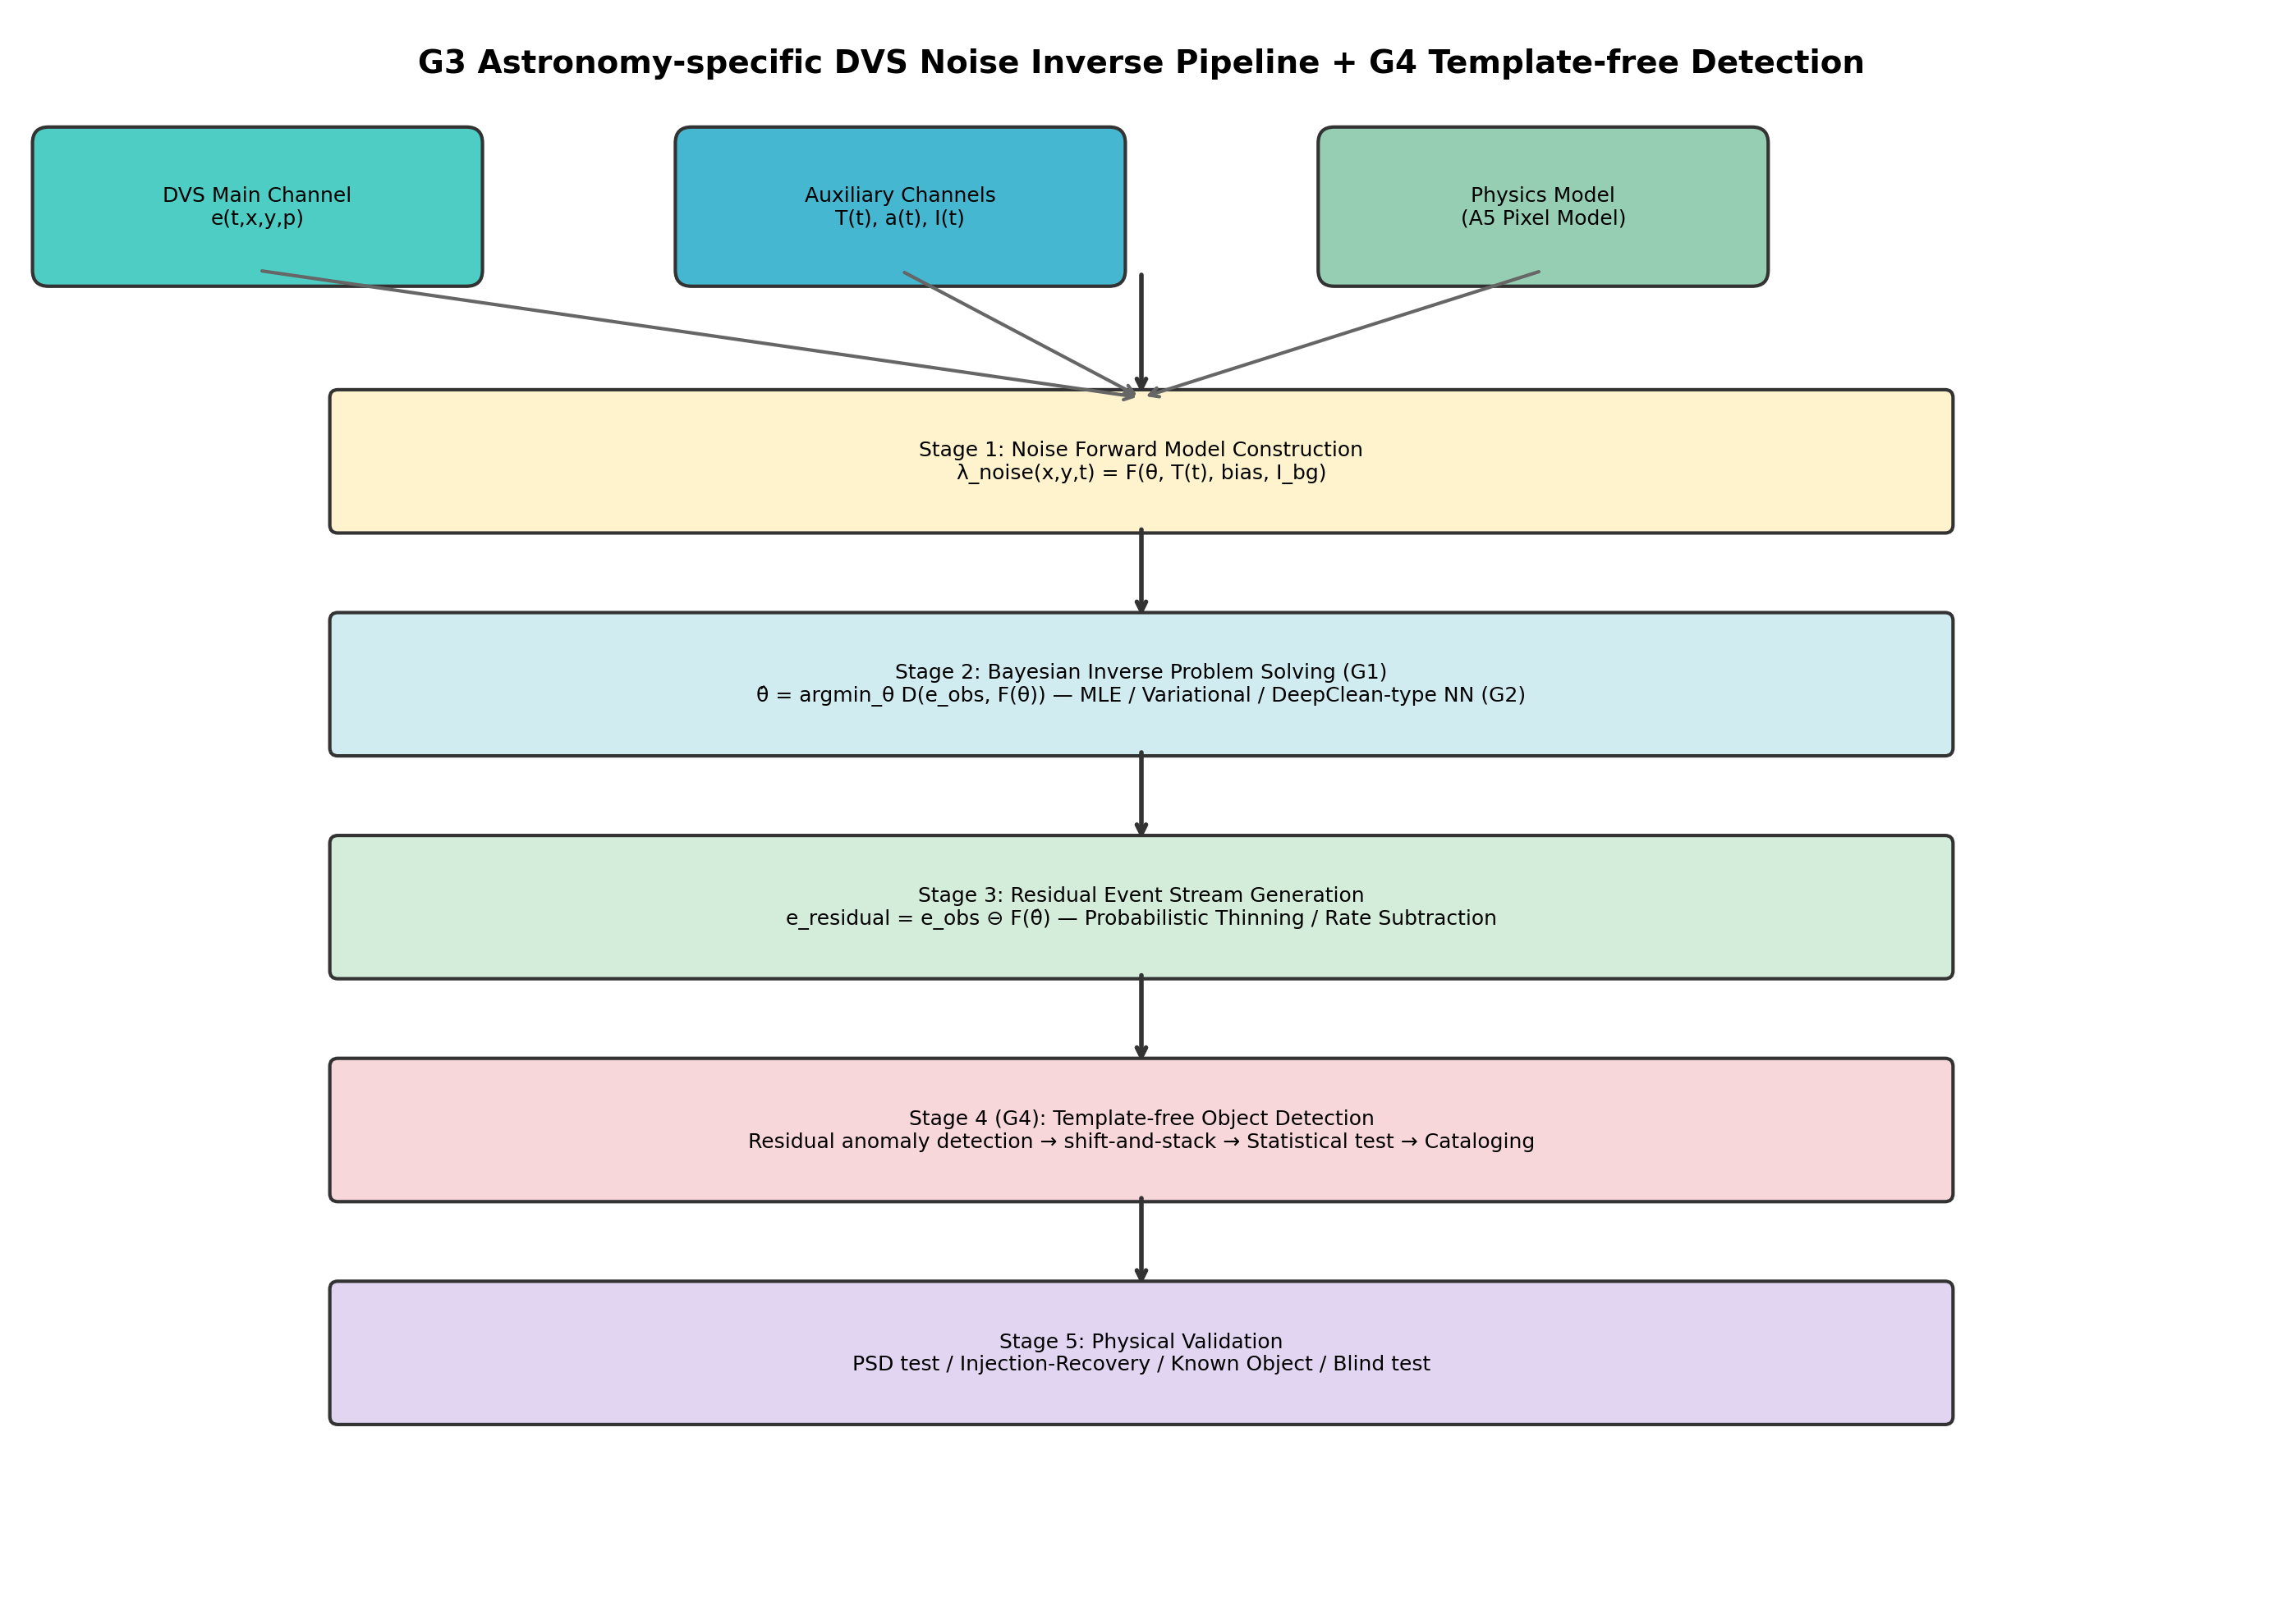
Fig. 2 — PI-DC-DVS Pipeline
System architecture: noise forward model → Bayesian inverse → residual → calibration.

Slide 3
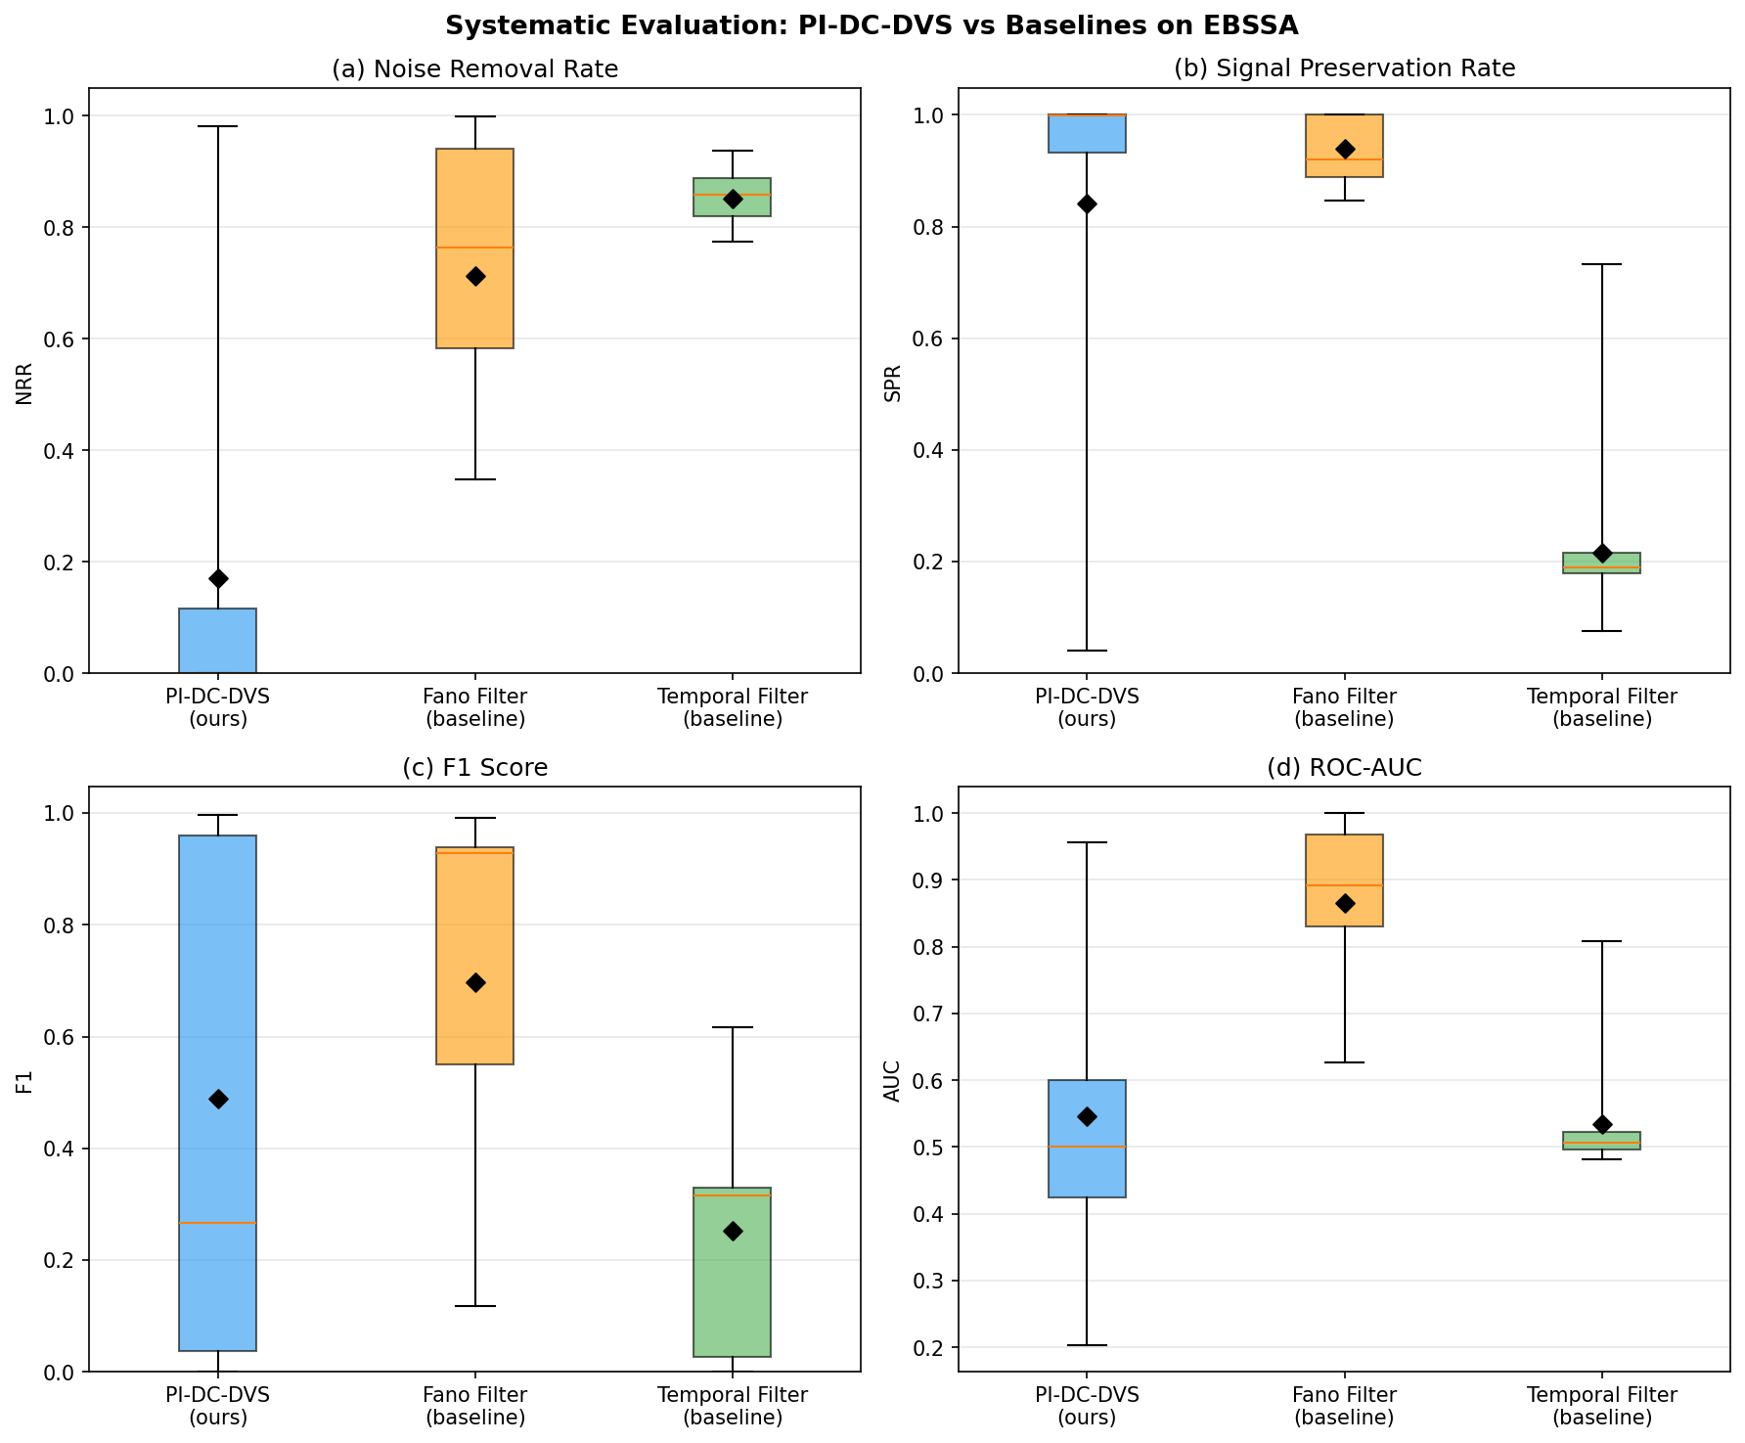
Fig. 3 — Systematic Evaluation
Boxplot comparison (NRR, SPR, F1, AUC) of three methods on 20 EBSSA recordings.

Slide 4
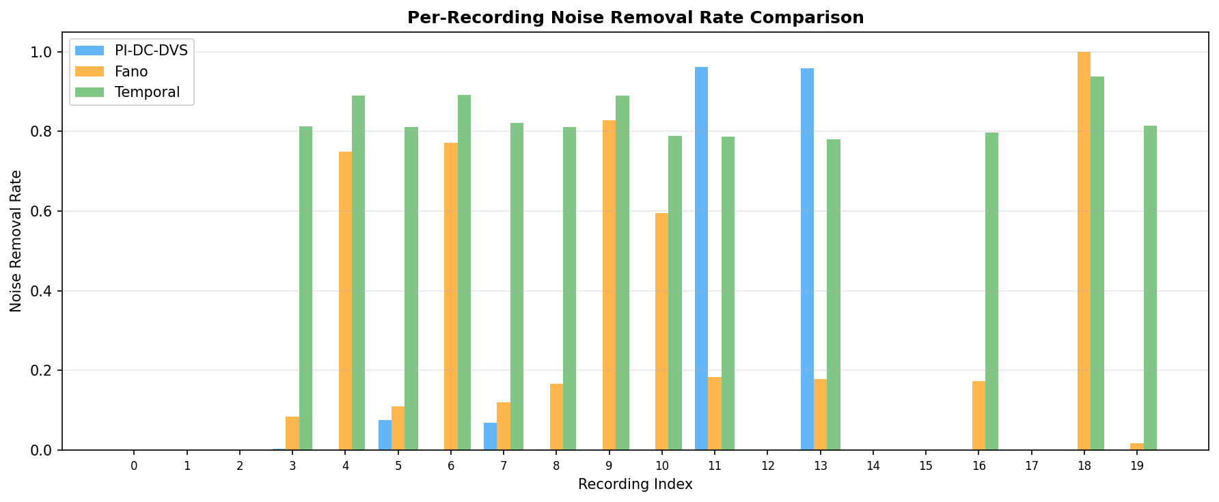
Fig. 4 — Per-Recording Comparison
Per-recording noise removal rate for Fano filter, PI-DC-DVS NN, and temporal filter.

Slide 5
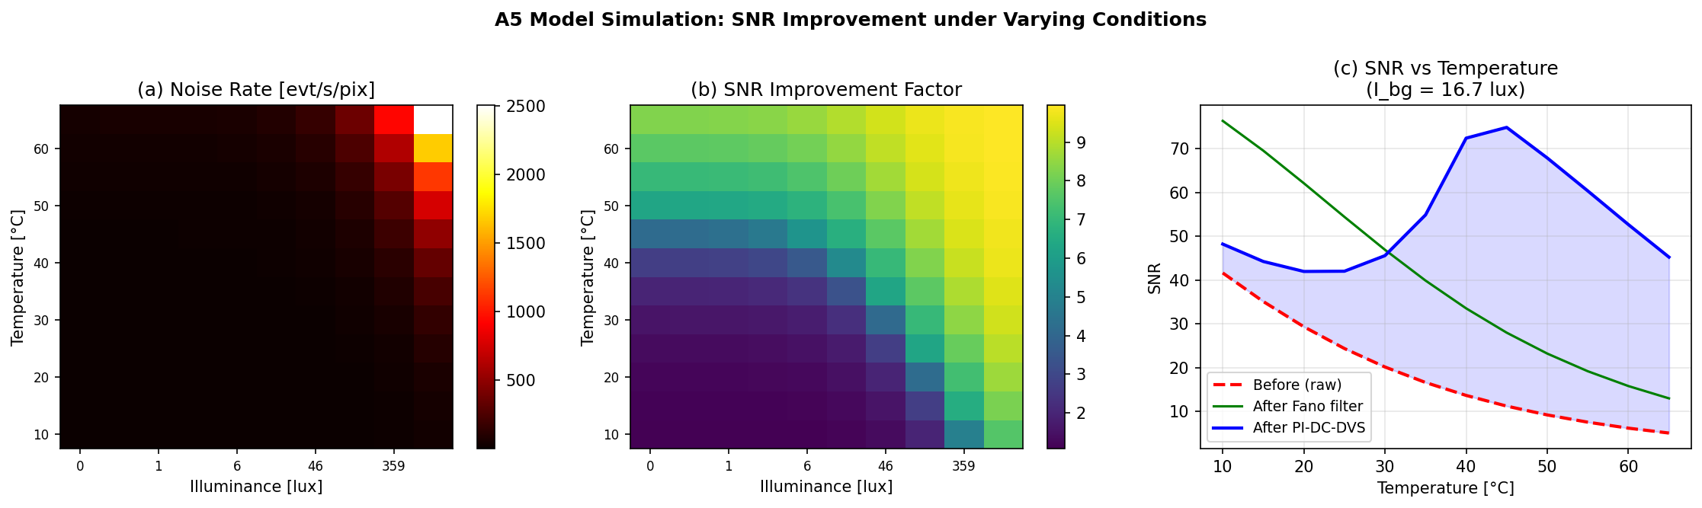
Fig. 5 — A5 Model Simulation
Noise rate and SNR improvement across temperature–illuminance parameter space.

Slide 6
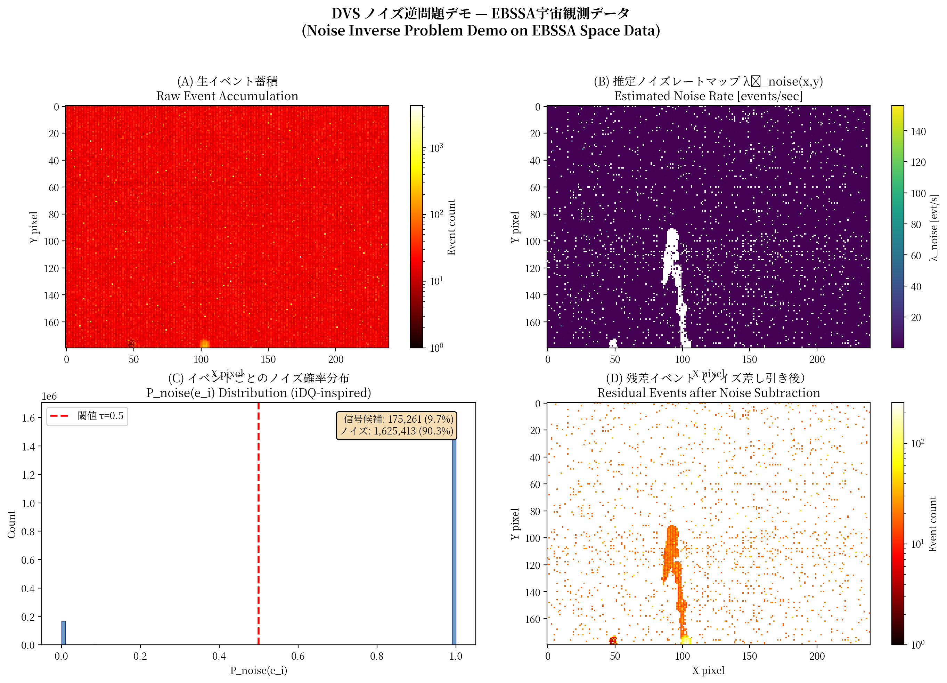
Fig. 6 — Noise Inverse Demo
Raw events → noise map → P_noise distribution → residual with satellite trail.

Slide 7
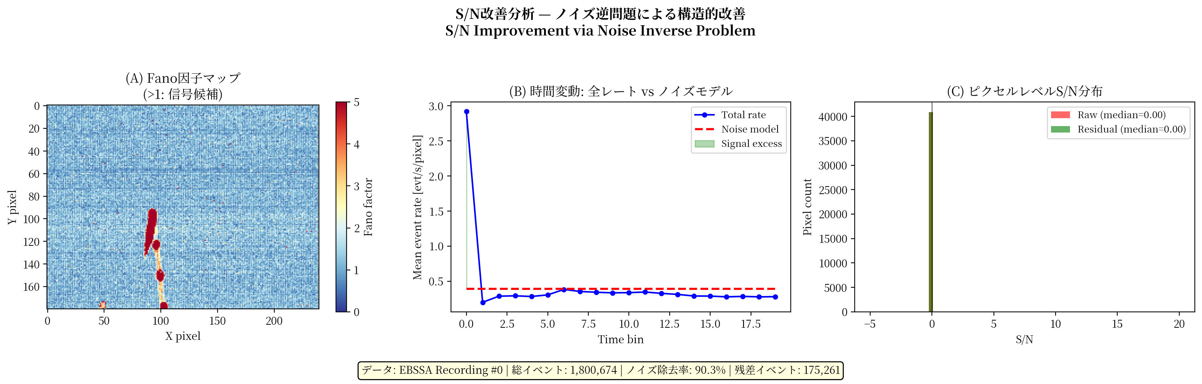
Fig. 7 — S/N Improvement
Fano factor map, temporal dynamics, and per-pixel SNR distribution.

