Slide 1
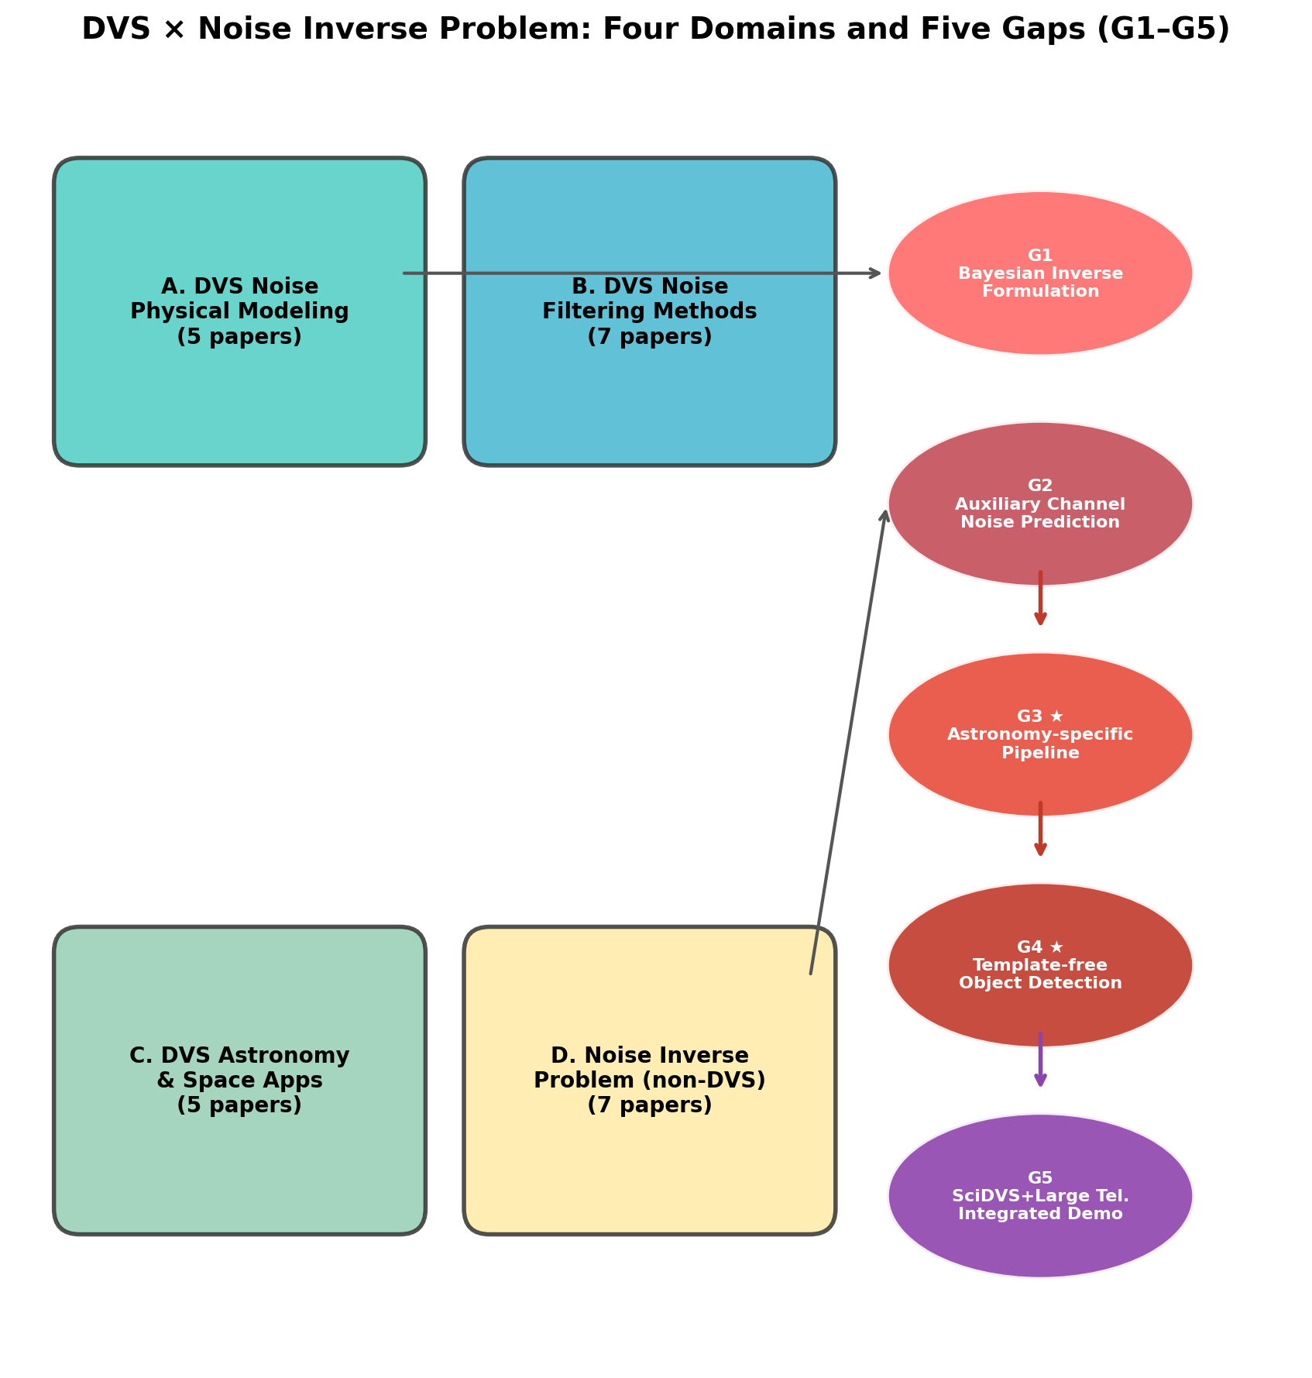
Figure 1: Gap Map
Four surveyed domains (A: DVS noise physics, B: DVS denoising, C: DVS astronomical applications, D: noise inverse problem methods) and five identified research gaps (G1–G5) at their intersections.

Slide 2
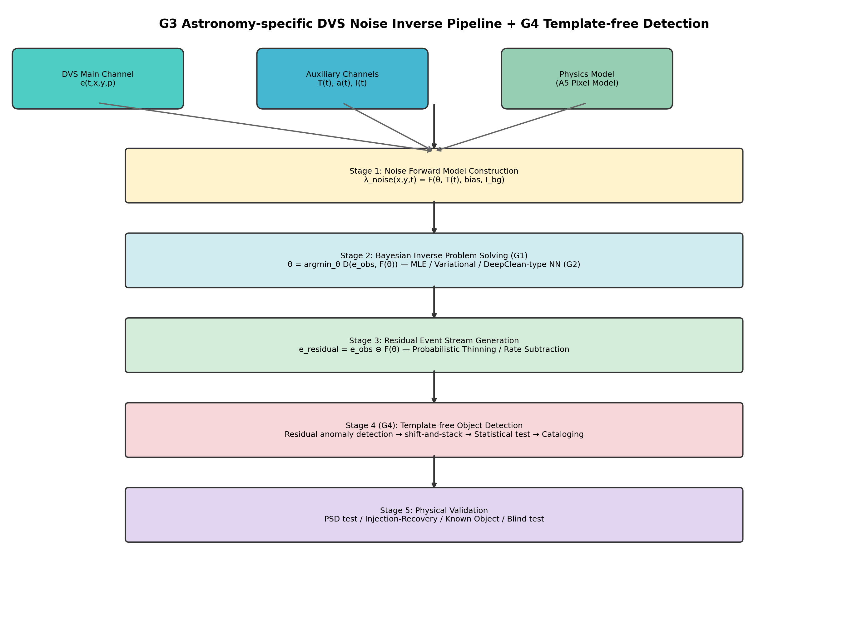
Figure 2: G3 Pipeline Architecture
System architecture of the G3 astronomy-specific DVS noise inverse problem pipeline. Four stages: (1) noise forward model construction, (2) Bayesian inverse problem solution, (3) residual event stream generation, (4) astronomical calibration and verification.

Slide 3
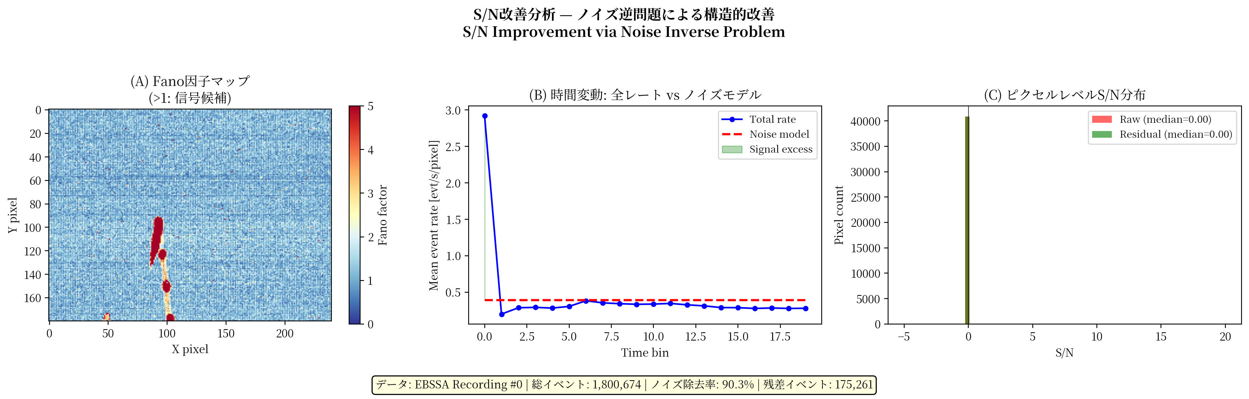
Figure 3: SNR Improvement Analysis
Signal-to-noise ratio improvement analysis. (a) Fano factor spatial map showing noise-dominated vs. signal pixels; (b) Temporal dynamics of noise and signal event rates; (c) Per-pixel SNR distribution before and after noise subtraction.

Slide 4
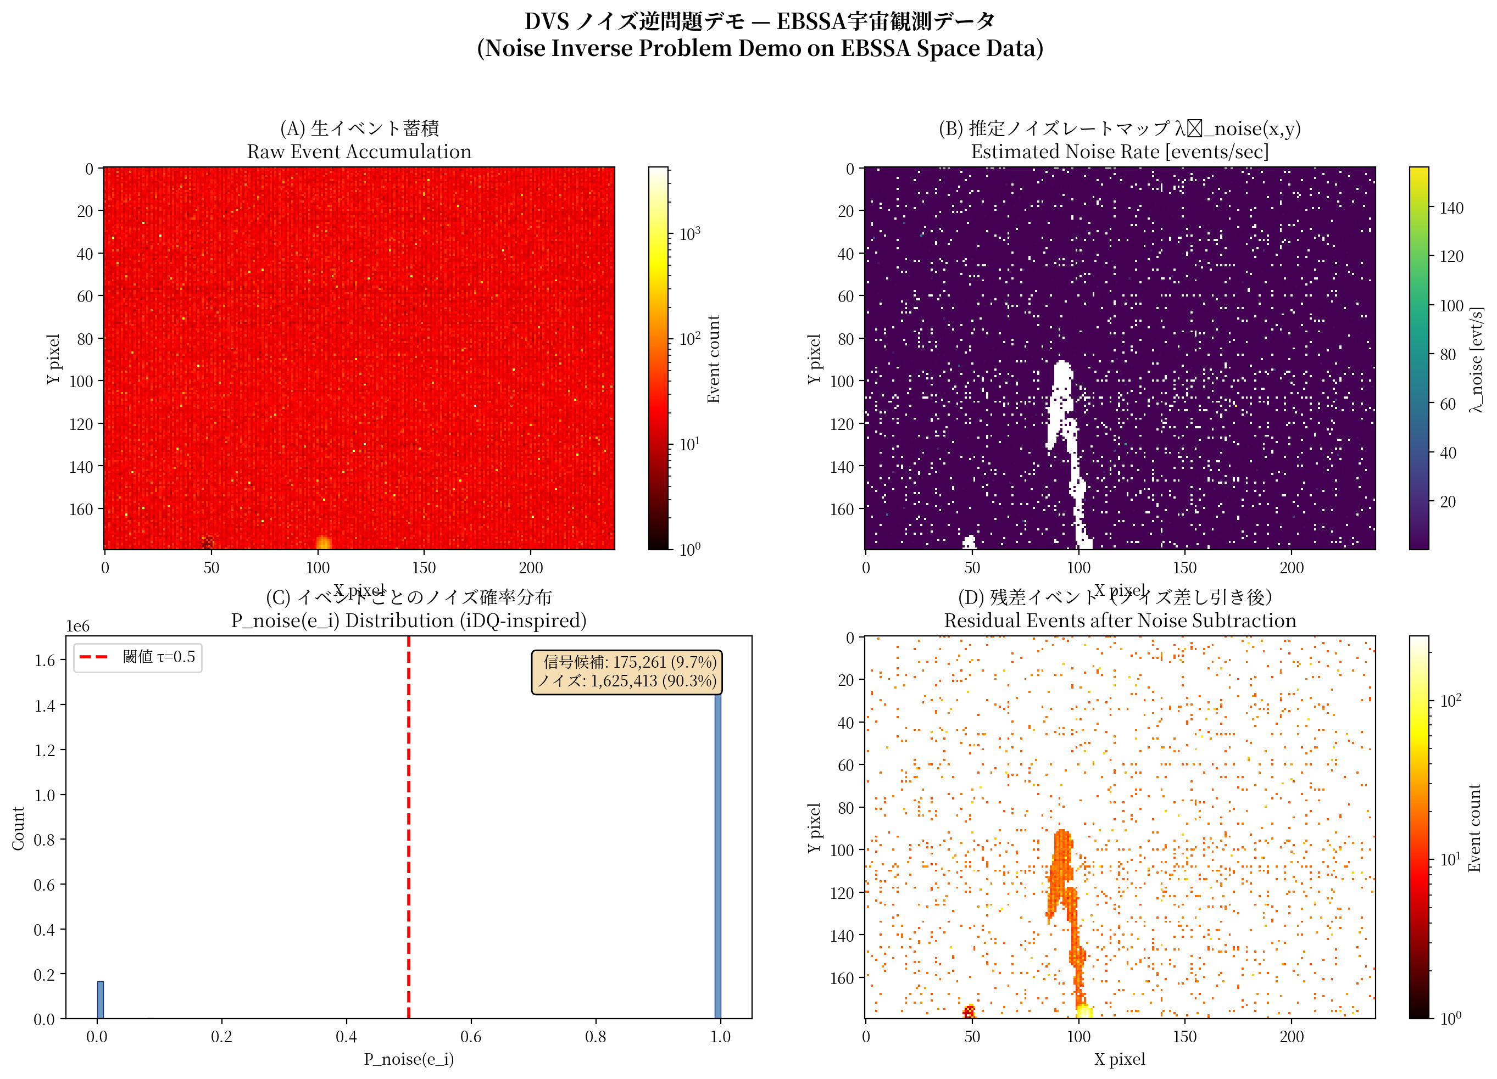
Figure 4: Proof-of-Concept Demonstration
Noise inverse problem demonstration on EBSSA data. (a) Raw event accumulation (1,800,674 events); (b) Estimated noise rate map; (c) Per-event noise probability distribution; (d) Residual events after 90.3% noise removal (175,261 events).

