Slide 1
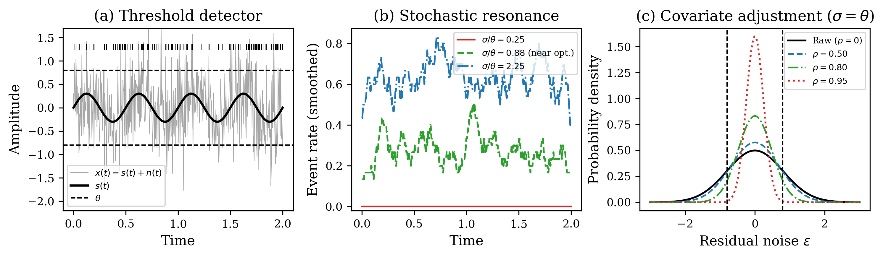
Figure 1
Conceptual schematic of covariate-adjusted stochastic resonance. (a) Threshold detector: subthreshold signal + noise triggers events. (b) SR: event-rate modulation peaks at intermediate noise. (c) Covariate adjustment narrows residual, shifting the SR operating point.

Slide 2
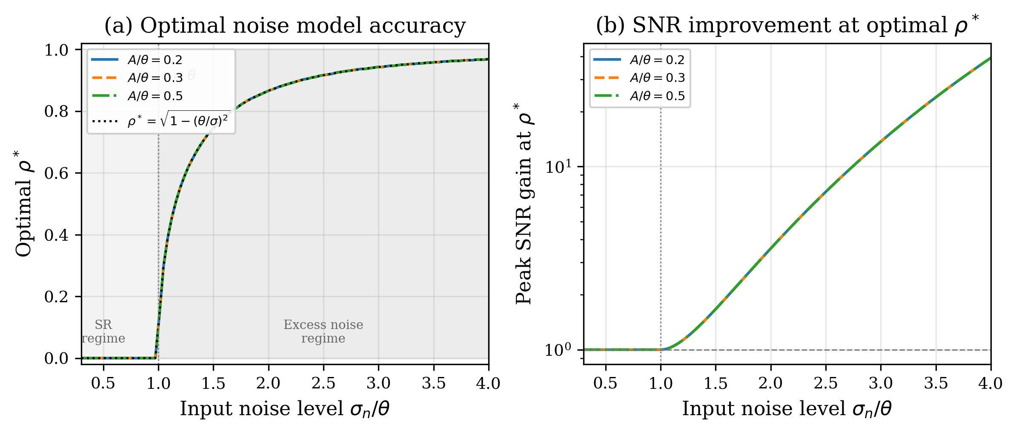
Figure 2
Optimal noise model accuracy. (a) ρ* vs. input noise: 0 in SR regime, √(1 − θ²/σ²) in excess-noise regime. (b) SNR gain at ρ* grows exponentially with σ/θ.

Slide 3
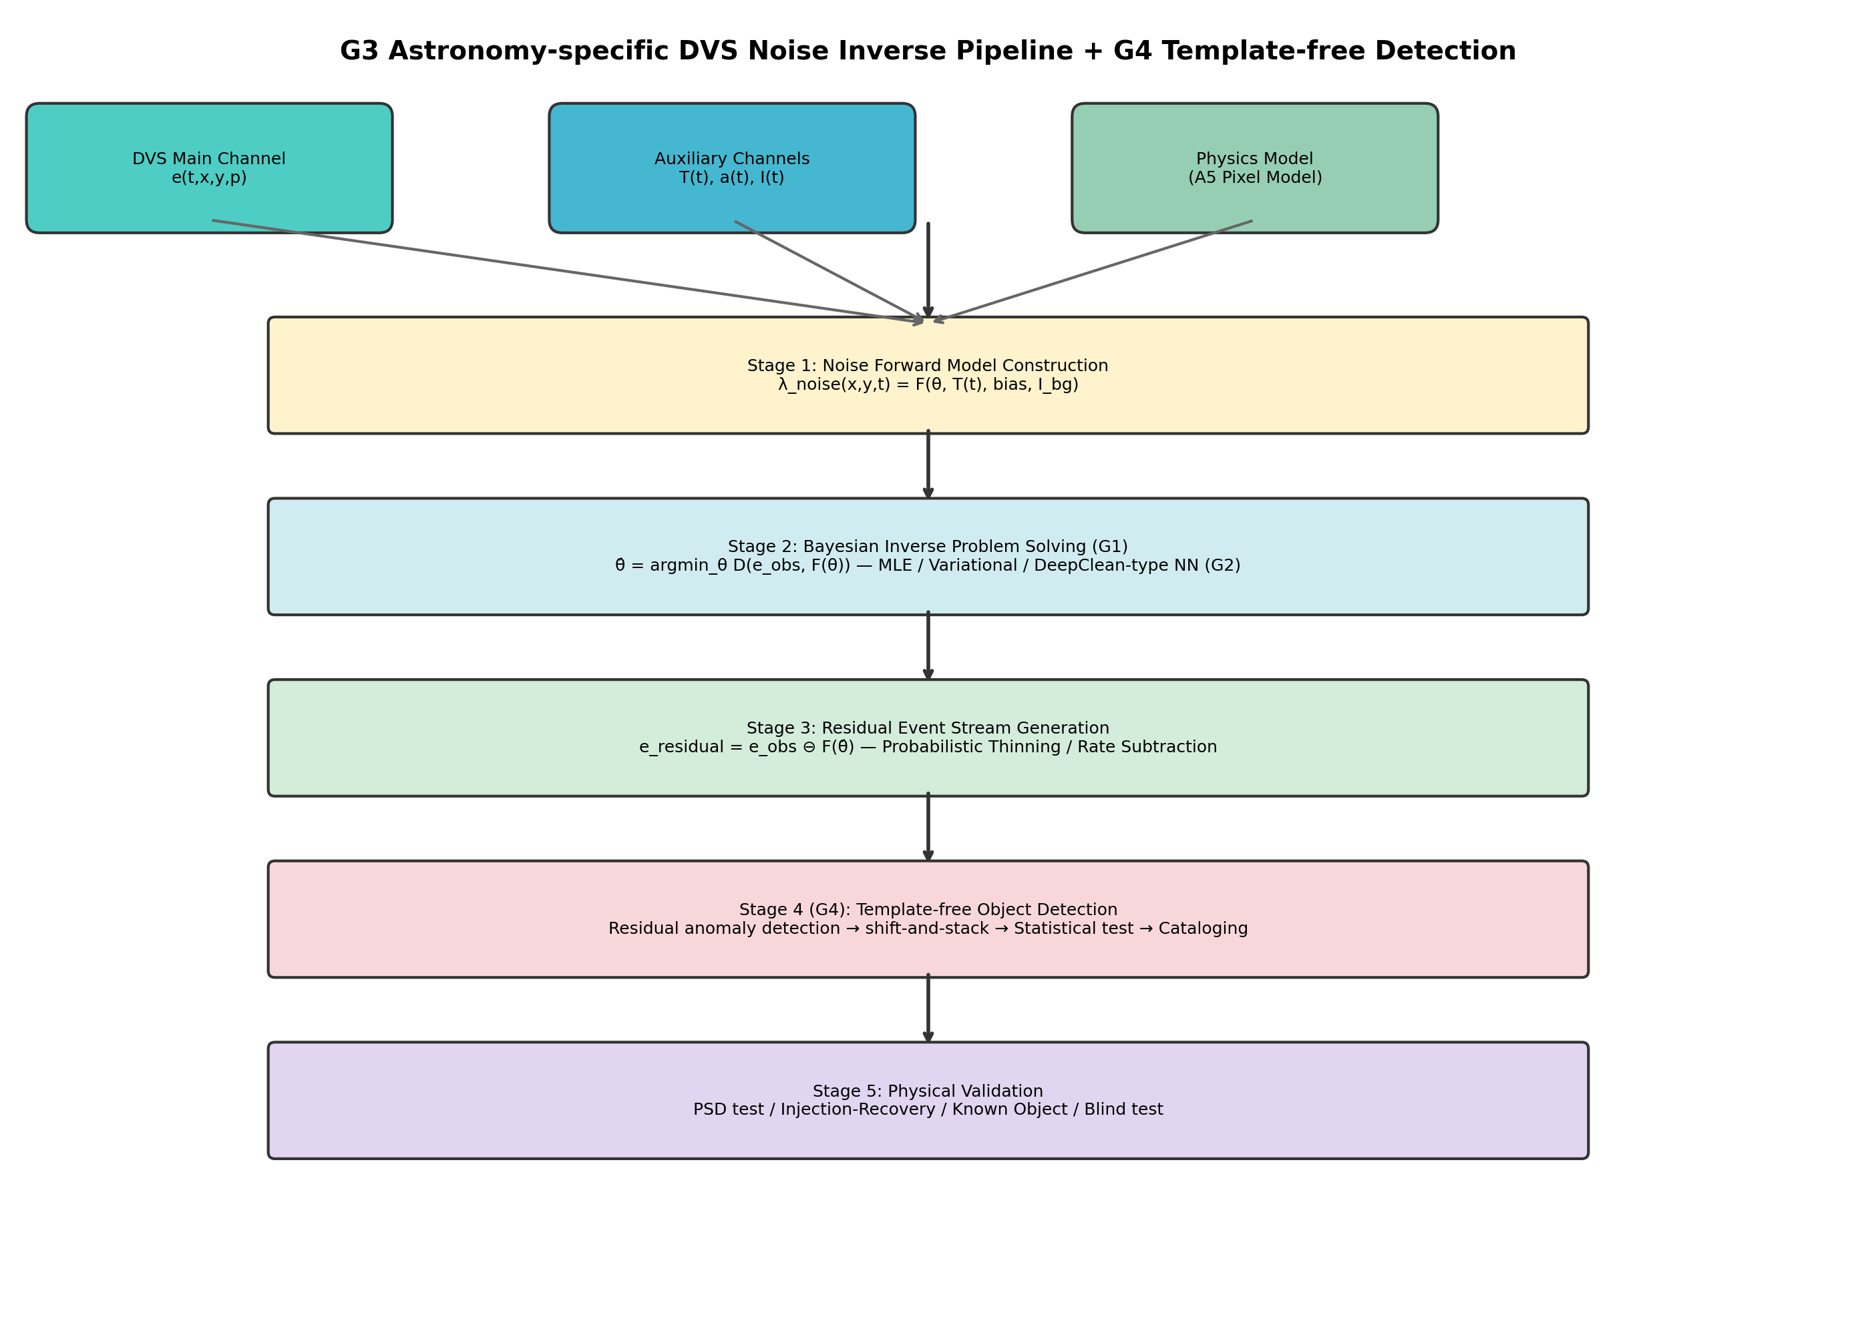
Figure 3
PI-DC-DVS pipeline: (1) A5 noise model + auxiliary channels; (2) Bayesian inverse solution; (3) probabilistic thinning; (4) calibration including Cal-6 satellite trails.

Slide 4
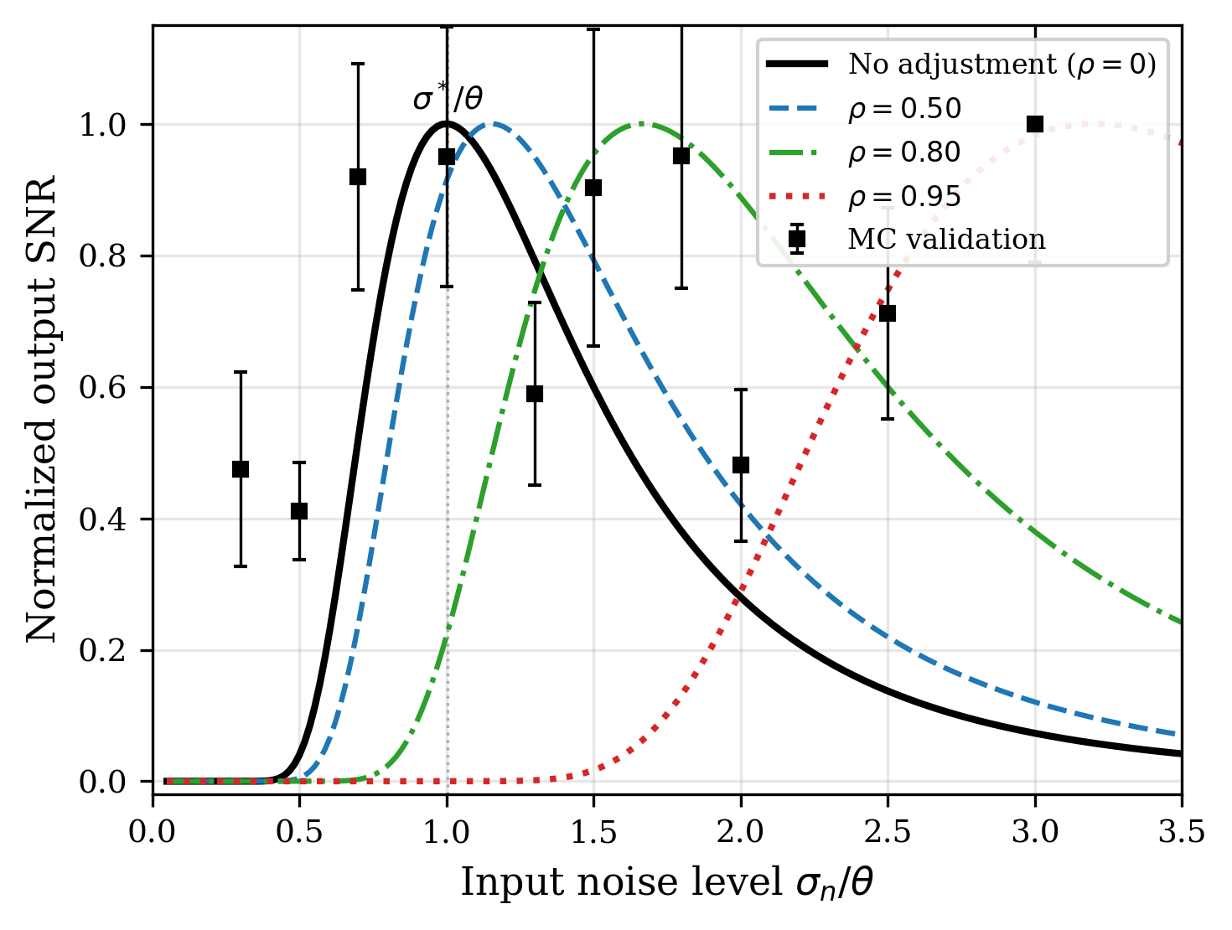
Figure 4
SR curves (A/θ = 0.3). Analytical (solid) + Monte Carlo validation (squares). Covariate adjustment shifts peak rightward.

Slide 5
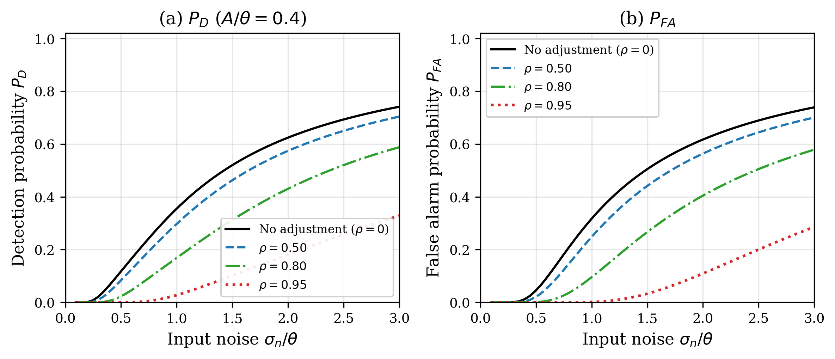
Figure 5
(a) Detection probability P_D and (b) false alarm P_FA vs. noise for different ρ (A/θ = 0.4). Higher ρ suppresses effective noise.

Slide 6
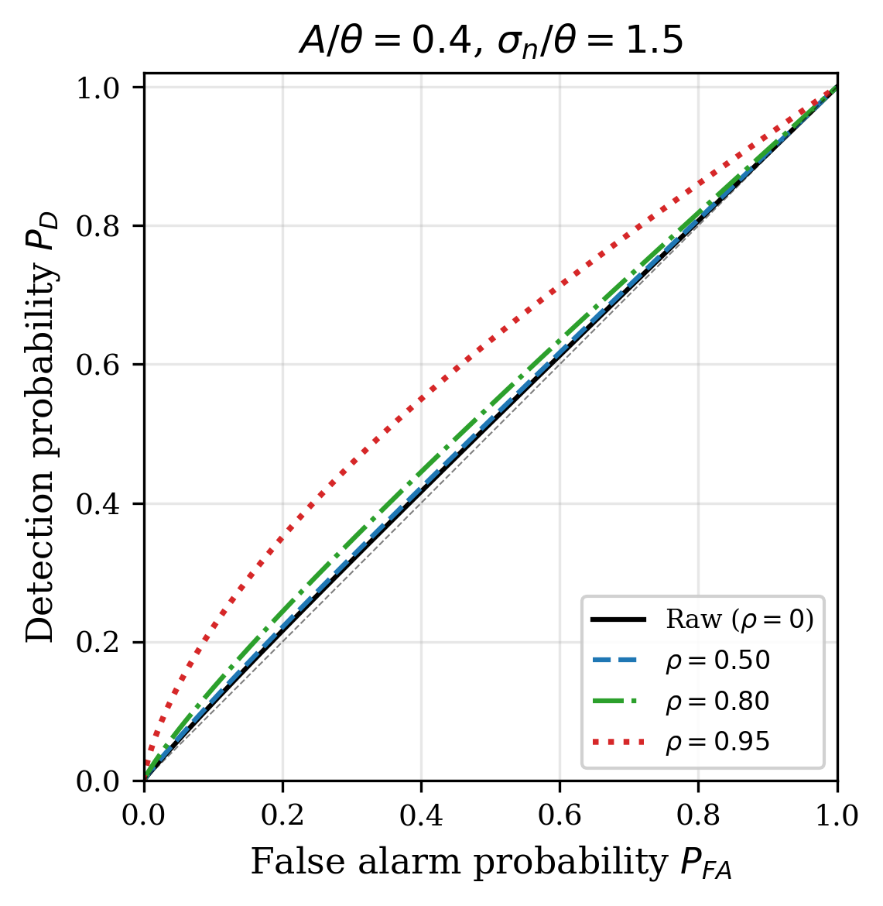
Figure 6
ROC curves at σ_n/θ = 1.5. Covariate adjustment (ρ = 0.95) achieves near-ideal signal/noise separation.

Slide 7
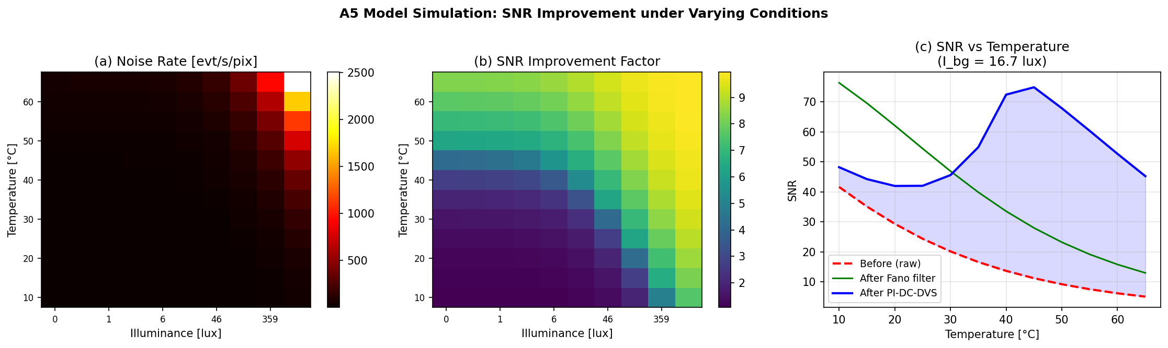
Figure 7
A5-based noise rate simulation. (a) Predicted noise rate [evt/s/pix]; (b) SNR improvement at 90% accuracy; (c) SNR vs. temperature.

Slide 8
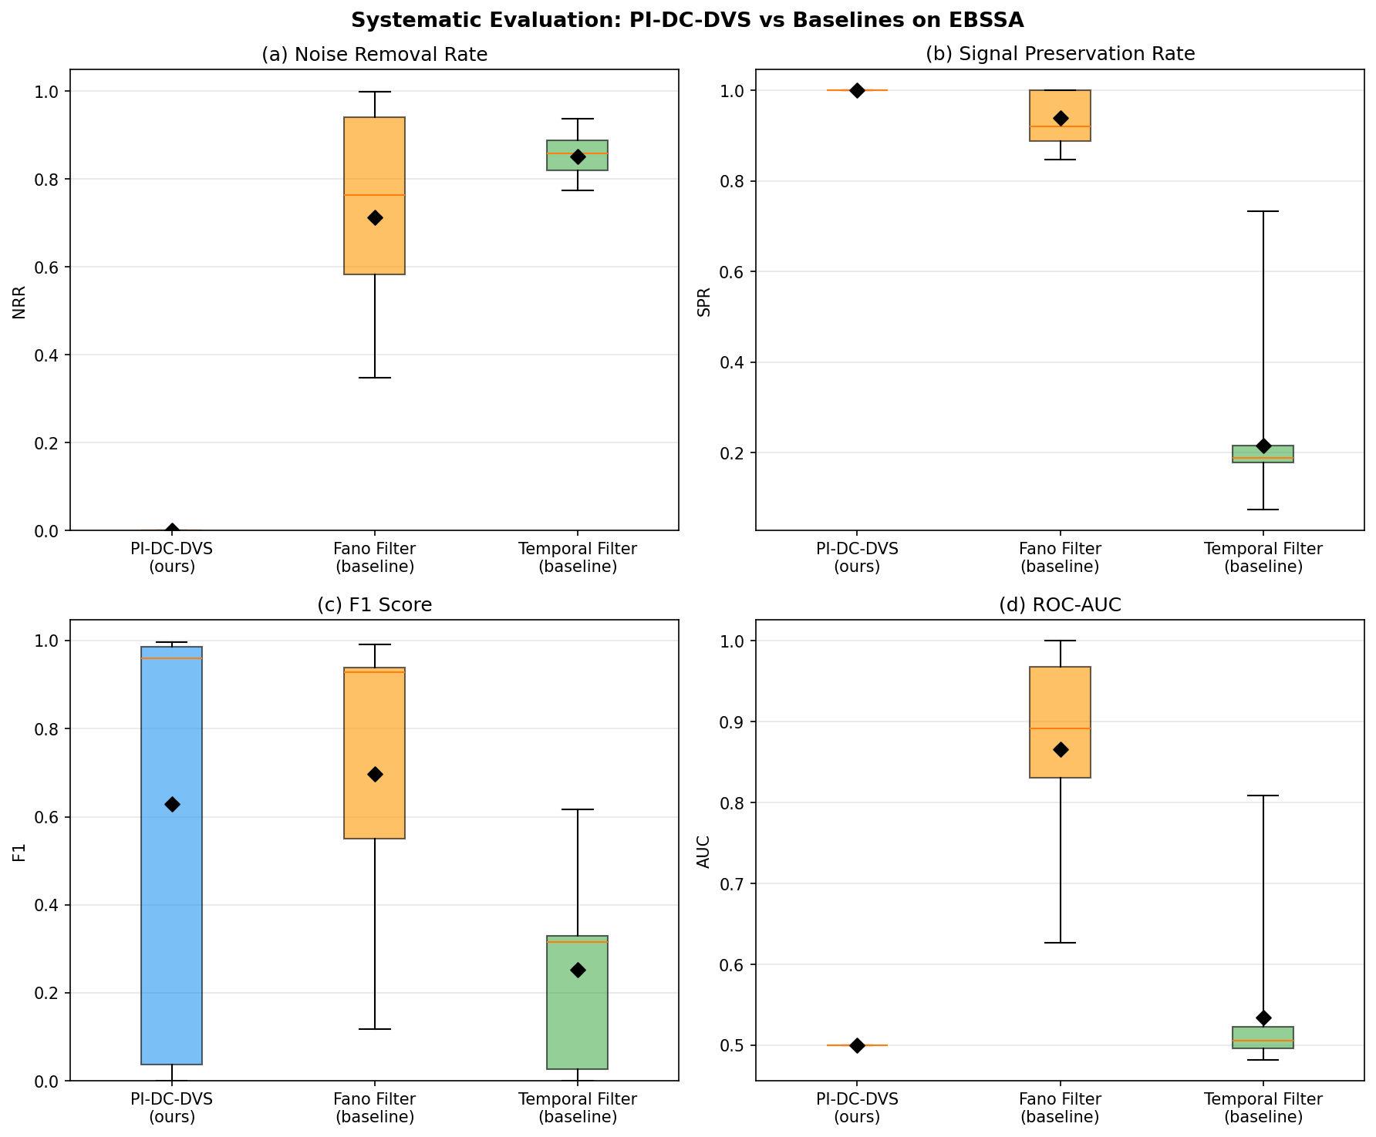
Figure 8
Systematic evaluation on the public EBSSA dataset (20 recordings). (a) NRR, (b) SPR, (c) F1, (d) ROC-AUC. Fano filter achieves best overall balance (AUC = 0.866).

Slide 9
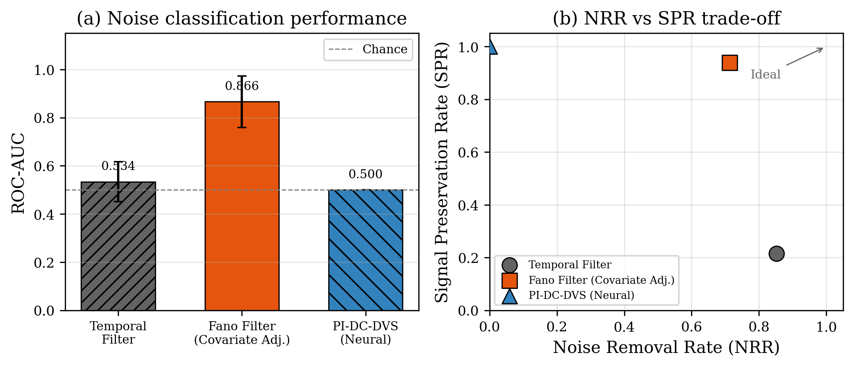
Figure 9
DVS results in SR framework. (a) ROC-AUC: Fano 0.866 vs temporal 0.534. (b) NRR vs SPR: 71.3% noise removed, 93.9% signal preserved.

Slide 10
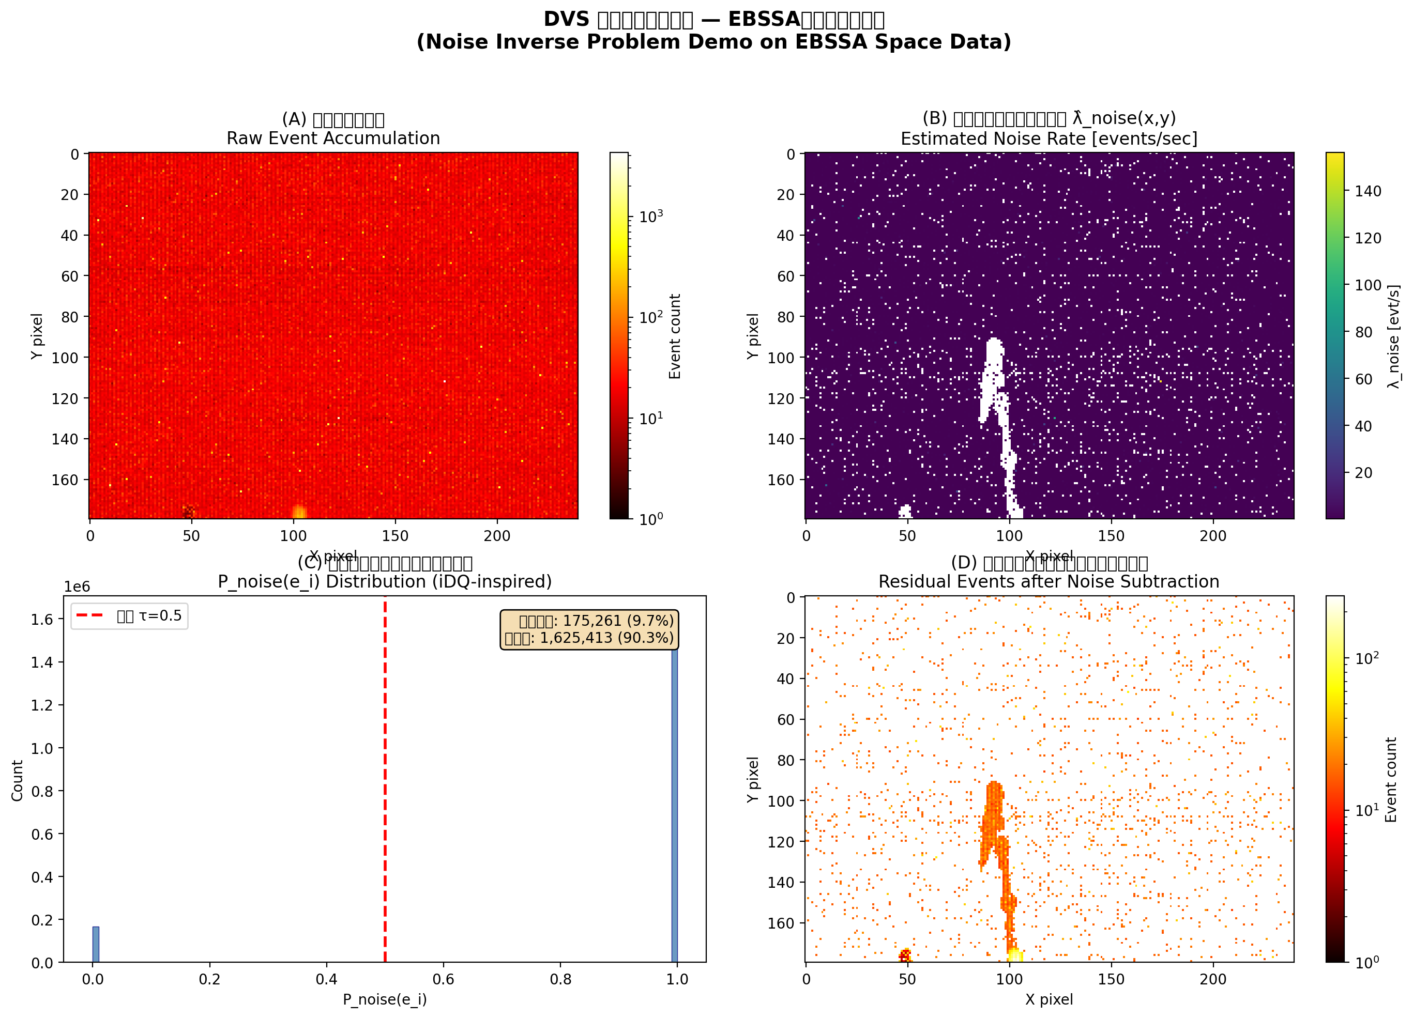
Figure 10
Proof-of-concept: (a) raw events; (b) noise rate map; (c) bimodal P_noise; (d) residual after 90.3% noise removal.

Slide 11
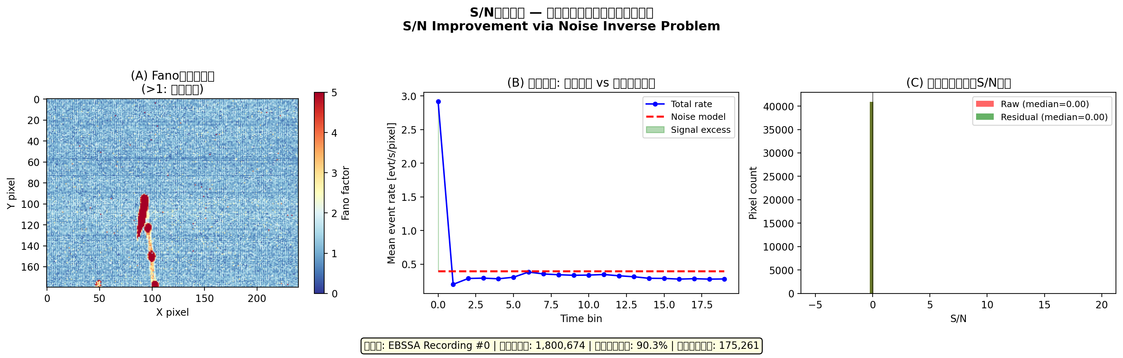
Figure 11
SNR improvement: (a) Fano spatial map (noise F≈1 vs signal F≫1); (b) temporal dynamics; (c) per-pixel SNR distribution.

