Slide 1
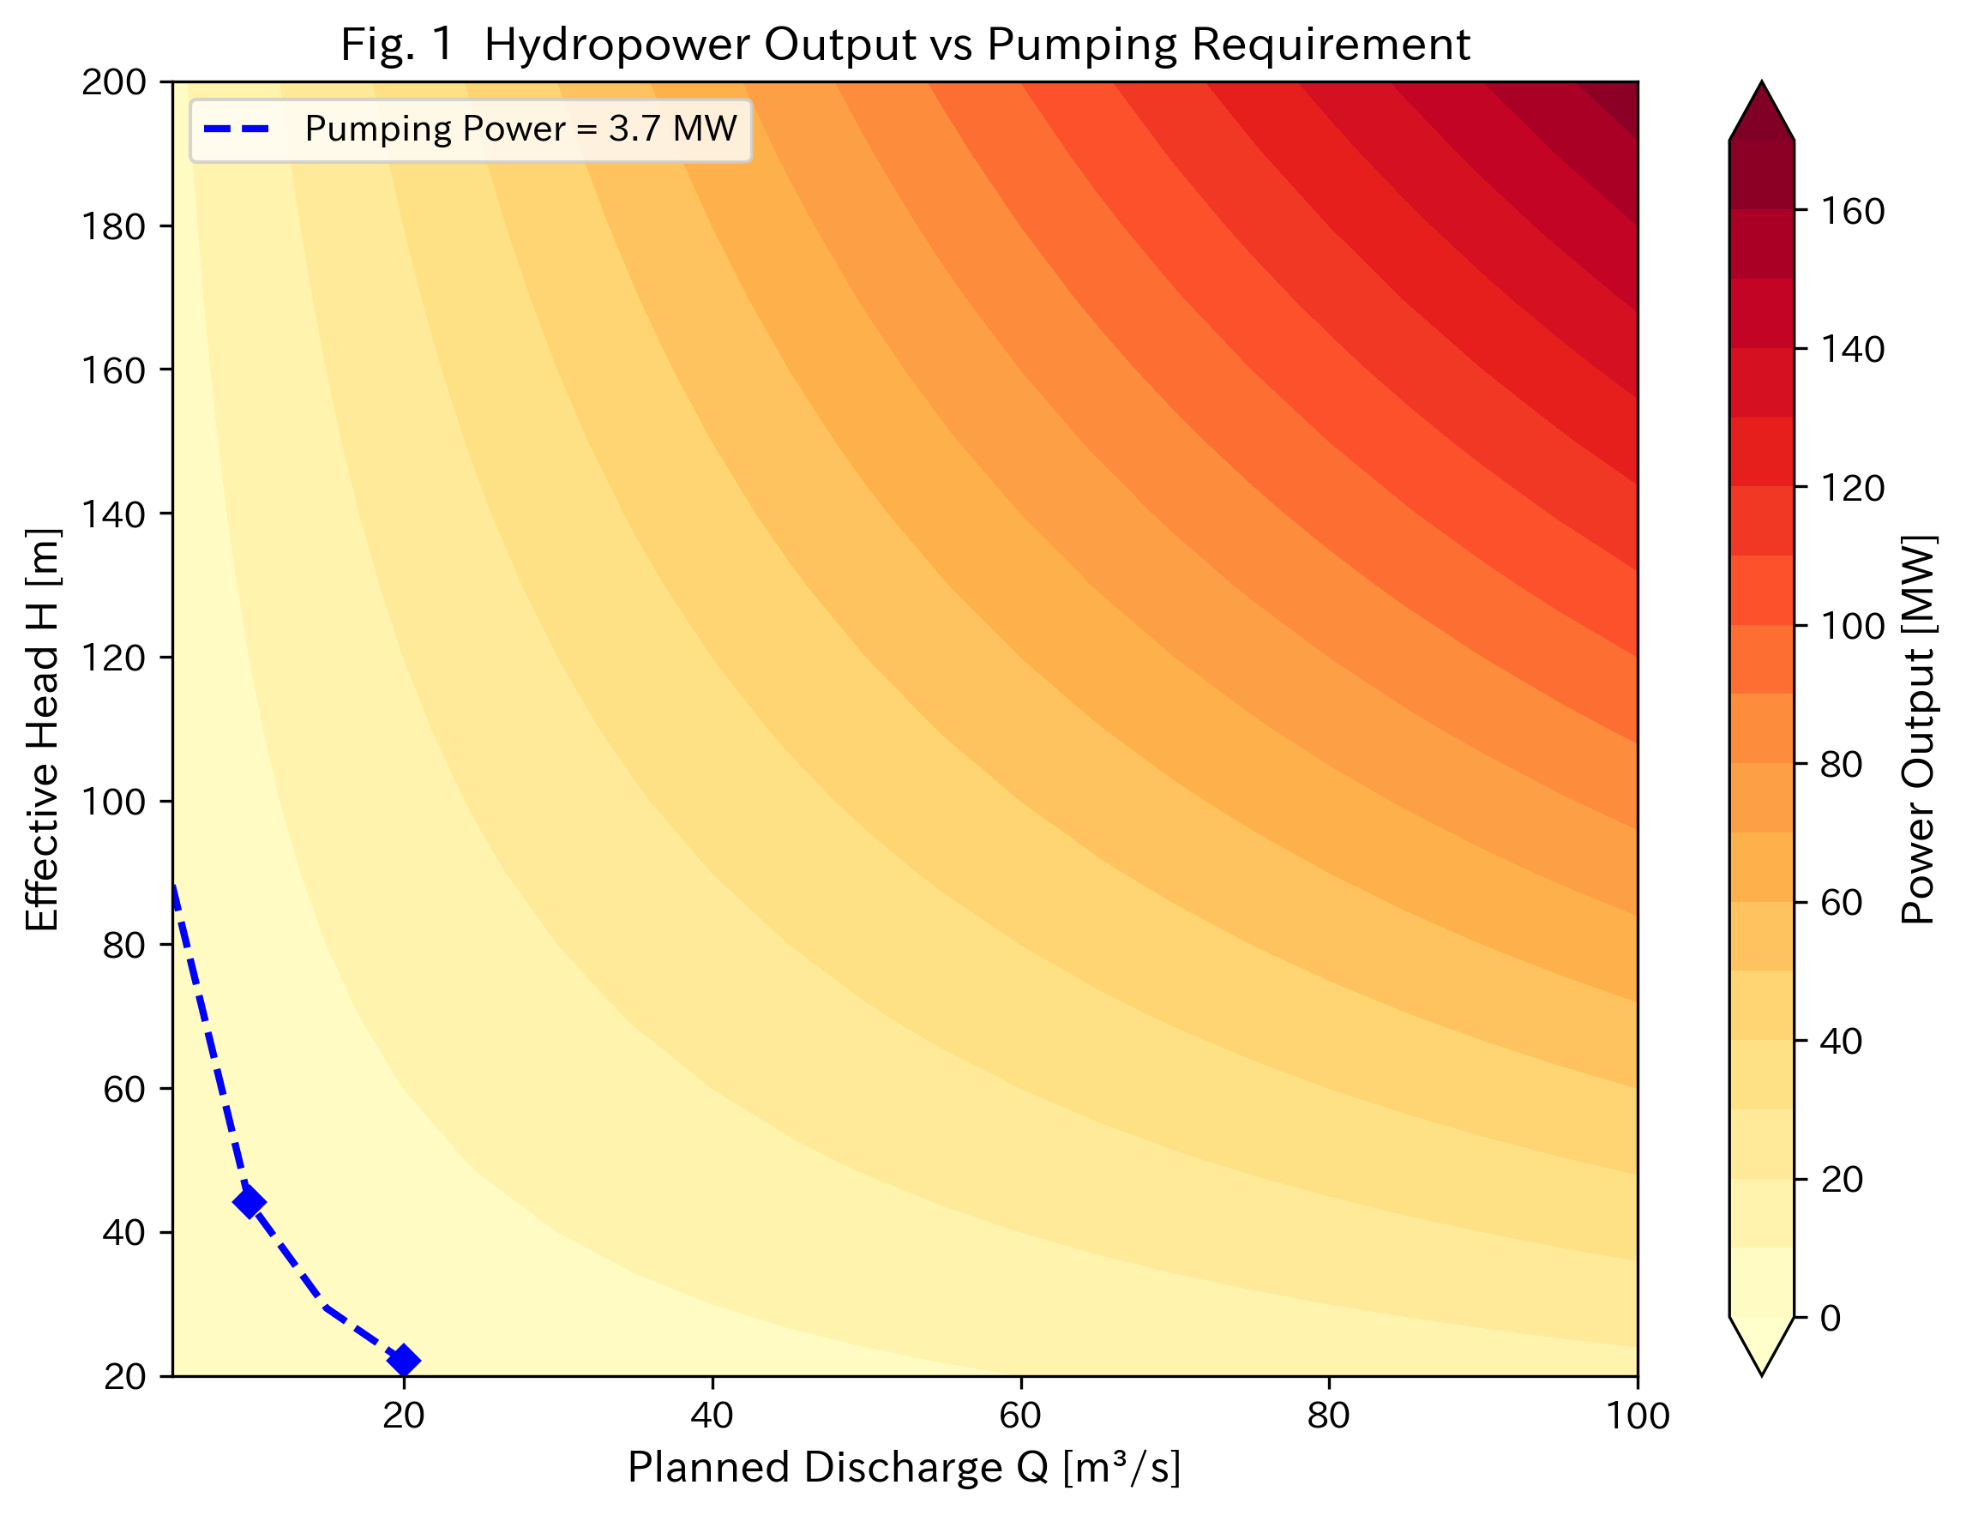
Figure 1
Figure 1. Energy balance contour map showing generated power (MW) as a function of effective head and discharge. The red dashed line indicates the pumping power requirement (3.68 MW). The green marker shows the reference scenario (H = 100 m, Q = 50 m³/s).

Slide 2
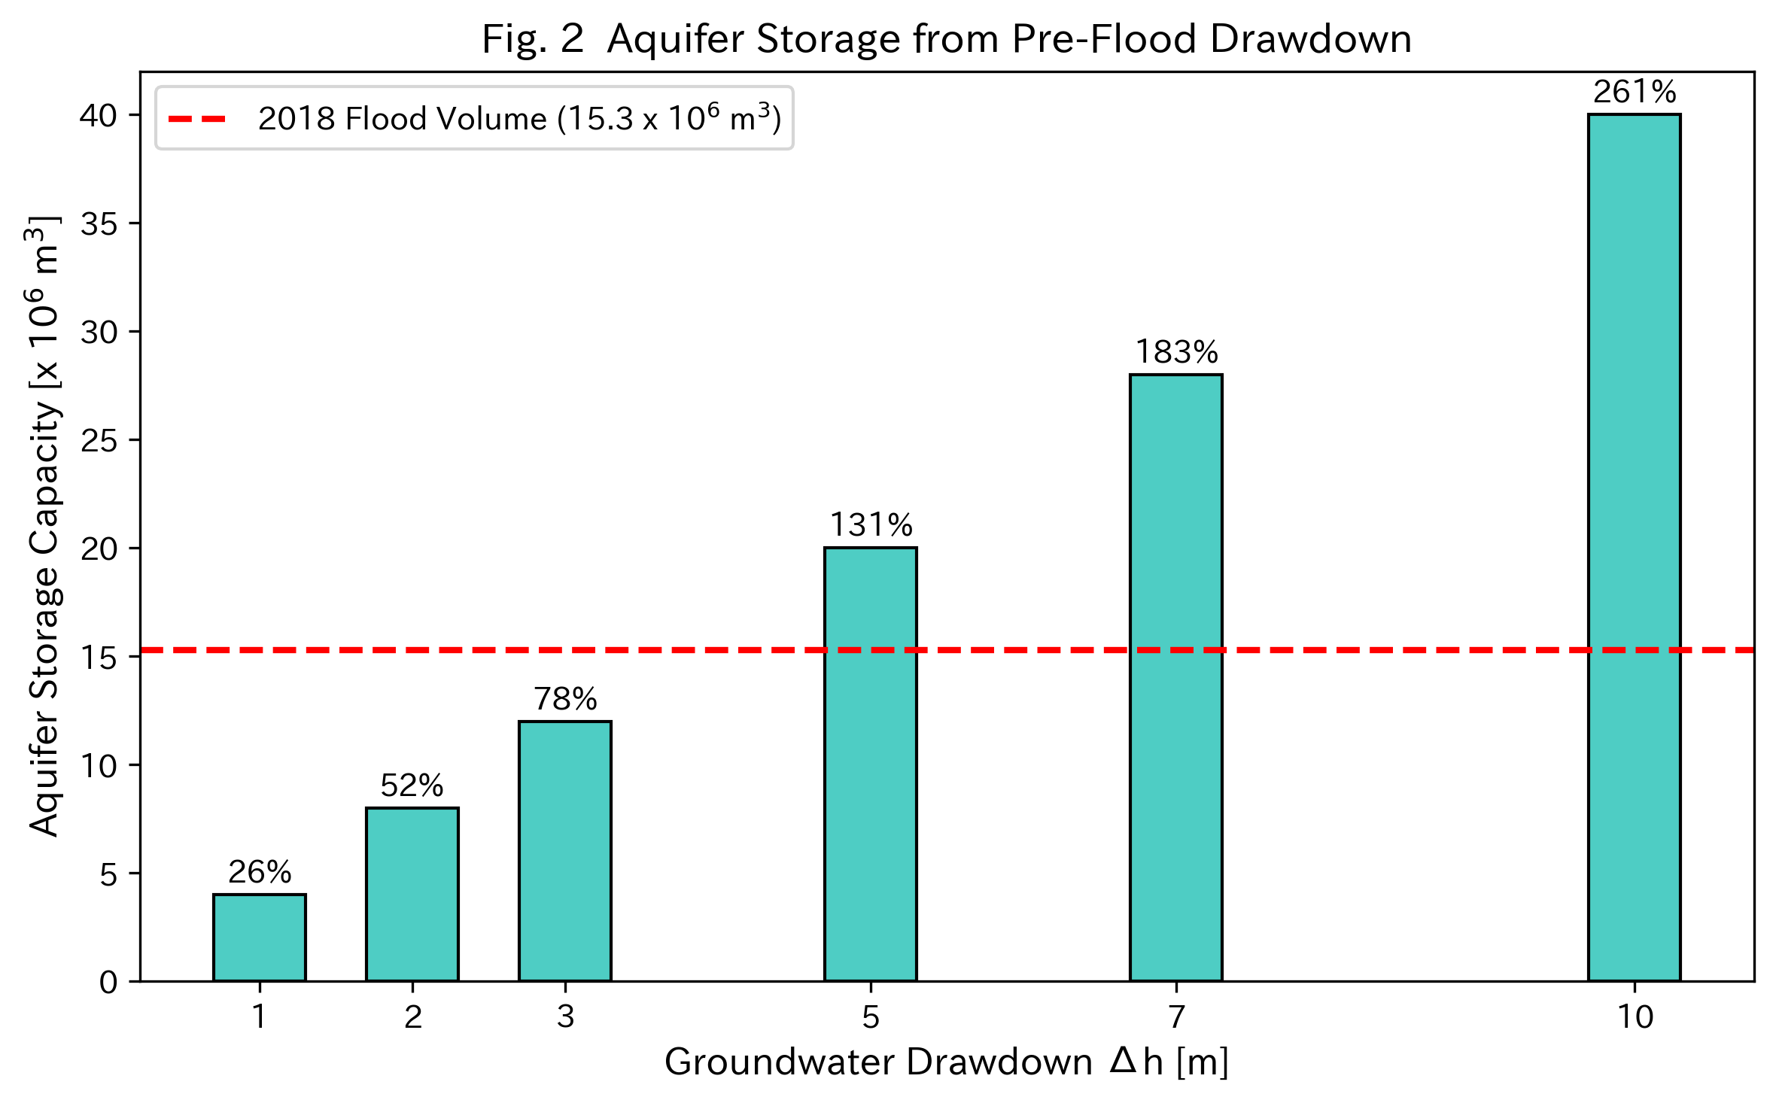
Figure 2
Figure 2. Aquifer storage capacity contours (10⁶ m³) as a function of recharge area and water table drawdown, assuming a specific yield of 0.2. The dashed line indicates the 2018 flood volume (15.3 × 10⁶ m³). The green marker shows the reference scenario.

Slide 3
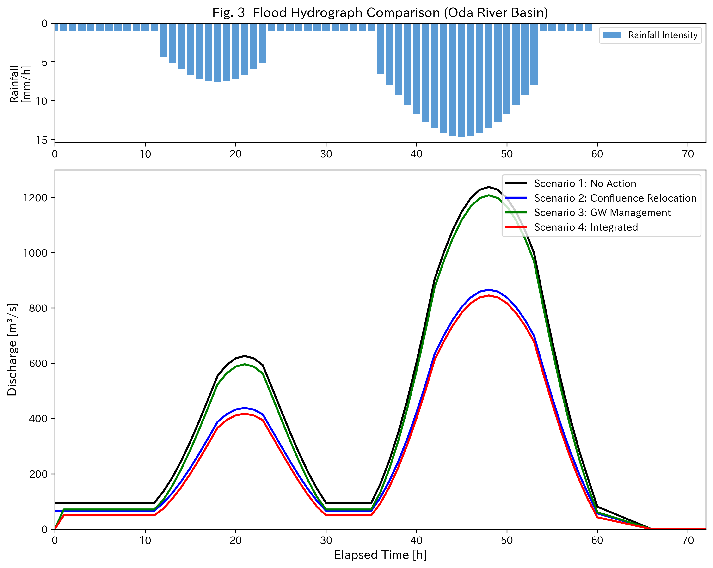
Figure 3
Figure 3. Flood hydrograph comparison for the 2018 event under four scenarios: no measures (baseline), confluence relocation only, groundwater management only, and integrated measures. Upper panel shows the 72-hour rainfall hyetograph.

Slide 4
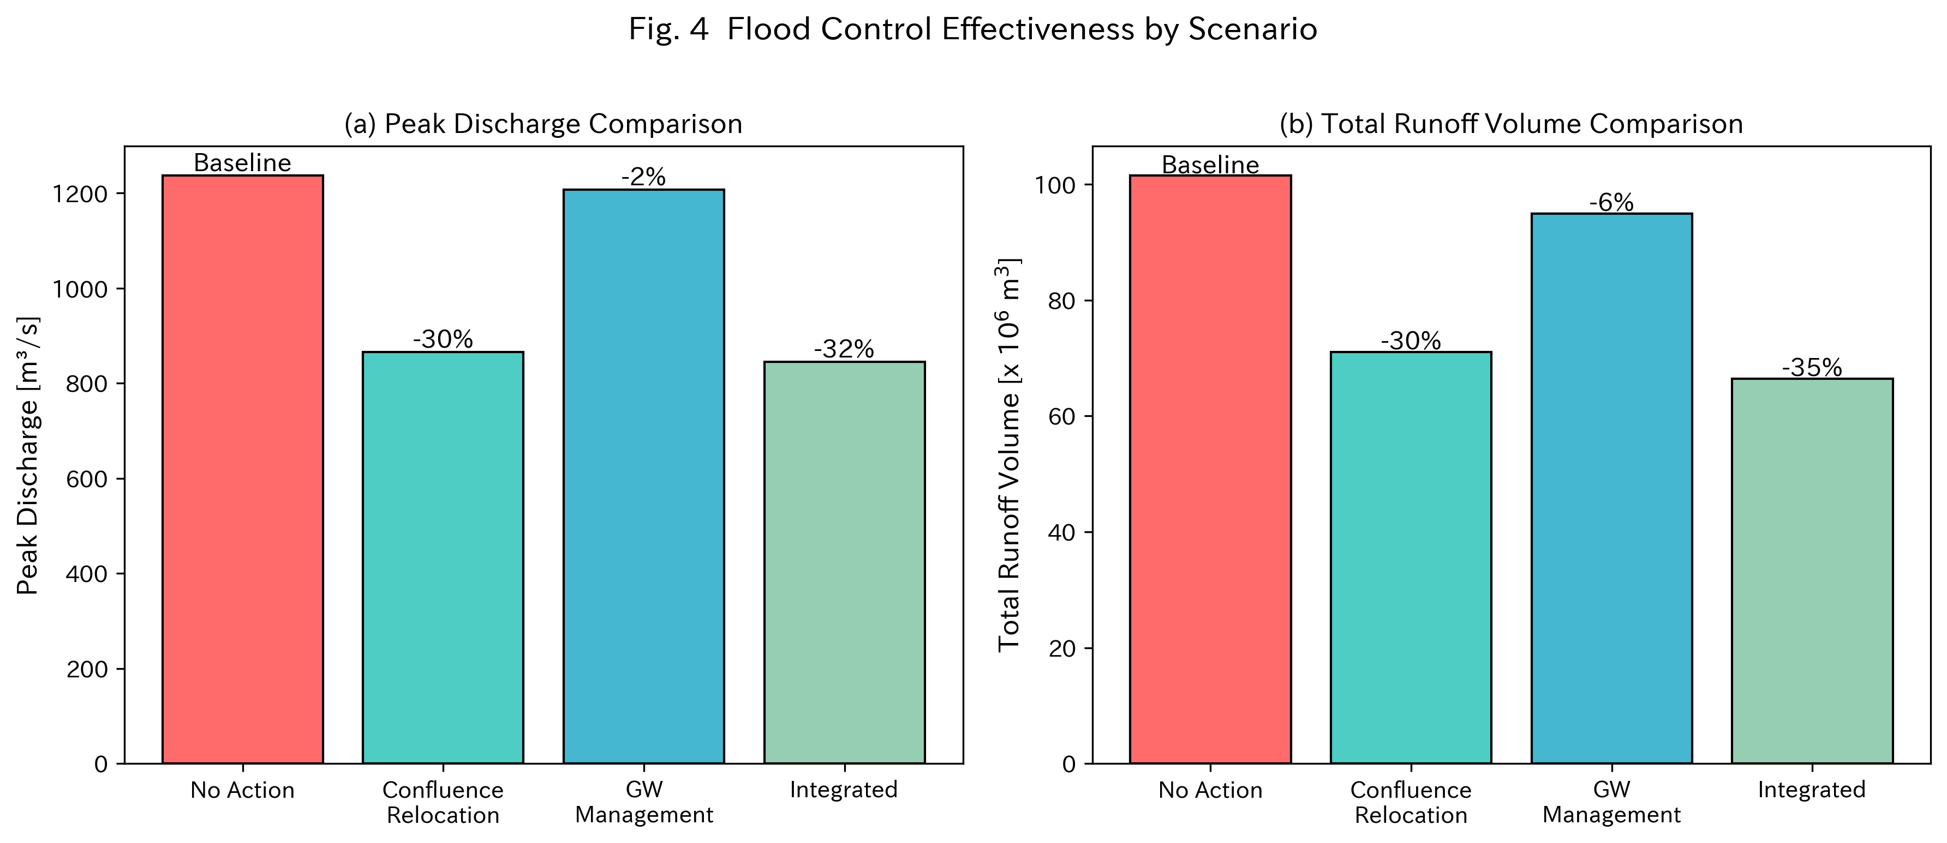
Figure 4
Figure 4. Comparison of peak discharge and total runoff volume across four scenarios. Error bars indicate ±10% sensitivity range.

