Slide 1
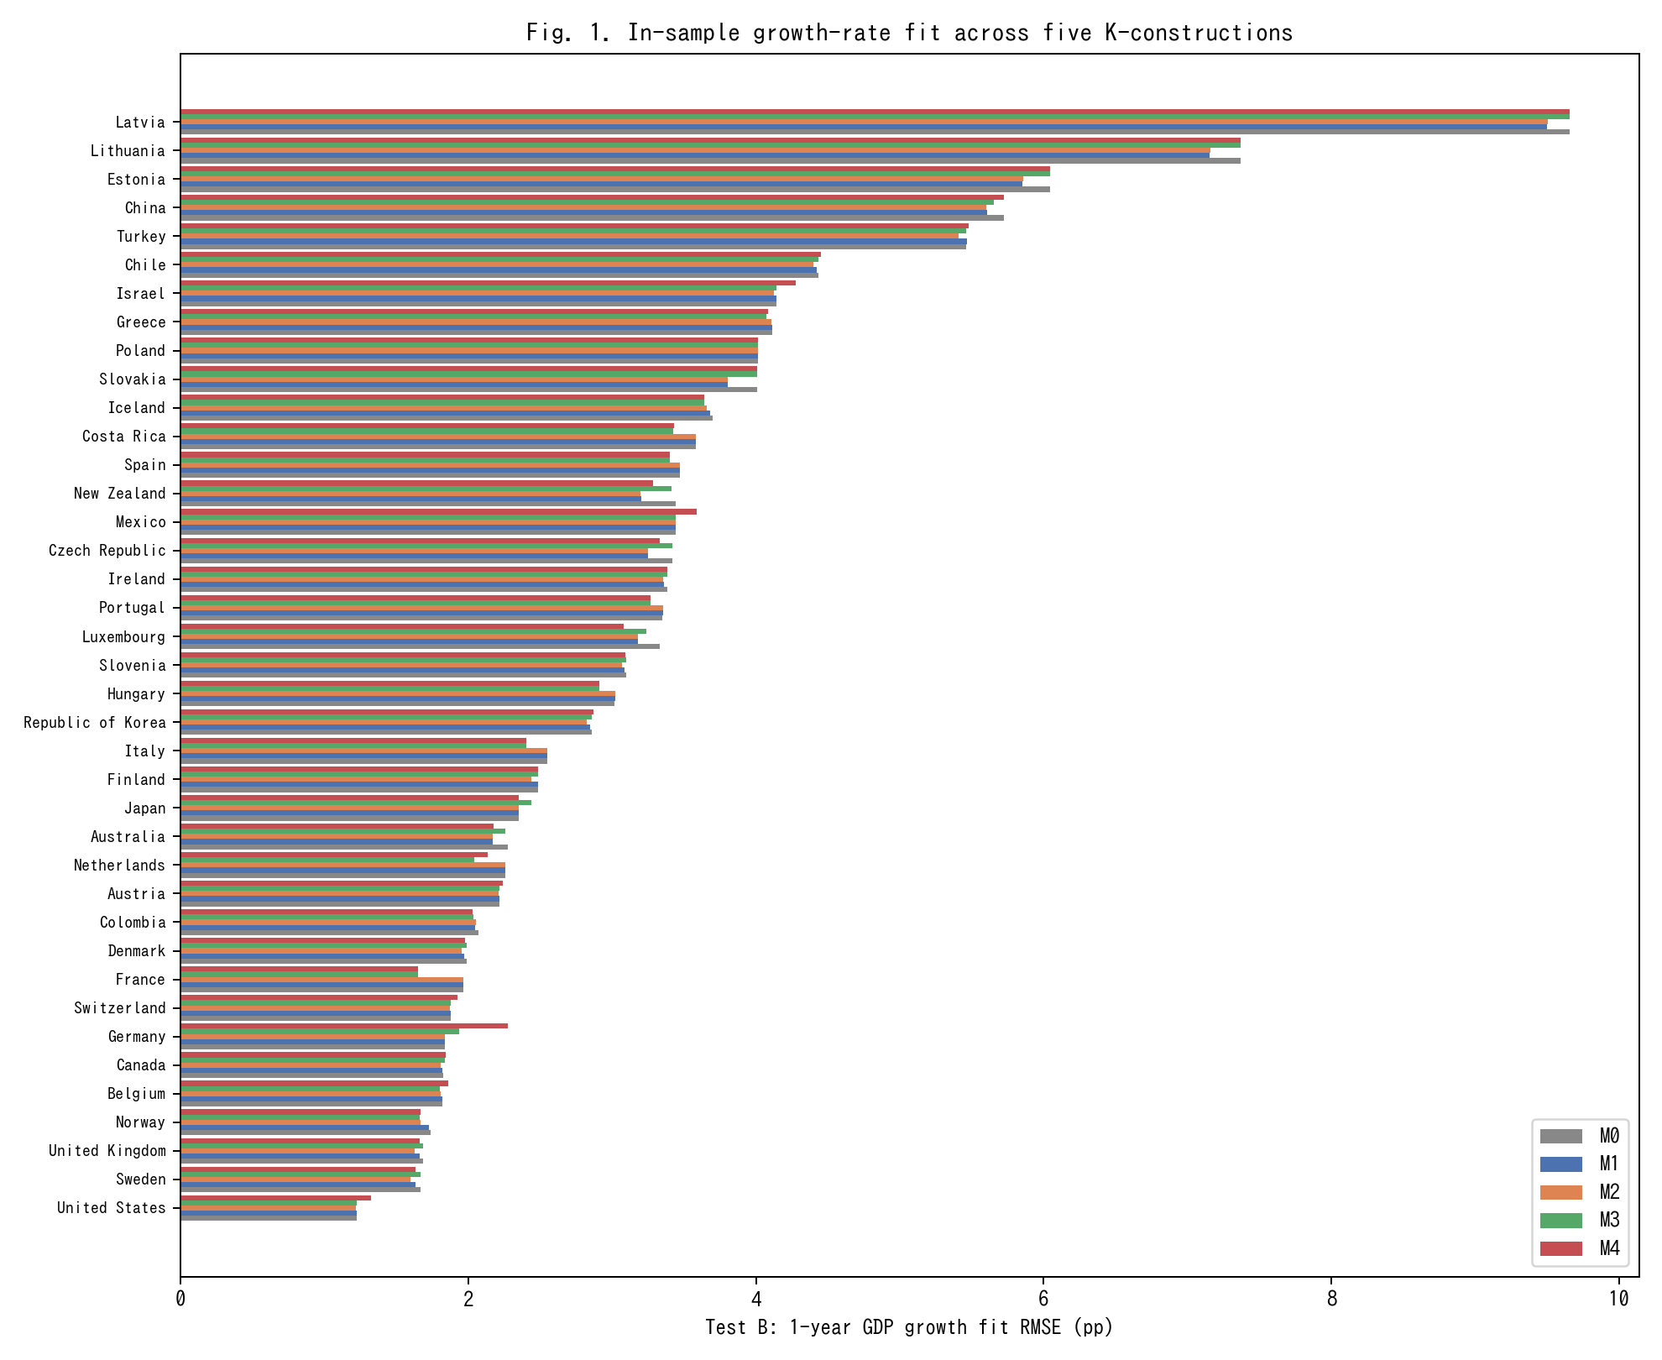
Fig. 1. In-sample 1-year GDP growth RMSE across M0-M4 for 39 countries (lower is better).
In-sample 1-year GDP growth RMSE across M0-M4 for 39 countries (lower is better).

Slide 2
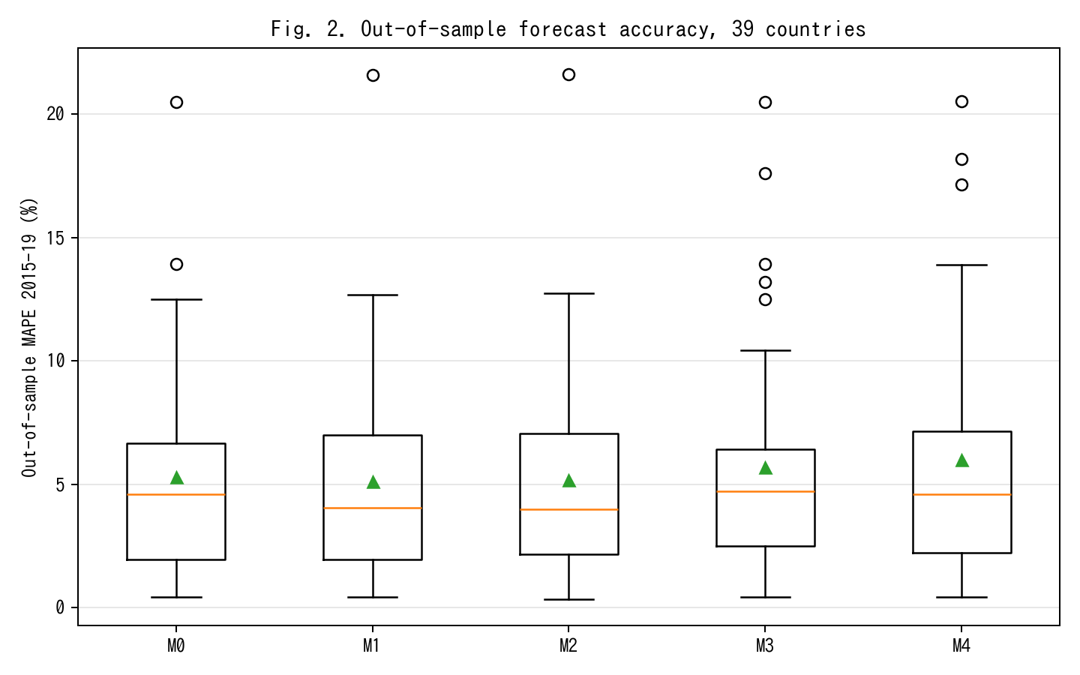
Fig. 2. Out-of-sample MAPE on 2015-19 held-out window; M2 achieves 13% relative improvement vs M0.
Out-of-sample MAPE on 2015-19 held-out window; M2 achieves 13% relative improvement vs M0.

Slide 3
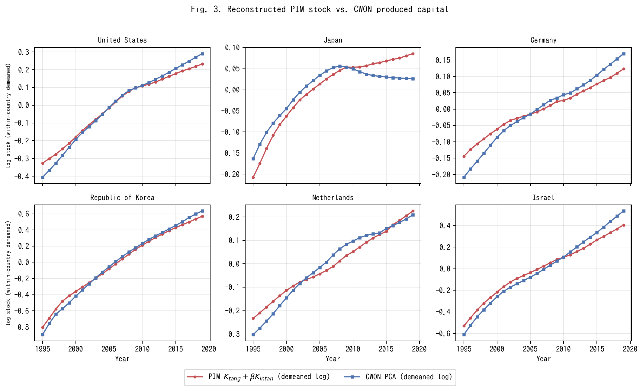
Fig. 3. PIM stock K_tang+betaK_I versus CWON PCA (within-country demeaned log).
PIM stock K_tang+betaK_I versus CWON PCA (within-country demeaned log).

Slide 4
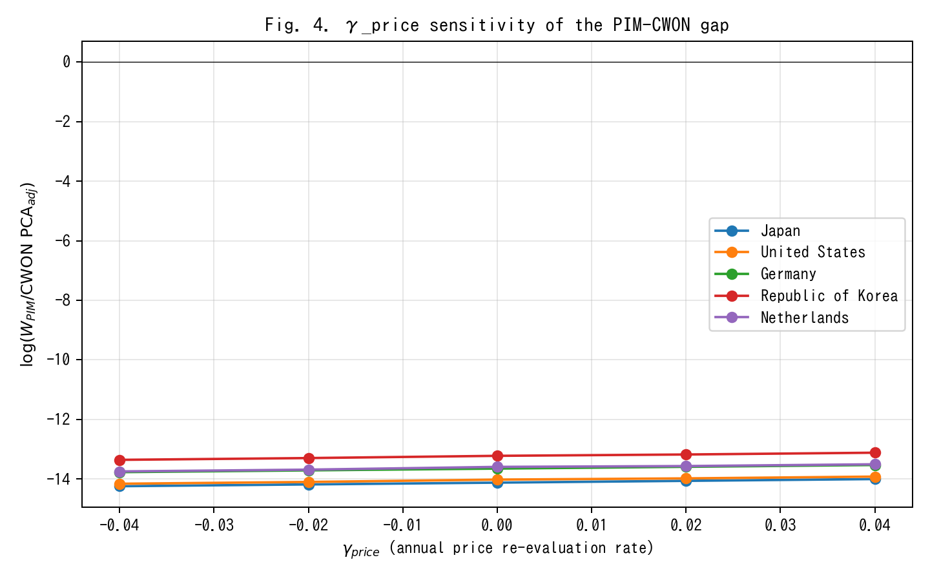
Fig. 4. gamma_price sensitivity of PIM/CWON log-ratio; Japan gap closes around gamma=+0.02.
gamma_price sensitivity of PIM/CWON log-ratio; Japan gap closes around gamma=+0.02.

Slide 5
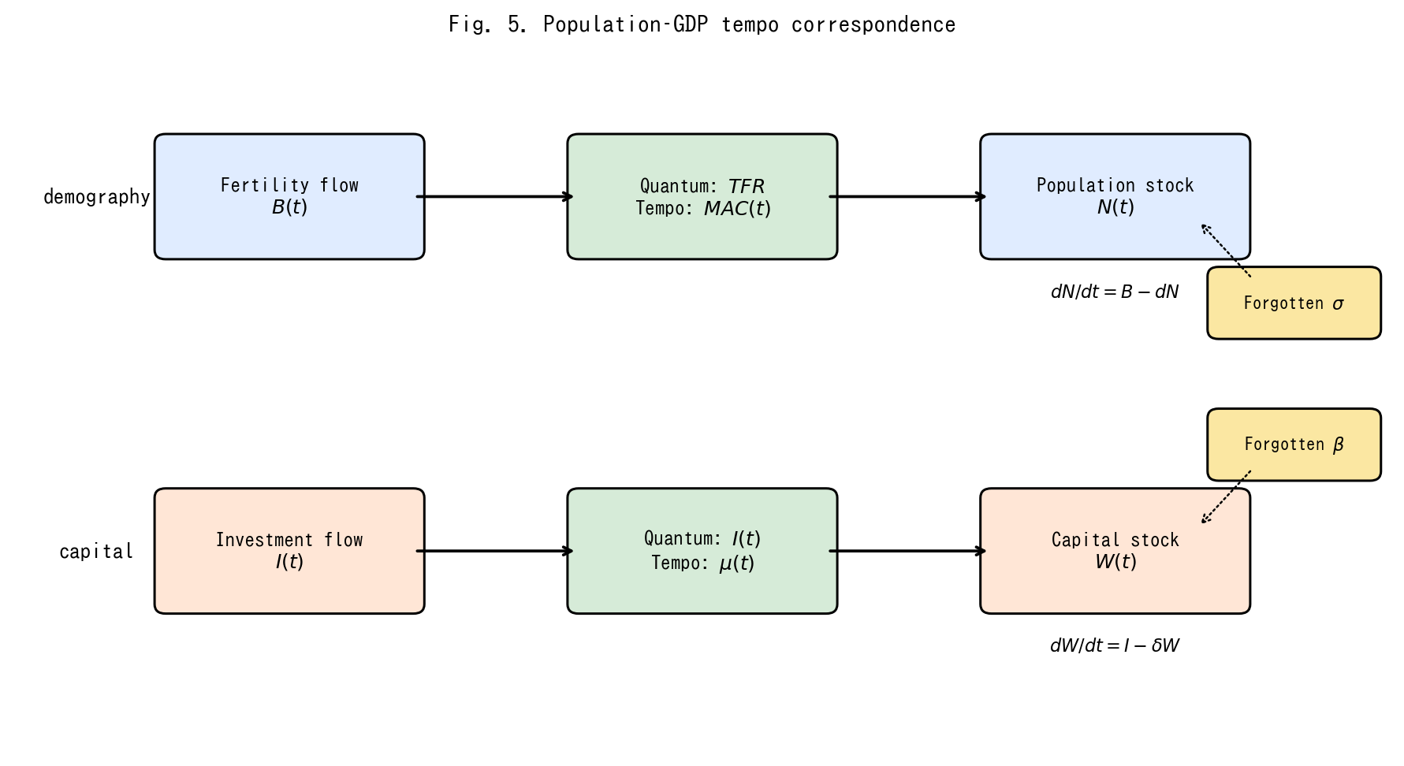
Fig. 5. Conceptual diagram of the population-capital tempo correspondence.
Conceptual diagram of the population-capital tempo correspondence.

Slide 6
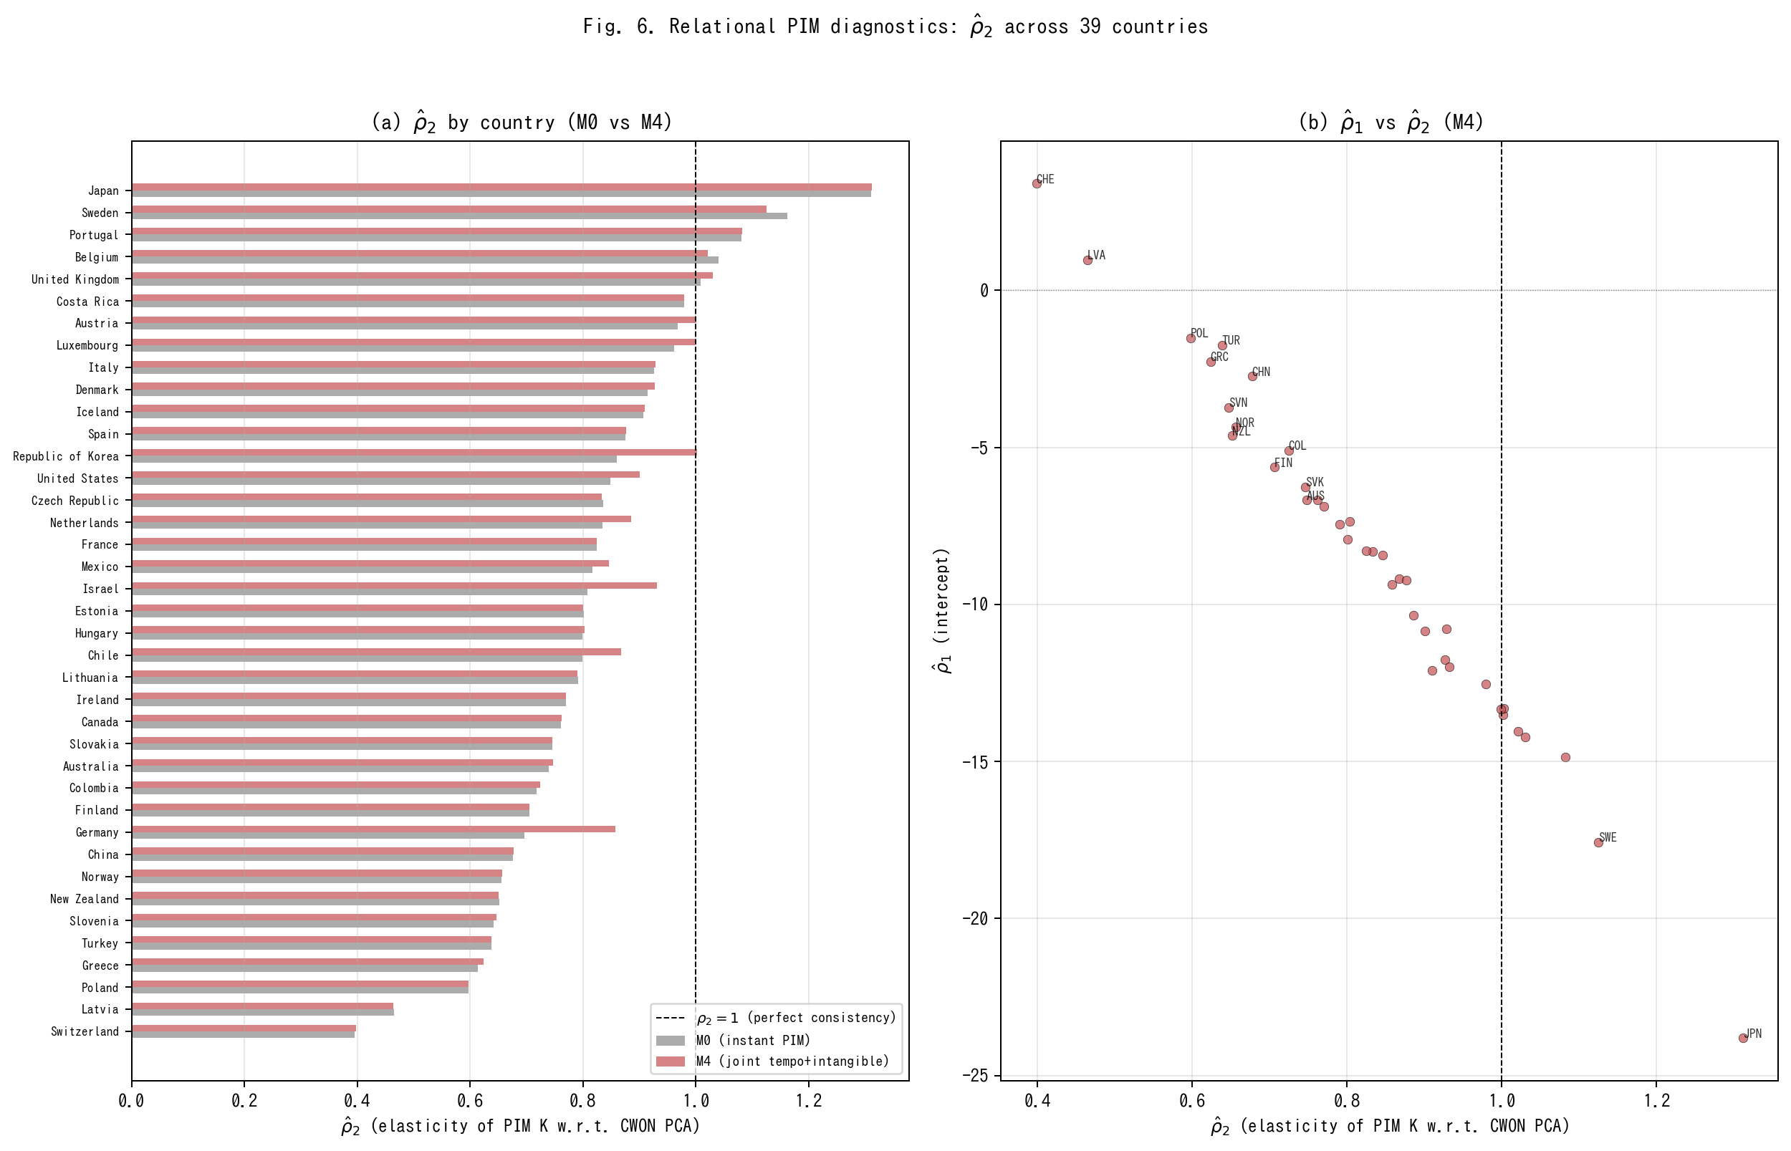
Fig. 6. Relational PIM diagnostics: rho_2 across 39 countries under M0 vs M4.
Relational PIM diagnostics: rho_2 across 39 countries under M0 vs M4.

Slide 7
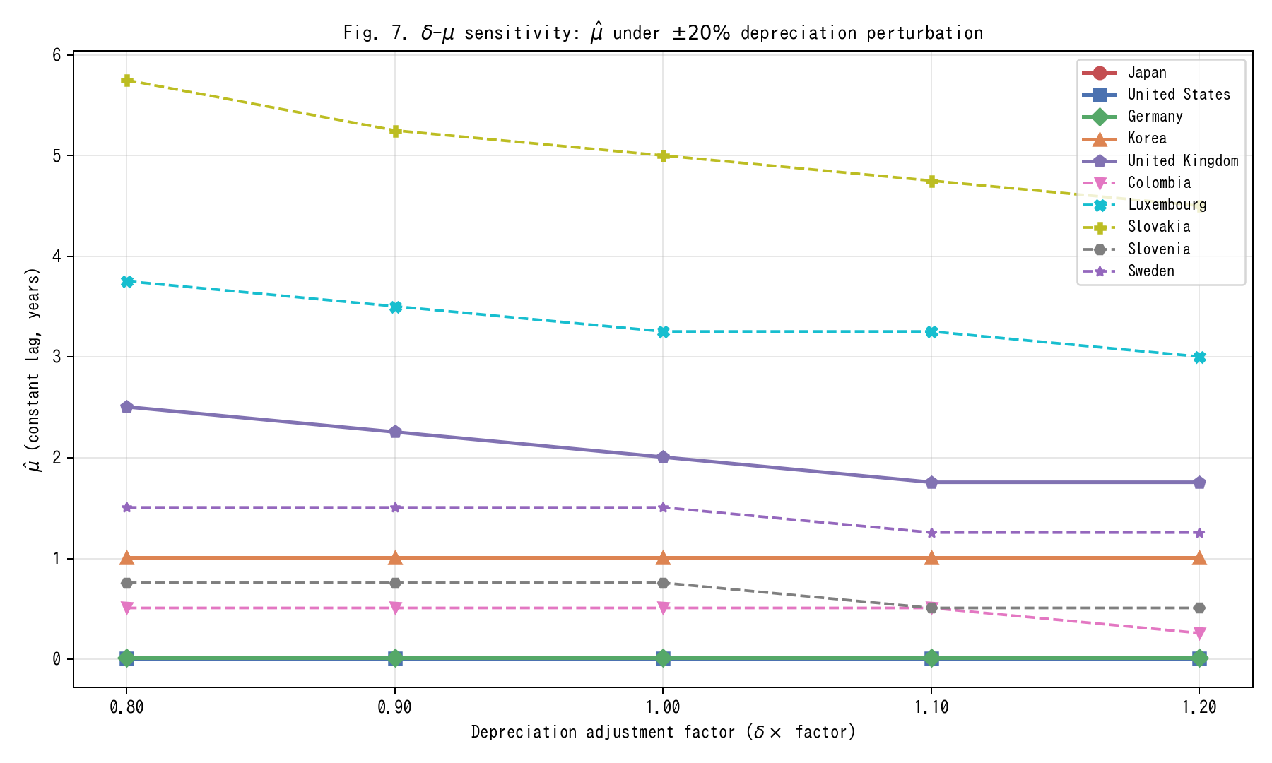
Fig. 7. Delta-mu sensitivity: mu_hat under +/-20% depreciation perturbation.
Delta-mu sensitivity: mu_hat under +/-20% depreciation perturbation.

Slide 8
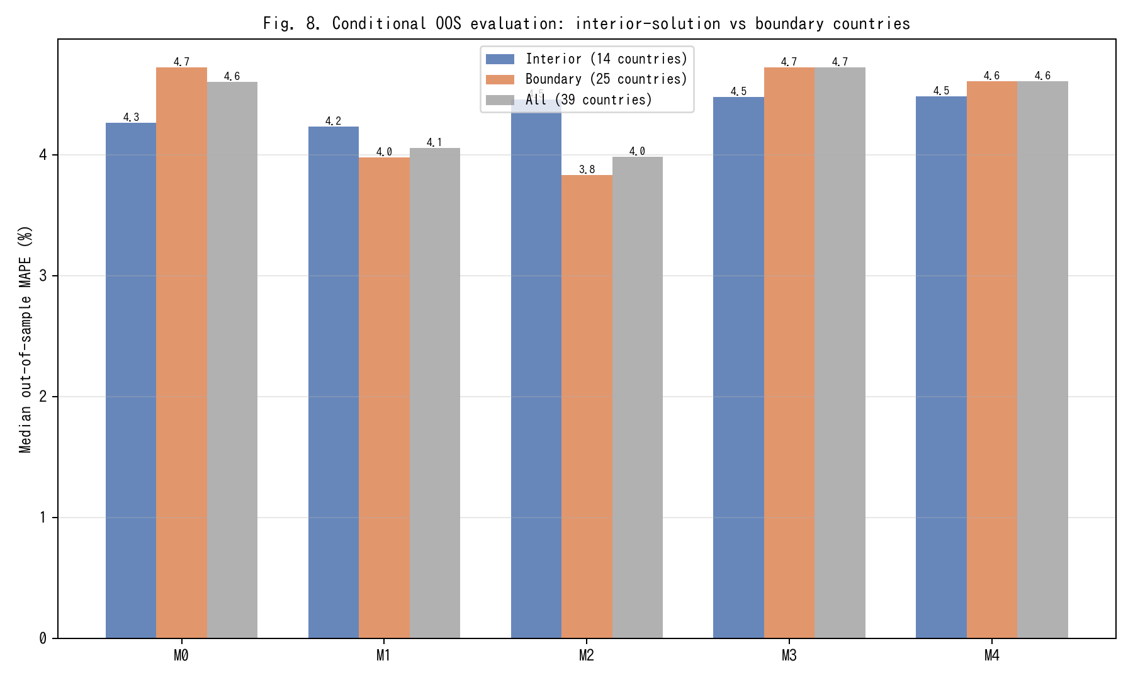
Fig. 8. Conditional OOS evaluation: interior-solution vs boundary countries.
Conditional OOS evaluation: interior-solution vs boundary countries.

Slide 9
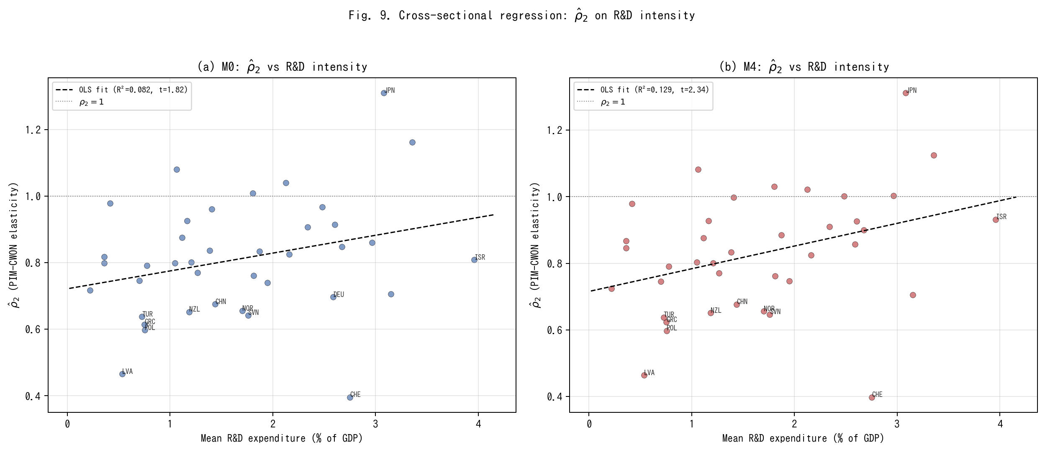
Fig. 9. Cross-sectional regression of rho_2 on R&D intensity.
Cross-sectional regression of rho_2 on R&D intensity.

Slide 10
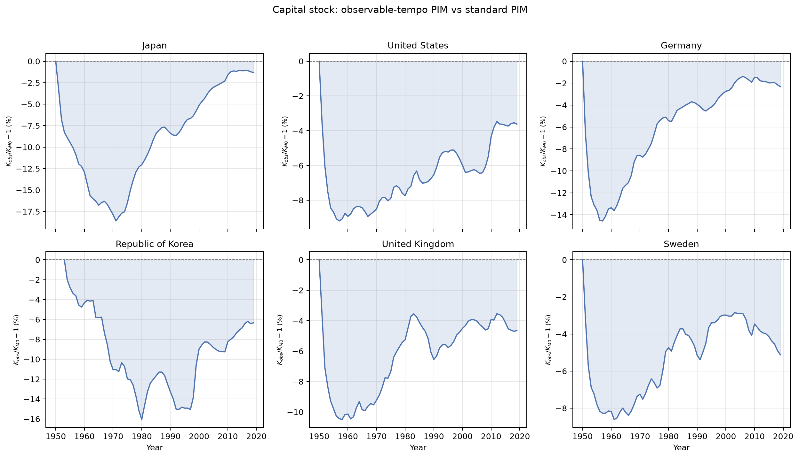
Fig. 10. Capital-stock divergence: K_obs vs K_M0 over time for six representative countries.
Capital-stock divergence: K_obs vs K_M0 over time for six representative countries.

Slide 11
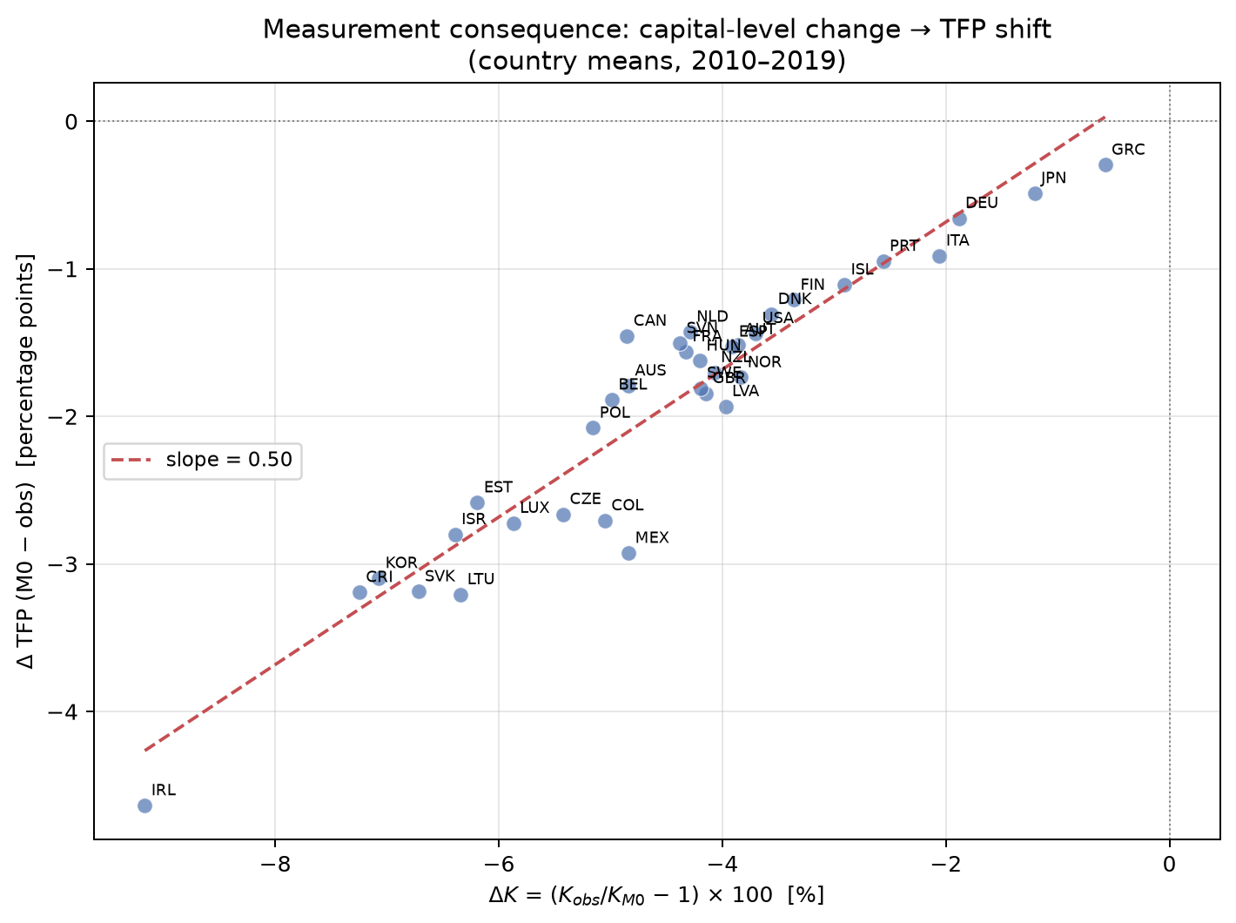
Fig. 11. Measurement consequence: K-level change vs TFP shift (country means, 2010-2019).
Measurement consequence: K-level change vs TFP shift (country means, 2010-2019).

Slide 12
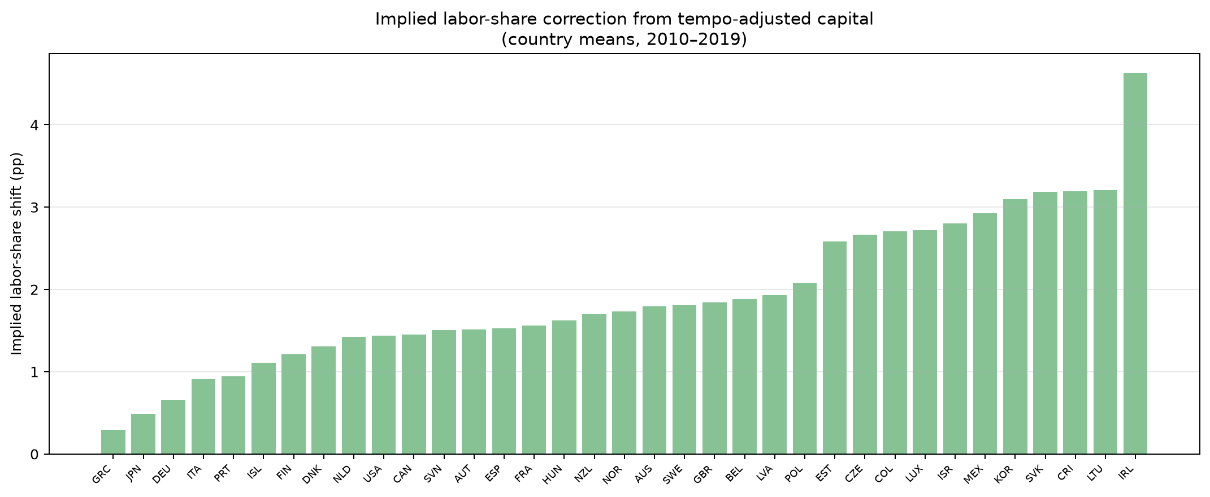
Fig. 12. Implied labour-share correction from tempo-adjusted capital (country means, 2010-2019).
Implied labour-share correction from tempo-adjusted capital (country means, 2010-2019).

Slide 13
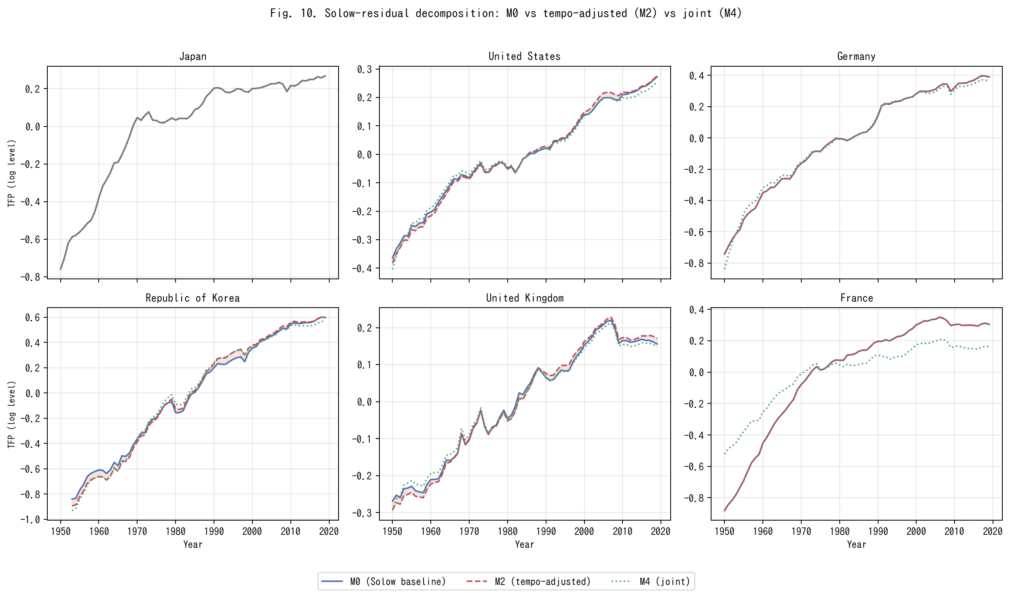
Fig. 13. Solow-residual decomposition: M0 vs tempo-adjusted (M2) vs joint (M4) for six representative countries.
Solow-residual decomposition: M0 vs tempo-adjusted (M2) vs joint (M4) for six representative countries.

Slide 14
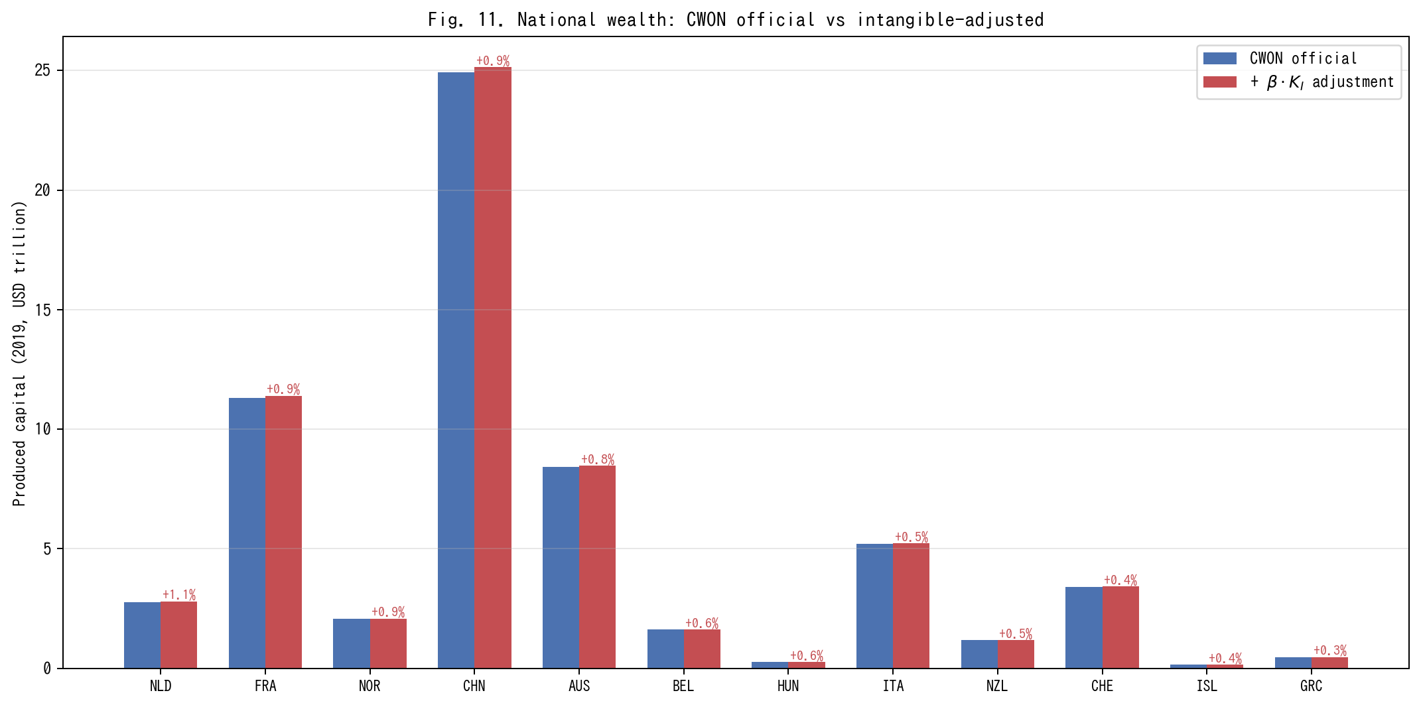
Fig. 14. National wealth: CWON official vs intangible-adjusted produced capital (2019).
National wealth: CWON official vs intangible-adjusted produced capital (2019).

