Slide 1
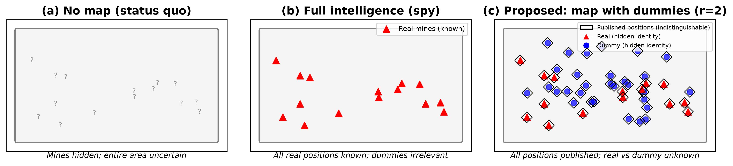
Figure 1
Conceptual comparison of three information regimes for minefields

Slide 2
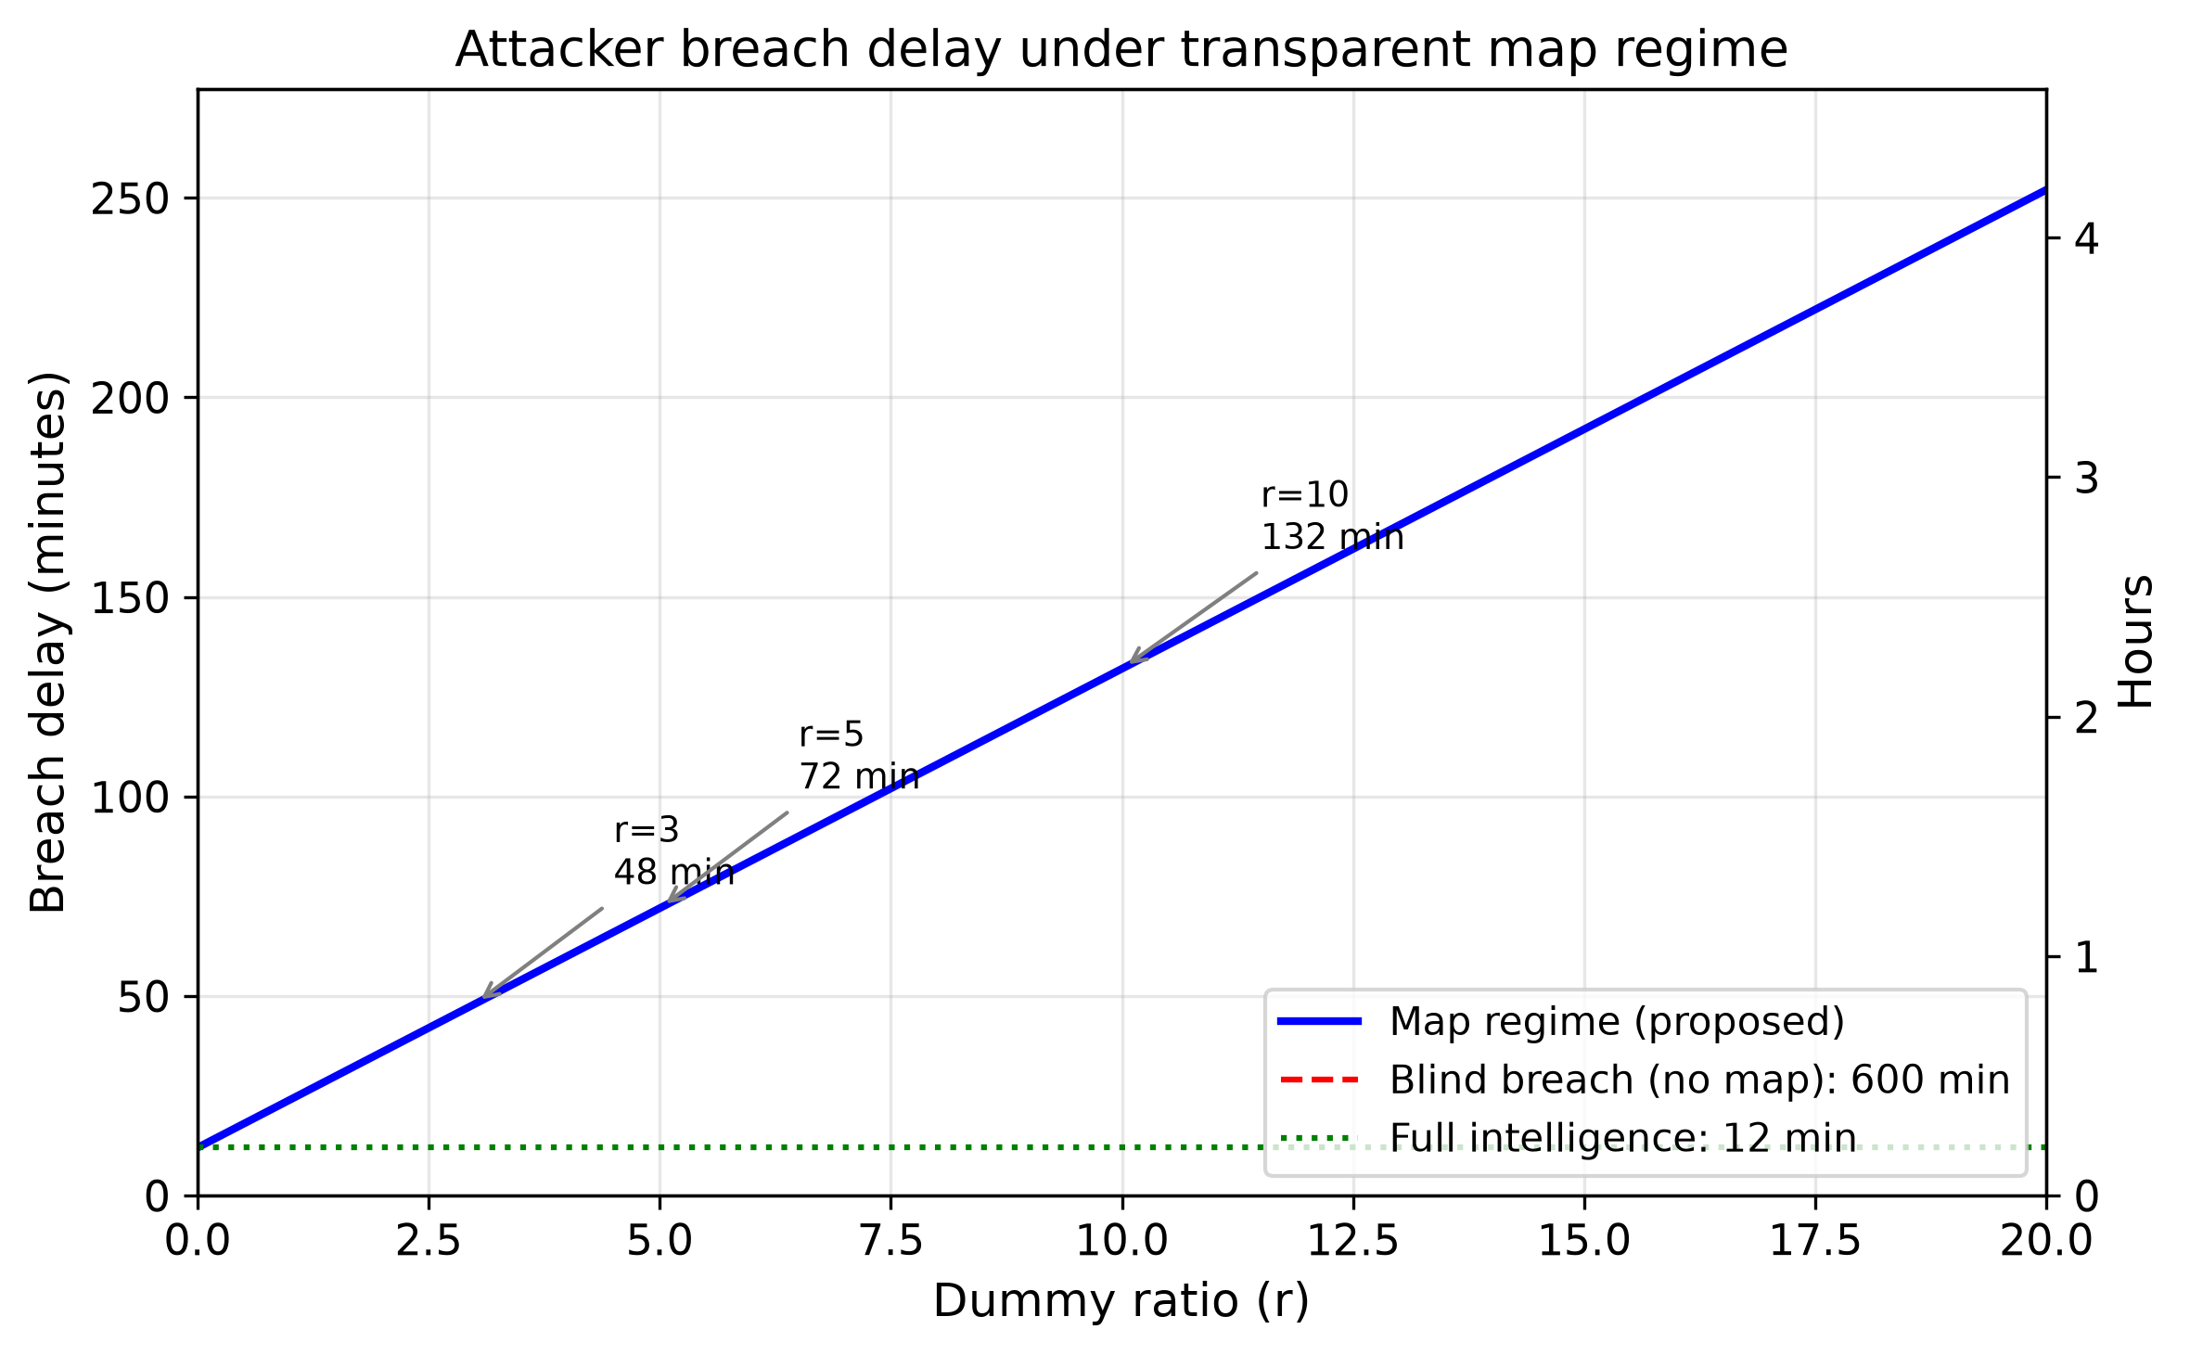
Figure 2
Attacker breach delay as a function of dummy ratio r

Slide 3
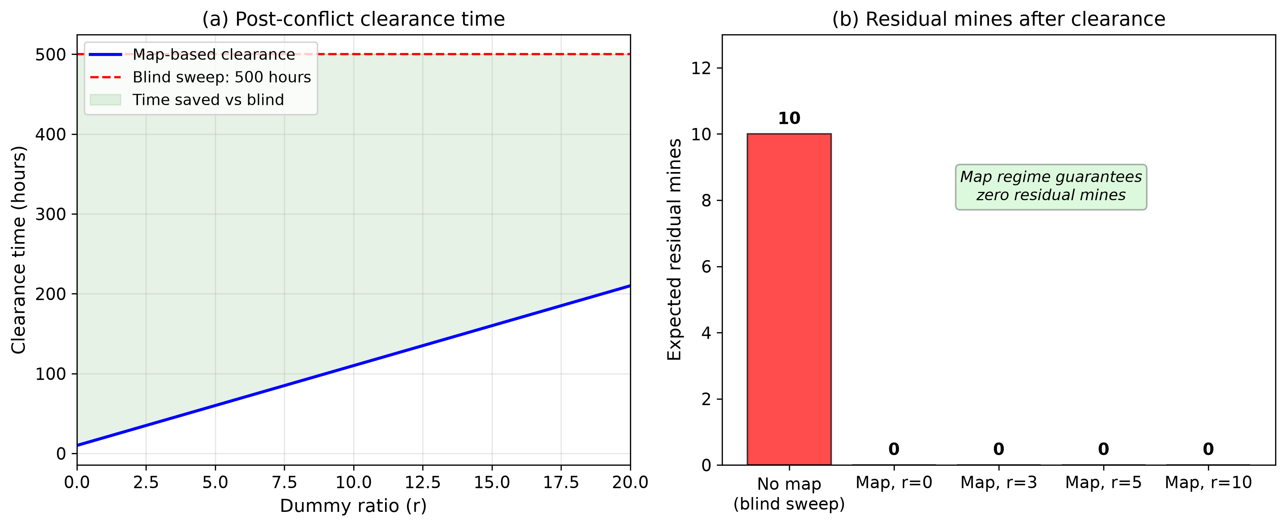
Figure 3
Post-conflict clearance: time savings and residual risk elimination

Slide 4
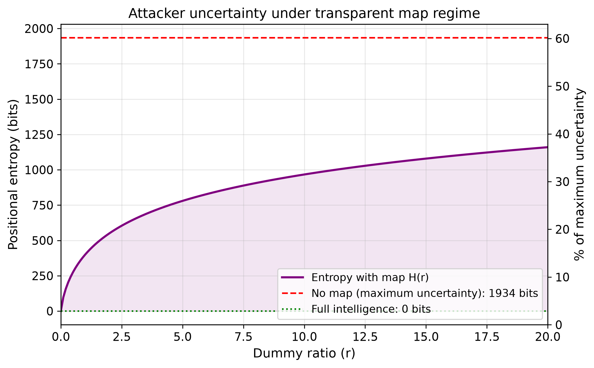
Figure 4
Positional entropy (attacker uncertainty) under transparent map regime

Slide 5
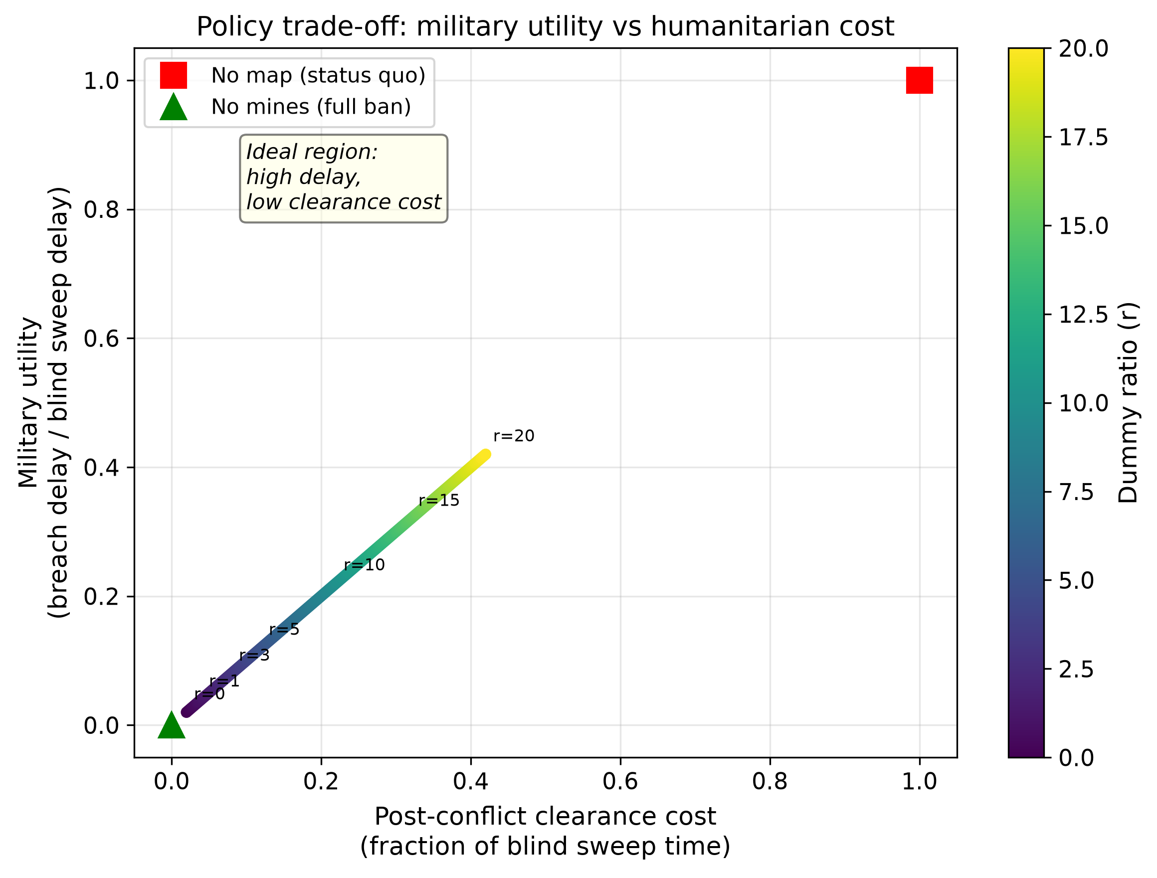
Figure 5
Policy trade-off between military utility and humanitarian cost

